Slide 1
IMAGE
SEGMENTATION
EMRE SÜMER
BASKENT UNIVERSITY
DEPT. OF COMPUTER ENGINEERING

Slide 2
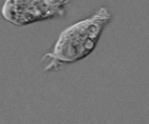

What is Segmentation?
Underlying goal of image segmentation is to partition an image into multiple groups/regions

Slide 3
Why segment?
Segmentation allows objects and regions to be analyzed in a more meaningful manner.
Some applications of segmentation:
– Object tracking (e.g., people tracking for surveillance purposes)
– Medical Image Analysis (e.g., tumor growth analysis)
– Remote Sensing Analysis (e.g., determine the ratio of different types of sea-ice within a region)
– Face recognition (e.g., partition face into individual parts for component recognition)

Slide 4
Types of Segmentation Algorithms
Some of the most common groups of segmentation algorithms are:
– Histogram based segmentation
– Clustering based segmentation
– Region growing segmentation
– Active contour based segmentation
– Watershed based segmentation

Slide 5
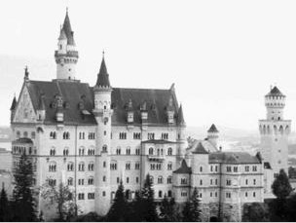
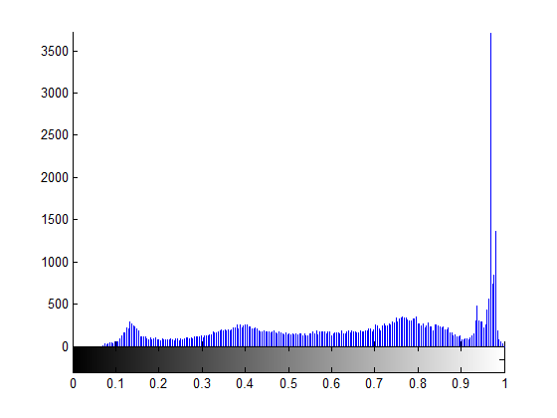
Histogram based Segmentation
One of the simplest and most efficient form of segmentation
Steps:
– Compute the histogram of the image

Slide 6
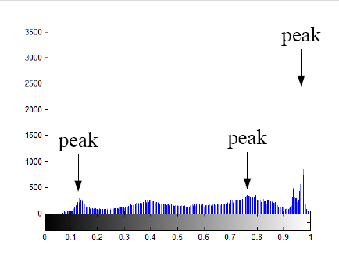
Histogram based Segmentation
Steps:
– Analyse peaks of the histogram and determine an appropriate point of thresholding

Slide 7
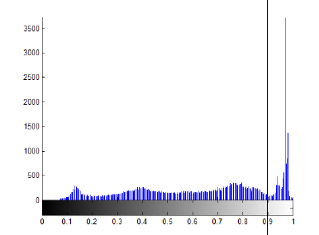
Histogram based Segmentation
Steps:
– Determine an appropriate point of thresholding based on what we want (e.g., segment foreground and background)
threshold

Slide 8
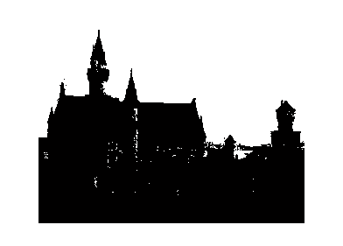
Histogram based Segmentation
Steps:
– Set all pixels to a set of fixed values based on threshold

Slide 9
Otsu's Method
Goal:
– Search for a threshold that minimizes the intra-class variance, defined as a weighted sum of variances of the two classes:
(weights are the probabilities ωi of the two classes separated by a threshold (t) and variances of
these classes).
Minimizing the intra-class variance is the same as maximizing inter-class variance:
(which is expressed in terms of class probabilities ωi and class means μi which in turn can be
updated iteratively).

Slide 10
Otsu's Method
Algorithm
Compute histogram and probabilities of each intensity level
Set up initial ω_{i}(0) and μ_{i}(0)
Step through all possible thresholds (t = 1….maximum intensity)
  3.1. Update ω_{i} and μ_{i}
  3.2. Compute
Desired threshold corresponds to the maximum
Problem: Expensive to compute!

Slide 11
Finite Mixture Models
Suppose we know that there are m clusters/classes in the image
Suppose that the probability distribution of each cluster/class can be modeled using a parametric model (e.g., Gaussian, Gamma, Cauchy, etc.)
Idea: We can model the probability distribution of the image as a mixture of m different probability distributions, one for each cluster/class

Slide 12
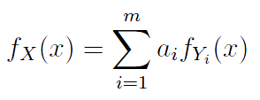
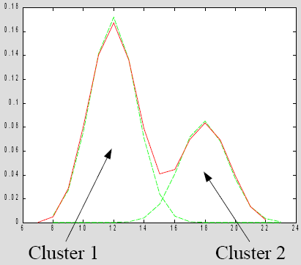
Finite Mixture Models
Formulation:
Example:

Slide 13
Finite Mixture Models
Steps:
– Learn the parameters of the distribution models for the m clusters
e.g., for Gaussian, learn the mean and standard deviation
– For each possible pixel
1. Determine the probability that its pixel intensity belongs to
each of the m clusters based on the distribution models
2. Assign the pixel's cluster label to the cluster that provides
the highest probability
– Therefore, thresholds between clusters coincide with at points of equal probabilities

Slide 14


Finite Mixture Models
Example: Suppose we have two classes, modeled by two Gaussians (u1=3, σ1=1, u2=5, σ2=1)
What is the threshold between these two classes?
– Set up distribution equations for each class

Slide 15
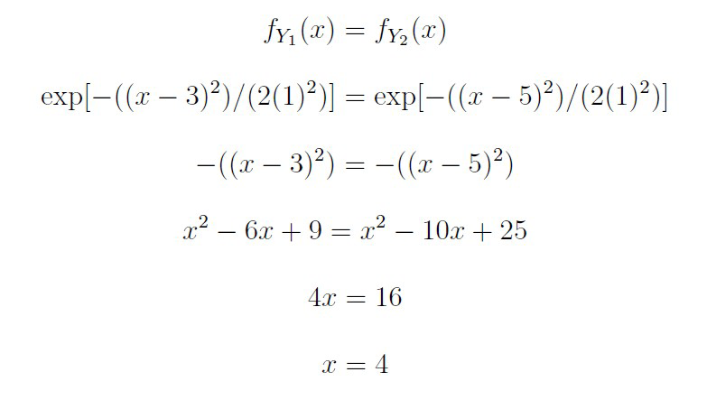
Finite Mixture Models
Since threshold is at point of equal probabilities:

Slide 16
Histogram based Segmentation
Advantages:
– Efficient (usually requires only one pass for simple segmentation cases)
Disadvantages:
– Often difficult to determine proper peaks in the histogram
– Difficult in situations where intensity is not sufficient to distinguish between two partitions (e.g., textured regions containing different mixes of intensities)

Slide 17
Clustering based Segmentation
Create partitions by grouping pixels into clusters
Steps (for K-means clustering):
– Pick k pixels in the image to act as the initial centers of the k
clusters
– For each pixel, find the cluster that minimizes your distance
metric
– For each cluster, recalculate the cluster center based on the pixel
locations within the cluster
– Re-do all previous steps until convergence
Distance metric can be the differences in:
– Pixel intensity
– Location
– Variance
– Weighted combination of these differences

Slide 18
Clustering based Segmentation
Advantages:
– Good for segmentation where there are multiple distinct partitions
Disadvantages:
– Performs poorly when the regions have irregular shapes that mix into each other

Slide 19
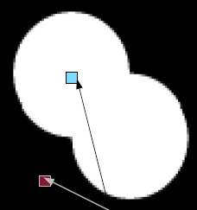
Region Growing Segmentation
Create partitions by continuously growing smaller regions until all pixels are accounted for
Steps:
– Pick initial seeds that mark the individual regions who wish to segment
seeds

Slide 20
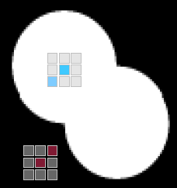
Region Growing Segmentation
Steps:
– For all neighboring pixels to the seed, compare the similarity between the seed and the pixel
– The pixel with the highest similarity is added to the seed to form a small region

Slide 21
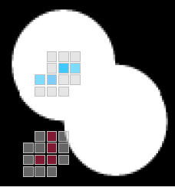
Region Growing Segmentation
Steps:
– For all neighboring pixels to the new regions, compare the similarity between the seed and the pixel
– The pixel with the highest similarity is added to the small region to form a bigger region
– Continue until all pixels in the image belong to a region

Slide 22
Region Growing Segmentation
Advantages:
– Good for segmentation with irregular shapes
Disadvantages:
– Slow

Slide 23
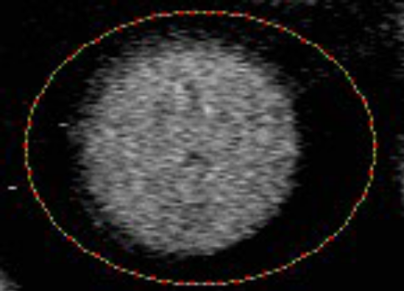
Active Contour Segmentation
Create partitions by forming rough boundaries around regions/objects of interest and refining the boundaries until it matches the actual boundaries of the objects
Steps:
– Create rough boundary around the object

Slide 24
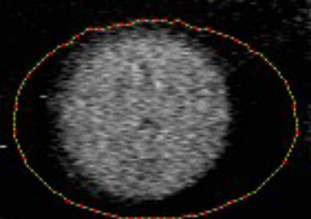
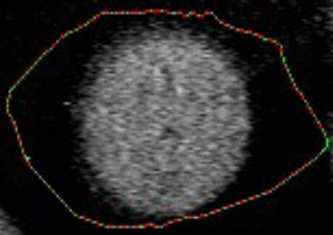
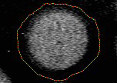
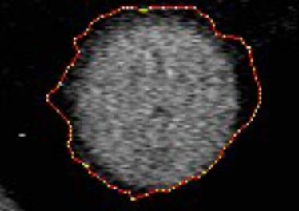
Active Contour Segmentation
Steps:
– Calculate energy gradient between the current location of the boundary and it's neighboring pixels
– Expand or contract the boundary based on the gradient
i=1
i=5
i=20
i=50

Slide 25

Active Contour Segmentation
Example – 1
- A snake can start far from the boundary and will converge to boundary concavities.

Slide 26

Active Contour Segmentation
Example – 2
- A snake can even be initialized across the boundaries
and converge again.

Slide 27
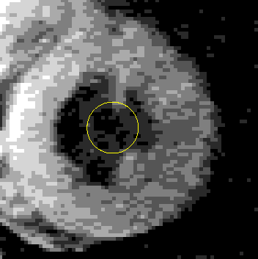
Active Contour Segmentation
Example – 3
- Snakes are defined for grayscale images as well as binary
images. Here a snake finds the heart wall on a magnetic
resonance image.

Slide 28
Active Contour Segmentation
Advantages:
– Good for segmenting and tracking objects with deformable motion and clear boundaries
– Motion information can be extracted from the contour
Disadvantage:
– Relatively slow
– Ill-suited for situations where your regions do not have clearly defined boundaries

Slide 29
Watershed Segmentation
What is a watershed?
– A ridge that divides different areas that different rivers and streams drain into
What is a catchment basin?
– An area that collects water within an area and drains into a body of water (e.g., sea, ocean, river, etc.)

Slide 30
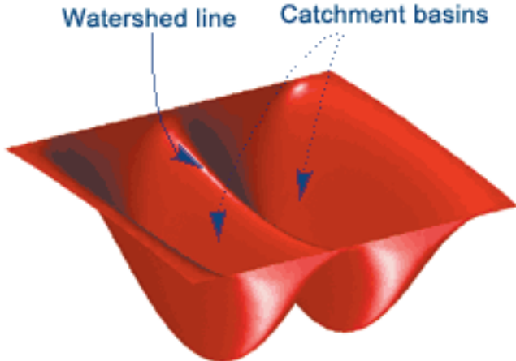
Watershed Segmentation
Idea:
– Let's treat bright areas as having high elevation and dark areas as having low elevation
– Let's treat boundaries between regions as watersheds and the local minimas of the regions as catchment basins

Slide 31
Watershed Segmentation
Idea:
– Suppose we took a water hose and pour water into the catchment basins until they are full of water
– Each of these filled catchment basins become the individual regions that you wish to segment!
– Small regions can be merged into larger regions by continuing to pure water into the basins and overflow the smaller basins until they form a larger basin

Slide 32
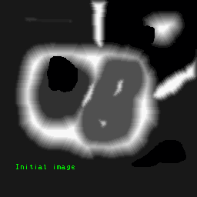
Watershed Segmentation
An example

Slide 33
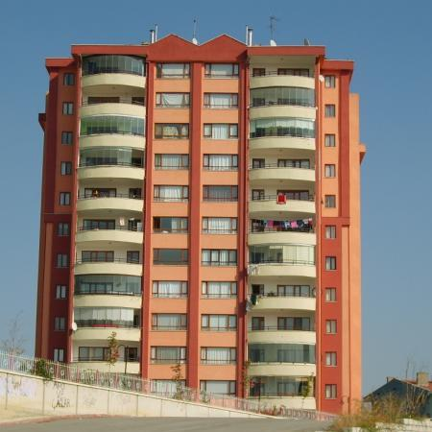
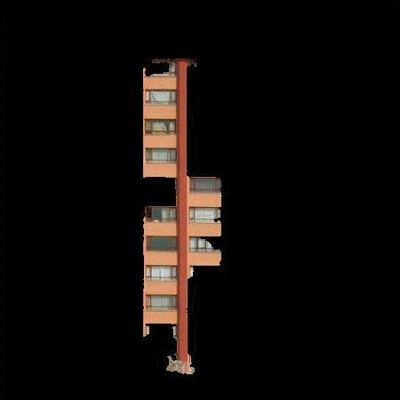
Watershed Segmentation (Repetitive)
An example

Slide 34
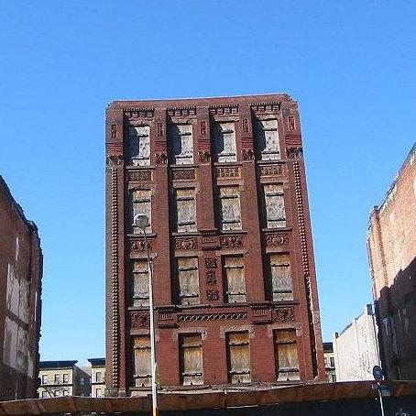

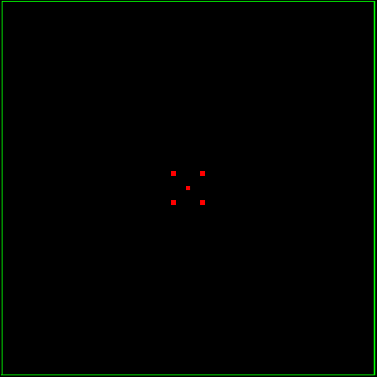

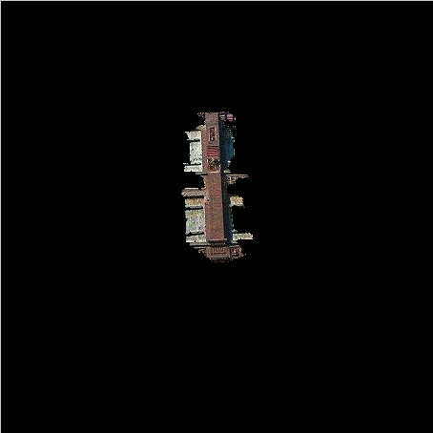
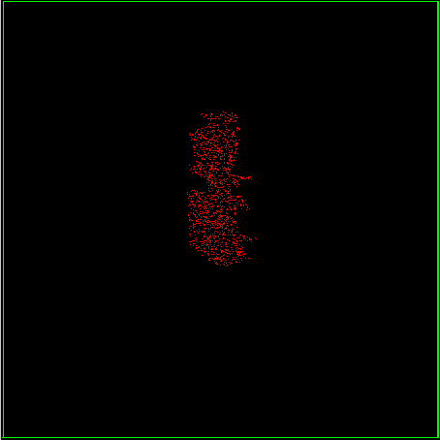

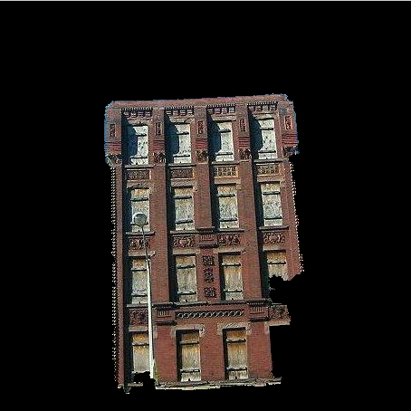
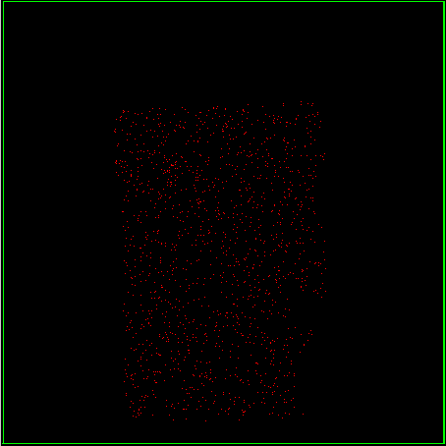

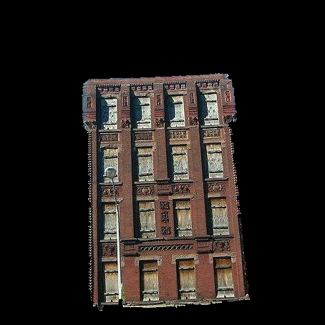

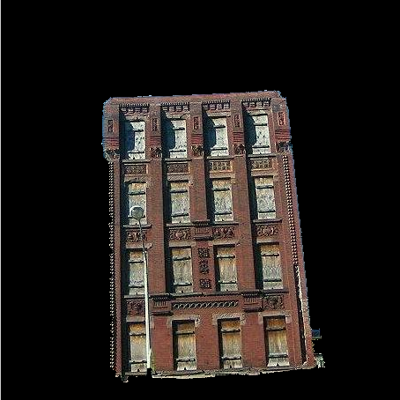





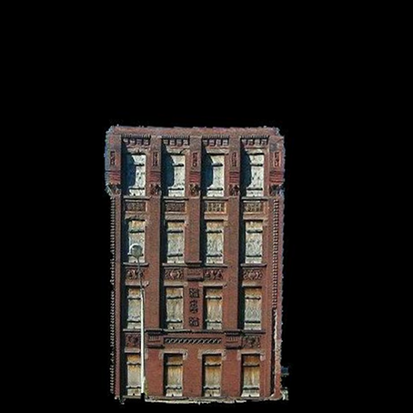
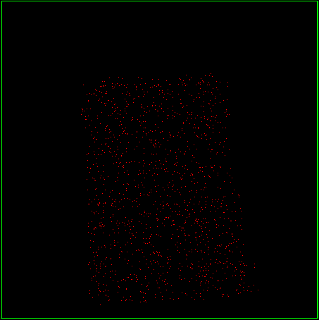
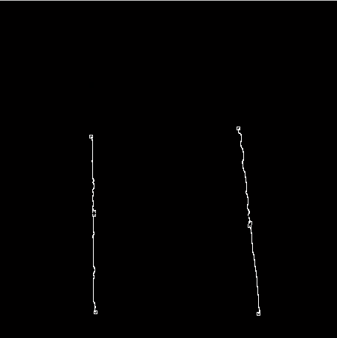
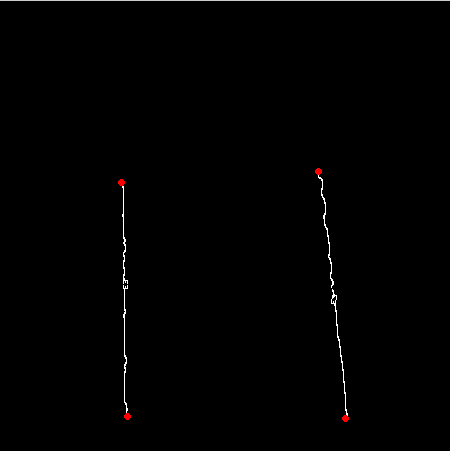
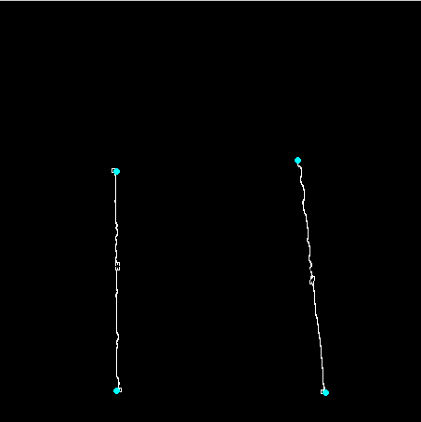
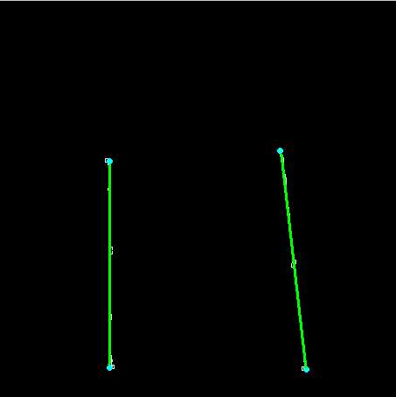
Watershed Segmentation (Repetitive)

Slide 35
Watershed Segmentation (Repetitive)
Advantages:
– Efficient
– Simple conceptually
Disadvantages:
– How much water do I pour?
* Too little water leads to over-segmentation (too many remaining regions)
* Too much water leads to under-segmentation (keep pouring water and the whole image becomes one big region)

