Slide 1
Image Enhancement
(Histogram Processing)
Over the next few lectures we will look at image enhancement techniques working in the spatial domain:
  What is image enhancement?
  Different kinds of image enhancement
  Histogram processing
  Point processing
  Neighbourhood operations

Slide 2
A Note About Grey Levels
So far when we have spoken about image grey level values we have said they are in the range [0, 255]
  Where 0 is black and 255 is white
There is no reason why we have to use this range
  The range [0,255] stems from display technologes
For many of the image processing operations in this lecture grey levels are assumed to be given in the range [0.0, 1.0]

Slide 3
What Is Image Enhancement?
Image enhancement is the process of making images more useful
The reasons for doing this include:
  Highlighting interesting detail in images
  Removing noise from images
  Making images more visually appealing

Slide 4
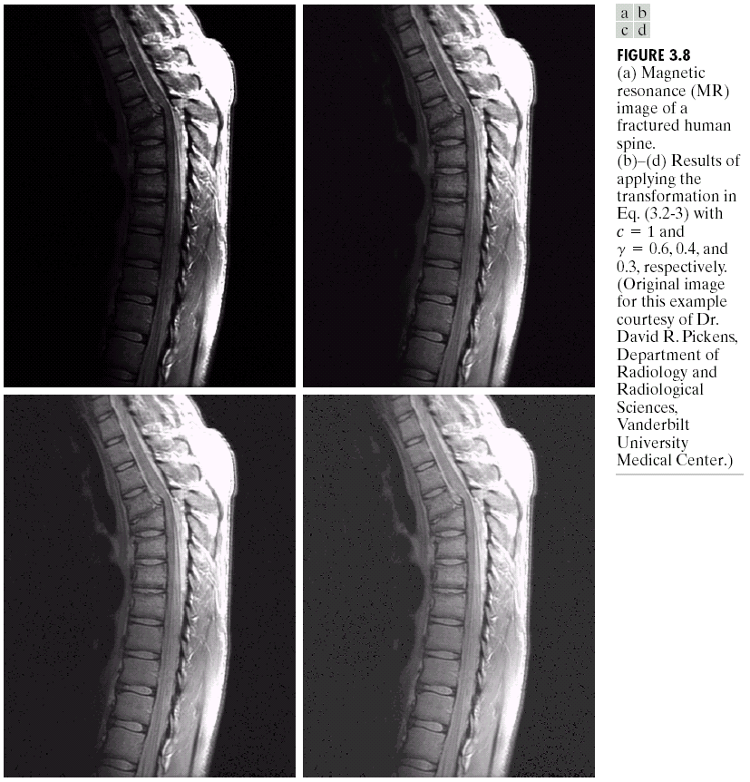

Image Enhancement Examples
Images taken from Gonzalez & Woods, Digital Image Processing (2002)

Slide 5
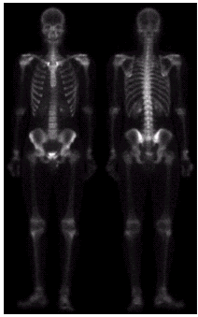
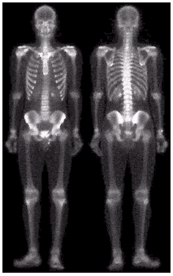
Image Enhancement Examples (cont…)
Images taken from Gonzalez & Woods, Digital Image Processing (2002)

Slide 6

Image Enhancement Examples (cont…)
Images taken from Gonzalez & Woods, Digital Image Processing (2002)

Slide 7
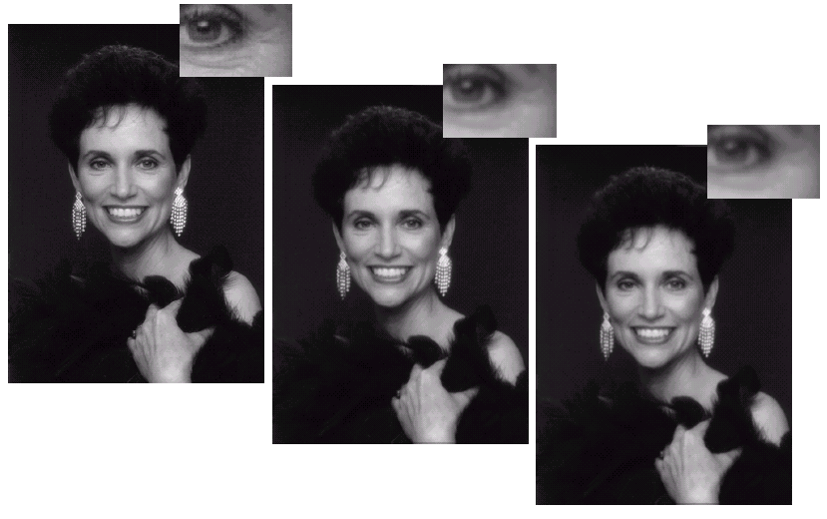
Image Enhancement Examples (cont…)
Images taken from Gonzalez & Woods, Digital Image Processing (2002)

Slide 8
Spatial & Frequency Domains
There are two broad categories of image enhancement techniques
  Spatial domain techniques
    Direct manipulation of image pixels
  Frequency domain techniques
    Manipulation of Fourier transform or wavelet transform of an image
For the moment we will concentrate on techniques that operate in the spatial domain

Slide 9
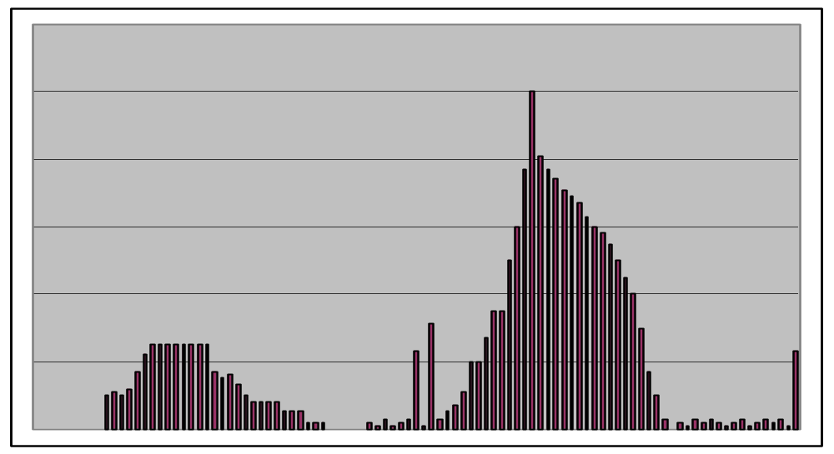
Image Histograms
The histogram of an image shows us the distribution of grey levels in the image
Massively useful in image processing, especially in segmentation
Frequencies
Grey Levels

Slide 10
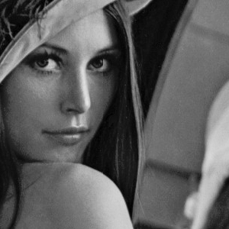
Histogram Examples
Images taken from Gonzalez & Woods, Digital Image Processing (2002)

Slide 11
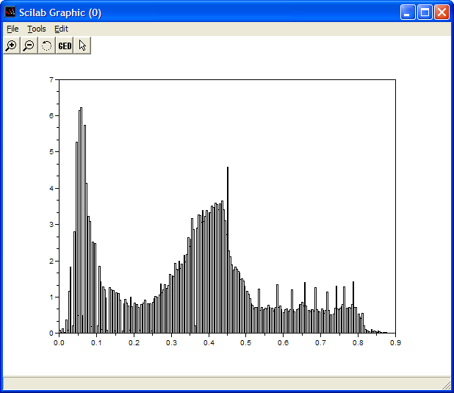
Histogram Examples (cont…)
Images taken from Gonzalez & Woods, Digital Image Processing (2002)

Slide 12
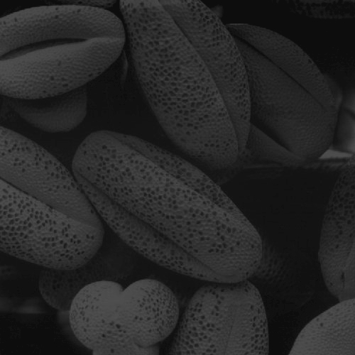
Histogram Examples (cont…)
Images taken from Gonzalez & Woods, Digital Image Processing (2002)

Slide 13
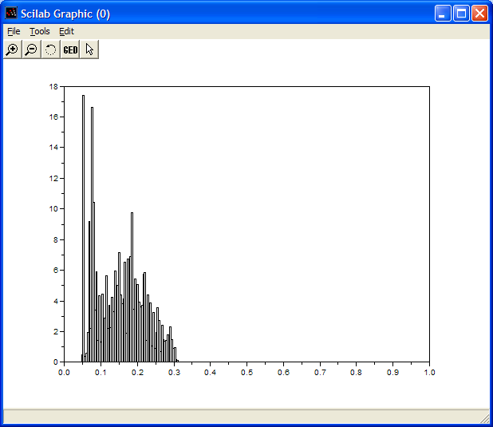
Histogram Examples (cont…)
Images taken from Gonzalez & Woods, Digital Image Processing (2002)

Slide 14
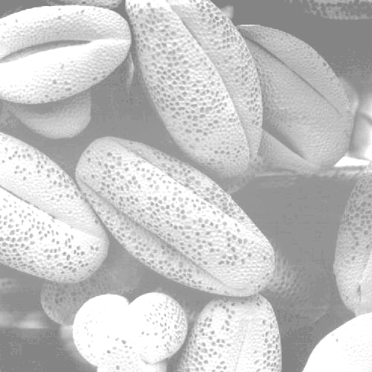
Histogram Examples (cont…)
Images taken from Gonzalez & Woods, Digital Image Processing (2002)

Slide 15
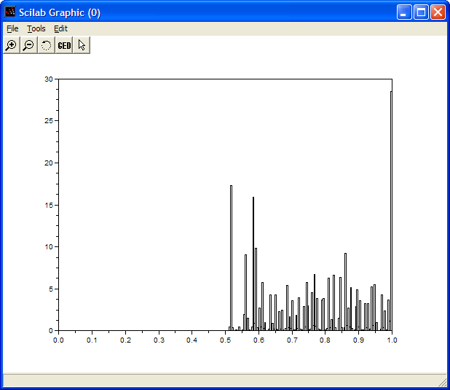
Histogram Examples (cont…)
Images taken from Gonzalez & Woods, Digital Image Processing (2002)

Slide 16

Histogram Examples (cont…)
Images taken from Gonzalez & Woods, Digital Image Processing (2002)

Slide 17
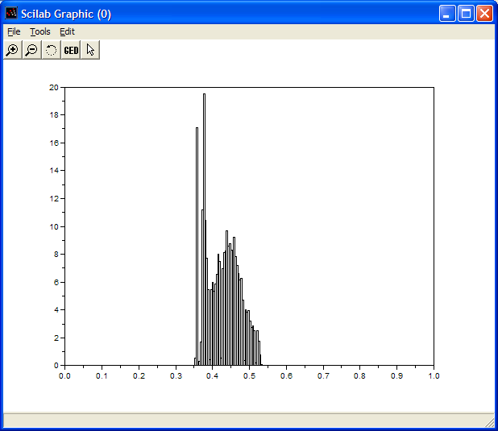
Histogram Examples (cont…)
Images taken from Gonzalez & Woods, Digital Image Processing (2002)

Slide 18
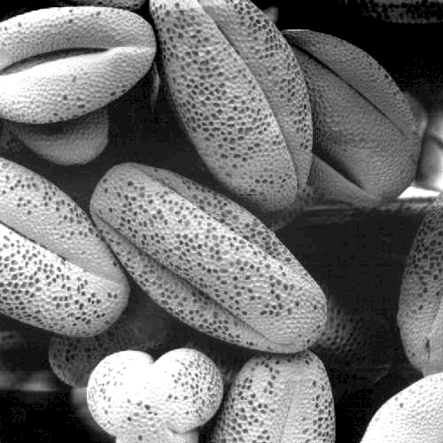
Histogram Examples (cont…)
Images taken from Gonzalez & Woods, Digital Image Processing (2002)

Slide 19
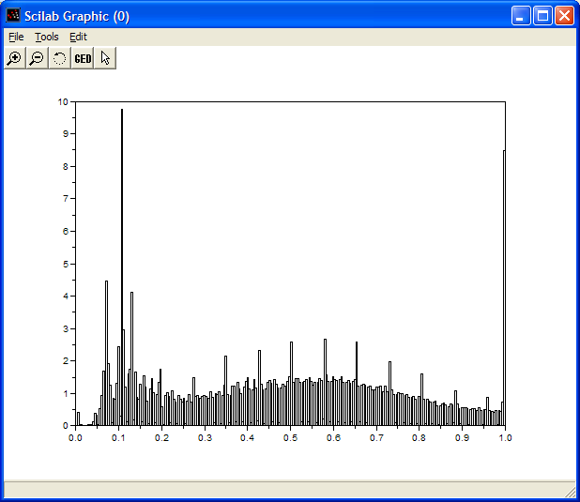
Histogram Examples (cont…)
Images taken from Gonzalez & Woods, Digital Image Processing (2002)

Slide 20
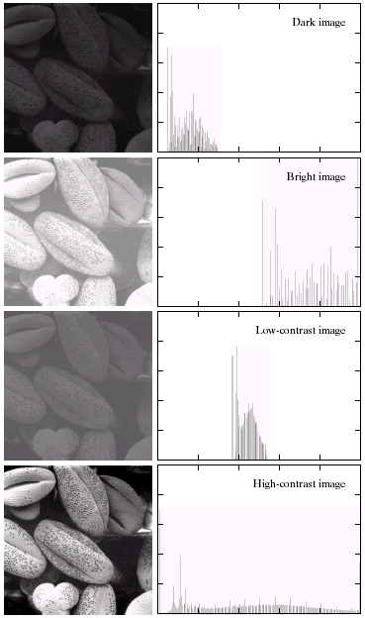
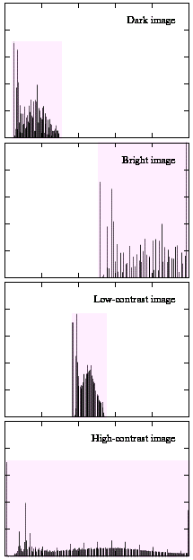
Histogram Examples (cont…)
A selection of images and
their histograms
Notice the relationships
between the images and
their histograms
Note that the high contrast
image has the most
evenly spaced histogram
Images taken from Gonzalez & Woods, Digital Image Processing (2002)

Slide 21
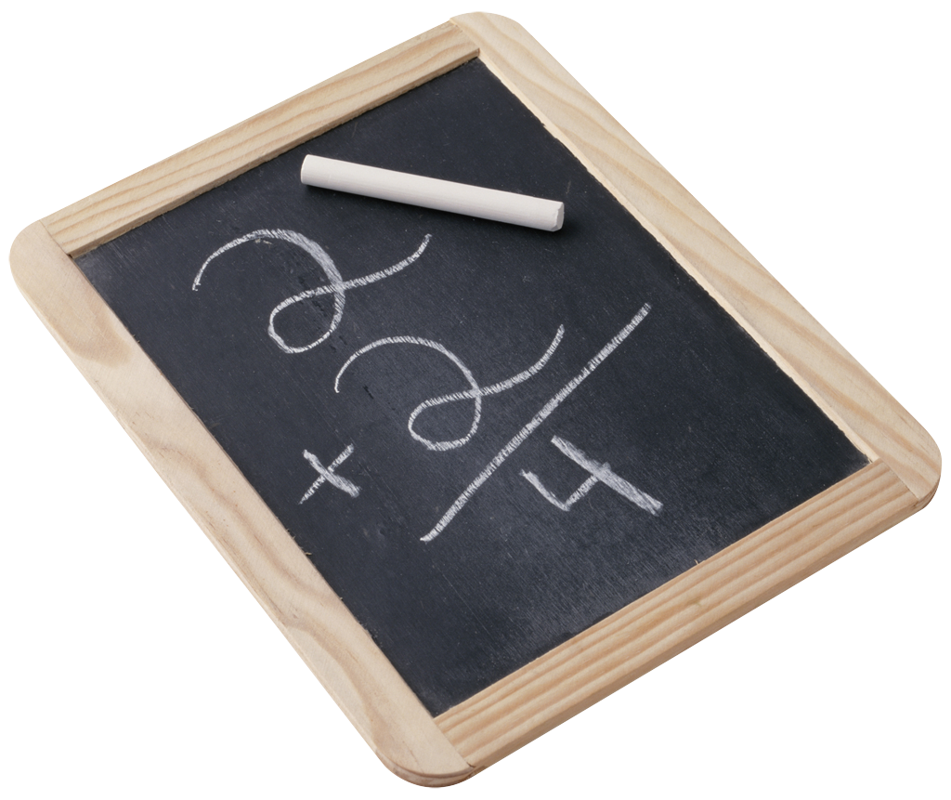
Contrast Stretching
We can fix images that have poor contrast by applying a pretty simple contrast specification
The interesting part is how do we decide on this transformation function?

Slide 22
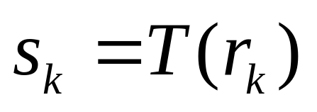
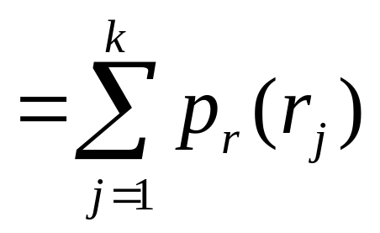
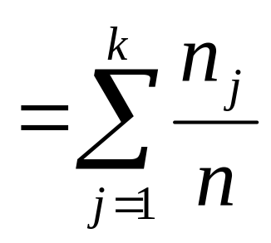
Histogram Equalisation
Spreading out the frequencies in an image (or equalising the image) is a simple way to improve dark or washed out images
The formula for histogram
equalisation is given where
  r_{k}: input intensity
  s_{k}: processed intensity
  k: the intensity range
  (e.g 0.0 – 1.0)
  n_{j}: the frequency of intensity j
  n: the sum of all frequencies

Slide 23
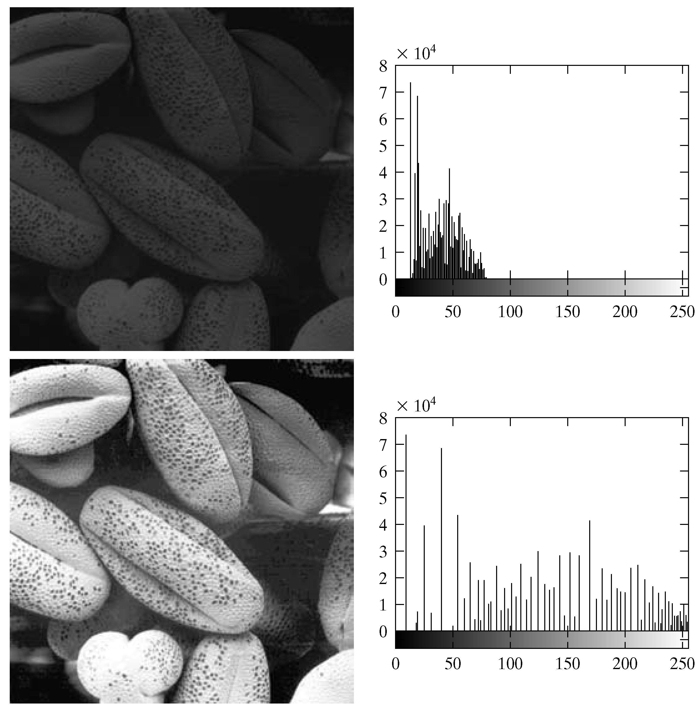
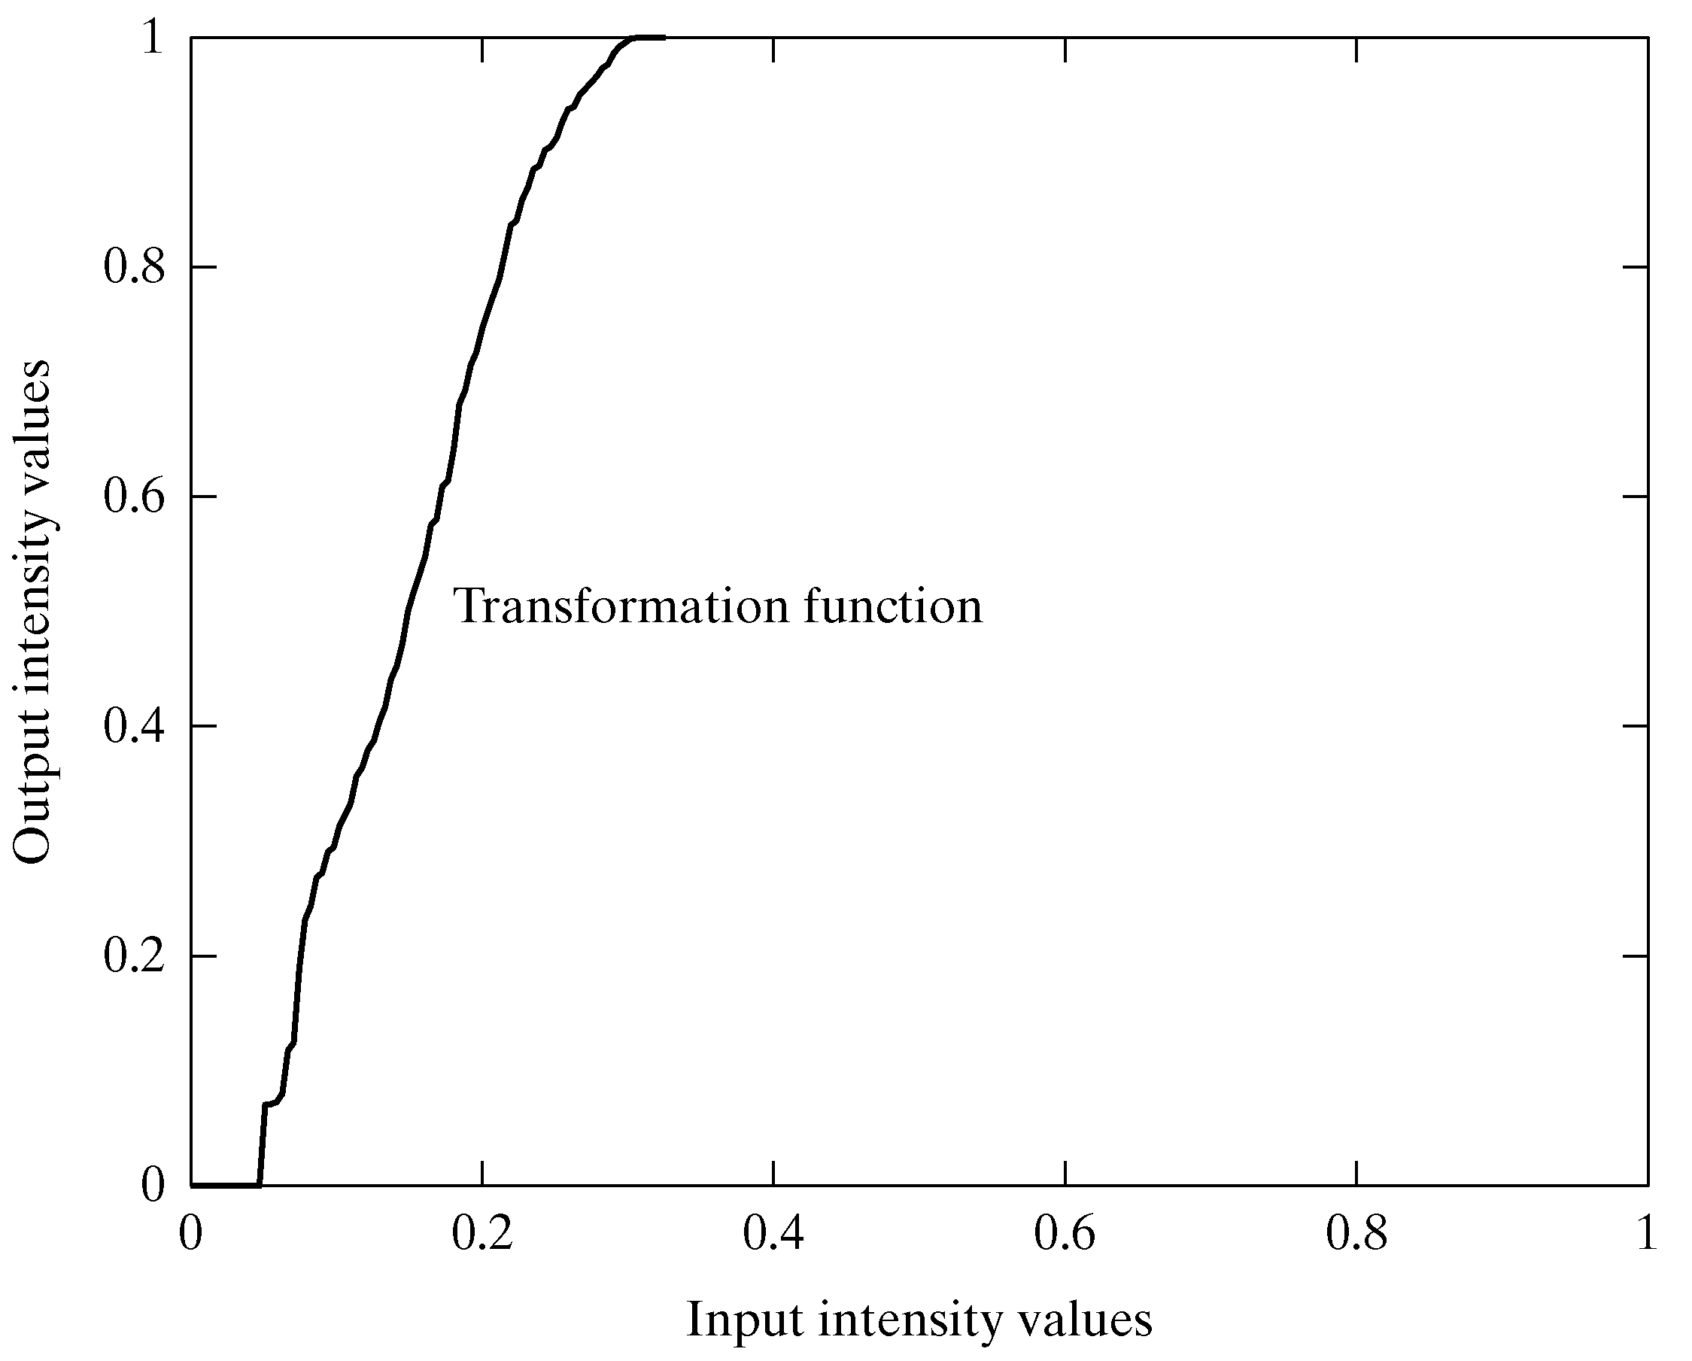
Equalisation Transformation Function
Images taken from Gonzalez & Woods, Digital Image Processing (2002)

Slide 24
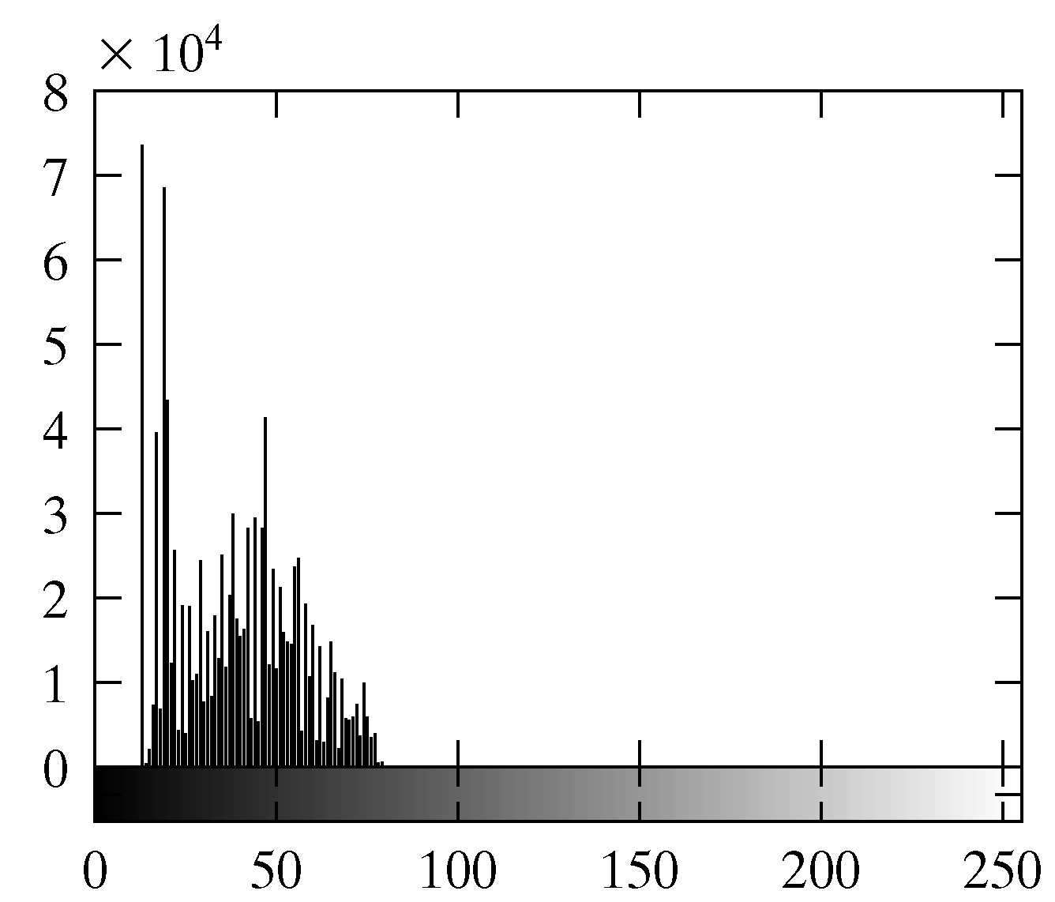
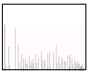
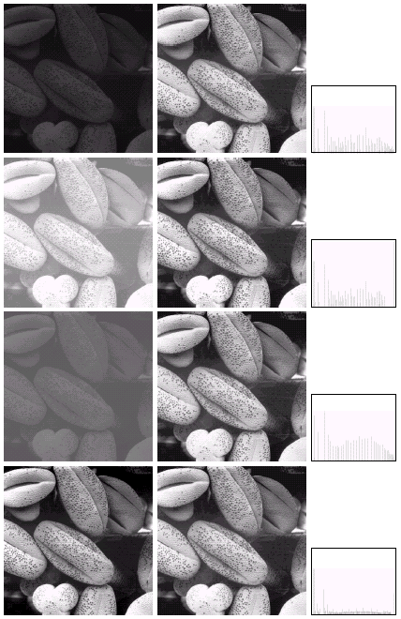
Equalisation Examples
1
Images taken from Gonzalez & Woods, Digital Image Processing (2002)

Slide 25
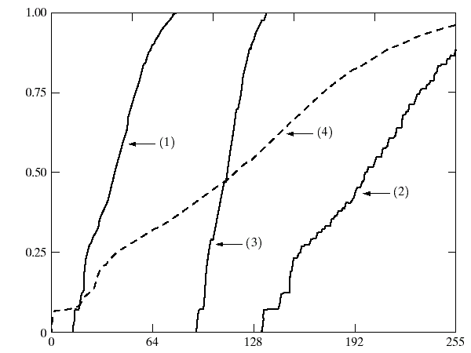
Equalisation Transformation Functions
The functions used to equalise the images in the previous example
Images taken from Gonzalez & Woods, Digital Image Processing (2002)

Slide 26
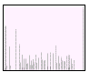
Equalisation Examples
2
Images taken from Gonzalez & Woods, Digital Image Processing (2002)

Slide 27
Equalisation Transformation Functions
The functions used to equalise the images in the previous example
Images taken from Gonzalez & Woods, Digital Image Processing (2002)

Slide 28
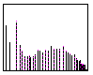
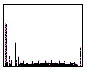
Equalisation Examples (cont…)
3
Images taken from Gonzalez & Woods, Digital Image Processing (2002)
4

Slide 29
Equalisation Examples (cont…)
3
Images taken from Gonzalez & Woods, Digital Image Processing (2002)
4

Slide 30
Equalisation Transformation Functions
The functions used to equalise the images in the previous examples
Images taken from Gonzalez & Woods, Digital Image Processing (2002)

Slide 31
Summary
We have looked at:
  Different kinds of image enhancement
  Histograms
  Histogram equalisation
Next time we will start to look at point processing and some neighbourhood operations

