Slide 1

Chapter 8, Object Design
Introduction to Design Patterns

Slide 2
Is this a good Model?
public interface SeatImplementation {
public int GetPosition();
public void SetPosition(int newPosition);
}
public class Stubcode implements SeatImplementation {
public int GetPosition() {
// stub code for GetPosition
}
...
}
public class AimSeat implements SeatImplementation {
public int GetPosition() {
// actual call to the AIM simulation system
}
….
}
public class SARTSeat implements SeatImplementation {
public int GetPosition() {
// actual call to the SART seat simulator
}
...
}
It depends!

Slide 3
A Game: Get-15
Start with the nine numbers 1,2,3,4, 5, 6, 7, 8 and 9.
You and your opponent take alternate turns, each taking a number
Each number can be taken only once: If you opponent has selected a number, you cannot also take it.
The first person to have any three numbers that total 15 wins the game.
Example:
You:
1
5
3
8
Opponent:
6
9
7
2
Opponent
Wins!

Slide 4
Characteristics of Get-15
Hard to play,
The game is especially hard, if you are not allowed to write anything done.
Why?
  All the numbers need to be scanned to see if you have won/lost
  It is hard to see what the opponent will take if you take a certain number
  The choice of the number depends on all the previous numbers
  Not easy to devise an simple strategy

Slide 5
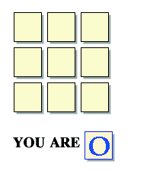
Another Game: Tic-Tac-Toe
Source: http://boulter.com/ttt/index.cgi

Slide 6
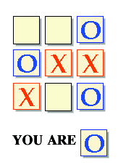
A Draw Sitation

Slide 7
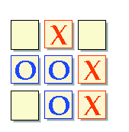
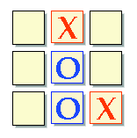
Strategy for determining a winning move

Slide 8
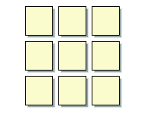
Winning Situations for Tic-Tac-Toe
Winning
Patterns

Slide 9
Tic-Tac-Toe is “Easy”
Why? Reduction of complexity through patterns and symmetries.
Patterns: Knowing the following three patterns, the player can anticipate the opponents move.
  Symmetries:
  The player needs to remember only these three patterns to deal with 8 different game situations
The player needs to memorize only 3 opening moves and their responses.

Slide 10
Get-15 and Tic-Tac-Toe are identical problems
Any three numbers that solve the 15 problem also solve tic-tac-toe.
Any tic-tac-toe solution is also a solution the 15 problem
To see the relationship between the two games, we simply arrange the 9 digits into the following pattern
8
1
6
3
5
7
4
9
2

Slide 11
You:
1
5
3
8
Opponent:
6
9
7
2
8
1
6
8
1
6
3
5
7
3
5
7
4
9
2
4
9
2

Slide 12
During Object Modeling we do many transformations and changes to the object model
It is important to make sure the object design model stays simple!
In the next two lectures we show how to use design patterns to keep system models simple.

Slide 13
Modeling Heuristics
Modeling must address our mental limitations:
  Our short-term memory has only limited capacity (7+-2)
Good models deal with this limitation, because they…
  … do not tax the mind
    A good model requires only a minimal mental effort to understand
  … reduce complexity
    Turn complex tasks into easy ones (by good choice of representation)
    Use of symmetries
  … use abstractions
    taxonomies
  … have organizational structure:
    Memory limitations are overcome with an appropriate representation (“natural model”).

Slide 14
Outline of the Lecture
Design Patterns
  Usefulness of design patterns
  Design Pattern Categories
Patterns covered in this lecture
  Composite: Model dynamic aggregates
  Facade: Interfacing to subsystems
  Adapter: Interfacing to existing systems (legacy systems)
  Bridge: Interfacing to existing and future systems
Patterns covered in the next lecture
  Abstract Factory
  Proxy
  Command
  Observer
  Strategy

Slide 15
Finding Objects
The hardest problems in object-oriented system development are:
  Identifying objects
  Decomposing the system into objects
Requirements Analysis focuses on application domain:
  Object identification
System Design addresses both, application and implementation domain:
  Subsystem Identification
Object Design focuses on implementation domain:
  Additional solution objects

Slide 16
Techniques for Finding Objects
Requirements Analysis
  Start with Use Cases. Identify participating objects
  Textual analysis of flow of events (find nouns, verbs, ...)
  Extract application domain objects by interviewing client (application domain knowledge)
  Find objects by using general knowledge
System Design
  Subsystem decomposition
  Try to identify layers and partitions
Object Design
  Find additional objects by applying implementation domain knowledge

Slide 17
Another Source for Finding Objects : Design Patterns
What are Design Patterns?
  A design pattern describes a problem which occurs over and over again in our environment
  Then it describes the core of the solution to that problem, in such a way that you can use the this solution a million times over, without ever doing it the same twice

Slide 18
What is common between these definitions?
Definition Software System
  A software system consists of subsystems which are either other subsystems or collection of classes
Definition Software Lifecycle:
  The software lifecycle consists of a set of development activities which are either other actitivies or collection of tasks

Slide 19
Introducing the Composite Pattern
Models tree structures that represent part-whole hierarchies with arbitrary depth and width.
The Composite Pattern lets client treat individual objects and compositions of these objects uniformly
Client
Component
Leaf
Operation()
Composite
Operation()
AddComponent
RemoveComponent()
GetChild()
Children

Slide 20
What is common between these definitions?
Software System:
  Definition: A software system consists of subsystems which are either other subsystems or collection of classes
  Composite: Subsystem (A software system consists of subsystems which consists of subsystems , which consists of subsystems, which...)
  Leaf node: Class
Software Lifecycle:
  Definition: The software lifecycle consists of a set of development activities which are either other actitivies or collection of tasks
  Composite: Activity (The software lifecycle consists of activities which consist of activities, which consist of activities, which....)
  Leaf node: Task.

Slide 21
Modeling a Software System_x001d__x001d__x001d__x001d__x001d__x001d_ with a Composite Pattern
User
Software
System
*
Class
Subsystem
Children

Slide 22
Modeling the Software Lifecycle with a Composite Pattern
Manager
Software
Lifecycle
*
Task
Activity
Children

Slide 23
The Composite Patterns models dynamic aggregates
Fixed Structure:
Car
*
*
Doors
Wheels
Battery
Engine
Organization Chart (variable aggregate):
*
*
Department
University
School
Composite
Pattern
Dynamic tree (recursive aggregate):
Program
Dynamic tree (recursive aggregate):
*
*
Block
Compound
Simple
Statement
Statement
Notes:
What you are seeing on this slide are what I would like to call patterns for analysis.
A pattern is a recurring theme, something once you get used to see something this way, allows you to very fast understand a situation.
It is well known, that if you show a set of chess positions of middle games tochess masters and non chess players, that chess masters are able to reconstruct these games without any effort.
However, if you give them random chess configurations, chess masters are about as bad as non-chess players in reconstructing the boards.
This tells you about the value of patterns. I would like you to learn about these aggregation patterns. In fact, I challenge you to see for your team and subsystem, if any of the analysis problems you face, can be cast in terms of one of the 3 patterns above.

Slide 24
Graphic Applications also use Composite Patterns
The Graphic Class represents both primitives (Line, Circle) and their containers (Picture)
Client
Graphic
Line
Draw()
Circle
Draw()
Picture
Draw()
Add(Graphic g)
RemoveGraphic)
GetChild(int)
Children

Slide 26
Reducing the Complexity of Models
To communicate a complex model we use navigation and reduction of complexity
  We do not simply use a picture from the CASE tool and dump it in front of the user
  The key is navigate through the model so the user can follow it
We start with a very simple model
  Start with the key abstractions
  Then decorate the model with additional classes
To reduce the complexity of the model further, we
  Look for inheritance (taxonomies)
    If the model is still too complex, we show subclasses on a separate slide
  Then we identify or introduce patterns in the model
    We make sure to use the name of the patterns.

Slide 27
Example: A Complex Model
Taxonomies
Basic Abstractions
Composite Patterns
Notes:
This model is already much more complex than the model shown on the previous slide. Its purpose is still for communication only.
Because it already has quite a number of abstractions, It can only be understood if we communicate the model well to the user. We can do this by navigating through the model and highlight basic abstractions and typical patterns.
For example, we can highlight the basic abstraction (the ones used in the previous slide) <<Proceed to first animation>> and tell the listener that these are the abstraction used in the previous slide (to make the point more clear, the instructor can move once more to the previous slide)
To reduce the complexity of the model, the instructor can then point out that Work Product, Task and Participant all are now basic leaves in a composite pattern. <<Proceed to the next animation, show the use of the composite patterns>>.
To reduce the complexity even further, the instructor finally points out the use of inheritance for the taxonomies (Resource, Staff, Work Product and Activity)
Given these three tips, the students should be able to understand the model themselves.

Slide 28
Exercise
Redraw the complete model for Project from your memory using the following knowledge
  The key abstractions are task, schedule, and participant
  Workproduct, Task and Participant are modeled with composite patterns, for example
  There are taxonomies for each of the key abstractions
You have 7 minutes!
*
Work
Product

Slide 29
Many design patterns use a combination of inheritance and delegation

Slide 30
Adapter Pattern (See Last Lecture)
Client
ClientInterface
LegacyClass
Request()
ExistingRequest()
adaptee
Inheritance
Adapter
Delegation
Request()
The adapter pattern uses inheritance as well as delegation:
  - Interface inheritance is used to specify the interface of the Adapter class.
  - Delegation is used to bind the Adapter and the Adaptee
Notes:
Delegation is used to bind an Adapter and an Adaptee (Legacy Class)
Interface inheritance is use to specify the interface of the Adapter class.
Adaptee (usually called legacy system) pre-exist the Adapter.
Client Interface may be realized as an interface in Java.

Slide 31
Adapter Pattern
The adapter pattern lets classes work together that couldn’t otherwise because of incompatible interfaces
  “Convert the interface of a class into another interface expected by a client class.”
  Used to provide a new interface to existing legacy components (Interface engineering, reengineering).
Two adapter patterns:
  Class adapter:
    Uses multiple inheritance to adapt one interface to another
  Object adapter:
    Uses single inheritance and delegation
Object adapters are much more frequent.
We cover only object adapters (and call them adapters).

Slide 32
More Patterns

Slide 33
Bridge Pattern
Use a bridge to “decouple an abstraction from its implementation so that the two can vary independently” (From [Gamma et al 1995])
Also know as a Handle/Body pattern
Allows different implementations of an interface to be decided upon dynamically.

Slide 34
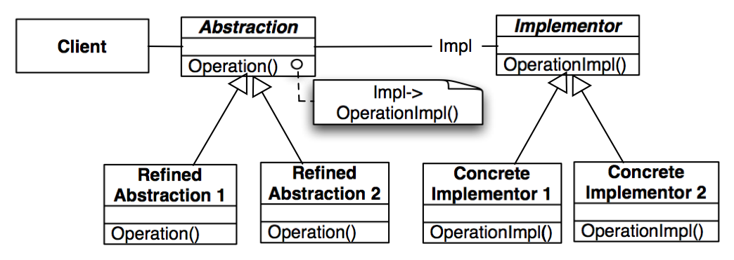
Bridge Pattern
Taxonomy in
Application Domain
Taxonomy in
Solution Domain

Slide 35
Why the Name Bridge Pattern?
Taxonomy in
Application Domain
Taxonomy in
Solution Domain
Notes:
It provides a bridge between the Abstraction (in the application domain) and the Implementor (in the solution domain)

Slide 36
Motivation for the Bridge Pattern
Decouples an abstraction from its implementation so that the two can vary independently
This allows to bind one from many different implementations of an interface to a client dynamically
Design decision that can be realized any time during the runtime of the system
  However, usually the binding occurs at start up time of the system (e.g. in the constructor of the interface class)
Notes:
Also know as a Handle/Body pattern.

Slide 37
Using a Bridge
The bridge pattern can be used to provide multiple implementations under the same interface
  Interface to a component that is incomplete (only Stub code is available), not yet known or unavailable during testing
  If seat data are required to be read, but the seat is not yet implemented (only stub code available), or only available by a simulation (AIM or SART), the bridge pattern can be used:
Seat
(in Vehicle Subsystem)
VIP
imp
SeatImplementation
GetPosition()
SetPosition()
Stub Code
AIMSeat
SARTSeat

Slide 38
Seat Implementation
public interface SeatImplementation {
public int GetPosition();
public void SetPosition(int newPosition);
}
public class Stubcode implements SeatImplementation {
public int GetPosition() {
// stub code for GetPosition
}
...
}
public class AimSeat implements SeatImplementation {
public int GetPosition() {
// actual call to the AIM simulation system
}
….
}
public class SARTSeat implements SeatImplementation {
public int GetPosition() {
// actual call to the SART seat simulator
}
...
}

Slide 39
Another use of the Bridge Pattern:
Support multiple Database Vendors
Arena
imp
LeagueStore
LeagueStoreImplementor
Stub Store
XML Store
JDBC Store
Implementor
Implementor
Implementor

Slide 40
Adapter vs Bridge
Similarities:
  Both are used to hide the details of the underlying implementation.
Difference:
  The adapter pattern is geared towards making unrelated components work together
    Applied to systems after they’re designed (reengineering, interface engineering).
    “Inheritance followed by delegation”
  A bridge, on the other hand, is used up-front in a design to let abstractions and implementations vary independently.
    Green field engineering of an “extensible system”
    New “beasts” can be added to the “object zoo”, even if these are not known at analysis or system design time.
    “Delegation followed by inheritance”

Slide 41
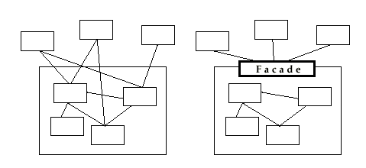
Facade Pattern
Provides a unified interface to a set of objects in a subsystem.
A facade defines a higher-level interface that makes the subsystem easier to use (i.e. it abstracts out the gory details)
Facades allow us to provide a closed architecture

Slide 42
Design Example
Subsystem 1 can look into the Subsystem 2 (vehicle subsystem) and call on any component or class operation at will.
This is “Ravioli Design”
Why is this good?
  Efficiency
Why is this bad?
  Can’t expect the caller to understand how the subsystem works or the complex relationships within the subsystem.
  We can be assured that the subsystem will be misused, leading to non-portable code
Subsystem 1
Subsystem 2
Seat
Card
AIM
SA/RT

Slide 43
Subsystem Design with Façade, Adapter, Bridge
The ideal structure of a subsystem consists of
  an interface object
  a set of application domain objects (entity objects) modeling real entities or existing systems
    Some of the application domain objects are interfaces to existing systems
  one or more control objects
We can use design patterns to realize this subsystem structure
Realization of the Interface Object: Facade
  Provides the interface to the subsystem
Interface to existing systems: Adapter or Bridge
  Provides the interface to existing system (legacy system)
  The existing system is not necessarily object-oriented!

Slide 44
Realizing an Opaque Architecture with a Facade
VIP Subsystem
The subsystem decides exactly how it is accessed
No need to worry about misuse by callers
If a façade is used the subsystem can be used in an early integration test
  We need to write only a driver
Vehicle Subsystem API
Seat
Card
AIM
SA/RT

Slide 45
When should you use these Design Patterns?
A façade should be offered by all subsystems in a software system who a services
  The façade delegates requests to the appropriate components within the subsystem. The façade usually does not have to be changed, when the components are changed
The adapter design pattern should be used to interface to existing components
  Example: A smart card software system should use an adapter for a smart card reader from a specific manufacturer
The bridge design pattern should be used to interface to a set of objects
  where the full set of objects is not completely known at analysis or design time.
  when a subsystem or component must be replaced later after the system has been deployed and client programs use it in the field.

Slide 46
Realizing an Opaque Architecture with a Facade
VIP Subsystem
The subsystem decides exactly how it is accessed.
No need to worry about misuse by callers
If a façade is used the subsystem can be used in an early integration test
  We need to write only a driver
Vehicle Subsystem API
Seat
Card
AIM
SA/RT

Slide 47
Patterns are not the cure for everything
What is wrong in the following pictures?

Slide 48


Slide 49


Slide 50


Slide 51


Slide 52


Slide 53
Note to the instructor: Show this slide briefly or as long as needed
until somebody sees the problem with the colors.

Slide 54
Summary
Design patterns are partial solutions to common problems such as
  such as separating an interface from a number of alternate implementations
  wrapping around a set of legacy classes
  protecting a caller from changes associated with specific platforms
A design pattern consists of a small number of classes
  uses delegation and inheritance
  provides a modifiable design solution
These classes can be adapted and refined for the specific system under construction
  Customization of the system
  Reuse of existing solutions.

Slide 55
Summary II
Composite Pattern:
  Models trees with dynamic width and dynamic depth
Facade Pattern:
  Interface to a subsystem
  Distinguish between closed vs open architecture
Adapter Pattern:
  Interface to reality
Bridge Pattern:
  Interface to reality and prepare for future

Slide 56
Additional Slides

Slide 57
Additional Readings
E. Gamma et.al., Design Patterns, 1994.
M. Fowler, Analysis Patterns: Reusable Object Models, 1997
F. Buschmann et. Al., Pattern-Oriented Software Architecture: A System of Patterns, 1996
T. J. Mowbray & R. C. Malveau, CORBA Design Patterns, 1997
S. W. Ambler, Process Patterns: Building Large-Scale Systems Using Object Technology, 1998.
Dependency management: P. Feiler & W. Tichy, “Propagator: A family of patterns,” in Proceedings of TOOLS-23'97, Santa Barbara, CA, Aug, 1997.
Configuration management: W. J. Brown et. Al., AntiPatterns and Patterns in Software Configuration Management, 1999.

Slide 58
What is this?
1.Nf3 d5 2.c4 c6 3.b3 Bf5 4.g3 Nf6 5.Bg2 Nbd7 6.Bb2 e6 7.O-O Bd6 8.d3 O-O 9.Nbd2 e5 10.cxd5 cxd5 11.Rc1 Qe7 12.Rc2 a5 13.a4 h6 14.Qa1 Rfe8 15.Rfc1
This is a fianchetto!
The fianchetto is one of the basic building-blocks of chess thinking.

Slide 59
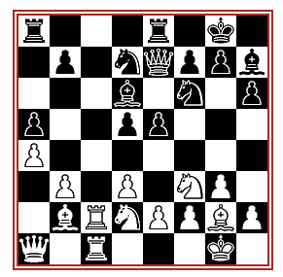
Fianchetto (Reti-Lasker)
The diagram is from Reti-Lasker, New York 1924. We can see that Reti has allowed Lasker to occupy the centre but Rtei has fianchettoed both Bishops to hit back at this, and has even backed up his Bb2 with a Queen on a1!

Slide 60
Additional Design Heuristics
Never use implementation inheritance, always use interface inheritance
A subclass should never hide operations implemented in a superclass
If you are tempted to use implementation inheritance, use delegation instead

Slide 61
The Java‘s AWT library can be modeled with the component pattern
Graphics
Component
*
getGraphics()
Text
Component
Button
Label
Container
add(Component c)
paint(Graphics g)
TextField
TextArea

Slide 62
Notation used in the Design Patterns Book
Erich Gamma, Richard Helm, Ralph Johnson, John Vlissides, Design Patterns: Elements of Reusable Object-Oriented Software, Addison Wesley, 1995
Based on OMT (a precursor to UML). Notational differences between the OMT notation and UML:
  Attributes come after the Operations
  Associations are called acquaintances
  Multiplicities are shown as solid circles
  Dashed line: Instantiation Assocation (Class can instantiate objects of associated class) (In UML it denotes a dependency)
  UML Note is called Dogear box (connected by dashed line to class operation): Pseudo-code implementation of operation.

Slide 63
Paradigms
Paradigms are like rules
They structure the environment and make them understandable
Information that does not fit into the paradigm is invisible.
Patterns are a special case of paradigms.

