Slide 1

Chapter 8, Object Design:
Design Patterns II
Using UML, Patterns, and Java
Object-Oriented Software Engineering

Slide 2
Recall: Why reusable Designs?
A design…
…enables flexibility to change (reusability)
…minimizes the introduction of new problems when fixing old ones (maintainability)
…allows the delivery of more functionality after an initial delivery (extensibility).

Slide 3
Definitions
Extensibility (Expandibility)
  A system is extensible, if new functional requirements can easily be added to the existing system
Customizability
  A system is customizable, if new nonfunctional requirements can be addressed in the existing system
Scalability
  A system is scalable, if existing components can easily be multiplied in the system
Reusability
  A system is reusable, if it can be used by another system without requiring major changes in the existing system model (design reuse) or code base (code reuse).

Slide 4
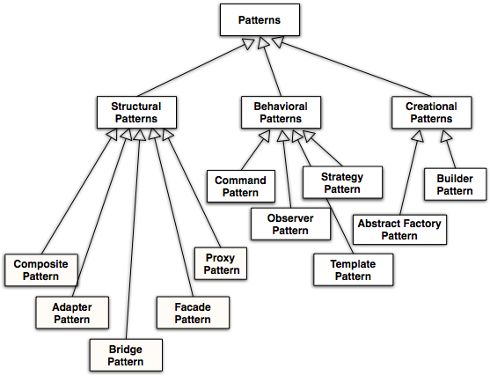
A Taxonomy of Design Patterns
√
√
√
√

Slide 5
The Proxy Pattern: 3 Types
Caching of information (“Remote Proxy”)
  The Proxy object is a local representative for an object in a different address space
  Good if information does not change too often
Standin (“Virtual Proxy”)
  Object is too expensive to create or too expensive to download.
  Good if the real object is not accessed too often
Access control (“Protection Proxy”)
  The proxy object provides protection for the real object
  Good when different actors should have different access and viewing rights for the same object
    Example: Grade information accessed by administrators, teachers and students.

Slide 6
√

Slide 7
Command Pattern: Motivation
You want to build a user interface
You want to provide menus
You want to make the menus reusable across many applications
  The applications only know what has to be done when a command from the menu is selected
  You don’t want to hardcode the menu commands for the various applications
Such a user interface can easily be implemented with the Command Pattern.
Notes:
You don’t want to hardcode the menu commands for
the various applications

Slide 8
Command pattern
Command
execute()
Invoker
Client
«binds»
ConcreteCommand1
execute()
Receiver
action1()
action2()
«binds»
ConcreteCommand2
execute()
Client (in this case a user interface builder) creates a ConcreteCommand and binds it to an action operation in Receiver
Client hands the ConcreteCommand over to the Invoker which stores it (for example in a menu)
The Invoker has the responsibility to execute or undo a command (based on a string entered by the user)
Notes:
A Command abstract class declares the interface supported by all ConcreteCommands. In the example shown here.
The client - in this case the client is a class in a user interface builder or in a class executing during startup of the application to build the user interface.
The client creates concreteCommands and binds them to specific Receivers, this can be strings like “commit”, “execute”, “undo”. So all user-visible commands are refinements of the Command abstract class.
The invoker - the class in the application program offering the menu of commands or buttons - actually invokes the concreteCommand based on the string entered and the binding between action and ConcreteCommand.
The command pattern can be nicely used to decouple interface objects from control objects:
Interface objects such as menu items and buttons, create and send messages to Command objects. Only the Command objects modify entity objects. When the user interface is changed (for example, a menu bar is replaced by a tool bar), only the interface objects are modified.

Slide 9
Comments to the Command Pattern
The Command abstract class declares the interface supported by all ConcreteCommands.
The client is a class in a user interface builder or in a class executing during startup of the application to build the user interface.
The client creates concreteCommands and binds them to specific Receivers, this can be strings like “commit”, “execute”, “undo”.
  So all user-visible commands are sub classes of the Command abstract class.
The invoker - the class in the application program offering the menu of commands or buttons - invokes theconcreteCommand based on the string entered and the binding between action and ConcreteCommand.

Slide 10
Decouples boundary objects from control objects
The command pattern can be nicely used to decouple boundary objects from control objects:
  Boundary objects such as menu items and buttons, send messages to the command objects (I.e. the control objects)
  Only the command objects modify entity objects
When the user interface is changed (for example, a menu bar is replaced by a tool bar), only the boundary objects are modified.

Slide 11
Command Pattern Applicability
Parameterize clients with different requests
Queue or log requests
Support undoable operations
Uses:
  Undo queues
  Database transaction buffering
Notes:
Encapsulate a request as an object, thereby letting you
parameterize clients with different requests,
queue or log requests, and
support undoable operations.
Uses:
Undo queues
Database transaction buffering

Slide 12
Applying the Command Pattern to Command Sets
Match
*
Move
play()
execute()
replay()
«binds»
GameBoard
TicTacToeMove
execute()
ChessMove
execute()

Slide 13
Applying the Command design pattern to Replay Matches in ARENA
ReplayedMatch
Match
*
Move
nextMove()
play()
execute()
previousMove()
replay()
«binds»
GameBoard
TicTacToeMove
ChessMove

Slide 14
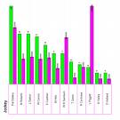



Observer Pattern Motivation
Portfolio
*
Stock
Problem:
  We have an object that changes its state quite often
    Example: A Portfolio of stocks
  We want to provide multiple views of the current state of the portfolio
    Example:Histogram view, pie chart view, time line view, alarm
Requirements:
  The system should maintain consistency across the (redundant) views, whenever the state of the observed object changes
  The system design should be highly extensible
    It should be possible to add new views without having to recompile the observed object or the existing views.

Slide 15
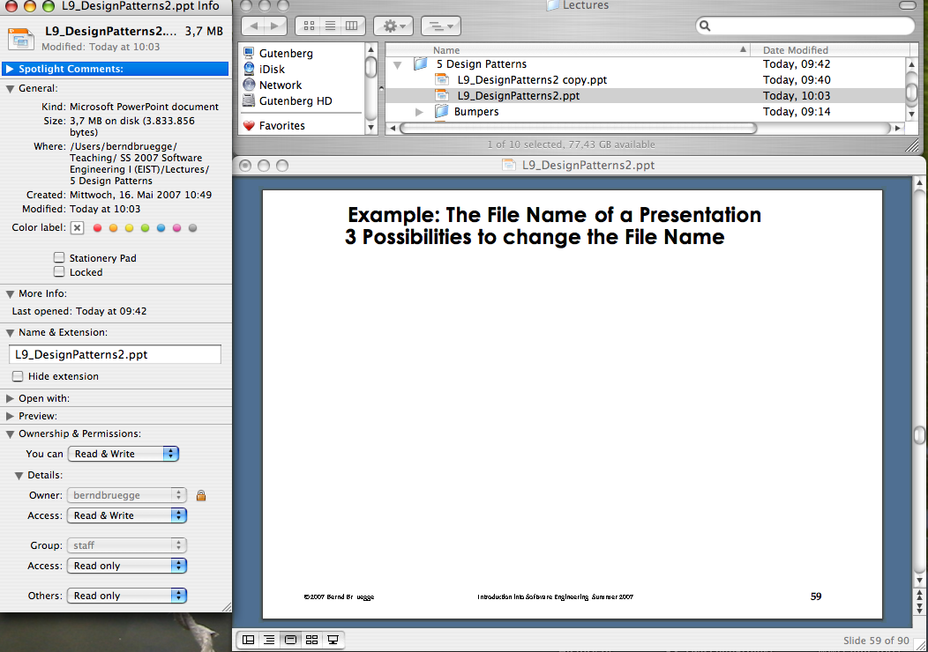
Example: The File Name of a Presentation
3 Possibilities to change the File Name
List View
Powerpoint
View
What happens
if I change
the file name of this presentation in List View
to foo?
InfoView

Slide 16
Observer Pattern: Decouples an Abstraction from its Views
Subject
Observer
observers
*
subscribe(subscriber)
unsubscribe(subscriber)
notify()
update()
ConcreteSubject
ConcreteObserver
state
observeState
getState()
setState()
update()
The Subject (“Publisher”) represents the entity object
Observers (“Subscribers”) attach to the Subject by calling subscribe()
Each Observer has a different view of the state of the entity object
  The state is contained in the subclass ConcreteSubject
  The state can be obtained and set by subclasses of type ConcreteObserver.
Notes:
The Publisher is called Subject, the Subscriber is called Observer in Gamma.

Slide 17
Observer Pattern
Models a 1-to-many dependency between objects
  Connects the state of an observed object, the subject with many observing objects, the observers
Usage:
  Maintaining consistency across redundant states
  Optimizing a batch of changes to maintain consistency
Three variants for maintaining the consistency:
  Push Notification: Every time the state of the subject changes, all the observers are notified of the change
    Push-Update Notification: The subject also sends the state that has been changed to the observers
  Pull Notification: An observer inquires about the state the of the subject
Also called Publish and Subscribe.

Slide 18
Modeling the event flow:
Change FileName to “foo”
Subject
observers
*
Observer
subscribe(subscriber)
unsubscribe(subscriber)
notify()
update()
ConcreteSubject
ConcreteObserver
state
observeState
getState()
setState()
update()
FileName:
Subject
InfoView:
ConcreteObserver
ListView:
ConcreteObserver
PowerpointView:
ConcreteObserver
FileName:
ConcreteSubject
Pull-
Notification
subscribe()
getState()
“L9_DesignPatterns2.ppt”
update()
subscribe()
subscribe()
setState(“foo”)
Is this a correct model
of the reality?
Push-Update
Notification
notify()
Push-
Notification
update(“foo”)
update()
update(“foo”))
update()
update()
update(“foo”)
getName()
“foo”
getName()
“foo”

Slide 19
Applying the Observer Pattern to maintain Consistency across Views
Subject
subscribe()
unsubscribe()
notify()
*
Observer
update()
File
-filename
InfoView
update()
getState()
setState()
ListView
update()
PowerpointView
update()

Slide 20
Applying the Observer Design Pattern to maintain Consistency across MatchViews
observers
Subject
Observer
1
*
subscribe(Subscriber)
update()
unsubscribe(Subscriber)
notify()
GameBoard
MatchView
state
gameBoard
getState()
update()
playMove()
Push, Pull or Push-Update Notification?

Slide 21
Strategy Pattern
Different algorithms exists for a specific task
  We can switch between the algorithms at run time
Examples of tasks:
  Different collision strategies for objects in video games
  Parsing a set of tokens into an abstract syntax tree (Bottom up, top down)
  Sorting a list of customers (Bubble sort, mergesort, quicksort)
Different algorithms will be appropriate at different times
  First build, testing the system, delivering the final product
If we need a new algorithm, we can add it without disturbing the application or the other algorithms.

Slide 22
Strategy Pattern
Policy
Context
ContextInterface()
*
Strategy
AlgorithmInterface
ConcreteStrategyA
AlgorithmInterface()
ConcreteStrategyB
AlgorithmInterface()
ConcreteStrategyC
AlgorithmInterface()
Policy decides which ConcreteStrategy is best in the current Context.

Slide 23
Using a Strategy Pattern to Decide between Algorithms at Runtime
Client
Policy
TimeIsImportant
SpaceIsImportant
Database
SelectSortAlgorithm()
Sort()
*
SortInterface
Sort()
BubbleSort
Sort()
QuickSort
Sort()
MergeSort
Sort()

Slide 24
Supporting Multiple implementations of a Network Interface
Context =
{Mobile, Home, Office}
LocationManager
Application
NetworkConnection
NetworkInterface
send()
open()
receive()
close()
setNetworkInterface()
send()
receive()
Ethernet
WaveLAN
UMTS
open()
open()
open()
close()
close()
close()
send()
send()
send()
receive()
receive()
receive()

Slide 25
√
√
√
√

Slide 26
Template Method Motivation
Several subclasses share the same algorithm but differ on the specifics
Common steps should not be duplicated in the subclasses
Examples:
  Executing a test suite of test cases
  Opening, reading, writing documents of
  different types
Approach
  The common steps of the algorithm are factored out into an abstract class
    Abstract methods are specified for each of these steps
  Subclasses provide different realizations for each of these steps.
step1();
…
step2();
…
step3();

Slide 27
Template Method
AbstractClass
templateMethod()
step1()
step2()
step3()
step1();
…
step2();
…
step3();
ConcreteClass
step1()
step2()
step3()
Notes:
The template method, defined in the abstract class, invokes the steps. The actual realization of the steps are done in the concrete class. The template methods allows the concrete class to provide extensions only for the defined steps and cannot change the order.

Slide 28
Template Method Example: Test Cases
TestCase
setUp();
try {
runTest();
} catch (Exception e){
recordFailure(e);
}
tearDown();
run()
setUp()
runTest()
tearDown()
MyTestCase
setUp()
runTest()
tearDown()
Notes:
The invariant of the algorithm is the collection of test results (e.g., failures) and is implemented in the run template method.
The specialized steps of the algorithm are the initialization (setUp()), execution (runTest()), and clean \up (tearDown()) of the specific test case and are implemented in the concrete class.

Slide 29
Template Method Example:
Opening Documents
Application
openDocument()
canOpenFile(f:File)
createDocument(f:File):Doc
aboutToOpenDocument(d:Doc)
if (canOpenFile(f)) {
Doc d;
d = createDocument(f);
aboutToOpenDocument(d);
d.open();
}
MyApplication
canOpenFile(f: File)
createDocument(f:File):Doc
aboutToOpenDocument(d:Doc)
Notes:
The framework (application abstract class) takes care of checking if documents can be opened, creating document objects, notifying the specialized class, and opening the document.
The concrete object only provides the individual steps but has not control over their order. This ensures (for example), that the application always checks if a file can be opened (access rights, file types, etc.) before the document is actually created and read into memory.

Slide 30
Template Method Pattern Applicability
Template method pattern uses inheritance to vary part of an algorithm
Strategy pattern uses delegation to vary the entire algorithm
Template Method is used in frameworks
  The framework implements the invariants of the algorithm
  The client customizations provide specialized steps for the algorithm
Principle: “Don’t call us, we’ll call you”.

Slide 31
√
√

Slide 32
Abstract Factory Pattern Motivation
Consider a user interface toolkit that supports multiple looks and feel standards for different operating systems:
  How can you write a single user interface and make it portable across the different look and feel standards for these window managers?
Consider a facility management system for an intelligent house that supports different control systems:
  How can you write a single control system that is independent from the manufacturer?
Notes:
Two Examples:
Consider a user interface toolkit that supports multiple looks and feel standards such as Motif, Windows 95 or the finder in MacOS.
How can you write a single user interface and make it portable across the different look and feel standards for these window managers?
Consider a facility management system for an intelligent house that supports different control systems such as Siemens’ Instabus, Johnson & Control Metasys or Zumtobel’s proprietary standard.
How can you write a single control system that is independent from the manufacturer?

Slide 33
Abstract Factory
AbstractProductA
AbstractFactory
CreateProductA
CreateProductB
Client
ProductA1
ProductA2
CreateProductA
CreateProductB
AbstractProductB
ConcreteFactory1
ProductB1
ProductB2
ConcreteFactory2
CreateProductA
CreateProductB
Initiation Assocation:
Class ConcreteFactory2 initiates the
associated classes ProductB2 and ProductA2

Slide 34
Applicability for Abstract Factory Pattern
Independence from Initialization or Representation
Manufacturer Independence
Constraints on related products
Cope with upcoming change
Notes:
Independence from Initialization or Representation:
The system should be independent of how its products are created, composed or represented
Manufacturer Independence:
A system should be configured with one family of products, where one has a choice from many different families.
You want to provide a class library for a customer (“facility management library”), but you don’t want to reveal what particular product you are using.
Constraints on related products
A family of related products is designed to be used together and you need to enforce this constraint
Cope with upcoming change:
You use one particular product family, but you expect that the underlying technology is changing very soon, and new products will appear on the market.

Slide 35
Example: A Facility Management System for a House
IntelligentHouse
HouseFactory
createBulb()
createBlind()
EIBFactory
LuxmateFactory
createBulb()
createBulb()
createBlind()
createBlind()
LightBulb
Blind
EIBBulb
LuxmateBulb
EIBBlind
LuxmateBlind
Notes:
Associations are shown dashed, they shown runtime dependencies (not compile time dependencies)

Slide 36
Applying the Abstract Factory Pattern to Games
Tournament
Game
createMatch()
createStatistics()
TicTacToe
Chess
createMatch()
createMatch()
createStats()
createStats()
Match
Statistics
TTTMatch
ChessMatch
TTTStats
ChessStats

Slide 37
Builder Pattern Motivation
The construction of a complex object is common across several representations
Example
  Converting a document to a number of different formats
    the steps for writing out a document are the same
    the specifics of each step depend on the format
Approach
  The construction algorithm is specified by a single class (the “director”)
  The abstract steps of the algorithm (one for each part) are specified by an interface (the “builder”)
  Each representation provides a concrete implementation of the interface (the “concrete builders”)
Notes:
Conversion of documents
Software companies make their money by introducing new formats, forcing users to upgrades
But you don’t want to upgrade your software every time there is an update of the format for Word documents
Idea: A reader for RTF format
Convert RTF to many text formats (EMACS, Framemaker 4.0, Framemaker 5.0, Framemaker 5.5, HTML, SGML, WordPerfect 3.5, WordPerfect 7.0, ….)
Problem: The number of conversions is open-ended.
Solution
Configure the RTF Reader with a “builder” object that specializes in conversions to any known format and can easily be extended to deal with any new format appearing on the market

Slide 38
Builder Pattern
Construct()
BuildPart()
Director
Builder
For all objects in Structure {
Builder->BuildPart()
}
Represen-
tation B
BuildPart()
GetResult()
ConcreteBuilderB
BuildPart()
GetResult()
ConcreteBuilderA
Represen-
tation A
Notes:
Note, this is similar to a template method, where the template method is provided by one class (the directory) and the concrete steps are provided by another (concrete builders).

Slide 39
Applicability of Builder Pattern
The creation of a complex product must be independent of the particular parts that make up the product
The creation process must allow different representations for the object that is constructed.
Notes:
The creation of a complex product must be independent of the particular parts that make up the product
In particular, the creation process should not know about the assembly process (how the parts are put together to make up the product)
The creation process must allow different representations for the object that is constructed. Examples:
A house with one floor, 3 rooms, 2 hallways, 1 garage and three doors.
A skyscraper with 50 floors, 15 offices and 5 hallways on each floor. The office layout varies for each floor.

Slide 40
Example: Converting an RTF Document into different representations
ConvertCharacter()
ConvertFontChange()
ConvertParagraph()
Builder
Parse()
RTFReader
while (t = GetNextToken()) {
switch t.Type {
CHAR: Builder->ConvertCharacter(t)
FONT: Builder->ConvertFontChange(t)
PARA: Builder->ConvertParagraph(t) }
}
ConvertCharacter()
ConvertFontChange()
ConvertParagraph()
GetASCIIText()
AsciiConverter
ConvertCharacter()
ConvertFontChange()
ConvertParagraph()
GetHTMLText()
ConvertCharacter()
ConvertFontChange()
ConvertParagraph()
GetTeXText()
HTMLConverter
TexConverter
TeXText
AsciiText
HTMLText
Notes:
A reader for the RTF document exchange format should be able to convert RFT to many text formats. The reader might convert RTF documents into plain ASCII text or into a text widget that can be edited interactively. The problem, however, is that the number of possible conversions is open-ended. So it should be easy to add a new conversion without modifying the reader.
A solution is to convfigure the RTFReader class with a TextConverter object that converts RTF to another textual representation. As the RTFReader parses the RTF document, it uses the TextConverter to perform the conversion. Whenever the RTFReader recognizes an RTF token (either plain text or an RTF control word), it issues a request to the TextConverter to convert the token. TextConvert objects are responsible both for performing the data conversion and for prepreseting the token in a particular format.
Subclasses of TextConverter specialize in different conversions and formats. For example, an ASCII Converter ignores requests to convert anything excetp plain text. A TeXConverter, on the other hand, will implement operations for all requests in order to produce a TeX reprszentation that captures all the stylistic information in the text. A TextWidgetConverter will produce a complex user interface object that lets the user see and edit the text.
Each kind of converter class takes the mechanism for creating and assempling a complex object and puts it behind an abstract interface. The converter is separate from the reader, which is responsible for parsing an RTF document from a file.

Slide 41
Comparison: Abstract Factory vs Builder
Abstract Factory
  Focuses on product family
  Does not hide the creation process
Builder
  The underlying product needs to be constructed as part of the system, but the creation is very complex
  The construction of the complex product changes from time to time
  Hides the creation process from the user
Abstract Factory and Builder work well together for a family of multiple complex products
Notes:
Abstract Factory
Focuses on product family
The products can be simple (“light bulb”) or complex (“engine”)
Does not hide the creation process
The product is immediately returned
Builder
The underlying product needs to be constructed as part of the system, but the creation is very complex
The construction of the complex product changes from time to time
The builder patterns hides the creation process from the user:
The product is returned after creation as a final step
Abstract Factory and Builder work well together for a family of multiple complex products

Slide 42
Clues in Nonfunctional Requirements for the Use of Design Patterns
Text: “manufacturer independent”,
“device independent”,
“must support a family of products”
  => Abstract Factory Pattern
Text: “must interface with an existing object”
  => Adapter Pattern
Text: “must interface to several systems, some
of them to be developed in the future”,
“ an early prototype must be demonstrated”
  =>Bridge Pattern
Text: “must interface to existing set of objects”
  => Façade Pattern
Notes:
Read the problem statement again
Use textual clues (similar to Abbot’s technique in Analysis) to identify design patterns

Slide 43
Clues in Nonfunctional Requirements for use of Design Patterns (2)
Text: “complex structure”,
“must have variable depth and width”
  => Composite Pattern
Text: “must be location transparent”
  => Proxy Pattern
Text: “must be extensible”,
“must be scalable”
  => Observer Pattern
Text: “must provide a policy independent from
the mechanism”
  => Strategy Pattern
Notes:
Here are a few more textual clues that may lead to the use of design patterns

Slide 44
Summary
Composite, Adapter, Bridge, Façade, Proxy (Structural Patterns)
  Focus: Composing objects to form larger structures
    Realize new functionality from old functionality,
    Provide flexibility and extensibility
Command, Observer, Strategy, Template (Behavioral Patterns)
  Focus: Algorithms and assignment of responsibilities to objects
    Avoid tight coupling to a particular solution
Abstract Factory, Builder (Creational Patterns)
  Focus: Creation of complex objects
    Hide how complex objects are created and put together

Slide 45
Conclusion
Design patterns
  provide solutions to common problems
  lead to extensible models and code
  can be used as is or as examples of interface inheritance and delegation
  apply the same principles to structure and to behavior
Design patterns solve a lot of your software development problems
  Pattern-oriented development
My favorites: Observer, Composite, Strategy and Builder.

