Slide 1

Chapter 1: Introduction

Slide 2
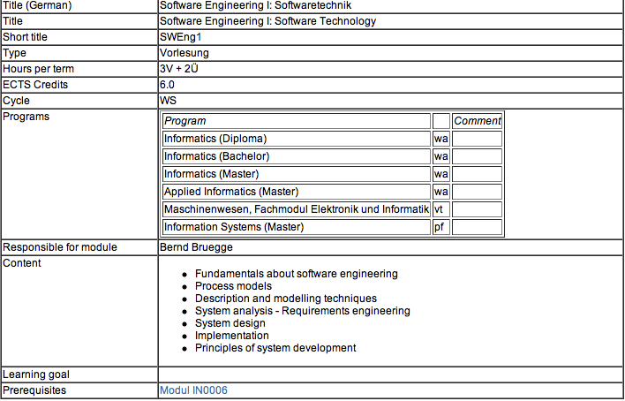


Slide 3
Intended audience
Informatics (Master, Bachelor)
Information Systems (Master)
Applied Informatics (Master)
Diploma Students
Mechanical Engineering: Module Elektronics and Informatics

Slide 4
Objectives of the Lectures
Appreciate the Fundamentals of Software Engineering:
  Methodologies
  Process models
  Description and modeling techniques
  System analysis - Requirements engineering
  System design
  Implementation: Principles of system development

Slide 5
Assumptions for this Class
Assumption:
  You have taken Module 006 EIST: Introduction to Software Engineering or a similar course
  You have already experience in at least one analysis and design technique
Beneficial:
  You have had practical experience with a large software system
  You have already participated in a large software project
  You have experienced major problems.
Notes:
You have practical experience with maintaining or developing a large software system

Slide 6
Times and Locations
Main lecture: HS 2
  Tuesdays 16:00 – 18:00
  Fridays 9:00 - 10:00
Exercises: Thursday 8:00-10:00
  Registration starts today
  Registration ends Thursday
  Exercise sessions start on Thursday , Oct 16
Written Exams:
  Mid-term
  Final

Slide 7
Grading Criteria
The final grade is the weighted average of the mid term (30%) and final grades (70%)
To pass this course your final grade must be 4.0 or better
Participation in the exercises is required (admission requirement for the final exam)
Information about the exercises will be made available on the exercise portal
Hours per week: 3 hours (lecture) + 2 hour (exercises)
ECTS Credits: 6.0.

Slide 8
Focus: Acquire Technical Knowledge
Different methodologies (“philosophies”) to model and develop software systems
Different modeling notations
Different modeling methods
Different software lifecycle models (empirical control models, defined control models)
Different testing techniques (eg. vertical testing, horizontal testing)
Rationale Management
Release and Configuration Management
Notes:
Understand system modeling
Learn a modeling notation (Unified Modeling Language)
Learn different modeling methods:
Functional modeling
Object modeling
Dynamic modeling
Learn to use Tools:
CASE (Computer Aided Software Engineering)
Testing
Different testing methods
Unit, integration and system testing
Move into Component-Based Software Engineering
Design patterns and frameworks
Reuse of existing knowledge

Slide 9
Acquire Managerial Knowledge
Learn the basics of software project management
Understand how to manage with a software lifecycle
Be able to capture software development knowledge (Rationale Management)
Manage change: Configuration Management
Learn the basic methodologies
  Traditional software development
  Agile methods.
Notes:
Software Project Management
Distinction between Process vs Product
Greenfield engineering, Interface engineering and reengineering projects
Software Lifecycle
Learn about different software lifecycles
Iterative approaches
Rationale Management
Issue management
Solving conflicts
Configuration Management
Identification of configuration items
Methodologies
Heavy and lightweight approaches

Slide 10
Outline of Today’s Lecture
The development challenge
Dealing with change
Concepts: Abstraction, Modeling, Hierarchy
Methodologies
Organizational issues
  Lecture schedule
  Exercise schedule
  Associated Project
Notes:
The goal of software engineering is to develop software systems. Some systems are impossible to develop, because the requirements are not clear or the technology is not available.
Sometimes the systems are difficult to develop, because it using experimental technology,
that has not matured yet.
Let us start, by looking at couple of problems associated with software systems.
The react in unexpected ways, and they can really frustrate the user.

Slide 11
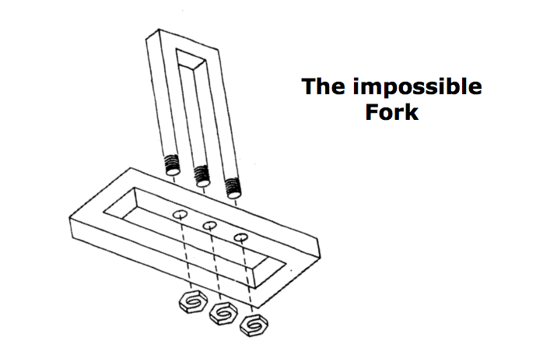
Can you develop this system?
Notes:
Among the most famous as well as the most interesting of all impossible figures is the impossible trident.
The outline of the middle prong merges into the outline of the two outer prongs. In addition, the middle prong appears to drop to a level lower than the two outer prongs. The paradox is quite powerful, because within it are various impossibility sources.
Can you build this? The question has, however, several possible answers. The first immediate answer might be no, because it is physically impossible. But we are engineers, let’s try. Let’s find out, if we can build it, and if not, what the problem is. Maybe we can fix the original problem specification.
----------------------------------------------

Slide 12
Can you develop this system?
Notes:
Cover up parts of the figure. If you cover the bottom half, you will find that the top part of the figure is entirely possible. In this case, you interpret the foreground figure as being built of flat faces constituting two rectangular prongs.

Slide 13
Can you develop this system?
Notes:
Now look at only the bottom half of the figure. You interpret this figure as built of curved surfaces constituting three separate cylindrical lines.
The two parts that are joined in this figure have different interpretations of their shapes when they are perceived separately.
Furthermore, when you join the two parts, surfaces that have one interpretation (part of the foreground figure), get a different interpretation (part of the background).
So the answer is: No, we cannot build this as it is drawnThe figure violates the basic distinction between background and elements of an object.
It has ambigous surfaces. In software engineering terminology the drawing has ambigous requirements. _x0004_One or more objects can be interpreted in two mutually exclusive ways.
To make this possible to develop, only one of the mutually exlusive objects has to be selected. Objects must have their own identity, they cannot overlap.
The answer to the question “Can we develop this” depends on what we mean by developing.
Even the question was imprecise: if we mean: “Can it be built as three-dimensional object?”, then the answer is “no”, because of the irresolvable conflict between the background and the foreground. However, be warned that the japanese artist Shigeo Fukuda has been able to construct 3-dimentional art pieces.
----------------------------------------------

Slide 14
Can you develop this system?
The impossible
Fork
Notes:
Can you build this? The question has, however, several possible answers. The first immediate answer might be no, because it is physically impossible. But we are engineers, let’s try. Let’s find out, if we can build it, and if not, what the problem is. Maybe we can fix the original problem specification.

Slide 15
Physical Model of the impossible Fork (Shigeo Fukuda)
See http://illusionworks.com/mod/movies/fukuda/DisappearingColumn.mov
Notes:
This is a physical construction of an impossible column, based on the classic idea of the impossible fork. There are three cylindrical columns at the top and two rectangular columns at the bottom. Somehow, they transform into each other. It is only possible to see this impossible configuration from one angle. Viewing this sculpture from any other angle will destroy the illusion.
There exists a computer generated movie showing how Fukudaﾕs Disappearing Pillar is constructed. Look at it using the URL shown on the slide.
So if we ask an artist, he will say, yes. Because in this case the end user is a connesseur of art, who puts a drawing of this on the wall in her living room or lets a 3-dimensional movie rotate on his computer as a screen saver. There are a variety of famous artists who made their fortune with these types of drawing (Escher, Dali).
So, in addition to the requirements of the system which have to be unambigous, we need to identify the end user ,the person that is ultimately using the system.
----------------------------------------------

Slide 16
Physical Model of the impossible Fork (Shigeo Fukuda)
Additional material can be found on
http://illusionworks.com/mod/movies/fukuda/
Images may be subject to copyright
Notes:
This is a physical construction of an impossible column, based on the classic idea of the impossible fork. There are three cylindrical columns at the top and two rectangular columns at the bottom. Somehow, they transform into each other. It is only possible to see this impossible configuration from one angle. Viewing this sculpture from any other angle will destroy the illusion.
There exists a computer generated movie showing how Fukudaﾕs Disappearing Pillar is constructed. Look at it using the URL shown on the slide.
So if we ask an artist, he will say, yes. Because in this case the end user is a connesseur of art, who puts a drawing of this on the wall in her living room or lets a 3-dimensional movie rotate on his computer as a screen saver. There are a variety of famous artists who made their fortune with these types of drawing (Escher, Dali).
So, in addition to the requirements of the system which have to be unambigous, we need to identify the end user ,the person that is ultimately using the system.
----------------------------------------------

Slide 17
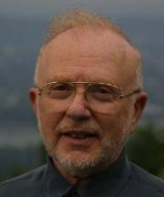
Why is software development difficult?
The problem domain (also called application domain) is difficult
The solution domain is difficult
The development process is difficult to manage
Software offers extreme flexibility
Software is a discrete system
  Continuous systems have no hidden surprises
  Discrete systems can have hidden surprises! (Parnas)
David Lorge Parnas is an early pioneer in
software engineering who developed the
concepts of modularity and information hiding
in systems which are the foundation of
object oriented methodologies.
Notes:
So, in addition to the requirements of the system which have to be unambigous, we need to identify the end user ,the person that is ultimately using the system.
The problem domain is sometimes difficult, just because we are not experts in it. That is, it might not be intellectually challenging, but because you are not an expert in it, you have to learn it. Couple this with learning several problem domains, and that is what you will have to do as a software engineer, and the problem becomes obvious.
The development process is very difficult to manage. This has taken some time and some billion dollars to learn, but we are now starting to accept the fact, that software development is a complex activity. One of the assumptions that managers have made in the past, is that software development can be managed as a set of steps in linear fashion, for example: Requirements Specification, followed by System Design followed by Implementation followed by Testing and Delivery.
In reality this is not that easy. Software Development does not follow a linear process. It is highly nonlinear. There are dependencies between the way you design a system and the functionality you require it to have. Moreover, and that makes it really tricky, some of these dependencies cannot be formulated unless you try the design.
Another issue: Software is extremely flexible. We can change almost anything that we have designed in software. While it is hard to change the layout of a washing machine, it is extremely easy to change the program running it.
Here is another problem: When you are sitting in a plane in a window seat, and you push a button to call the steward for a drink, you don’t expect the system to take a hard left turn and dive down into the pacific. This can happen with digital systems. One of the reasons: While you can decompose the system into subsystems, say “Call Steward” and “Flight Control” subsystems, if you don’t follow good design rules, you might have used some global variable for each of these subsystems.
In the old days, when memory was expensive, programmers did this, as we learned in the case of the space shuttle.
And one of these global variables used by the “Flight Control” subsystem might have unintentionally ben been overwritten by the “Call Steward” SubSystem.

Slide 18
Software Engineering is more than writing Code
Problem solving
  Creating a solution
  Engineering a system based on the solution
Modeling
Knowledge acquisition
Rationale management
Notes:
It requires the most differing activities and abilities in problem solving, abstract thinking, knowledge acquisition and understanding the reasons behind decisions
We will cover each of these areas in class as we move along.
To aid you in each of these areas, we are using 3 types of weapons, Techniques, Methodologies and Tools

Slide 19
Techniques, Methodologies and Tools
Techniques:
  Formal procedures for producing results using some well-defined notation
Methodologies:
  Collection of techniques applied across software development and unified by a philosophical approach
Tools:
  Instruments or automated systems to accomplish a technique
  CASE = Computer Aided Software Engineering
Notes:
:Techniques are well known procedures that you know will produce a result (Algorithms, cook book recipes are examples of techniques).
Some people use the word “method” instead of technique, but this word is already reserved in our object-oriented development language, so we won’t use it here.
A collection of techniques is called a methodology. (A cookbook is a methodology).
A Tool is an instrument that helps you to accomplish a method. Examples of tools are: Pans, pots and stove.
Note that these weapons are not enough to make a really good sauce. That is only possible if you are a good cook. In our case, if you are a good software engineer.
Techniques, methodologies and tools are the domain of discourse for computer scientists as well. What is the difference?

Slide 20
Computer Science vs. Engineering
Computer Scientist
  Assumes techniques and tools have to be developed.
  Proves theorems about algorithms, designs languages, defines knowledge representation schemes
  Has infinite time…
Engineer
  Develops a solution for a problem formulated by a client
  Uses computers & languages, techniques and tools
Software Engineer
  Works in multiple application domains
  Has only 3 months...
  …while changes occurs in the problem formulation (requirements) and also in the available technology.
Notes:
A computer scientist assumes that techniques, methodologies and tools are to be developed. They investigate in designs for each of these weapons, and prove theorems that specify they do what they are intended to do. They also design languages that allow us to express techniques. To do all this, a computer scientist has available an infinite amount of time.
A software engineering views these issues as solved. The only question for the software engineer is how these tools, techniques and methodologies can be used to solve the problem at hand. What they have to worry about is how to do it under the time pressure of a deadline. In addition they have to worry about a budget that might constrain the solution, and often, the use of tools. Good software engineering tools can cost up to a couple of $10,000 Dollars

Slide 21
Software Engineering: A Working Definition
Software Engineering is a collection of techniques,
methodologies and tools that help with the
production of
  A high quality software system developed with a given budget before a given deadline
while change occurs
Challenge: Dealing with complexity and change
20
Notes:
Let‘s come up with th a working definition for software engineering. This definition helps us to get started, because it contains the major problem areas that we have to deal with during software development.

Slide 22
Software Engineering:
A Problem Solving Activity
Analysis:
  Understand the nature of the problem and break the problem into pieces
Synthesis:
  Put the pieces together into a large structure
For problem solving we use techniques, methodologies and tools.
Notes:
What is Software Engineering? The goal is to produce high quality software to satisfy a set of functional and nonfunctional requirements. How do we do that?
First, and foremost, by acknowledging that it is a problem solving activity. That is, it has to rely on well known techniques that are used all over the world for solving problems. There are two major parts of any problem solving process:
Analysis: Understand the nature of the problem. This is done by looking at the problem and trying to see if there are subaspects that can be solved independently from each other. This means, that we need to identify the pieces of the puzzle (In object-oriented development, we will call this object identification).
Synthesis: Once you have identified the pieces, you want to put them back together into a larger structure, usually by keeping some type of structure within the structure.

Slide 23
Course Outline
Dealing with Complexity
  Notations (UML, OCL)
  Requirements Engineering, Analysis and Design
    OOSE, SA/SD, scenario-based design, formal specifications
  Testing
    Vertical and horizontal testing
Dealing with Change
  Rationale Management
    Knowledge Management
  Release Management
    Big Bang vs Continuous Integration
  Software Life Cycle
    Linear models
    Iterative models
    Activity-vs Entity-based views
Patterns
Application of these Concepts in the Exercises
Notes:
Focus of Lectures: Technical topics focusing on the complexity and change of systems and how to cope with it.

Slide 24
Tentative Lecture Schedule
Block 1 (Oct 14 – Oct 17) Introduction, Methodologies
Block 2 (Oct 21 – Oct 24) The UML notation
Block 3 (Oct 28 – Nov 14) Requirements Elicitation, Analysis/Design
Block 4 (Nov 18 – Nov 21) Build and Release Management
Block 5 (Nov 25 – Nov 28) Testing, Programming Contest
Block 6 (Dec 9– Dec 12) Software Lifecycle Models
Block 7 (Dec 16– Jan 9) Detailed Design/Implementation Concepts
(Mapping models to code)
Midterm Exam: Dec 18
Christmas Break until January 8
Block 8 (January and February)
- Specific methodologies: XP, Scrum, Rugby, Royce
- Plus invited lectures from industry
Final Exam: Feb 9

Slide 25
Exercises
The exercises are organized in two groups
Each group has one exercise session (2 hour) per week: Thursday 8:00-10:00
Registration, attendance in the exercise sessions and attempting/finishing the homeworks is mandatory.

Slide 26

Textbook
Bernd Bruegge, Allen H. Dutoit
Object-Oriented Software Engineering: Using UML, Patterns and Java, 3rd Edition
Publisher: Prentice Hall, Upper Saddle River, NJ, 2009;
ISBN-10: 0136061257
ISBN-13: 978-0136061250
Additional readings will be added during each lecture.

Slide 27
Questions?
Lecture Portal:
  The lecture slides will be posted in PDF format after the lecture is given
Exercise Portal:
  Separate home page will be set up for the exercise materials
What happens if I don’t participate in the exercises?

Slide 28
What happens if I don’t participate in the exercises?
Play the movie
http://www.youtube.com/watch?v=_VFS8zRo0pc
Notes:
If the URL is not correct, go to YouTub and search for Chinese Tree Catcher

