Slide 1

Chapter 11, Testing

Slide 2
Outline of the 3 Lectures on Testing
Today:
Terminology
Testing Activities
Unit testing
Third Lecture:
Model-based Testing
U2TP Testing Profile
Next lecture:
Integration testing
  Testing strategy
  Design patterns & testing
System testing
  Function testing
  Acceptance testing.
Notes:
Outline anpassen

Slide 3


Famous Problems
F-16 : crossing equator using autopilot
  Result: plane flipped over
  Reason?
    Reuse of autopilot
    software
The Therac-25 accidents (1985-1987), quite possibly the most serious non-military computer-related failure ever in terms of human life (at least five died)
  Reason: Bad event handling in the GUI
NASA Mars Climate Orbiter destroyed due to incorrect orbit insertion (September 23, 1999)
  Reason: Unit conversion problem.

Slide 4
Terminology
Failure: Any deviation of the observed behavior from the specified behavior
Erroneous state (error): The system is in a state such that further processing by the system can lead to a failure
Fault: The mechanical or algorithmic cause of an error (“bug”)
Validation: Activity of checking for deviations between the observed behavior of a system and its specification.

Slide 5
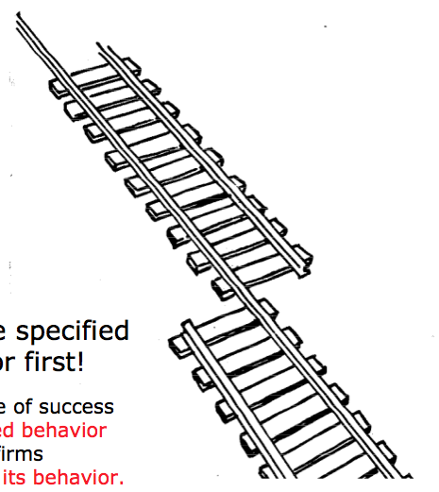
What is this?
A failure?
An error?
A fault?
We need to describe specified
and desired behavior first!

Slide 6
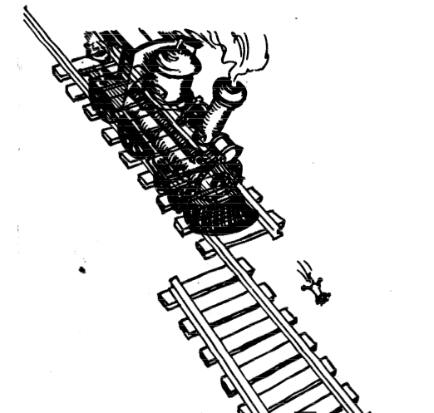
Erroneous State (“Error”)

Slide 7
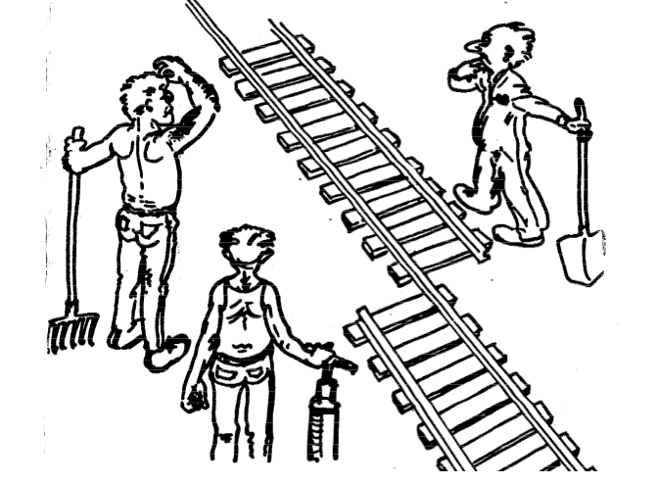
Algorithmic Fault

Slide 8

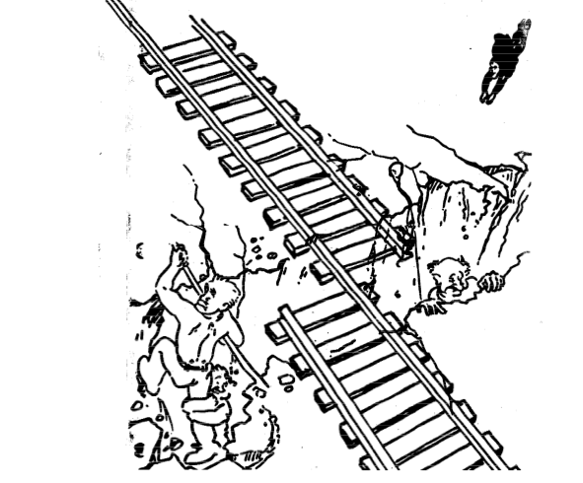
Mechanical Fault

Slide 9
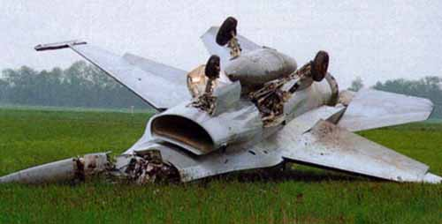
F-16 Bug
What is the failure?
What is the error?
What is the fault?
  Bad use of implementation
  inheritance
  A Plane is not a rocket.
Rocket
Plane

Slide 10
Examples of Faults and Errors
Faults in the Interface specification
  Mismatch between what the client needs and what the server offers
  Mismatch between requirements and implementation
Algorithmic Faults
  Missing initialization
  Incorrect branching condition
  Missing test for null
Mechanical Faults (very hard to find)
  Operating temperature outside of equipment specification
Errors
  Null reference errors
  Concurrency errors
  Exceptions.
Notes:
Beispiel Itunes
Jeder freier song

Slide 11
How do we deal with Errors, Failures and Faults?

Slide 12
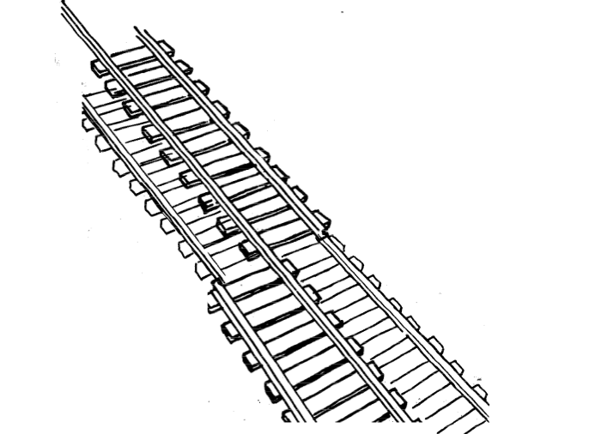
Modular Redundancy

Slide 13
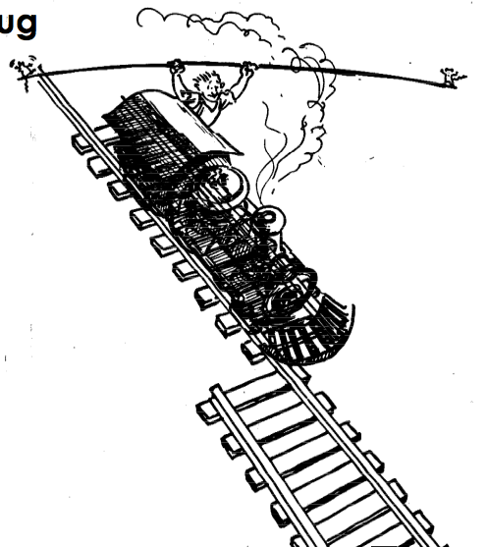
Declaring the Bug as a Feature

Slide 14
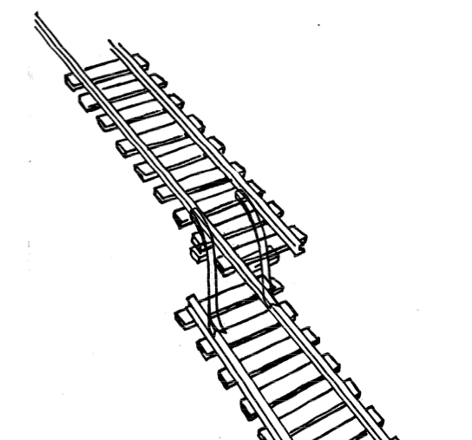
Patching

Slide 15
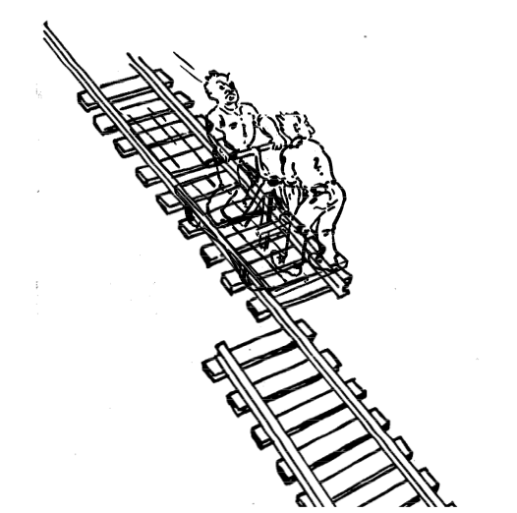
Testing

Slide 16
Another View on How to Deal with Faults
Fault avoidance
  Use methodology to reduce complexity
  Use configuration management to prevent inconsistency
  Apply verification to prevent algorithmic faults
  Use Reviews
Fault detection
  Testing: Activity to provoke failures in a planned way
  Debugging: Find and remove the cause (Faults) of an observed failure
  Monitoring: Deliver information about state => Used during debugging
Fault tolerance
  Exception handling
  Modular redundancy.
Notes:
Fault avoidance (before the system is released):
Use programming methodology to reduce complexity
Use configuration management to prevent inconsistency
Apply verification to prevent algorithmic faults
Reviews
Fault detection (while system is running):
Testing: Create failures in a planned way
Debugging: Start with an unplanned failures
Monitoring: Deliver information about state. Find performance bugs
Fault tolerance (recover from failure once the system is released):
Atomic transactions (database systems)
Modular redundancy

Slide 17
Taxonomy for Fault Handling Techniques
Fault Handling
Fault
Avoidance
Fault
Detection
Fault
Tolerance
Methodoloy
Configuration
Management
Atomic
Transactions
Modular
Redundancy
Verification
Testing
Debugging
Unit
Testing
Integration
Testing
System
Testing
Notes:
Richtig machen

Slide 18
Observations
It is impossible to completely test any nontrivial module or system
  Practical limitations: Complete testing is prohibitive in time and cost
  Theoretical limitations: e.g. Halting problem
“Testing can only show the presence of bugs, not their absence” (Dijkstra).
Testing is not for free
=> Define your goals and priorities

Slide 19
Testing takes creativity
To develop an effective test, one must have:
  Detailed understanding of the system
  Application and solution domain knowledge
  Knowledge of the testing techniques
  Skill to apply these techniques
Testing is done best by independent testers
  We often develop a certain mental attitude that the program should in a certain way when in fact it does not
  Programmers often stick to the data set that makes the program work
  A program often does not work when tried by somebody else.
behave
Notes:
Testing often viewed as dirty work.
To develop an effective test, one must have:
Detailed understanding of the system
Knowledge of the testing techniques
Skill to apply these techniques in an effective and efficient manner
Testing is done best by independent testers
We often develop a certain mental attitude that the program should in a certain way when in fact it does not.
Programmer often stick to the data set that makes the program work
"Don’t mess up my code!"
A program often does not work when tried by somebody else.
"Every new user uncovers a new class of bugs”

Slide 20
Testing Activities
Unit
Testing
Integration
Testing
System
Testing
Acceptance
Testing
Object
Design
Document
System
Design
Document
Requirements
Analysis
Document
Client
Expectation
Unit
Testing
Integration
Testing
System
Testing
Acceptance
Testing
Developer
Client

Slide 21
Types of Testing
Unit
Testing
Integration
Testing
System
Testing
Acceptance
Testing
Unit Testing
  Individual component (class or subsystem)
  Carried out by developers
  Goal: Confirm that the component or subsystem is correctly coded and carries out the intended functionality
Integration Testing
  Groups of subsystems (collection of subsystems) and eventually the entire system
  Carried out by developers
  Goal: Test the interfaces among the subsystems.

Slide 22
Types of Testing continued...
Unit
Testing
Integration
Testing
System
Testing
Acceptance
Testing
System Testing
  The entire system
  Carried out by developers
  Goal: Determine if the system meets the requirements (functional and nonfunctional)
Acceptance Testing
  Evaluates the system delivered by developers
  Carried out by the client. May involve executing typical transactions on site on a trial basis
  Goal: Demonstrate that the system meets the requirements and is ready to use.

Slide 23
When should you write a test?
Traditionally after the source code is written
In XP before the source code written
  Test-Driven Development Cycle
    Add a test
    Run the automated tests
      => see the new one fail
    Write some code
    Run the automated tests
  => see them succeed
    Refactor code.

Slide 24
Unit Testing
Unit
Testing
Integration
Testing
System
Testing
Acceptance
Testing
Static Testing (at compile time)
  Static Analysis
  Review
    Walk-through (informal)
    Code inspection (formal)
Dynamic Testing (at run time)
  Black-box testing
  White-box testing.
Notes:
Static Analysis:
Manual execution: Reading the source code
Walk-through (informal presentation to others)
Code inspection (formal presentation to others)
Automated tools checking for
syntactic and semantic errors
departure from coding standards
Dynamic Analysis:
Black-box testing
White-box testing
Data-structure based testing
Black-box testing (Test the input/output behavior)
White-box testing (Test the internal logic of the subsystem or object)
Data-structure based testing (Data types determine test cases)

Slide 25




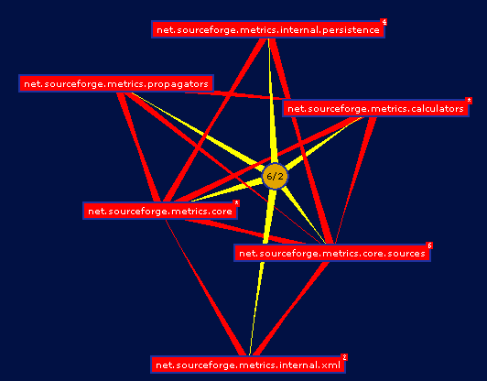
Static Analysis with Eclipse
Unit
Testing
Integration
Testing
System
Testing
Acceptance
Testing
Compiler Warnings and Errors
  Possibly uninitialized Variable
  Undocumented empty block
  Assignment has no effect
Checkstyle
  Check for code guideline violations
  http://checkstyle.sourceforge.net
FindBugs
  Check for code anomalies
  http://findbugs.sourceforge.net
Metrics
  Check for structural anomalies
  http://metrics.sourceforge.net

Slide 26
Black-box testing
Unit
Testing
Integration
Testing
System
Testing
Acceptance
Testing
Focus: I/O behavior
  If for any given input, we can predict the output, then the component passes the test
  Requires test oracle
Goal: Reduce number of test cases by equivalence partitioning:
  Divide input conditions into equivalence classes
  Choose test cases for each equivalence class.
Notes:
Focus: I/O behavior. If for any given input, we can predict the output, then the module passes the test.
Almost always impossible to generate all possible inputs ("test cases")
Goal: Reduce number of test cases by equivalence partitioning:
Divide input conditions into equivalence classes
Choose test cases for each equivalence class. (Example: If an object is supposed to accept a negative number, testing one negative number is enough)

Slide 27
Black-box testing: Test case selection
a) Input is valid across range of values
  Developer selects test cases from 3 equivalence classes:
    Below the range
    Within the range
    Above the range
b) Input is only valid, if it is a member of a discrete set
  Developer selects test cases from 2 equivalence classes:
    Valid discrete values
    Invalid discrete values
No rules, only guidelines.
Notes:
Rauslassen?

Slide 28
Black box testing: An example
public class MyCalendar {
public int getNumDaysInMonth(int month, int year)
throws InvalidMonthException
{ … }
}
Representation for month:
  1: January, 2: February, …., 12: December
Representation for year:
  1904, … 1999, 2000,…, 2006, …
How many test cases do we need for the black box testing of getNumDaysInMonth()?
Notes:
Depends on calendar: gregorian calendar
Month parameter equivalence classes
30 days
31 days
February
No month 0, 13, -1
year: parameter equivalence classes
Normal year
Leap year:
/4
/100
/400
Before christ/ After Christ year -200
Before at and after 2000
=> 12 test cases

Slide 29
White-box testing overview
Unit
Testing
Integration
Testing
System
Testing
Acceptance
Testing
Code coverage
Branch coverage
Condition coverage
Path coverage
=> Details in the exercise session about testing

Slide 30
Unit Testing Heuristics
1. Create unit tests when object design is completed
  Black-box test: Test the functional model
  White-box test: Test the dynamic model
2. Develop the test cases
  Goal: Find effective num-
  ber of test cases
3. Cross-check the test cases to eliminate duplicates
  Don't waste your time!
4. Desk check your source code
  Sometimes reduces testing time
5. Create a test harness
  Test drivers and test stubs are needed for integration testing
6. Describe the test oracle
  Often the result of the first successfully executed test
7. Execute the test cases
  Re-execute test whenever a change is made (“regression testing”)
8. Compare the results of the test with the test oracle
  Automate this if possible.
Notes:
Develop the test cases
Goal: Find minimal num-
ber of test cases to cover as many paths as possible
Don’t forget regression testing
Re-execute test cases every time a change is made.

Slide 31
JUnit: Overview
Unit
Testing
Integration
Testing
System
Testing
Acceptance
Testing
A Java framework for writing and running unit tests
  Test cases and fixtures
  Test suites
  Test runner
Written by Kent Beck and Erich Gamma
Written with “test first” and pattern-based development in mind
  Tests written before code
  Allows for regression testing
  Facilitates refactoring
JUnit is Open Source
  www.junit.org
  JUnit Version 4, released Mar 2006

Slide 32
JUnit Classes
*
TestResult
Test
run(TestResult)
TestCase
TestSuite
testName:String
run(TestResult)
run(TestResult)
addTest()
setUp()
tearDown()
runTest()
ConcreteTestCase
UnitToBeTested
Methods under Test
setUp()
tearDown()
runTest()

Slide 33
An example: Testing MyList
Unit to be tested
  MyList
Methods under test
  add()
  remove()
  contains()
  size()
Concrete Test case
  MyListTestCase

Slide 34
*
TestResult
Test
run(TestResult)
TestCase
TestSuite
testName:String
run(TestResult)
run(TestResult)
addTest()
setUp()
tearDown()
runTest()
MyListTestCase
MyList
setUp()
tearDown()
runTest()
testAdd()
testRemove()
add()
remove()
contains()
size()

Slide 35
Writing TestCases in JUnit
public class MyListTestCase extends TestCase {
public MyListTestCase(String name) {
super(name);
}
public void testAdd() {
// Set up the test
List aList = new MyList();
String anElement = “a string”;
// Perform the test
aList.add(anElement);
// Check if test succeeded
assertTrue(aList.size() == 1);
assertTrue(aList.contains(anElement));
}
protected void runTest() {
testAdd();
}
}
*
TestResult
Test
run(TestResult)
TestCase
TestSuite
testName:String
run(TestResult)
run(TestResult)
addTest()
setUp()
tearDown()
runTest()
MyListTestCase
MyList
setUp()
tearDown()
runTest()
testAdd()
testRemove()
add()
remove()
contains()
size()

Slide 36
Writing Fixtures and Test Cases
public class MyListTestCase extends TestCase {
// …
private MyList aList;
private String anElement;
public void setUp() {
aList = new MyList();
anElement = “a string”;
}
public void testAdd() {
aList.add(anElement);
assertTrue(aList.size() == 1);
assertTrue(aList.contains(anElement));
}
public void testRemove() {
aList.add(anElement);
aList.remove(anElement);
assertTrue(aList.size() == 0);
assertFalse(aList.contains(anElement));
}
Test Fixture
Test Case
Test Case
Notes:
A test fixture is a set of instances and links that are used as a dummyenvironment for the test cases. By factoring out the initialization of the fixture into the setUp() method, fixtures can be reused between test cases.The tearDown() method is used to clean up after a test, so that the fixturecan be rebuilt from scratch for the next test case.The white paper from which these concepts are taken can be found at:
http://junit.sourceforge.net/doc/cookbook/cookbook.htm

Slide 37
Collecting TestCases into TestSuites
public static Test suite() {
TestSuite suite = new TestSuite();
suite.addTest(new MyListTest(“testAdd”));
suite.addTest(new MyListTest(“testRemove”));
return suite;
}
*
Test
Composite Pattern!
run(TestResult)
TestCase
TestSuite
testName:String
run(TestResult)
run(TestResult)
addTest()
setUp()
tearDown()
runTest()

Slide 38
Design patterns in JUnit
*
TestResult
Test
Command Pattern
run(TestResult)
Composite
Pattern
TestCase
TestSuite
testName:String
run(TestResult)
Template Method
Pattern
run(TestResult)
addTest()
setUp()
tearDown()
runTest()
ConcreteTestCase
TestedUnit
Adapter
Pattern
setUp()
tearDown()
runTest()

Slide 39
Design patterns in JUnit
*
TestResult
Test
Command Pattern
run(TestResult)
Composite
Pattern
TestCase
TestSuite
testName:String
run(TestResult)
Template Method
Pattern
run(TestResult)
addTest()
setUp()
tearDown()
runTest()
ConcreteTestCase
TestedUnit
Adapter
Pattern
setUp()
tearDown()
runTest()

Slide 40
Other JUnit features
Textual and GUI interface
  Displays status of tests
  Displays stack trace when tests fail
Integrated with Maven and Continuous Integration
  http://maven.apache.org
    Build and Release Management Tool
  http://Maven.apache.org/continuum
    Continous integration server for Java programs
  All tests are run before release (regression tests)
  Test results are advertised as a project report
Many specialized variants
  Unit testing of web applications
  J2EE applications

Slide 41
Additional Readings
JUnit Website www.junit.org/index.htm

