Slide 1

Chapter 11, Testing:
Model-based Testing

Slide 2
Outline of the Lectures on Testing
Terminology
Types of errors
Approaches for dealing with errors
Testing activities
Unit testing
Integration testing
System testing
Model-based Testing

Slide 3
Generating Tests from a System Model
There are many different ways to "derive" tests from a system model
  Manual generation
  Automatic generation
Because testing is usually experimental and based on heuristics, there is no one best way to do this.
  It is common to consolidate all test related decisions into a package that is often known as "test requirements” or "test package”.
This test package can contain e.g. information about the part of the system model that should be the focus for testing, or about the conditions where it is correct to stop testing (test stopping criteria).

Slide 4
Model Driven Architecture (MDA)
Recall: MDA focuses on forward engineering, i.e. producing code from a system model
  Note: The term “architecture” in MDA does not mean the architecture of the system being modeled, but refers the architecture of the various standards and models that serve as the technology basis for MDA
    UML: Unified Modeling Language
    MOF: Meta-Object Facility
    XMI: Metadata Interchange
    EDOC: Enterprise Distributed Object Computing
    SPEM: Software Process Engineering Metamodel
    CWM: Common Warehouse Metamodel
An important objective of MDA is executable UML.

Slide 5
Executable UML
Executable UML means that given a UML system model the following steps can be performed automatically:
  Code generation
  Simulation Validation
  Test generation (“Model based Testing”)

Slide 6
Model Based Testing
Definition Model Based Testing: All testing is based on a system model which is used to (manually) generate test cases and oracles
Advantage:
  Increased effectiveness of testing
  Decreased costs
  Reuse of artifacts such as analysis and design models
Requirement:
  The system model is formalized (specification model) and described in UML 2.0

Slide 7
Model Driven Testing
Model Driven Testing is a special case of model based testing:
  All the test cases are automatically generated from the system model
Advantage:
  Automatic generation of tests suites
  Better test thoroughness
  Reduces the cost of test execution.

Slide 8
Observations on Model Based Testing
A system model is an abstract representation of the system’s desired behavior
  The test cases derived from this model are functional tests on the same level of abstraction as the model
  These test cases are known as the abstract test suite
Because test suites are derived from models - not from source code - model-based testing is a form of black-box testing
The abstract test suite cannot be executed
  An executable test suite must be derived from the abstract test suite which communicates with the system under test (SUT)
  This is done by mapping the abstract test suite to concrete test cases suitable for execution.
    This mapping is not part of our lecture.

Slide 9
U2TP: A UML Profile for Model Based Testing:
In 2001, the OMG released a Request for Proposals (RFP) for a Testing Profile for UML to support model based testing
Several companies and institutions (Ericsson, Fraunhofer/FOKUS, IBM, Motorola, Rational, Softeam, Telelogic, University of Lübeck) responded to this RFP, and after some discussion, decided to work together as a consortium to produce U2TP
U2TP: UML 2 based Test Profile

Slide 10
U2TP
UML-2 Testing Profile (U2TP):
  A UML extension that makes UML applicable to software testing.
  U2TP allows the collection of all information required for the model-based testing process
    Deriving a test model from the system model.
Test Model:
  A set of test cases derived from the system model.

Slide 11
Overview of Concepts used in U2TP
Test behavior
  Test objective, test case
  Default behavior, verdict
Test architecture
  Test component, test configuration, test context
  SUT (System under Test)
  Test control, arbiter, scheduler
Test Data
  Wildcards, data pools, data partition, data selector, coding rules
Time Concepts
  Timers, time zone.

Slide 12
General Definitions used in U2TP
Test: An attempt to create a difference between the observed behavior and the specified behavior of a system a planned way
Test data: The structures and meaning of values to be processed in a test
System under test (SUT)
  A system, subsystem or component
  The SUT is treated as black-box. This means:
    The SUT can be accessed only via a public interface
    No information on the internal structure of the SUT is available for use in the specification of test cases.
  Test case: Describes a specified behavior, that is, a behavior specified in the system model (normative behavior) of the SUT.

Slide 13
Test Objective
Test objective
  Find any difference between the observed behavior and the specified behavior, that is, the behavior specified in the system model.
UML Example
  The test objective in the diagram below specifies that the objective of the ValidWithdrawal test case is to validate the WithdrawMoney use case.
<<testcase>>
ValidWithdrawal
<<usecase>>
WithdrawMoney
<<objective>>

Slide 14
Test Architecture Definitions
Test component: An object within a test system
Test architecture: The test components and their relationships in a test system
Testing configuration: The combination of a test system with a SUT
Test control: A ordering of the execution of the tests performed on the SUT
Test context: A description of
  A set of test cases
  A test configuration
  A test control.

Slide 15
Mandatory Elements in a test based on U2TP
A test system following the U2TP testing profile must consists at least of the following parts:
  Test architecture: SUT, Test Context
  Test behavior: TestCase, Verdict.
Architecture | Behavior | Data | Time
SUT | Objective |  | Timer
TestContext | TestCase |  | StartTimerAction
TestConfiguration | Observation |  | StopTimerAction
TestComponent | Stimulus |  | TimeOut
Arbiter | Verdict
Mandatory Elements

Slide 16
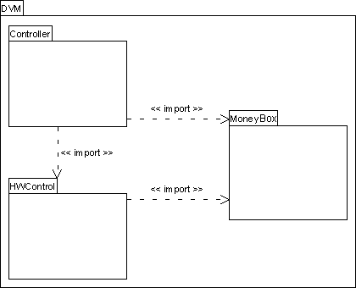
Example: Test System for a Vending Machine
Drink Vending Machine (DVM) with 3 use cases:_x0001_
  The drinking machine accepts cash payment
  If the inserted money is sufficient, a drink is returned
  If not, the money is returned.

Slide 17
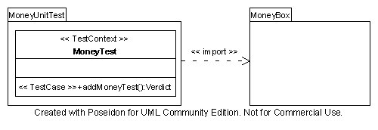
Model-based Testing of Moneybox
Test System
SUT
The test system MoneyUnitTest is developed with the purpose of unit testing the class Moneybox, which is part of the system under test
Moneybox must be imported by MoneyUnitTest to be accessible.

Slide 18
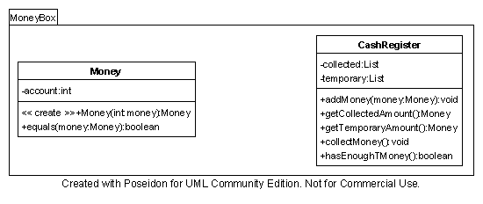
UML System Model of the Moneybox

Slide 19
Testing the addMoney Operation (Unit Test)
Test that the machine correctly counts the money inserted by the user into the Moneybox.

Slide 20
Sequence Diagram for addMoney
:customer
cashRegister
:Money(x)
money1:Money
:Money(y)
money2:Money
:addMoney(money1)
:addMoney(money2)
:Money(z)
money3:Money
:getTemporaryAmout()
:money4
:equals(money4)
:true

Slide 21
Model-based Testing of Moneybox
Test System
SUT
TestContext
Test Case
MoneyTest is the test context
MoneyUnitTest is the test case

Slide 22
Definition Test Case
Test case: A test case implements a test objective. It describes a specified behavior, that is, a behavior specified in the system model (normative behavior) of the SUT
A test case is defined in terms of sequences, alternatives, loops, and defaults of stimuli to and observations from the SUT.
A test case consists of
  Flow of events (use case, sequence diagram)
    Stimulus to and Observation from the SUT
  Verdict: Assessment of the correctness of the SUT
  Arbiter: Evaluates the outcome of the test.

Slide 23
Test Case
A Test case specifies how a set of test components interact with the system under test realize a test objective
A test case is owned by a test context
Components of a test case
  Event flow: Sequence of steps to execute the SUT
    May include timing information
  Input: Stimulus
  Output: Observation
  Expected result: Oracle
  Verdict: Observation equals Oracle
    Comparison done by an arbiter
A test case may invoke other test cases.

Slide 24
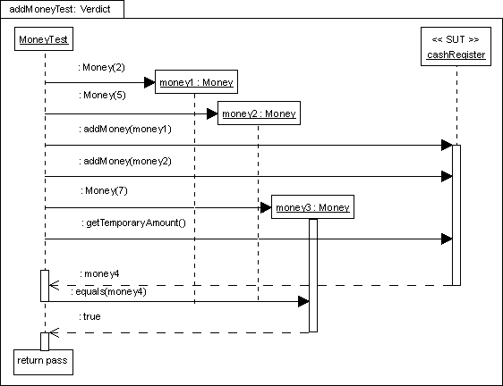
Sequence Diagram for addMoneyTest
Instantiated SUT
Stimulus

Slide 25
Stimulus and Observation
Stimulus: Data sent to the SUT
stimulus()
Observation: Data returned from the SUT as a result of a stimulus.
observation
Both, stimuli and observations are described as Test data.

Slide 26
Stimulus and Observation in addMoneyTest
Instantiated SUT
Stimulus
Observation

Slide 27
Test Data
Test Data: A generalization of stimulus and observation. There are three types of test data:
  Data pool: Test data which are unspecific in their properties
  Data partition: Test data which are unspecific in their values
  Wild card: Test data which are unspecific in certain elements
  Data selector: An operation that defines how data values or equivalence classes are selected from a data pool or data partition.
Coding rules: Describe the encoding/decoding of test data to be sent to the interfaces of the SUT.

Slide 28
Data Pool
Data pools are a collection of data partitions or explicit values that are used by a test context, or test components, during the evaluation of test contexts and test cases. They can be used for repeated tests.
Example
  see figure on next slide

Slide 29
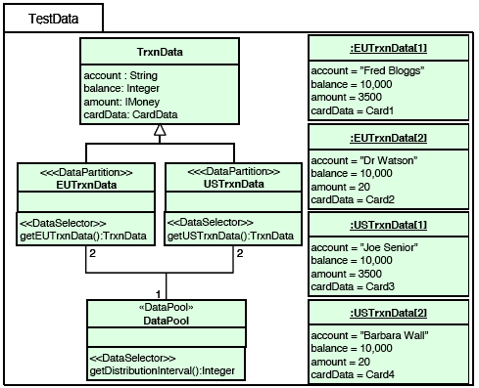
Data Pool Example
Notes:
Figure above is a package illustrating the data pool, data partition and data selector concepts. The TestData package defines for TrxnData the data pool DataPool and the data partitions EUTrxnData and USTrxnData. The data partitions have two data samples defined each. Data selectors getEUTrxnData, getUSTrxnData and getDistributionInterval are used for the
access to the data pool and the data partitions.

Slide 30
Verdict
A test verdict describes the result of a test case execution:
  Pass indicates that the specified behavior equals the observed behavior of the SUT for that specific test case
  Fail describes that the specified behavior is not equal to the observed behavior of the SUT for that test case
  Inconclusive is used if neither a Pass nor a Fail verdict can be given
  Error is used to indicate a failure in the test case itself.

Slide 31
Verdict in addMoneyTest
Instantiated SUT
Stimulus
Verdict
Observation

Slide 32
Scheduler:
Predefined interface in U2TP that controls the execution of the test components that take part in a test case
  Keeps control over the creation and destruction of test components
  Collaborates with the arbiter to inform it when it is time to issue a verdict.
Operations
  Scheduler() : Constructor of Scheduler. Starts SUT and Arbiter.
  startTestCase() : Starts test case by notifying all involved test components.
  finishTestCase(t:TestComponent) : Records that test component t has finished its execution. Notifies the arbiter, when all test components in the current test case are finished
  createTestComponent(t:TestComponent) : Records that the test component t has been created by some other test component.

Slide 33
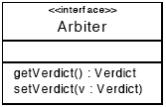
Arbiter
Arbiter: Called by the scheduler. Evaluates the execution of the test case and assigns a verdict to it
  Arbiter is an interface provided by the UML Testing Profile.
  Operations
    getVerdict: Returns the current verdict
    setVerdict: Sets a new verdict value
  Semantic of Arbiter:
    If a verdict is pass, it can be changed to inconclusive, fail, or error.
    If a verdict is inconclusive, it can be changed to fail or error.
    If a verdict is fail, it can be changed to error only.
    If a verdict is error, it cannot be changed.

Slide 34
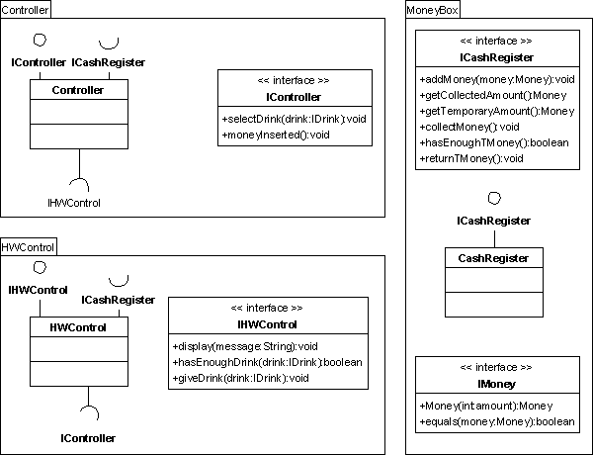
Testing the DVM (Integration Test)
Test Objective
  Check the operation of the DVM when a user buys a drink
  System is not yet complete:
    HWControl and CashRegister are not yet developed.
Provided interface
Required interface
Notes:
Show the public parts of the packages. Controller is the center of our Faute tests in diagram: one must have CashRegister which establishes ICashRegister and Money which establishes IMoney. In more it is MoneyBox.

Slide 35
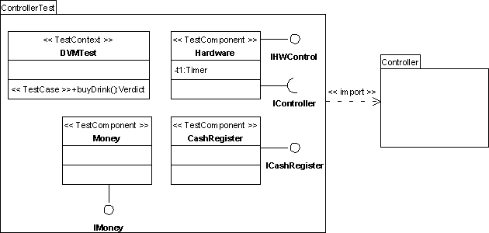
Develop the Test Components
Test components implement the interfaces of emulated components
The test components also interact with SUT
TestComponents
Notes:
Contradiction enters the 2 diagrams: money is emulated or not?
§Extends the interface bus so that if one realized it testComponent one can use it in the place of testComponent without changing the code (see MockObject).
To add IController for cash register . How does a Component test function?
How to make the emulation?
TestPackage: Elements necessary to specify the test together. Import Controller for xxx with the elements to test.

Slide 36
Test Configuration
Test Configuration: The test configuration defines instances of the test component (test objects and the connections between them)
Initial test configuration: State of the test objects at the beginning of a test
UML Example:
  Testing Configuration for the Vending machine
  Next slide.

Slide 37
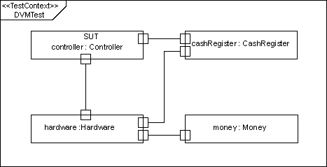
Test Configuration for the Vending Machine
  Collection of test components and ports between these components and the SUT
  Defines the connections when the test case is launched.
    the maximum number of ports and test components during the execution of the test case.
Notes:
Controller is the center of our tests.
What is the difference with the preceding diagram?

Slide 38
Timer
Timer is a mechanism to generate a timeout event occurrence
This may occur when a pre-specified time interval has expired
Timers are defined as properties of test components
  A timeout indicates the timer expiration
  A timer can be stopped.
  The expiration time of a running timer and its current status (e.g., active/inactive) can be checked.

Slide 39
Timer (2)
StartTimerAction
  Semantics: Start Timer t1 with the value 1.5 sec
  Parameter: duration
  Notation:
StopTimerAction
  Semantics: Stop Timer
  Notation:
TimeOut
  The time specified as duration in StartTimer has expired
Example:
  Test that the hardware provides a drink (“giveDrink”) within 1.5 seconds after a drink has been selected.

Slide 40
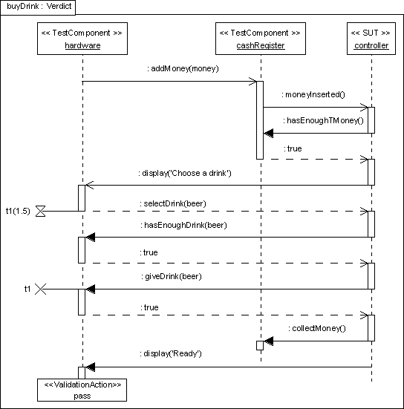
Timer Example
Start the Timer t1
Stop the Timer t1

Slide 41
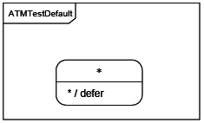
Wildcards
Wildcards are special symbols representing values or ranges of values
They specify whether the value is present or not, and/or whether it is of any value
Wildcard types:
  Wildcard for any value
    Example: “?” (question mark)
  Wildcard for any value or no value at all (i.e. an omitted value)
    Example: “*” (star)
  Wildcard for an omitted value

Slide 42
Additional Readings
XMI
  http://en.wikipedia.org/wiki/XMI
MDA
  http://en.wikipedia.org/wiki/Model-driven_architecture
UML Testing Profile Tutorial
  Ina Schieferdecker, Øystein Haugen, 2004
    http://folk.uio.no/oysteinh/Schieferdecker-Haugen-ECOOP2004-U2TP.pdf

Slide 43
Summary
Review of all the definitions introduced in this part of the lecture.
Writing test cases for a use case
  Write the use case
  Determine SUT
  Add Stimulus, Observation and Verdict to use case, turning it into a test case.

Slide 44

Additional Slides

Slide 45
Sequence Diagram for addMoney
:customer
cashRegister
:Money(x)
money1:Money
:Money(y)
money2:Money
:addMoney(money1)
:addMoney(money2)
:Money(z)
money3:Money
:getTemporaryAmout()
:money4
:equals(money4)
:true

Slide 46
Stimulus and Observation in addMoneyTest
Instantiated SUT

Slide 47
Defaults
A default is a behavior triggered by a test observation that is
not handled by the behavior of the test case per se. A default
is triggered whenever a test observation is not handled by the
behavior of a test case. There is a hierarchy of defaults:
within the behavior of a test component object associated to a state (i.e. in a state machine) or to a combined fragment (in an interaction diagram);
for the complete behavior of a test component object associated to a part (typed with a test component) in the internal structure of a test context (i.e. in a test configuration);
for all test component objects of a test component associated to a test component in a test architecture.
Notes:
A UML specification is not necessarily complete. To be complete in this sense means that it specifies every possible trace
of execution. In particular if Interactions are used to specify the behavior, the normal situation is that the specification is
partial only specifying in detail those scenarios that are of particular importance. In a testing context, however, there is a
need to have complete definitions such that the number of erroneous test case executions can be kept to a minimum.
The Default specifications are units of specification defined in the Testing Profile as a means to make partial definitions
of test components complete in a compact, yet flexible way. The Testing Profile defines mechanisms for defaults on
Interactions as well as State Machines.
The general idea about defaults is the following. A test behavior specification typically describes the normative or
expected behaviors for the SUT. However, if during test execution an unexpected behavior is observed, then a default
handler is applied. We have included default behavior definitions on several different levels. If the innermost default fail
to recognize the observed behavior, the default of the next level is tried.

Slide 48
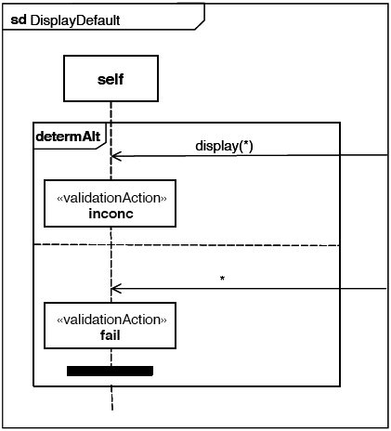
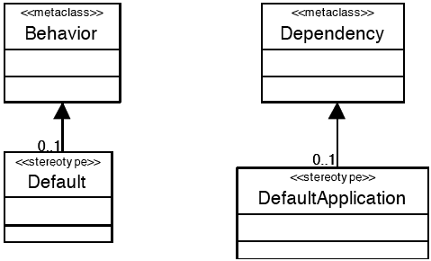
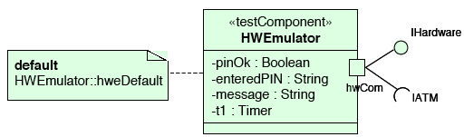
Default Examples

Slide 49

Validation Action
A validation action is an action performed by a
test component to assess a test observations
and/or additional characteristics/parameters. A
notation to model validation actions is still to be
defined.
Example

