Slide 1

Chapter 12,
Rationale Management

Slide 2

An aircraft example
A320
First fly-by-wire passenger aircraft
150 seats, short to medium haul
A319 & A321
Derivatives of A320
Same handling as A320
Design rationale
Reduce pilot training & maintenance costs
Increase flexibility for airline

Slide 3
An aircraft example (2)
A330 & A340
Long haul and ultra long haul
2x seats, 3x range
Similar handling than A320 family
Design rationale
With minimum cross training, A320 pilots can be certified to fly A330 and A340 airplanes
Consequence
Any change in these five airplanes must maintain this similarity

Slide 4
Overview: rationale
What is rationale?
Why is it critical in software engineering?
Centralized traffic control example
Rationale in project management
  Consensus building
  Consistency with goals
  Rapid knowledge construction
Summary

Slide 5
What is rationale?
Rationale is the reasoning that lead to the system.
Rationale includes:
the issues that were addressed,
the alternatives that were considered,
the decisions that were made to resolve the issues,
the criteria that were used to guide decisions, and
the debate developers went through to reach a decision.

Slide 6
Why is rationale important in software engineering?
Many software systems are like aircraft:
They result from a large number of decisions taken over an extended period of time.
Evolving assumptions
Legacy decisions
Conflicting criteria
-> high maintenance cost
-> loss & rediscovery of information

Slide 7
Uses of rationale in software engineering
Improve design support
  Avoid duplicate evaluation of poor alternatives
  Make consistent and explicit trade-offs
Improve documentation support
  Makes it easier for non developers (e.g., managers, lawyers, technical writers) to review the design
Improve maintenance support
  Provide maintainers with design context
Improve learning
  New staff can learn the design by replaying the decisions that produced it

Slide 8
Representing rationale: issue models
Argumentation is the most promising approach so far:
More information than document: captures trade-offs and discarded alternatives that design documents do not.
Less messy than communication records: communication records contain everything.
Issue models represent arguments in a semi-structure form:
Nodes represent argument steps
Links represent their relationships

Slide 9
ATM Example
Question: Alternative Authentication Mechanisms?
References: Service: Authenticate
Decision: Smart Card + PIN
Criteria 1:
ATM Unit Cost
Criteria 2:
Privacy
Option 1: Account number
+
–
Option 2: Finger print reader
–
+
Option 3: Smart Card + PIN
+
+

Slide 10
Centralized traffic control
CTC systems enable dispatchers to monitor and control trains remotely
CTC allows the planning of routes and replanning in case of problems

Slide 11
Centralized traffic control (2)
CTC systems are ideal examples of rationale capture:
Long lived systems (some systems include relays installed last century)
  Extended maintenance life cycle
Although not life critical, downtime is expensive
  Low tolerance for bugs
  Transition to mature technology

Slide 12
Issues
Issues are concrete problem which usually do not have a unique, correct solution.
Issues are phrased as questions.
input?:Issue
display?:Issue
How should the dispatcher input commands?
How should track sections be displayed?

Slide 13
Proposals
Proposals are possible alternatives to issues.
One proposal can be shared across multiple issues.
input?:Issue
display?:Issue
addressed by
addressed by
addressed by
text-based:Proposal
point&click:Proposal
The display used by the dispatcher can be a text only display with graphic characters to represent track segments.
The interface for the dispatcher could be realized with a point & click interface.

Slide 14
Consequent issue
Consequent issues are issues raised by the introduction of a proposal.
input?:Issue
display?:Issue
addressed by
addressed by
addressed by
text-based:Proposal
point&click:Proposal
raises
terminal?:Issue
Which terminal emulation should be used for the display?

Slide 15
Criteria
A criteria represent a goodness measure.
Criteria are often design goals or nonfunctional requirements.
input?:Issue
display?:Issue
addressed by
addressed by
addressed by
text-based:Proposal
point&click:Proposal
raises
meets
meets
terminal?:Issue
fails
fails
usability$:Criterion
availability$:Criterion
The time to input commands should be less than two seconds.
The CTC system should have at least a 99% availability.

Slide 16
Arguments
Arguments represent the debate developers went through to arrive to resolve the issue.
Arguments can support or oppose any other part of the rationale.
Arguments constitute the most part of rationale.

Slide 17
Arguments (2)
input?:Issue
display?:Issue
addressed by
addressed by
addressed by
text-based:Proposal
point&click:Proposal
raises
meets
meets
terminal?:Issue
fails
fails
is opposed by
usability$:Criterion
availability$:Criterion
is supported by
availability-first!:Argument
Point&click interfaces are more complex to implement than text-based interfaces. Hence, they are also more difficult to test. The point&click interface risks introducing fatal errors in the system that would offset any usability benefit the interface would provide.

Slide 18
Resolutions
Resolutions represent decisions.
A resolution summarizes the chosen alternative and the argument supporting it.
A resolved issue is said to be closed.
A resolved issue can be re-opened if necessary, in which case the resolution is demoted.

Slide 19
Resolutions (2)
text-based&keyboard
:Resolution
resolves
resolves
input?:Issue
display?:Issue
addressed by
addressed by
addressed by
text-based:Proposal
point&click:Proposal
raises
meets
meets
terminal?:Issue
fails
fails
is opposed by
usability$:Criterion
availability$:Criterion
is supported by
availability-first!:Argument

Slide 20
Questions, Options, Criteria
Designed for capturing rationale after the fact (e.g., quality assessment).
QOC emphasizes criteria
Question ?
consequent question
response
positive
assessment +
Option !
Criterion $
negative
assessment -
supports +
objects-to -
supports +
objects-to -
Argument .

Slide 21
Other issue models:
Decision Representation Language
Decision Problem
is a good alternative for
Alternative
achieves
Goal
AchievesLink
Claim
denies
denies
supports
supports
presupposes
Claim
is a result of
raises
answers
Procedure
is an answering
procedure for
Question

Slide 22
Overview: rationale
What is rationale?
Why is it critical in software engineering?
Centralized traffic control example
Rationale in project management
  Consensus building (WinWin)
  Consistency with goals (NFR Framework)
  Rapid knowledge construction (Compendium)
Summary
Notes:
Now, we finished the first part of this lecture, in which we motivated the need for rationale and introduced basic notations for representing this knowledge.
Next, we will look into three concrete examples of techniques using rationale:
The first technique aims at bringing a number of stakeholders to consensus, a typical problem during requirements engineering
The second technique provides a framework for systematically developing and evaluating solutions for a set of inter dependent (and often conflicting) criteria
The third technique aims at formalizing knowledge elicited from different organizations and stakeholders

Slide 23
Consensus building
Problem
Any realistic project suffers the tension of conflicting goals
  Stakeholders come from different background
  Stakeholders have different criteria
Example
Requirements engineering
  Client: business process (cost and schedule)
  User: functionality
  Developer: architecture
  Manager: development process (cost and schedule)
Notes:
Diverging goals by different stakeholders is often a cause of failure in software projects. Not only stakeholders have different goals, they come from different backgrounds, which makes it easy to misunderstand each others’ issues and resulting agreements. While this problem is typical throughout the software life cycle, it is most visible during requirements engineering, as clients, users, developers, and project managers push issues from their own perspectives.

Slide 24
Consensus building: WinWin
Incremental, risk-driven spiral process
  Identification of stakeholders
  Identification of win conditions
  Conflict resolution
Asynchronous groupware tool
  Stakeholders post win conditions
  Facilitator detects conflict
  Stakeholders discuss alternatives
  Stakeholders make agreements
Notes:
Winwin is an approach developed by Barry Boehm to address this problem. During his experience as a program officer at ARPA, he was familiar with the the problem of dealing with consortiums including a wide variety of stakeholders with different expectations and incompatible win conditions. The WinWin approach was first introduced in the 1994, based on the harward negotiation method. It was later refined and supported by a groupware tool, also called, WinWin, facilitating the tracking of issues and agreements over longer periods of time. The tool support was recognized early as needed for recording decisions made in meetings with their rationale, providing sufficient context for the next meeting to move further, reducing the frustration of rehashing the same issues over again.

Slide 25
Consensus building: Model
Notes:
The rhetorical model behind the WinWin technique is very similar to QOC.
The model starts with Win conditions, which are mandatory requirements expressed by stakeholders. Win conditions include both functional requirements and nonfunctional requirements. In other words, a win condition represents something that the system must provide for the system to succeed in the stakeholder’s view.
Taxonomy categories are provided for sorting win conditions according to functional or nonfunctional groups.
Issues represent apparent conflicts between different win conditions from different stakeholders. Issues point to the win conditions that need to be negotiated in order to bring consensus to the group of stakeholders. Issues are addressed by proposing different options. Once a suitable option is found that everybody can live with (e.g., rephrasing a win condition, dropping a win condition, etc), the decision is recorded as an agreement.

Slide 26
Consensus building: Process
2. Identify stakeholders’
win conditions
1. Identify stakeholders
3. Reconcile win conditions.
Establish alternatives.
7. Review & commit
6. Validate
4. Evaluate & resolve risks.
5. Define solution
Notes:
Boehm describes WinWin as an extension of the sprial model, during the planning of the cycle. In each cycle, the relevant stakeholders are identified. During a series of WinWin sessions, they identify and reconcile their win conditions. The resulting list of win conditions is prioritized and used as requirements for the current cycle. The remaining activities of the cycle are the same as the original spiral model, namely, the evaluation and resolution of risks, the construction of a solution, the validation of the solution, and, finally, the review and acceptance of the current solution as a basis for the next cycle.

Slide 27
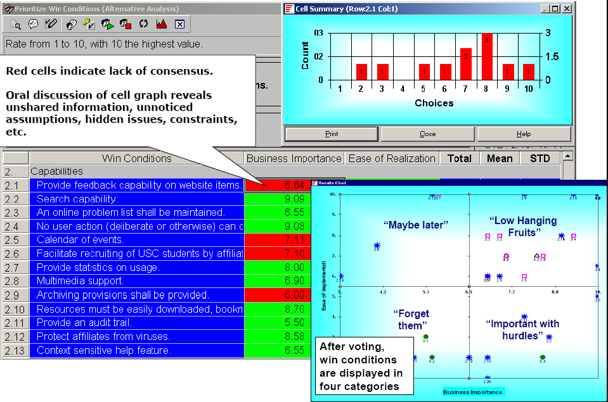
Consensus building: EasyWinWin tool
Notes:
The Easy WinWin tool provides functionality for stakeholders to brainstorm, vote, and prioritize win conditions, allowing them to focus quickly on the few win conditions involved in conflicts. By rating the importance and the ease of realization of each win conditions, stakeholders can allocate the meeting time accordingly. For example, win conditions that are both easy to realize and have high business value do not need to be discussed in detail, while high value win conditions that are difficult to realize need more attention.

Slide 28
Consensus building: Experiences
Context
Initial case studies used project courses with real customers
Used in industry
Results
Risk management focus
Trust building between developers and clients
Discipline
Inadequate tool support
Notes:
WinWin was first evaluted during project courses and then in industry. It was found to build trust between developers and client, and force a certain discipline when prioritizing requirements or addressing conflicts. Its focus on risk management increased the likelihood of project success.
The WinWIn approach was initially hampered by lack of scalable tool support. Typical sessions involved up to 10 stakeholders and produced several hundreds of win conditions. EasyWinWin, adding focus on the brainstorming phase of the negotiation, is a now commercial tool and is used by many companies

Slide 29
Consistency with goals
Problem
Once multiple criteria have been acknowledged
  Find solutions that satisfy all of them
  Document the trade-offs that were made
Example
Authentication should be secure, flexible for the user, and low cost.
Notes:
Winwin is a technique for bringing a number of stakeholders to agree on the same set of Win conditions. The output of WinWin is agreement from stakeholders. However, the list of requirements produced by WinWIn can still be long and include requirements that are difficult to reconcile. This is often the case with nonfunctional requirements, which are initially described at a high level of abstraction.
Now, we look at a technique for exploring and evaluating options against a list of nonfunctional requirements and tracking the trade-offs and decisions that were made. The NFR framework was intiially proposed by Mylopoulos and Chung in 1990 and continuously refined, eventually covering architectural decisions in the late 1990s. As an illustrative example, let’s revisit the ATM example we used at the beginning of this presentation, we are investigating mechanisms for authenticating users that are secure, flexible, and low cost.

Slide 30
Consistency with goals: NFR Framework
NFR goal refinement
  NFRs are represented as goals in a graph
  Leaf nodes of the graph are operational requirements
  Relationships represent “help” “hurt” relationships
  One graph can represent many alternatives
NFR evaluation
  Make and break values are propagated through the graph automatically
  Developer can evaluate different alternatives and compare them
Notes:
The NFR framework supports the refinement of NFRs and the evaluation of options against NFRs.
During the refinement step, NFRs are arranged into a goal graph. Each NFR is a top level node that needs to be achieved. Each goal can be decomposed into subgoals. The NFR goal graph allows both for AND decompositions (I.e., all subgoals need to be achieved for a specific goal to be achieved) and OR decompositions (any subgoal can be achieved for a specific goal to be achieved). Additionally, goals and subgoals are related with help and hurt relationships, denoting how different goals can potentially conflict.
The leaf nodes of the graph represent options, that is, features in the system that realize some or all of the NFRs.
During the evaluation step, developers select a subset of options, and propagate “make” and “break” values through the graph. Using a tool, the developer can quickly evaluate which NFRs can be met with which set of options. The developer can also evaluate different sets of alternatives and compare them.

Slide 31
Consistency with goals: Model
x


Notes:
In the ATM example, we start with the nonfunctional requirements “flexibility”, “low cost”, and “security”.
We first decompose the security requriement into authentication, confidentiality, and integrity. Note that all three subgoals must be addressed for the security goal to be achieved.
Next, we decomposition the authentication goal into three subgoals:
Asking the user for his account and PIN
Asking for a finger print
Asking for a smart card and a PIN
Note that selecting any one of these subgoals would achieve the authentication goal. Note also that we reached the leaves of the tree, that is, these last three goals are features provided by the system, not nonfunctional requirements.
The dashed lines represent “hurt” and “help” links between the subgoals and the flexibility and low cost goals. In our example, we only depict a subset of the links for clarity.
During the evaluation step, we investigate the “Account+PIN” option. We can see how the low cost and flexibility goals are impacted.

Slide 32
Consistency with goals: Process
Elicit
high-level goals
Evaluate
alternatives
Refine into
detailed goals
Identify
operational goals
Identify goal
dependencies
Notes:
The NFR framework assumes an iterative process. First high-level goals are elicited and refined. Hurt and help dependencies are then identified and options (operational goals) are defined. The evaluation of options often leads to discovering that the goal graph is over constrained, which leads to reformulating the high-level goals or clarifying them, or eliciting new high-level goals.

Slide 33
Consistency with goals: Experiences
Case studies on existing systems lead to clearer trade-offs
Research into integrating NFR framework and design patterns
  Match NFRs to design pattern “Forces”
  Link NFRs, design patterns, and functional requirements
Tool support inexistent
Notes:
Many case studies using the NFR framework have been done and yielded promising results. However, few tools support this techniques, making it difficult to scale and apply to realistic problems.
In general, much research has focused on the functional aspects of requirements engineering and on eliciting early requirements from stakeholders. However, there are few general approaches to nonfunctional requirements.

Slide 34
Rapid knowledge construction
Problem
When a company is large enough, it doesn’t know what it does.
  Knowledge rarely crosses organizational boundaries
  Knowledge rarely crosses physical boundaries
Example
Identify resources at risk for Y2K and prioritize responses.
Notes:
With WinWin and the NFR framework, we focused on construction activities, that is, on activities in which a set of stakeholders constructs a solution satisfying a set of implicit criteria. Next, we look at an analytical technique in which existing decisions are made explicit and their rationale formalized.

Slide 35
Rapid knowledge construction: Compendium
Meeting facilitation
  Stakeholders from different business units
  External facilitator
Real-time construction of knowledge maps
  The focus of the meeting is a concept map under construction
  Map includes the issue model nodes and custom nodes
  (e.g., process, resource, etc.)
Knowledge structuring for long term use
  Concept map exported as document outline, process model, memos, etc.
Notes:
Compendium is a technique resulting the lessons learned from gIBIS (Conklin). An external faciltiator trained in the compendium technique is responsible for organizing a meeting, typically involving a number of stakeholders from different business units. The role of the facilitator is to elicit and capture knowledge for the stakeholders. By having a group sitting in the same room, more information is extracted, similar to brainstorming sessions. The knowledge map under construction is continuously reviewed by the stakeholders. The facilitator refines and expands the map as new information is made explicit.
The outcome of the meeting is a concept map that can be used for structuring knowledge in the long term (as opposed to meeting minutes which become obsolete fairly quickly). The knowledge map is used as a basis for generating document outlines, models, or other graphs that are typically understood by the stakeholders.

Slide 36
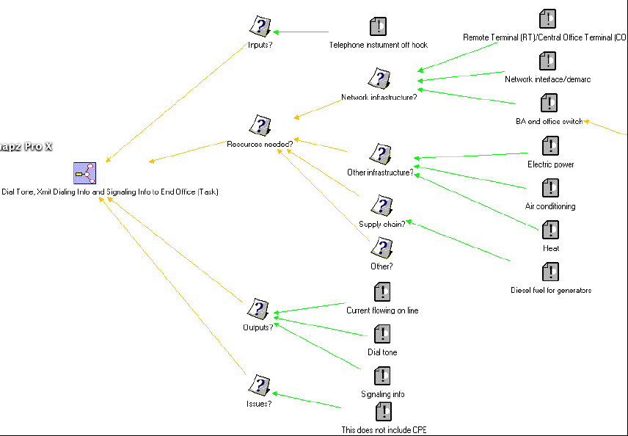
Rapid knowledge construction: Model
Notes:
The core of Compendium model is the IBIS issue model. However, facilitators can extend the meta model to include any other related concepts, such as resources, processes, requirements, and so on.
In the example above, the nodes with question marks are questions or issues that are used at the beginning of the meeting to elicit the knowledge. The nodes with exclamation marks are positions (options) that are added during brainstorming. Each added position can in turn trigger more issues.

Slide 37
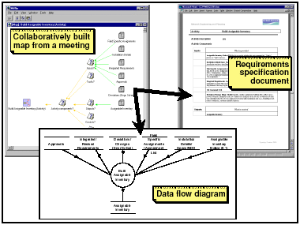
Rapid knowledge construction: Process example
Notes:
The concept map is then used as a basis to construct models or documents that stakeholders are familiar with.

Slide 38
Rapid knowledge Construction: Experiences
Context
Several industrial case studies, including
Y2K contingency planning at Bell Atlantic
Results
Increased meeting efficiency (templates are reused)
Knowledge reused for other tasks
Notes:
A typical example of how compendium can help is the risk assessment activities for Y2K. Such workshops requires the collaboration of stakeholders from different business units, often with different perspectives and unaware of dependencies across business units. It was also observed that the meta model resulting from the workshops could be reused for other tasks, illustrating the long term memory effect of these efforts.

Slide 39
Summary
Rationale can be used in project management
  To build consensus (WinWin)
  To ensure quality (NFR Framework)
  To elicit knowledge (Compendium)
Other applications include
  Risk management
  Change management
  Process improvement
Open issues
  Tool support
  User acceptance
Notes:
In this lecture, we introduced the basic concepts of rationale management, motivated its use in software engineering, and presented three concrete examples of techniques using rationale. Rationale management can also be applied to such diverse areas as risk management, change management, or process improvement. In practice however, most applications of rationale are localized and informal, documented as natural language in targeted documents. Systematic, formal applications of issue models is not wide spread, limited by lack of tool support and user acceptance.

