Slide 1

Chapter 16, Methodologies: Scrum

Slide 2
Outline
Motivation
Concepts
Documents
Roles
Activities
Scrum Technique
Summary

Slide 3
Motivation: Challenges
Low bandwith
  Participants speak slower than they can read
  Participants get side tracked or interrupted
  Agreeing on the purpose of a meeting can consume most of the meeting
Cost
  Participants attending meetings do not produce anything else
  Participants need time to get to the meeting and return to their work place
Volatility
  What is said and not recorded is forgotten fast

Slide 4
Motivation: Meeting Management Goals
Keep meetings short
  Define scope of meeting before hand
  Focus only on issues within scope
Invite the right participants
  Do not invite participants who cannot contribute
  Do invite participants whose agreement is needed
Record to agreements for closed items
  Ensure that all remember the same outcome
Record context for open items
  Shorten follow up discussions on the same theme

Slide 5
Meeting Concepts
Agenda
Minutes
invites
assigned to
scoped by
Participant
records
Issue
Action Item
realized by
addressed by
selected by
Decision
Option
Criterion
supports
opposes
assessed by
Argument
makes explicit

Slide 6
Meeting Documents
Agenda
  Defines the scope of the meeting in terms of open issues (from the Issue Database)
  Invites participants whose agreement is needed to resolve the issues
  A time budget _x0004_is allocated to each issue before the meeting
Minutes
  For each issue
    Records decisions and their realization, OR
    Records the current progress of the discussion in terms of options, criteria, and arguments

Slide 7
Meeting Roles
Facilitator
  Responsible for keeping the meeting within scope
  Interupts or redirects participants who get side tracked
  Ensures that decisions represent consensus
Time keeper
  Informs the facilitator when an specific issue takes more time than budgeted
Minute taker
  Records decisions, action items, options, …
  Distributes the meeting minutes to all other participants shortly after the meeting

Slide 8
Meeting Activities
Facilitator
Participant
Minute Taker
Post Agenda
Review Agenda
Revise Agenda
Initiate Meeting
Facilitate Meeting
Discuss &
Resolve Issues
Record Meeting
Close Meeting
Realize
Action Items
Post Minutes

Slide 9
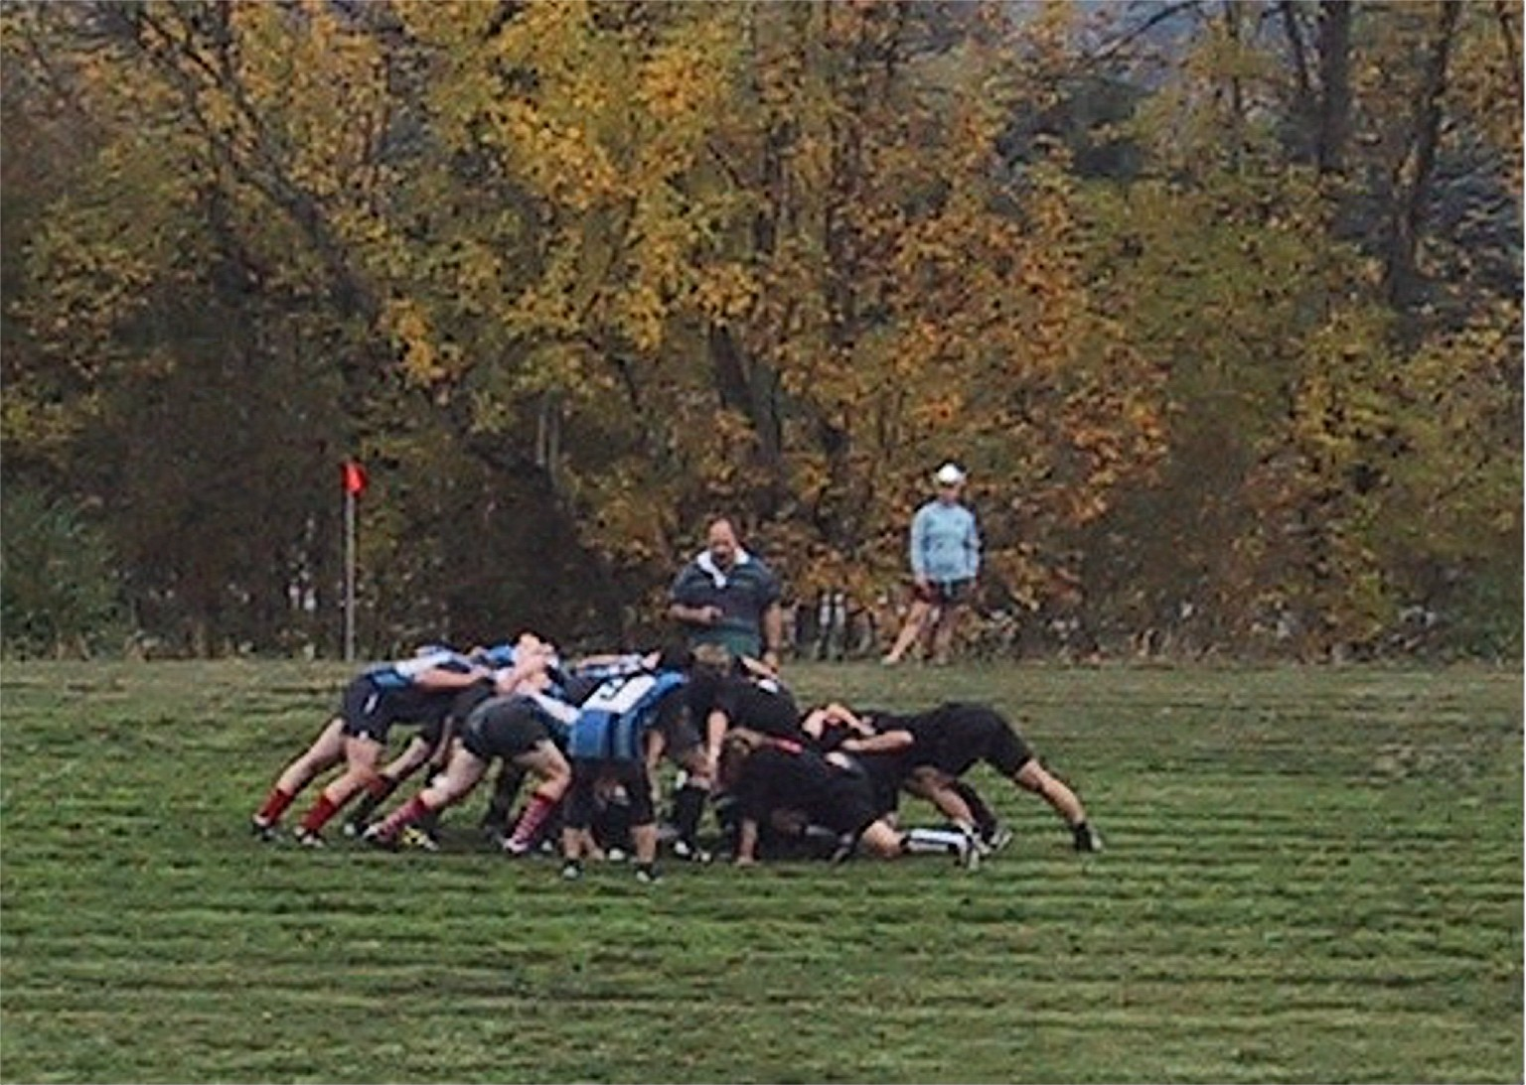
Scrum
Most Prominent Spokespeople
  Ken Schwaber, Mike Biddle
Focus: Day-to-day management of a software project
Notes:
Entity-oriented software lifecycle with 30-day iterations (called “sprints”)
❖ Issue-based

Slide 10
Managing a Software Project with Scrum
Two Lists
  Project Backlog: Issues for the whole project
  Sprint Backlog: Issues for one iteration(“sprint”)
Two Management Activities
  Establish the Project Backlog: List of requirements from stakeholders (developers, manager and customer)
  Establish the Sprint Backlog: List of issues to be addressed in current iteration
_x0013_Four Types of Meetings
  Kickoff Meeting: At the beginning of a project
  Sprint Planning Meeting: List of prioritized features
  Daily Scrum: Informal status meeting, about 15 min
  Sprint Review Meeting: Demonstration of features to management and customer
Notes:
Two Lists
Project Feature List (”Product Backlog”): List of Issues for the whole project
Iteration Feature List (”Sprint Backlog”): List of Issues for an iteration
Two Management Activities
Establish the Project Backlog: List of features from developers, manager and customer
Establish the Sprint Backlog: List of issues to be addressed in current iteration
_x0013_Four Types of Meetings
Kickoff Meeting: At the beginning of a project
Sprint Planning Meeting: At the beginning of an iteration (”sprint”) to establish a list of prioritized features to be implemented
Daily Scrum: Daily informal status meeting, about 15 min
Sprint Review Meeting: Demonstration of features, shown to management and customer

Slide 11
Lists, Activities and Meetings in Scrum
Kickoff
Meeting
Project
Backlog
Create Project
Backlog
Sprint
Planning
Meeting
Sprint
Review
Meeting
Sprint
Backlog
Daily
Scrum
Meeting
Create Sprint
Backlog

Slide 12
Characteristics of Scrum
Basis of work is done by teams
  Teams are put in a time-box and told to create a product
  The teams focus on what can be done and how the problem can be solved
  Teams are self-organizing, no formal agendas
  Roles and tasks and are established by the teams
  All estimates are also done by the teams
Notes:
Instead of waiting for instructions, the team takes initiative
In Rugby the whole team moves simultaneously

Slide 13
Characteristics of Scrum
Scrum Room
  A single place for informal daily meetings
Scrum is more than a meeting management technique
  No formal planning phase
    No PERT Charts, no cost estimates, no roles, no individual assignments
  Product functionality is delivered incrementally
    Increments are regularly built & discussed (“daily build”)

Slide 14
Activities in the Scrum Kickoff Meeting
Identify the Product Backlog
  Product Backlog is never expected to be finalized, even if the project is finished
  Product Backlog content comes from many sources: Users, Customers, Sales, Marketing, Customer Service and Engineering.
Identify the product owner
  Only the product owner can prioritize the Product Backlog
Set up Scrum Teams
  Cross-functional teams that do the development
  Scrum teams select from the Product Backlog as much as they believe they can develop in additional system functionality within a 30 day iteration (“sprint”).

Slide 15
Activities in the Sprint Planning Meeting
Talk to the customer: Understand the task at hand
  What problem do we need to solve?
Check the Sprint Backlog (“list of issues”)
  Sort the issues by highest-priority
Training:
  What skills do we have?
  What skills do we need to learn? (Read Ant, Read XML, Modify Configuration Makefile)
Identify the system functionality for the sprint
  What is the next functionality to be implemented
  What needs to be done to build it?

Slide 16
Activities in the Daily Scrum Meeting
Check the Sprint Backlog (“list of open issues”)
Are there new issues? Add them to the Sprint Backlog
Sort the issues by highest-priority
Identify action items for the team members

Slide 17
Summary
Meetings are costly and low bandwith events
Prior to the meeting
  Define scope
  Identify correct audience
During meeting
  Focus on scope
  Table issues to ad hoc meetings, if needed
After meeting
  Record decisions and action items
  Record context
Scrum: Can be used for issue-based meetings.

Slide 18
Backup and Example Slides

Slide 19
Example Agenda
AGENDA: Integration of access control and notification
1. Purpose
The first revisions of the hardware/software mapping and the persistent storage design have been completed. The access control model needs to be defined and its integration with the current subsystems, such as NotificationService and TrackingSubsystem, needs to be defined.
2. Desired outcome
Resolve issues about the integration of access control with notification.
3. Information sharing [Allocated time: 15 minutes]
AI[1]: Dave: Investigate the access control model provided by the middleware.
4. Discussion [Allocated time: 35 minutes]
I[1]: Can a dispatcher see other dispatchers’ TrackSections?
I[2]: Can a dispatcher modify another dispatchers’ TrackSections?
I[3]: How should access control be integrated with TrackSections and NotificationService?
5. Wrap up [Allocated time: 5 minutes]
Review and assign new action items.
Meeting critique.

Slide 20
Example Unstructured Minutes
Integration of access control and notification
4. Discussion
...
I[3]: How should access control be integrated with TrackSections and NotificationService?
Dave: The TrackSection maintains an access list. The notification service asks the
TrackSection about who has access.
Alice: We should probably reverse the dependency between TrackSection
and NotificationService. Instead, the UIClient requests subscriptions from the
TrackSection, which checks for access and then calls the NotificationService.
This way, all protected methods are in one place.
Dave: This way the TrackSection can also more easily unsubscribe dispatchers when
their access is revoked.
Ed: Hey, no need for access control in NotificationService: Dispatchers can see all
TrackSections. As long as the NotificationService is not used for changing
the TrackSection state, there is no need to restrict subscriptions.
Alice: But thinking about the access control on notification would be more general.
Ed: But more complex. Let’s just separate access control and notification at this point
and revisit the issue if the requirements change.
Alice: Ok. I’ll take care of revising the TrackingSubsystem API.
...

Slide 21
Example Structured Minutes
STRUCTURED MINUTES: Integration of access control and notification
4. Discussion
...
I[3]: How should access control be integrated with TrackSections and NotificationService?
P[3.1]: TrackSections maintain an access list of who can examine or modify the state
of the TrackSection. To subscribe to events, a subsystem sends a request to
the NotificationService, which in turns sends a request to the corresponding
TrackSection to check access.
P[3.2]: TrackSections host all protected operations. The UIClient requests
subscription to TrackSection events by sending a request to the TrackSection,
which checks access and sends a request to the NotificationService.
A[3.1] for P[3.2]: Access control and protected operations are centralized
into a single class.
P[3.3]: There is no need to restrict the access to the event subscription. The UIClient
requests subscriptions directly from the NotificationService. The
NotificationService need not check access.
A[3.2] for P[3.3] Dispatchers can see the state of any TrackSections (see
R[1]).
A[3.3] for P[3.3]: Simplicity.
R[3]: P[3.3]. See action item AI[2].
...

Slide 22
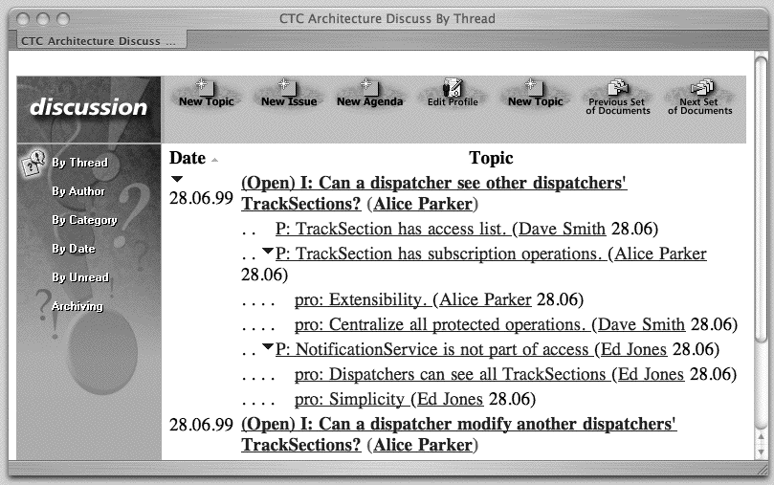
Example Issue Database

