Slide 1

Chapter 15, Software Life Cycle,
Reengineering
Notes:
http://www.agimatec.de/blog/wp-content/uploads/2008/07/lifecycle.jpg

Slide 2
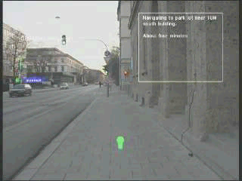
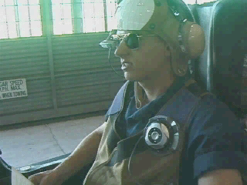
Do we need Software Lifecycle Models?
„Yes!“
  IT-Systems, Space-Shuttle, Airbus
„No!“
  Algorithms, sorting, searching, ftp
„Maybe!“
  Airbag controller, brake systems
• Mobile systems
  • Mobile maintenance, mobile health care,
  “blue collar” applications
• Augmented Reality
  Overlay of virtual information
  on real objects in real time
• Mobile ubiquitous systems
“We need a new lifecycle model!”
Notes:
When do we need Software Lifecycle Models: Whenever we engineer really complex and changing systems.

Slide 3
Review of Definitions
Software life cycle
  Set of activities and their relationships to each other to support the development of a software system
Software lifecycle management (SLC)
  Managing a software lifecycle (tailoring, adding and reordering activities, adding and removing dependencies between activities)
Software development methodology
  A collection of techniques for building models applied across a software life cycle.
Notes:
Development activities deal with the complexity by constructing and validating models of the application domain or the system. Development activities include: requirements elicitation, analysis, system design, object design. Implementation,. testing
A methodology is a collection of methods for solving a class of problems and specifies how and when each method should be used.
A seafood cookbook with a collection of recipes is a methodology for preparing seafood if it also contains advice on how ingredients should be used and what to do if not all ingredients are always available. Royce’s methodology [Royce, 1998], the Object Modeling Technique (OMT [Rumbaugh et al., 1991]), the Booch methodology [Booch, 1994], and Catalysis [D’Souza & Wills, 1999], are object-oriented methodologies for developing software.

Slide 4
Typical Software Life Cycle Management Questions (Review Slide)
Which activities should we select for the software project?
What are the dependencies between activities?
How should we schedule the activities?
To find these activities and dependencies we can use the same modeling techniques we use for software development:
  Functional Modeling of a Software Lifecycle
    Scenarios
    Use case model
  Structural modeling of a Software Lifecycle
    Object identification
    Class diagrams
  Dynamic Modeling of a Software Lifecycle
    Sequence diagrams, statechart and activity diagrams

Slide 5
Functional Model of a simple life cycle model
Software development
<<include>>
<<include>>
<<include>>
Problem definition
System development
System operation
Client
Project manager
Developer
Administrator
End user
Notes:
So far we used UML as a modeling language for describing and communicating about systems. In this chapter, we focus on models of the software development process, called software life cycle models.
Modeling the software life cycle is a difficult undertaking, because it is a complex and changing system. As software systems, software life cycles can be described by several different models.
Most proposed life cycle models have focused on the activities of software development and represented them explicitly as first class objects. This view of the software life cycle is called activity centered.
An alternative view of the software life cycle is to focus on the work products created by these activities. This alternate view is called entity centered. The activity-centered view leads participants to focus on how work products are created.
The entity-centered view leads participants to focus on the content and structure of the work products. This slide shows a simple life cycle for software development using three activities: Problem definition, System development, and System operation.

Slide 6
Activity Diagram for the Life Cycle Model
Software development goes through a linear progression of states
called software development activities
Notes:
This slide shows an activity-centered view of this simplistic life cycle model.
The associations between the activities show a linear time dependency, which is implied by the use of the activity diagram notation: The problem statement precedes system development, which in turn precedes system operation. Alternate time dependencies are possible

Slide 7
Alternative Life Cycle Model
System
development
activity
System
upgrade
activity
Market
creation
activity
System Development and Market creation can be done in parallel.
They must be done before the system upgrade activity
Notes:
For example, in the software life cycle shown in this slide, the activities System development and Market creation can be done concurrently

Slide 8
Two Major Views of the Software Life Cycle
Activity-oriented view of a software life cycle
  Software development consists of a set of development activities
  All the examples so far
Entity-oriented view of a software life cycle
  Software development consists of the creation of a set of deliverables.

Slide 9
Entity-centered view of Software Development
Software development consists of the creation of a
set of deliverables
Notes:
This slide shows an entity centered view of the model shown in the previous slides.
Software development produces four entities, a Market survey document, a Requirements specification document, an Executable system and a Lessons learned document

Slide 10
Combining Activities and Entities in One View
Notes:
The activity-centered view and the entity-centered view are complementary, as illustrated in this slide.
For every product there is one or more activity that generates it.
The Problem definition activity uses a Market survey document as input and generates a Requirements specification document.
The System development activity takes the Requirements specification document as input and produces an Executable system.
System operation generates a Lessons learned document that could be used during the development of the next product.
Alternatively, every activity generates one or more products.

Slide 11
IEEE Std 1074: Standard for Software Life Cycle Activities
Process Group
IEEE Std 1074
Project
Management
Pre-
Development
Develop-
ment
Post-
Development
Cross-
Development
(Integral Processes)
> Project Initiation
>Project Monitoring
&Control
> Software Quality
Management
> Concept
Exploration
> System
Allocation
> Requirements
> Design
> Implemen-
tation
> Installation
> Operation &
Support
> Maintenance
> Retirement
> V & V
> Configuration
Management
> Documen-
tation
> Training
Process
Notes:
The life cycle activities are defined by the IEEE 1074 standard [IEEE Std. 1074-1997].
This standard introduces precise definitions that enable project participants to understand and communicate effectively about the life cycle..
The goal _x0004__x0004_of the standard is to establish a common framework for developing life cycle models and provide examples for typical situations. The main activities introduced by the standard can be described by using UML diagrams.
A process is a set of activities that is performed towards a specific purpose (e.g., requirements, management, delivery). The IEEE standard lists a total of 17 processes. The processes are grouped into higher levels of abstractions called process groups.
Examples of process groups are project management, pre-development, development, and post-development. Examples of processes in the development process group include:
the Requirements Process, during which the developers develop the system models
the Design Process, during which developers decompose the system into components
the Implementation Process, during which developers realize each componen
From the developers’ point of view, the first processes (i.e., the Project Management Processes, and the Predevelopment Processes) have often already been initiated before their involvement with the project.

Slide 12
Object Model of the IEEE 1074 Standard
Software Life Cycle
Money
*
Process Group
Time
Participant
*
Process
*
Resource
*
Work Unit
*
consumed by
Activity
Task
*
Work Product
produces
Notes:
Model of the software life cycle (UML class diagram).
A software life cycle consists of process groups, which in turn consist of processes.
A process accomplishes a specific purpose (e.g., requirements, design, installation).
A process consists of activities, which are in turn consists of sub-activities or tasks.
Tasks represent the smallest piece of work that is relevant to management.
Tasks consume resources and produces one or more work products. A project is an instance of a software life cycle
During planning, activities are decomposed into project specific tasks, are given a start and ending date
and assigned to a team or a project participant
During the project, actual work is tracked against planned tasks, and resources are reallocated to respond to problems

Slide 13
Life Cycle Modeling
Many models have been proposed to deal with the problems of defining activities and associating them with each other
  Waterfall model, V model, Spiral model, Unified Process
    Were covered in Software Engineering I
  Business Process modeling, Reengineering
    Topic of today’s class
Notes:
Royce in 1970

Slide 14
Business Reengineering
“The fundamental rethinking and radical redesign of business processes to achieve dramatic improvements in critical, contemporary measures of performance, such as cost, quality, service, and speed”
  Michael Hammer & James Champy “Reengineering the Corporation”
Notes:
Reengineering means sweeping changes to the company.
Give formal definition

Slide 15
Keys Words in Definition
fundamental
    “begins with no assumptions and no givens”
radical
    “reinvention not improvement or enhancement”
dramatic
    “huge increase in performance or efficiency”
Business processes
Notes:
Fundamental:
no assumptions, question rule about how companies should work.
ie. if you ask “how can we perform customer credit check more efficiently” you are assuming you have to check credit
might cost more to check than than lost in checking.
Radical:
Go to the root of things. disregard existing structures and procedures
Dramatic:
Not about making incremental changes, but large improvements are the goal. Need radical redesign to get dramatic change in performance
Process:
breaking things into small tasks as it has been done for the last 200 years, causes you to lose sight of the overall objective of creating something of value for the customer.

Slide 16
Business Process
A business process gives a customer something of value
    A collection of activities that takes one or more kinds of input and creates an output that is of value to the customer”
Business Process Examples:
  Manufacturing cars
  Selling cars
  Software Product Development
Notes:
A process has some input and gives the customer something of value. Companies do not have organizations based on processes. How many companies have a vp of order fulfillment?

Slide 17
Business Process in a Functional Organization
Marketing
Development
Production
Software Product Development: From requirements to product
Notes:
Marketing and Development and productions are organizational boundaries. They all work at some point on the process of Product Development. This is one of the most important Ideas and the hardest to communicate and the hardest for companies trying to reengineer to find in their company.

Slide 18
When is Business Reengineering necessary?
The Company can no longer afford the overhead of large complex tasks
Diseconomies of scale
  When the number of workers goes up, the number of overhead people (bureaucracy) goes up faster
The customer changes
The competition changes
Notes:
The big “impregnable” companies are no longer that way, they have huge momentum and can’t necessarily jump on market opportunities. This is a huge disadvantage.

Slide 19
Customers have changed
Customers demand tailored products
Lots of products available - lots of choices
Customers can make informed decisions
Service is now much more important
Notes:
Customers have changed over the years.
tailored products: they want to have the exact product to do what they want. and if you don’t give it to them, someone else will
Lots of choices: customers can now choice before it’s like “wow I have a refrigerator, because before there was no such thing” now it’s like “ I want the cool drink station on the front- it needs to be modern jet black..”
Informed decisions: They use consumer reports and the mag will catch you if your product is weak
Service: Backing up products has become important to the customer also
Tech: Desktop publishing companies beware- now customers can do it themselves- companies need to offer more, customers don’t need you

Slide 20
Competition has intensified
Global market - companies from other countries raise the stakes
Customer doesn’t care where the product comes from
Start-up companies can jump on niche opportunities
Notes:
Now there are so many companies that are competing for the same customer, the one-up manship gets out of hand. to keep up you need to be ready for change and quickly. Carrying around extra baggage people will not cut it.
Customers will buy from basically anyone as long as they get the best deal.
Companies with no management overhead can spring on an idea and take over that niche market

Slide 21
Examples of Business Process Change
Several jobs combined into one
Workers make decisions
Processes have multiple versions
Checks and controls reduced
Work performed where it makes the most sense
Notes:
Several Jobs combined
case worker: one person who deals with the whole process. know how to do the general stuff, and asks help for the difficult stuff
Workers have power to make decisions
workers now think and can take authority and responsiblity for making the customer happy and not the boss
Processes have multiple vers:
ie insurance claims - if claim less than $500 pay it and be done with it, if claim between $2000 and $500 check background and recommend an autobody shop, if more than $2000 check for best price in town
Checks and controls reduced:
ie instead of checking each purchase, give credit card with limit and check the bill once a month.
Work performed where it makes sense:
ie. Wal-mart? moved the responsiblity of stocking pampers to proctor and gamble, because they had a much better big picture of how many would be needed.

Slide 22
Change
Change happens fast
Most of the important changes are the unexpected
Anticipate and react to unusual technology happenings
  Wayne Gretzky “because I go where the puck is going to be, not where it is”
“Change is the only thing that is constant”
Notes:
need to recognize how technology will affect the market and aim there
unexpected changes: all of a sudden people like this new idea from startup - business needs to react quickly and get on the development ball
look carefully at what is in the labs now, because that is what will be out on market soon
be a good company and do as Wayne does (btw, spell checker checks Gretzky as Great)

Slide 23
Enabling Technologies
Advances in information systems have freed up the structure of companies
Companies now ask:
  What can these technologies allow us to do that we don’t do now?
Fundamental Error:
  Trying to use technology within the current task oriented system (Maintenance)
Examples of technology enablers from Hammer&Champy, Chapter 5
Notes:
Before there was no way of having and using more than one copy of the same document. This is no longer true. So people can look up information and use expert systems to solve problems.
It is true that you can get speed up by getting rid of paper and make the queues go faster, but that does not solve the bigger problem.
automation is not reinvention
So figure out what assumptions you can break with info tech- such as people need to hand off paper for an application and fill in blanks, now just bring up file edit and write back. Everyone does this and can do it concurrently

Slide 24
Technology Enabler Example
Old rule
  Managers make all the decisions
Enabling technology (disruptive technlogy)
    Decision support tools (database access, modeling software)
New rule
  Decision making is part of everybody’s job.

Slide 25
Technology Enabler Example 2
Old rule
  Businesses must choose between centralization and decentralization
Enabling technology
    Telecommunication networks
New rule
  Businesses can simultaneously reap the benefits of centralization and decentralization

Slide 26
Technology Enabler Example 3
Old rule
  Field personnel needs physical office space where they can receive store, retrieve and transmit information
Enabling technology
  Wireless data communication and laptops
New rule
  Field personnel can send and receive information wherever they are.

Slide 27
Technology Enabler Example 4
Old rule
  You have to find out where things are
Enabling technology
  RFID
New rule
  Things tell you where they are.

Slide 28
Maintenance vs Reengineering
System considered irreplaceable
(legacy system)
Modifiability
High
Maintain
Enhance
Discard
Reengineer
Low
Low
High
Business Value
Notes:
System
considered
irreplacable
2

Slide 29
Legacy System
A system is called a legacy system when it has one or all of the the following properties
  Evolved over 10 - 30 years
  Actively used in a production environment
  Considered irreplaceable because reimplementation is too expensive or impossible
  Very high maintenance cost
  Designed without modern software design methodologies or design has been "lost”.

Slide 30
Other Definitions
Maintenance: Modification of a software product after delivery to correct faults, improve performance, add functionality or adapt the system to a new environment.
  Corrective, adaptive, perfective, preventive maintenance
Redocumentation: Creation of a semantically equivalent representation within the same level of abstraction.
Refactoring: Transformation from one representation (often source code level)
to another at the same level of abstraction.
Reverse Documentation: Document recovery from code
3
Notes:
Reverse Engineering: (Origin in Hardware) Design recovery from an
implementation (Architecture was lost, code from competitor). No changes to
original system. REV: I -> D
3

Slide 31
And More Definitions
Forward Engineering: (from SE I)
  Activity of creating an executable representation of a analysis model
Reverse Engineering: Design recovery from an implementation. No changes to original system
Reverse Modeling: Recovery of application domain model
Reengineering: A software process involving all or a subset of the above reverse activities to redevelop a system with given functional requirements
Round-trip Engineering: Iterating between forward engineering and reverse engineering.
Notes:
MDA is a technique that automates forward engineering.

Slide 32
Model Transformations
Forward
engineering
Refactoring
Model
transformation
Reverse
engineering
Model space
Source code space

Slide 33
How do we do reengineering?
Reenginereing is still not a well known process
Extremely non-linear and highly incremental process
  Progress often determined by tiny bits of information from various sources
Each of the following factors increase the difficulty of reengineering by an order of magnitude:
  Missing business specification
  Documentation inconsistent and incomplete
  Original company team no longer associated with company
  Application domain expert inaccessible
Need more experience: Master thesis
  Reengineering projects at the chair

Slide 34
Modeling Reengineering as a Process
The process of creating an abstract description of the system (“system model”), reason about a change and then re-implement the system.
Reengineering = Reverse Engineering+ Change Activities + Forward Engineering
Reverse Engineering: Recover the system model
  Inventory analysis
  Recover model of application domain (reverse modeling)
  Recover lost architecture (reverse design)
Change Activities: Change design or functionality
  Facilitate reuse (include design patterns if possible)
Forward Engineering:
  Create an executable representation of the system model.
Notes:
Why else do you want to reengineer the system?

Slide 35
Inventory Analysis Activities
Goal: Identify and Characterize the
  Completeness of the system
    Are the requirements in the delivered system
  Consistency of the system
    Is the documentation consistent with the code?
    Is the code consistent with the model?
Source Code Documentation Data Layout
Common
Sense
"Enhancement" Tools
- Restructuring
- Annotation
- Transformation
_x0004_
System Model
Domain (Expert)
Knowledge
Analysis Tools
-Static
Data flow analyzers
Cross reference tools
-Dynamic
Debuggers,
Execution Profilers
Monitors
Test case generators
Modeling Tools
ARIS
MEGa

Slide 36
Inventory Analysis Activities 2
Is the system operational?
  Which subsystems are not part of the system? Why?
  Which part of the system is not executed? (fossile code)
Can we get the system running in our (new) development environment (reverse delivery)?
  What are the names of the test cases and where are they located? Do they exist, do they execute?
  Unit, system and subsystem tests

Slide 37
Inventory Analysis Activities 3
Quality Assurance Questions
  Is version control being used? Is it used system-wide?
  What kind of release policy is used for the running system? Can we reuse it?
  Can a system snapshot be done, that is, can we freeze the system during delivery?
Configuration Management Questions
  Is the current system still evolving during the reengineering process?
  Can we freeze the system development while reengineering it?

Slide 38
Inventory Analysis Activities 4
Modeling Questions
  Which parts of the existing system are modeled? Which not?
Documentation Questions
  Which documents are missing?
  Existing documentation consistent with models and/or code?
Project Management Questions
  Are application domain experts available?
  How often will they be available?
  Can they be part of the reengineering team?
  Can we locate the developers? Will they be available?
  Should the current developers be involved in the reengineering project?
    If yes, in all activities?
  Should the current managers be involved in the reengineering project?

Slide 39
Reengineering Activities depend on the required Change
Increase readability
  Restructure the code
Increase consistency
  Re-document the system
Increase performance
  Change algorithms, data structures, control structure
Platform independence, Port to new platforms
  Redesign the system architecture
New business rules, new functional or nonfunctional requirements:
  Re-elicit requirements
  Re-analyze the system model
Tool support is crucial.

Slide 40
Inventory Analysis 5
Project Management Questions ctd
  How committed is the current management to the reengineering job?
    Are there stakeholders who will (secretly) object against the reengineering goals?
  Is every aspect of the system assigned to at least one person?
  Is it a time-critical project? (Estimates are very hard)
  Who manages and maintains the new system?
    Should the current system maintainers be retrained?
    Should the current system manager be involved?
Tools
  What tools are available?
  Should they be used?
  Should new tools be purchased?

Slide 41
System Understanding Tools
Reverse documentation
  Recover documentation from the code
Restructuring tools
  Control flow transformations (goto elimination, ...)
  Data structure transformations, renaming (aliases, ...)
Static analysis tools
  Data flow, data comparators (old & new representations)
Dynamic analysis tools
  Debuggers, Monitors, Testing tools
Configuration management tools
  Multi-system configuration management (must track changes in legacy system as well as in in new system)
Design recovery tools
Business process modeling tools

Slide 42
The Ideal Business Process Modeling Tool
Supports the whole business process
  Starts at business process specification
  Finishes at Implementation and Delivery

Slide 43
Business Process Modeling Tools
ARIS IT Architect (Scheer)
MEGA Modeling Suite (MEGA)
PlanningIT (alfabet)

Slide 44
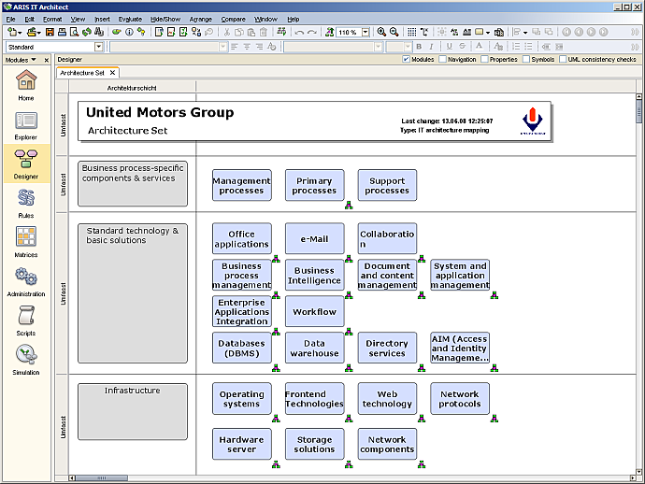
ARIS IT Architect
For IT architecture and process management
Inventory of systems and technologies
Specification and documentation of IT standards
http://www.ids-scheer.com/en/ARIS/ARIS_Software/ARIS_IT_Architect/3741.htm

Slide 45
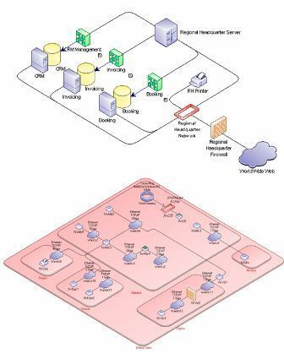
MEGA Modeling Suite
Enterprise Architecture Management
IT Planning and Roadmapping
Business Process Analysis and Improvement
http://www.mega.com/index.asp/l/en/c/product/p/mega-modeling-suite

Slide 46
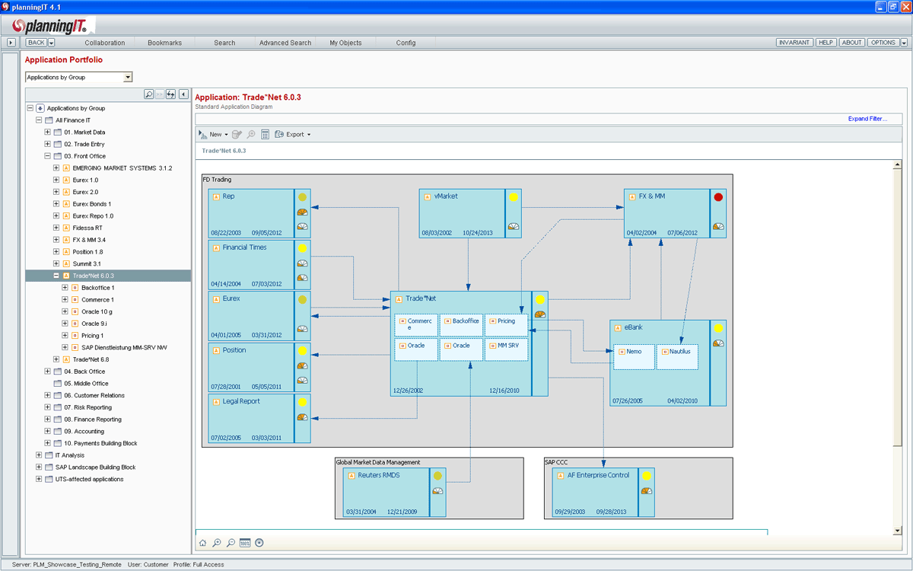
planningIT
IT Architecture Management
Infrastructure Management
Project Portfolio Management
Landscape Management
http://www.alfabet.com/products/overview

Slide 47
Three Different Reengineering Scenarios
Apply all the changes at the same time (“Big-bang reengineering”)
  Functionality is changed (new analysis model)
  New system design model
    New technology is introduced
    All subsystems are changed simultaneously
    New hardware/software mapping (new eployment diagrams)
Partial change in nonfunctional requirements (“Incremental reengineering”)
  Only one change is applied to the system, preferrably a single subsystem
Change the functional requirements
  Change the business rules

Slide 48
Additional Readings
Michael Hammer and James Champy
    Reengineering the Corporation, Harper Collins Publishers, 1993

