Slide 1
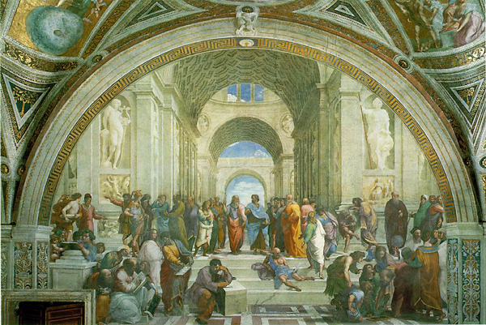
Final Course Review:
Single Semester Course or
First Semester Questions
Notes:
The cover picture shows: The School of Athens by Raphael with Socrates (left) and Plato (right) in the center

Slide 2
Outline for Today
  Reality and modeling, Abbot’s Technique
  Different ways to use models
  Model Transformations
  Software Development Activities
  Design Patterns
  Object Design
  Mapping Object Models
  Software process
  Methodologies
  Scheduling
  Estimation
  Continuous Integration

Slide 3
Reality and Model
Reality R
  Real things, people, processes happening during some time, relationships between things
Model M
  Abstractions from things, people , processes and relationships between these abstractions
  The things really exist or can be abstractions (“ideas”) as well.

Slide 4
Verification vs Validation of models
System
Design
Object
Design
Implemen-
tation
Analysis
R
M_{Analysis}
M_{System}
M_{Object}
M_{Impl}
f_{R}
f_{MA}
f_{MS}
f_{MD}
f_{Impl}
R
M_{Analysis}
M_{System}
M_{Object}
M_{Impl}
Validation
Verification
Verification
Verification
M
M
f_{M}
I
I
R
R
f_{R}

Slide 5
Why Modeling?
We use models
  To abstract away from details in the application domain, so we can draw complicated conclusions in the reality by performing simple steps in the model
  To get insights into the past or presence
  To make predictions about the future
We can model all kinds of systems
  Natural systems (Astronomy, Astrophysics)
  Human beings (Psychology, Sociology, HCI, CSCW)
  Artificial Systems (Computer Science)
  Event philosophical ideas can be modeled

Slide 6
System Modeling
Functional model
    Scenarios, use case model
Structural model
    Class diagrams, instance diagrams, component diagrams, deployment diagrams
Dynamic model
    Sequence diagrams, statechart and activity diagrams

Slide 7
When is a Model Dominant?
Object model:
  The system has classes with nontrivial states and many relationships between the classes
Dynamic model:
  The model has many different types of events: Input, output, exceptions, errors, etc.
Functional model:
  The model performs complicated transformations (eg. computations consisting of many steps).
Which model is dominant in these applications?
  Compiler
  Database system
  Spreadsheet program

Slide 8
Mapping parts of speech to model components (Abbot’s Technique)
Example
Part of speech
UML model component
“Monopoly”
Proper noun
object
Toy
Improper noun
class
Buy, recommend
Doing verb
operation
is-a
being verb
inheritance
has an
having verb
aggregation
must be
modal verb
constraint
dangerous
adjective
attribute
enter
transitive verb
operation
depends on
intransitive verb
Constraint, class,
association
Notes:
First proposed by Abbot in an article for the Communication of the ACM in 1983

Slide 9
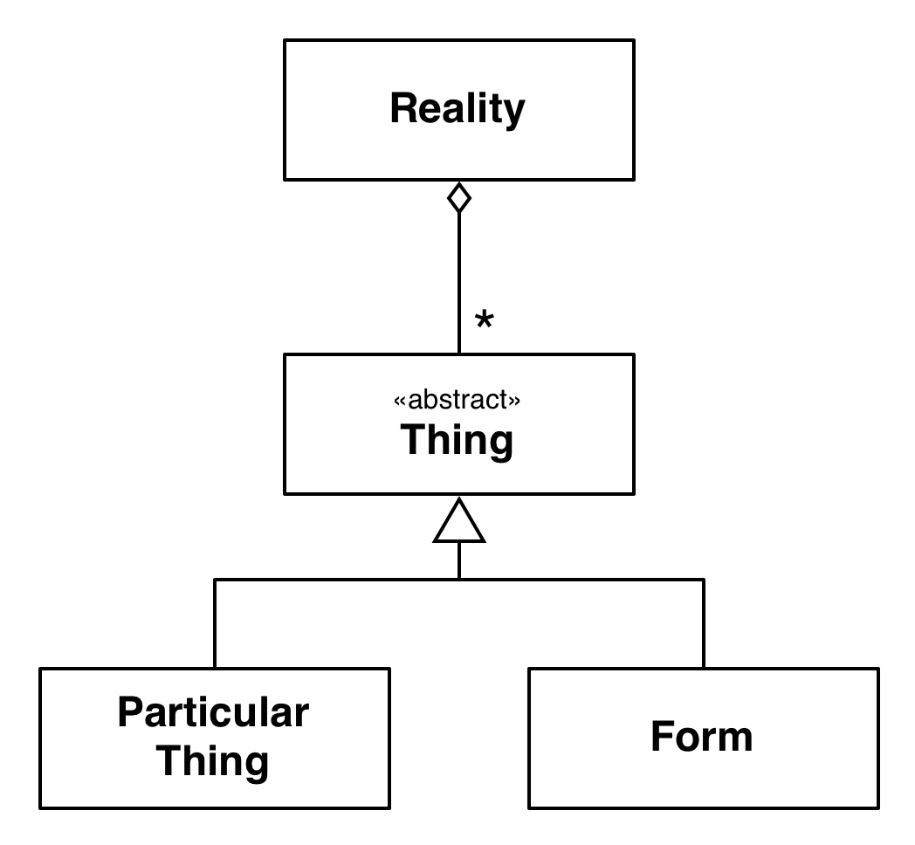
Using Abbot’s Technique:
Plato’s Model of Reality
Plato
Plato’s model of reality:
Reality consists of many Things
A Thing can be either a Particular Thing or a Form
Beauty is not a particular thing, but it is real and exists.
How does the corresponding system model look like?
Hint: Use Abbot’s Technique
Notes:
Plato’s model of reality (UML class diagram).
Reality consists of many particular things and many forms.
Note, that forms are not abstract classes that need to be instantiated.
Forms such as beauty really exist independent from a particular, that is they can be instantiated by themself.
Aristotle’s model of reality:
Reality consists of many particular things called substances.
Each substance is composed of form and matter.
Beauty is real but it does not exist on its own, it is always part of a really existing thing called the substance.

Slide 10
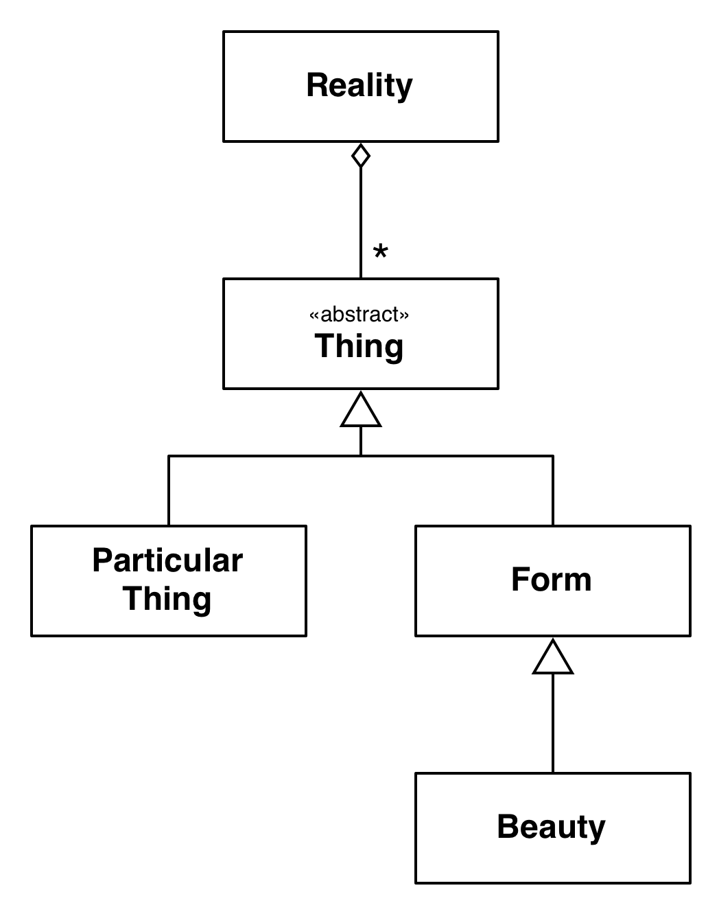
Plato’s Model of Beauty
Plato
Plato’s model of reality:
Reality consists of many particular things and many forms
A Thing can be either a Particular Thing or a Form
Beauty is not a particular thing, but it is real and exists.
Notes:
Plato’s model of reality (UML class diagram).
Reality consists of many particular things and many forms.
Note, that forms are not abstract classes that need to be instantiated.
Forms such as beauty really exist independent from a particular, that is they can be instantiated by themself.
Aristotle’s model of reality:
Reality consists of many particular things called substances.
Each substance is composed of form and matter.
Beauty is real but it does not exist on its own, it is always part of a really existing thing called the substance.

Slide 11
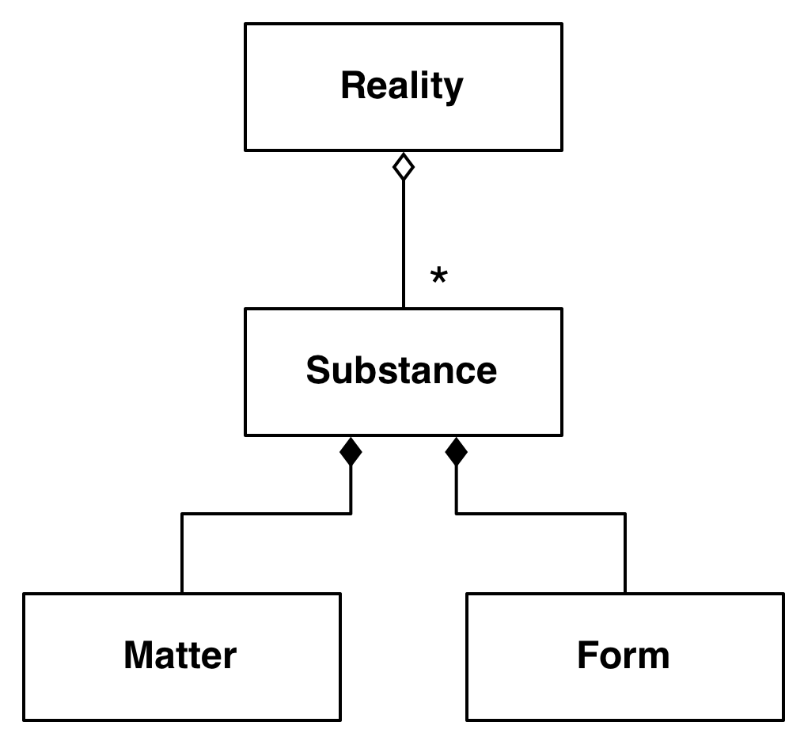
Aristotle’s View of Reality
Aristotle
Aristotle’s model of reality:
Reality consists of many particular things called substances
Each substance is composed of form and matter
Notes:
Plato’s model of reality (UML class diagram).
Reality consists of many particular things and many forms.
Note, that forms are not abstract classes that need to be instantiated.
Forms such as beauty really exist independent from a particular, that is they can be instantiated by themself.
Aristotle’s model of reality:
Reality consists of many particular things called substances.
Each substance is composed of form and matter.
Beauty is real but it does not exist on its own, it is always part of a really existing thing called the substance.

Slide 12
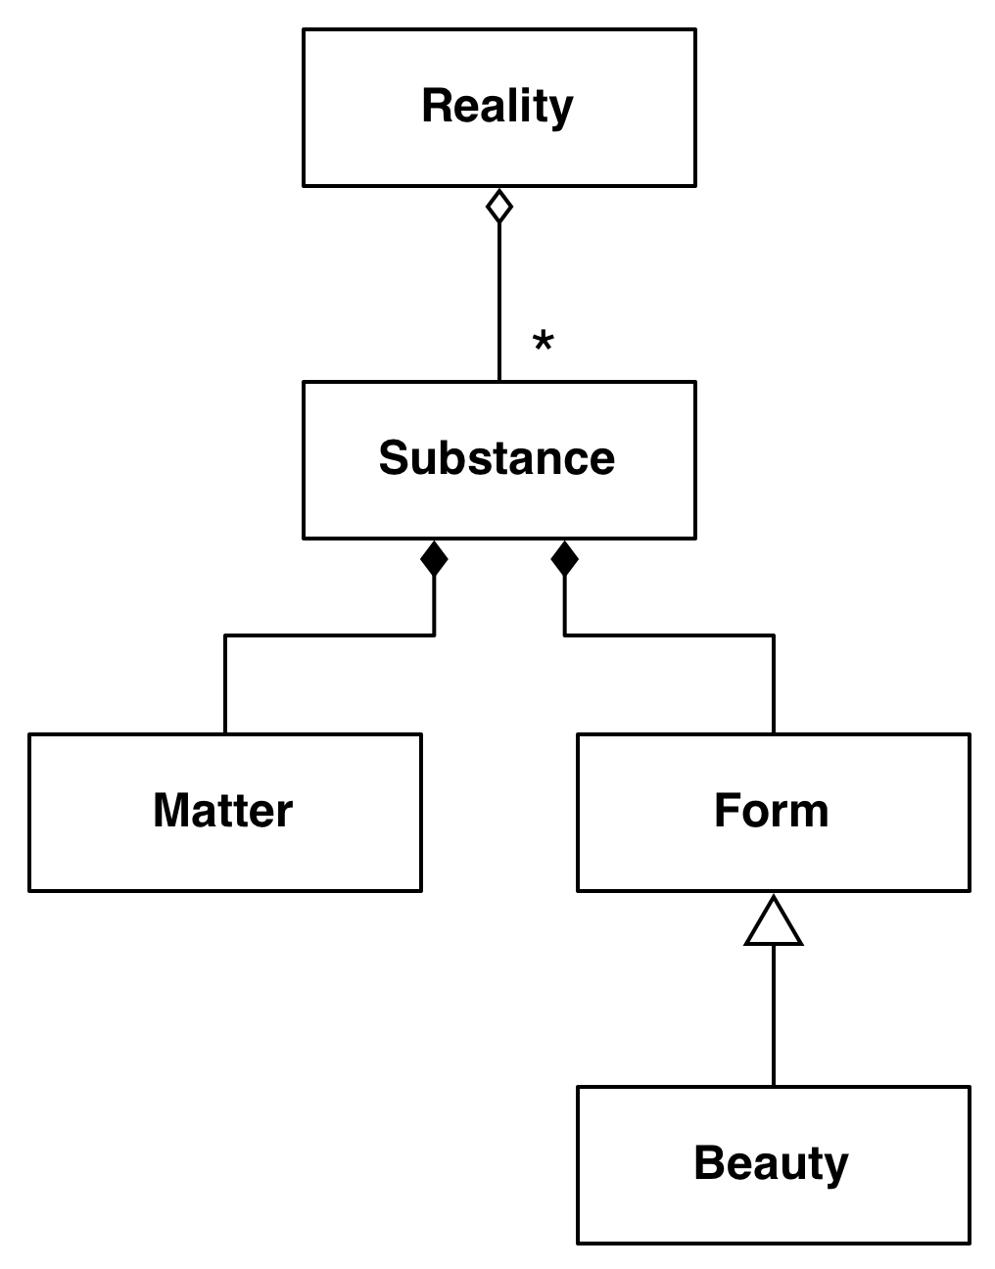
Aristotle’s View of Beauty
Aristotle
Aristotle’s model of reality:
Reality consists of many particular things called substances
Each substance is composed of form and matter
Beauty is real, but it does not exist on its own, it is always part of a substance.
Notes:
Plato’s model of reality (UML class diagram).
Reality consists of many particular things and many forms.
Note, that forms are not abstract classes that need to be instantiated.
Forms such as beauty really exist independent from a particular, that is they can be instantiated by themself.
Aristotle’s model of reality:
Reality consists of many particular things called substances.
Each substance is composed of form and matter.
Beauty is real but it does not exist on its own, it is always part of a really existing thing called the substance.

Slide 13
Comparison of Plato’s and Aristotle’s Views
Plato
Aristotle
Notes:
Plato’s model of reality (UML class diagram).
Reality consists of many particular things and many forms.
Note, that forms are not abstract classes that need to be instantiated.
Forms such as beauty really exist independent from a particular, that is they can be instantiated by themself.
Aristotle’s model of reality:
Reality consists of many particular things called substances.
Each substance is composed of form and matter.
Beauty is real but it does not exist on its own, it is always part of a really existing thing called the substance.

Slide 14
Comparison of Plato’s and Aristotle’s Views
Thing
Matter
Plato
Aristotle
Notes:
Plato’s model of reality (UML class diagram).
Reality consists of many particular things and many forms.
Note, that forms are not abstract classes that need to be instantiated.
Forms such as beauty really exist independent from a particular, that is they can be instantiated by themself.
Aristotle’s model of reality:
Reality consists of many particular things called substances.
Each substance is composed of form and matter.
Beauty is real but it does not exist on its own, it is always part of a really existing thing called the substance.

Slide 15
UML: Notation for Models
Baloo:Baer
Hellabrunn Zoo:Zoo
Reality
Mammal
40
Idea
:Baer
Taxonomy
Baer

Slide 16
Models can be used in 3 Ways
Models support three different types of activities:
  Communication: The model provides a common vocabulary. An model is communicated informally
    Target is a human being (developer, end user)
  Analysis and Design: Models enable developers to specify and reason about a future system
    Target is a tool (CASE tool, compiler)
  Archival: Compact representation for storing the design and rationale of an existing system
    Target is the human (analysis, project manager)

Slide 17
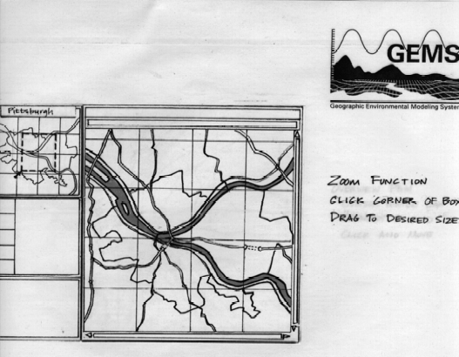
Example of a Conceptual Model (“Napkin Design”)
Notes:
This shows a drawing from the user interface design for the GEMS System, an environmental system for modeling pollution in cities of the United States.

Slide 18
Example of a Model for Analysis and Design:
Controlled Items in a CVS System
*
Controlled
Item
*
Version
CM Aggregate
Configuration
Item
*
Promotion
Release
*
Master
Directory
Repository

Slide 19
An Object-Oriented View of the OSI Model
The OSI Model is a closed software architecture (i.e., it uses opaque layering)
Each layer can be modeled as a UML package containing a set of classes available for the layer above
Notes:
An example of a closed architecture is the Reference Model of Open Systems Interconnection (in short, the OSI model) is composed of seven layers [Tanenbaum, 1996]. Each layer is responsible for performing a well defined function. In addition, each layer provides its services by using services by the layer below. The Physical layer represents the hardware interface to the network. It is responsible for transmitting bits over a communication channels. The DataLink layer is responsible for transmitting data frames without error using the services of the Physical layer. The Network layer is responsible for transmitting and routing packets within a network. The Transport layer is responsible for ensuring that the data is reliably transmitted from end to end. The Transport layer is the interface Unix programmers see when transmitting information over TCP/IP sockets between two processes. The Session layer is responsible for the initialization of a connection, including authentication. The Presentation layer performs data transformation services, such as byte swapping or encryption. The Application layer is the system you are designing (unless you are building an operating system or protocol stack). The application layer can and should, of course, also consist of layered subsystems.
An example of closed architecture: the OSI model (UML class diagram). The OSI model decomposes network services into seven layers, each responsible for a different level of abstraction.

Slide 20
Topics
  Reality and modeling, Abbot’s Technique
  Different ways to use models
  Model Transformations
  Design Patterns
  System Design
  Object Design
  Mapping Object Models
  Software process
  Methodologies

Slide 21
Model Transformations
Object-Oriented modeling means transformation of a single model throughout the software development activities
  Forward Engineering, Reverse Engineering, Re-Engineering, Refactoring

Slide 22
4 Different Types of Transformations
Program
(in Java)
Yet Another
System Model
Another
System Model
Forward
engineering
Refactoring
Model
transformation
Another
Program
Reverse
engineering
System Model
(in UML)
Model space
Source code space

Slide 23

Example of a Model Transformation:
Pull up Field
Object model before transformation:
LeagueOwner
Advertiser
Player
+email:Address
+email:Address
+email:Address
Object model after transformation:
User
+email:Address
LeagueOwner
Advertiser
Player

Slide 24
Example of Refactoring: Pull Up Field
public class Player {
private String email;
//...
}
public class LeagueOwner {
private String eMail;
//...
}
public class Advertiser {
private String email_address;
//...
}
public class User {
private String email;
}
public class Player extends User {
//...
}
public class LeagueOwner extends User {
//...
}
public class Advertiser extends User {
//...
}

Slide 25
Examples: Model Transformation & Forward Engineering
Model Transformations
  Goal: Optimizing the object design model
    Collapsing objects
    Delaying expensive computations
Forward Engineering
  Goal: Implementing the object design model in a programming language
  Mapping inheritance
  Mapping associations
  Mapping contracts to exceptions
  Mapping object models to tables

Slide 26
Collapsing Objects
Object design model before transformation:
Person
SocialSecurity
number:String
Object design model after transformation:
Person
SSN:String
Turning an object into an attribute of another object is usually
done, if the object does not have any interesting dynamic behavior (only get and set operations).

Slide 27
Delaying expensive computations
Object design model before transformation:
Image
filename:String
data:byte[]
paint()
Object design model after transformation:
Proxy Pattern!
Image
filename:String
paint()
image
ImageProxy
1
0..1
RealImage
filename:String
data:byte[]
paint()
paint()
Notes:
Question: Which pattern is being used here? Answer: The proxy pattern!
Why: Image is an analysis domain object, the proxy pattern subclasses Imageproxy and RealImage are solution
domain objects!

Slide 28
Examples of Model Transformations and Forward Engineering
Model Transformations
  Goal: Optimizing the object design model
    Collapsing objects
    Delaying expensive computations
Forward Engineering
  Goal: Implementing the object design model in a programming language
  Mapping inheritance
  Mapping associations
  Mapping object models to tables

Slide 29
Forward Engineering: Mapping a UML Model into Source Code
Java provides the following constructs:
  Overwriting of methods (default in Java)
  Final classes
  Final methods
  Abstract methods
  Abstract classes
  Interfaces.
Notes:
For each of these mechanisms a project manager can specify heuristics to use them properly

Slide 30
Realizing Inheritance in Java
Realisation of specialization and generalization
  Definition of subclasses
  Java keyword: extends
Realisation of simple inheritance
  Overwriting of methods is not allowed
  Java keyword: final
Realisation of implementation inheritance
  Overwriting of methods
  No keyword necessary:
    Overwriting of methods is default in Java
Realisation of specification inheritance
  Specification of an interface
  Java keywords: abstract, interface
Notes:
Java offers several techniques to realize the different types of inheritance:
Realisation of simple inheritance also called strict inheritance

Slide 31
Mapping Inheritance
Object design model before transformation:
User
LeagueOwner
-email:String
-maxNumLeagues:int
+getEmail():String
+setEmail(e:String)
+notify(msg:String)
+getMaxNumLeagues():int
+setNaxNumLeagues(n:int)
Source code after transformation:
public class User {
private String email;
public String getEmail() {
return email;
}
public void setEmail(String value){
email = value;
}
public void notify(String msg) {
// ....
}
}
public class LeagueOwner extends User {
private int maxNumLeagues;
public int getMaxNumLeagues() {
return maxNumLeagues;
}
public void setMaxNumLeagues
(int value) {
maxNumLeagues = value;
}
}

Slide 32
Examples of Model Transformations and Forward Engineering
Model Transformations
  Goal: Optimizing the object design model
    Collapsing objects
    Delaying expensive computations
Forward Engineering
  Goal: Implementing the object design model in a programming language
  Mapping inheritance
  Mapping associations
  Mapping contracts to exceptions
  Mapping object models to tables

Slide 33
Mapping Associations
Unidirectional one-to-one association
Bidirectional one-to-one association
Bidirectional one-to-many association
Bidirectional many-to-many association.

Slide 34
Unidirectional one-to-one association
Object design model before transformation:
1
1
Advertiser
Account
Source code after transformation:
public class Advertiser {
private Account account;
public Advertiser() {
account = new Account();
}
public Account getAccount() {
return account;
}
}
Notes:
If Advertiser accesses only Account, but not vice versa, the class Account can be made a local attribute in the Advertiser class

Slide 35
Bidirectional one-to-one association
Object design model before transformation:
Advertiser
1
1
Account
Source code after transformation:
public class Advertiser {
/* account is initialized
* in the constructor and never
* modified. */
private Account account;
public Advertiser() {
account = new Account(this);
}
public Account getAccount() {
return account;
}
}
public class Account {
/* owner is initialized
* in the constructor and
* never modified. */
private Advertiser owner;
publicAccount(owner:Advertiser) {
this.owner = owner;
}
public Advertiser getOwner() {
return owner;
}
}

Slide 36
Bidirectional many-to-many association
Object design model before transformation
Tournament
*
*
Player
Source code after transformation
public class Tournament {
private List players;
public Tournament() {
players = new ArrayList();
}
public void addPlayer(Player p) {
if (!players.contains(p)) {
players.add(p);
p.addTournament(this);
}
}
}
public class Player {
private List tournaments;
public Player() {
tournaments = new ArrayList();
}
public void addTournament(Tournament t) {
if (!tournaments.contains(t)) {
tournaments.add(t);
t.addPlayer(this);
}
}
}

Slide 37
Mapping Object Models to Relational Databases
UML object models can be mapped to relational databases
The basic idea of the mapping:
  Each class is mapped to its own table
  Each class attribute is mapped to a column in the table
  An instance of a class represents a row in the table
  One-to-many associations are implemented with a buried foreign key
  Many-to-many associations are mapped to their own tables
Methods are not mapped
Realization of associations
  Generic associations, inheritance
Notes:
UML object models can be mapped to relational databases
Some degradation occurs because all UML constructs must be mapped to a single relational database construct - the table
UML mappings (Chapter 10, p 414ff)

Slide 38
Topics
  Reality and modeling, Abbot’s Technique
  Different ways to use models
  Model Transformations
  Software Development Activities
  Design Patterns
  Object Design
  Mapping Object Models
  Software process
  Methodologies

Slide 39
Software Development Activities
Object-Oriented modeling means transformation of a single model throughout the software development activities
Software Development Activities
  Requirements Analysis
  System Design
  Object Design (Patterns)
  Testing
  Implementation

Slide 40
System Development as a Set of Activities
System Model
Problem
Application objects
Analysis
Solution objects
Design
Custom objects
- Object Design
Off-the-Shelf Components
- System Design
Existing Machine
Notes:
Off-the-shelf components are also sometimes called COTS (commercial off-the-shelf components)

Slide 41
Requirements Analysis Questions
1. What are the transformations?
  Create scenarios and use case diagrams
    - Talk to client, observe, get historical records
Functional Modeling
2. What is the structure of the system?
  Create class diagrams
    - Identify objects.
    What are the associations between them?
    What is their multiplicity?
    - What are the attributes of the objects?
    - What operations are defined on the objects?
Object Modeling
3. What is its behavior?
  Create sequence diagrams
    - Identify senders and receivers
    Show sequence of events exchanged between objects.
    Identify event dependencies and event concurrency.
  Create state diagrams
    - Only for the dynamically interesting objects.
Dynamic Modeling
Notes:
The textbook has a relatively elaborate dynamic model for a programmable thermostat. To get the concept through to you and to show the relation to the object model, I would like to use an even simpler example: The movement of a toy train.

Slide 42
Requirements Analysis
1. What are the transformations?
    Talk to the client
    Observe the end user
    Get historical records
    Create scenarios and use case diagrams
Functional Modeling
Notes:
The textbook has a relatively elaborate dynamic model for a programmable thermostat. To get the concept through to you and to show the relation to the object model, I would like to use an even simpler example: The movement of a toy train.

Slide 43
Requirements Analysis (cont’d)
2. What is the structure of the system?
  Identify objects
  What are the associations between them?
  What is their multiplicity?
  What are the attributes of the objects?
  What operations are defined on the objects?
  Create class diagrams
Object Modeling
Notes:
The textbook has a relatively elaborate dynamic model for a programmable thermostat. To get the concept through to you and to show the relation to the object model, I would like to use an even simpler example: The movement of a toy train.

Slide 44
Requirements Analysis (cont’d)
3. What is the behavior of the system?
  Identify senders and receivers
  Show sequence of events between objects
  Identify event dependencies and concurrency
  Are there dynamically interesting objects?
  Create sequence diagrams
  Create activity and state diagrams
Dynamic Modeling
Notes:
The textbook has a relatively elaborate dynamic model for a programmable thermostat. To get the concept through to you and to show the relation to the object model, I would like to use an even simpler example: The movement of a toy train.

Slide 45
From Analysis to System Design
Nonfunctional
Requirements
Functional Model
8. Boundary
Conditions
1. Design Goals
Definition
Trade-offs
Initialization
Termination
Failure
Functional Model
2. System Decomposition
Dynamic
Model
Layers vs Partitions
Coherence/Coupling
7. Software
Control
Dynamic
Model
Object Model
Monolithic
Event-Driven
Conc. Processes
4. Hardware/
Software Mapping
5. Data
Management
6. Global Resource
Handlung
3. Concurrency
Identification of
Threads
Special Purpose Systems
Buy vs Build
Allocation of Resources
Connectivity
Persistent Objects
Filesystem vs Database
Access Control List
vs Capabilities
Security
Notes:
1. Design goals
2. System decomposition
Breaking the system into subsystems, Layers and partitions, System information flow (topology)
3. Identification of concurrency
Threads of control
4. Hardware/software allocation
Estimate hardware requirements, Hardware/software trade-offs, Describe processor allocation, Physical connectivity (existing hardware)
5. Data management
Data structures implemented in memory or secondary storage
6. Global resource handling
Choose access control
7. Software control implementation
Procedure-based, event-based, concurrent systems
8. Boundary conditions
Describe behavior at initialization, termination and failure
9. Feasibility
Discuss design alternatives, Technological constraints that drive the design, What if the constraints change?

Slide 46
System Design Activities
8. Boundary
Conditions
1. Identify Design Goals
- Identify Additional Nonfunc-
tional Requirements
- Discuss Trade-offs
- Initialization
- Termination
- Failure.
2. Subsystem Decomposition
7. Software
Control
- Layers vs Partitions
- Coherence & Coupling
- Monolithic
- Event-Driven
- Conc. Processes
3. Identify Concurrency
4. Hardware/
Software Mapping
5. Persistent Data
Management
- Identification of
Parallelism
(Processes,
Threads)
6. Global Resource
Handlung
- Identification of Nodes
- Special Purpose Systems
- Buy vs Build Decisions
- Network Connectivity
Storing Entity Objects
- Filesystem vs Database
- Access Control
- ACL vs Capabilities
- Security
Notes:
1. Design goals
2. System decomposition
Breaking the system into subsystems, Layers and partitions, System information flow (topology)
3. Identification of concurrency
Threads of control
4. Hardware/software allocation
Estimate hardware requirements, Hardware/software trade-offs, Describe processor allocation, Physical connectivity (existing hardware)
5. Data management
Data structures implemented in memory or secondary storage
6. Global resource handling
Choose access control
7. Software control implementation
Procedure-based, event-based, concurrent systems
8. Boundary conditions
Describe behavior at initialization, termination and failure
9. Feasibility
Discuss design alternatives, Technological constraints that drive the design, What if the constraints change?

Slide 47
How the Analysis Models influence System Design
Nonfunctional Requirements
  => Definition of Design Goals
Functional model
  => Subsystem Decomposition
Object model
  => Hardware/Software Mapping, Persistent Data Management
Dynamic model
  => Identification of Concurrency, Global Resource Handling, Software Control
Finally: Hardware/Software Mapping
  => Boundary conditions
Notes:
In Requirements analysis we have beautifully built 3 descriptions of the problem, the models.
Where do the models go in system design? The above list of system design issues looks a little bit random.
But there is a reason behind it:
Nonfunctional Requirements
=> Definition of Design Goals
Functional model
=> Subsystem Decomposition (Subsystems based on functional requirements, coherence & coupling)
Object model
=> Hardware/software Mapping and Data Management (Persistent objects)
Dynamic model
=> Identification of Concurrency, Global Resource Handling, Software Control
Finally: From the Subsystem Decomposition
=> Boundary conditions

Slide 48
Other System Design Topics
Examples of Design Goals
Architectural Styles and Architectures
Open and closed Architectures
Layering vs Partitioning
Good Design: Coupling and Coherence
Hardware Software Mapping
Mapping object models to relational databases
Access Control

Slide 49
Object Design
Developers play different roles during object design
Class User
Call Class
Developer
Class Implementor
Realize Class
Class Extender
Refine Class

Slide 50
Object Design Activities
Select Subsystem
Specification
Reuse
Identifying missing
Identifying components
attributes & operations
Specifying visibility
Adjusting components
Specifying types &
signatures
Identifying patterns
Specifying constraints
Specifying exceptions
Applying patterns
Notes:
A Detailed View of Object Design Activities

Slide 51
The use of Inheritance
Inheritance is used to achieve two different goals
  Description of Taxonomies
  Interface Specification
Description of Taxonomies
  Used during requirements analysis
  Activity: identify application domain objects that are hierarchically related
  Goal: make the analysis model more understandable
Interface Specification
  Used during object design
  Activity: identify the signatures of all identified objects
  Goal: increase reusability, enhance modifiability and extensibility
Notes:
Let us think about how we model, When we observation Modeling of the Real World, we notice that we identify existing objects.
Modeling of the real world leads to a system that reflects today’s realities but not necessarily tomorrow’s, or the visionary Scenario that drives our analysis.
Transition to next slide: “Inheritance is found either by specialization or generalization”

Slide 52
Metamodel for Inheritance
Object
Design
Analysis
activity
Inheritance
Taxonomy
Inheritance
for Reuse
Inheritance
detected by
Inheritance
detected by
Specification
Implementation
Inheritance
Inheritance
specialization
generalization
Strict
Inheritance
Contraction
Notes:
This is the final metamodel for modeling inheritance.
Today we have added strict inheritance and contractions as two additional ways to use implementation inheritance: We identified strict inheritance as a good citizen, and if used this way, then implementation inheritance is a good thing. And we have shown that contract is a bad idea, because it leads to unmaintainable systems and unpredictable behavior.

Slide 53
Realizing Inheritance in Java
Realisation of specialization and generalization
  Definition of subclasses
  Java keyword: extends
Realisation of simple inheritance
  Overwriting of methods is not allowed
  Java keyword: final
Realisation of implementation inheritance
  Overwriting of methods
  No keyword necessary:
    Overwriting of methods is default in Java
Realisation of specification inheritance
  Specification of an interface
  Java keywords: abstract, interface
Notes:
Java offers several techniques to realize the different types of inheritance:
Realisation of simple inheritance also called strict inheritance

Slide 54
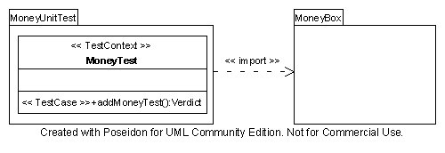
Model-based Testing
Test System
SUT
TestContext
Test Case
MoneyTest is the test context
MoneyUnitTest is the test case

Slide 55
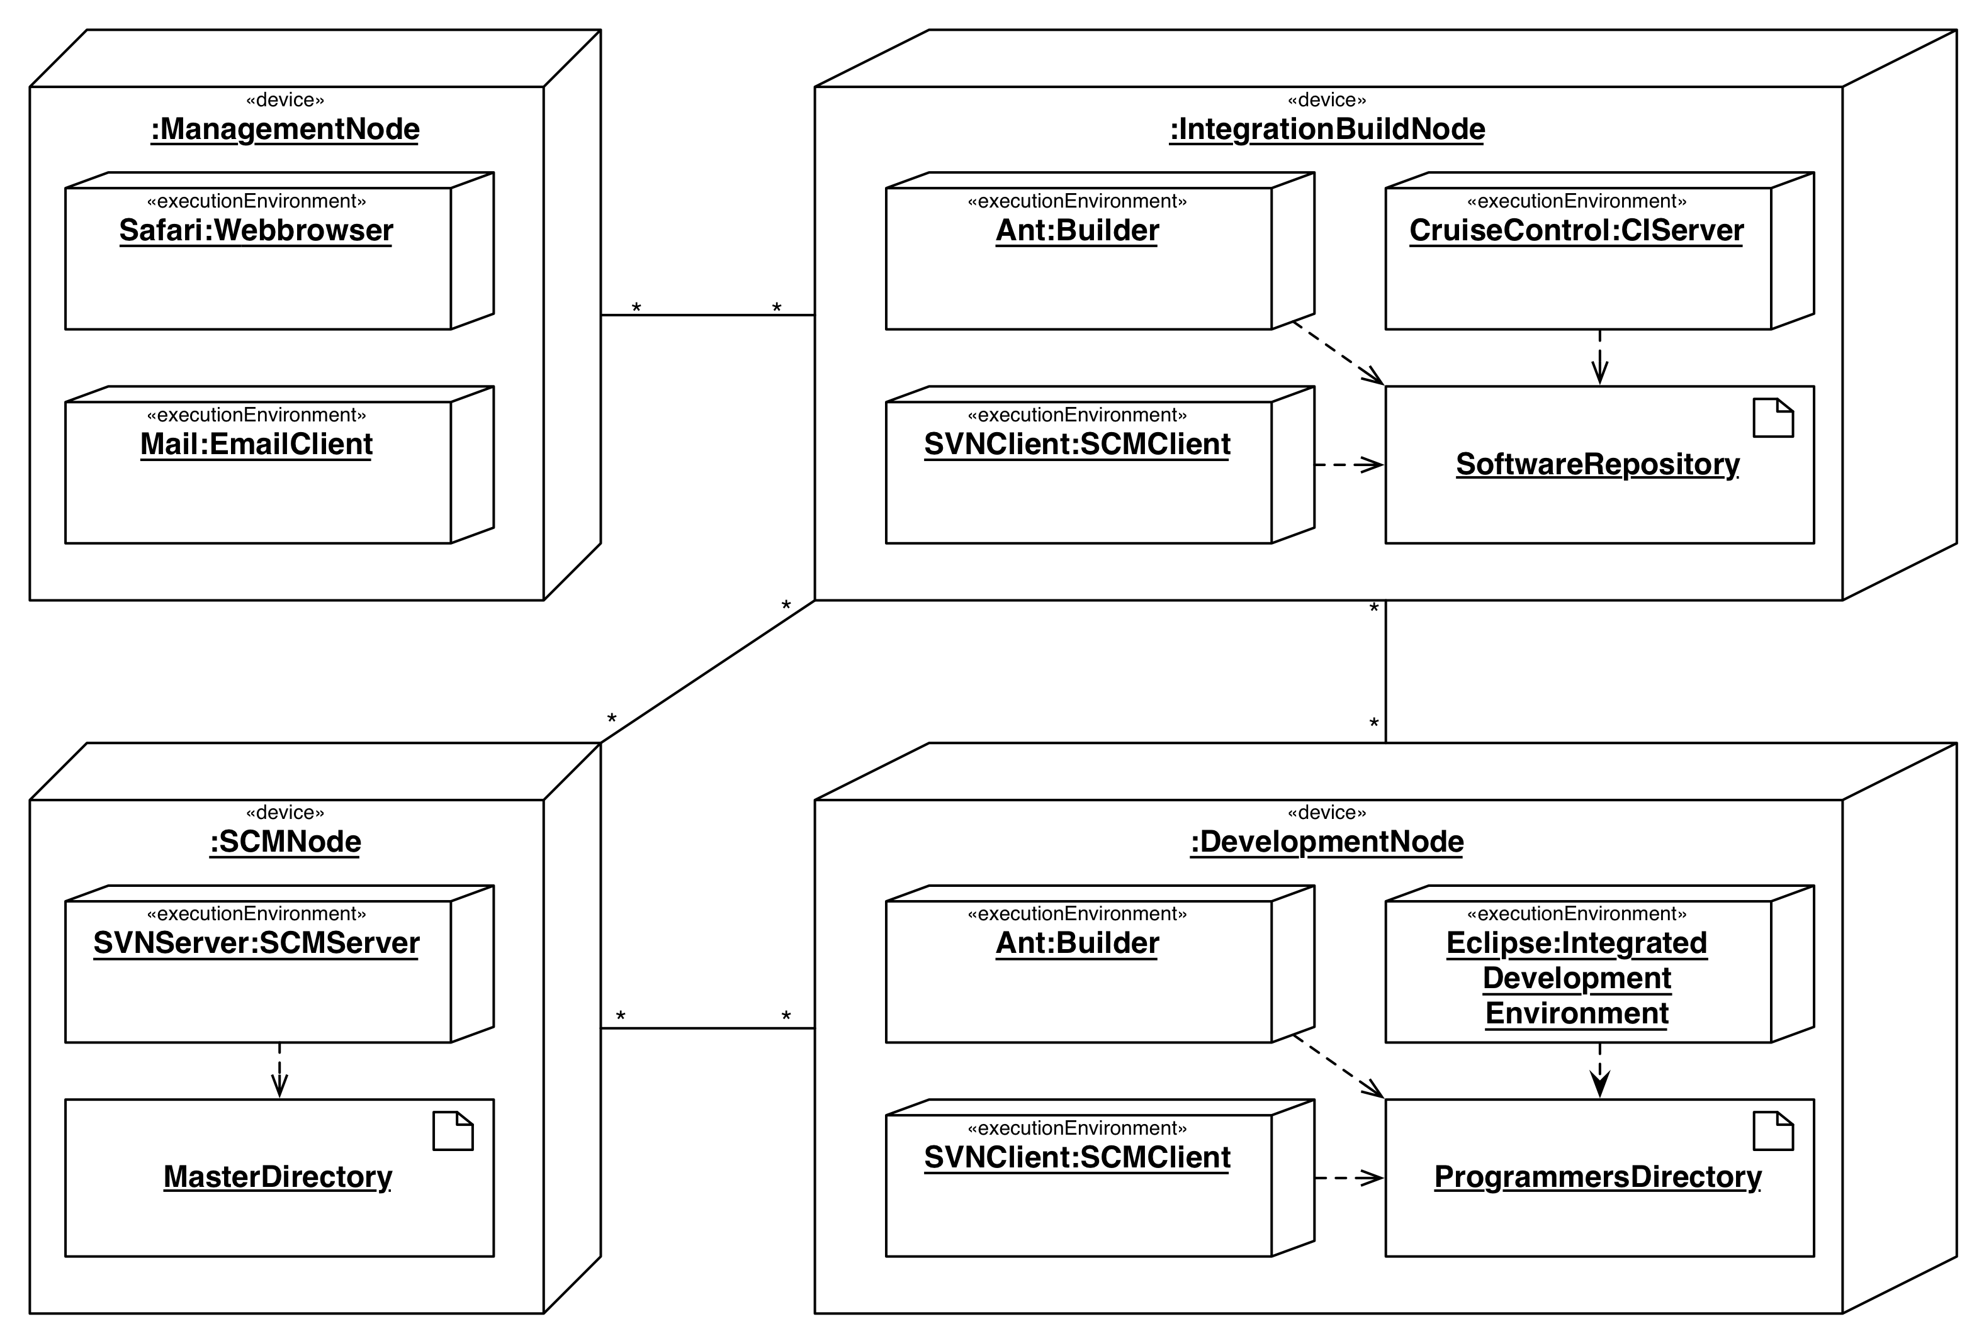
Deployment Diagram of a Continuous Integration System
Notes:
Has been detected. Not when it has occurred!!

Slide 56
Other Topics
Requirements Analysis vs. Object Design
Component-Based Software Engineering
COTS-Development
Reuse (White box vs black box reuse)
Generalizations and Specification
Delegation vs Inheritance
The Use of Inheritance
  Taxonomies
  Interface Specification
    Implementation Inheritance vs Specification Inheritance
Push vs Pull Notification, Push-Update-Notification
Notes:
Object design is the process of adding details to the requirements analysis and making
implementation decisions
The object designer must choose among different ways to implement the analysis model
with the goal to minimize execution time, memory and other measures of cost.
Requirements Analysis: The functional model and the dynamic model deliver operations for the object model
Object Design: We decide on where to put these operations in the object model
Object design serves as the basis of implementation

Slide 57
Topics
  Reality and modeling, Abbot’s Technique
  Different ways to use models
  Model Transformations
  Software Development Activities
  Design Patterns
  Object Design
  Mapping Object Models
  Software process
  Methodologies

Slide 58
Design Patterns
  Composite: Model dynamic aggregates
  Adapter: Interface to existing systems (“legacy systems”)
  Bridge: Interface to existing and future systems
  Facade: Interface to subsystems, hiding the internals
  Proxy: Provide Location transparency
  Command: Encapsulate control flow
  Observer: Publisher/ subscribe mechanism
  Strategy: Support a family of algorithms
  Abstract Factory: Provide manufacturer independence
  Builder: Hide a complex creation process
  Template: Provide the workflow for a solution

Slide 59
Design Patterns
Structural Patterns
  Focus: Composing objects to form larger structures
  Problems solved:
    Realize new functionality from old functionality
Behavioral Patterns
  Focus: Assignment of responsibilities to objects
  Problem solved: Tight coupling to particular algorithms
Creational Patterns
  Focus: Creation of complex objects
  Problems solved: Hide how objects are created or put together
Notes:
Provide flexibility and extensibility
Focus: Algorithms and assignment of responsibilities to objects

Slide 60
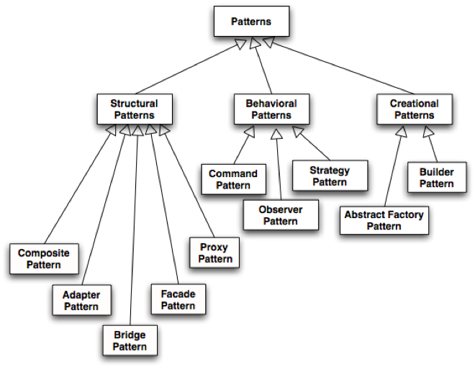
Taxonomy for Design Patterns

Slide 61
Patterns can be combined: Example JUnit
*
TestResult
Test
Command Pattern
run(TestResult)
Composite
Pattern
TestCase
TestSuite
testName:String
run(TestResult)
Template Method
Pattern
run(TestResult)
addTest()
setUp()
tearDown()
runTest()
ConcreteTestCase
TestedUnit
Adapter
Pattern
setUp()
tearDown()
runTest()

Slide 62
Application Domain vs System Domain
Application Domain
Solution Domain
System Model
System Model
Summary
Display
MapDisplay
TrafficControl
TrafficController
FlightPlanDatabase
Aircraft
Airport
TrafficControl
FlightPlan

Slide 63
Example: Observer Pattern
Subject
Observer
observers
*
subscribe(subscriber)
unsubscribe(subscriber)
notify()
update()
Solution Domain
(Design Knowledge)
ConcreteSubject
ConcreteObserver
state
observeState
getState()
setState()
Application Domain
(Application Knowledge)
update()
The Subject (“Publisher”) represents the entity object
Observers (“Subscribers”) attach to the Subject by calling subscribe()
Each Observer has a different view of the state of the entity object
  The state is contained in the subclass ConcreteSubject
  The state can be obtained and set by subclasses of type ConcreteObserver.
Notes:
The Publisher is called Subject, the Subscriber is called Observer in Gamma.

Slide 64
Observer Pattern
Models a 1-to-many dependency between objects
  Connects the state of an observed object, the subject with many observing objects, the observers
Usage:
  Maintaining consistency across redundant states
  Optimizing a batch of changes to maintain consistency
Three variants for maintaining the consistency:
  Push Notification: Every time the state of the subject changes, all the observers are notified of the change
    Push-Update Notification: The subject also sends the state that has been changed to the observers
  Pull Notification: An observer inquires about the state the of the subject
Also called Publish and Subscribe.

Slide 65
Model-View-Controller Architectural Style
Subsystems are classified into 3 different types
  Model subsystem: Responsible for application domain knowledge
  View subsystem: Responsible for displaying application domain objects to the user
  Controller subsystem: Responsible for sequence of interactions with the user and notifying views of changes in the model
Class Diagram
initiator
Controller
1
repository
*
Model
1
notifier
subscriber
View
*
Better understanding with a Collaboration Diagram
Notes:
The MVC style is a special case of the repository architectural style:
Model subsystem implements the Repository, the Controller subsystem explicitly dictates the control flow
Example: Filesystem based on MVC

Slide 66
Access Matrix Implementations
Access control list
  Associates a list of (actor,operation) pairs with each class to be accessed.
  Every time an instance of this class is accessed, the access list is checked for the corresponding actor and operation.
Capability
  Associates a (class,operation) pair with an actor.
  A capability provides an actor to gain control access to an object of the class described in the capability.
Notes:
Access control list associates a list of (actor,operation) pairs with each class to be accessed.
Every time an object is accessed, its access list is checked for the corresponding actor and operation.
Example: guest list for a party.
A capability associates a (class,operation) pair with an actor.
A capability provides an actor to gain control access to an object of the class described in the capability.
Example: An invitation card for a party.
Which is the right implementation?

Slide 67
Modeling Boundary Conditions
Boundary conditions are best modeled as use cases with actors and objects
We call them boundary use cases or administrative use cases
Actor: often the system administrator
Interesting use cases:
  Start up of a subsystem
  Start up of the full system
  Termination of a subsystem
  Error in a subsystem or component, failure of a subsystem or component.

Slide 68
Contracts
Contracts enable the caller and the provider to share the same assumptions about the class
A contract is an exact specification of the interface of an object
A contract includes three types of constraints
  Invariants
  Preconditions (“rights”)
  Postconditions (“obligations”)
Contract restrict the model space
  They constrain what can be instantiated
Notes:
Contracts enable the caller and provider to share the same assumptions about the class.
A contract is an exact specification of the interface of an object.
A contract include three types of constraints:
Invariant:
A predicate that is always true for all instances of a class. Invariants are constraints associated with classes or interfaces.
Precondition (“rights”):
Preconditions are predicates associated with a specific operation and must be true before the operation is invoked.
Postcondition (“oblicgation”):
Postconditions are predicates associated with a specific operation and must be true after an operation is invoked.
If the invariants, rights and oblications in the contract are unambigious, the contract is called a formal specification
Preconditions are used to specify constraints that a caller must meet before calling an operation.
Postconditions are used to specify constraints that the object must ensure after the invocation of the operation.

Slide 69
OCL: Object Constraint Language
Formal language for expressing constraints over a set of objects and their attributes
Part of the UML standard
  For expressing constraints that cannot be modeled in UML
Declarative
  No side effects, No control flow
Based on Sets and Multi Sets
OCL expressions are predicates that return True or False
  Evaluated in a specified context, either in the context of a class or in the context of an operation
  All constraints apply to all instances

Slide 70
Specifying Model Constraints
Local attribute navigation
  context Tournament inv:
  end - start <= Calendar.WEEK
Directly related class navigation
  context Tournament::acceptPlayer(p)
  pre:
  league.players->includes(p)
League
*
+start:Date
+end:Date
+getActivePlayers()
{ordered}
*
tournaments
Tournament
+start:Date
+end:Date
+acceptPlayer(p:Player)
Indirectly related class navigation
  context League::getActivePlayers
  post:
  result=tournaments.players->asSet
*
tournaments
players
*
players
Player
*
+name:String
+email:String

Slide 71
Access Matrix
The rows of the matrix represents the actors of the system
The column represent classes whose access we want to control
Access Right: An entry in the access matrix. It lists the operations that can be executed on instances of the class by the actor.

Slide 72
Lasts Hints
If a topic was not mentioned here, that does not imply that it will not appear in the exam
Scope of the exam: Chapter 1 – 11, Appendix A and B in the text book
Form a study group
  Formulate questions that others in the group must answer
  Rotate questioner and answerer
Some typical questions:
  Here is a problem statement or a napkin design of a system. Model it in UML
  What is…? Name advantages and/or disadvantages of ...
  Here is some code. Reverse engineer the model
  Here is a model. Forward engineer the code

Slide 73
Final Course Review:
Second Semester Questions
Notes:
The cover picture shows: The School of Athens by Raphael with Socrates (left) and Plato (right) in the center

Slide 74
Rationale Management
What is rationale?
Why is it critical in software engineering?
Use of rationale in software development
Issue Models
Resolutions

Slide 75
Example of an Issue Model
input?:Issue
display?:Issue
addressed by
addressed by
addressed by
text-based:Proposal
point&click:Proposal
raises
meets
meets
terminal?:Issue
fails
fails
usability$:Criterion
availability$:Criterion
The time to input commands should be less than two seconds.
The CTC system should have at least a 99% availability.

Slide 76
Software Process
Key Question: How do we control software development?
Through organizational maturity (Humphrey)
  Defined process, Capability Maturity Model (CMM)
Through agility (Schwaber)
  Software development is empirical in nature
  Cannot be modeled with a defined process
  Should be described with an empirical process control model
Notes:
There is a difference between defined and empirical process
Large parts of software development is empirical in nature

Slide 77
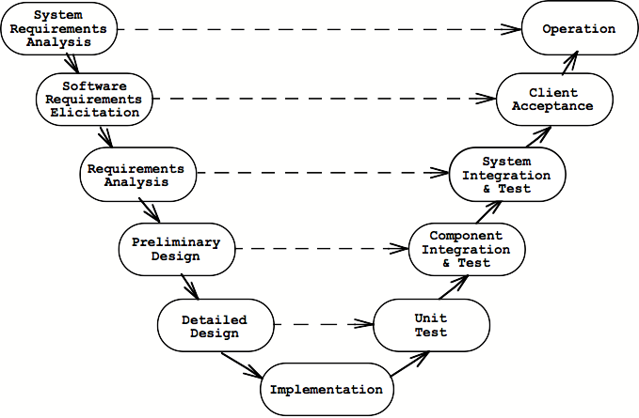
Example of a Lifecycle Model: The V-Model
Notes:
Example: V-Model

Slide 78
The Key Problems in Software Engineering
The three main challenges in software development
  How do we harness complexity?
  How do we react to change?
  How do we deal with uncertainty?
Methodologies

Slide 79
Methodologies
Software methodologies provide
  Guidance and general principles for dealing with complexity, change and uncertainty
  Strategies for selecting methods and tools in a given project environment
  Guidance what to do when things go wrong

Slide 80
Methodologies (cont’d)
Key questions in a methodology
  How much involvement of the customer?
  How much planning?
  How much reuse?
  How much modeling?
  How much process?
  How much control and monitoring?

Slide 81
WBS, Estimation and Scheduling
Determining Work and Tasks Sizes
Different Approaches for developing WBSs
Notations for Work Breakdown Structures
Heuristics for Developing Good WBS
Boehm’s Cone of Uncertainty
Dependency Diagrams and Notations
Critical Path Analysis (Forward Path and Backward Path Analysis)
Burndown Charts

Slide 82
Computing a critical path
Activity 1
t₁ = 5
Activity 2
t₂ = 1
Activity 1
t₁ = 5
Start
t = 0
Start
t = 0
End
t = 0
End
t = 0
Activity 3
t₃ = 1
Activity 4
t₄ = 3
Activity5
5 = 2
Activity5
t₅ = 2
Critical path with bold and red arrows

Slide 83
Additional Topics
Icebreaker
Basic Concepts (Work Package, WBS, Task, Activity, Project Baseline, Release, Promotion, Configuration Management, Deliverable, Audience List, etc, etc)
Structures in Organization
  Functional vs Matrix vs Project-based Organizations
Architecture-centric Project Management
Agile Project Management, Situated actions

Slide 84
Setting up a Project: Example
1. Define Subsystem decomposition (“Top-Level Design”)
2. Determine the Work Breakdown Structure
UserInterface
Develop
System
Develop
Develop Control
Control
UserInterface
Subsystem
Develop Database
Database
Subsystem
Notes:
Here we have a system that has been decomposed into 3 subsystems. To develop the system in a project, we broke the problem down into work to be performed. So first, we developed the work breakdown structure.
The next task is now to identify the resources, that can perform the identified work. This is the task of the project organization

Slide 85
Setting up a Project: Example
2. Determine the Work Breakdown Structure
3. Set up the Teams
UserInterface
:Team
Develop
System
Develop
Develop Control
Control
:Team
UserInterface
Subsystem
Develop Database
Database
:Team
Subsystem
Notes:
To develop the system in a project, we can assign a team to each of the subsystems.
In this example, we have the work assigned to 3 teams.
Every time, you do a project organization, the same set of issues appear:
How are the teams organized?
Who are the Key players?
What Roles and Responsibilities do they assume?
Structure: What is the information flow between roles
Benefits and Challenges (“pros and cons”)
Paulish‘s book on architecture-centric project management contains a detailed description of the
the opportunities when the software architecture is formulated simultaeneously with the SPMP

Slide 86
Binding Roles To People
Project To-Do List
(from your WBS)
Person A
Role 1
• Item 1
Item 1
• Item 2
Item 2
Role 1
• Item 3
Item 9
Role 2
• Item 4
Role 2
• Item 5
Item 4
Person B
Item 5
• Item 6
Item 7
• Item 7
• Item 8
Role 3
• Item 9
Role 3
Item 3
Item 6
Item 8
Roles-Person Bindings are
made during Initial Planning phase
(First team meeting, etc …)
To-Do Role Bindings are made during Project-Initiation Phase

Slide 87
Key Concepts for Binding Roles to People
Responsibility
  The commitment to achieve specific results
  Redefinition of role: A role is a set responsibilities
Delegation
  Rebinding a responsibility assigned to one person (including yourself) to another person.
Authority
  The ability to make the binding decisions between roles and people
Accountability
  Tracking a task performance to a person

Slide 88
Structures in Organizations
An organization usually has 3 different types of associations between organizational units
  Reporting structure
    Shows how status information is reported
  Decision structure
    Shows how decisions are propagated
  Communication structure
    Shows how information is exchanged.

Slide 89
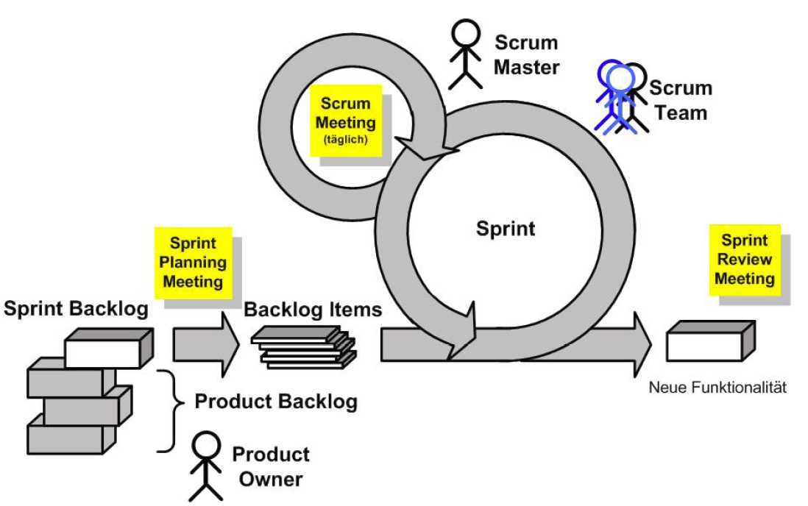
Scrum („Napkin Design“)
Scrum
Master
Daily
Scrum
meeting
Potentially shippable
Product Increment
Notes:
Funktionsweise an Grafik darstellen (Graphik hat einen Fehler!! Sprint Planung Meeting VOR Sprint Backlog!):

Slide 90
Dealing with Uncertainty, Complexity and Change (Agile Manifesto)
Individuals and Interactions | Processes and Tools
Working Software | Comprehensive Documentation
Customer Collaboration | Contract Negotiation
Responding to Change | Following a Plan
Notes:
Different approaches to deal with uncertainty, complexity and change.
One can trust the people that they get their job down, or one does not trust them. In this case, one instutionalizes a process and sets up tools, that help to avoid errors.
Another focus is to pay emphasis on working software, or comprehensive documentation (the worker may leave the company)
Trust is also important with respect to the customer: Either we trust them, or we don’t, in the latter case we better contact a lawyer, and write a legal contract.
Finally, what do we do when unexpected change occurs? We can respond to this change, or we insist on following the plan that we originally set up for our mission.

Slide 91


Dealing with Uncertainty, Complexity and Change (Agile Manifesto)
Scrum
Royce
Individuals and Interactions | Processes and Tools
Working Software | Comprehensive Documentation
Customer Collaboration | Contract Negotiation
Responding to Change | Following a Plan
Light,
Agile
Heavy
Extreme
Programming
Waterfall

Slide 92
Lasts Hints
If a topic was not mentioned here, that does not imply that it will not appear in the exam
Scope of the exam: Chapter 12 – 16 in the text book
Form a study group
  Formulate questions that others in the group must answer
  Rotate questioner and answerer
Some typical questions:
  Here is a problem statement or a napkin design of a system. Model it in UML
  What is…? Name advantages and/or disadvantages of ...
  Here is some code. Reverse engineer the model
  Here is a model. Forward engineer the code.

