Slide 1
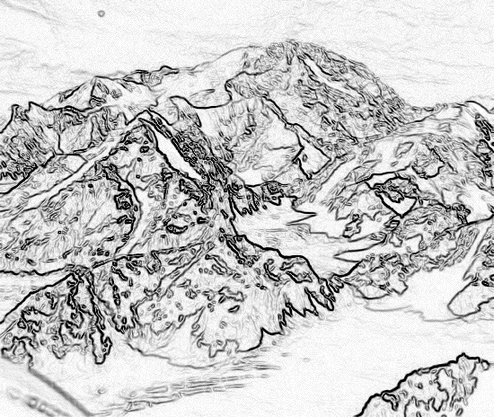
Chapter 2,
Modeling with UML, Part 3
UML 2 Hightlights

Slide 2
Outline for today
UML 2: UML is a living language
Overview of important changes in UML 2
  Frames and nesting
  Activity diagrams
  Deployment diagrams
  Sequence diagrams
  Profiles, Stereotypes
  UML Metamodel

Slide 3
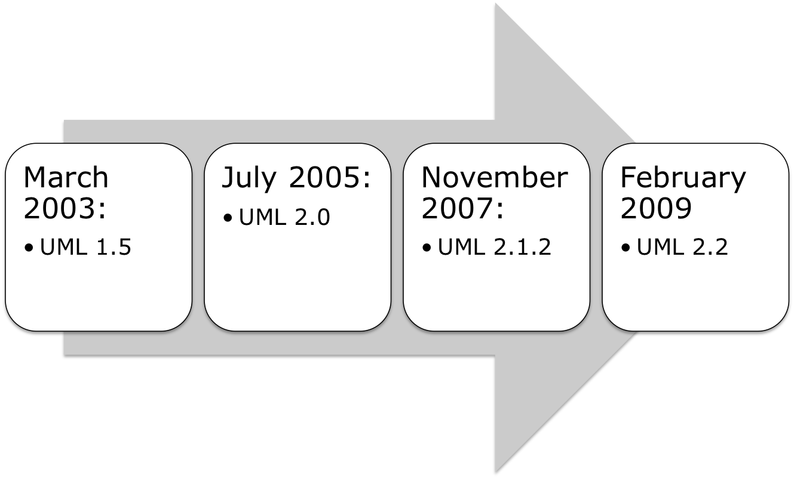
Recent History of UML

Slide 4
UML now usable with Model Driven Architecture (MDA)
  Better support for the automatic transformation of a Platform Independent Model (PIM) into a Platform Specific Model (PSM)
UML 2 is based on a meta model
  Meta Object Facility (MOF)
Notes:
If you are talking of UML as a model, then MOF is its meta model.

Slide 5
Changes in UML 2
  Frames and nesting
Changes in diagram notation:
  Activity diagram
  Deployment diagram
  Sequence diagram
Profiles and stereotypes
New diagram types:
  Composite structure diagrams
  Timing diagrams
  Not covered in this lecture

Slide 6
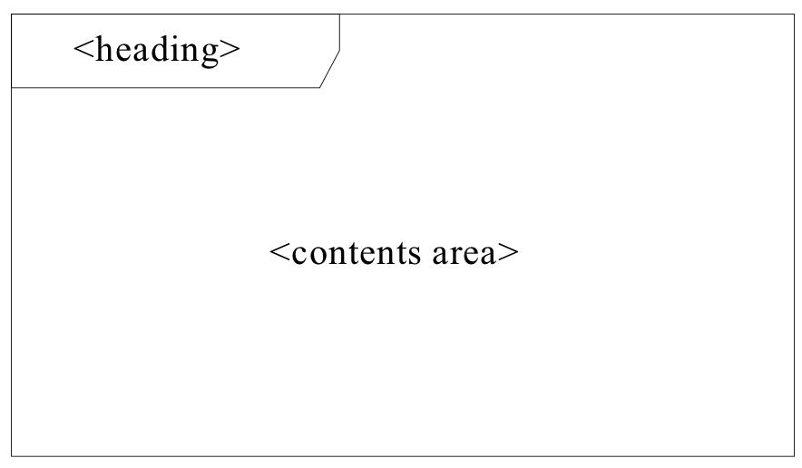
Notation for all UML 2 Diagrams
Mandatory is now the contents area
Optional: The contents area can be surrounded with frame and a heading
Frame
  <heading> ::= [<diagram kind>]<name>[<parameters>]

Slide 7
Diagram Kinds
Activity diagram
Class diagram
Component diagram
Interaction diagram
Package
state machine diagram
Use case diagram
The following abbreviations are usually used for diagram frames:
act (for activity frames)
cmp (for component frames)
sd (for interaction frames)
pkg (for package frames)
stm (for state machine frames)
uc (for use case frames)
Why are interaction frames abbreviated with “sd”?
Historical: sequence diagram

Slide 8
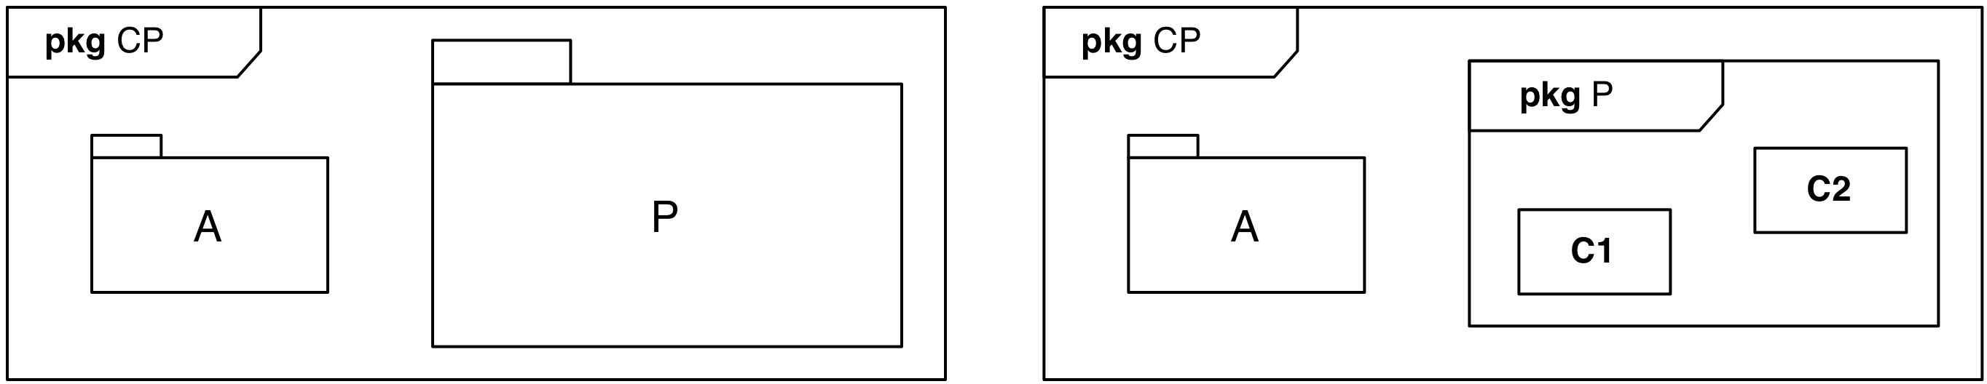
Nested Diagrams
UML 2 supports nested diagrams
  e.g. an activity diagram inside a class
The frame concept visually groups elements that belong to one diagram

Slide 9
UML 2 Activity Diagrams
An activity diagram consists of nodes and edges
There are three types of activity nodes
    Control nodes
    Executable nodes
      Most prominent: Action
    Object nodes
      E.g. a document
An edge is a directed connection between nodes
    There are two types of edges
      Control flow edges
      Object flow edges

Slide 10





Control Nodes in an Activity Diagram
Initial node
Final node
  Activity final node
  Flow final node
Fork node
Join node
Merge node
Decision node

Slide 11
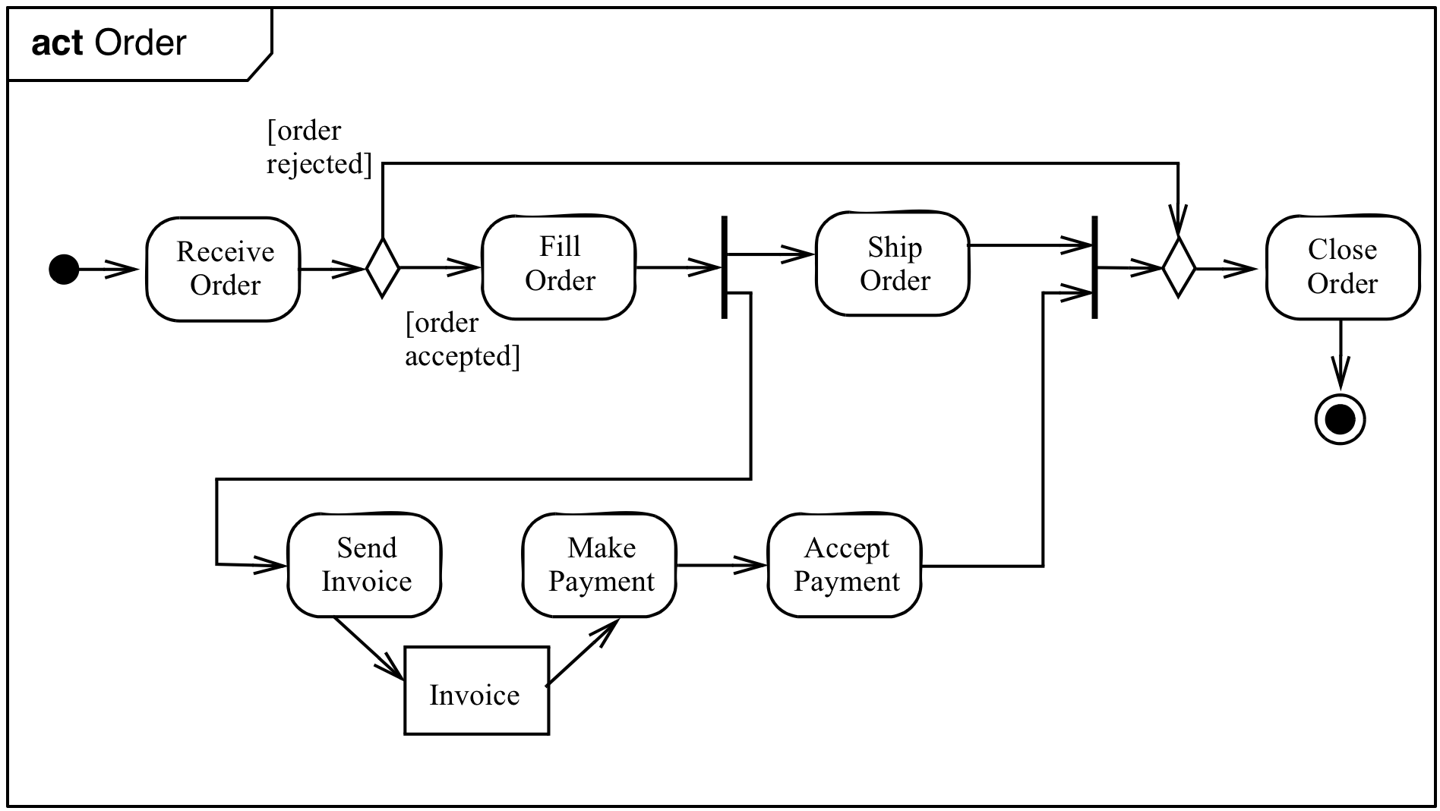
Example of a Activity Diagram with a Frame

Slide 12
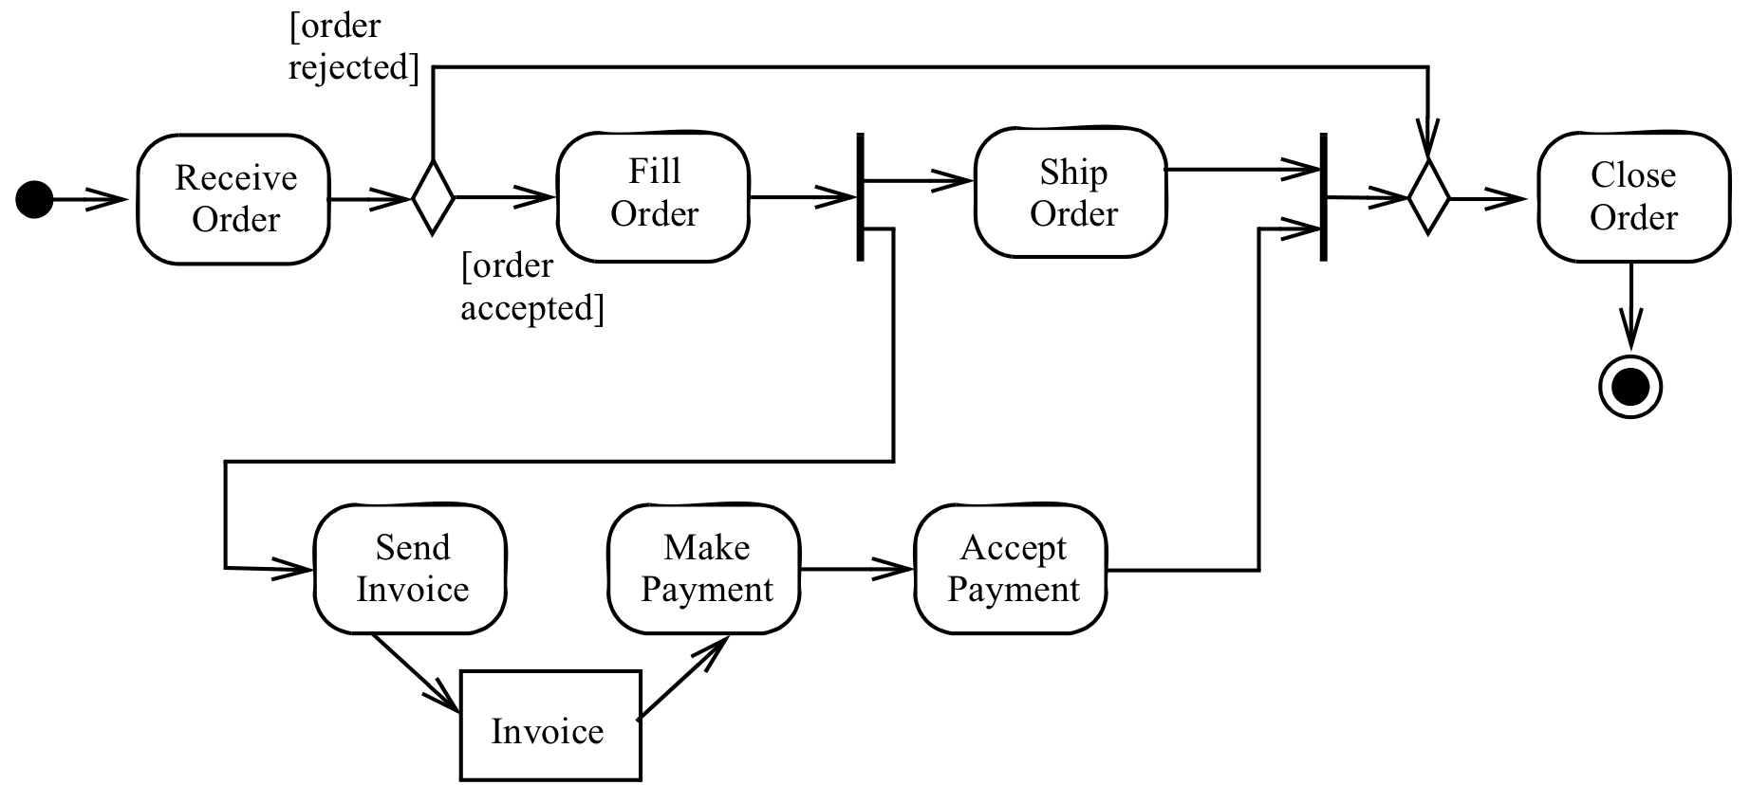
The Activity Diagram without Frame
Notes:
Initial Node (Control)
Decision Node

Slide 13
Activity Diagram Example
Fork node
Join node
Merge node
Initial node
Final node
Notes:
Initial Node (Control)
Decision Node

Slide 14
Activity Diagram: Activity Nodes & Edges
An activity diagram consists of nodes and edges
There are three types of activity nodes
    Control nodes
    Executable nodes
      Most prominent: Action
    Object nodes
      E.g. a document
An edge is a directed connection between nodes
    There are two types of edges
      Control flow edges
      Object flow edges

Slide 15
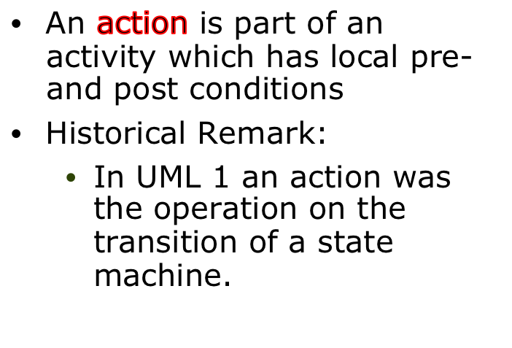
Action Nodes and Object Nodes
Action Node
Object Node
Action
Name
Object
Name
Write
Thesis
Thesis
ReviewThesis

Slide 16
Activity Diagram Example
Action
Object node
Notes:
Initial Node (Control)
Decision Node

Slide 17
Activity Diagram: Activity Nodes & Edges
An activity diagram consists of nodes and edges
There are three types of activity nodes
    Control nodes
    Executable nodes
      Most prominent: Action
    Object nodes
      E.g. a document
An edge is a directed connection between nodes
    There are two types of edges
      Control flow edges
      Object flow edges

Slide 18
Activity Diagram Example
Control flow
Object flow
Notes:
Initial Node (Control)
Decision Node

Slide 19
Summary: Activity Diagram Example
Fork node
Join node
Merge node
Initial node
Control flow
Final node
Action
Object node
Object flow
Notes:
Initial Node (Control)
Decision Node

Slide 20
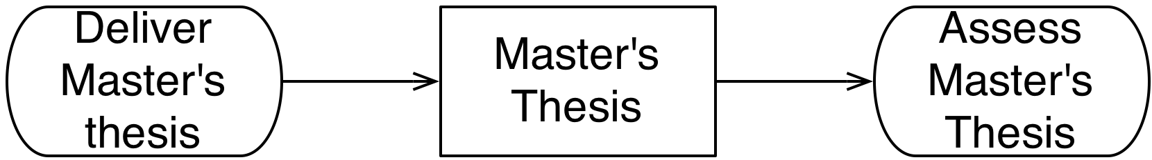
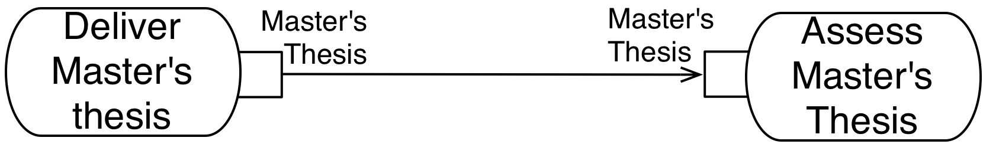
Activity Diagram: Pins
Pin: Abbreviated notation for an object node
  Different notations with same semantics
Both notations define object flow in an activity

Slide 21
Outline for today
UML 2: UML is a living language
Overview of important changes in UML 2
  Frames and nesting
  Activity diagrams
  Deployment diagrams
  Sequence diagrams
  Profiles, Stereotypes
  UML Metamodel

Slide 22
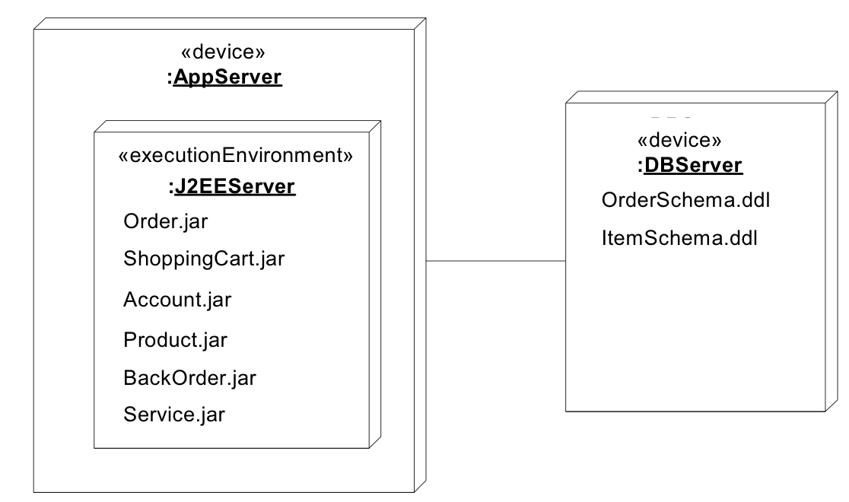
UML 2 Deployment Diagrams
Two node types:
  Device
  Execution environment

Slide 23
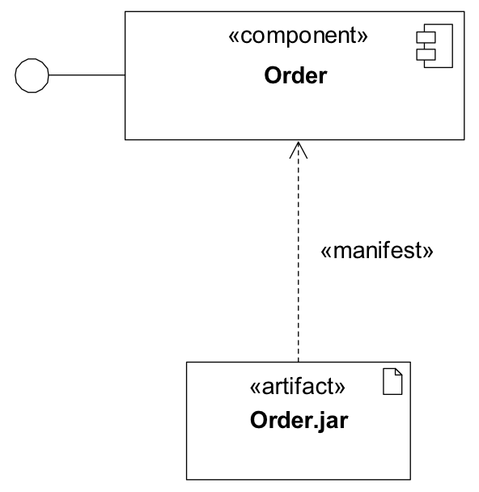
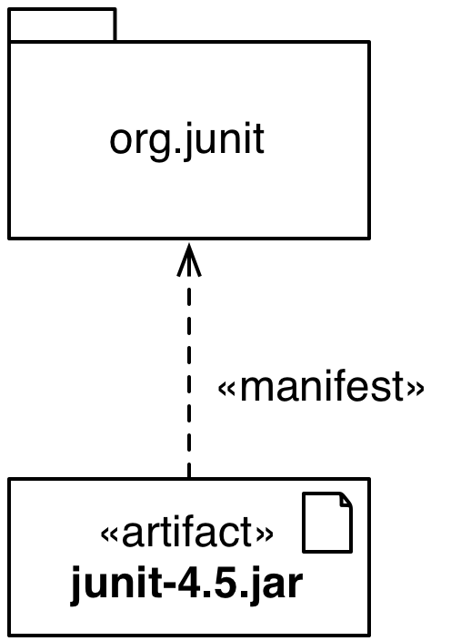
Deployment Diagram Changes II
Artifacts can now manifest any packageable element, not just components
Manifestation is shown by a dependency with keyword «manifest»

Slide 24
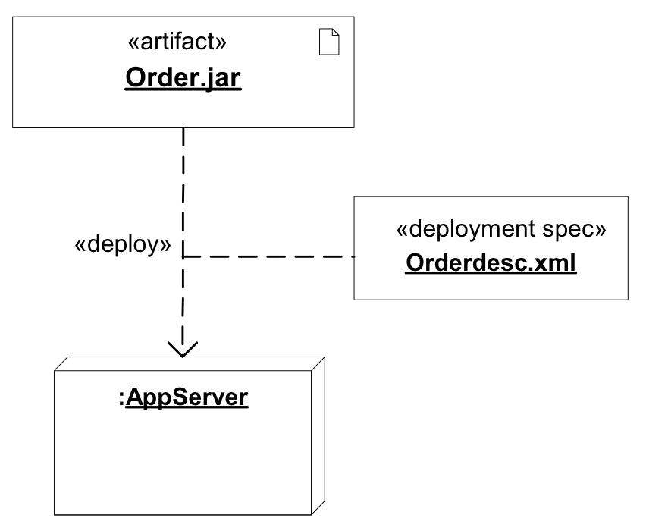
Deployment Diagram
A deployment diagam can have a deployment specification

Slide 25
Sequence Diagram Changes
New concept of interaction fragments
Before going into detail with interaction fragments, we cover the concept of an interaction

Slide 26
Interaction
An Interaction is a concept providing a basis for interaction diagrams:
  Sequence diagrams
  Communication diagrams
  Interaction overview diagrams
  Timing diagrams
An interaction is a unit of behavior that focuses on the observable exchange of information between connectable elements.
We only focus on the impact of interactions on sequence diagrams

Slide 27
Usage of Interactions
UML Interactions are used to get a better grip of an interaction situation
Interactions are also used during the detailed design phase if precise inter-process communication must be set up according to formal protocols
When testing is performed, the traces of the system can be described as interactions and compared with those of the earlier phases.

Slide 28
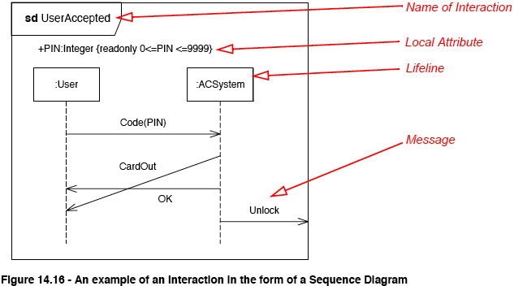
Example of an Interaction: Sequence Diagram

Slide 29
Explanation for the Previous Slide
The sequence diagram on the previous slide shows three messages between two anonymous lifelines of type User and ACSystem: CodePin, CardOut and OK
  The message CardOut overtakes the message OK in the way that the receiving event occurrences are in the opposite order of the sending event occurrences.
  Such communication may occur when the messages are asynchronous.
A fourth message Unlock is sent from the ACSystem to the environment
  Through a gate with the implicit name out_Unlock.

Slide 30
Interaction Fragment
Interaction Fragment
  Is a piece of an interaction
  Acts like an interaction itself
Combined Fragment
  Is a subtype of interaction fragment
  defines an expression of interaction fragments
  defined by an interaction operator and corresponding interaction operands

Slide 31
Interaction Operators
A combined fragment defines an expression of interaction fragments. The following operators are allowed in an combined fragment expression:
  Alt
  Opt
  Par
  Loop
  Critical
  Neg
  Assert
  Strict
  Seq
  Ignore
  Consider

Slide 32
Alt and Else Operators
The interaction operator alt designates that the combined fragment represents a choice of behavior.
  At most one of the operands will be chosen. The chosen operand must have an explicit or implicit guard expression that evaluates to true at this point in the interaction. An implicit true guard is implied if the operand has no guard.
  The set of traces that defines a choice is the union of the (guarded) traces of the operands.
An operand guarded by else designates a guard that is the negation of the disjunction of all other guards in the enclosing combined fragment.
  If none of the operands has a guard that evaluates to true, none of the operands are executed and the remainder of the enclosing interaction fragment is executed.

Slide 33
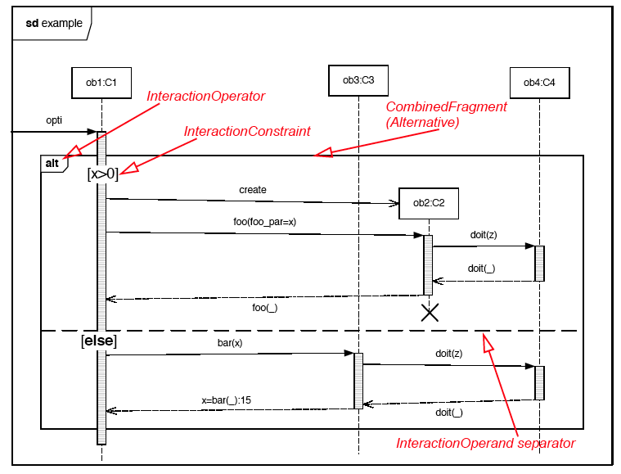
Example of a Combined Fragment

Slide 34
Opt and Break Operators
Option: The interaction operator opt designates a choice of behavior where either the (sole) operand happens or nothing happens.
Break: The interaction operator break represents a breaking scenario: The operand is a scenario that is performed instead of the remainder of the enclosing interaction fragment.
  A break operator with a guard is chosen when the guard is true
  When the guard of the break operand is false, the break operand is ignored and the rest of the enclosing interaction fragment is chosen.
  The choice between a break operand without a guard and the rest of the enclosing interaction fragment is done non-deterministically.

Slide 35
Parallel and Critical Operator
Parallel: The interaction operator par designates a parallel merge between the behaviors of the operands of a combined fragment.
  The event occurrences of the different operands can be interleaved in any way as long as the ordering imposed by each operand is preserved.
  A parallel merge defines a set of traces that describes all the ways that event occurrences of the operands may be interleaved.
Critical: The interaction operator critical designates that the combined fragment represents a critical region.
  The traces of the region cannot be interleaved by other event occurrences (on the Lifelines covered by the region). This means that the region is treated atomically by the enclosing fragment.

Slide 36
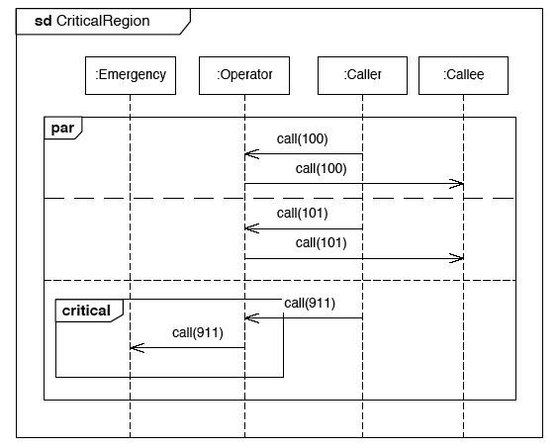
Example of a Critical Region
The Operator must make sure to forward a 911-call to the Emergency object
before doing anything else. Normal calls can be freely interleaved.
Notes:
Don’t forget to point out that this is also an example for a use of the par fragment

Slide 37
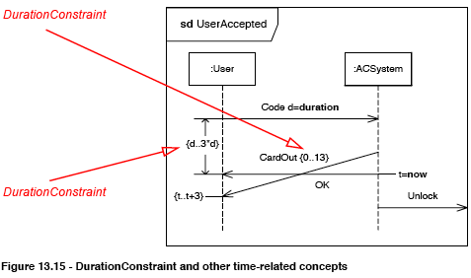
Time Constraint with Messages
In this example, time constraints are associated with the duration of a Message and the duration between two event occurrences.

Slide 38
Where are we?
  Introduction
  Frames and nesting
Changes in diagram notation:
  Activity diagram
  Deployment diagram
  Sequence diagram
Profiles and stereotypes

Slide 39
Meta Modeling
Meta model: A model describing a model
Meta class: Part of the meta model, describing the structure of a model element
Why are we talking about this?
  Meta models can be used to explain the UML notation
  More about this in Friday’s lecture but we need the term meta class already to explain UML profiles and stereotypes.

Slide 40
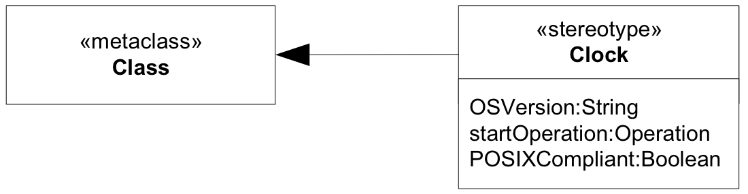
Stereotype
Defines how an existing meta class may be extended
Can only be used in conjunction with a meta class
A meta class may be extended by one or more stereotypes
Why should we want to do this?
  We may want to use platform or domain specific terminology
Notes:
A Stereotype is like a Class that extends Classes through an extension.

Slide 41

Stereotype Notations
The application of a stereotype is shown as a string enclosed in guillemets before the classifier name
  E.g. «boundary» button
Stereotypes can additionally have an image
  The image may replace the standard notation of the element the stereotype has been applied to
Notes:
TODO: Griffige Formulierung finden, die den Unterschied verdeutlicht

Slide 42
Applying a Stereotype
The attributes of a stereotype are called tagged values
Applying a stereotype to an instance of a meta class means instantiating the stereotype
  If the stereotype has attributes, you have to provide values for them
Confused? See following slide…
Notes:
On the previous slide, you have seen an example for defining stereotypes (see picture)

Slide 43
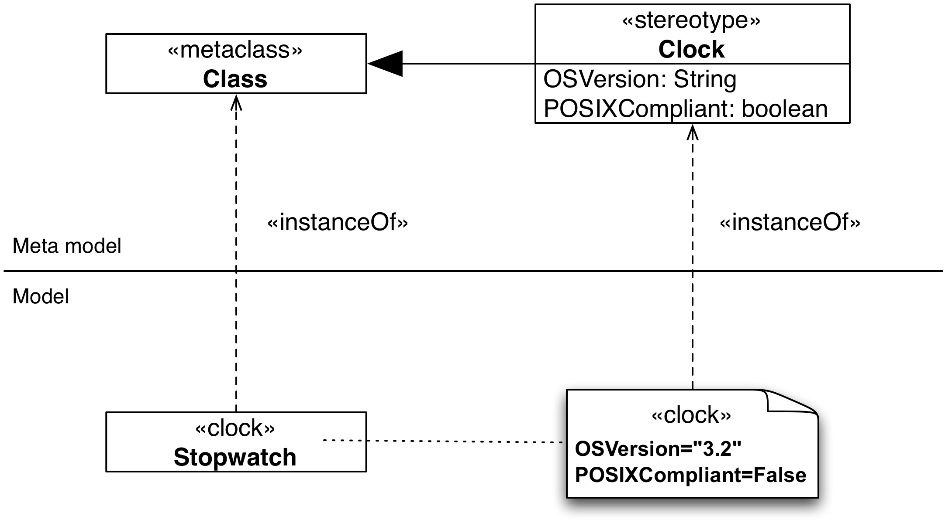
Applying a Sterotype (ctd)
Notes:
On the previous slide, you have seen an example for defining stereotypes (see picture)

Slide 44
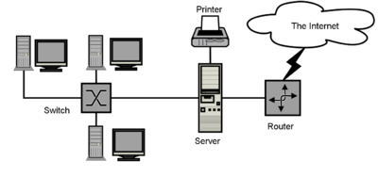
Icons and Symbols for Stereotypes
One can also use icons or graphical symbols to identify a stereotype
  When the stereotype is applied to a UML model element, the graphic replaces the standard notation for the model element.
Example: When modeling a network, you can use icons for representing classes of type Switch, Server, Router, Printer, etc.
Icon for
Class of type
Router
Iconfor
Class of type
Switch
Icon for
Server Class

Slide 45
Pros and Cons of Stereotype Graphics
Advantages:
  UML diagrams may be easier to understand if they contain graphics and icons for stereotypes
    This can increase the readability of the diagram, especially if the client is not trained in UML
    And they are still UML diagrams!
Disadvantages:
  If developers are unfamiliar with the symbols being used, it can become much harder to understand what is going on
  Additional symbols add to the burden of learning to read the diagrams
If you end up applying stereotypes all over your model, you should think of defining a profile.

Slide 46
Stereotypes vs. Keywords
Not to be mixed up with keywords
  Same notation (String enclosed in guillemets)
  «interface» is no stereotype!
  «extend» is no stereotype!
See Annexes B and C of the UML Superstructure specification.
Notes:
TODO: Griffige Formulierung finden, die den Unterschied verdeutlicht

Slide 47
UML Profiles
A lightweight extension mechanism for UML
Concepts partially present in earlier versions
  Stereotypes
  Tagged Values
Established as a specific meta-modeling technique in UML 2.0
  Contains mechanisms that allow meta classes from existing meta models to be extended
  ability to tailor the UML meta model for different platforms or domains
  consistent with the OMG Meta Object Facility (MOF)
    MOF will be covered in the next lecture on metamodeling.
Notes:
Example platforms: J2EE or .NET
Example domains: real-time or business process modeling
Standard way to extend UML
Can be seen as a UML “dialect”
A Model using a profile is fully compatible to UML

Slide 48
Additional Readings
UML 2.2 specification
  The specification consists of two complementary parts which constitute the complete speciication of UML 2:
    Infrastructure and Superstructure.
The infrastructure specification defines the foundational language constructs
  http://www.omg.org/spec/UML/2.2/Infrastructure/PDF
The superstructure defines the user level constructs.
  http://www.omg.org/spec/UML/2.2/Superstructure/PDF
For a complete list of all UML specifications, see
  http://www.omg.org/spec/UML/
Notes:
Main source for lecture today: Specification

