Slide 1
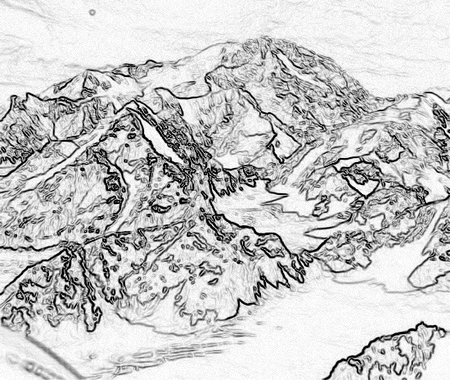
Chapter 2,
Modeling with UML, Part 4
UML 2 Metamodel

Slide 2
Outline for today
From model instances to meta models
MOF meta model hierarchy
How UML relates to MOF
  Example: Use case diagram meta model
  Example: Class diagram meta model
Different notations for the UML meta model describe the same language
UML Profiles: Adding new members to the family
Notes:
Object model: What is the structure of the system? What are the objects and how are they related?
Functional model: What are the functions of the system? How is data flowing through the system?
Dynamic model: How does the system react to external events? How is the event flow in the system ?

Slide 3
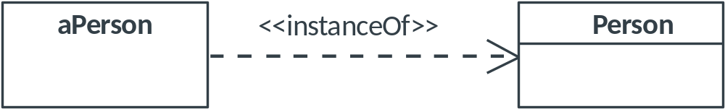
From Model Instances to Meta Models
Canonical model-instance-relationship:
  aPerson is an instance of the class Person.
  Thus the class Person is a model for aPerson.
Can we generalize this relationship?
  ➔ What is the model for the class Person?

Slide 4
From Model Instances to Meta Models
Canonical model-instance-relationship:
  The instance aPerson and the class Person are on different levels of abstraction
  The class Person specifies features that characterize the structure and behavior of Persons
  ➔The model for the class Person must characterize the structure and behavior of classes

Slide 5
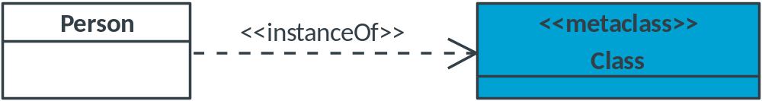
From Model Instances to Meta Models
Relationship between model and meta-model:
  The meta class Class is a model for the class Person
  Since Person is a model (for the instance aPerson), Class is a meta model (model for models)
Notes:
Note for instructors: Do not change this slide. The blue box is out of the viewing area, but when animated it will appear correctly.

Slide 6
From Model Instances to Meta Models
At first this might be confusing, so:
  Think about the different layers of abstraction:
    Instances are concrete
    Models are an abstract description of the instances
    Meta models are an abstract description of models
    …
Notes:
(no abstraction)

Slide 7
Meta Models
Why do we need them?
  Meta models can be used for instance to formalize UML notations:
    The UML is a Language, meta models are used to describe the grammar
    The UML meta model describes all models one can create using UML
    The meta model allows to talk about semantics

Slide 8
Meta Models
OK, so meta models are cool, but how do I create a meta model?
To approach this problem, we will look at the history of UML’s meta model first.

Slide 9
The History of UML’s Meta Model
UML 1.0 had a lot of semantic problems
The OMG tried to deal with these problems by formalizing the language
  Idea: Use meta modeling!
The OMG realized that all that was needed to describe meta models was to use a subset of UML class diagram elements
  Insight: To describe any meta model, the UML class diagram notation itself can be used!
Notes:
In practice there exist different meta models

Slide 10
Meta Object Facility (MOF)
In UML 2, the OMG introduced the MOF to create a common approach to meta modeling
A meta model which is defined using MOF is called MOF compliant.

Slide 11
Advantages of MOF Compliant Meta Models
They can easily be compared
MOF compliant models can be exchanged in a standardized way
  XML Metadata Interchange
MOF compliant instances can live in the same metadata repository (data warehousing)

Slide 12
The Meta Object Facility (MOF)
We have seen the used the modeling sequence
  instance → model → meta model → meta-meta model →
  This sequence could be continued infinitely, but four models are enough for most modeling purposes.
MOF defines a four-layer meta model hierarchy
  Layer M3: Meta-meta model layer (The MOF model)
  Layer M2: Meta model layer (The UML meta model)
  Layer M1: Model layer (The UML model)
  Layer M0: Information layer (the Application)
MOF and UML are aligned
  The UML infrastructure contains all the concepts needed for the specification of UML and MOF.

Slide 13
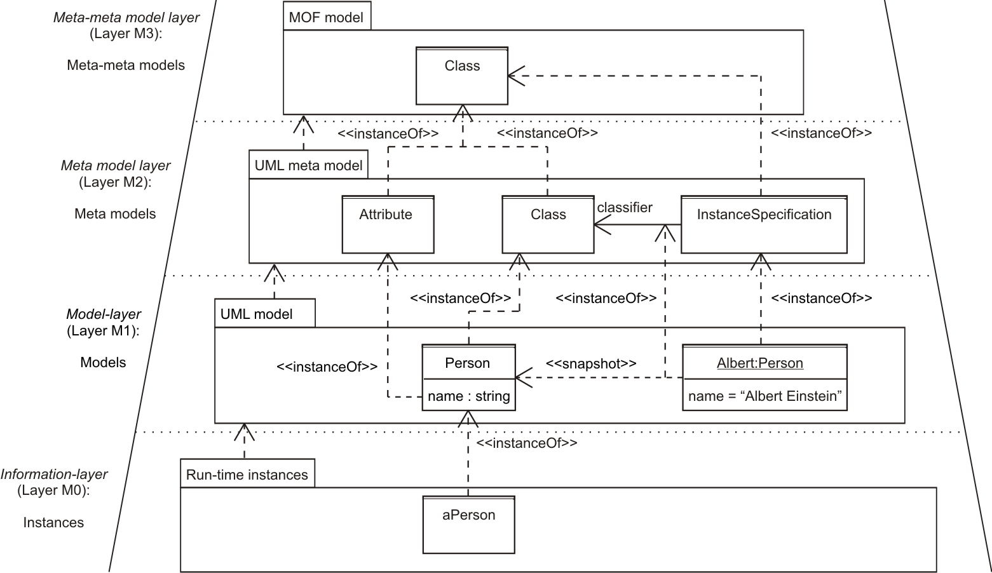
Meta model Hierarchy of the MOF (UML-specific)

Slide 14
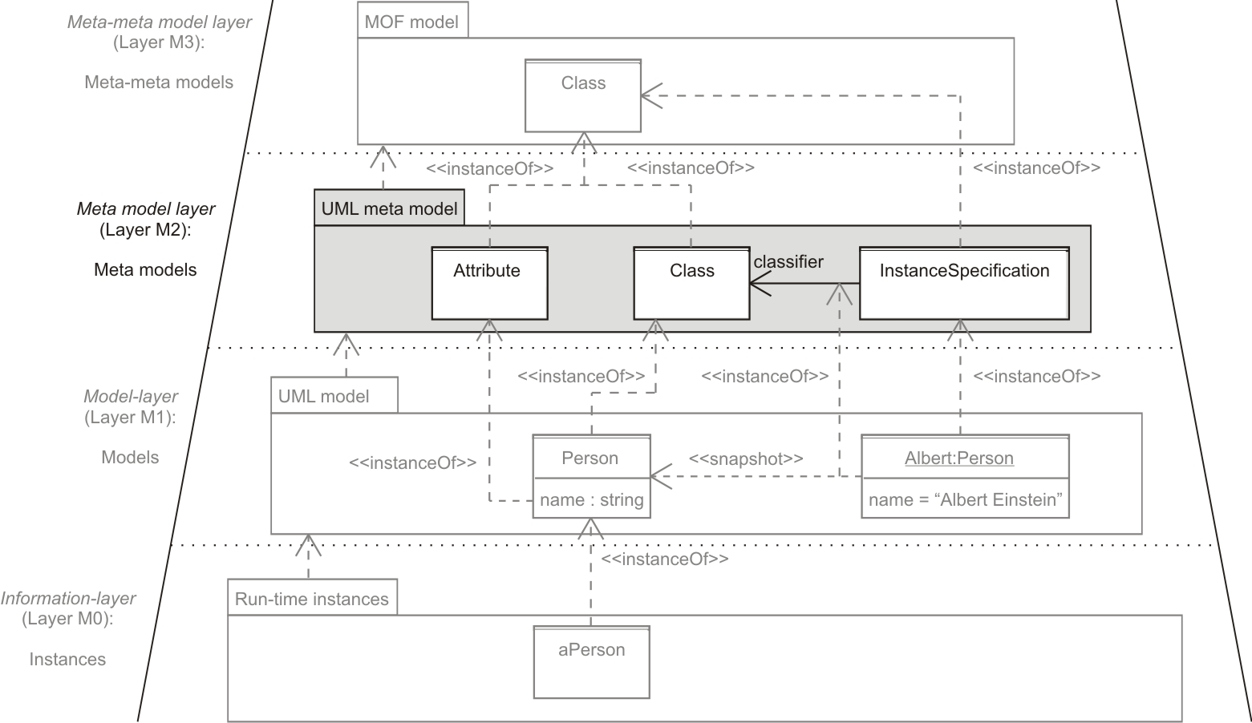
Meta model hierarchy of the MOF (UML-specific)
Layer M2: UML meta model
Models the language UML, i.e., defines concepts like classes, attributes, associations
➔ Layer M2 contains descriptions of elements that can be used to describe the models on the model layer

Slide 15
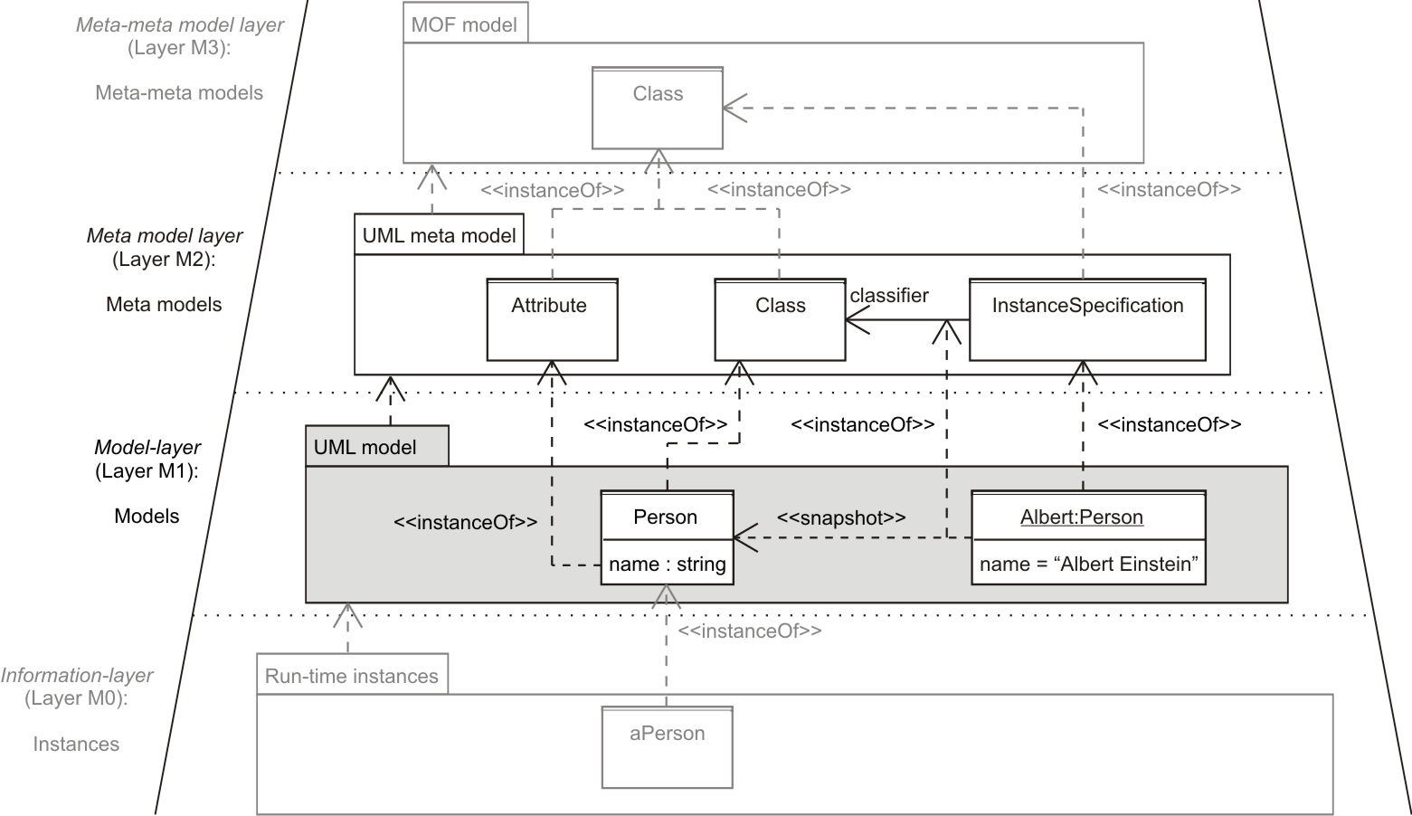
Meta model hierarchy of the MOF (UML-specific)
Layer M1: UML-model
By using any UML diagram, we instantiate the UML meta model and obtain a UML model
➔ Layer M1 contains application-specific models

Slide 16
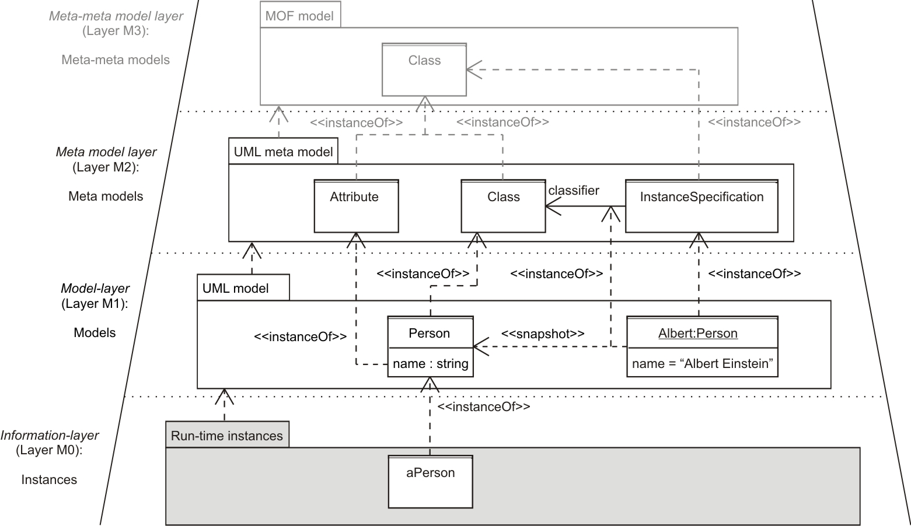
Meta model hierarchy of the MOF (UML-specific)
_x0013_Layer M0: Run-time Instances
Real instances of the models
Layer M0 contains concrete run-time instances
Note the difference between instance specification and real instance!

Slide 17
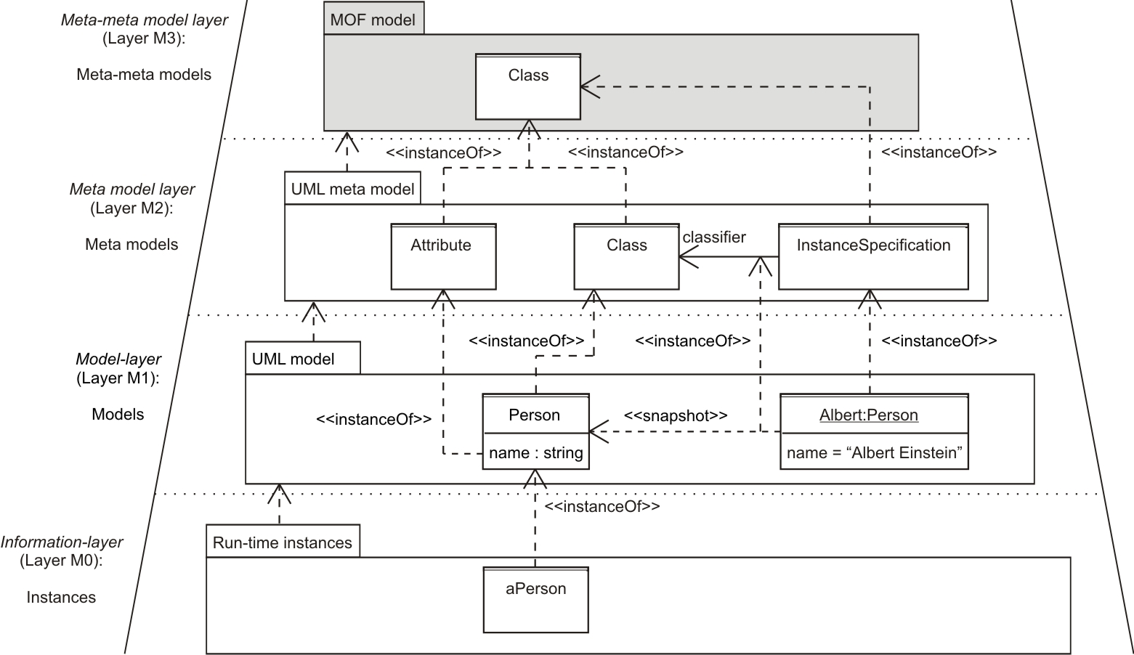
Meta model hierarchy of the MOF (UML-specific)
Layer M3: MOF model
The UML meta model is an instance of a yet more abstract model, namely the MOF model
M3 : M2 ≈ M2 : M1
➔ Layer M3 contains meta-meta models

Slide 18
Meta model hierarchy of the MOF (UML-specific)
Remember that UML is only one possibility or modeling with MOF
We looked at a UML-specific hierarchy
MOF describes meta models in general

Slide 19
Where are we?
From model instances to meta models
MOF meta model hierarchy
How UML relates to MOF
  Example: Use case diagram meta model
  Example: Class diagram meta model
Different notations for the UML meta model describe the same language
UML Profiles: Adding new members to the family
Notes:
Object model: What is the structure of the system? What are the objects and how are they related?
Functional model: What are the functions of the system? How is data flowing through the system?
Dynamic model: How does the system react to external events? How is the event flow in the system ?

Slide 20
How UML relates to MOF
UML is MOF-compliant:
  The UML meta model is an instance of the MOF model
Let’s see the UML meta model in action!

Slide 21
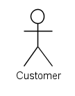
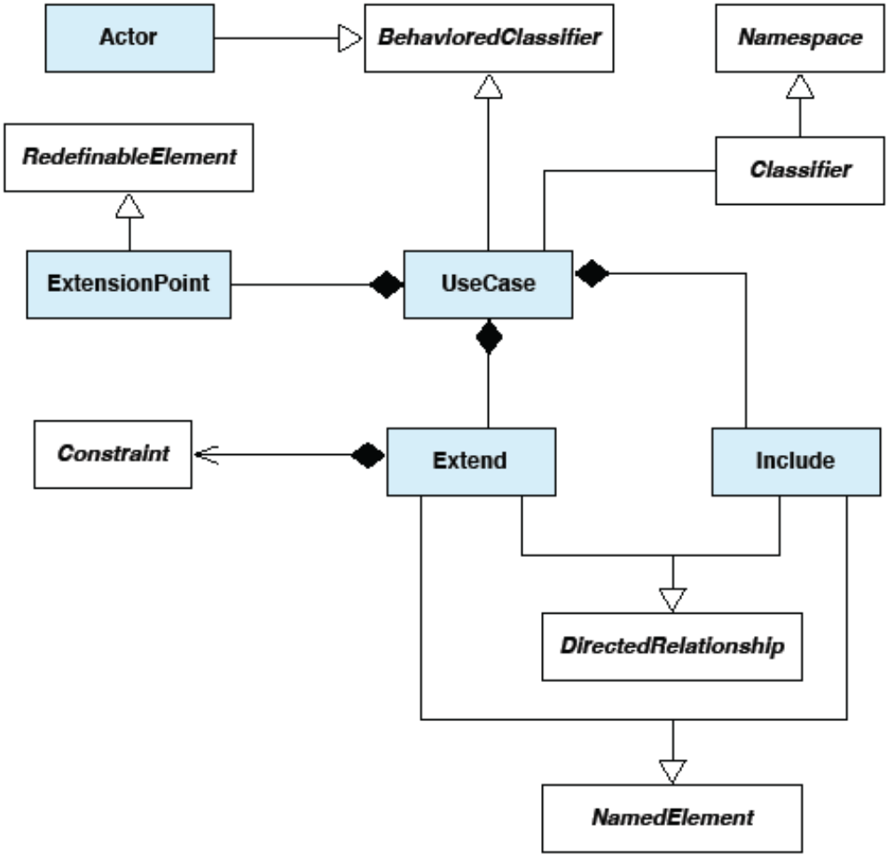
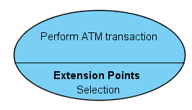
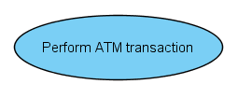
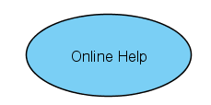

Use Case Diagram Meta Model (simplified)
<<instanceOf>>
*
<<instanceOf>>
1
*
1
*
1..*
1
1
1
<<instanceOf>>
*
*
*
*
*
0..1
0..1
<<Include>>
<<instanceOf>>
<<instanceOf>>
<<Extend>>

Slide 22
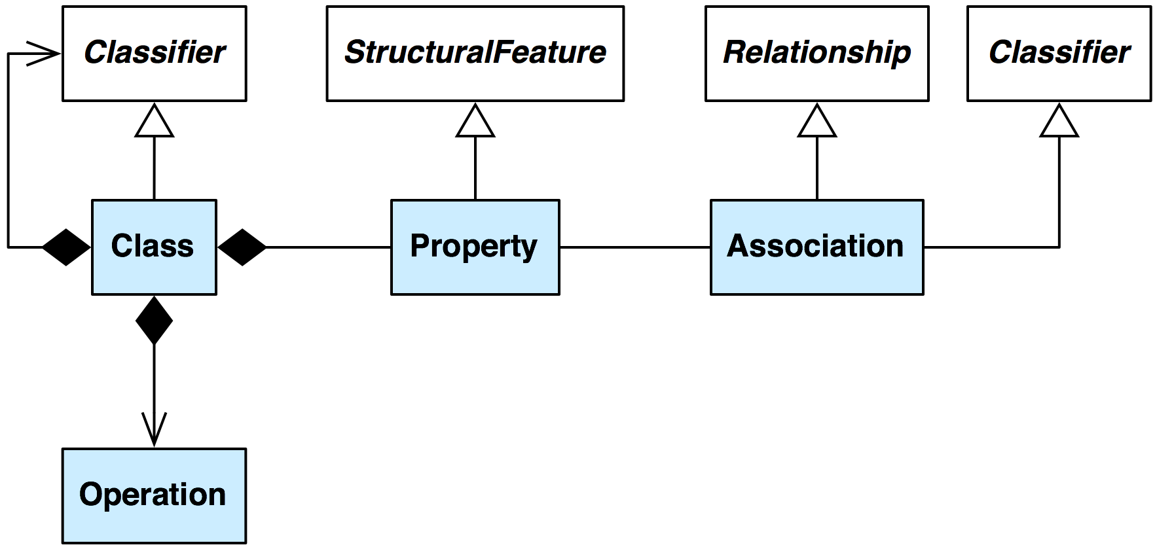
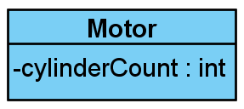
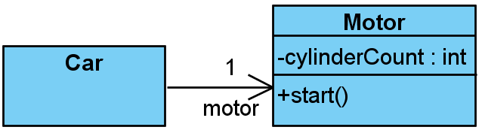
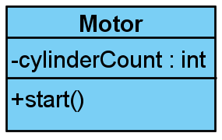
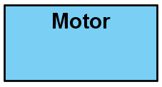
Class Diagram Meta Model (simplified)
*
0..1
0..1
*
2..*
0..1
0..1
*
<<instanceOf>>
<<instanceOf>>
<<instanceOf>>
<<instanceOf>>

Slide 23

Notations for the UML Meta Model
The UML meta model defines a language for specifying UML models
The notation used to depict UML models provides graphical constructs representing instances of meta model elements
  (Sticky figure represents an Actor)
The notation is a function from meta model elements to model elements
  (“uml-notation(Actor) = “)

Slide 24
UML Profiles
Consist of stereotypes, tagged values and constraints
Customize UML models for particular domains or platforms
Are applied to elements of the UML meta model (M2)!
Are developed by manufacturers or standardization organizations (CORBA, .NET)

Slide 25
Applying UML Profiles
By applying a UML profile, we
  Apply stereotypes to meta classes
  Get a deeper undestanding for the model
  Narrow the amount of valid models (see the following slide).

Slide 26
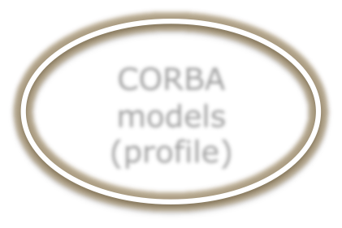
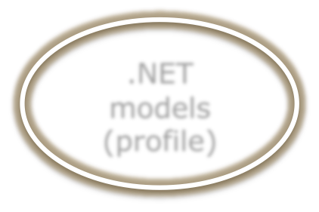

UML Profiles
All models (MOF)
UML models
CORBA models
(profile)
.NET models
(profile)
SysML models

Slide 27
Additional Readings
The current MOF Specification
  http://www.omg.org/technology/documents/modeling_spec_catalog.htm#MOF
RSS Feed:
  feed://www.omg.org/mof/rss/index.xml

