Slide 1

Chapter 3, Project Organization and Communication

Slide 2
A Communication Example
"Two missile electrical boxes manufactured by different contractors were joined together by a pair of wires.
Box 1
Pair of Wires
Box 2

Slide 3
A Communication Example (continued)
Thanks to a particular thorough preflight check, it was discovered that the wires had been reversed."
Box 1
Box 2

Slide 4
After the Crash...
...
"The postflight analysis revealed that the contractors had indeed corrected the reversed wires as instructed."

Slide 5
“In fact, both of them had.”
Box 1
Box 2

Slide 6
Communication is important
In large system development efforts, you will spend more time communicating than coding
A software engineer needs to learn the so-called soft skills: technical writing, reading documentation, communication, collaboration, management, presentations.
It’d be nice for each of you to (acquire and) demonstrate the following skills:
Management: Run a team meeting
Presentation: Present a major aspect of your project during its development phase.
Collaboration: Negotiate requirements with the client and with members from your team and other teams.
Technical writing: Write part of the documentation of your software

Slide 7

Have to organize well for effective communication...

Slide 8
Project components (developer’s perspective)
Work product
  Piece of code, a UC model, a design document, deliverables (to the client) ...
Schedule
  Intermediate (internal) deadlines
  Alpha, beta, public release dates
  Project management software
Participant / project member
  Developer, tester, technical writer, product manager ...
Task
  Design a component, test a component, fix a bug, write User’s Guide ...
  Issue tracking software

Slide 9
Project organizations
Team based
Interaction via reporting, decision, and communication
Example organization
  Management team
  User Interface team
  Database team
  Control team

Slide 10
Roles
Each member may assume multiple roles
Role types
  Management roles
    Project manager, team leader ...
  Development roles
    System architect, object designer, implementor, tester ...
  Cross-functional roles
    API engineer, document editor, configuration manager, tester ...
  Consultant roles
    Client, end-user, application domain specialist, solution domain specialist ...

Slide 11
Tasks and work products
Task: well-defined work assignment for a role
  Design a component, test a component, fix a bug, write User’s Guide ...
Work product: tangible item resulting from a task
  Piece of code, a UC model, a design document, deliverables (to the client) ...

Slide 12
Schedule
Mapping of tasks onto time with dependencies specified

Slide 13
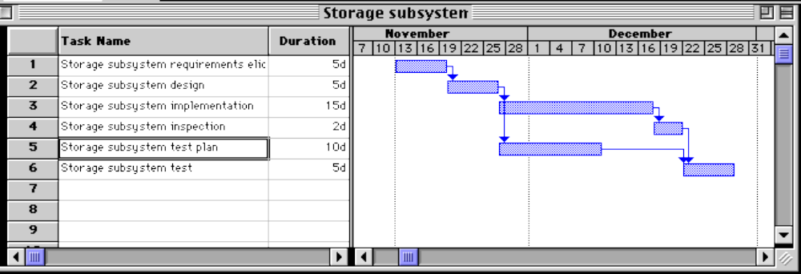
Schedule – Gannt chart

Slide 14
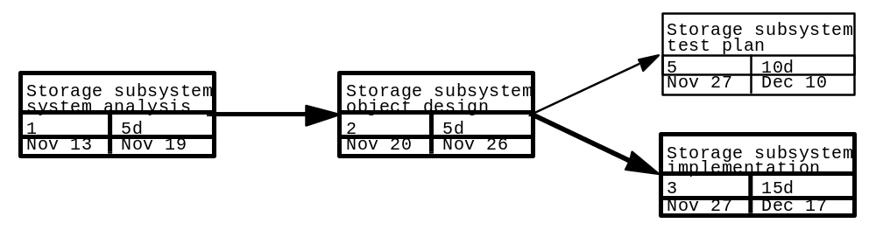
Schedule – PERT chart

