Slide 1

Chapter 8, Object Design
Introduction to Design Patterns

Slide 2
During Object Modeling we do many transformations and changes to the object model
It is important to make sure the object design model stays simple!
Design patterns helps keep system models simple.

Slide 3
Finding Objects
The hardest problems in object-oriented system development are:
  Identifying objects
  Decomposing the system into objects
Requirements Analysis focuses on application domain:
  Object identification
System Design addresses both, application and implementation domain:
  Subsystem Identification
Object Design focuses on implementation domain:
  Additional solution objects

Slide 4
Techniques for Finding Objects
Requirements Analysis
  Start with Use Cases. Identify participating objects
  Textual analysis of flow of events (find nouns, verbs, ...)
  Extract application domain objects by interviewing client (application domain knowledge)
  Find objects by using general knowledge
  Extract objects from Use Case scenarios (dynamic model)
System Design
  Subsystem decomposition
  Try to identify layers and partitions
Object Design
  Find additional objects by applying implementation domain knowledge

Slide 5
Another Source for Finding Objects : Design Patterns
What are Design Patterns?
  The recurring aspects of designs are called design patterns [Gamma et al 1995].
  A pattern is the outline of a reusable solution to a general problem encountered in a particular context.
  It describes the core of the solution to that problem, in such a way that you can use this solution a million times over, without ever doing it the same twice. Many of them have been systematically documented for all software developers to use.
  Studying patterns is an effective way to learn from the experience of others

Slide 6
What is common between these definitions?
Definition Software System
  A software system consists of subsystems which are either other subsystems or collection of classes
Definition Software Lifecycle:
  The software lifecycle consists of a set of development activities which are either other actitivies or collection of tasks

Slide 7
Introducing the Composite Pattern
Models tree structures that represent part-whole hierarchies with arbitrary depth and width.
The Composite Pattern lets client treat individual objects and compositions of these objects uniformly
Client
Component
*
Leaf
Operation()
Composite
Operation()
AddComponent
RemoveComponent()
GetChild()
Children

Slide 8
Modeling a Software System with a Composite Pattern
User
Software
System
*
Class
Subsystem
children

Slide 9
Graphic Applications also use Composite Patterns
The Graphic Class represents both primitives (Line, Circle) and their containers (Picture)
Client
Graphic
*
Line
Draw()
Circle
Draw()
Picture
Draw()
Add(Graphic g)
RemoveGraphic)
GetChild(int)
Children

Slide 10
Reducing the Complexity of Models
To communicate a complex model we use navigation and reduction of complexity
  We do not simply use a picture from the CASE tool and dump it in front of the user
  The key is to navigate through the model so the user can follow it
We start with a very simple model
  Start with the key abstractions
  Then decorate the model with additional classes
To reduce the complexity of the model further, we
  Look for inheritance (taxonomies)
    If the model is still too complex, we show subclasses on a separate slide
  Then we identify or introduce patterns in the model
    We make sure to use the name of the patterns.

Slide 11
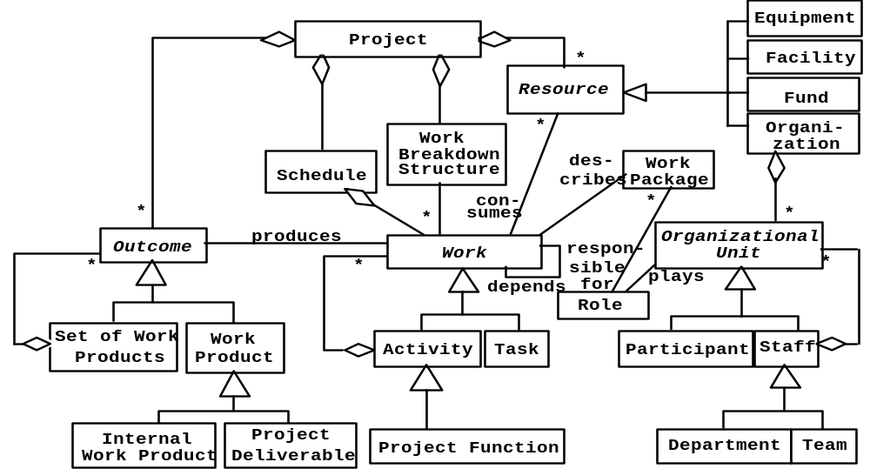
Example: A Complex Model
Taxonomies
Basic Abstractions
Composite Patterns
Notes:
This model is already much more complex than the model shown on the previous slide. Its purpose is still for communication only.
Because it already has quite a number of abstractions, It can only be understood if we communicate the model well to the user. We can do this by navigating through the model and highlight basic abstractions and typical patterns.
For example, we can highlight the basic abstraction (the ones used in the previous slide) <<Proceed to first animation>> and tell the listener that these are the abstraction used in the previous slide (to make the point more clear, the instructor can move once more to the previous slide)
To reduce the complexity of the model, the instructor can then point out that Work Product, Task and Participant all are now basic leaves in a composite pattern. <<Proceed to the next animation, show the use of the composite patterns>>.
To reduce the complexity even further, the instructor finally points out the use of inheritance for the taxonomies (Resource, Staff, Work Product and Activity)
Given these three tips, the students should be able to understand the model themselves.

Slide 12
Many design patterns use a combination of inheritance and delegation

Slide 13
Adapter Pattern
Client
ClientInterface
LegacyClass
Request()
ExistingRequest()
adaptee
Inheritance
Adapter
Delegation
Request()
The adapter pattern uses inheritance as well as delegation:
  - Interface inheritance is used to specify the interface of the Adapter class.
  - Delegation is used to bind the Adapter and the Adaptee
Notes:
Delegation is used to bind an Adapter and an Adaptee (Legacy Class)
Interface inheritance is use to specify the interface of the Adapter class.
Adaptee (usually called legacy system) pre-exist the Adapter.
Client Interface may be realized as an interface in Java.

Slide 14
Adapter Pattern
The adapter pattern lets classes work together that couldn’t otherwise because of incompatible interfaces
  “Convert the interface of a class into another interface expected by a client class.”
  Used to provide a new interface to existing legacy components (Interface engineering, reengineering).
Two adapter patterns:
  Class adapter:
    Uses multiple inheritance to adapt one interface to another
  Object adapter:
    Uses single inheritance and delegation
Object adapters are much more frequent.
We cover only object adapters (and call them adapters).

Slide 15
Bridge Pattern
Use a bridge to “decouple an abstraction from its implementation so that the two can vary independently”
  Publish interface in an inheritance hierarchy, and bury implementation in its own inheritance hierarchy.
  Beyond encapsulation, to insulation
Also know as a Handle/Body pattern
Allows different implementations of an interface to be decided upon dynamically.

Slide 16
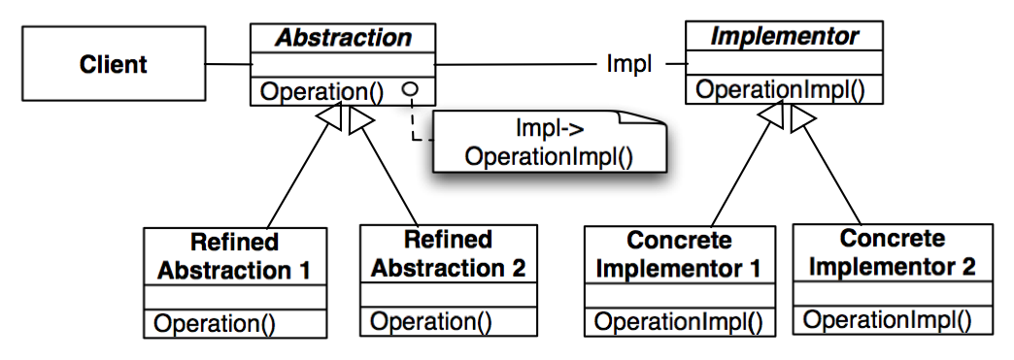
Bridge Pattern
Taxonomy in
Application Domain
Taxonomy in
Solution Domain

Slide 17
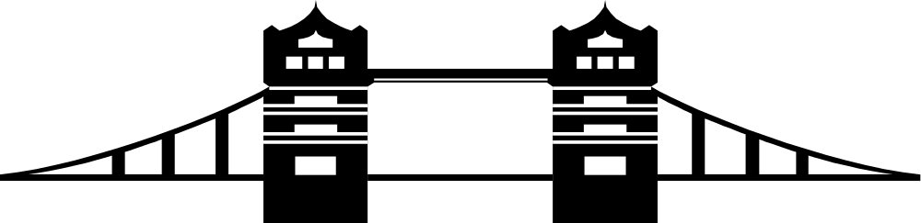
Why the Name Bridge Pattern?
Taxonomy in
Application Domain
Taxonomy in
Solution Domain
Notes:
It provides a bridge between the Abstraction (in the application domain) and the Implementor (in the solution domain)

Slide 18
Motivation for the Bridge Pattern
Decouples an abstraction from its implementation so that the two can vary independently
This allows to bind one from many different implementations of an interface to a client dynamically
Design decision that can be realized any time during the runtime of the system
  However, usually the binding occurs at start up time of the system (e.g. in the constructor of the interface class)
Notes:
Also know as a Handle/Body pattern.

Slide 19
Using a Bridge
The bridge pattern can be used to provide multiple implementations under the same interface

Slide 20
Example use of the Bridge Pattern:
Support multiple Database Vendors
Arena
imp
LeagueStore
LeagueStoreImplementor
Stub Store
XML Store
JDBC Store
Implementor
Implementor
Implementor

Slide 21
Adapter vs Bridge
Similarities:
  Both are used to hide the details of the underlying implementation.
Difference:
  The adapter pattern is geared towards making unrelated components work together
    Applied to systems after they’re designed (reengineering, interface engineering).
    “Inheritance followed by delegation”
  A bridge, on the other hand, is used up-front in a design to let abstractions and implementations vary independently.
    Green field engineering of an “extensible system”
    New “beasts” can be added to the “object zoo”, even if these are not known at analysis or system design time.
    “Delegation followed by inheritance”

Slide 22
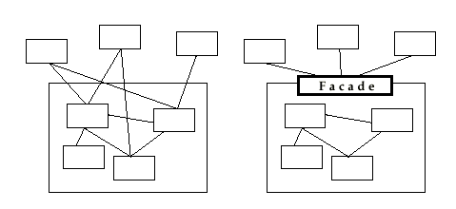
Facade Pattern
Provides a unified interface to a set of objects in a subsystem.
A facade defines a higher-level interface that makes the subsystem easier to use (i.e. it abstracts out the gory details)
Facades allow us to provide a closed architecture

Slide 23
Design Example
Subsystem 1 can look into the Subsystem 2 (vehicle subsystem) and call on any component or class operation at will.
This is “Ravioli Design”
Why is this good?
  Efficiency
Why is this bad?
  Can’t expect the caller to understand how the subsystem works or the complex relationships within the subsystem.
  We can be assured that the subsystem will be misused, leading to non-portable code
Subsystem 1
Subsystem 2
Seat
Card
AIM
SA/RT

Slide 24
Subsystem Design with Façade, Adapter, Bridge
The ideal structure of a subsystem consists of
  an interface object
  a set of application domain objects (entity objects) modeling real entities or existing systems
    Some of the application domain objects are interfaces to existing systems
  one or more control objects
We can use design patterns to realize this subsystem structure
Realization of the Interface Object: Facade
  Provides the interface to the subsystem
Interface to existing systems: Adapter or Bridge
  Provides the interface to existing system (legacy system)
  The existing system is not necessarily object-oriented!

Slide 25
When should you use these Design Patterns?
A façade should be offered by all subsystems in a software system who a services
  The façade delegates requests to the appropriate components within the subsystem. The façade usually does not have to be changed, when the components are changed
The adapter design pattern should be used to interface to existing components
  Example: A smart card software system should use an adapter for a smart card reader from a specific manufacturer
The bridge design pattern should be used to interface to a set of objects
  where the full set of objects is not completely known at analysis or design time.
  when a subsystem or component must be replaced later after the system has been deployed and client programs use it in the field.

Slide 26
Summary
Design patterns are partial solutions to common problems such as
  such as separating an interface from a number of alternate implementations
  wrapping around a set of legacy classes
  protecting a caller from changes associated with specific platforms
A design pattern consists of a small number of classes
  uses delegation and inheritance
  provides a modifiable design solution
These classes can be adapted and refined for the specific system under construction
  Customization of the system
  Reuse of existing solutions.

