Slide 1
KTO Karatay University
CE 455 Machine Learning
Concept Learning
CE 455 Machine Learning KTO Karatay University

Slide 2
Concept Learning
concept
Concept Learning: Acquiring the definition of a general category from given sample positive and negative training examples of the category
Concept Learning can seen as a problem of searching through a predefined space of potential hypotheses for the hypothesis that best fits the training examples
The hypothesis space has a general-to-specific ordering of hypotheses
CE 455 Machine Learning KTO Karatay University

Slide 3
Concept Learning
A Formal Definition
Inferring a boolean-valued function from training examples of its input and output
An example for concept-learning is the learning of bird-concept from the given examples of birds (positive examples) and non-birds (negative examples).
We are trying to learn the definition of a concept from given examples
CE 455 Machine Learning KTO Karatay University

Slide 4
Example – Enjoy Sport
Sample | Sky | AirTemp | Humidity | Wind | Water | Forecast | EnjoySport
1 | Sunny | Warm | Normal | Strong | Warm | Same | YES
2 | Sunny | Warm | High | Strong | Warm | Same | YES
3 | Rainy | Cold | High | Strong | Warm | Change | NO
4 | Sunny | Warm | High | Strong | Warm | Change | YES
ATTRIBUTES
CONCEPT
The task is to learn to predict the value of EnjoySport for arbitrary day, based on the values of its 6 attribute values
CE 455 Machine Learning KTO Karatay University

Slide 5
EnjoySport – Hypothesis Representation
Hypothesis (h) is a conjuction of constraints on the attributes
Each hypothesis will be a vector of six constraints, specifying the values of the six attributes
  (Sky, AirTemp, Humidity, Wind, Water, Forecast)
  h = <Sunny, ? , ? , Strong, ? , Same>
Each attribute will be:
  ? - don’t care
  a specific value (eg. Warm)
  0 - no value allowed
CE 455 Machine Learning KTO Karatay University

Slide 6
Hypothesis Representation
A hypothesis:
Sky AirTemp Humidity Wind Water Forecast
< Sunny, ? , ? , Strong , ? , Same >
The most general hypothesis – that every day is a positive example
<?, ?, ?, ?, ?, ?>
The most specific hypothesis – that no day is a positive example
<0, 0, 0, 0, 0, 0>
EnjoySport concept learning task requires learning the sets of days for which EnjoySport=yes, describing this set by a conjunction of constraints over the instance attributes.
CE 455 Machine Learning KTO Karatay University

Slide 7
EnjoySport Concept Learning Task
Given
  Instances X : Possible days, each described by the attributes
    Sky – (values: Sunny, Cloudy, Rainy)
    AirTemp – (values: Warm, Cold)
    Humidity – (values: Normal, High)
    Wind – (values: Strong, Weak)
    Water – (values: Warm, Cold)
    Forecast – (values: Same, Change)
  Target Function (Concept) c : EnjoySport : X → {0,1}
  Hypotheses H : Conjunction of constraints on the attributes
  <?, Cold, High, ?, ?, ?>
  Training Examples D : positive and negative examples of the target function
  <x1, c(x1), …, <xn, c(xn)>
Determine
  A hypothesis h in H such that h(x) = c(x) for all x in D.
CE 455 Machine Learning KTO Karatay University

Slide 8
The Inductive Learning Hypothesis
The Inductive Learning Hypothesis - Any hypothesis found to approximate the target function well over a sufficiently large set of training examples will also approximate the target function well over other unobserved examples.
CE 455 Machine Learning KTO Karatay University

Slide 9
Concept Learning As Search
Concept learning can be viewed as the task of searching through a large space of hypotheses implicitly defined by the hypothesis representation.
The goal of this search is to find the hypothesis that best fits the training examples.
By selecting a hypothesis representation, the designer of the learning algorithm implicitly defines the space of all hypotheses that the program can ever represent and therefore can ever learn.
CE 455 Machine Learning KTO Karatay University

Slide 10
Enjoy Sport - Hypothesis Space
Sky has 3 possible values, and other 5 attributes have 2 possible values → 3x2x2x2x2x2 = 96 distinct instances in X.
5x4x4x4x4x4=5120 syntactically distinct hypotheses in H.
  Two more values for attributes: ? and 0
Every hypothesis containing one or more 0 symbols represents the empty set of instances; that is, it classifies every instance as negative.
4x3x3x3x3x3+1=973 semantically distinct hypotheses in H.
  Only one more value for attributes: ?, and one hypothesis representing empty set of instances → <ϕ, ϕ, ϕ, ϕ, ϕ, ϕ>
Although EnjoySport has small, finite hypothesis space, most learning tasks have much larger (even infinite) hypothesis spaces.
  We need efficient search algorithms on the hypothesis spaces.
CE 455 Machine Learning KTO Karatay University

Slide 11
Ordering of Hypotheses → General-to-Specific
Consider two hypotheses
h1 = (Sunny, ?, ?, Strong, ?, ?)
h2 = (Sunny, ?, ?, ?, ?, ?)
  Because h2 imposes fewer constraints on the instance, it classifies more instances as positive.
  Any instance classified positive by h1 will also be classified positive by h2.
  Therefore, we say that h2 is more general than h1.
CE 455 Machine Learning KTO Karatay University

Slide 12
More-General-Than Relation
Let h1 and h2 be two boolean-valued functions defined over X
h1 is more-general-than h2 ( h1 > h2) if and only if h1≥h2 is true and h2≥h1 is false.
We also say h2 is more-specific-than h1.
CE 455 Machine Learning KTO Karatay University

Slide 13
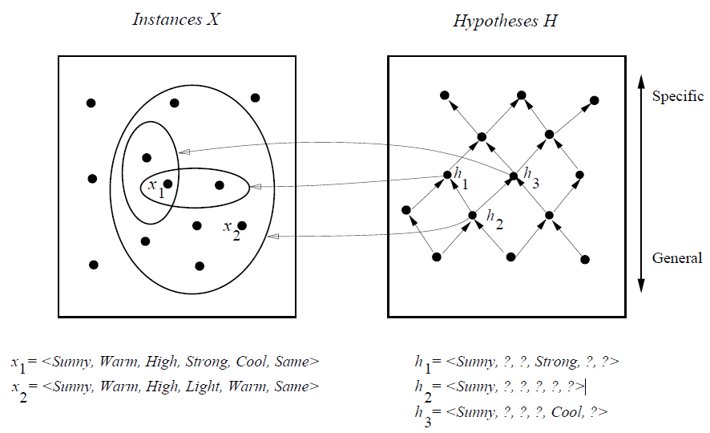
Instances, Hypotheses and More-General-Than
h2 > h1 and h2 > h3
But there is no more-general-than relation between h1 and h3
CE 455 Machine Learning KTO Karatay University

Slide 14
FIND-S ALGORITHM
FIND-S Algorithm starts from the most specific hypothesis and generalize it by considering only positive examples.
FIND-S algorithm ignores negative examples
FIND-S algorithm finds the most specific hypothesis within H that is consistent with the positive training examples
CE 455 Machine Learning KTO Karatay University

Slide 15
FIND-S ALGORITHM
Initialize h to the most specific hypothesis in H
For each positive training instance x
  For each attribute constraint ai in h
If the constraint ai is satisfied by x
Then do nothing
  Else replace ai in h by the next more general constraint that is satisfied by x
Output hypothesis h
CE 455 Machine Learning KTO Karatay University

Slide 16
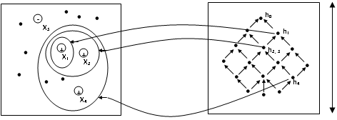
FIND-S ALGORITHM - Enjoy Sport
Specific
General
+x₁=(Sunny, Warm,Normal,Strong,Warm,Same)
h₀=(φ,φ,φ,φ,φ,φ)
+x₂=(Sunny,Warm,High,Strong,Warm,Same)
h₁=(Sunny,Warm,Normal,Strong,Warm,Same)
-x₃=(Rainy,Cold,High,Strong,Warm,Change)
h₂=(Sunny,Warm,?,Strong,Warm,Same)
h₃=(Sunny,Warm,?,Strong,Warm,Same)
+x₄=(Sunny,Warm,High,Strong,Cool,Change)
h₄=(Sunny,Warm,?,Strong,?, ?)
CE 455 Machine Learning KTO Karatay University

Slide 17
Questions about FIND-S Algorithm
Did we learn the target concept?
Are the training data consistent?
Why we are picking the most specific hypothesis?
What if there are several maximally specific hypothesis?
CE 455 Machine Learning KTO Karatay University

Slide 18
Candidate-Elimination Algorithm
FIND-S outputs a hypothesis from H, that is consistent with the training examples, this is just one of many hypotheses from H that might fit the training data equally well
The key idea in the Candidate-Elimination algorithm is to output a description of the set of all hypotheses consistent with the training examples.
A subset of all hypotheses → Version Space
CE 455 Machine Learning KTO Karatay University

Slide 19
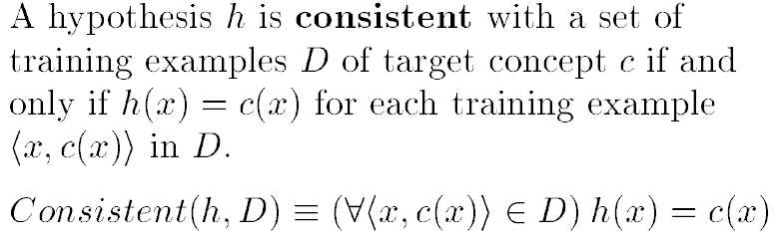
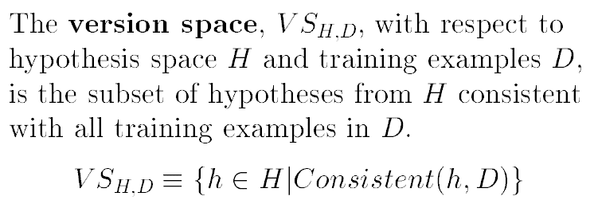
Consistent Hypothesis and Version Space
CE 455 Machine Learning KTO Karatay University

Slide 20
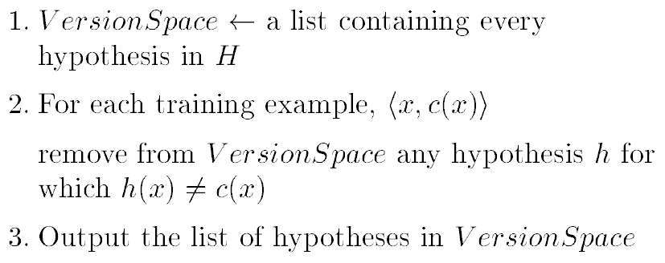
List-Then-Eliminate Algorithm
  -- Advantage --
  It is guaranteed to output all hypotheses consistent with the training data
-- Disadvantage --
Requires exhaustively enumerating all hypotheses in H
CE 455 Machine Learning KTO Karatay University

Slide 21
Compact Representation of Version Spaces
A version space can be represented with its general and specific boundary sets.
The Candidate-Elimination algorithm represents the version space by storing only its most general members G and its most specific members S.
Every member of the version space lies between these boundaries
where x ≥y means x is more general or equal to y.
CE 455 Machine Learning KTO Karatay University

Slide 22
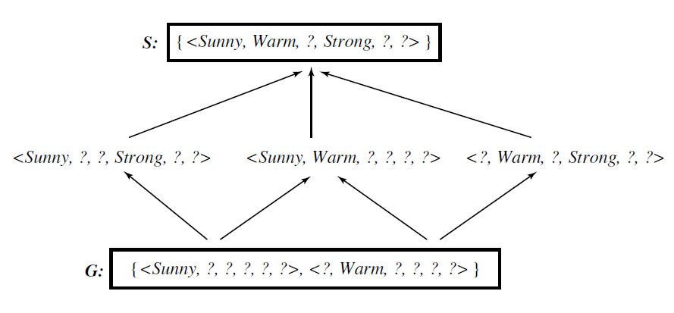
Example Version Space
The version space includes all six hypotheses shown here, but can be represented more simply by S and G
CE 455 Machine Learning KTO Karatay University

Slide 23
Candidate-Elimination Algorithm
The Candidate-Elimination algorithm computes the version space containing all hypotheses from H that are consistent with an observed sequence of training examples.
It begins by initializing the version space to the set of all hypotheses in H; that is, by initializing the G boundary set to contain the most general hypothesis in H
G0 ← { <?, ?, ?, ?, ?, ?> }
and initializing the S boundary set to contain the most specific hypothesis
S0 ← { <0, 0, 0, 0, 0, 0> }
These two boundary sets delimit the entire hypothesis space, because every other hypothesis in H is both more general than S0 and more specific than G0.
As each training example is considered, the S and G boundary sets are generalized and specialized, respectively, to eliminate from the version space any hypotheses found inconsistent with the new training example.
After all examples have been processed, the computed version space contains all the hypotheses consistent with these examples and only these hypotheses.
CE 455 Machine Learning KTO Karatay University

Slide 24
Candidate-Elimination Algorithm
Initialize G to the set of maximally general hypotheses in H
Initialize S to the set of maximally specific hypotheses in H
For each training example d, do
  If d is a positive example
    Remove from G any hypothesis inconsistent with d ,
    For each hypothesis s in S that is not consistent with d ,-
      Remove s from S
      Add to S all minimal generalizations h of s such that
        h is consistent with d, and some member of G is more general than h
      Remove from S any hypothesis that is more general than another hypothesis in S
  If d is a negative example
    Remove from S any hypothesis inconsistent with d
    For each hypothesis g in G that is not consistent with d
      Remove g from G
      Add to G all minimal specializations h of g such that
        h is consistent with d, and some member of S is more specific than h
      Remove from G any hypothesis that is less general than another hypothesis in G
CE 455 Machine Learning KTO Karatay University

Slide 25
Candidate-Elimination Algorithm
S0 ← { <0, 0, 0, 0, 0, 0> }
-- Initial Condition (No training data yet) ---
G0 ← { <?, ?, ?, ?, ?, ?> }
CE 455 Machine Learning KTO Karatay University

Slide 26
Candidate-Elimination Algorithm
Training Examples (Positive)
+ 1. (Sunny, Warm, Normal, Strong, Warm, Same)
+ 2. (Sunny, Warm, High, Strong, Warm, Same)
(φ,φ,φ,φ,φ,φ)
S₀:
S₁:
(Sunny, Warm, Normal, Strong, Warm, Same)
S₂:
(Sunny, Warm, ? , Strong, Warm, Same)
S boundary becomes more general
G₀, G₁ , G₂:
(?, ?, ?, ?, ?, ?)
G boundary does not change
CE 455 Machine Learning KTO Karatay University

Slide 27
Candidate-Elimination Algorithm
Training Example (Negative)
- 3. (Rainy, Cold, High, Strong, Warm, Change)
S_{2,} S₃ :
(Sunny, Warm, ? , Strong, Warm, Same)
No change
G boundary becomes more specific
G₃:
(Sunny, ?, ? , ?, ?, ?), (?, Warm, ? , ?, ?, ?), (?, ?, ? , ?, ?, Same)
Possible hypotheses after 3rd training example
(Sunny, ?, ?, ?, ?, ?)
(Cloudy, ?, ?, ?, ?, ?) → Inconsistent with S (Eliminate)
(?, Warm, ?, ?, ?, ?)
(?, ?, Normal, ?, ?, ?) → There is more general hypotheses in S (Eliminate)
(?, ?, ?, Weak, ?, ?) → Inconsistent with S (Eliminate)
(?, ?, ?, ?, Cool, ?) → Inconsistent with S (Eliminate)
(?, ?, ?, ?, ?, Same)
CE 455 Machine Learning KTO Karatay University

Slide 28
Candidate-Elimination Algorithm
In fact, the S boundary of the version space forms a summary of the previously encountered positive examples that can be used to determine whether any given hypothesis is consistent with these examples.
The G boundary summarizes the information from previously encountered negative examples. Any hypothesis more specific than G is assured to be consistent with past negative examples
CE 455 Machine Learning KTO Karatay University

Slide 29
Candidate-Elimination Algorithm
Training Example (Positive)
+ 4. (Sunny, Warm, High, Strong, Cool, Change)
S₃ :
(Sunny, Warm, ? , Strong, Warm, Same)
S₄ :
(Sunny, Warm, ? , Strong, ?, ?)
G₄:
(Sunny, ?, ? , ?, ?, ?), (?, Warm, ? , ?, ?, ?)
G₃:
(Sunny, ?, ? , ?, ?, ?), (?, Warm, ? , ?, ?, ?), (?, ?, ? , ?, ?, Same)
Inconsistent with the new training example (Eliminate)
CE 455 Machine Learning KTO Karatay University

Slide 30
Candidate-Elimination Algorithm – Final Version Space
S₄ :
(Sunny, Warm, ? , Strong, ?, ?)
G₄:
(Sunny, ?, ? , ?, ?, ?), (?, Warm, ? , ?, ?, ?)
After processing these four examples, the boundary sets S4 and G4 delimit the version space of all hypotheses consistent with the set of incrementally observed training examples.
This learned version space is independent of the sequence in which the training examples are presented (because in the end it contains all hypotheses consistent with the set of examples).
As further training data is encountered, the S and G boundaries will move monotonically closer to each other, delimiting a smaller and smaller version space of candidate hypotheses.
CE 455 Machine Learning KTO Karatay University

Slide 31
Candidate-Elimination Algorithm - Final Version Space
S₄ :
(Sunny, Warm, ? , Strong, ?, ?)
More-general-than
relationship
(Sunny, ?, ?, Strong, ?, ?)
(Sunny, Warm, ?, ?, ?, ?)
(?, Warm, ?, Strong, ?, ?)
More-general-than
relationship
G₄:
(Sunny, ?, ? , ?, ?, ?), (?, Warm, ? , ?, ?, ?)
CE 455 Machine Learning KTO Karatay University

Slide 32
Will Candidate-Elimination Algorithm
Converge to Correct Hypothesis?
The version space learned by the Candidate-Elimination Algorithm will converge toward the hypothesis that correctly describes the target concept, provided
  There are no errors in the training examples, and
  there is some hypothesis in H that correctly describes the target concept.
What will happen if the training data contains errors?
  The algorithm removes the correct target concept from the version space.
  S and G boundary sets eventually converge to an empty version space if sufficient additional training data is available.
  Such an empty version space indicates that there is no hypothesis in H consistent with all observed training examples.
A similar symptom will appear when the training examples are correct, but the target concept cannot be described in the hypothesis representation.
  e.g., if the target concept is a disjunction of feature attributes and the hypothesis space supports only conjunctive descriptions
CE 455 Machine Learning KTO Karatay University

Slide 33
What Training Example Should the Learner Request Next?
We have assumed that training examples are provided to the learner by some external teacher.
Suppose instead that the learner is allowed to conduct experiments in which it chooses the next instance, then obtains the correct classification for this instance from an external oracle (e.g., nature or a teacher).
  This scenario covers situations in which the learner may conduct experiments in nature or in which a teacher is available to provide the correct classification.
  We use the term query to refer to such instances constructed by the learner, which are then classified by an external oracle.
Considering the version space learned from the four training examples of the EnjoySport concept.
  What would be a good query for the learner to pose at this point?
  What is a good query strategy in general?
CE 455 Machine Learning KTO Karatay University

Slide 34
What Training Example Should the Learner Request Next?
The learner should attempt to discriminate among the alternative competing hypotheses in its current version space.
  Therefore, it should choose an instance that would be classified positive by some of these hypotheses, but negative by others.
  One such instance is <Sunny, Warm, Normal, Light, Warm, Same>
  This instance satisfies three of the six hypotheses in the current version space.
  If the trainer classifies this instance as a positive example, the S boundary of the version space can then be generalized.
  Alternatively, if the trainer indicates that this is a negative example, the G boundary can then be specialized.
In general, the optimal query strategy for a concept learner is to generate instances that satisfy exactly half the hypotheses in the current version space.
When this is possible, the size of the version space is reduced by half with each new example, and the correct target concept can therefore be found with only ⎡log₂ |VS| ⎤ experiments.
CE 455 Machine Learning KTO Karatay University

Slide 35
How Can Partially Learned Concepts Be Used?
Even though the learned version space still contains multiple hypotheses, indicating that the target concept has not yet been fully learned, it is possible to classify certain examples with the same degree of confidence as if the target concept had been uniquely identified.
Let us assume that the followings are new instances to be classified:
 |  | New Instances
 |  | Sky | Temp | Humidity | Wind | Water | Forecast | EnjoySport
(S) (G) (%50) (2/4) | A B C D | Sunny Rainy Sunny Sunny | Warm Cold Warm Cold | Normal Normal Normal Normal | Strong Light Light Strong | Cool Warm Warm Warm | Change Same Same Same | ? (+) ? (-) ? ?
CE 455 Machine Learning KTO Karatay University

Slide 36
How Can Partially Learned Concepts Be Used?
Instance A was is classified as a positive instance by every hypothesis in the current version space.
Because the hypotheses in the version space unanimously agree that this is a positive instance, the learner can classify instance A as positive with the same confidence it would have if it had already converged to the single, correct target concept.
Regardless of which hypothesis in the version space is eventually found to be the correct target concept, it is already clear that it will classify instance A as a positive example.
Notice furthermore that we need not enumerate every hypothesis in the version space in order to test whether each classifies the instance as positive.
  This condition will be met if and only if the instance satisfies every member of S.
  The reason is that every other hypothesis in the version space is at least as general as some member of S.
  By our definition of more-general-than, if the new instance satisfies all members of S it must also satisfy each of these more general hypotheses.
CE 455 Machine Learning KTO Karatay University

Slide 37
How Can Partially Learned Concepts Be Used?
Instance B is classified as a negative instance by every hypothesis in the version space.
  This instance can therefore be safely classified as negative, given the partially learned concept.
  An efficient test for this condition is that the instance satisfies none of the members of G.
Half of the version space hypotheses classify instance C as positive and half classify it as negative.
  Thus, the learner cannot classify this example with confidence until further training examples are available.
Instance D is classified as positive by two of the version space hypotheses and negative by the other four hypotheses.
  In this case we have less confidence in the classification than in the unambiguous cases of instances A and B.
  Still, the vote is in favor of a negative classification, and one approach we could take would be to output the majority vote, perhaps with a confidence rating indicating how close the vote was.
CE 455 Machine Learning KTO Karatay University

Slide 38
Inductive Bias - Fundamental Questions
for Inductive Inference
The Candidate-Elimination Algorithm will converge toward the true target concept provided it is given accurate training examples and provided its initial hypothesis space contains the target concept.
What if the target concept is not contained in the hypothesis space?
Can we avoid this difficulty by using a hypothesis space that includes every possible hypothesis?
How does the size of this hypothesis space influence the ability of the algorithm to generalize to unobserved instances?
How does the size of the hypothesis space influence the number of training examples that must be observed?
CE 455 Machine Learning KTO Karatay University

Slide 39
Inductive Bias - A Biased Hypothesis Space
In EnjoySport example, we restricted the hypothesis space to include only conjunctions of attribute values.
  Because of this restriction, the hypothesis space is unable to represent even simple disjunctive target concepts such as "Sky = Sunny or Sky = Cloudy."
 | Instances
 | Sky | Temp | Humidity | Wind | Water | Forecast | EnjoySport
1 2 3 | Sunny Cloudy Rainy | Warm Warm Warm | Normal Normal Normal | Strong Strong Strong | Cool Cool Cool | Change Change Change | + + -
From first two examples ➔ S2 : <?, Warm, Normal, Strong, Cool, Change>
  This is inconsistent with third examples, and there are no hypotheses consistent with these three examples
PROBLEM: We have biased the learner to consider only conjunctive hypotheses.
➔ We require a more expressive hypothesis space.
CE 455 Machine Learning KTO Karatay University

Slide 40
Inductive Bias - An Unbiased Learner
The obvious solution to the problem of assuring that the target concept is in the hypothesis space H is to provide a hypothesis space capable of representing every teachable concept.
  Every possible subset of the instances X ➔ the power set of X.
What is the size of the hypothesis space H (the power set of X) ?
  In EnjoySport, the size of the instance space X is 96.
  The size of the power set of X is 2^{|X|} ➔ The size of H is 2⁹⁶
  Our conjunctive hypothesis space is able to represent only 973of these hypotheses.
  ➔ a very biased hypothesis space
CE 455 Machine Learning KTO Karatay University

Slide 41
Inductive Bias - An Unbiased Learner : Problem
Let the hypothesis space H to be the power set of X.
  A hypothesis can be represented with disjunctions, conjunctions, and negations of our earlier hypotheses.
  The target concept "Sky = Sunny or Sky = Cloudy" could then be described as
  <Sunny, ?, ?, ?, ?, ?> ∨ <Cloudy, ?, ?, ?, ?, ?>
NEW PROBLEM: our concept learning algorithm is now completely unable to generalize beyond the observed examples.
  three positive examples (xl,x2,x3) and two negative examples (x4,x5) to the learner.
  S : { x1 ∨ x2 ∨ x3 } and G : { ¬ (x4 ∨ x5) } ➔ NO GENERALIZATION
  Therefore, the only examples that will be unambiguously classified by S and G are the observed training examples themselves.
CE 455 Machine Learning KTO Karatay University

Slide 42
Inductive Bias –
Fundamental Property of Inductive Inference
A learner that makes no a priori assumptions regarding the identity of the target concept has no rational basis for classifying any unseen instances.
Inductive Leap: A learner should be able to generalize training data using prior assumptions in order to classify unseen instances.
The generalization is known as inductive leap and our prior assumptions are the inductive bias of the learner.
Inductive Bias (prior assumptions) of Candidate-Elimination Algorithm is that the target concept can be represented by a conjunction of attribute values, the target concept is contained in the hypothesis space and training examples are correct.
CE 455 Machine Learning KTO Karatay University

Slide 43
Inductive Bias – Three Learning Algorithms
ROTE-LEARNER: Learning corresponds simply to storing each observed training example in memory. Subsequent instances are classified by looking them up in memory. If the instance is found in memory, the stored classification is returned. Otherwise, the system refuses to classify the new instance.
Inductive Bias: No inductive bias
CANDIDATE-ELIMINATION: New instances are classified only in the case where all members of the current version space agree on the classification. Otherwise, the system refuses to classify the new instance.
Inductive Bias: the target concept can be represented in its hypothesis space.
FIND-S: This algorithm, described earlier, finds the most specific hypothesis consistent with the training examples. It then uses this hypothesis to classify all subsequent instances.
Inductive Bias: the target concept can be represented in its hypothesis space, and specific hypotheses are preferred over general hypotheses.
CE 455 Machine Learning KTO Karatay University

Slide 44
Example Questions - Concept Learning
Assume that the following training examples are given:
Ex Attrb1 Attrb2 Attrb3 Attrb4 Attrb5 TargetAttrb
1 a b b b a yes
2 a b b a a yes
3 b c a a b no
4 c b b b b yes
where possible values for attributes area as follows:
Possible values for Attrb1: a, b, c
Possible values for Attrb2: a, b, c, d
Possible values for Attrb3: a, b
Possible values for Attrb4: a, b
Possible values for Attrb5: a, b, c
Possible values for TargetAttrb: yes, no
Assume that each hypothesis is described by a conjunction of constraints on the attributes.
CE 455 Machine Learning KTO Karatay University

Slide 45
Example Questions - Concept Learning
Q1) Answer the following short question about the hypothesis space H.
How many distinct instances are there in the instance space X?
How many syntactically distinct hypotheses in H?
How many semantically distinct hypotheses in H?
What is the set of instances that the hypothesis <?,a,a,?,a> represents?
What is the set of hypotheses that is represented by the following version space:
S: <a,?,b,?,b> G: { <?,?,b,?,b>, <a,?,b,?,?> }
A1)
3x4x2x2x3 = 144
5x6x4x4x5 = 2400
1 + 4x5x3x3x4 = 721
{ <a,a,a,a,a>, <a,a,a,b,a>, <b,a,a,a,a>, <b,a,a,b,a>,<c,a,a,a,a>, <c,a,a,b,a> }
VS = { <?,?,b,?,b>, <a,?,b,?,b>, <a,?,b,?,?> }
CE 455 Machine Learning KTO Karatay University

Slide 46
Example Questions - Concept Learning
Q2)
Find the target function (the hypothesis) that is learned by FIND-S algorithm by giving the trace of FIND-S algorithm for the training examples above.
What are the classifications of the following instances by the learned target function?
<a,a,a,a,,a> <a,b,b,b,a> <a,b,b,c,a> <a,b,b,c,c>
A2)
i)
Initial: <0,0,0,0,0>
Ex. 1 → <a,b,b,b,a>
Ex. 2 → <a,b,b,?,a>
Ex. 3 → <a,b,b,?,a>
Ex. 4 → <?,b,b,?,?>
A2)
ii)
• <a,a,a,a,,a> = no
• <a,b,b,b,,a> = yes
• <a,b,b,c,a> = yes
• <a,b,b,c,c> = yes
CE 455 Machine Learning KTO Karatay University

Slide 47
Example Questions - Concept Learning
Q3)
Find the target function (version space) that is learned by CANDIDATE-ELIMANITION algorithm by giving the trace of CANDIDATE-ELIMANITION algorithm for the training examples above.
What are the classifications of the following instances by the learned target function?
<a,a,a,a,a> <a,b,b,b,a> <a,b,b,c,a> <a,b,b,c,c
A3)
i)
Initial → G0 = { <?,?,?,?,?> } S0 = { <0,0,0,0,0> }
Ex. 1 →G1 = { <?,?,?,?,?> } S1 = { <a,b,b,b,a> }
Ex. 2 →G2 = { <?,?,?,?,?> } S2 = { <a,b,b,?,a> }
Ex. 3 →G3= { <a,?,?,?,?>, <?,b,?,?,?>, <?,?,b,?,?>, <?,?,?,?,a> } S3 = { <a,b,b,?,a> }
Ex. 4 →G4 = { <?,b,?,?,?>, <?,?,b,?,?> } S4 = { <?,b,b,?,?> }
ii) <a,a,a,a,a> = no <a,b,b,b,a> = yes <a,b,b,c,a> = yes <a,b,b,c,c> = yes
CE 455 Machine Learning KTO Karatay University

