Slide 1
KTO Karatay University
CE 455 Machine Learning
Decision Tree Learning
CE 455 Machine Learning KTO Karatay University

Slide 2
Decision Tree Learning
Decision tree learning is a method for approximating discrete-valued target functions.
The learned function is represented by a decision tree
A learned decision tree can also be re-represented as a set of if-then rules
Decision tree learning is one of the most widely used and practical methods for inductive inference
It is robust to noisy data and capable of learning disjunctive expressions
CE 455 Machine Learning KTO Karatay University

Slide 3
Decision Tree Learning
Decision tree learning method searches a completely expressive hypothesis .
  Avoids the difficulties of restricted hypothesis spaces.
  Its inductive bias is a preference for small trees over large trees
The decision tree algorithms such as ID3, C4.5 are very popular inductive inference algorithms, and they are sucessfully applied to many leaning tasks.
CE 455 Machine Learning KTO Karatay University

Slide 4
Decision Tree for PlayTennis
Outlook
Sunny
Overcast
Rain
Humidity
Yes
Wind
High
Normal
Strong
Weak
No
Yes
No
Yes
CE 455 Machine Learning KTO Karatay University

Slide 5
Decision Tree
Decision trees represent a disjunction of conjunctions of constraints on the attribute values of instances.
Each path from the tree root to a leaf corresponds to a conjunction of attribute tests, and
The tree itself is a disjunction of these conjunctions.
(Outlook = Sunny ∧ Humidity = Normal)
(Outlook = Overcast)
(Outlook = Rain ∧ Wind = Weak)
Outlook
Sunny
Overcast
Rain
Humidity
Yes
Wind
High
Normal
Strong
Weak
No
Yes
No
Yes
CE 455 Machine Learning KTO Karatay University

Slide 6
Decision Tree
Decision trees classify instances by sorting them down the tree from the root to some leaf node, which provides the classification of the instance
Each node in the tree specifies a test of some attribute of the instance
Each branch descending from a node corresponds to one of the possible values for the attribute.
Each leaf node assigns a classification
The instance
(Outlook=Sunny, Temperature=Hot, Humidity=High, Wind=Strong)
is classified as a negative instance
CE 455 Machine Learning KTO Karatay University

Slide 7
When to Consider Decision Trees
Instances are represented by attribute-value pairs.
  Fixed set of attributes, and the attributes take a small number of disjoint possible values.
The target function has discrete output values.
  Decision tree learning is appropriate for a boolean classification, but it easily extends to learning functions with more than two possible output values.
Disjunctive descriptions may be required.
  decision trees naturally represent disjunctive expressions.
CE 455 Machine Learning KTO Karatay University

Slide 8
When to Consider Decision Trees
The training data may contain errors.
  Decision tree learning methods are robust to errors, both errors in classifications of the training examples and errors in the attribute values that describe these examples
The training data may contain missing attribute values.
  Decision tree methods can be used even when some training examples have unknown values.
Decision tree learning has been applied to problems such as learning to classify
  medical patients by their disease,
  equipment malfunctions by their cause, and
  credit risk analysis
CE 455 Machine Learning KTO Karatay University

Slide 9
ID3 Algorithm – Top-down Induction
A ← the “best” decision attribute for next node
Assign A as decision attribute for node
For each value of A create new descendant node
Sort training examples to leaf node according to the attribute value of the branch
If all training examples are perfectly classified (same value of target attribute) STOP,
else iterate over new leaf nodes.
CE 455 Machine Learning KTO Karatay University

Slide 10
Which Attribute is ”best”?
The attribute that is most useful for classifying examples is the ”best”
Informution gain measures how well a given attribute separates the training examples according to their target classification.
ID3 uses this information gain measure to select among the candidate attributes at each step while growing the tree.
In order to define information gain precisely, we use a measure commonly used in information theory, called entropy
Entropy characterizes the (im)purity of an arbitrary collection of examples.
CE 455 Machine Learning KTO Karatay University

Slide 11
Which Attribute is ”best”?
[29+,35-]
A₁=?
A₂=?
[29+,35-]
True
False
True
False
[21+, 5-]
[8+, 30-]
[18+, 33-]
[11+, 2-]
CE 455 Machine Learning KTO Karatay University

Slide 12
Entropy
Given a collection S, containing positive and negative examples of some target concept, the entropy of S relative to this boolean classification is:
  Entropy(S) = -p⊕ log₂ p⊕ - p_{Ɵ}log2 p_{Ɵ}
S is a sample of training examples
p⊕ → the proportion of positive examples
p_{Ɵ} → the proportion of negative examples
CE 455 Machine Learning KTO Karatay University

Slide 13
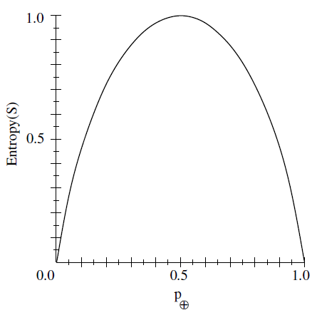
Entropy
CE 455 Machine Learning KTO Karatay University

Slide 14
Entropy
Entropy([9+,5-] = – (9/14) log₂(9/14) – (5/14) log₂(5/14) = 0.940
Entropy([12+,4-] = – (12/16) log₂(12/16) – (4/16) log₂(4/16) = 0.811
Entropy([12+,5-] = – (12/17) log₂(12/17) – (5/17) log₂(5/17) = 0.874
Entropy([8+,8-] = – (8/16) log₂(8/16) – (8/16) log₂(8/16) = 1.0
Entropy([8+,0-] = – (8/8) log₂(8/8) – (0/8) log₂(0/8) = 0.0
Entropy([0+,8-] = – (0/8) log₂(0/8) - (8/8) log₂(8/8) = 0.0
log₂(0) = 0
CE 455 Machine Learning KTO Karatay University

Slide 15
Entropy - Non-Boolean Target Classification
If the target attribute can take on c different values, then
Entropy(S) = -p_{i} log₂p_{i}
p_{i} is the proportion of S belonging to class i.
If the target attribute can take on c possible values, the entropy can be as large as log₂c.
c
∑
i=1
CE 455 Machine Learning KTO Karatay University

Slide 16
Information Gain
entropy is a measure of the impurity in a collection of training examples
information gain is a measure of the effectiveness of an attribute in classifying the training data.
information gain measures the expected reduction in entropy by partitioning the examples according to an attribute.
Gain(S,A) = Entropy(S) - ( |S_{v}| / |S| ) Entropy(S_{v})
S – a collection of examples
A – an attribute
Values(A) – possible values of attribute A
S_{v} – the subset of S for which attribute A has value v
∑
v∈Values(A)
CE 455 Machine Learning KTO Karatay University

Slide 17
Which attribute is the best classifier?
S: [29+,35-] Attributes: A and B
possible values for A: a,b possible values for B: c,d
Entropy([29+,35-]) = -29/64 log₂ 29/64 – 35/64 log₂ 35/64 = 0.99
A?
B?
a
b
c
d
[21+, 5-]
[8+, 30-]
[18+, 33-]
[11+, 2-]
CE 455 Machine Learning KTO Karatay University

Slide 18
Which attribute is the best classifier?
E([29+,35-]) = 0.99
E([29+,35-]) = 0.99
A?
B?
a
b
c
d
[21+, 5-]
[8+, 30-]
[18+, 33-]
[11+, 2-]
E([21+,5-]) = 0.71
E([8+,30-]) = 0.74
E([18+,33-]) = 0.94
E([11+,2-]) = 0.62
Gain(S,A) = Entropy(S)
-26/64*Entropy([21+,5-])
-38/64*Entropy([8+,30-])
= 0.27
Gain(S,B) = Entropy(S)
-51/64*Entropy([18+,33-])
-13/64*Entropy([11+,2-])
= 0.12
A provides greater information gain than B.
A is a better classifier than B.
CE 455 Machine Learning KTO Karatay University

Slide 19
ID3 – Training Examples [+9,-5]
Day | Outlook | Temp. | Humidity | Wind | Play Tennis
D1 | Sunny | Hot | High | Weak | No
D2 | Sunny | Hot | High | Strong | No
D3 | Overcast | Hot | High | Weak | Yes
D4 | Rain | Mild | High | Weak | Yes
D5 | Rain | Cool | Normal | Weak | Yes
D6 | Rain | Cool | Normal | Strong | No
D7 | Overcast | Cool | Normal | Weak | Yes
D8 | Sunny | Mild | High | Weak | No
D9 | Sunny | Cold | Normal | Weak | Yes
D10 | Rain | Mild | Normal | Strong | Yes
D11 | Sunny | Mild | Normal | Strong | Yes
D12 | Overcast | Mild | High | Strong | Yes
D13 | Overcast | Hot | Normal | Weak | Yes
D14 | Rain | Mild | High | Strong | No
CE 455 Machine Learning KTO Karatay University

Slide 20
ID3 – Selecting Next Attribute
Entropy([9+,5-] = – (9/14) log₂(9/14) – (5/14) log₂(5/14) = 0.940
S=[9+,5-]
E=0.940
S=[9+,5-]
E=0.940
Humidity
Wind
High
Normal
Weak
Strong
[3+, 4-]
[6+, 1-]
[6+, 2-]
[3+, 3-]
E=0.985
E=0.592
E =0.811
E =1.00
Gain(S,Humidity) =
0.940-(7/14)*0.985-(7/14)*0.592
= 0.151
Gain(S,Wind) =
0.940-(8/14)*0.811-(6/14)*1.0
= 0.048
CE 455 Machine Learning KTO Karatay University

Slide 21
ID3 – Selecting Next Attribute
S=[9+,5-]
E=0.940
Outlook
Sunny
Overcast
Rain
[2+, 3-]
[4+, 0]
[3+, 2-]
E=0.971
E=0.0
E=0.971
Gain(S,Outlook) =
0.940-(5/14)*0.971 -(4/14)*0.0 -(5/14)*0.0971
= 0.247
CE 455 Machine Learning KTO Karatay University

Slide 22
ID3 – Selecting Next Attribute
S=[9+,5-]
E=0.940
Temperature
Hot
Mild
Cold
[2+, 2-]
[4+, 2-]
[3+, 1-]
E=1.0
E= 0.911
E=0.811
Gain(S,Outlook) =
0.940-(4/14)*1.0 - (6/14)*0.911 - (4/14)*0.811
= 0.029
CE 455 Machine Learning KTO Karatay University

Slide 23
Best Attribute - Outlook
S=[9+,5-]
S={D1,D2,…,D14}
Outlook
Sunny
Overcast
Rain
[2+, 3-]
[4+, 0]
[3+, 2-]
S_{sunny}={D1,D2,D8,D9,D11}
S_{overcast}={D3,D7,D12,D13}
S_{rain}={D4,D5,D6,D10,D14}
?
Yes
?
Which attribute should be tested here?
CE 455 Machine Learning KTO Karatay University

Slide 24
ID3 - S_{sunny}
Day | Outlook | Temp. | Humidity | Wind | Play Tennis
D1 | Sunny | Hot | High | Weak | No
D2 | Sunny | Hot | High | Strong | No
D8 | Sunny | Mild | High | Weak | No
D9 | Sunny | Cold | Normal | Weak | Yes
D11 | Sunny | Mild | Normal | Strong | Yes
Entropy_{(Humidity=Normal)}= -2/2log2(2/2)-0/2log2(0/2)=0.0
Entropy_{(Humidity=High)}= -0/3log2(0/3)-3/3log2(3/3)=0.0
Gain(S_{sunny},Humidity)=(Entropy_{(Outlook=Sunny)})-(2/5)(Entropy_{(Humidity=Normal)})-3/5(Entropy_{(Humidity=High)})
Gain(S_{sunny},Humidity)= 0.970 - (2/5)0.0 – 3/5(0.0) = 0.970
CE 455 Machine Learning KTO Karatay University

Slide 25
ID3 - S_{sunny}
Day | Outlook | Temp. | Humidity | Wind | Play Tennis
D1 | Sunny | Hot | High | Weak | No
D2 | Sunny | Hot | High | Strong | No
D8 | Sunny | Mild | High | Weak | No
D9 | Sunny | Cold | Normal | Weak | Yes
D11 | Sunny | Mild | Normal | Strong | Yes
Gain(S_{sunny} , Humidity) = 0.970-(2/5)0.0 – 3/5(0.0) = 0.970
Gain(S_{sunny} , Temp.) = 0.970-(2/5)0.0 –2/5(1.0)-(1/5)0.0 = 0.570
Gain(S_{sunny} , Wind) = 0.970 - (2/5)1.0 – 3/5(0.918) = 0.019
So, Hummudity will be selected
CE 455 Machine Learning KTO Karatay University

Slide 26
ID3 - Result
Outlook
Sunny
Overcast
Rain
Humidity
Yes
Wind
[D3,D7,D12,D13]
High
Normal
Strong
Weak
No
Yes
No
Yes
[D1,D2,D8]
[D9,D11]
[D6,D14]
[D4,D5,D10]
CE 455 Machine Learning KTO Karatay University

Slide 27
ID3 - Algorithm
ID3(Examples, TargetAttribute, Attributes)
Create a Root node for the tree
If all Examples are positive, Return the single-node tree Root, with label = +
If all Examples are negative, Return the single-node tree Root, with label = -
If Attributes is empty, Return the single-node tree Root, with label = most common value of TargetAttribute in Examples
Otherwise Begin
  A ← the attribute from Attributes that best classifies Examples
  The decision attribute for Root ←A
  For each possible value, vi, of A,
    Add a new tree branch below Root, corresponding to the test A = vi
    Let Examples_{vi} be the subset of Examples that have value vi for A
    If Examples_{vi} is empty
      Then below this new branch add a leaf node with label = most common value of TargetAttribute in Examples
      Else below this new branch add the subtree
      ID3(Examples_{vi} , TargetAttribute, Attributes – {A})
End
Return Root
CE 455 Machine Learning KTO Karatay University

Slide 28
Hypothesis Space Search in
Decision Tree Learning (ID3)
The hypothesis space searched by ID3 is the set of possible decision trees.
ID3 performs a simple-to complex, hill-climbing search through this hypothesis space,
Begins with the empty tree, then considers progressively more elaborate hypotheses in search of a decision tree that correctly classifies the training data.
The information gain measure guides the hill-climbing search.
CE 455 Machine Learning KTO Karatay University

Slide 29
ID3 - Capabilities and Limitations
ID3’s hypothesis space of all decision trees is a complete space of finite discrete-valued functions.
  Every finite discrete-valued function can be represented by some decision tree.
  Target function is surely in the hypothesis space.
ID3 maintains only a single current hypothesis, and outputs only a single hypothesis.
  ID3 loses the capabilities that follow from explicitly representing all consistent hypotheses.
  ID3 cannot determine how many alternative decision trees are consistent with the available training data.
No backtracking on selected attributes (greedy search)
  Local minimal (suboptimal splits)
Statistically-based search choices
  Robust to noisy data
CE 455 Machine Learning KTO Karatay University

Slide 30
Inductive Bias in ID3
ID3 search strategy
  selects in favor of shorter trees over longer ones,
  selects trees that place the attributes with highest information gain closest to the root.
  because ID3 uses the information gain heuristic and a hill climbing strategy, it does not always find the shortest consistent tree, and it is biased to favor trees that place attributes with high information gain closest to the root.
Inductive Bias of ID3:
  Shorter trees are preferred over longer trees.
  Trees that place high information gain attributes close to the root are preferred over those that do not.
CE 455 Machine Learning KTO Karatay University

Slide 31
Inductive Bias in ID3 - Occam’s Razor
OCCAM'S RAZOR: Prefer the simplest hypothesis that fits the data.
Why prefer short hypotheses?
Argument in favor:
  Fewer short hypotheses than long hypotheses
  A short hypothesis that fits the data is unlikely to be a coincidence
  A long hypothesis that fits the data might be a coincidence
Argument opposed:
  There are many ways to define small sets of hypotheses
  What is so special about small sets based on size of hypothesis
CE 455 Machine Learning KTO Karatay University

Slide 32
ID3 vs Candidate Elimination
ID3 searches a complete hypothesis space
  It searches incompletely through this space, from simple to complex hypotheses, until its termination condition is met
  Its inductive bias is solely a consequence of the ordering of hypotheses by its search strategy.
Candidate Elimination searches an incomplete hypothesis space
  It searches this space completely, finding every hypothesis consistent with the training data.
  Its inductive bias is solely a consequence of the expressive power of its hypothesis representation.
CE 455 Machine Learning KTO Karatay University

Slide 33
Overfitting
Given a hypothesis space H, a hypothesis h∈H is said to OVERFIT the training data if there exists some alternative hypothesis h'∈H, such that h has smaller error than h' over the training examples, but h' has a smaller error than h over the entire distribution of instances.
Reasons for overfitting:
  Errors and noise in training examples
  Coincidental regularities (especially small number of examples are associated with leaf nodes).
CE 455 Machine Learning KTO Karatay University

Slide 34
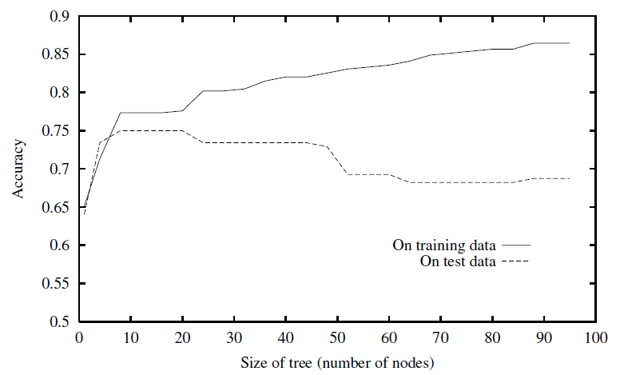
Overfitting
As ID3 adds new nodes to grow the decision tree, the accuracy of the tree measured
over the training examples increases monotonically.
However, when measured over a set of test examples independent of the training
examples, accuracy first increases, then decreases.
CE 455 Machine Learning KTO Karatay University

Slide 35
Avoid Overfitting
How can we avoid overfitting?
  Stop growing earlier
    stop growing the tree earlier, before it reaches the point where it perfectly classifies the training data
  Grow full tree then post-prune
    allow the tree to overfit the data, and then post-prune the tree.
The correct tree size is found by stopping early or by post-pruning, a key question is what criterion is to be used to determine the correct final tree size.
  Use a separate set of examples, distinct from the training examples, to evaluate the utility of post-pruning nodes from the tree.
  Use all the available data for training, but apply a statistical test to estimate whether expanding a particular node is likely to produce an improvement beyond the training set. ( chi-square test )
CE 455 Machine Learning KTO Karatay University

Slide 36
Avoid Overfitting - Reduced-Error Pruning
Split data into training and validation set
Do until further pruning is harmful:
  Evaluate impact on validation set of pruning each possible node (plus those below it)
  Greedily remove the node that most improves the validation set accuracy
Pruning of nodes continues until further pruning is harmful (i.e., decreases accuracy of the tree over the validation set).
Using a separate set of data to guide pruning is an effective approach provided a large amount of data is available.
CE 455 Machine Learning KTO Karatay University

Slide 37
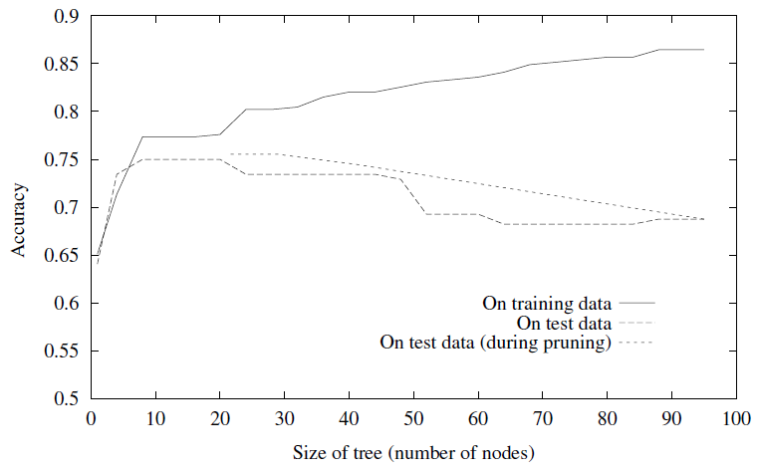
Effect of Reduced Error Pruning
the accuracy increases over the test set as nodes are pruned from the tree.
the validation set used for pruning is distinct from both the training and test sets.
CE 455 Machine Learning KTO Karatay University

Slide 38
Rule-Post Pruning
Rule-Post Prunning is another sucessful method for finding high accuracy hypotheses.
It is used by C4.5 learning algorithm (an extension of ID3).
Steps of Rule-Post Pruning:
  Infer the decision tree from the training set.
  Convert the learned tree into an equivalent set of rules by creating one rule for each path from the root node to a leaf node.
  Prune (generalize) each rule by removing any preconditions that result in improving its estimated accuracy.
  Sort the pruned rules by their estimated accuracy, and consider them in this sequence when classifying subsequent instances.
CE 455 Machine Learning KTO Karatay University

Slide 39
Converting a Decision Tree to Rules
Outlook
Sunny
Overcast
Rain
Humidity
Yes
Wind
High
Normal
Strong
Weak
No
Yes
No
Yes
R1: If (Outlook=Sunny) ∧ (Humidity=High) Then PlayTennis=No
R2: If (Outlook=Sunny) ∧ (Humidity=Normal) Then PlayTennis=Yes
R3: If (Outlook=Overcast) Then PlayTennis=Yes
R4: If (Outlook=Rain) ∧ (Wind=Strong) Then PlayTennis=No
R5: If (Outlook=Rain) ∧ (Wind=Weak) Then PlayTennis=Yes
CE 455 Machine Learning KTO Karatay University

Slide 40
Pruning Rules
Each rule is pruned by removing any precondition
  Ex. Prune R1 by removing (Outlook=Sunny) or (Humidity=High)
Select whichever of the pruning steps produced the greatest improvement in estimated rule accuracy.
  Then, continue with other preconditions.
  No pruning step is performed if it reduces the estimated rule accuracy.
In order to estimate rule accuracy:
  use a validation set of examples disjoint from the training set
  evaluate performance based on the training set itself (using statistical techniques). C4.5 uses this approach.
CE 455 Machine Learning KTO Karatay University

Slide 41
Why Rules?
Converting to rules improves readability.
  Rules are often easier to understand for us
Different pruning decision for each path from any node
No difference for root/inner nodes
  Otherwise, if tree structure were used we need to reorganize tree if a node is pruned
CE 455 Machine Learning KTO Karatay University

Slide 42
Continuous-Valued Attributes
ID3 is restricted to attributes that take on a discrete set of values.
Define new discrete valued attributes that partition the continuous attribute value into a discrete set of intervals
For a continuous-valued attribute A that is, create a new boolean attribute A_{c}, that is true if A < c and false otherwise.
The problem is → What will be the threshold value ‘c’ ?
Answer → The value of c must maximize the information gain and always lie at a boundary
CE 455 Machine Learning KTO Karatay University

Slide 43
Continuous-Valued Attributes - Example
Temperature | 40 | 48 | 60 | 72 | 80 | 90
Play Tennis | No | No | Yes | Yes | Yes | No
Two candidate thresholds: (48+60)/2=54 (80+90)/2=85
Check the information gain for new boolean attributes:
Temperature_{>54} Temperature_{>85}
Use these new new boolean attributes same as other discrete valued attributes
Continous valued attributes can be divided more than two intervals
CE 455 Machine Learning KTO Karatay University

Slide 44
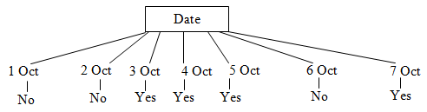
Alternative Measures for Attribute Selection
Information gain measure favors attributes with many values
  separates data into small subsets
  high gain, poor prediction
What about ‘PlayTennis’ on 8 October??? → No Answer
CE 455 Machine Learning KTO Karatay University

Slide 45
Alternative Measures for Attribute Selection
Date attribute has many values, and may separate training examples into very small subsets (even singleton sets – perfect partitions)
  Information gain will be very high for Date attribute.
  Perfect partition ➔maximum gain
  Gain(S,Date) = Entropy(S) – 0 = Entropy(S) , because log₂(1/1) is 0.
  It has high information gain, but very poor predictor for unseen data.
There are alternative selection measures such as GainRatio measure based on SplitInformation
CE 455 Machine Learning KTO Karatay University

Slide 46
Split Information
The gain ratio measure penalizes attributes with many values (such as Date) by incorporating a term, called split informution
Split information for boolean attributes is 1 (= log₂2),
Split information fot attributes for n values is log₂n
SplitInformation term discourages the selection of attributes with many uniformly distributed values.
c
∑
SplitInformation(S,A) = - ( |Si| / |S| ) log₂ ( |Si| / |S| )
i=1
GainRatio(S,A) = Gain(S,A) / SplitInformation(S,A)
CE 455 Machine Learning KTO Karatay University

Slide 47
Missing Attribute Values
The available data may be missing values for some attributes.
It is common to estimate the missing attribute value based on other examples for which this attribute has a known value.
Assume that an example (with classification c) in S has a missing value for attribute A.
  Assign the most common value of A in S.
  Assign the most common value of in the examples having c classification in S.
  Or, use probability value for each possible attribute value
  (C4.5 Algorithm uses this technique for classification)
CE 455 Machine Learning KTO Karatay University

Slide 48
Handling Attributes with Differing Costs
In some learning problems, measuring an attribute can have higher costs than the others
Cheaper ones must be prefered over others while building the decision tree
Expensive ones can only be preferred depending on gain
A cost term is introduced in selection measure to penalize the higher cost attributes
Lower cost attributes will be closer to the root node
The decision tree will be constructed based on lower cost attributes
CE 455 Machine Learning KTO Karatay University

Slide 49
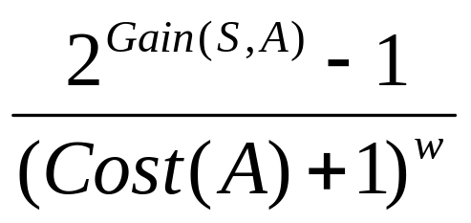
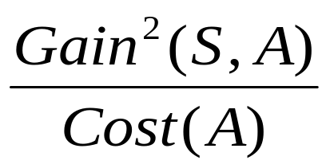
Handling Attributes with Differing Costs
For medical diagnosis →
w є [0,1] → a constant value indicating the importance of the cost relative to the gain
For robot applications →
CE 455 Machine Learning KTO Karatay University

Slide 50
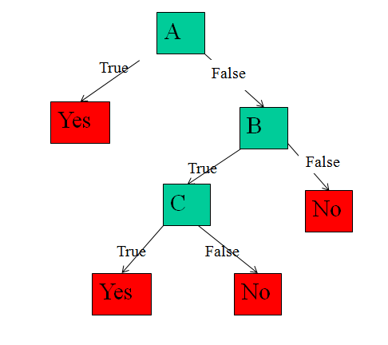
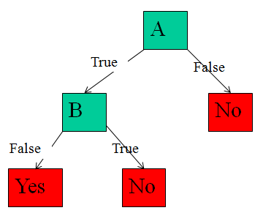
Example Questions - Decision Tree Learning
Q1) Give decision trees to represent the following boolean functions
a) A ∧ ¬B
b) A ∨ [B ∧ C]
c) [A ∧ B] ∨ [C ∧ D]
A1)
a) A ∧ ¬B
A1)
b) A ∨ [B ∧ C]
CE 455 Machine Learning KTO Karatay University

Slide 51
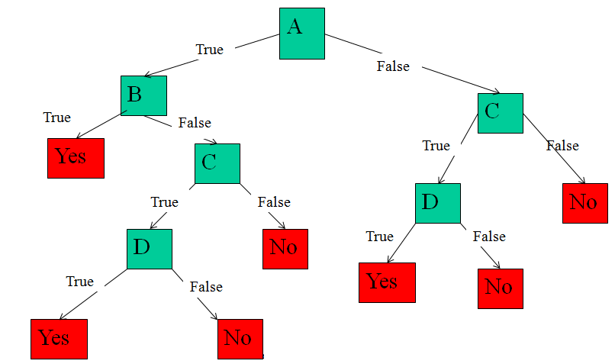
Example Questions - Decision Tree Learning
A1)
c) [A ∧ B] ∨ [C ∧ D]
CE 455 Machine Learning KTO Karatay University

Slide 52
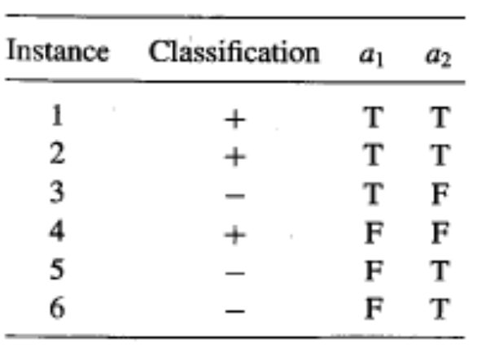
Example Questions - Decision Tree Learning
Q2) Consider the following set of training examples
What is the entropy of this collection of training examples with respect to the target function classification?
Entropy = -3/6(log3/6) – 3/6(log3/6) = 1
CE 455 Machine Learning KTO Karatay University

Slide 53
Example Questions - Decision Tree Learning
Q2) Consider the following set of training examples
b) What is the information gain of a2 relative to these training examples?
E(a2 =T) = -2/4log(2/4) – 2/4log(2/4) = 1
E(a2 =F) = -1/2log(1/2) – 1/2log(1/2) = 1
Gain of a2 = E(S) – 4/6E(a2 =T) – 2/6E(a2 =F) = 1- 4/6 – 2/6 = 0
CE 455 Machine Learning KTO Karatay University

Slide 54
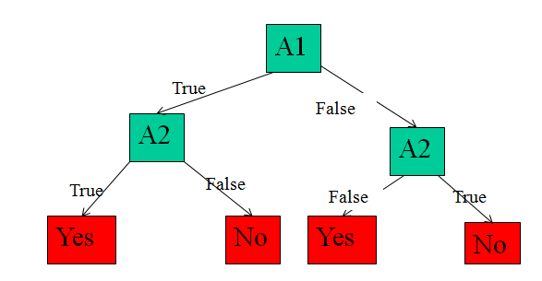
Example Questions - Decision Tree Learning
Q2) Consider the following set of training examples
c) Create the decision tree for these training examples using ID3.
Gain(S,a₁) > Gain(S,a₂)
CE 455 Machine Learning KTO Karatay University

Slide 55
Example Questions - Decision Tree Learning
Q2)
d) Convert the decision tree into the rules
d) If (A1=true ^ A2=true) Then Classification=Yes
If (A1=true ^ A2=false) Then Classification=No
If (A1=false ^ A2=false) Then Classification=Yes
If (A1=false ^ A2=true) Then Classification=No
CE 455 Machine Learning KTO Karatay University

Slide 56
Example Questions - Decision Tree Learning
Q3) Consider the following set of training examples
Instance | Classification | Attrb1 | Attrb2 | Attrb3
1 | c1 | a | T | a
2 | c1 | a | T | b
3 | c2 | b | F | c
4 | c1 | c | T | d
5 | c3 | a | F | a
6 | c3 | b | T | b
7 | c2 | c | F | c
8 | c2 | b | T | c
9 | c1 | a | T | a
10 | c1 | b | F | b
What is the entropy of this collection of training examples with respect to the target function classification?
Entropy = -5/10log(5/10) – 3/10log(3/10) – 2/10log(2/10) = 1.48
CE 455 Machine Learning KTO Karatay University

Slide 57
Example Questions - Decision Tree Learning
Q3) Consider the following set of training examples
Instance | Classification | Attrb1 | Attrb2 | Attrb3
1 | c1 | a | T | a
2 | c1 | a | T | b
3 | c2 | b | F | c
4 | c1 | c | T | d
5 | c3 | a | F | a
6 | c3 | b | T | b
7 | c2 | c | F | c
8 | c2 | b | T | c
9 | c1 | a | T | a
10 | c1 | b | F | b
b) What is the information gain of Attrb1 relative to these training examples?
E(Attrb1 = a) = -3/4log(3/4) – 1/4log(1/4) = 0.811
E(Attrb1 = b) = -2/4log(2/4) – 1/4log(1/4) – 1/4log(1/4) = 1.5
E(Attrb1 = c) = -1/2log(1/2) – 1/2log(1/2) = 1
Gain of Attrb1 = E – 4/10 E(Attrb1=a) – 4/10 E(Attrb1=b) – 2/10 E(Attrb1 = c)
= 0.36
CE 455 Machine Learning KTO Karatay University

Slide 58
Example Questions - Decision Tree Learning
Q4) Consider the following set of training examples
Instance | Classification | Attrb1 | Attrb2
1 | T | 4 | F
2 | T | 10 | T
3 | F | 20 | F
4 | F | 34 | T
5 | F | 50 | F
6 | F | 70 | F
7 | T | 76 | F
8 | T | 80 | T
9 | F | 90 | T
10 | F | 92 | T
Find the corresponding boolean-valued attributes for Attrb1.
(Attrb1 is a continuous-valued attribute)
A4) There are 6 booelan-valued attributes
Attrb1<15, Attrb1>15, Attrb1<73, Attrb1>73, Attrb1<85, Attrb1>85
CE 455 Machine Learning KTO Karatay University

