Slide 1
KTO Karatay University
CE 455 Machine Learning
Artificial Neural Networks
CE 455 Machine Learning KTO Karatay University

Slide 2
Artificial Neural Networks
Artificial neural networks (ANNs) provide a general, practical method for learning real-valued, discrete-valued, and vector-valued functions from examples.
ANN learning is robust to errors in the training data and has been successfully applied to problems such as interpreting visual scenes, speech recognition, and learning robot control strategies.
CE 455 Machine Learning KTO Karatay University

Slide 3
Biological Motivation Behind ANNs
Human brain
  Number of neurons → 10¹⁰
  Connections per neuron → 10⁴⁻⁵
  Scene recognition time → 0.1 sec
  Neuron switching time → 0.001 sec
  Much parallel computation
ANNS
  Many neuron-like threshold switching units
  Many weighted interconnections among units
  Highly parallel, distributed process
  Automatic weight tuning
CE 455 Machine Learning KTO Karatay University

Slide 4
When to consider ANNs
Input is high-dimensional discrete or real-valued data
(e.g. raw sensor input)
Output may be discrete or real-valued
Output may be a vector of values
Data may contain errors
Form of target function is unknown
Human readability of result is unimportant
Examples
  Speech recognition
  Image classification
  Financial prediction
  Etc.
CE 455 Machine Learning KTO Karatay University

Slide 5
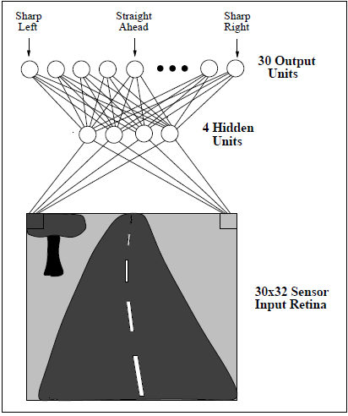
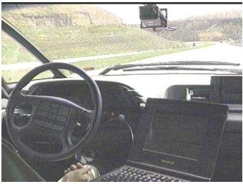
ALVINN drives 110 km per hour on highways
CE 455 Machine Learning KTO Karatay University

Slide 6
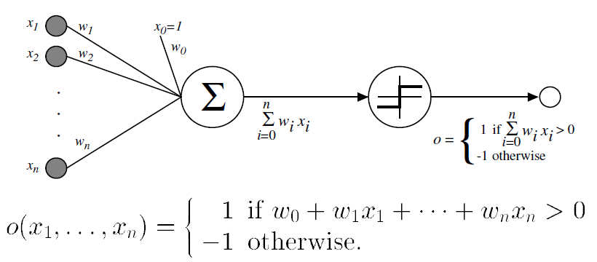
Perceptron
Perceptron is a Linear Threshold Unit (LTU)
A perceptron takes a vector of real-valued inputs, calculates a linear combination of these inputs, then outputs a 1 if the result is greater than some threshold and -1 otherwise
CE 455 Machine Learning KTO Karatay University

Slide 7

Perceptron Learning
Learning a perceptron involves choosing values for weights w₀, …,w_{n}.
The space H of candidate hypotheses considered in perceptron learning is the set of all possible real-valued weight vectors
CE 455 Machine Learning KTO Karatay University

Slide 8
Representational Power of Perceptrons
A perceptron represents a hyperplane decision surface in the
n-dimensional space of instances.
The perceptron outputs a 1 for instances lying on one side of the hyperplane and outputs a -1 for instances lying on the other side.
Some sets of positive and negative examples cannot be separated by any hyperplane. Those that can be separated are called linearly separable sets of examples.
A single perceptron can be used to represent many boolean functions.
  AND, OR, NAND, NOR are representable by a perceptron
  XOR cannot be representable by a perceptron.
CE 455 Machine Learning KTO Karatay University

Slide 9
Representational Power of Perceptrons
x₂
x₂
+
+
+
+
-
-
-
x₁
x₁
+
-
-
+
-
Representable by a perceptron
NOT representable by a perceptron
CE 455 Machine Learning KTO Karatay University

Slide 10
Perceptron Training Rule
To learn an acceptable weight vector is to begin with random weights, then iteratively apply the perceptron to each training example, modifying the perceptron weights whenever it misclassifies an example.
  If the training example classifies correctly, weights are not updated.
This process is repeated, iterating through the training examples as many times as needed until the perceptron classifies all training examples correctly.
  Each pass through all of the training examples is called one epoch
Weights are modified at each step according to
perceptron training rule
CE 455 Machine Learning KTO Karatay University

Slide 11
Perceptron Training Rule
  w_{i} = w_{i} + Δw_{i}
  Δw_{i} = η (t - o) x_{i}
t is the target value
o is the perceptron output
η is a small constant (e.g. 0.1) called learning rate
If the output is correct (t=o) the weights w_{i} are not changed
If the output is incorrect (t≠o) the weights w_{i} are changed such that the output of the perceptron for the new weights is closer to t.
The algorithm converges to the correct classification
  if the training data is linearly separable
  and η is sufficiently small
CE 455 Machine Learning KTO Karatay University

Slide 12
Perceptron Learning Rule – Learning OR
x1 | x2 | T | O | Δw1 | w1 | Δw2 | w2 | Δw0 | w0
- | - | - | - | - | .1 | - | .5 | - | -.8
0 | 0 | 0 | 0 | 0 | .1 | 0 | .5 | 0 | -.8
0 | 1 | 1 | 0 | 0 | .1 | .2 | .7 | .2 | -.6
1 | 0 | 1 | 0 | .2 | .3 | 0 | .7 | .2 | -.4
1 | 1 | 1 | 1 | 0 | .3 | 0 | .7 | 0 | -.4
0 | 0 | 0 | 0 | 0 | .3 | 0 | .7 | 0 | -.4
0 | 1 | 1 | 1 | 0 | .3 | 0 | .7 | 0 | -.4
1 | 0 | 1 | 0 | .2 | .5 | 0 | .7 | .2 | -.2
1 | 1 | 1 | 1 | 0 | .5 | 0 | .7 | 0 | -.2
0 | 0 | 0 | 0 | 0 | .5 | 0 | .7 | 0 | -.2
0 | 1 | 1 | 1 | 0 | .5 | 0 | .7 | 0 | -.2
1 | 0 | 1 | 1 | 0 | .5 | 0 | .7 | 0 | -.2
1 | 1 | 1 | 1 | 0 | .5 | 0 | .7 | 0 | -.2
Learning rate parameter (η) is 0.2
The result of executing the learning algorithm for 3 epochs.
  w_{i} = w_{i} + Δw_{i}
  Δw_{i} = η (t - o) x_{i}
CE 455 Machine Learning KTO Karatay University

Slide 13
Gradient Descent and the Delta Rule
The perceptron rule finds a successful weight vector when the training examples are linearly separable
It can fail to converge if the examples are not linearly separable.
The delta rule overcomes this difficulty.
If the training examples are not linearly separable, the delta rule converges toward a best-fit approximation to the target concept.
The key idea behind the delta rule is to use gradient descent to search the hypothesis space of possible weight vectors to find the weights that best fit the training examples.
The delta rule is important because gradient descent provides the basis for the BACKPROPAGATION algorithm, which can learn networks with many interconnected units.
  The gradient descent can serve as the basis for learning algorithms that must search through hypothesis spaces containing many different types of continuously parameterized hypotheses
CE 455 Machine Learning KTO Karatay University

Slide 14
Gradient Descent
Consider linear unit without threshold and continuous output o (not just –1,1)
  o = w₀ + w₁ x₁ + … + w_{n} x_{n}
Train the w_{i}’s such that they minimize the squared error
  E[w₀,…,w_{n}] = ½ Σ_{d∈D} (t_{d} - o_{d})²
where D is the set of training examples t_{d} is the target output for training example d, and o_{d} is the output of the linear unit for training example d.
CE 455 Machine Learning KTO Karatay University

Slide 15
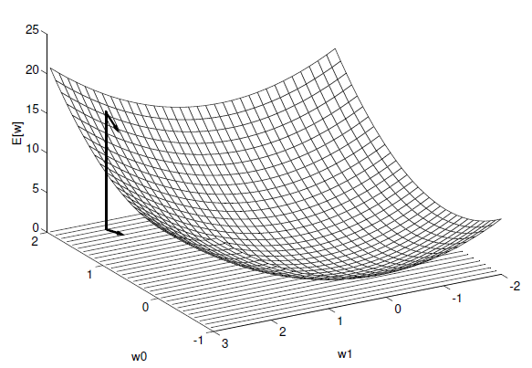
Gradient Descent
The w₀, w_{l} plane represents the entire hypothesis space.
The vertical axis indicates the error E relative to some fixed set of training examples.
The error surface summarizes the desirability of every weight vector in the hypothesis space (we desire a hypothesis with minimum error).
The arrow shows the negated gradient at one particular point, indicating the direction in the w₀, w_{l} plane producing steepest descent along the error surface.
CE 455 Machine Learning KTO Karatay University

Slide 16
Gradient Descent
Gradient descent search determines a weight vector that minimizes E by starting with an arbitrary initial weight vector, then repeatedly modifying it in small steps.
At each step, the weight vector is altered in the direction that produces the steepest descent along the error surface.
This process continues until the global minimum error is reached.
CE 455 Machine Learning KTO Karatay University

Slide 17
Gradient Descent
How can we calculate the direction of steepest descent along the error surface?
This direction can be found by computing the derivative of E with respect to each component of the vector w₀,..,w_{n}.
This vector derivative is called the gradient of E with respect to w₁,..,w_{n}, written ∇E(w₀,…,w_{n})
Gradient:
∇E[w₀,…,w_{n}] = [∂E/∂w₀,… ∂E/∂w_{n}]
When the gradient is interpreted as a vector in weight space, the gradient specifies the direction that produces the steepest increase in E.
The negative of this vector ( -∇E[w₀,…,w_{n}] ) gives the direction of steepest decrease.
CE 455 Machine Learning KTO Karatay University

Slide 18
Training Rule for Gradient Descent
For each weight w_{i}
  w_{i} = w_{i} + Δw_{i}
  Δw_{i} = - η ∇E[w_{i}]
η is a small constant called learning rate
Δwi = - η ∇E[w_{i}]
= - η ( ∂E/∂w_{i} )
.
.
Δw_{i} = - η Σ_{d∈D} (t_{d}-o_{d}) (-x_{id})
∂E/∂wi = ∂/∂w_{i} ½ Σ_{d∈D} (t_{d}-o_{d})²
= ½ Σ_{d∈D} ∂/∂w_{i} (t_{d}-o_{d})²
= ½ Σ_{d∈D} 2(t_{d}-o_{d}) ∂/∂w_{i} (t_{d}-o_{d})
= Σ_{d∈D} (t_{d}-o_{d}) ∂/∂wi (t_{d}-(w₀x_{0d}+…+w_{n}x_{nd}))
∂E/∂wi = Σ_{d∈D} (t_{d}-o_{d}) (-x_{id})
CE 455 Machine Learning KTO Karatay University

Slide 19
Gradient Descent Algorithm
Gradient-Descent(training_examples, η)
Each training example is a pair of the form <(x₁,…x_{n}),t> where (x₁,…,x_{n}) is the vector of input values, and t is the target output value, η is the learning rate (e.g. 0.1)
Initialize each w_{i} to some small random value
Until the termination condition is met, Do
  Initialize each Δw_{i} to zero
  For each <(x₁,…x_{n}),t> in training_examples, Do
    Input the instance (x₁,…,x_{n}) to the linear unit and compute the output o
    For each linear unit weight w_{i} Do
      Δw_{i}= Δw_{i} + η (t-o) x_{i}
  For each linear unit weight wi, Do
    w_{i}=w_{i}+Δw_{i}
CE 455 Machine Learning KTO Karatay University

Slide 20
Incremental (Stochastic) Gradient Descent
Gradient descent is a strategy for searching through a large or
infinite hypothesis space that can be applied whenever
  the hypothesis space contains continuously parameterized hypotheses (e.g., the weights in a linear unit), and
  the error can be differentiated with respect to these hypothesis parameters.
The key practical difficulties in applying gradient descent are
  converging to a local minimum can sometimes be quite slow (i.e.,it can require many thousands of gradient descent steps), and
  if there are multiple local minima in the error surface, then there is no guarantee that the procedure will find the global minimum.
Incremental (stochastic) gradient descent tries to solve these problems.
CE 455 Machine Learning KTO Karatay University

Slide 21
Incremental (Stochastic) Gradient Descent
Batch mode : gradient descent
  w=w - η ∇E_{D}[w] over the entire data D
  E_{D}[w]=1/2Σ_{d}(t_{d}-o_{d})²
Incremental mode: gradient descent
  w=w - η ∇E_{d}[w] over individual training examples d
  E_{d}[w]=1/2 (t_{d}-o_{d})²
Incremental Gradient Descent can approximate Batch Gradient Descent
arbitrarily closely if η is small enough
CE 455 Machine Learning KTO Karatay University

Slide 22
Incremental (Stochastic) Gradient Descent
Incremental (Stochastic) Gradient-Descent(training_examples, η)
Each training example is a pair of the form <(x₁,…x_{n}),t> where (x₁,…,x_{n}) is the vector of input values, and t is the target output value, η is the learning rate (e.g. 0.1)
Initialize each w_{i} to some small random value
Until the termination condition is met, Do
  Initialize each Δw_{i} to zero
  For each <(x₁,…x_{n}),t> in training_examples, Do
    Input the instance (x₁,…,x_{n}) to the linear unit and compute the output o
    For each linear unit weight w_{i} Do
      Δw_{i}= Δw_{i} + η (t-o) x_{i} w_{i}= w_{i} + η (t-o) x_{i}
  For each linear unit weight wi, Do
    w_{i}=w_{i}+Δw_{i}
--------------------------------
--------------------------
-----------------------------------------
-----------------
CE 455 Machine Learning KTO Karatay University

Slide 23
Incremental (Stochastic) Gradient Descent
In standard gradient descent, the error is summed over all examples before updating weights, whereas in stochastic gradient descent weights are updated upon examining each training example.
Summing over multiple examples in standard gradient descent requires more computation per weight update step. On the other hand, because it uses the true gradient, standard gradient descent is often used with a larger step size per weight update than stochastic gradient descent.
In cases where there are multiple local minima with respect to E(w₀,…,w_{n}), stochastic gradient descent can sometimes avoid falling into these local minima because it uses the various ∇E_{d}(w₀,…,w_{n}) rather than ∇E (w₀,…,w_{n}) to guide its search.
CE 455 Machine Learning KTO Karatay University

Slide 24
Comparison of Perceptron and Gradient Descent Rule
Perceptron learning rule guaranteed to succeed if
Training examples are linearly separable
Sufficiently small learning rate η
Linear unit training rules uses gradient descent
Guaranteed to converge to hypothesis with minimum squared error
Given sufficiently small learning rate η
Even when training data contains noise
Even when training data not separable by H
CE 455 Machine Learning KTO Karatay University

Slide 25
Multi-Layer Networks
Single perceptrons can only express linear decision surfaces.
Multilayer networks are capable of expressing a rich variety of nonlinear decision surfaces.
output layer
hidden layer
input layer
CE 455 Machine Learning KTO Karatay University

Slide 26
Multi-Layer Networks with Non-Linear Units
Multiple layers of cascaded linear units still produce only linear functions.
We prefer networks capable of representing highly nonlinear functions.
What we need is a unit whose output is a nonlinear function of its inputs, but whose output is also a differentiable function of its inputs.
One solution is the sigmoid unit, a unit very much like a perceptron, but based on a smoothed, differentiable threshold function.
CE 455 Machine Learning KTO Karatay University

Slide 27
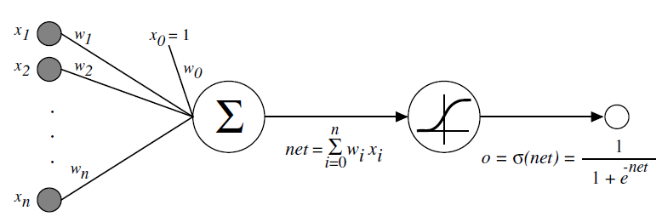
Sigmoid Unit
σ(x) is the sigmoid function: 1/(1+e^{-x)}
dσ(x)/dx = σ(x) (1- σ(x))
← differentiable function
Derive gradient descent rules to train:
  one sigmoid function
∂E/∂w_{i} = -Σ_{d}(t_{d}-o_{d}) o_{d} (1-o_{d}) x_{id}
  Multilayer networks of sigmoid units → backpropagation
CE 455 Machine Learning KTO Karatay University

Slide 28
Backpropagation Algorithm
Create a feed-forward network with n_{i} inputs, n_{hidden} hidden units, and n_{out} output units.
Initialize each w_{i} to some small random value (e.g., between -.05 and .05).
Until the termination condition is met, Do
  For each training example <(x₁,…x_{n}),t>, Do
    // Propagate the input forward through the network:
    Input the instance (x₁,…,x_{n}) to the network and compute the network outputs o_{k} for every unit
    // Propagate the errors backward through the network:
    For each output unit k, calculate its error term δ_{k}
      δ_{k} = o_{k}(1-o_{k})(t_{k}-o_{k})
    For each hidden unit h, calculate its error term δ_{h}
      δ_{h}=o_{h}(1-o_{h}) Σ_{k} w_{h,k} δ_{k}
    For each network weight w_{i,j} , Do
    w_{i,j}=w_{i,j}+Δw_{i,j} where Δw_{i,j}= η δ_{j} x_{i,j}
CE 455 Machine Learning KTO Karatay University

Slide 29
Backpropagation
Will find a local, not necessarily global error minimum
-in practice often works well (can be invoked multiple times with different initial weights)
Often include weight momentum (α) term
      Δw_{i,j}(n)= η δ_{j} x_{i,j} + α Δw_{i,j} (n-1)
Minimizes error over training examples
  Will it generalize weel to unseen examples?
Training can be slow typical 1000-10000 iterations
Using network after training is fast
CE 455 Machine Learning KTO Karatay University

Slide 30
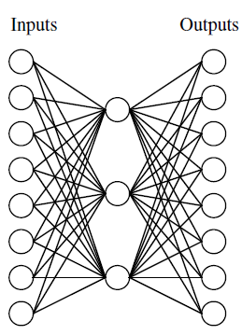
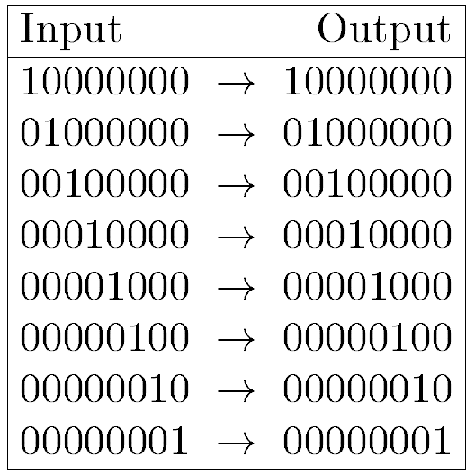
8-3-8 Binary Encoder -Decoder
Can this be learned?
CE 455 Machine Learning KTO Karatay University

Slide 31
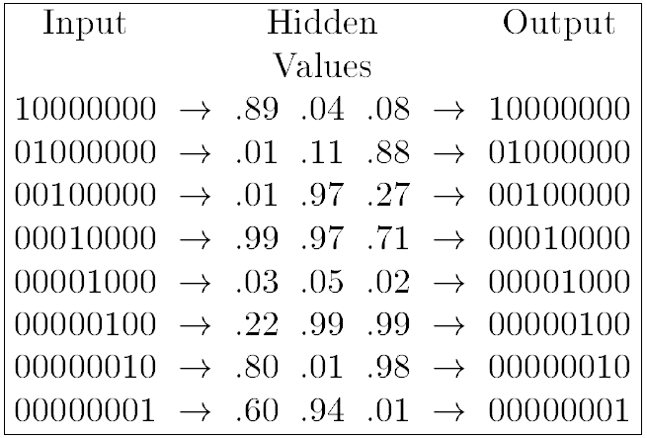
8-3-8 Binary Encoder -Decoder
8 x 3 x 8 network was trained to learn the identity function, using the eight training examples shown.
After 5000 training epochs, the three hidden unit values encode the eight distinct inputs using the encoding shown on the right.
If the encoded values are rounded to zero or one, the result is the standard binary encoding for eight distinct values.
CE 455 Machine Learning KTO Karatay University

Slide 32
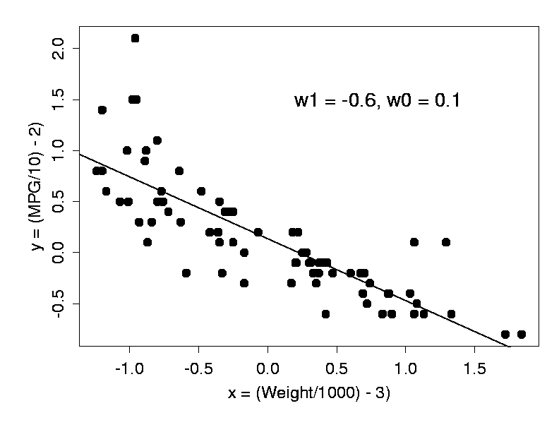
Single Layer Problem
CE 455 Machine Learning KTO Karatay University

Slide 33
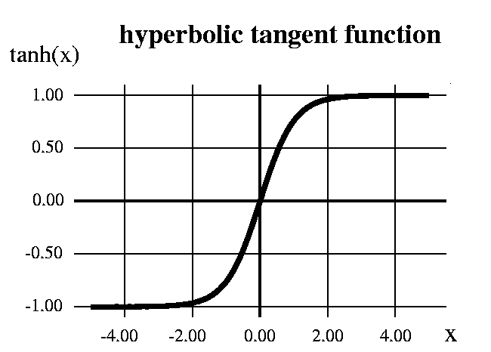
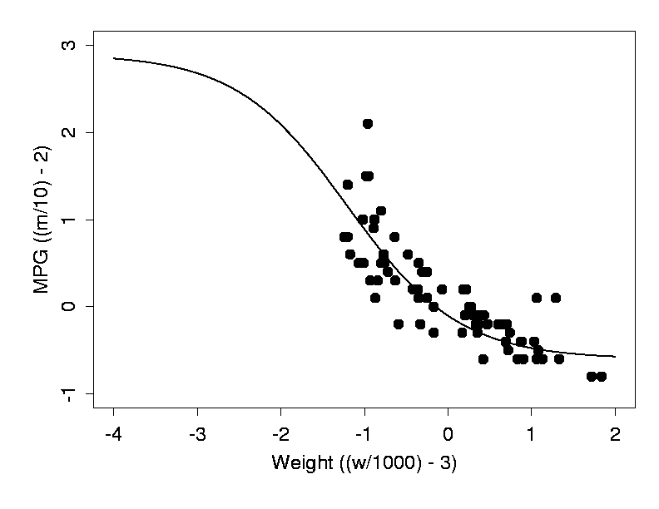
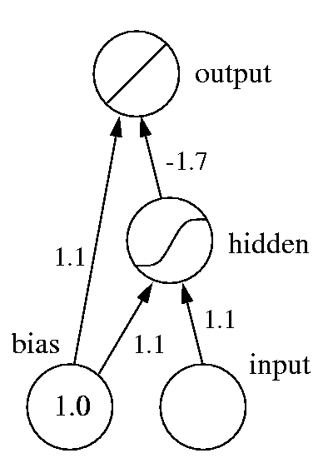
Multi-Layer Network – NonLinear Problem
CE 455 Machine Learning KTO Karatay University

Slide 34
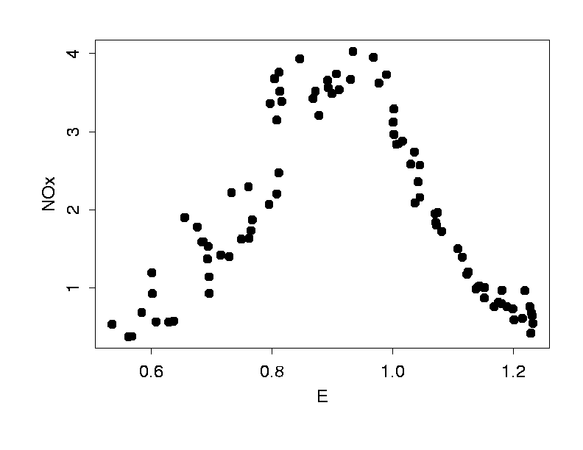
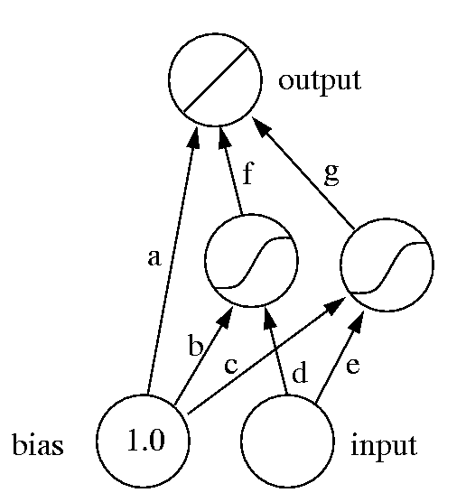
Multi-Layer Network – NonLinear Problem 2
output = f tanh(x) + g tanh2(x) +a
tanh1(x) = tanh(d*x + b)
tanh2(x) = tanh(e*x + c)
CE 455 Machine Learning KTO Karatay University

Slide 35
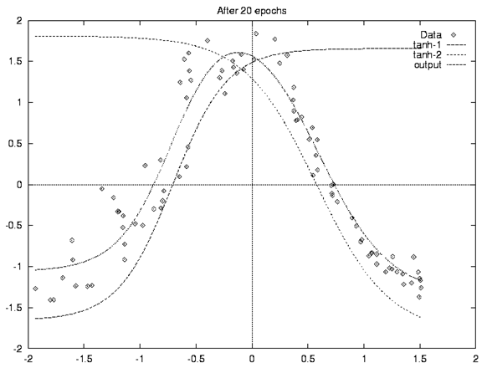
Multi-Layer Network – NonLinear Problem 2
CE 455 Machine Learning KTO Karatay University

Slide 36
Expressive Capabilities of ANNs
Boolean functions
  Every boolean function can be represented by network with single hidden layer
  but might require exponential (in number of inputs) hidden units
Continuous functions
  Every bounded continuous function can be approximated with arbitrarily small error by network with one hidden layer
  Any function can be approximated to arbitrary accuracy by a network with two hidden layers
CE 455 Machine Learning KTO Karatay University

