Slide 1
Finite State Machines
יהודה אפק, נתן אינטרטור
אוניברסיטת תל אביב
Based on lectures from
George Mason and CMU

Slide 2
Resources
Sundar Rajan, Essential VHDL: RTL Synthesis
Done Right
Chapter 6, Finite State Machines
Chapter 10, Getting the Most from Your State
Machine
Introduction to VHDL
http://www-ee.uta.edu/Online/Zhu/Fall_2004/
VHDL CHIP http://altera.com/

Slide 3
Definition of a State Machine
All programmable logic designs can be specified in Boolean form. However some designs are easier to conceptualize and implement using non-Boolean models. The State Machine model is one such model.

Slide 4
Definition of a State Machine
A state machine represents a system as a set of states, the transitions between them, along with the associated inputs and outputs.
So, a state machine is a particular conceptualization of a particular sequential circuit. State machines can be used for many other things beyond logic design and computer architecture.

Slide 5
Finite State Machines
Any Circuit with Memory Is a Finite State Machine
  Even computers can be viewed as huge FSMs
Design of FSMs Involves
  Defining states
  Defining transitions between states
  Optimization / minimization
Above Approach Is Practical for Small FSMs Only

Slide 6
State Machines: Definition of Terms
State Diagram
  Illustrates the form and function of a state machine. Usually drawn as a bubble-and-arrow diagram.
State
  A uniquely identifiable set of values measured at various points in a digital system.
Next State
  The state to which the state machine makes the next transition, determined by the inputs present when the device is clocked.
Branch
  A change from present state to next state.
Mealy Machine
  A state machine that determines its outputs from the present state and from the inputs.
Moore Machine
  A state machine that determines its outputs from the present state only.

Slide 7
Present State and Next State
State 4
For any given state, there is a finite number of possible next states. On each clock cycle, the state machine branches to the next state. One of the possible next states becomes the new present state, depending on the inputs present on the clock cycle.
State 5
State 6
State 7
On a well-drawn state diagram, all possible transitions will be visible, including loops back to the same state. From this diagram it can be deduced that if the present state is State 5, then the previous state was either State 4 or 5 and the next state must be either 5, 6, or 7.

Slide 8
Moore and Mealy Machines
Both these machine types follow the basic characteristics of state machines, but differ in the way that outputs are produced.
Moore Machine:
  Outputs are independent of the inputs, ie outputs are effectively produced from within the state of the state machine.
Mealy Machine:
  Outputs can be determined by the present state alone, or by the present state and the present inputs, ie outputs are produced as the machine makes a transition from one state to another.

Slide 9
Machine Models
Inputs
Inputs
Combinatorial
Logic to
Determine State
Combinatorial
Logic to
Determine State
Present State
Register Bank
Present State
Register Bank
Combinatorial
Logic to
Determine
Output Based on:
Present State
Combinatorial
Logic to
Determine
Output Based on:
Present State
Present Inputs
Moore Machine
Mealy Machine
Output
Output

Slide 10
Moore Machine Diagrams
The Moore State Machine
output is shown inside the
state bubble, because the
output remains the same as
long as the state machine
remains in that state.
The output can be arbitrarily
complex but must be the
same every time the
machine enters that
state.
State 1
q,r
a,b
Input condition that
must exist in order
to execute these
transitions from
State 1
i,j
Output condition that
results from being in
a particular present
state
State 2
x,y

Slide 11
Mealy Machine Diagrams
The Mealy State Machine generates outputs based on:
The Present State, and
The Inputs to the M/c.
So, it is capable of generating many different patterns of output signals for the same state, depending on the inputs present on the clock cycle.
Outputs are shown on transitions since they are determined in the same way as is the next state.
State 1
a,b
q,r
Input condition that
must exist in order
to execute these
transitions from
State 1
i,j
x,y
Output condition that
results from being in
a particular present
state
State 2

Slide 12
Moore Machine
Describe Outputs as Concurrent Statements Depending on State Only
transition
condition 1
state 1 /
output 1
state 2 /
output 2
transition
condition 2

Slide 13
Mealy Machine
Describe Outputs as Concurrent Statements Depending on State and Inputs
transition condition 1 /
output 1
state 1
state 2
transition condition 2 /
output 2

Slide 14
Moore vs. Mealy FSM (1)
Moore and Mealy FSMs Can Be Functionally Equivalent
Mealy FSM Has Richer Description and Usually Requires Smaller Number of States
  Smaller circuit area

Slide 15
Moore vs. Mealy FSM (2)
Mealy FSM Computes Outputs as soon as Inputs Change
  Mealy FSM responds one clock cycle sooner than equivalent Moore FSM
Moore FSM Has No Combinational Path Between Inputs and Outputs
  Moore FSM is less likely to have a shorter critical path

Slide 16
Moore FSM - Example 1
Moore FSM that Recognizes Sequence 10
0
1
0
S0 / 0
1
S1 / 0
S2 / 1
1
reset
0
S0: No
elements
of the
sequence
observed
S1: “1”
observed
S1: “10”
observed
Meaning
of states:

Slide 17
Mealy FSM - Example 1
Mealy FSM that Recognizes Sequence 10
0 / 0
1 / 0
1 / 0
S0
S1
reset
0 / 1
S0: No
elements
of the
sequence
observed
S1: “1”
observed
Meaning
of states:

Slide 18
Moore & Mealy FSMs – Example 1
clock
0 1 0 0 0
input
S0 S1 S2 S0 S0
Moore
S0 S1 S0 S0 S0
Mealy

Slide 19
Finite State Machine (FSM)
0
00/0
=Iקלט (כמקודם)
1
0
01/0
0
0
1
11/0
=Oפלט
1
10/1
1
האוטומט פולט 1 אחרי ש"ראה" לפחות 3 1-ים מאז ה- 0 האחרון.
פלט מצוייר במצבים Moore FSM

Slide 20
Finite State Machine (FSM)
0/0
00
קלט (כמקודם)
1/0
0/0
01
0/0
0/0
1/0
10
פלט
1/1
11
1/1
האוטומט פולט 1 אחרי ש"ראה" לפחות 3 1-ים מאז ה- 0 האחרון.
פלט מצוייר על הקשתות Mealy FSM
Notes:
חובר בספטמבר 2001

Slide 21
טבלת המצבים –Moore
0
00/0
A_{t} | B_{t} | I=0 |  | I=1
 |  | A_{t+1} | B_{t+1} | A_{t+1} | B_{t+1} | O_{t}
0 | 0 | 0 | 0 | 0 | 1 | 0
0 | 1 | 0 | 0 | 1 | 1 | 0
1 | 1 | 0 | 0 | 1 | 0 | 0
1 | 0 | 0 | 0 | 1 | 0 | 1
1
0
01/0
1
0
11/0
1
0
10/1
1
הפלט תלוי ב – A & B
Notes:
חובר בספטמבר 2001

Slide 22
טבלת המצבים - Mealy
A_{t} | B_{t} | X=0 |  | X=1 |  | X=0 | X=1
 |  | A_{t+1} | B_{t+1} | A_{t+1} | B_{t+1} | O_{t} | O_{t}
0 | 0 | 0 | 0 | 0 | 1 | 0 | 0
0 | 1 | 0 | 0 | 1 | 0 | 0 | 0
1 | 0 | 0 | 0 | 1 | 1 | 0 | 1
1 | 1 | 0 | 0 | 1 | 1 | 0 | 1
הפלט תלוי ב - X
Notes:
חובר בספטמבר 2001

Slide 23
טבלת המצבים – Moore
0
00/0
A_{t} | B_{t} | I=0 |  | I=1
 |  | A_{t+1} | B_{t+1} | A_{t+1} | B_{t+1} | O_{t}
0 | 0 | 0 | 0 | 0 | 1 | 0
0 | 1 | 0 | 0 | 1 | 1 | 0
1 | 1 | 0 | 0 | 1 | 0 | 0
1 | 0 | 0 | 0 | 1 | 0 | 1
1
0
01/0
1
11/0
1
0
0
10/1
1
AB
AB
Bt+1 | 00 | 01 | 11 | 10
0
1
At+1 | 00 | 01 | 11 | 10
0
1
I

Slide 24
דוגמא - Moore
I
D
Q
A
Q’
O
D
Q
B
Q’
At+1= A*I + B * I= I(A+B)
Bt+1= A*I
כניסה אחת ויציאה אחת
2FF מסוג Data ⇐ 4 מצבים.
O = A*B

Slide 25
דוגמא – Mealy
D
Q
A
Q’
X
Out
D
Q
B
Q’
כניסה אחת ויציאה אחת
היציאה תלויה ב- Q_{A}, Q_{B} ו- X.
2FF מסוג Data ⇐ 4 מצבים.
Notes:
חובר בספטמבר 2001

Slide 26
Moore Vs. Mealy
פלט:
Moore – פונקציה של המצב לבד
Mealy – פונקציה של המצב והקלט
אוטומט:
Moore – הפלט "רשום" על המצב
Mealy – הפלט "רשום" על הקשת (מעבר)
שיקולים:
Moore – לא תלוי ב"יציבות" הקלט (מספיק שיהיה קבוע T_{s} + T_{h}) אך ידרשו FFs נוספים אם דרושה תלות היציאה בקלט.
Mealy – פשוט לממוש אם יש תלות של היציאה בקלט אך נדרשת יציבות.
Moore שקול ל – Mealy (ולהפך)
Notes:
חובר בספטמבר 2001

Slide 27
Example: Vending Machine
Takes only quarters and dollar bills
Won't hold more than $1.00
Sodas cost $.75
Possible actions (inputs)
  deposit $.25 (25)
  deposit $1.00 ($)
  push button to get soda (soda)
  push button to get money returned (ret)

Slide 28
Example: Vending Machine
State: description of the internal settings of the machine, e.g. how much money has been depositied and not spent
Finite states: 0, 25, 50, 75, 100,
Rules: determine how inputs can change state

Slide 29
Example: Vending Machine
25
25
50
001
010
25
25
ret
ret
soda
soda
75
0
000
ret
011
100
ret
25
Inputs
25 = 00
100 = 01
soda = 10
ret = 11
100
100

Slide 30
Example: Vending Machine
state input new state
S2 S1 S0 I0 I1 S2 S1 S0
0 0 0 0 0 0 0 1
0 0 1 0 0 0 1 0
0 1 0 0 0 0 1 1
0 1 1 0 0 1 0 0
1 0 0 0 0 1 0 0
0 0 0 0 1 1 0 0
0 0 1 0 1 0 0 1
0 1 0 0 1 0 1 0
0 1 1 0 1 0 1 1
1 0 0 0 1 1 0 0
state input new state
S2 S1 S0 I0 I1 S2 S1 S0
0 0 0 1 0 0 0 0
0 0 1 1 0 0 0 1
0 1 0 1 0 0 1 0
0 1 1 1 0 0 0 0
1 0 0 1 0 0 0 1
0 0 0 1 1 0 0 0
0 0 1 1 1 0 0 0
0 1 0 1 1 0 0 0
0 1 1 1 1 0 0 0
1 0 0 1 1 0 0 0

Slide 31
Example: Vending Machine
state input new state
S2 S1 S0 I0 I1 S2 S1 S0
0 0 0 0 0 0 0 1
0 0 1 0 0 0 1 0
0 1 0 0 0 0 1 1
0 1 1 0 0 1 0 0
1 0 0 0 X 1 0 0
0 0 0 0 1 1 0 0
0 0 1 0 1 0 0 1
0 1 0 0 1 0 1 0
0 1 1 0 1 0 1 1
state input new state
S2 S1 S0 I0 I1 S2 S1 S0
0 0 0 1 0 0 0 0
0 0 1 1 0 0 0 1
0 1 0 1 0 0 1 0
0 1 1 1 0 0 0 0
1 0 0 1 0 0 0 1
X X X 1 1 0 0 0

Slide 32
What is VHDL?
Very High Speed Integrated Circuit Hardware Description Language
Used to describe a desired logic circuit
Compiled, Synthesized and Burned onto a working chip
Simplifies hardware for large projects
Examples: Combinatorial Logic, Finite State Machines

Slide 33
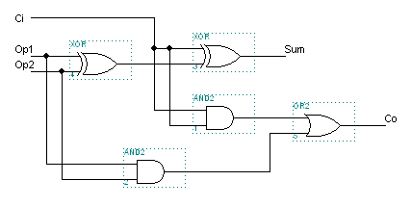
Let’s Start Simple
Combinatorial/Arithmetic Logic
1-bit full-adder
Three Approaches to VHDL Programming: Structural, Arithmetic, and Behavioral

Slide 34
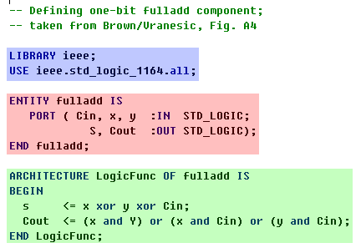
Structural (I)
Included Libraries: Used in compiling and synthesis. The same for each project.
Entity Declaration: Indicates what comes in and what goes out.
Architecture Declaration: Defines the entity on a functional level.

Slide 35

Structural (II)
Structurally defined code assigns a logical function of the inputs to each output
This is most useful for simple combinatorial logic

Slide 36
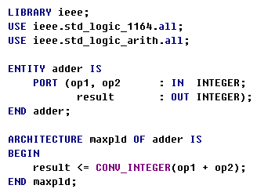
Arithmetic
Arithmetic Operation allows for simpler code, but possibly at the expense of chip real estate.
What is wrong with this code? Think about how the integers are implemented by the synthesizer.

Slide 37

Arithmetic (II)
If you choose to code on a higher level, be sure to specify ranges for your variables, otherwise Altera will assume 32-bit unsigned values.
There is not enough room on the whole chip to store one 32-bit value.

Slide 38
Behavioral
Describe how the circuit works is meant to work and let the synthesizer work out the details.
This is most useful for Finite State Machines and programs involving sequential statements and processes. We’ll see some examples shortly.

Slide 39
Bringing Components Together
You can design several different “circuits” in Altera and then bring them together to form a larger design on a single chip.
Two methods:
-Code Directly via the Netlist
-Altera Tools Graphical Editor

Slide 40
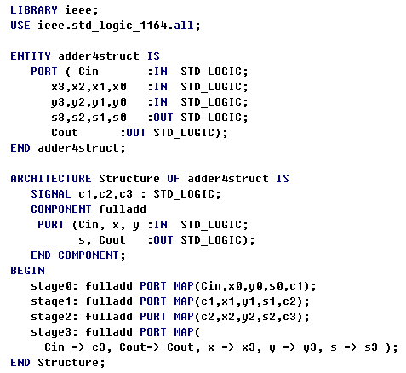
Structural Netlist
Using our Full Adder code from earlier. . .
-Each stage is made up of a full adder component.
-The fulladd code from earlier is also part of this vhdl file, it is not shown here.
-The carry out from each stage is assigned as carry in to the next stage.
-Notice that c1, c2, c3 are internal signals written in to allow transfer of data between the stages.
-This is important because you cannot specify an output pin of a component as an input pin in the same entity. c1, c2, and c3 are like buffers.

Slide 41
Syntax Notes and Helpful Hints
Don’t forget semi-colons where necessary
Top level entity and filename must be the same
If you design a smaller “circuit” to be part of a larger project, it is worthwhile for you to test that small piece to ensure that it functions as you intend it to.
More is often less. Be specific about your code and the synthesizer will reward you with ample chip space.

Slide 42
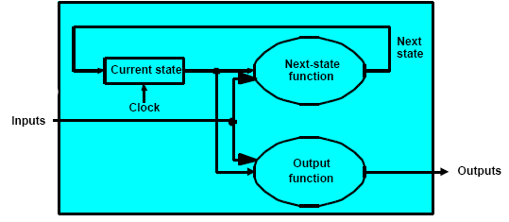
Finite State Machines (FSMs)
What is an FSM?
Two types:
  Moore
  Mealy
Figure B.27
Computer Organization & Design. 2nd Ed. (Patterson, Hennessy)
Notes:
FSM takes inputs and Current state to produce next state and Outputs.

Slide 43
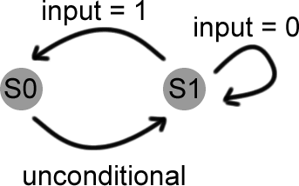
Moore FSM
Output depends
ONLY on current state
Outputs associated with each state are set at clock transition

Slide 44
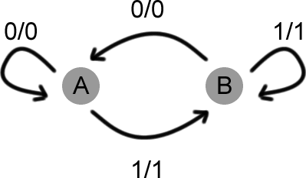
Mealy FSM
Output depends on inputs AND current state
Outputs are set during transitions
Notes:
Inputs = current state + inputs
Output = Inputs + prev_output

Slide 45
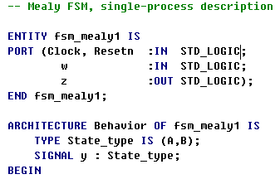
Coding FSMs in Altera

Slide 46

Process Statement
Process computes outputs of sequential statements on each clock tick with respect to the sensitive signals.
Sensitivity list

Slide 47
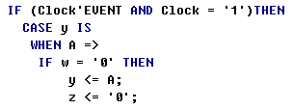
’EVENT
’EVENT is an Altera construct that represents when the signal is transitioning
IF statement reads:
If Clock is making a positive transition THEN
…

Slide 48
VHDL codes for FSM
Mealy FSM – see mealy1.vhd on the web
Moore FSM - see moore.vhd on the web
Now let’s take a look how to edit, compile, simulate and synthesize your design using Altera software ….
…. (proceed with hands on tutorial)

Slide 49
FSMs in VHDL
Finite State Machines Can Be Easily Described With Processes
Synthesis Tools Understand FSM Description If Certain Rules Are Followed
  State transitions should be described in a process sensitive to clock and asynchronous reset signals only
  Outputs described as concurrent statements outside the process

Slide 50
FSM States (1)
architecture behavior of FSM is
type state is (list of states);
signal FSM_state: state;
begin
process(clk, reset)
begin
if reset = ‘1’ then
FSM_state <= initial state;
else
case FSM_state is

Slide 51
FSM States (2)
case FSM_state is
when state_1 =>
if transition condition 1 then
FSM_state <= state_1;
end if;
when state_2 =>
if transition condition 2 then
FSM_state <= state_2;
end if;
end case;
end if; end process;

Slide 52
Moore FSM - Example 1
Moore FSM that Recognizes Sequence 10
0
1
0
S0 / 0
1
S1 / 0
S2 / 1
1
reset
0

Slide 53
Moore FSM in VHDL
type state is (S0, S1, S2);
signal Moore_state: state;
U_Moore: process(clock, reset)
Begin
if(reset = ‘1’) then
Moore_state <= S0;
elsif (clock = ‘1’ and clock’event) then
case Moore_state is
when S0 =>
if input = ‘1’ then Moore_state <= S1; end if;
when S1 =>
if input = ‘0’ then Moore_state <= S2; end if;
when S2 =>
if input = ‘0’ then Moore_state <= S0;
else Moore_state <= S1; end if;
end case;
end if;
End process;
Output <= ‘1’ when Moore_state = S2 else ‘0’;

Slide 54
Mealy FSM - Example 1
Mealy FSM that Recognizes Sequence 10
0 / 0
1 / 0
1 / 0
S0
S1
reset
0 / 1

Slide 55
Mealy FSM in VHDL
type state is (S0, S1);
signal Mealy_state: state;
U_Mealy: process(clock, reset)
Begin
if(reset = ‘1’) then
Mealy_state <= S0;
elsif (clock = ‘1’ and clock’event) then
case Mealy_state is
when S0 =>
if input = ‘1’ then Mealy_state <= S1; end if;
when S1 =>
if input = ‘0’ then Mealy_state <= S0; end if;
end case;
end if;
End process;
Output <= ‘1’ when (Mealy_state = S1 and input = ‘0’) else ‘0’;

Slide 56
Moore FSM – Example 2: State diagram
Reset
w
=
1
w
=
0
A
⁄
z
=
0
B
⁄
z
=
0
w
=
0
w
=
0
w
=
1
C
⁄
z
=
1
w
=
1

Slide 57
Moore FSM – Example 2: State table
Present
Next state
Output
state
w
=
0
w
=
1
z
A
A
B
0
B
A
C
0
C
A
C
1

Slide 58
Moore FSM
Input: w
Transition
function
Next State:
Present State:
y
Memory
(register)
Output
function
Output: z

Slide 59
Moore FSM – Example 2: VHDL code (1)
USE ieee.std_logic_1164.all ;
ENTITY simple IS
PORT ( Clock, Resetn, w : IN STD_LOGIC ;
z : OUT STD_LOGIC ) ;
END simple ;
ARCHITECTURE Behavior OF simple IS
TYPE State_type IS (A, B, C) ;
SIGNAL y : State_type ;
BEGIN
PROCESS ( Resetn, Clock )
BEGIN
IF Resetn = '0' THEN
y <= A ;
ELSIF (Clock'EVENT AND Clock = '1') THEN
con’t ...

Slide 60
Moore FSM – Example 2: VHDL code (2)
CASE y IS
WHEN A =>
IF w = '0' THEN
y <= A ;
ELSE
y <= B ;
END IF ;
WHEN B =>
IF w = '0' THEN
y <= A ;
ELSE
y <= C ;
END IF ;
WHEN C =>
IF w = '0' THEN
y <= A ;
ELSE
y <= C ;
END IF ;
END CASE ;
END IF ;
END PROCESS ;
z <= '1' WHEN y = C ELSE '0' ;
END Behavior ;

Slide 61
Moore FSM
Input: w
Transition
function
Next State:
y_next
Present State:
y_present
Memory
(register)
Output
function
Output: z

Slide 62
Alternative VHDL code (1)
ARCHITECTURE Behavior OF simple IS
TYPE State_type IS (A, B, C) ;
SIGNAL y_present, y_next : State_type ;
BEGIN
PROCESS ( w, y_present )
BEGIN
CASE y_present IS
WHEN A =>
IF w = '0' THEN
y_next <= A ;
ELSE
y_next <= B ;
END IF ;
WHEN B =>
IF w = '0' THEN
y_next <= A ;
ELSE
y_next <= C ;
END IF ;

Slide 63
Alternative VHDL code (2)
WHEN C =>
IF w = '0' THEN
y_next <= A ;
ELSE
y_next <= C ;
END IF ;
END CASE ;
END PROCESS ;
PROCESS (Clock, Resetn)
BEGIN
IF Resetn = '0' THEN
y_present <= A ;
ELSIF (Clock'EVENT AND Clock = '1') THEN
y_present <= y_next ;
END IF ;
END PROCESS ;
z <= '1' WHEN y_present = C ELSE '0' ;
END Behavior ;

Slide 64
Mealy FSM – Example 2: State diagram
Reset
w
=
1
⁄
z
=
0
w
=
0
⁄
z
=
0
A
B
w
=
1
⁄
z
=
1
w
=
0
⁄
z
=
0

Slide 65
Mealy FSM – Example 2: State table
Present
Next state
Output
z
state
w
=
0
w
=
1
w
=
0
w
=
1
A
A
B
0
0
B
A
B
0
1

Slide 66
Mealy FSM
Input: w
Transition
function
Next State
Present State: y
Memory
(register)
Output
function
Output: z

Slide 67
Mealy FSM – Example 2: VHDL code (1)
LIBRARY ieee ;
USE ieee.std_logic_1164.all ;
ENTITY mealy IS
PORT ( Clock, Resetn, w : IN STD_LOGIC ;
z : OUT STD_LOGIC ) ;
END mealy ;
ARCHITECTURE Behavior OF mealy IS
TYPE State_type IS (A, B) ;
SIGNAL y : State_type ;
BEGIN
PROCESS ( Resetn, Clock )
BEGIN
IF Resetn = '0' THEN
y <= A ;
ELSIF (Clock'EVENT AND Clock = '1') THEN
CASE y IS
WHEN A =>
IF w = '0' THEN y <= A ;
ELSE y <= B ;
END IF ;

Slide 68
Mealy FSM – Example 2: VHDL code (2)
WHEN B =>
IF w = '0' THEN y <= A ;
ELSE y <= B ;
END IF ;
END CASE ;
END IF ;
END PROCESS ;
with y select
z <= w when B,
z <= ‘0’ when others;
END Behavior ;

Slide 69
State Encoding Problem
State Encoding Can Have a Big Influence on Optimality of the FSM Implementation
  No methods other than checking all possible encodings are known to produce optimal circuit
  Feasible for small circuits only
Using Enumerated Types for States in VHDL Leaves Encoding Problem for Synthesis Tool

Slide 70
Types of State Encodings (1)
Binary (Sequential) – States Encoded as Consecutive Binary Numbers
  Small number of used flip-flops
  Potentially complex transition functions leading to slow implementations
One-Hot – Only One Bit Is Active
  Number of used flip-flops as big as number of states
  Simple and fast transition functions
  Preferable coding technique in FPGAs

Slide 71
Types of State Encodings (2)
State | Binary Code | One-Hot Code
S0 | 000 | 10000000
S1 | 001 | 01000000
S2 | 010 | 00100000
S3 | 011 | 00010000
S4 | 100 | 00001000
S5 | 101 | 00000100
S6 | 110 | 00000010
S7 | 111 | 00000001

Slide 72
A user-defined attribute for manual
state assignment
(ENTITY declaration not shown)
ARCHITECTURE Behavior OF simple IS
TYPE State_type IS (A, B, C) ;
ATTRIBUTE ENUM_ENCODING : STRING ;
ATTRIBUTE ENUM_ENCODING OF State_type : TYPE IS "00 01 11" ;
SIGNAL y_present, y_next : State_type ;
BEGIN
con’t ...
Figure 8.34

Slide 73
Using constants for manual state assignment (1)
ARCHITECTURE Behavior OF simple IS
SUBTYPE ABC_STATE is STD_LOGIC_VECTOR(1 DOWNTO 0);
CONSTANT A : ABC_STATE := "00" ;
CONSTANT B : ABC_STATE := "01" ;
CONSTANT C : ABC_STATE := "11" ;
SIGNAL y_present, y_next : ABC_STATE;
BEGIN
PROCESS ( w, y_present )
BEGIN
CASE y_present IS
WHEN A =>
IF w = '0' THEN y_next <= A ;
ELSE y_next <= B ;
END IF ;
… con’t

Slide 74
RTL Design Components
Data Inputs
Control Inputs
Datapath
Circuit
Control
Circuit
Data Outputs

Slide 75
Datapath Circuit
Provides All Necessary Resources and Interconnects Among Them to Perform Specified Task
Examples of Resources
  Adders, Multipliers, Registers, Memories, etc.

Slide 76
Control Circuit
Controls Data Movements in Operational Circuit by Switching Multiplexers and Enabling or Disabling Resources
Follows Some ‘Program’ or Schedule
Usually Implemented as FSM

Slide 77
Control Unit Example: Arbiter (1)
reset
r1
g1
r2
Arbiter
g2
r3
g3
clock

Slide 78
Control Unit Example: Arbiter (2)
Reset
000
Idle
0xx
1xx
gnt1
⁄
g
1
=
1
x0x
1xx
01x
gnt2
⁄
g
2
=
1
xx0
x1x
001
gnt3
⁄
g
3
=
1
xx1

Slide 79
Control Unit Example: Arbiter (3)
Reset
r
1
r
2
r
3
Idle
r
1
r
1
gnt1
⁄
g
1
=
1
r
r
1
r
r
2
1
2
gnt2
⁄
g
2
=
1
r
3
r
2
r
r
r
1
2
3
gnt3
⁄
g
3
=
1
r
3

Slide 80
Arbiter – VHDL code (1)
LIBRARY ieee;
USE ieee.std_logic_1164.all;
ENTITY arbiter IS
PORT ( Clock, Resetn : IN STD_LOGIC ;
r : IN STD_LOGIC_VECTOR(1 TO 3) ;
g : OUT STD_LOGIC_VECTOR(1 TO 3) ) ;
END arbiter ;
ARCHITECTURE Behavior OF arbiter IS
TYPE State_type IS (Idle, gnt1, gnt2, gnt3) ;
SIGNAL y : State_type ;
BEGIN
PROCESS ( Resetn, Clock )
BEGIN
IF Resetn = '0' THEN y <= Idle ;
ELSIF (Clock'EVENT AND Clock = '1') THEN
CASE y IS
WHEN Idle =>
IF r(1) = '1' THEN y <= gnt1 ;
ELSIF r(2) = '1' THEN y <= gnt2 ;
ELSIF r(3) = '1' THEN y <= gnt3 ;
ELSE y <= Idle ;
END IF ;

Slide 81
Arbiter – VHDL code (2)
WHEN gnt1 =>
IF r(1) = '1' THEN y <= gnt1 ;
ELSE y <= Idle ;
END IF ;
WHEN gnt2 =>
IF r(2) = '1' THEN y <= gnt2 ;
ELSE y <= Idle ;
END IF ;
WHEN gnt3 =>
IF r(3) = '1' THEN y <= gnt3 ;
ELSE y <= Idle ;
END IF ;
END CASE ;
END IF ;
END PROCESS ;
g(1) <= '1' WHEN y = gnt1 ELSE '0' ;
g(2) <= '1' WHEN y = gnt2 ELSE '0' ;
g(3) <= '1' WHEN y = gnt3 ELSE '0' ;
END Behavior ;

Slide 82
Questions?

Slide 83
Arrays of std_logic_vectors
32
L(0)
REP_BLOCK
1
32
L(1)
REP_BLOCK
2
32
L(2)
REP_BLOCK
3
32
L(3)
. . . . . . . . . .
. . .
32
L(M-1)
REP_BLOCK
M
32
L(M)

Slide 84
Arrays of std_logic_vectors
type sig_array is array(0 to M) of std_logic_vector(31 downto 0);
…
signal L: sig_array;
…
begin
L(0) <= A;
CASCADE: for I in 1 to M generate
C: REP_BLOCK
port map(REP_IN => L(I-1),
REP_OUT=>L(I));
end generate;
Z <= L(M);
end;

