Slide 1
FOURIER SERIES
Complex Exponentials as Eigenfunctions of LTI Systems
Fourier Series of CT Periodic Signals
CT Fourier Series Properties
Periodic Convolution
Symmetry Advantage
Gibbs Phenomenon

Slide 2
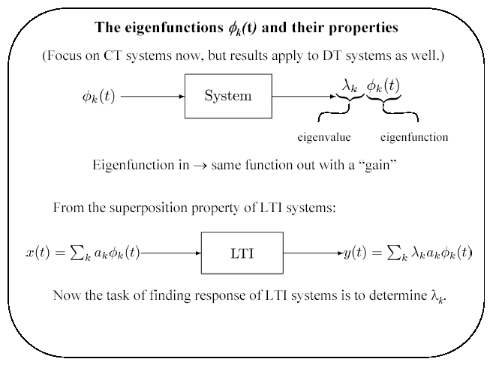

Slide 3
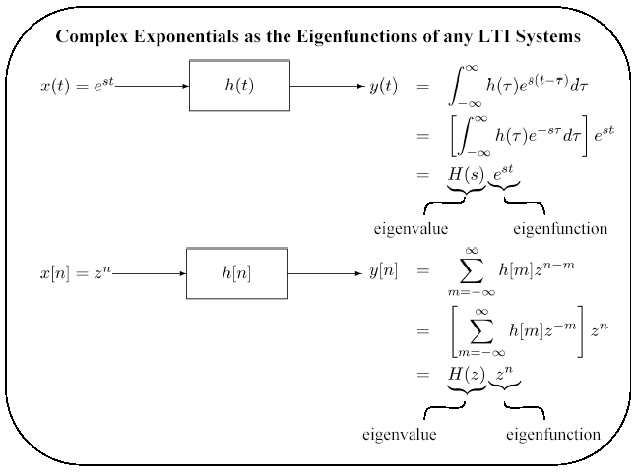

Slide 4
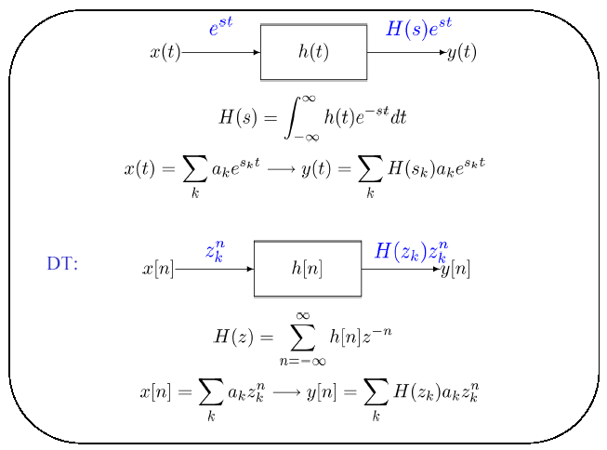

Slide 5
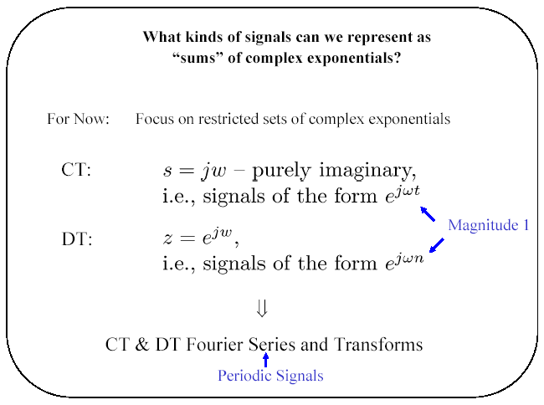

Slide 6
CT complex exponential (sinusoid):
x(t) = e^{st}|_{s=jω} = e^{jωt} = cos(ωt) + j sin(ωt)
s = jω => Re{s} = 0, Im{s} = ω
DT complex exponential (sinusoid):
z^{n} =(|z| e^{j⁄z})^{n} = =|z|^{n} e^{jωn}, ω = ⁄z , |z| = 1
x[n] = z^{n}|_{|z|=1} = e^{jωn} = cos(ωn) + j sin(ωn)

Slide 7
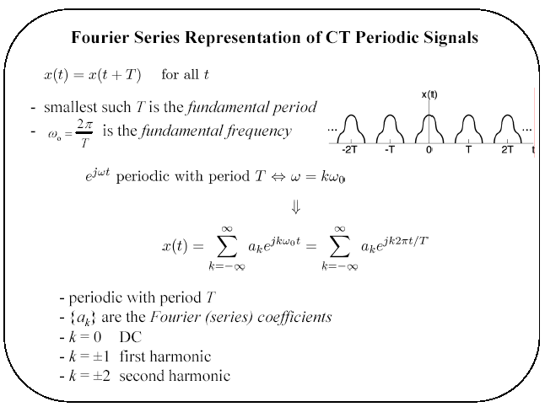
or spectral coefficients

Slide 8
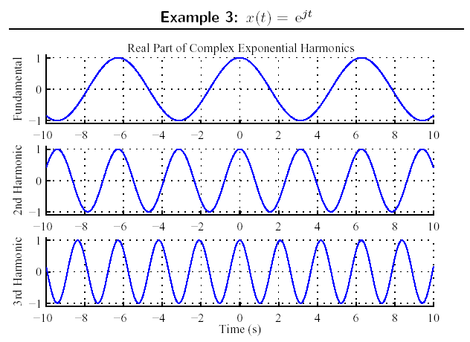

Slide 9
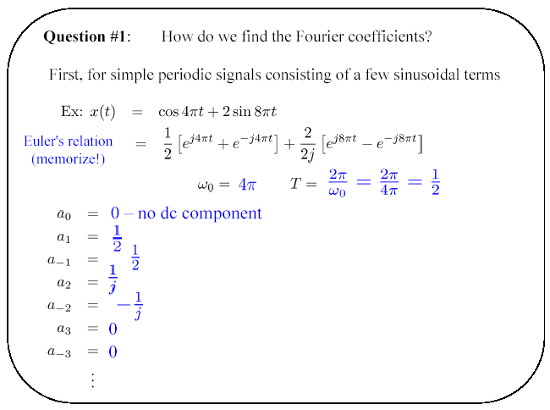

Slide 10
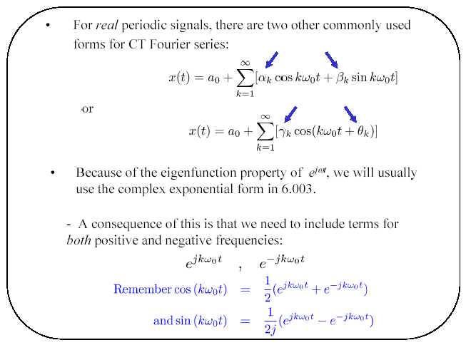

Slide 11
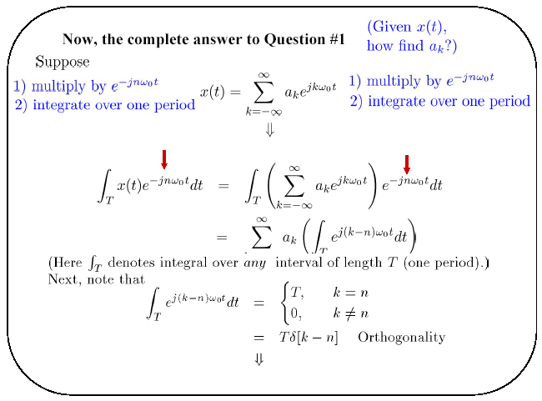

Slide 12
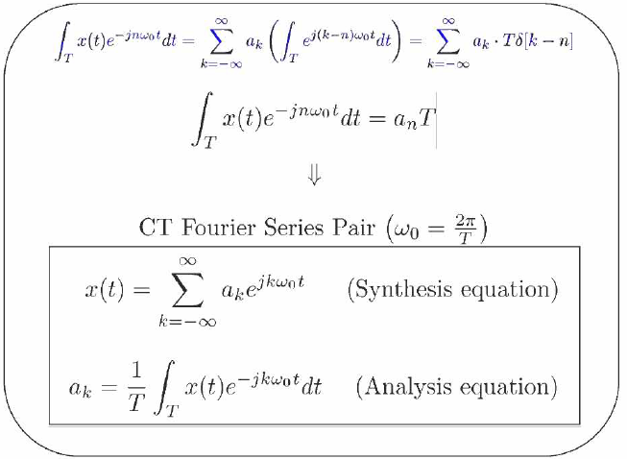

Slide 13
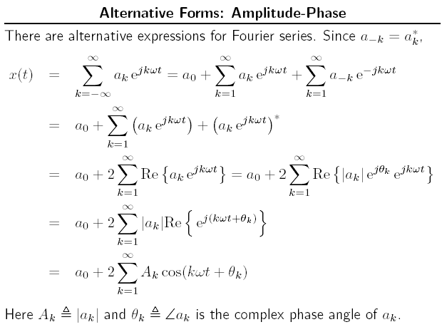

Slide 14
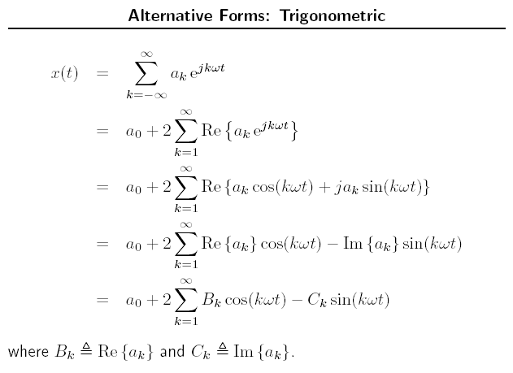

Slide 15
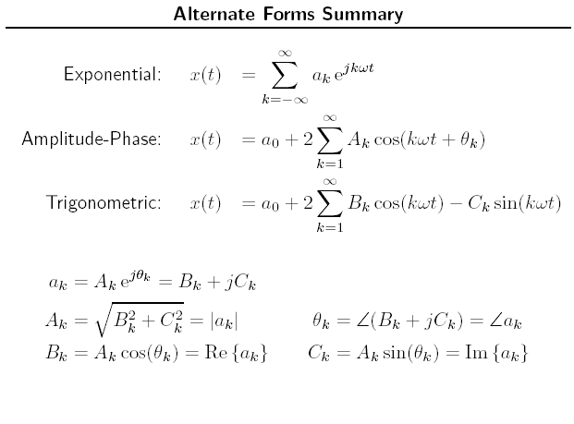

Slide 16
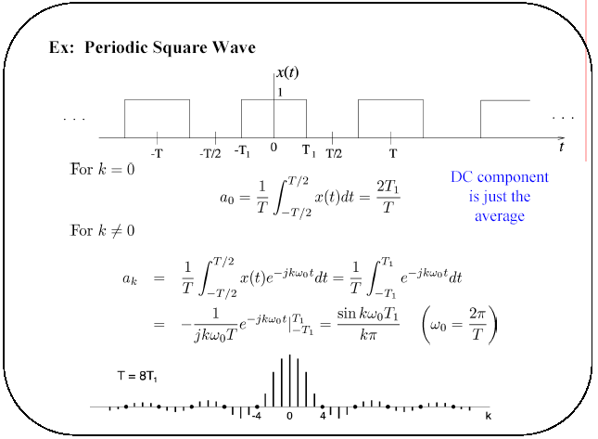

Slide 17
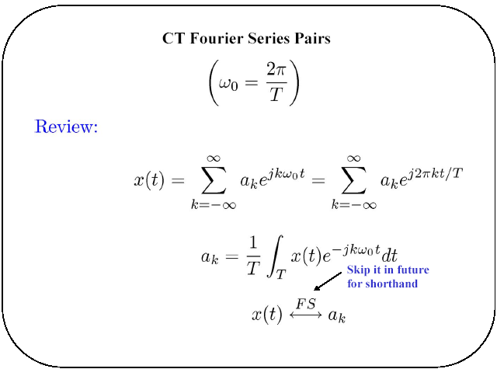

Slide 18
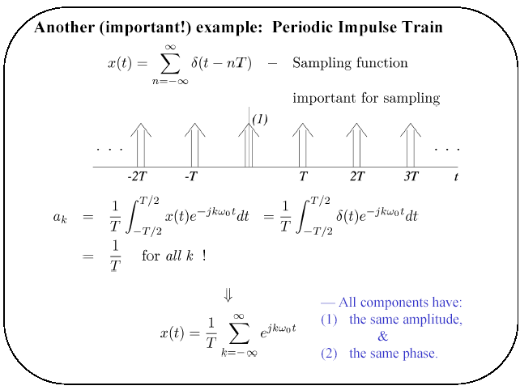

Slide 19
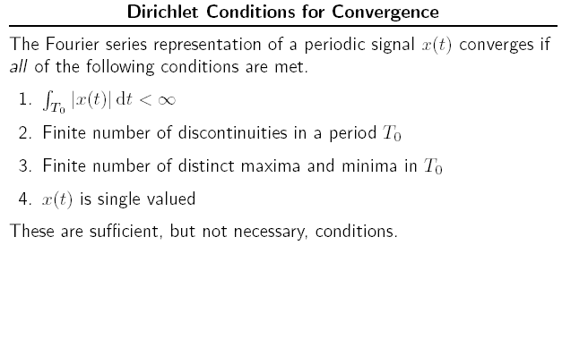

Slide 20
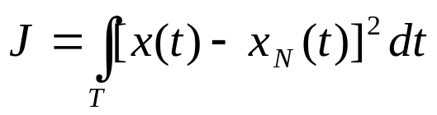
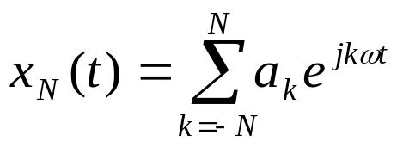
These conditions are usually satisfied in practical context
When these conditions satisfied, the truncated Fourier series, with finite (N) no. of terms, will be the best approximation to the original function;
The total squared-error magnitude over one period is used for comparison:

Slide 21
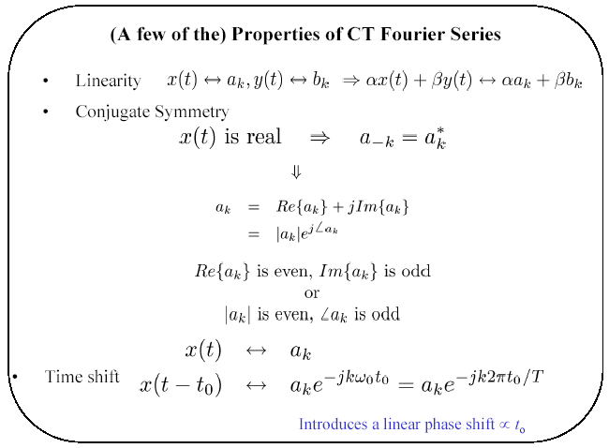

Slide 22
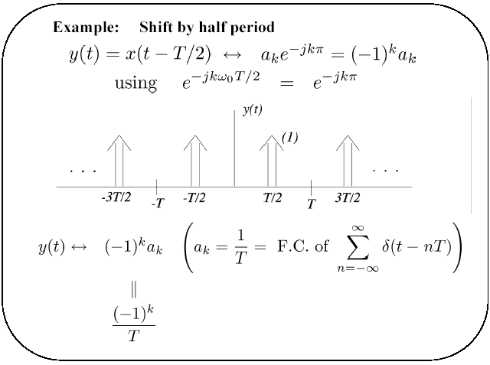

Slide 23
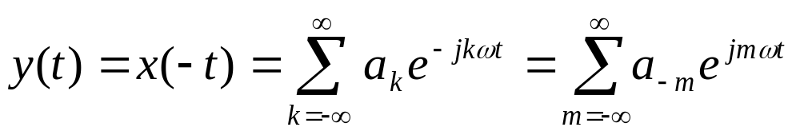
  Time Reversal
  y(t)=x(-t), the period T is unchanged,
  where k = -m substitution is made.
  x(t) ↔ a_{k} then x(-t) ↔ a_{-k}
  Note that if x(t) is even, x(-t) = x(t) then a_{-k} = a_{k} ;
  And if x(t) is odd; x(-t) = -x(t) then a_{-k} = -a_{k} ;

Slide 24
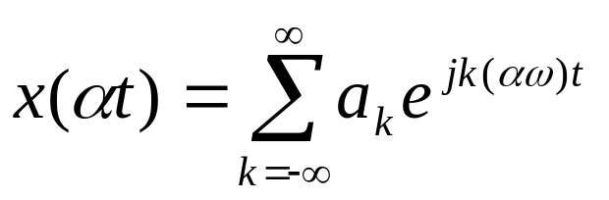
  Time Scaling
For a positive real number α, x(αt) will be periodic
with T/α and fundamental frequency αω;
Note that the Fourier coefficients have not changed
but the Fourier series representation has changed.

Slide 25
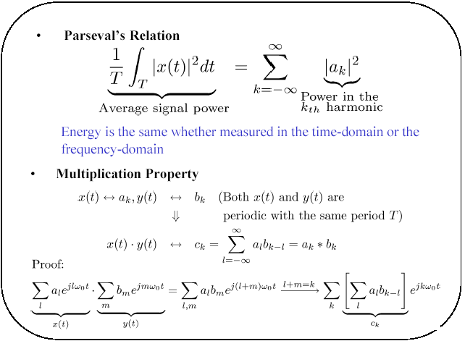
(applies to power signals)
P =

Slide 26
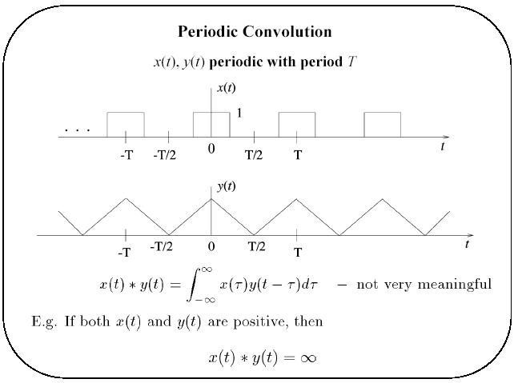

Slide 27
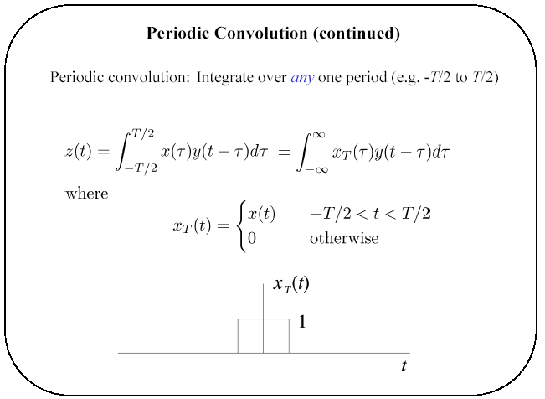

Slide 28
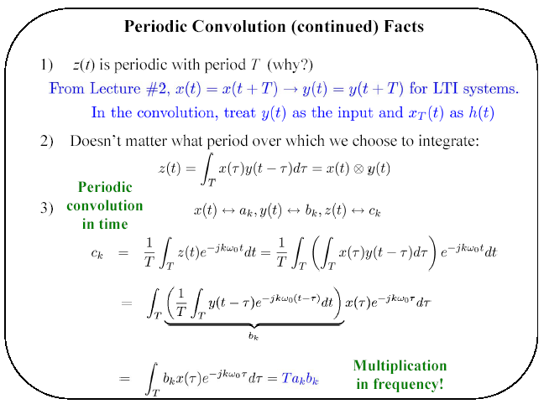

Slide 29
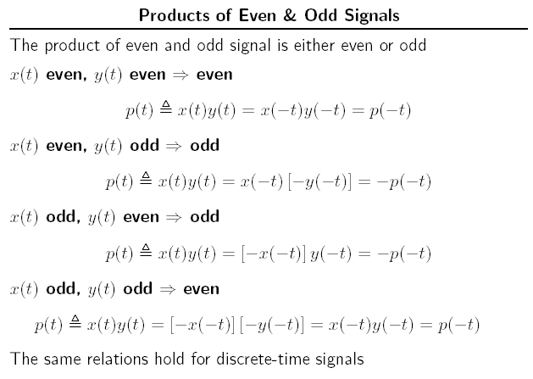

Slide 30
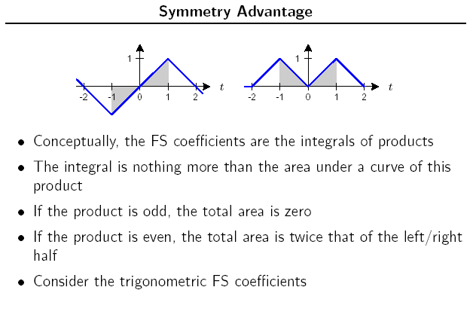

Slide 31
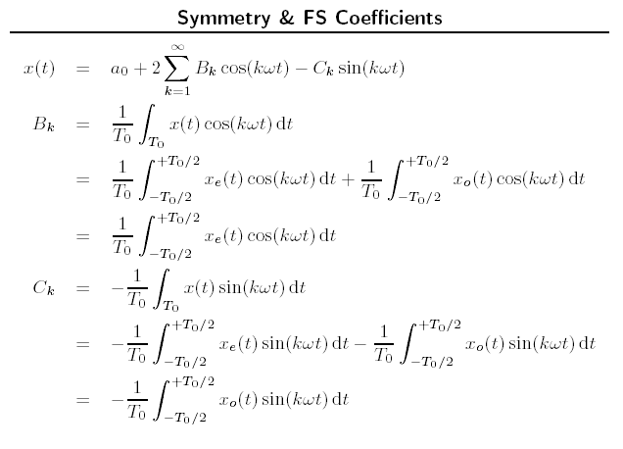

Slide 32
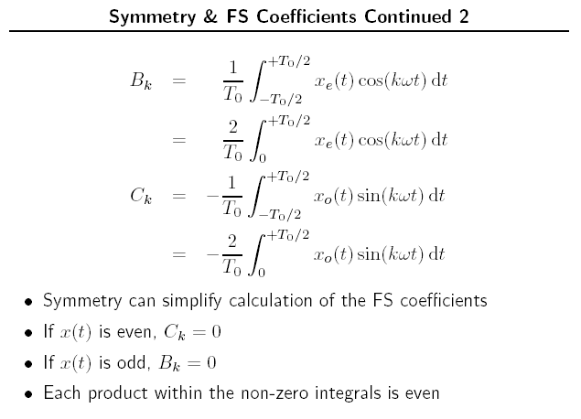

Slide 33
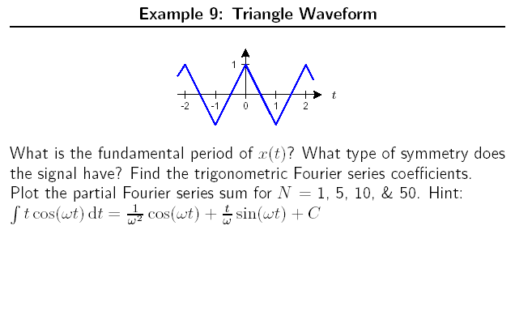

Slide 34
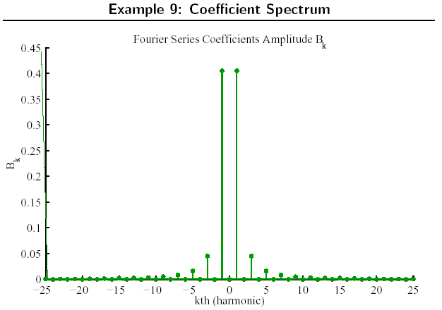

Slide 35
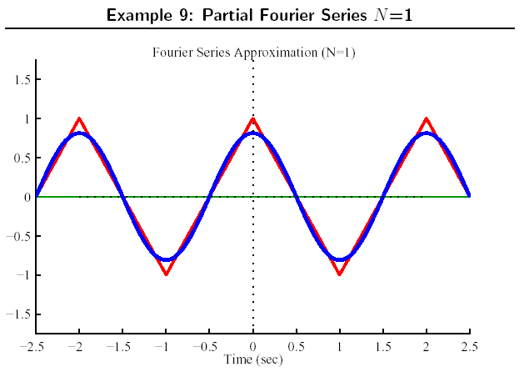

Slide 36
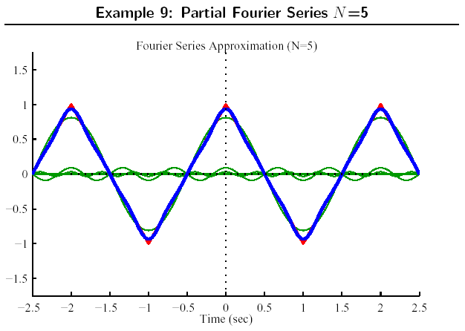

Slide 37
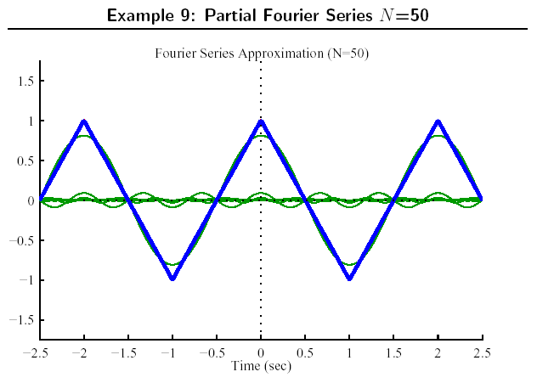

Slide 38
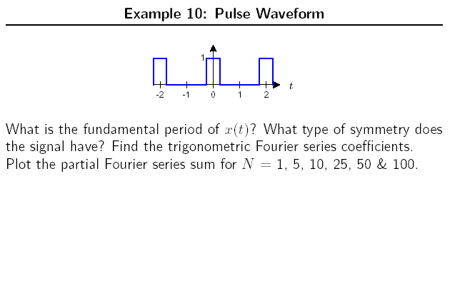

Slide 39
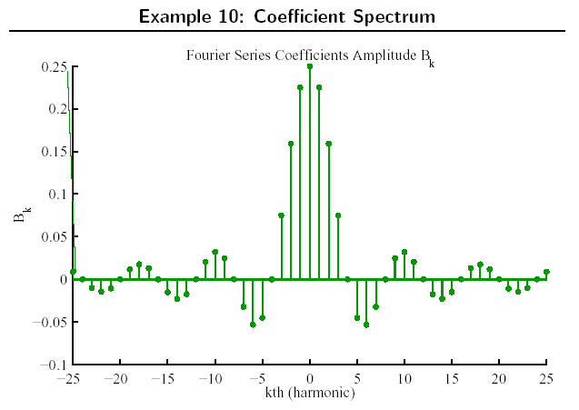

Slide 40
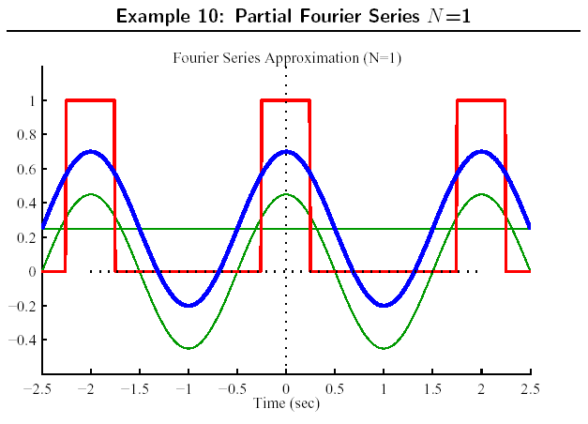

Slide 41
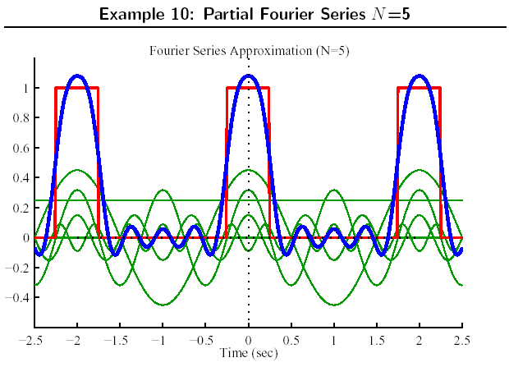

Slide 42
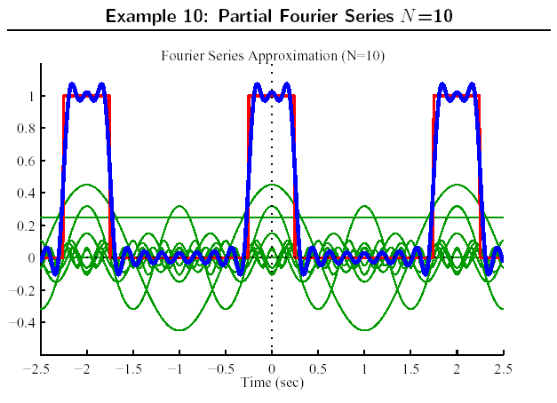

Slide 43
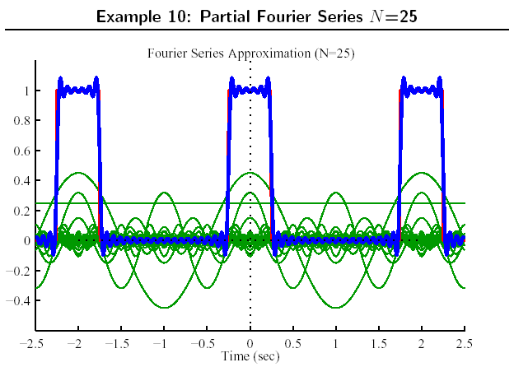

Slide 44
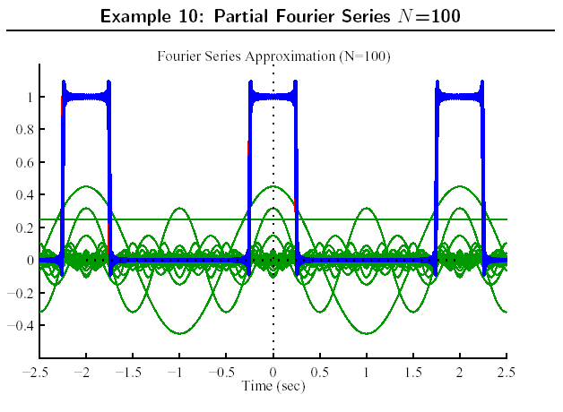

Slide 45
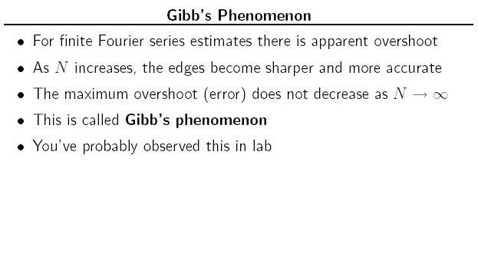

Slide 46
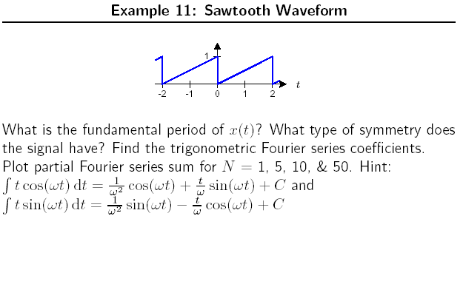

Slide 47
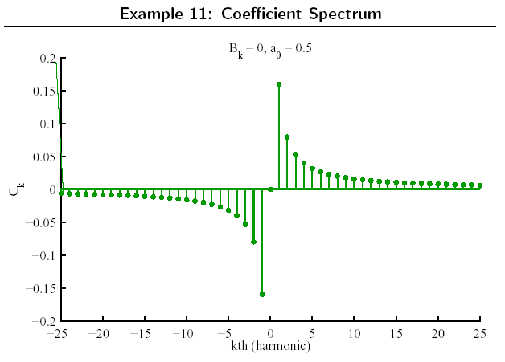

Slide 48
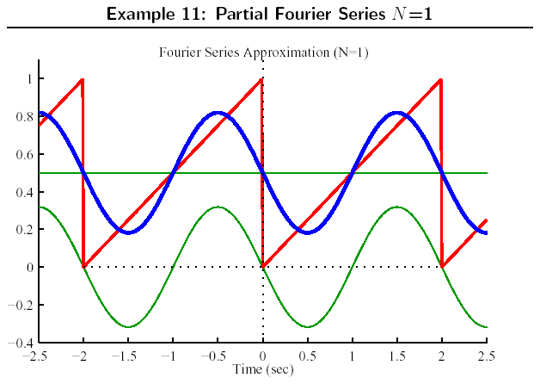

Slide 49
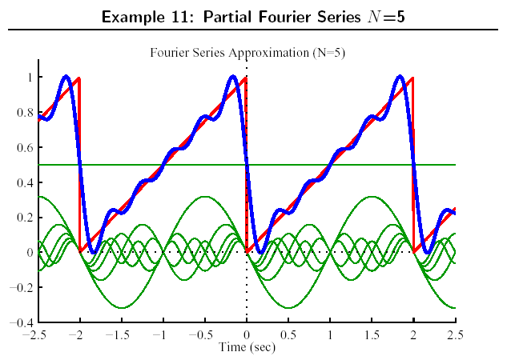

Slide 50
