Slide 1
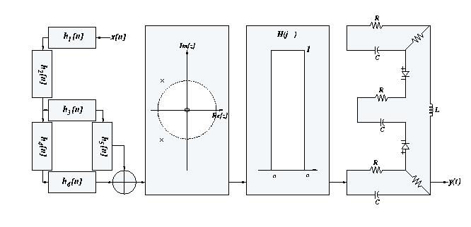
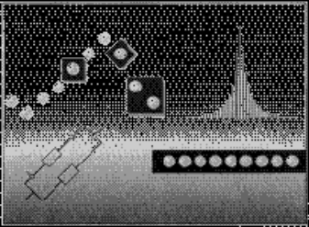
Signals and Systems
Spring 2007
Lecture #10
13 March 2007
Examples of the DT Fourier Transform
Properties of the DT Fourier Transform
The Convolution Property and its
Implications and Uses

Slide 2
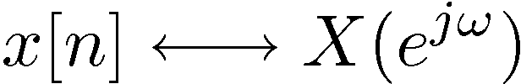
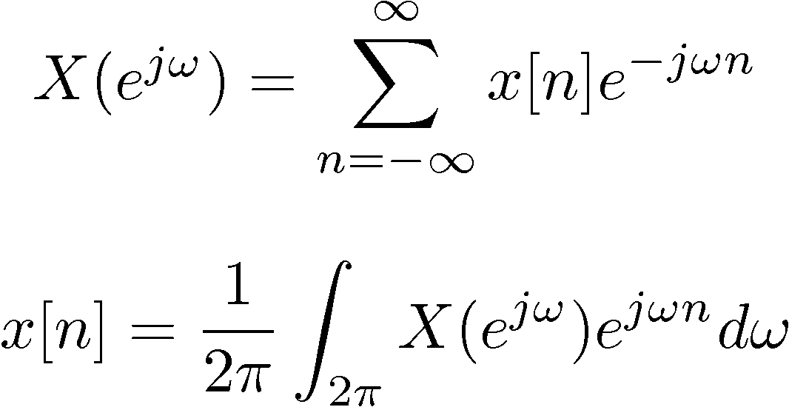
DT Fourier Transform Pair
– Analysis Equation
– FT
– Synthesis Equation
– Inverse FT

Slide 3
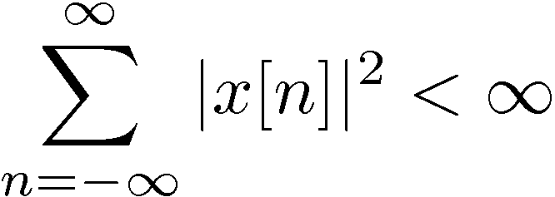
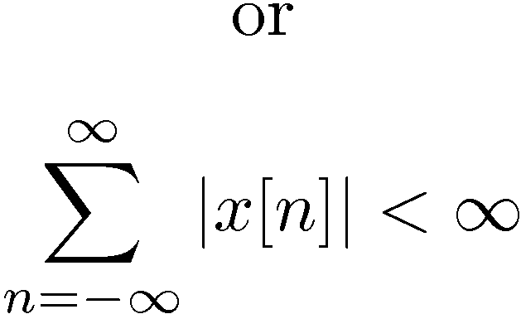
Convergence Issues
Synthesis Equation: None, since integrating over a finite interval
Analysis Equation: Need conditions analogous to CTFT, e.g.
— Finite energy
— Absolutely summable

Slide 4

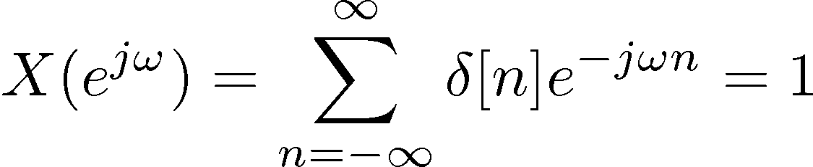
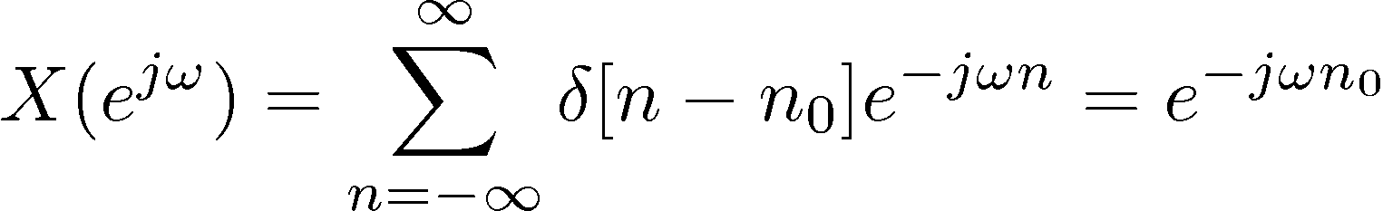
Examples
Parallel with the CT examples in Lecture #8

Slide 5
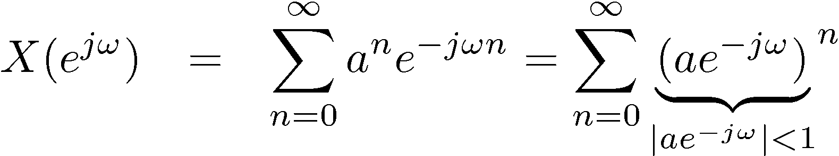
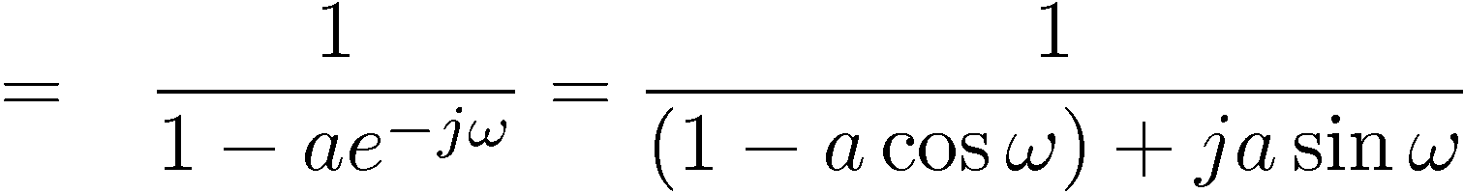
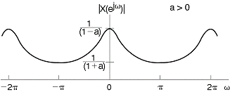
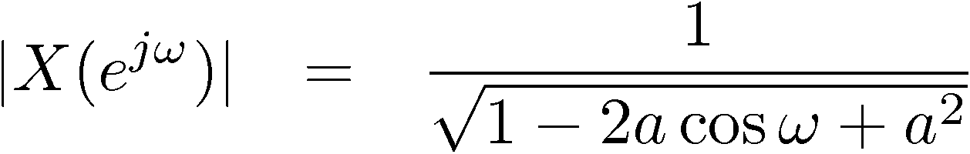
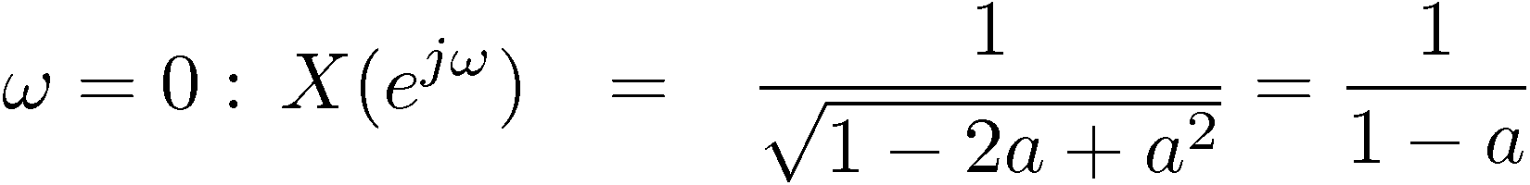
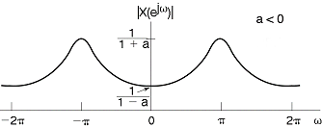
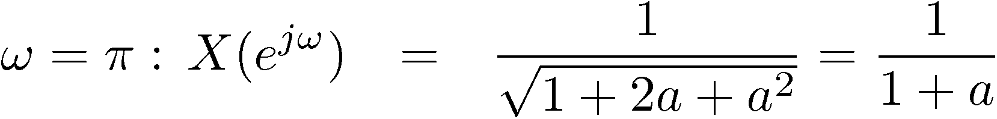
More Examples

Slide 6
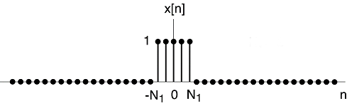
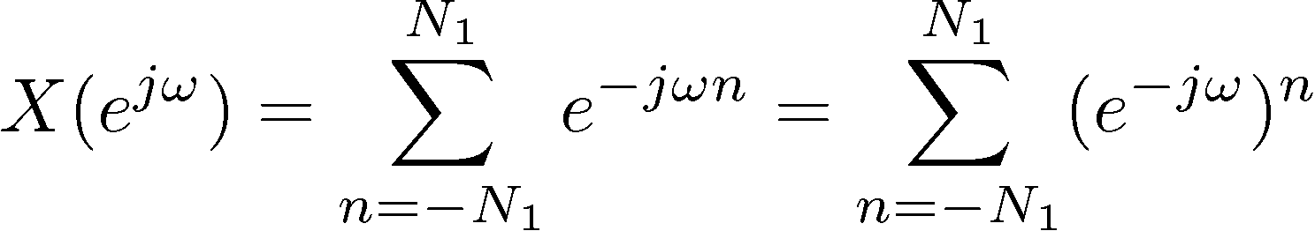
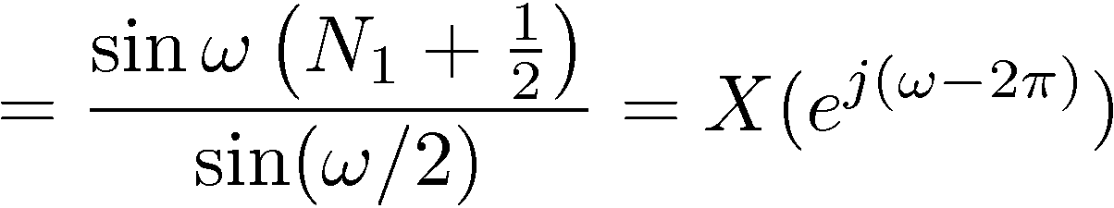
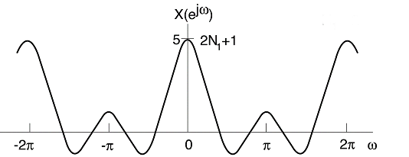
Still More
4) DT Rectangular pulse
(Drawn for N₁ = 2)

Slide 7
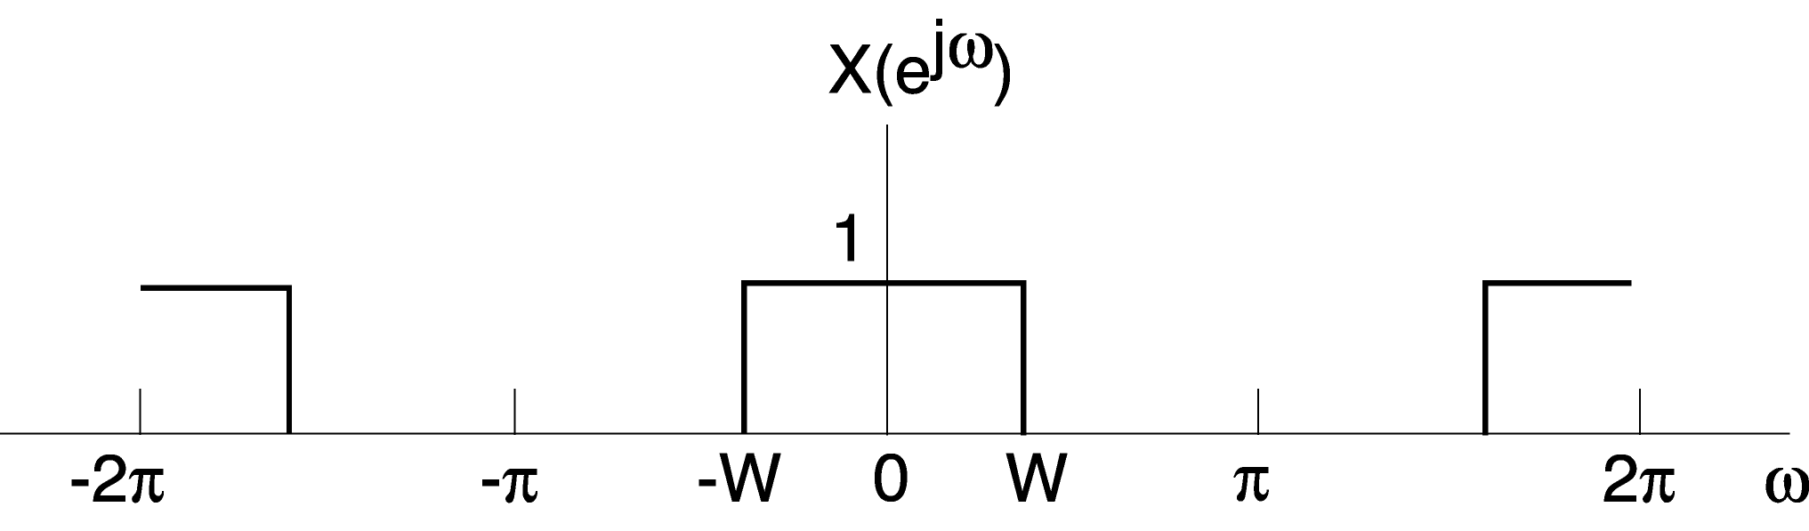
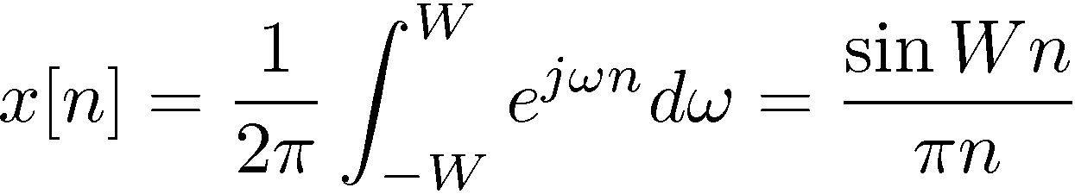
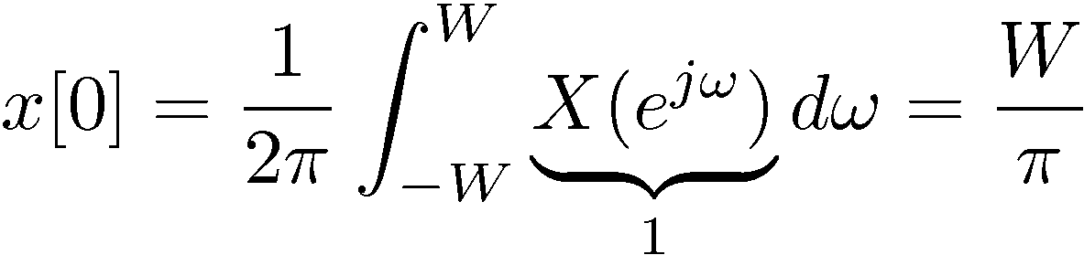
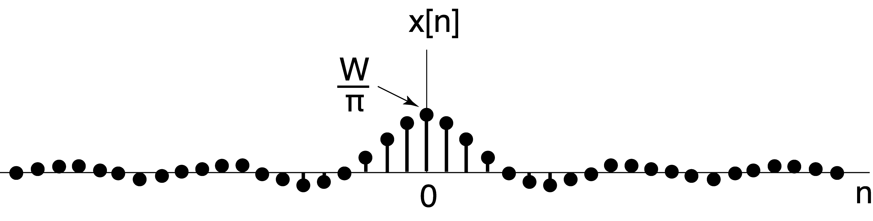
5)

Slide 8
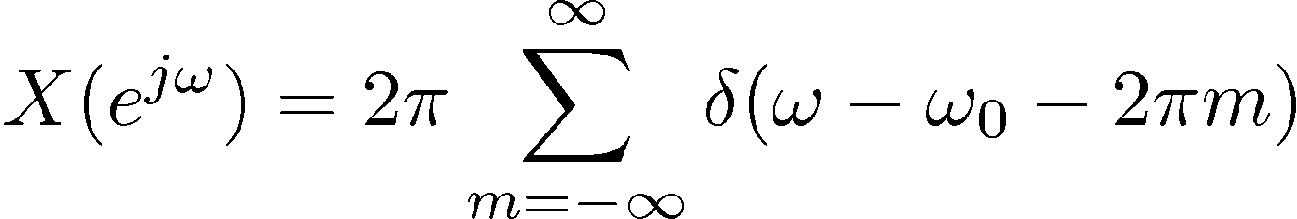
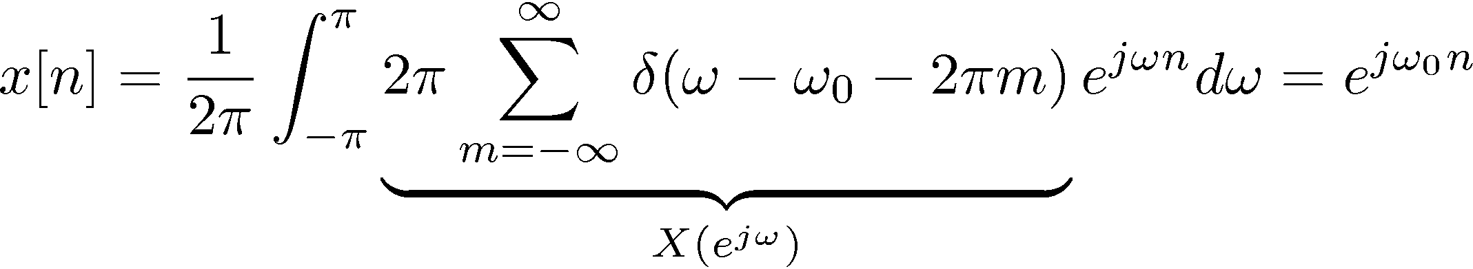
DTFTs of Sums of Complex Exponentials
Recall CT result:
What about DT:
We expect an impulse (of area 2π) at ω = ω_{o}
But X(e^{jω}) must be periodic with period 2π
In fact
Note: The integration in the synthesis equation is over 2π period,
only need X(e^{jω}) in one 2π period. Thus,

Slide 9

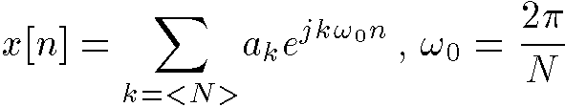
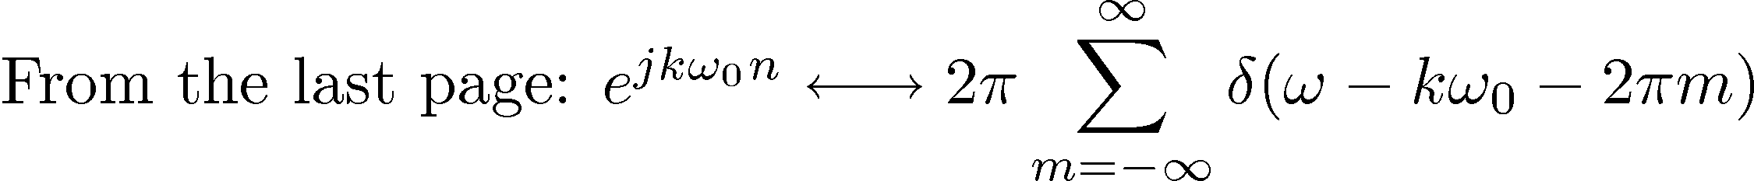
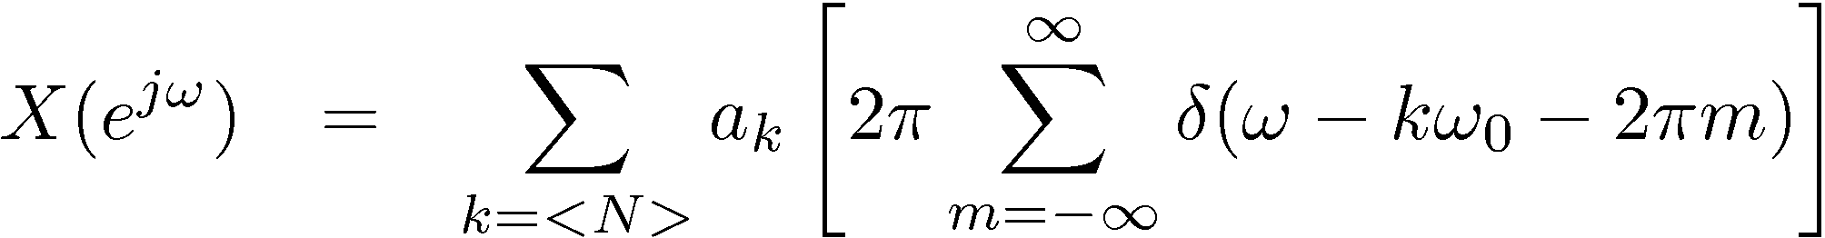
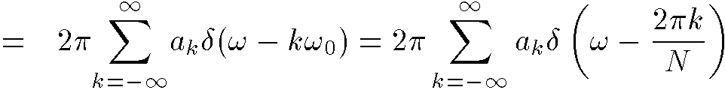
DTFT of Periodic Signals
Linearity
of DTFT

Slide 10
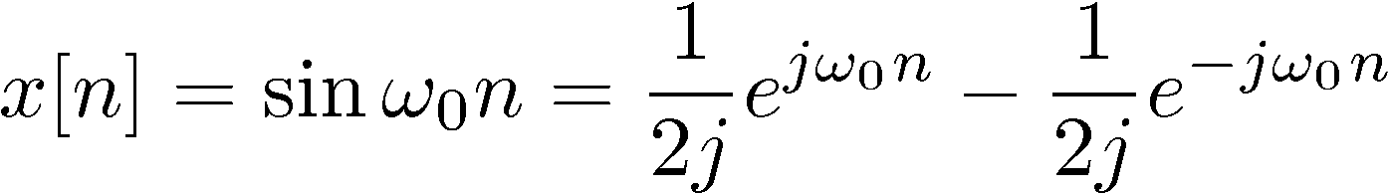
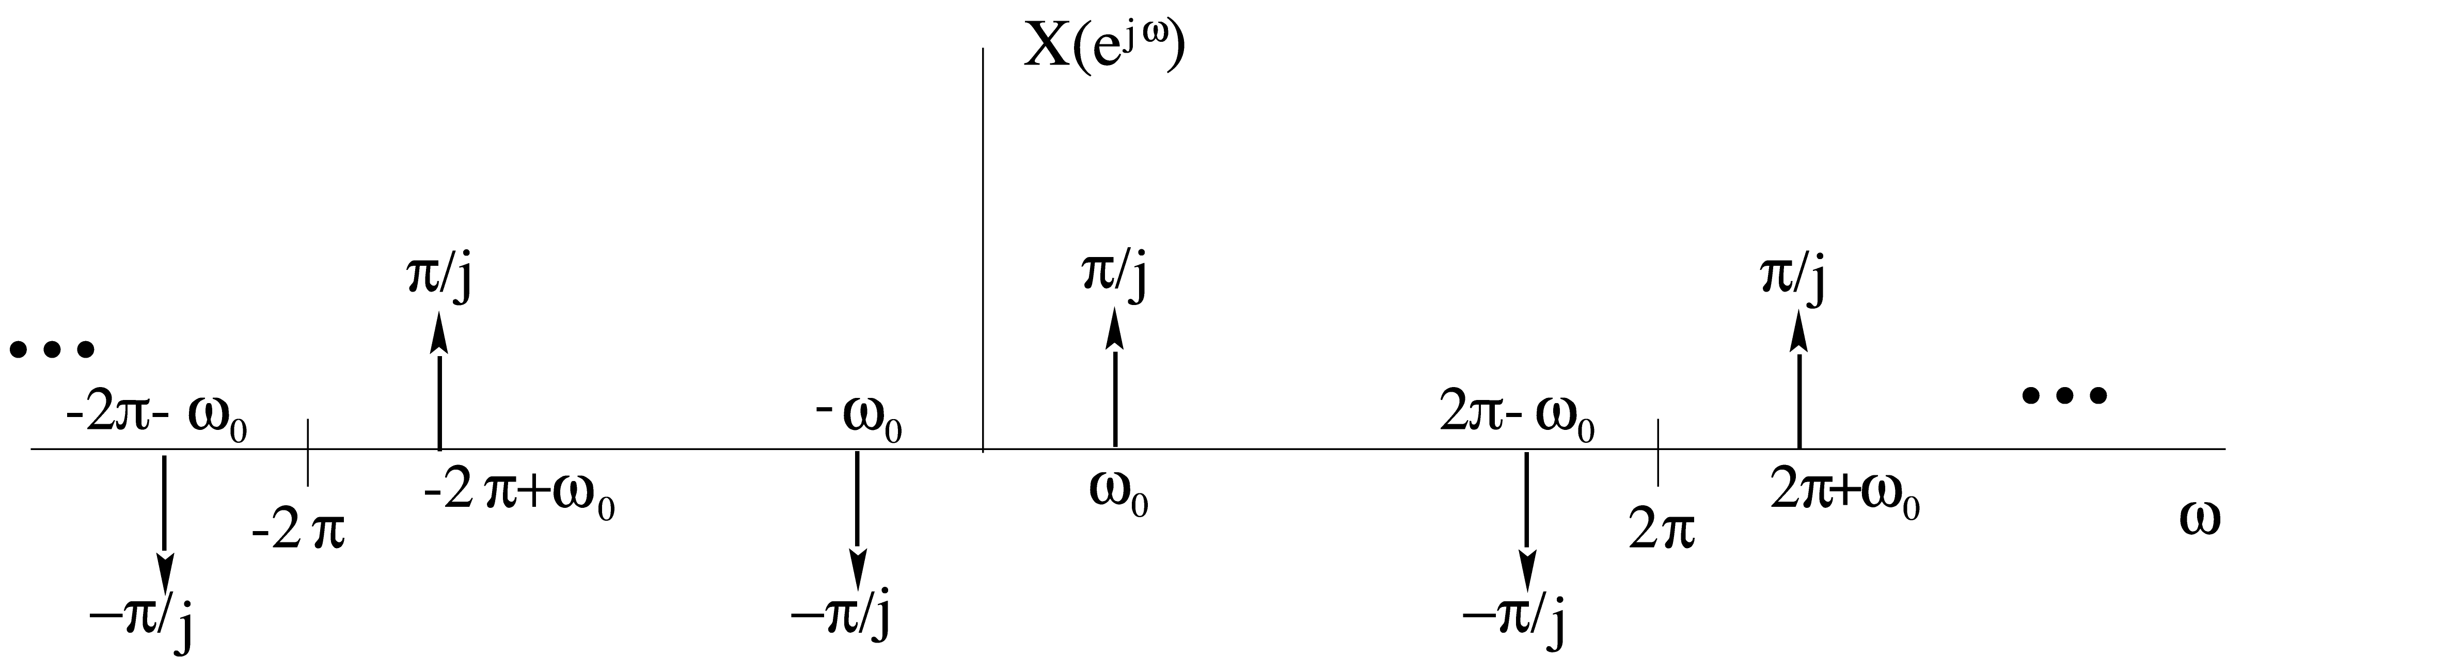
Example #1: DT sine function

Slide 11
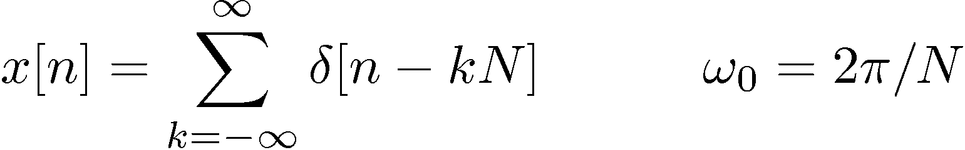
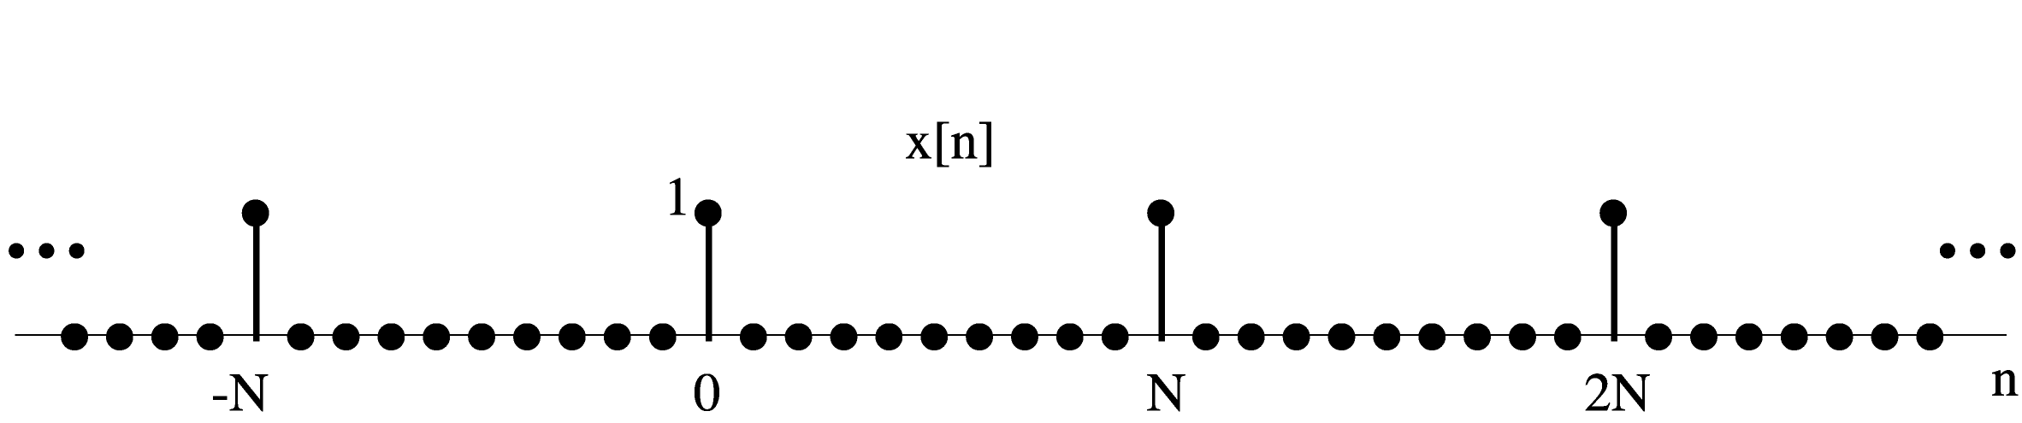
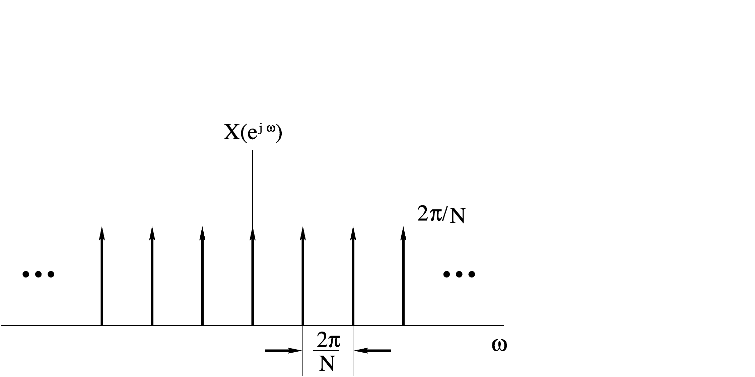
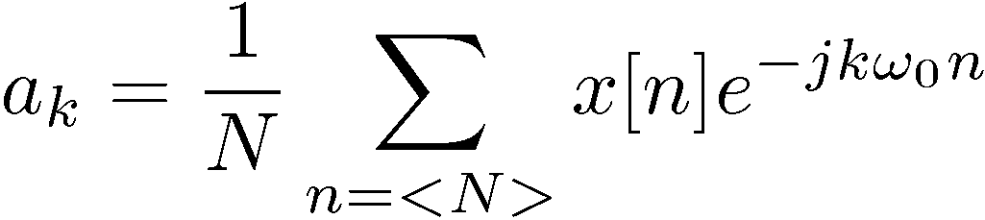
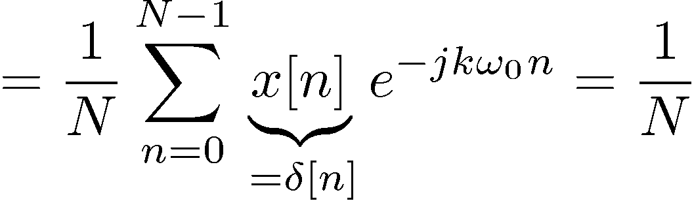

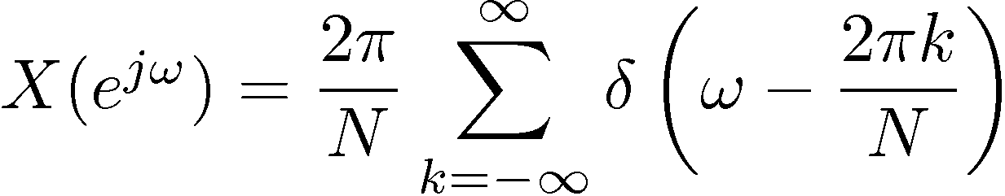
Example #2: DT periodic impulse train
— Also periodic impulse train – in the frequency domain!

Slide 12
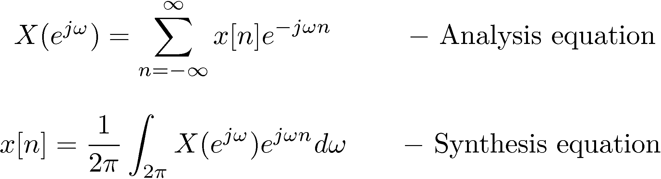
Properties of the DT Fourier Transform
— Different from CTFT

Slide 13
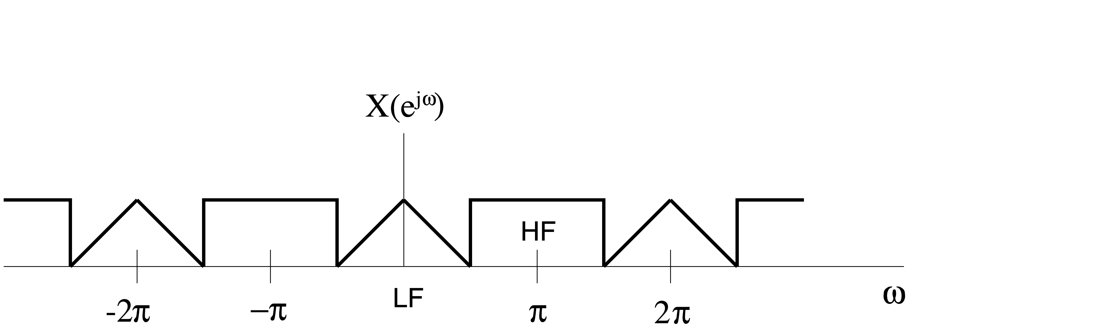
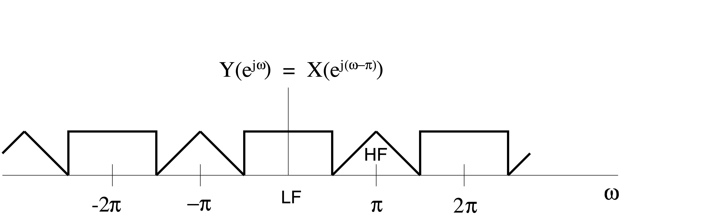
More Properties
— Important implications in DT because of periodicity
Example

Slide 14
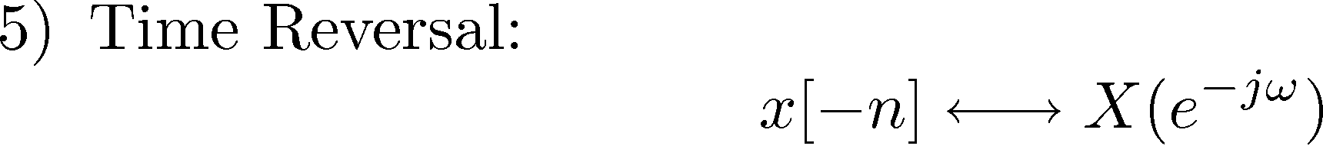
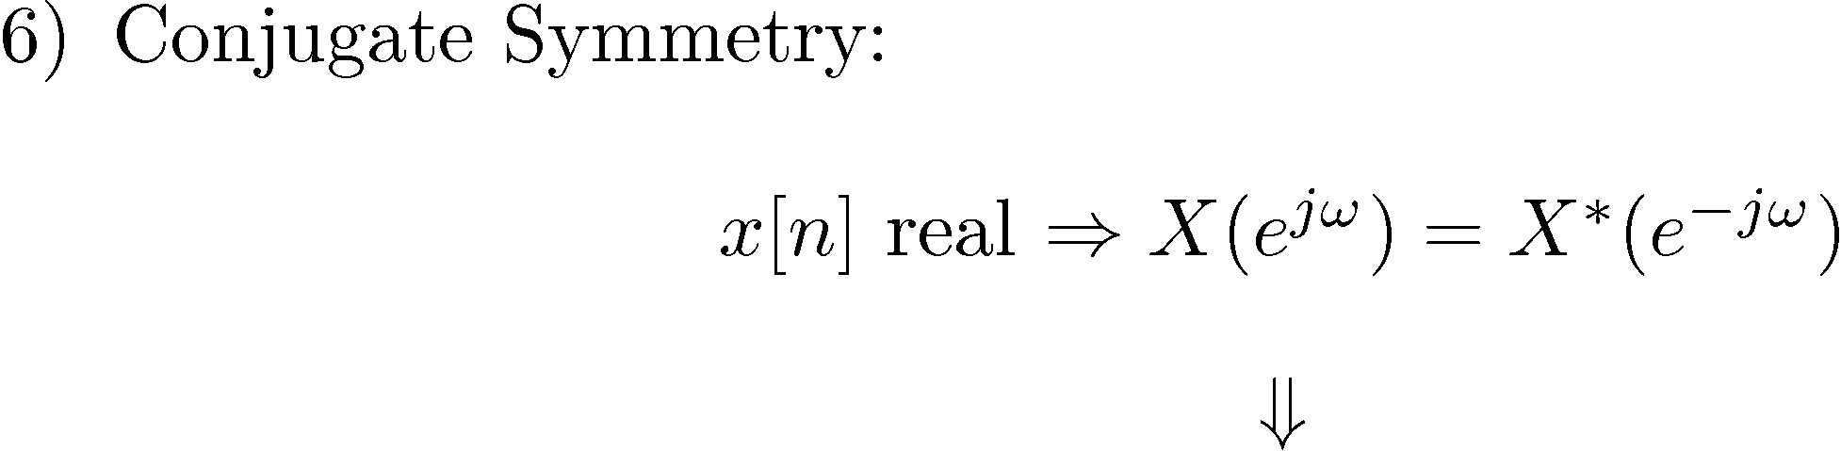
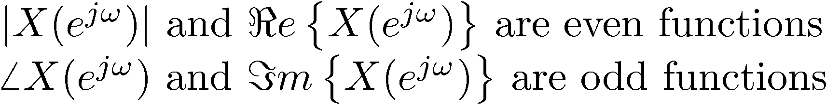
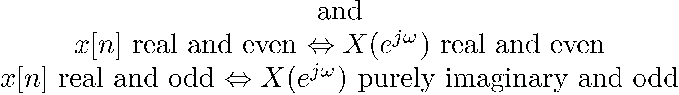
Still More Properties

Slide 15
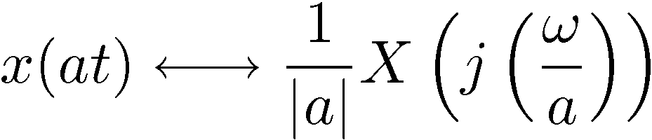
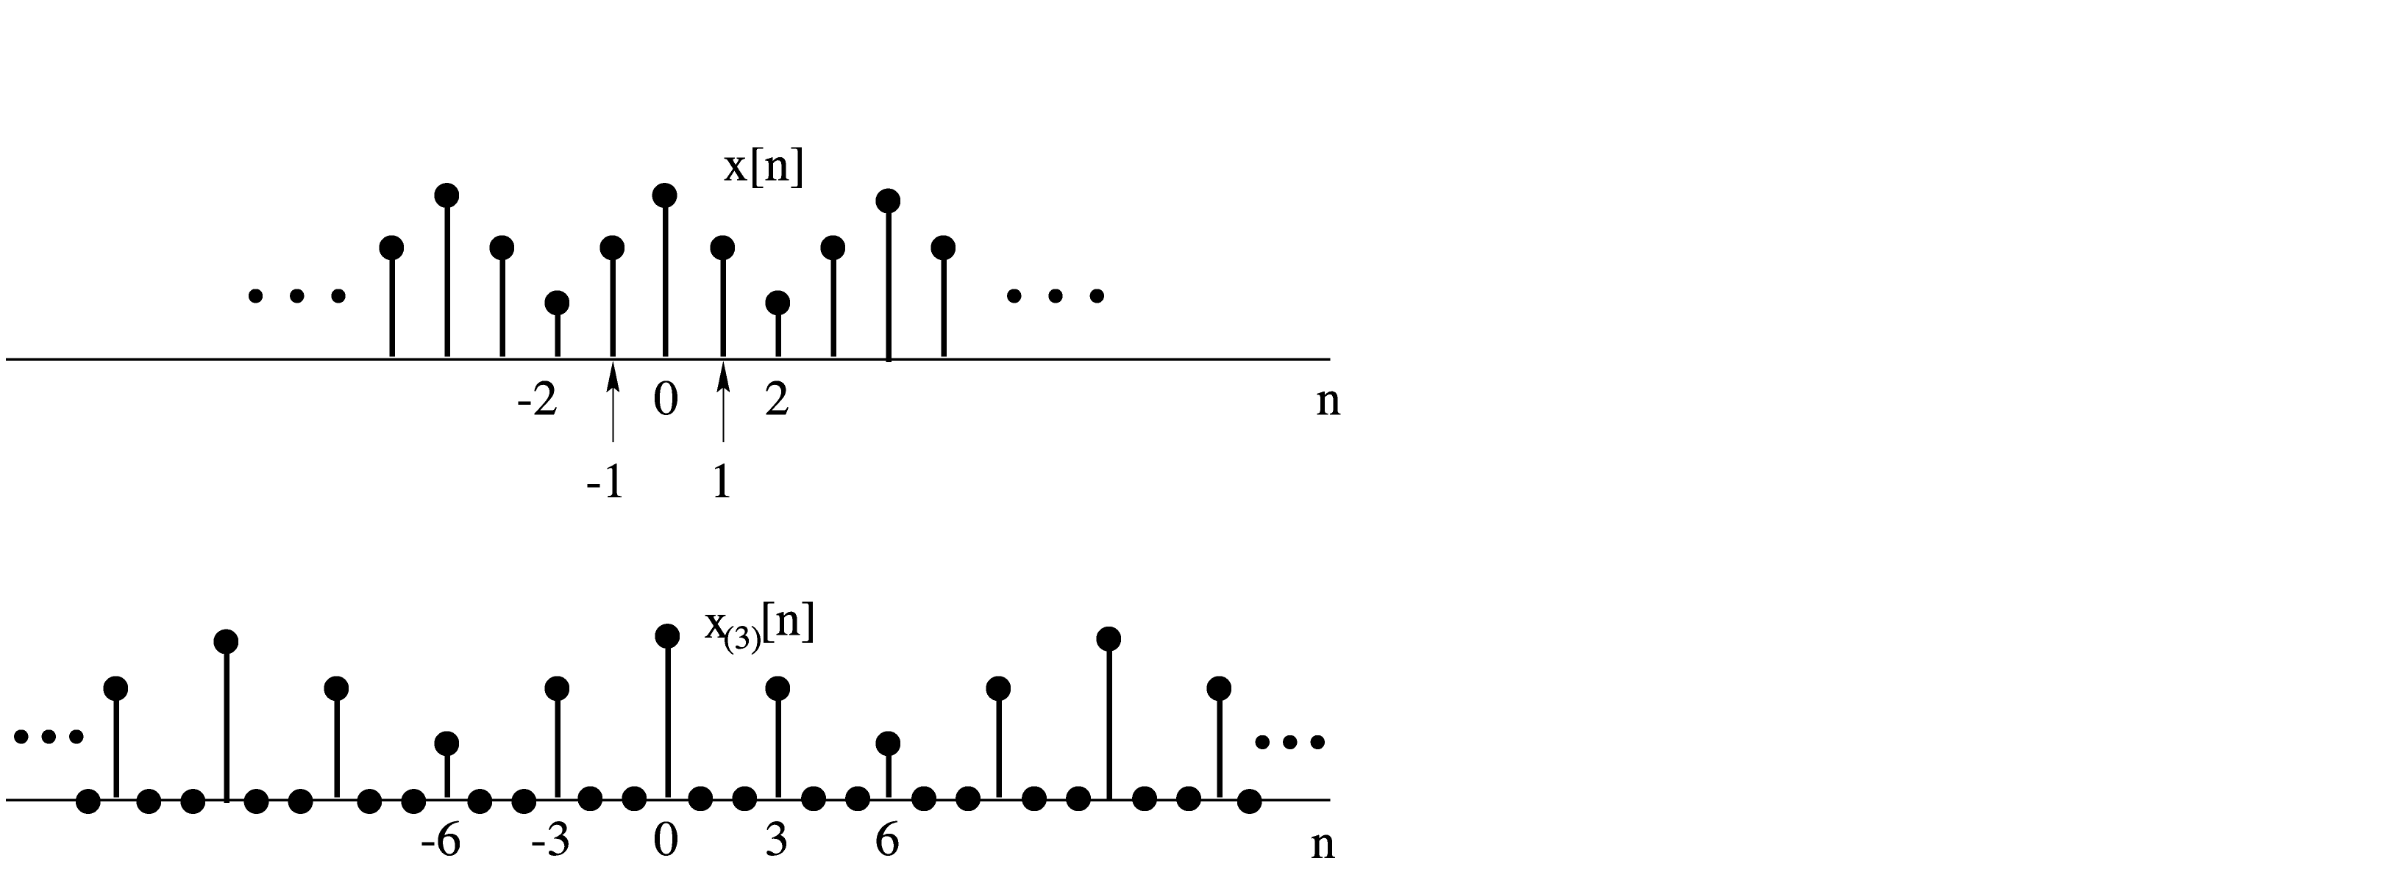
Yet Still More Properties
7) Time Expansion
Recall CT property:
Time scale in CT is
infinitely fine
But in DT: x[n/2] makes no sense
x[2n] misses odd values of x[n]
But we can “slow” a DT signal down by inserting zeros:
k — an integer ≥ 1
x_{(k)}[n] — insert (k - 1) zeros between successive values
Insert two zeros
in this example
(k=3)

Slide 16
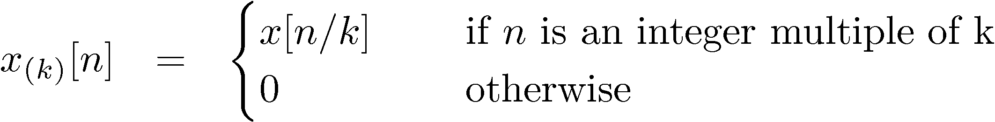
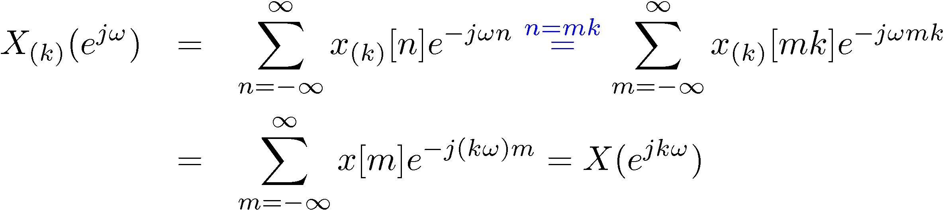
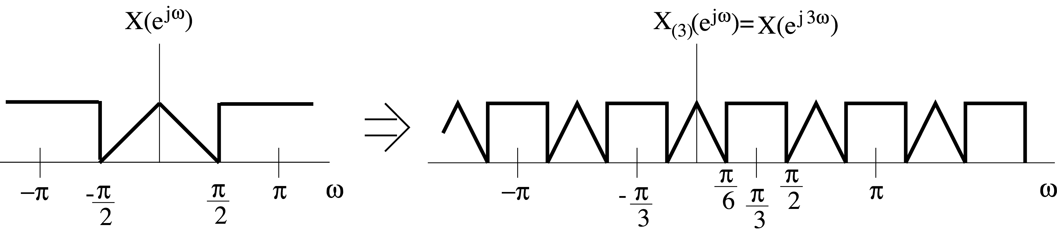
Time Expansion (continued)
— Stretched by a factor
of k in time domain
-compressed by a factor of k in frequency domain

Slide 17
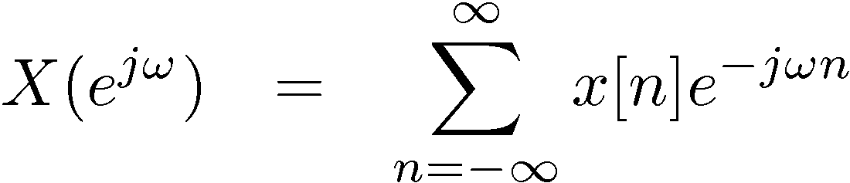



Is There No End to These Properties?
8) Differentiation in Frequency
9) Parseval’s Relation
Total energy in
time domain
Total energy in
frequency domain

Slide 18


The Convolution Property
Example #1:

Slide 19



Example #2: Ideal Lowpass Filter

Slide 20


Example #3:

