Slide 1
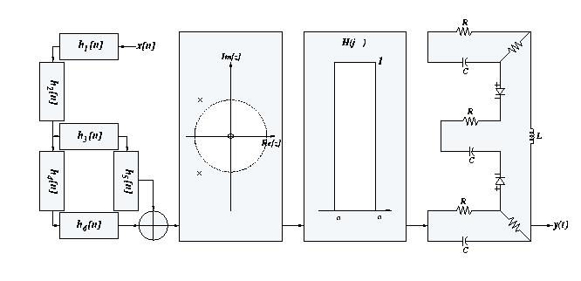
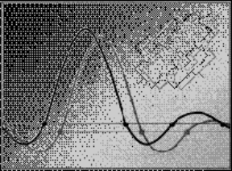
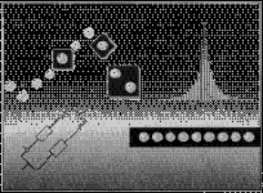
Signals and Systems
Spring 2007
Lecture #9
8 March 2007
The Convolution Property of the CTFT
Frequency Response and LTI Systems Revisited
Multiplication Property and
Parseval’s Relation
The DT Fourier Transform
Chap. 4
Chap. 5

Slide 2
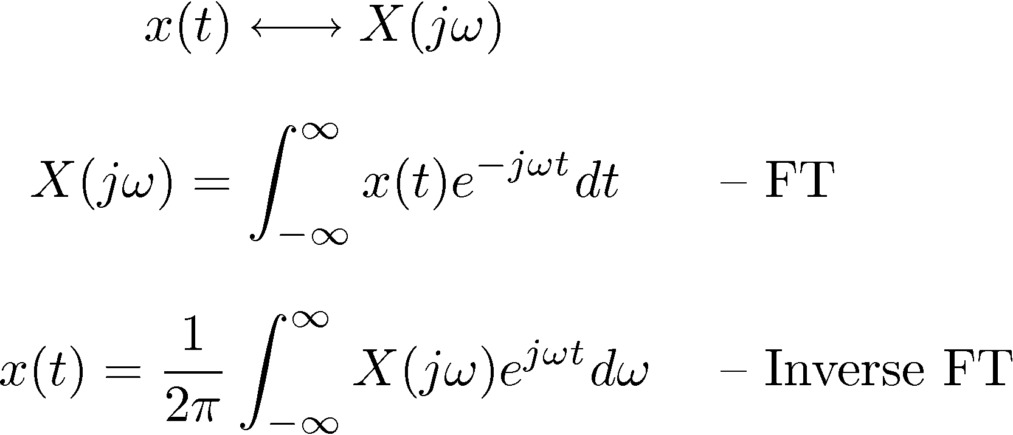
The CT Fourier Transform Pair

Slide 3






Convolution Property
A consequence of the eigenfunction property:

Slide 4









The Frequency Response Revisited
The frequency response of a CT LTI system is simply the Fourier transform of its impulse response
Example #1:

Slide 5


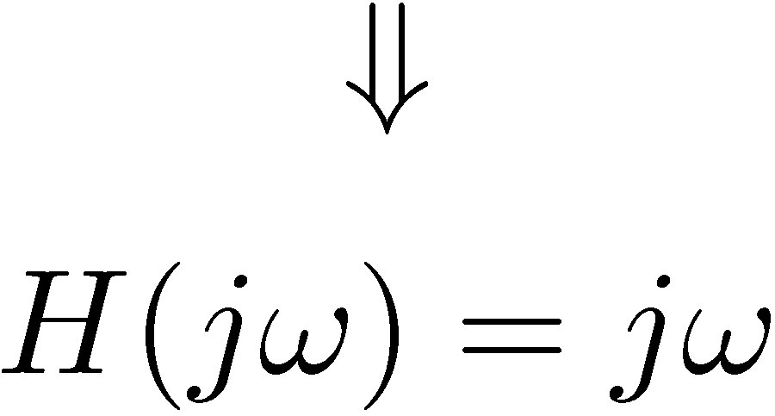
Example #2: A differentiator
Differentiation property:
1) Amplifies high frequencies (enhances sharp edges)

Slide 6
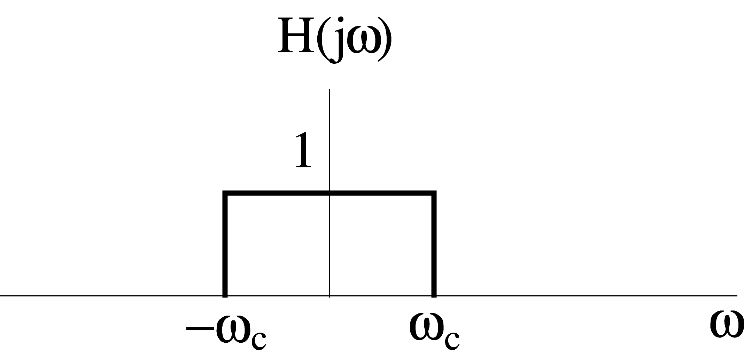
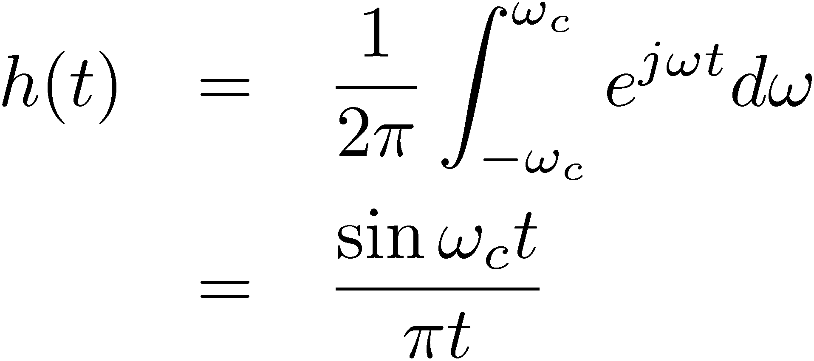



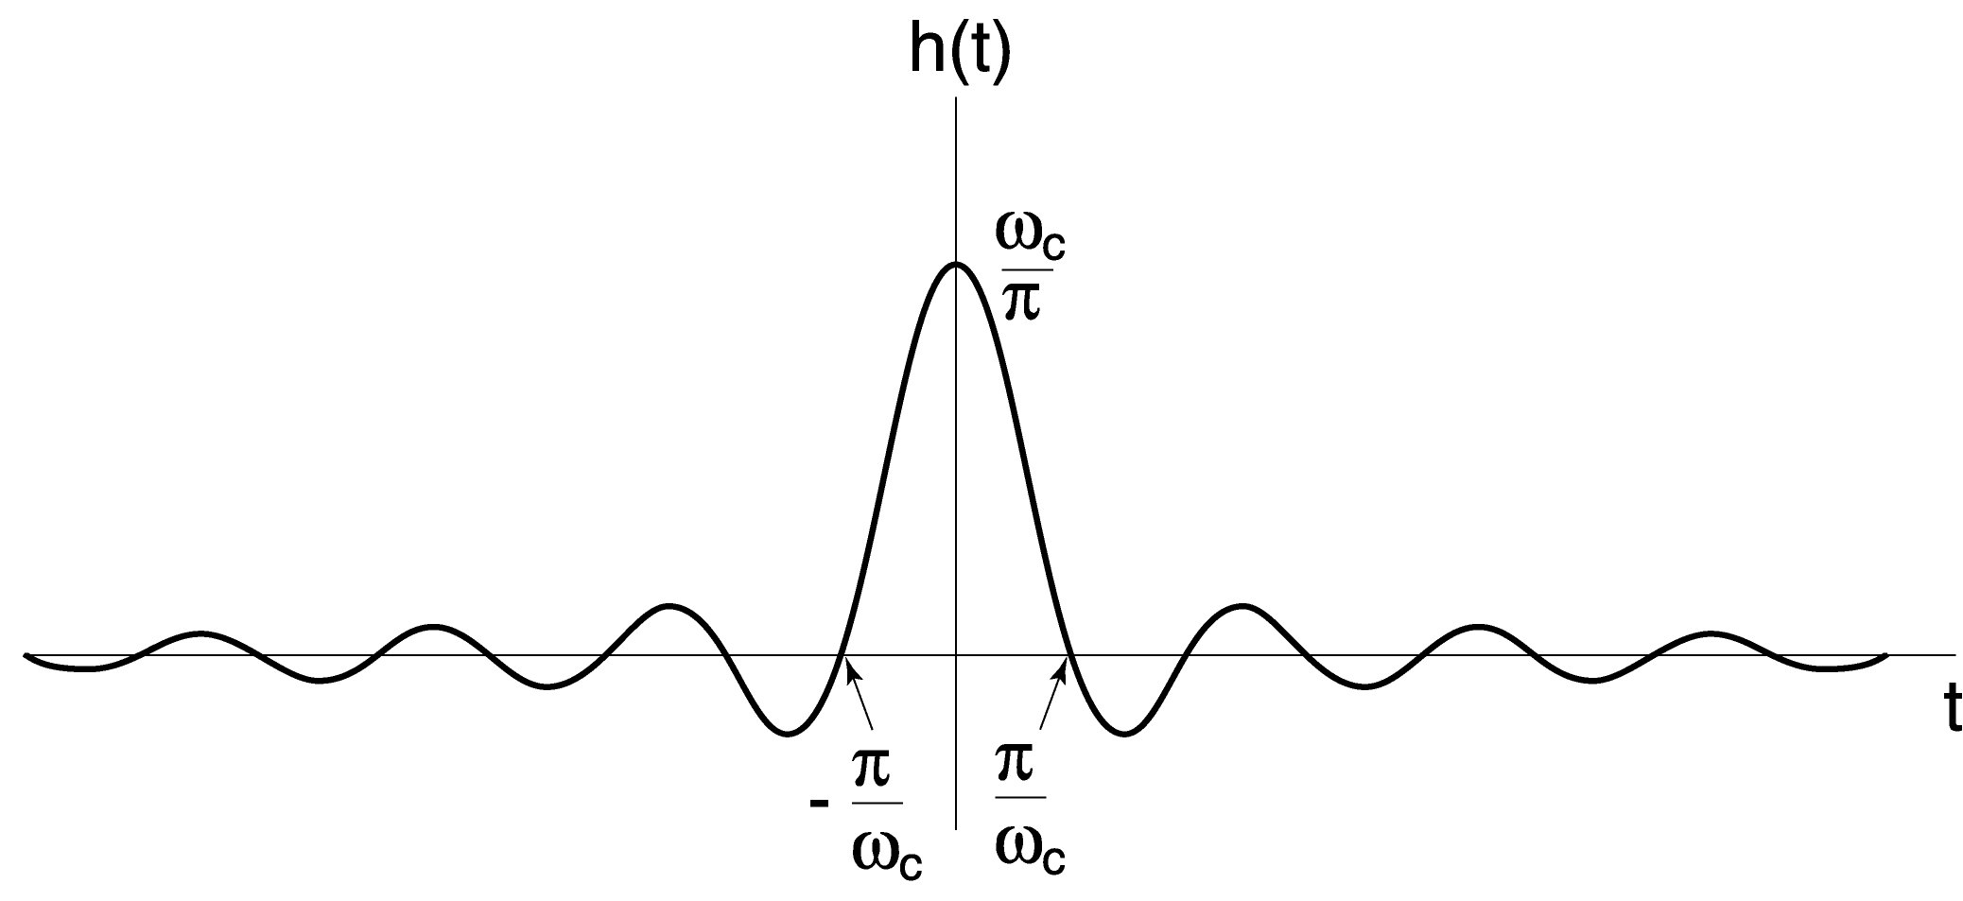


Example #3: Impulse Response of an Ideal Lowpass Filter
Questions:
1) Is this a causal system?
2) What is h(0)?
3) What is the steady-state value of
the step response, i.e. s(∞)?

Slide 7

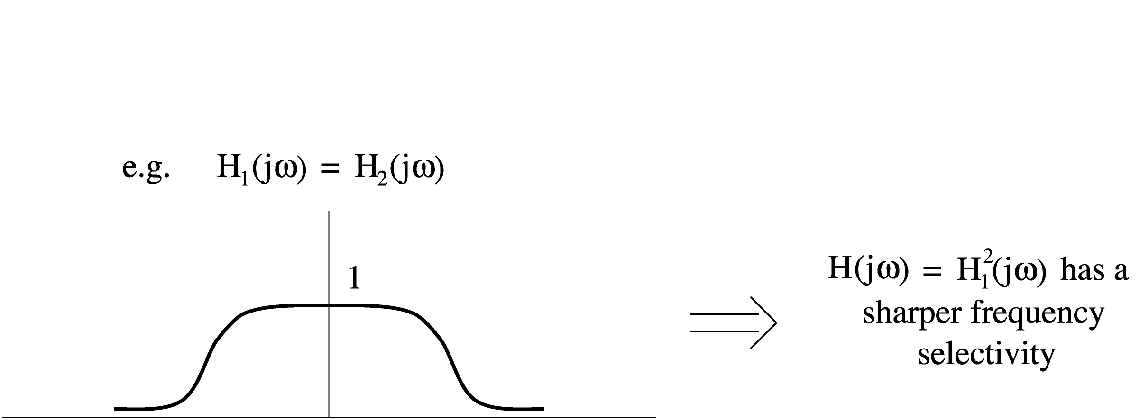
Example #4: Cascading filtering operations

Slide 8
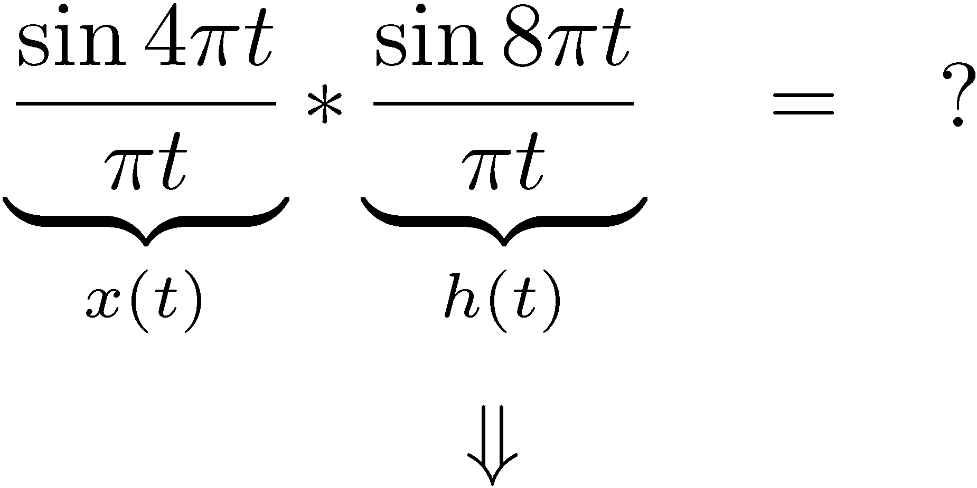

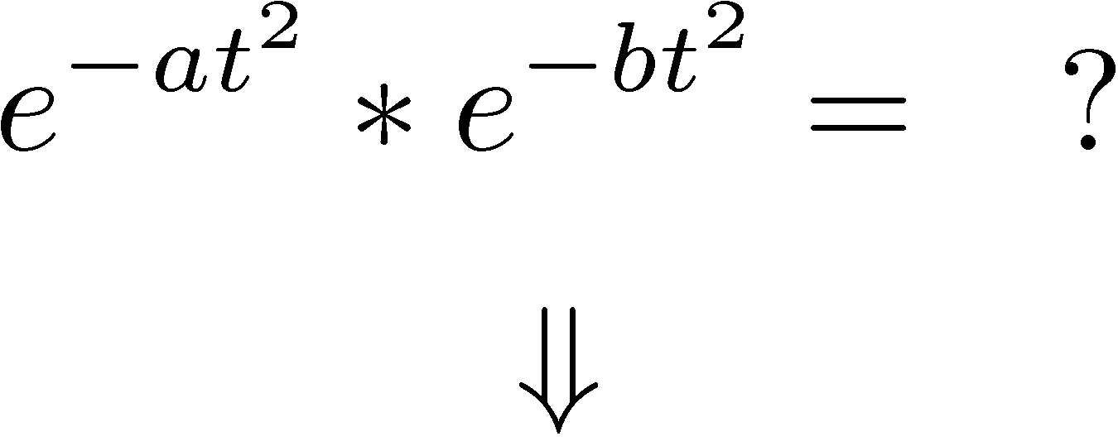

Example #5:
Example #6:
Gaussian × Gaussian = Gaussian )
Gaussian ∗ Gaussian = Gaussian

Slide 9
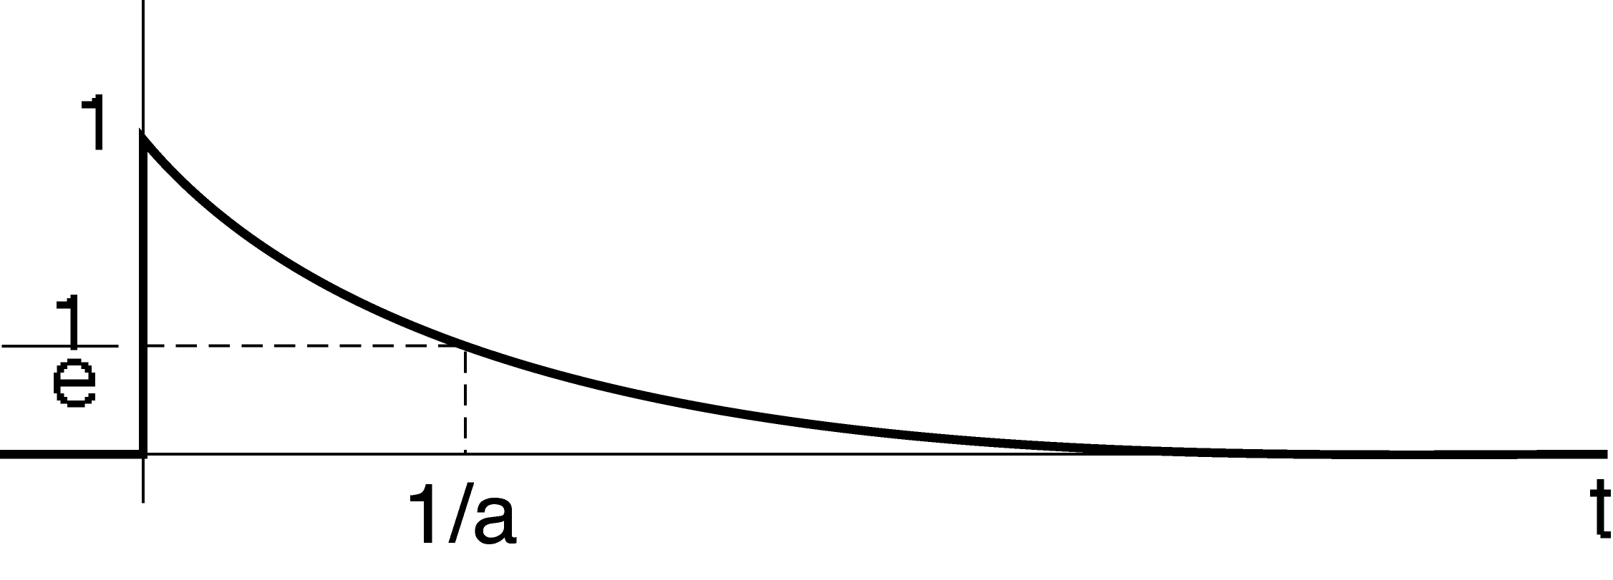
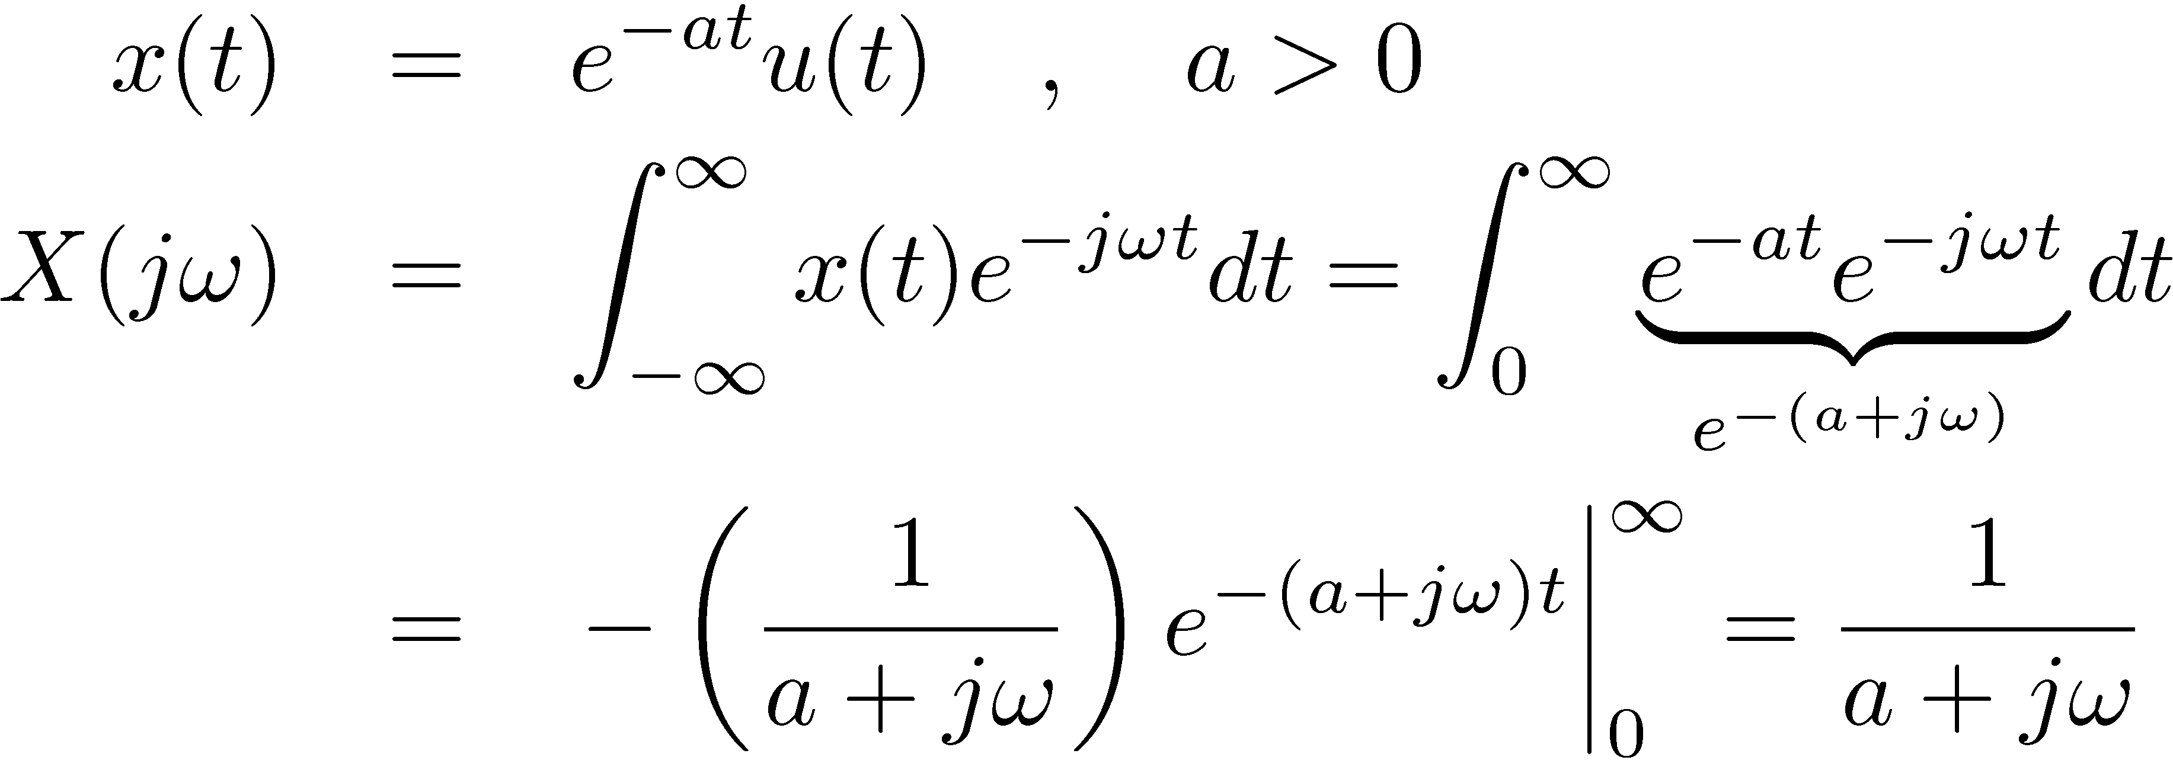
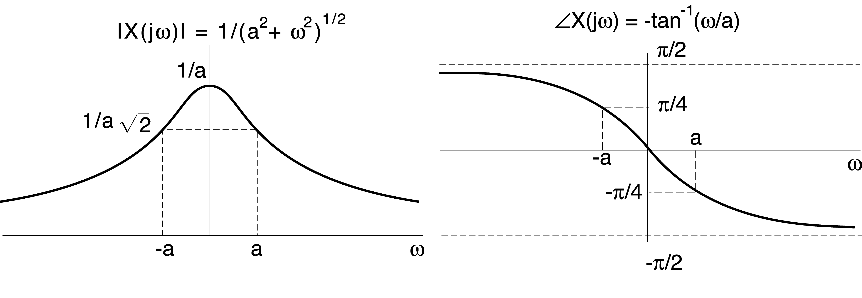
Example #2 from last lecture

Slide 10
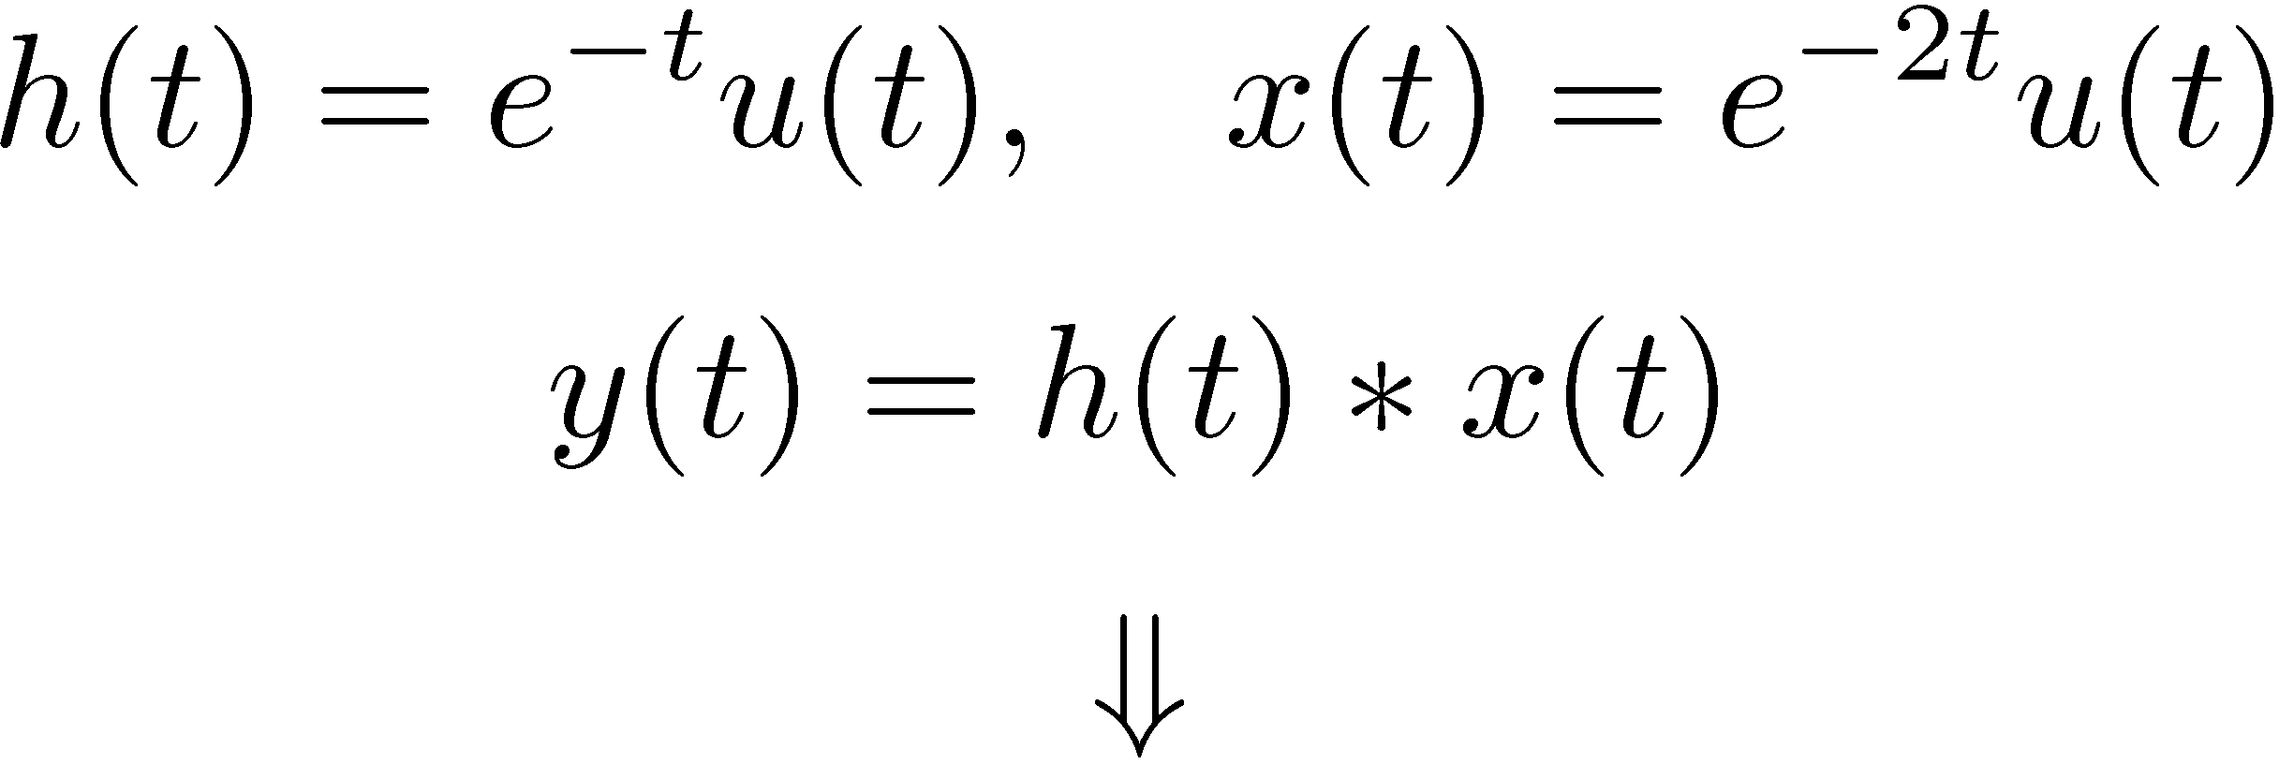



Example #7:

Slide 11



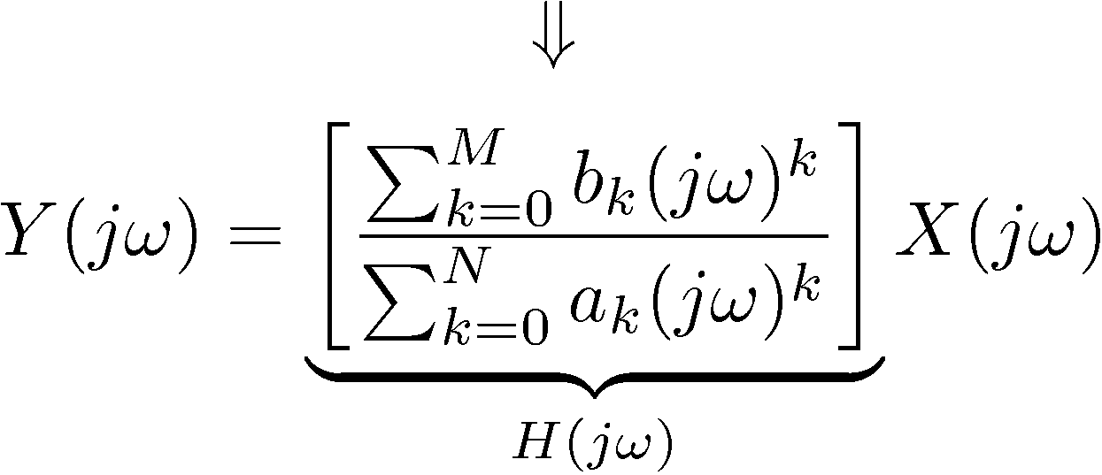


Example #8: LTI Systems Described by LCCDE’s
(Linear-constant-coefficient differential equations)
Using the Differentiation Property
Rational, can use
PFE to get h(t)
If X(jω) is rational
e.g.
then Y(jω) is also rational

Slide 12

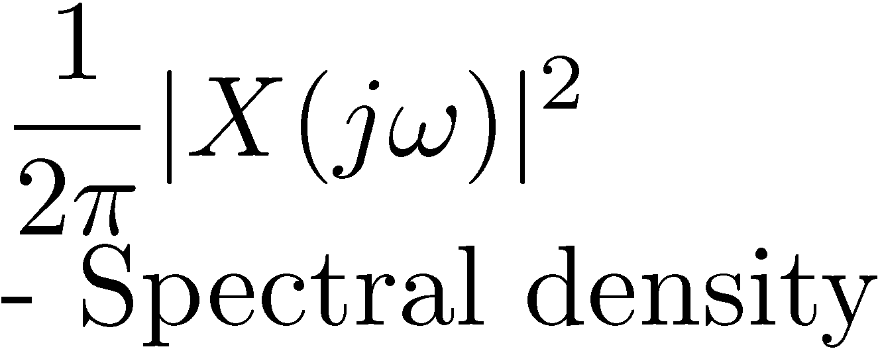
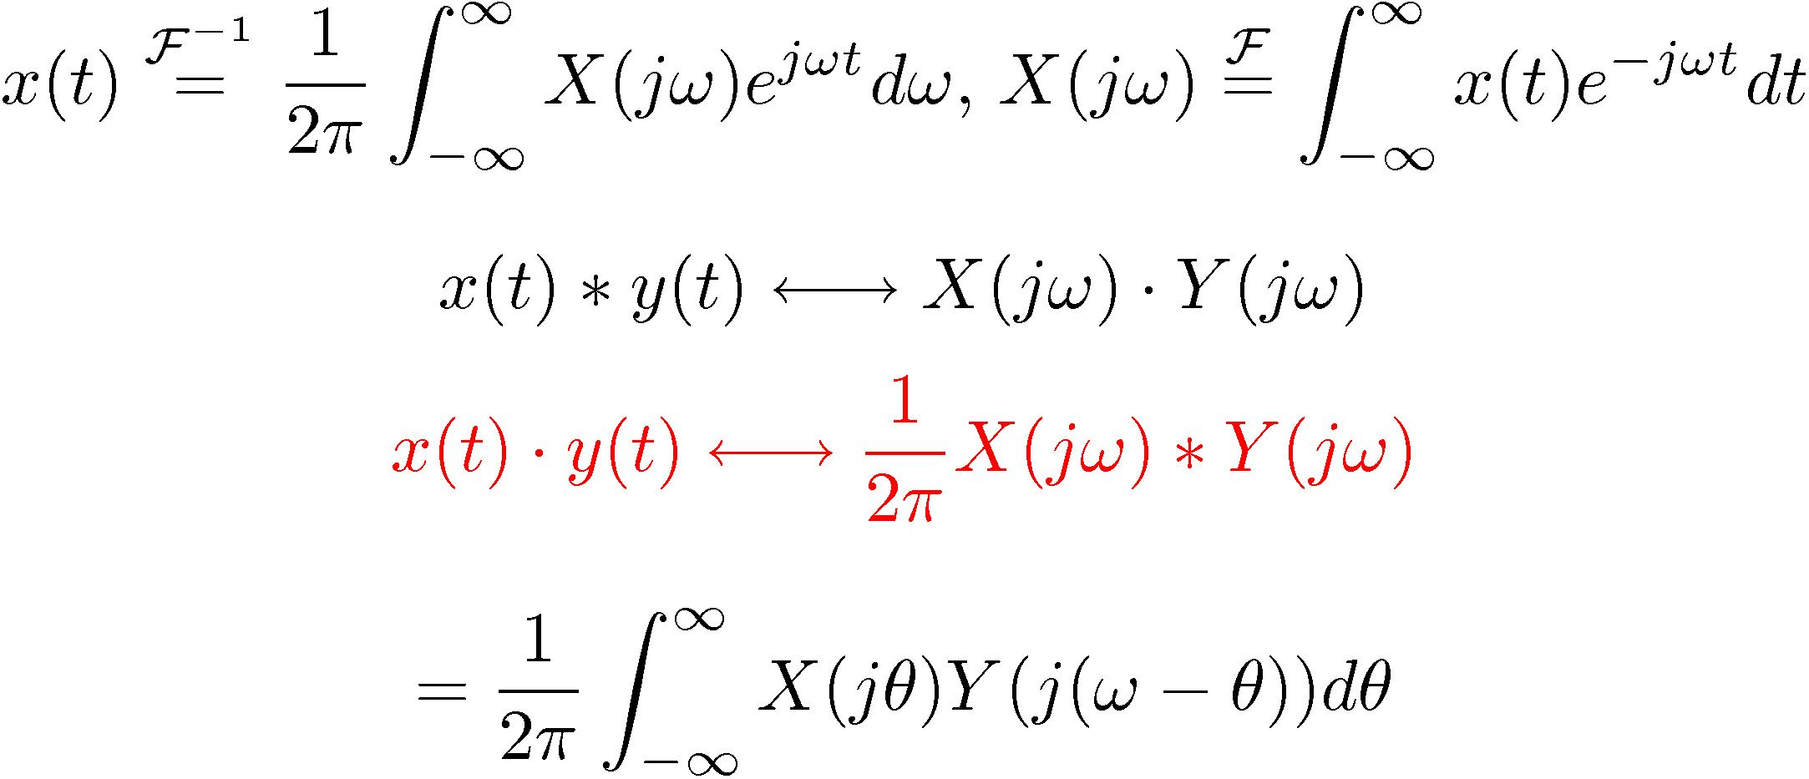
Parseval’s Relation
Multiplication Property
FT is highly symmetric,
We already know that:
Then it isn’t a
surprise that:
Convolution in ω
— A consequence of Duality

Slide 13

Examples of the Multiplication Property
⇓
For any s(t) ...

Slide 14
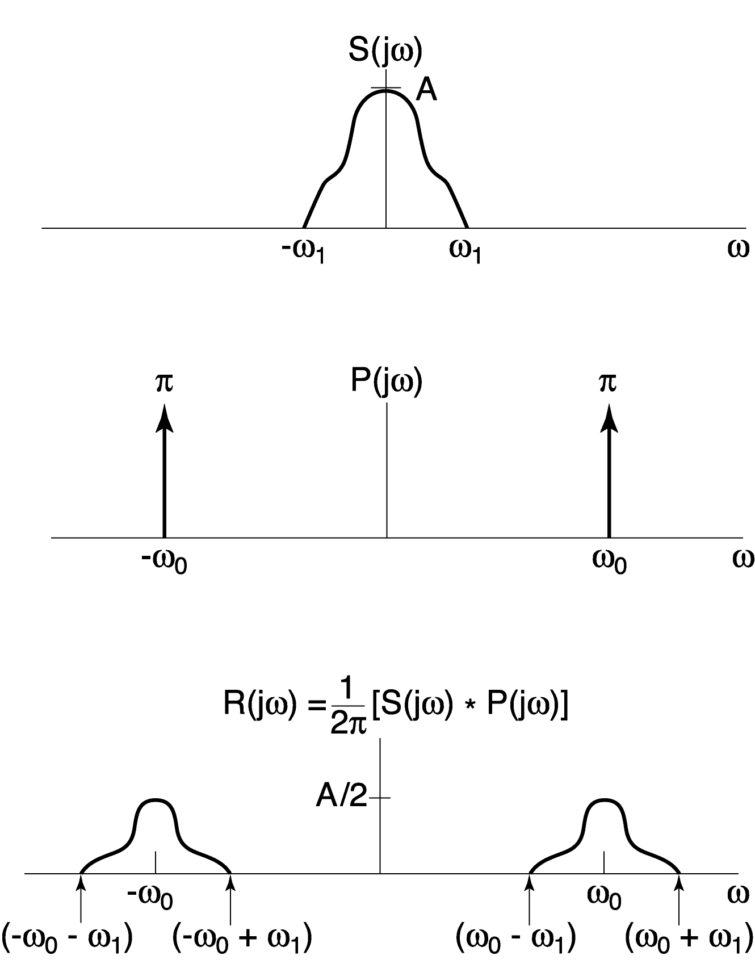
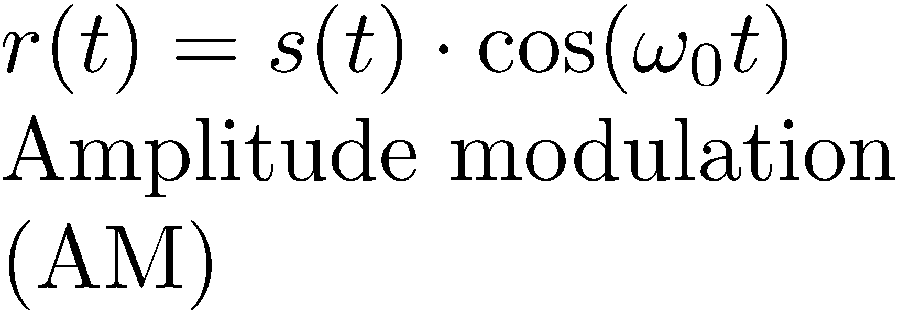

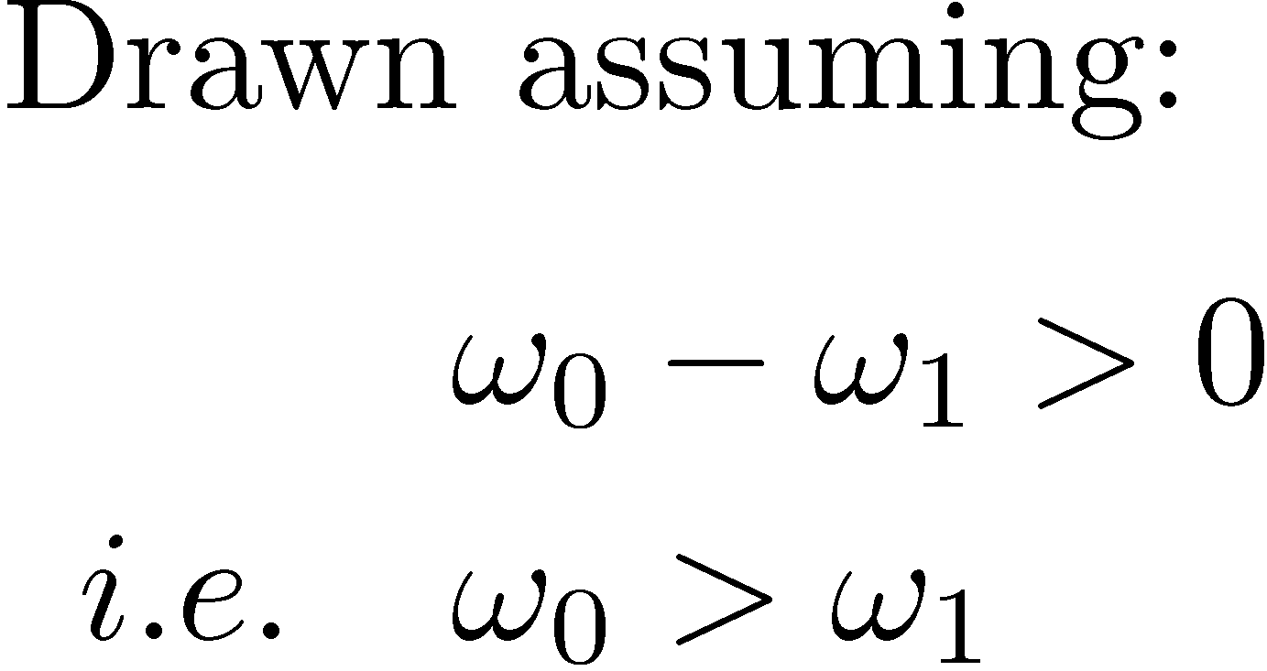
Example (continued)

Slide 15

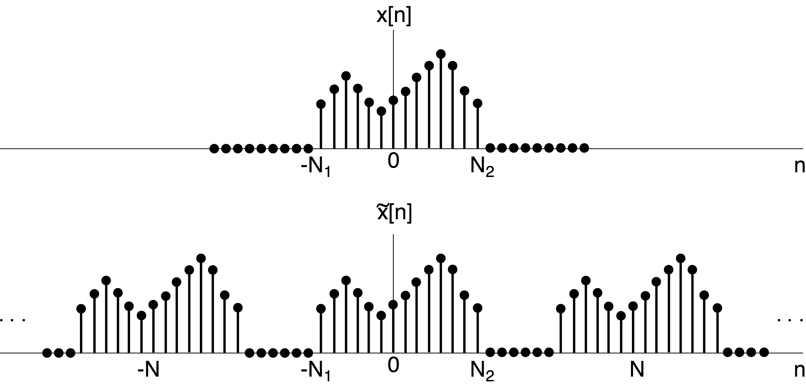
The Discrete-Time Fourier Transform

Slide 16
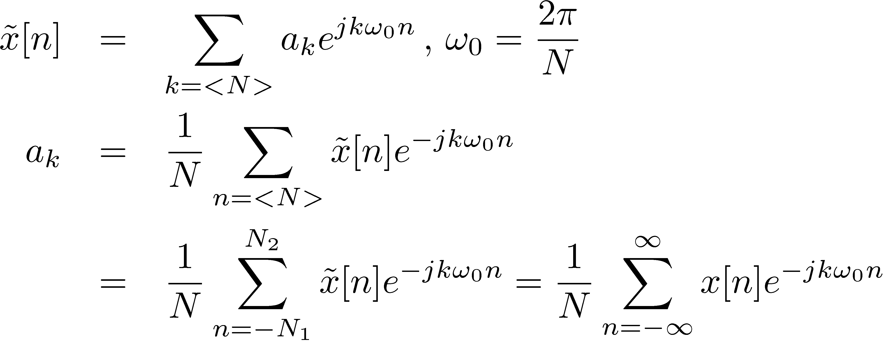

DTFT Derivation (Continued)
Define

Slide 17

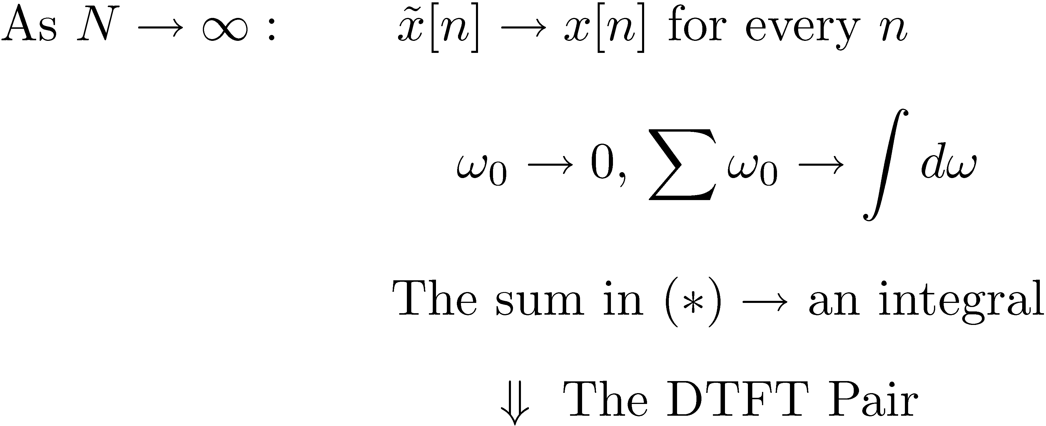


DTFT Derivation (Home Stretch)

