Slide 1

MATLAB for Signal Processing
Introduction
The MathWorks Inc.
Natick, MA
USA

Slide 2
Outline
Signal Processing
MATLAB and Signal Processing Toolbox
Topics Covered
  Signals
    Representation and manipulation
  Linear systems
    Representation and manipulation
    Applying to signals
  Filter design
    Finite Impulse Response (FIR)
    Infinite Impulse Response (IIR)
  Spectral analysis
Representation and analysis of spectra
Notes:
Outline
Signal Processing
MATLAB and Signal Processing Toolbox
Topics Covered
Signals
Representation and manipulation
Linear Systems
Representation and manipulation
Applying to signals
Filter Design
Finite Impulse Response (FIR)
Infinite Impulse Response (IIR)
Spectral Analysis
Representation and analysis of spectra
This course assumes a basic knowledge and understanding of signals and systems, including such topics as filter and linear system theory and basic Fourier analysis.
The basic entities that toolbox functions work with are signals and systems. The functions emphasize digital, or discrete, signals and filters, as opposed to analog, or continuous, signals. The principal filter type the toolbox supports is the linear, time-invariant digital filter with a single input and a single output. You can represent linear time-invariant systems using one of several models (such as transfer function, state-space, zero-pole-gain, and second-order section) and convert between representations.
In addition to its core functions, the toolbox provides rich,
customizable support for the key areas of filter design and
spectral analysis. It is easy to implement a design technique
that suits your application, design digital filters directly, or
create analog prototypes and discretize them. Toolbox
functions also estimate power spectral density and cross
spectral density, using either parametric or nonparametric
techniques

Slide 3
Signal Processing
Signals
  Information carriers in noise
Signal Processing
  Extract information
  Remove noise
  Process information
Systems
  Used to process the signals
  LTI
Notes:
Signal Processing
Signals
Information carriers in noise
Signal Processing
Extract information
Remove noise
Process information
Systems
Used to process the signals
LTI

Slide 4
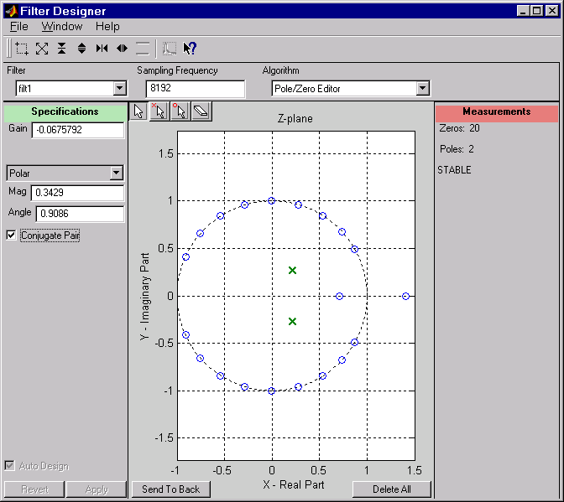
MATLAB and Signal Processing Toolbox
MATLAB
  High-level language
  Vector/matrix math
  Linear algebra
  Data visualization
Signal Processing Toolbox
Library of MATLAB Functions
  Waveform generation
  Filter analysis and implement
  Linear system transformations
  IIR digital filter design
  IIR filter order selection
  FIR filter design
  Transforms
  Windows
  Statistical signal processing
  Spectral analysis
  Parametric modeling
  Specialized operations
  Analog filter prototypes
  Frequency translation
  Filter discretization
  SPTOOL
  FDATOOL
Notes:
MATLAB and Signal Processing Toolbox
The Signal Processing Toolbox is a collection of tools built
on the MATLAB® numeric computing environment. The
toolbox supports a wide range of signal processing operations, from waveform generation to filter design and
implementation, parametric modeling, and spectral analysis. The toolbox provides two categories of tools:
Signal processing command line functions
A suite of graphical user interfaces (GUIs) for:
-Interactive filter design
-Signal plotting and analysis
-Spectral analysis
-Filtering signals
-Analyzing filter designs

