Slide 1

MATLAB for Signal Processing
Defining Signals
The MathWorks Inc.
Natick, MA
USA

Slide 2
Defining Signals Outline
Review basic signal processing
Represent signals from command line
Visualize signals
Introduce SPTool GUI
Generate signals
Import data signals from external files
Notes:
Defining Signals Outline
Review basic signal processing
Represent signals from command line
Visualize signals
Introduce SPTool GUI
Generate signals
Import data signals from external files

Slide 3
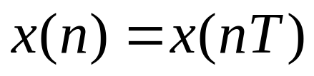
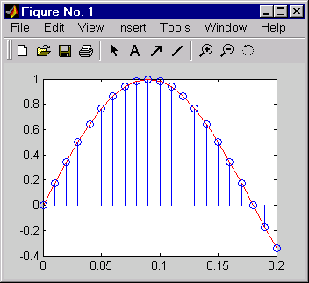
Signals
Analog Signal
  Electromagnetic, audio, sonar, biomedical
Sampling
  Sample at rate >= 2* Nyquist frequency
  Aliasing
Digital Signal
  Vector
  x=[1 2 3 4 5]
Notes:
See: Signal Processing Toolbox User’s Guide
Pages: 1-4
Signals
Analog Signal
Electromagnetic, audio, sonar,
biomedical
Sampling
Sample at rate >= 2* Nyquist frequency
Aliasing
Digital Signal
Vector
x=[1 2 3 4 5]
The central data construct in MATLAB is the numeric
array, an ordered collection of real or complex numeric
data with one or more dimensions. The basic data objects
of signal processing (one-dimensional signals or sequences,
multi-channel signals, and two-dimensional signals) are all naturally suited to array representation.
MATLAB represents ordinary one-dimensional sampled
data signals, or sequences, as vectors. Vectors are 1-by-n or
n-by-1 arrays, where n is the number of samples in the sequence. One way to introduce a sequence into MATLAB is to enter it as a list of elements at the command prompt. The statement
x=[1 2 3 4 5]
creates a simple five-element real sequence in a row vector.

Slide 4
Signal Representation
Vectors
  Data x=[1.0 3.2 2.0 8.5]
  Time base t=[0.0 0.1 0.2 0.3]
    fs=10;N=4;stop_time=0.3;
    t=(0:N-1)/fs;
    t=(0:1/fs:stop_time);
    e.g. x=func(t);
Working with Signals
  Command line, M-files
  SPTool GUI
Notes:
See: Signal Processing Toolbox User’s Guide
Pages: 1-4 to 1-8
Signal Representation
Vectors
Data x=[1.0 3.2 2.0 8.5]
Time base t=[0.0 0.1 0.2 0.3]
fs=10;N=4;stop_time=0.3;
t=(0:N-1)/fs;
t=(0:1/fs:stop_time);
e.g. x=func(t);
Working with Signals
-Command line, M-files
-SPTool GUI
A variety of toolbox functions generate waveforms. Most
require you to begin with a vector representing a time base.

Slide 5
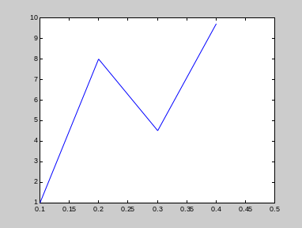
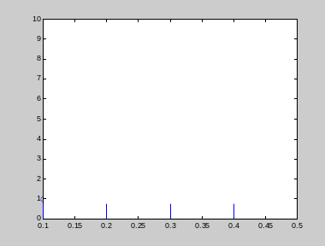
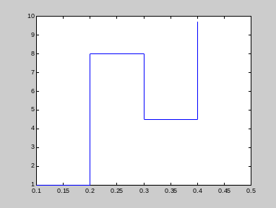
Data Visualization
View signal amplitude vs. time index
Functions
plot, stem, strips, stairs
sound(x,fs)
t=[0.1 0.2 0.3 0.4];
x=[1.0 8.0 4.5 9.7];
plot(t,x) stem(t,x) stairs(t,x)
Notes:
Data Visualization
View Signal Amplitude vs Time-Index
Functions
plot, stem, strips, stairs
sound(x,fs)
t=[0.1 0.2 0.3 0.4];
x= [1.0 8.0 4.5 9.7];
plot(t,x)
stem(t,x)
stairs(t,x)
Here is another example of a discrete-time signal:
X[n]=2n -5≤ n < 5
X[n]=0 otherwise
try this in MATLAB:
n=[-5:5];
x=2*n;
stem(n,x) %to visualize the outcome
Try:
>>helpwin graph2d
>>help sound

Slide 6
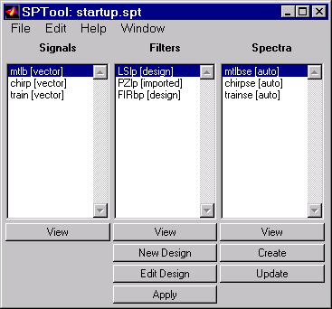
SPTool (sptool): Main Window
Menus used for
importing, renaming,
copying, deleting.
View highlighted
objects
Create or modify
a filter design.
{
Analyze spectrum of
highlighted signals
Create new signal by filtering the highlighted
signal with the highlighted filter.
sptool
Notes:
SPTool Main Window
>>sptool
The power of the Signal Processing Toolbox is greatly
enhanced by its easy-to-use interactive tools. SPTool
provides a rich graphical environment for signal viewing,
filter design, and spectral analysis.
You can use SPTool to analyze signals, design filters, analyze
(view) filters, filter signals and analyze signal spectra. You can accomplish these tasks using four GUIs that you access from
within SPTool:
The Signal Browser is for analyzing signals. You can also play portions of signals using your computer's audio hardware.
The Filter Designer is for designing or editing FIR and
IIR digital filters. Please note that the FDATool is the preferred GUI to use for Filter Design. FDATool will be discussed later in this section.
The Filter Viewer is for analyzing filter characteristics.
The Spectrum Viewer is for spectral analysis.
See: Signal Processing Toolbox User’s Guide
Pages: 6-4
Menus used for
importing, renaming,
copying, deleting
View highlighted
objects
Analyze spectrum of highlighted signal
Create new signal by filtering the highlighted
signal with the highlighted filter.
Create or modify a filter design

Slide 7
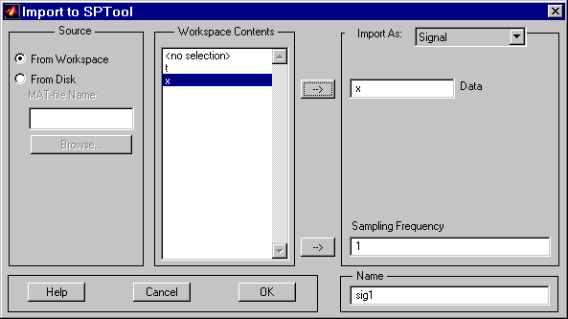
Importing a Signal in SPTool
Destination (signal)
MATLAB expression
to evaluate for data
(can include functions,
math, indexing, etc.)
Matlab expression
for sampling frequency
Use highlighted selection
Name used within
sptool
Notes:
See: Signal Processing Toolbox User’s Guide
Pages: 6-18, 6-19
Importing a Signal in SPTool
You can use SPTool to analyze signals, filters, or spectra
that you create at the MATLAB command line.
You can import signals, filters, or spectra from the
MATLAB workspace into the SPTool workspace using
the Import item under the File menu.
Note you can import filters and spectra into SPTool in much the same way as you import signals. See section “Importing a Filter into SPTool” on 4-4 for an example.
Use highlighted selection
Name used within SPTool
MATLAB expression
to evaluate for data
(can include functions, math, indexing, etc.)
Destination (signal)
MATLAB expression
for sampling frequency

Slide 8
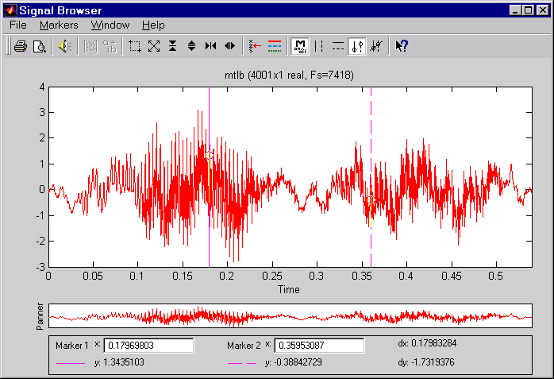
Signal Browser in SPTool
Choose color & style
of selected signal
Ruler
orientation
Slope
display
Zoom
controls
Display
window
Panning
window
Panning
window
Marker measurements
Notes:
See: Signal Processing Toolbox User’s Guide
Pages: 6-5, 6-6
Signal Browser
The Signal Browser tool is an interactive signal exploration environment. It provides a graphical view of the signal object(s) currently selected in the signals column of SPTool.
Using the signal browser you can:
1) View and compare vector/array signals
2) Zoom in on a range of signal data to examine it
more closely
3) Measure a variety of characteristics of signal
data
4) Play signal data on audio hardware
To open/activate signal browser for SPTool:
1) Click on one or more signals (use the Shift key for multiple
selections) in signals column of SPTool
2) Press View in the signals panel of SPTool
Marker measurements
Ruler orientation
Zoom controls
Choose color & style of selected signal
Display window
Slope display
Panning window

Slide 9
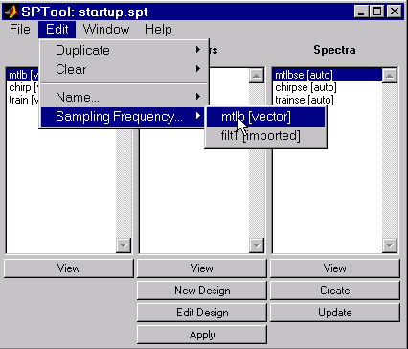
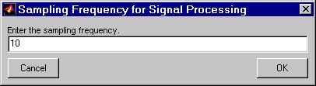
Changing Sample Rates Using SPTool
Notes:
Changing Sample Rates
To change the sample rate of a signal in SPTool:
1) Click on one signal in signals column of SPTool
2) Select the Sampling Frequency item in the Edit menu.
3) Enter the desired sampling frequency and press OK

Slide 10

Signal Generation
Functions
  Non-periodic functions
    Unit impulse, ramp, step
    ones, zeros, step
  Periodic function
  sin, cos, square, sawtooth, etc.
  Create time base vector t.
  Define signal as function of time e.g.
  t=[0:0.1:2];
  x=sin(pi*t/2);
Notes:
See: Signal Processing Toolbox User’s Guide
Pages:1-6,1-7,
1-10,1-11
Signal Generation
Functions
Non-periodic functions
unit impulse, ramp, step
ones, zeros, step
Periodic function
sin, cos, square, sawtooth
Create time base vector t.
Define signal as function of time e.g.
T=[0:0.1:2];
x=sin(pi*t/2);
Consider generating data with a 1000 Hz sample frequency, for example. An appropriate time vector is
t = [0:0.001:1];
where MATLAB's colon operator creates a 1001-element row
vector that represents time running from zero to 1 second in
steps of 1 millisecond.
Given t you can create a sample signal, y, consisting of two sinusoids, one at 50 Hz and one at 120 Hz with twice the amplitude.
y = sin(2*pi*50*t) + 2*sin(2*pi*120*t);

Slide 11
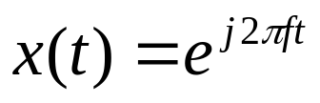
Signal Generation
  Functions
    Noise
    randn, rand
  Complex Data
    x=exp(2*pi*j*f*t);
Notes:
Signal Generation
Functions
Noise
randn, rand
Complex Data
x=exp(2*pi*j*f*t);
The new variable y, formed from vector t, is also 1001
elements long. You can add normally distributed white
noise to the signal and graph the first fifty points using
t = [0:0.001:1];
y = sin(2*pi*50*t) + 2*sin(2*pi*120*t);
randn('state',0);
yn = y + 0.5*randn(size(t));
plot(t(1:50),yn(1:50))
Here’s an example of a complex signal, where
0 ≤ n ≤ 32
n=[0:32];
x=exp((j*pi/8)*n);
stem(n,real(x)) %real part
stem(n,imag(x)) %imaginary part
stem(n,abs(x)) %magnitude
stem(n,angle(x)*(180/pi)) %phase in degrees

Slide 12
Importing Data from external files
External
  Data file or data acquisition device
  Importing data
    load mtlb;
    t=(0:length(mtlb)-1)/Fs;
    plot(t,mtlb);
    sound(mtlb,Fs);
Wave files
    [y,Fs]=wavread('signalmix.wav');
    sound(y,Fs)
Notes:
See: Signal Processing Toolbox User’s Guide
Pages: 1-13
Importing Data from external files
External
Data file or data acquisition device
Importing data
load mtlb;
t=(0:length(mtlb)-1)/Fs;
plot(t,mtlb);
sound(mtlb,Fs);
Wave files
Importing data
[y,Fs]=wavread(‘signalmix.wav’);
sound(y,Fs)
You may need to import data from outside of MATLAB.
Depending on your data format you can do this in the
following way:
1) Load your data from an ASCII file or a MAT-file
with the MATLAB load command
2) Read data into MATLAB with low level file I/O function
such as fopen, fread, fscanf
3) Develop a MEX-file to read your data

Slide 13
Exercise: Generate a Signal
Create a signal equal to the sum of 2 cosine waves with the following characteristics:
  200 samples
  Sample rate, 10 Hz
  Sinusoid 1: freq. 0.05Hz, amp 1.0, phase = 0
  Sinusoid 2: freq. 5Hz, amp 0.25, phase = 0
Display signal with plot
Import into SPTool and view
Notes:
Exercise: Generate a Signal
Create a signal equal to the sum of 2 cosine
waves with the following characteristics:
-200 samples
-Sample rate, 10 Hz
-Sinusoid 1: freq. 0.05Hz, amp 1.0, phase = 0
-Sinusoid 2: freq. 5Hz, amp 0.25, phase = 0
Display signal with plot
Import into SPTool and view
Note that we must use cosine waveforms here and not sine
waveforms because we are sampling at the Nyquist rate.

Slide 14
Solution on Next Page

Slide 15
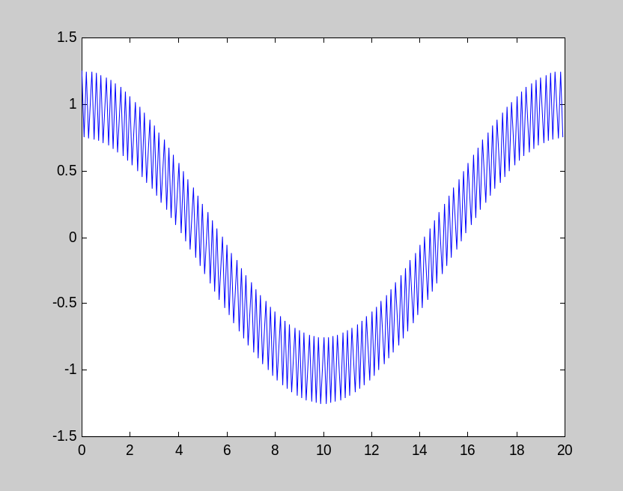
Solution: Generate a Signal
N=200; fs=10; % No. samples and sampling rate
t=(0:N-1)/fs; % Time base
a=[1.00 0.25]; % Amplitudes
f=[0.05; 5.0]; % Frequencies
x=a*cos(2*pi*f*t); % Signal without noise plot(t,x);
generate_signal
Notes:
Solution: Generate a Signal
N=200; fs=10; % No. samples and sampling rate
t=(0:N-1)/fs; % Time base
a=[1.00 0.25]; % Amplitudes
f=[0.05; 5.0]; % Frequencies
x=a*cos(2*pi*f*t); % Signal without noise
plot(t,x);
>>generate_signal
Here we are using matrix multiplication (as opposed to array multiplication) to create a weighted sum of row vectors.
Or this solution:
N = 200; % Number of samples
fs = 10; % Sampling rate
a1 = 1; % Amplitude 1
a2 = .25; % Amplitude 2
f1 = .05; % Frequency 1
f2 = 5; % Frequency 2
t = (0:N-1)/fs; % Time base
x1 = a1*cos(2*pi*f1*t); % Signal 1
x2 = a2*cos(2*pi*f2*t); % Signal 2
x = x1 + x2; % Signal without noise
plot(t,x)

Slide 16
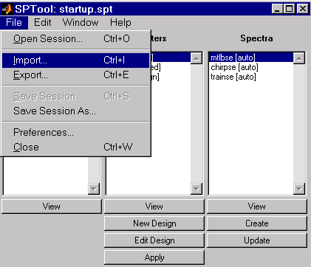
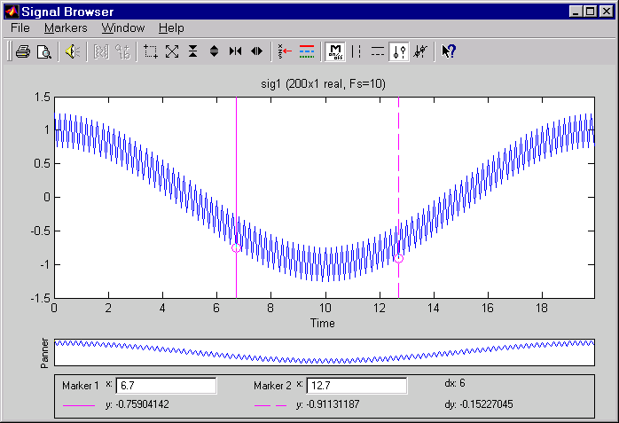
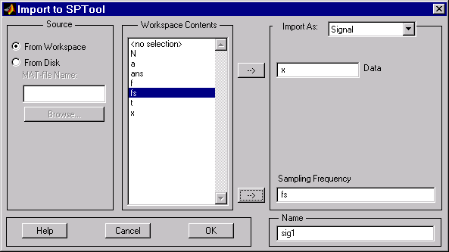
Solution: Generate a Signal
Notes:
Solution: Generate a Signal
File -->Import --> From Workspace
View selected signal in SPTool GUI

Slide 17
Summary
    Review basic signal processing
    Represent signals from command line
    Visualize signals
    Introduce SPTool GUI
    Generate signals
    Import data signals from external files
Notes:
Summary
Define Signals
-Represent signals from command line
-Visualize signals
-Introduce SPTool GUI
-Generate signals
-Import data signals from external files

