Slide 1

MATLAB for Signal Processing
Linear Systems
The MathWorks Inc.
Natick, MA
USA

Slide 2
Linear Systems Outline
Represent Linear Systems
    Review discrete LTI systems
      Convolution
      Difference equations
    Represent frequency response
      Z-transforms
      Frequency response of signal
    Pole-zero analysis
      Transfer function
      Z-plane
Notes:
Linear Systems Outline
Represent Linear Systems
Review discrete LTI systems
Convolution
Difference equations
Frequency response analysis
Z-transforms
Frequency response of signal
Pole-zero analysis
Transfer function
Z-plane

Slide 3
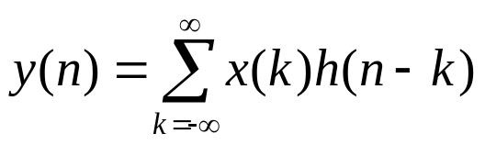

Linear Systems
What is a Discrete LTI System?
  Linear combination, input and output
  Impulse response h(n)
Convolution
  y=conv(h,x)
x(n)
h(n)
y(n)
Notes:
Linear Systems
What is a Discrete LTI System?
Linear combination, input and output
Impulse response h(n)
Convolution
y=conv(h,x)
Analytically determine y[n]=x[n]*x[n], such that
x[n]=1 for 0≤n ≤ 5
x[n]=0 otherwise
n=[0:5];
x=[ones(1,length(n))];
y=conv(x,x);
ny=[0:length(y)-1];
stem(ny,y)
xlabel(‘n’), ylabel(‘x[n]*x[n]’)
Try
>>help conv

Slide 4
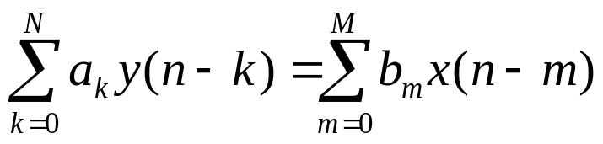
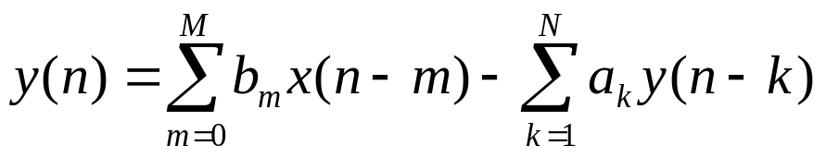
Linear System Representation
Difference equations
Represent system as two vectors
  b=[b0 b1 .. bM], a=[a0 a1 .. aN]
  e.g. b=[1 2 3], a=[1 0 0]
Notes:
Linear System Representation
Difference equations
Represent system as two vectors
b=[b0 b1 .. bM], a=[a0 a1 .. aN]
e.g. b=[1 2 3], a=[1 0 0]
The Signal Processing Toolbox provides several models for representing linear-time invariant (LTI) systems. This flexibility
lets you choose the representational scheme that best suits
your application and, within the bounds of numeric stability,
convert freely to and from most other models.

Slide 5

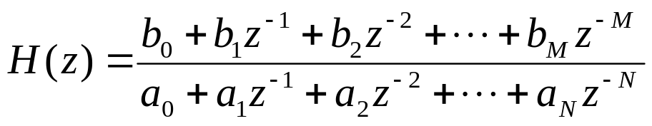

Frequency Response
Z transform
Frequency response
    freqz(b,a), [h,w]= freqz(b,a,N,Fs);
    freqzplot(h,w)
Normalized frequency
    Frequencies specified relative to Nyquist rate
    In the range 0 to 1, where 1=Fs/2
Notes:
Frequency Response
Z transform
Frequency response
freqz(b,a),[h,w]= freqz(b,a,N,Fs);
frezplot(h,w)
Normalized frequency
Frequencies specified relative to Nyquist rate
In the range 0 to 1, where 1=Fs/2
Note freqz uses normalized frequencies (0 to 1), where 1 is equivalent to Fs/2, the Nyquist frequency.
freqzplot(h,w) plots the frequency response data contained
in h at the frequencies specified in vector w. The magnitude
h is plotted in dB and the phase of h is plotted in degrees.
Try
>>help freqz
>>help freqzplot

Slide 6


Example: Frequency Response
Plot the frequency response of two simple filters. Fs=10Hz.
  Low pass,
  b=[0.5 0.5]
  High pass,
  b=[0.5 -0.5]
Notes:
Example: Frequency Response
Plot the frequency response of two averaging
filters. Fs=10Hz.
Low pass,
b=[0.5 0.5]
High pass,
b=[0.5 -0.5]

Slide 7
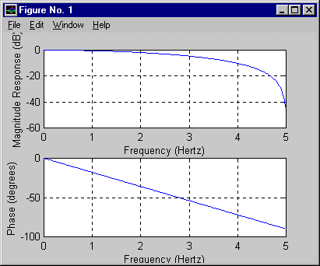
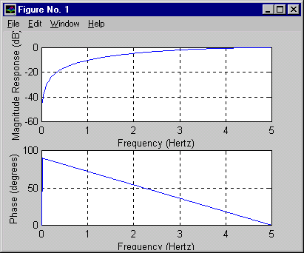
Example: Frequency Response
freqz([0.5 0.5],1,256,fs);
freqz([0.5 -0.5],1,256,fs);
freqz_example
Notes:
Solution: Frequency Response
freqz([0.5 0.5],1,256,fs);
freqz([0.5 -0.5],1,256,fs);
>>freqz_example

Slide 8
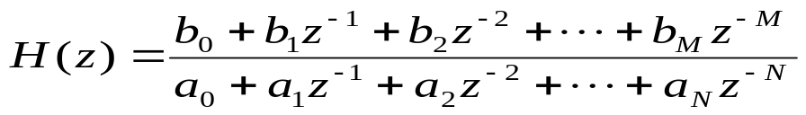
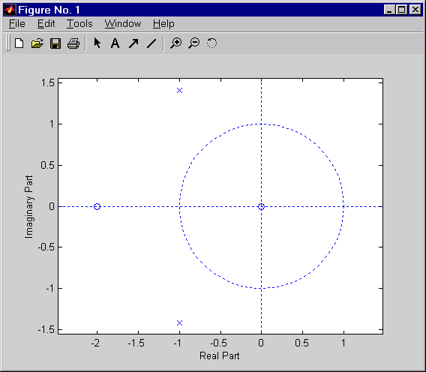
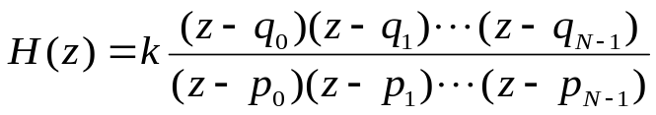
Pole-Zero Analysis
Transfer function
Pole Zero form
Convert function
  [z,p,k]=tf2zp(b,a)
Plot zplane(z,p)
Example
  b=[1 2 0]; a=[1 2 3];
  [z,p,k]=tf2zp(b,a)
  zplane(z,p)
Notes:
Pole-Zero Analysis
Transfer function
Pole zero form
Convert function
[z,p,k]=tf2zp(b,a)
Plot zplane(z,p)
Example
b=[1 2 0]; a=[1 2 3];
[z,p,k]=tf2zp(b,a);
zplane(z,p)
zplane(Z,P) plots the zeros, Z, and poles, P, with the unit
circle for reference. Each zero is represented with ‘o’ and each
pole with ‘x’ on the plot. For example, given a proper system:
See: Signal Processing Toolbox User’s Guide
Pages: 6-33 to 6-35

Slide 9
Exercise: Poles and Zeros
Create pole and zero plots for the two simple lowpass and highpass filters in the last exercise.
  Note: tf2zp requires length(b)= length(a)
Notes:
Exercise: Poles and Zeros
Create pole and zero plots for the two simple
lowpass and highpass filters in the last exercise.
Note: tf2zp requires length(b)= length(a)

Slide 10
Solution on Next Page

Slide 11
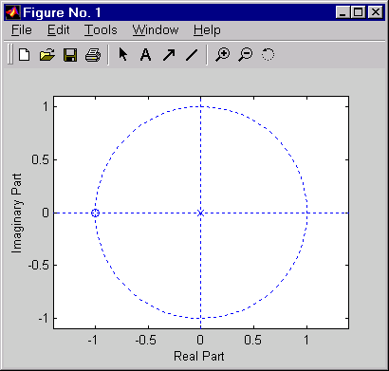
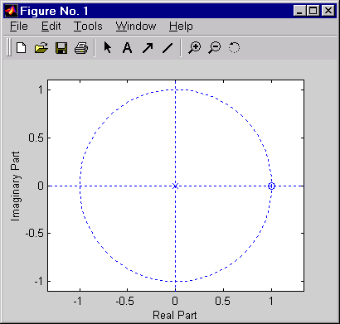
Solution: Poles and Zeros
[z,p,k]=tf2zp([0.5 0.5],[1 0]); zplane(z,p);
[z,p,k]=tf2zp([0.5 -0.5],[1 0]); zplane(z,p);
zpk_exercise
Notes:
Solution: Poles and Zeros
[z,p,k]=tf2zp([0.5 0.5],[1 0]); zplane(z,p);
[z,p,k]=tf2zp([0.5 -0.5],[1 0]); zplane(z,p);
>>zpk_exercise

Slide 12
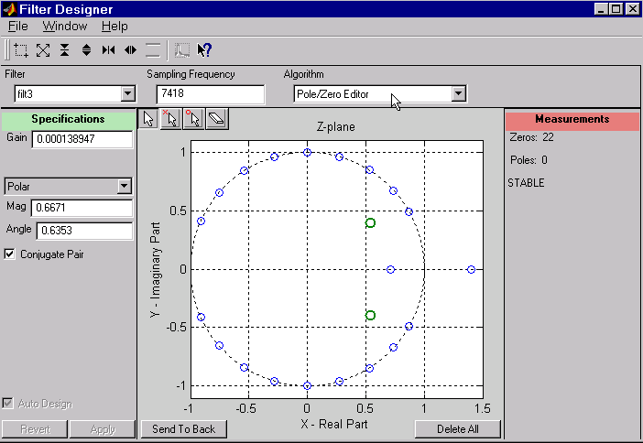
Pole/Zero Editing
Choose pole/zero editor design method
View characteristics as you edit
Notes:
Pole/Zero Editing
Choose pole/zero editor design method
View characteristics as you edit
To access Pole/Zero Editor in SPTool:
1) Click on New Design in the Filter column of SPTool
2) Select the Pole/Zero Editor item in the Algorithm selection.

Slide 13
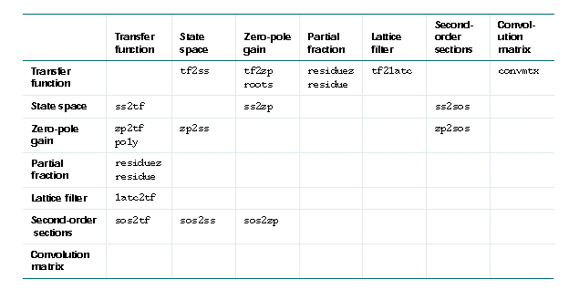
Linear System Transformations
Functions
Notes:
Linear System Transformations
Functions

Slide 14
Summary
Represent Linear Systems
    Review discrete LTI systems
      Convolution
      Difference equations
    Represent frequency response
      Z-transforms
      Frequency response of signal
    Pole-zero analysis
      Transfer function
      Z-plane
Notes:
Summary
Represent Linear Systems
Review discrete LTI systems
Convolution
Difference equations
Represent frequency response
Z-transforms
Frequency response of signal
Pole-zero analysis
Transfer function
Z-plane

