Slide 1

MATLAB for Signal Processing
Filter Design
The MathWorks Inc.
Natick, MA
USA

Slide 2
Design Filters Outline
Implement real world filter using filter
Create LTI systems with specific magnitude response
Filter types
Filter specification
IIR Filter Design
Filter Design and Analysis Tool (FDATool)
Filter Analysis with SPTool
FIR Filter Design
Filter in time domain
Notes:
Design Filters Outline
Implement real world filter using filter
Create LTI systems with specific
magnitude responses
Filter types
Filter specification
IIR filter design
Filter design and analysis tool (FDATool)
Filter analysis with SPTool
FIR filter design
Filter in time domain

Slide 3

The filter Function
The filter function implements a difference equation
  y=filter(b,a,x)
Example: Averaging filter
  b=[0.5 0.5], a=1
  ylow=filter(b,a,x)
Notes:
The filter Function
The filter function implements a
difference equation
y=filter(b,a,x)
Example: Averaging filter
b=[0.5 0.5], a=1
ylow=filter(b,a,x)
Try:
>>help filter

Slide 4
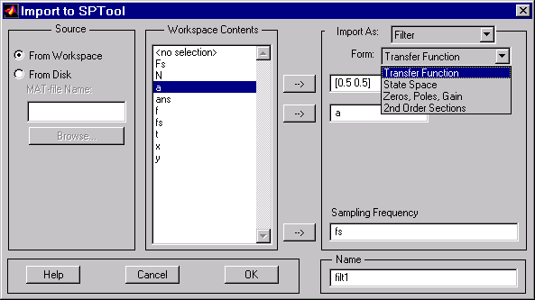
Importing a Filter into SPTool
Destination (filter)
Form of Filter
MATLAB expression
to evaluate for data
MATLAB expression
for sampling frequency
Name used within
SPTool for Filter
Use highlighted selection
Notes:
Importing a Filter into SPTool
Destination (filter)
MATLAB expression to evaluate for data
MATLAB expression for sampling frequency
Form of filter
Name used within SPTool
Use highlighted selection
See: Signal Processing Toolbox User’s Guide
Pages: 6-42

Slide 5
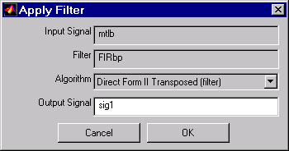
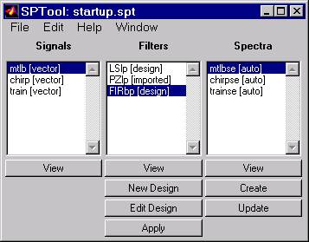
Applying a Filter in SPTool
Select signal and filter
Apply filter to signal
Notes:
Applying a Filter
Select signal and filter
Apply filter to signal

Slide 6

Exercise: High and Low Pass Filter
High pass and low pass filter test signal x with filter and plot result
Do the same in SPTool
Note: Test signal was:
N=200; fs=10;t=(0:N-1)/fs;
a=[1.00 0.25];f=[0.05; 5.0];
x=a*cos(2*pi*f*t);
Notes:
Exercise: High Pass Filter
High pass and low pass filter test signal x with filter and plot result
Do the same in SPTool
Note: Test signal was:
N=200; fs=10;t=(0:N-1)/fs;
a=[1.00 0.25];f=[0.05; 5.0];
x=a*cos(2*pi*f*t);

Slide 7
Solution on Next Page

Slide 8
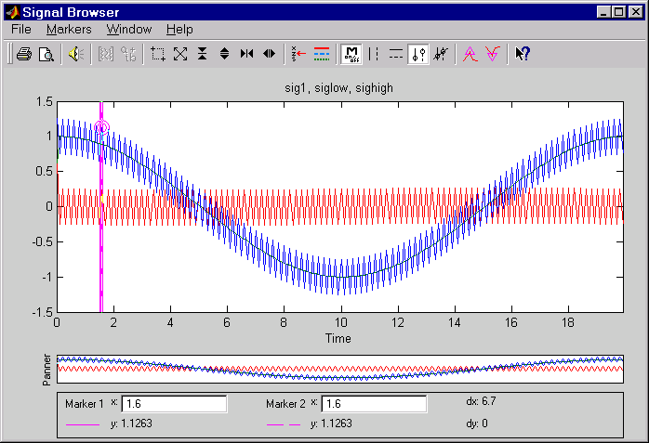
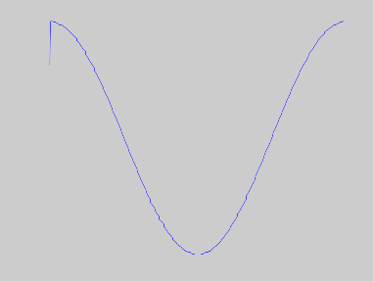
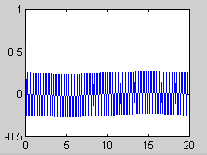
Solution: High and Low Pass Filter
y=filter([0.5 0.5],1,x);
plot(t,y)
y=filter([0.5 -0.5],1,x);
plot(t,y)
filter_soln
Notes:
Solution
y=filter([0.5 0.5],1,x);
plot(t,y);
y=filter([0.5 -0.5],1,x);
plot(t,y);
>>filter_soln

Slide 9
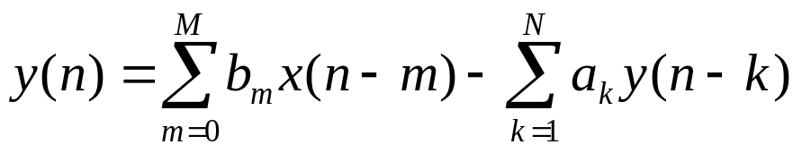
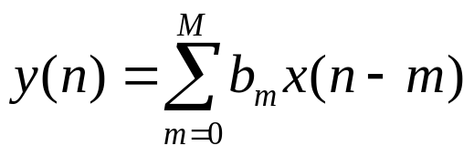
Filter Design
Frequency selective system
Analog
Digital
  Infinite impulse response (IIR)
  Finite impulse response (FIR) a=1
Notes:
Filter Design
Frequency selective system
Analog
Digital
Infinite impulse response (IIR)
Finite impulse response (FIR) a=1
The Filter Design and Analysis Tool (FDATool) provides a more comprehensive collection of features for addressing the problem of filter design.
The FDATool also offers seamless access to the additional filter design methods and quantization features of the Filter Design Toolbox when that product is installed.

Slide 10
Filter Design Methods
Filters
Continuous
Discrete
IIR
FIR
Butterworth
Windowing
Analog
prototyped
filters
Bilinear
Chebyshev I
Equiripple
Transformation
Chebyshev II
Least Squares
Eliptic
Arbitrary Response
Bessel
Yulewalk
Raised Cosine
Notes:
Filter Design Methods
Bilinear
Transformation

Slide 11
Filter Types
Lowpass
Highpass
Bandpass
Bandstop
Notes:
Filter Types
Lowpass
Highpass
Bandpass
Bandstop

Slide 12
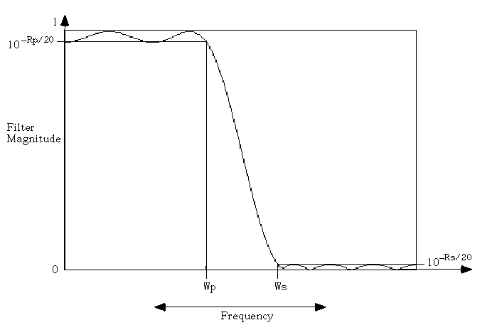
Filter Specification
Wp, Ws, Rp, Rs
Passband Ripple
Stopband
Attenuation
Fs/2
Passband
Transition Band
Stopband
Notes:
Filter Specification
Wp, Ws, Rp, Rs
Transition band
Stopband
attenuation
Passband ripple
Passband
Stopband
Fs/2

Slide 13
Filter Design Functions
IIR
  Features
  Design principle
    Analog to discrete
  Methods
    Butterworth, Chebyshev I and II, Elliptic
  Functions
    butter, cheby1, cheby2, ellip
Notes:
Filter Design Functions
IIR
Features
Design principle
Analog to discrete
Methods
Butterworth, Chebyshev I and II, Elliptic
Functions
butter, cheby1, cheby2, ellip
Try:
>>help butter
>>help cheby1
>>help cheby2
>>help ellip

Slide 14
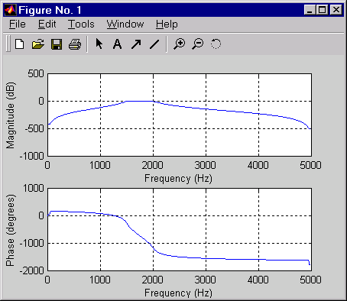
IIR Filter Design
Functions
  [b,a]=butter(order,specs,’type’)
Example: Order 10 Butterworth. Fs=10 KHz (Nyquist=5kHz), bandpass 1.5KHz and 2KHz
  [b,a]=butter(10,[0.3 0.4],'bandpass');
  Frequency response
    freqz(b,a,512,10000)
Notes:
IIR Filter Design
Functions
[b,a]=butter(order,specs,’type’)
Example: Order 10 Butterworth.
Fs=10 KHz (Nyquist=5kHz), bandpass
1.5KHz and 2KHz
[b,a]=butter(10,[1.5/(Fs/2) 2/(Fs/2)],'bandpass');
Frequency response
freqz(b,a,512,10000)

Slide 15
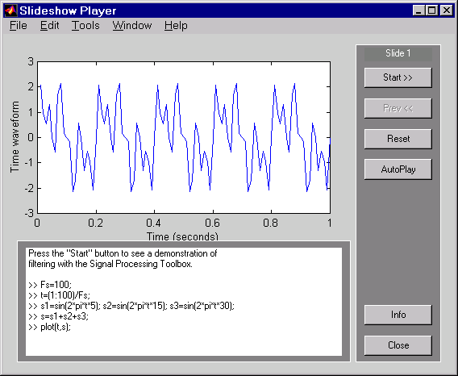
Example: filtdem
filtdem
Notes:
Example: filtdem
>>filtdem
filtdem is a filter design and filtering demo. This demonstration designs a filter with the Signal Processing Toolbox and applies it to a signal made up of harmonic components.

Slide 16
Arbitrary Response IIR
Specify arbitrary magnitude response and frequency points
Calculates IIR coefficients
Function
  [b,a] = yulewalk(order,freq_vec,mag_vec);
Example
  f = [0 0.6 0.6 1]; m = [1 1 0 0];
  [b,a] = yulewalk(8,f,m);
  freqz(b,a,128,Fs);
Notes:
Arbitrary Response IIR
Specify arbitrary magnitude response and
frequency points
Calculate IIR coefficients
Function
[b,a] = yulewalk(order,freq_vec,mag_vec);
Example
f = [0 0.6 0.6 1]; m = [1 1 0 0];
plot(f,m)
[b,a] = yulewalk(8,f,m);
freqz(b,a,128);
Try:
>>help yulewalk

Slide 17
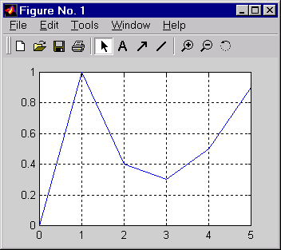
Exercise: Arbitrary Response IIR
Using yulewalk, design an order 5 filter with this magnitude response and a Sampling Frequency of 10 Hz. Plot desired and actual response together.
Notes:
Exercise: Arbitrary Response FIR
Using yulewalk, design an order 5 filter with this magnitude response and a sampling frequency of 10 Hz. Plot desired and actual response together.
Remember you need to normalize your frequencies, therefore:
f = [0 0.2 0.4 0.6 0.8 1];

Slide 18
Solution on Next Page

Slide 19
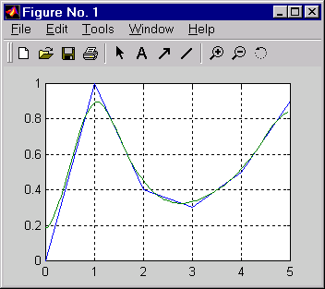
Solution: Arbitrary Response IIR
f = [0 0.2 0.4 0.6 0.8 1];
m = [0 1 .4 .3 .5 .9];
Fs=10;
[b,a] = yulewalk(5,f,m);
[h,w] = freqz(b,a,128,Fs);
plot(f*Fs/2,m,w,abs(h));
grid;
yulewalk_soln
Notes:
Solution: Arbitrary Response FIR
f = [0 0.2 0.4 0.6 0.8 1];
m = [0 1 .4 .3 .5 .9];
Fs=10;
[b,a] = yulewalk(5,f,m);
[h,w] = freqz(b,a,128,Fs);
plot(f*Fs/2,m,w,abs(h));
grid;
>>yulewalk_soln

Slide 20
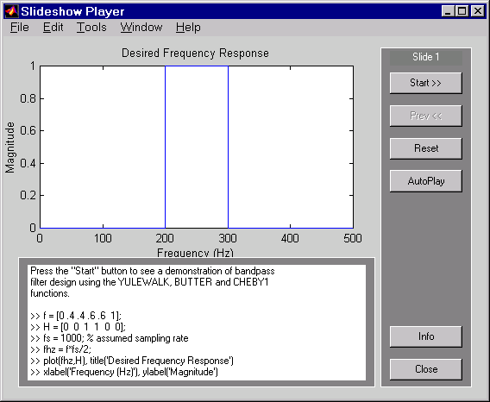
Example: filtdem2
filtdem2
Notes:
Example: filtdem2
>>filtdem2
This demonstration designs bandpass filters using the yulewalk, butter, and cheby1 functions in the Signal Processing Toolbox.

Slide 21
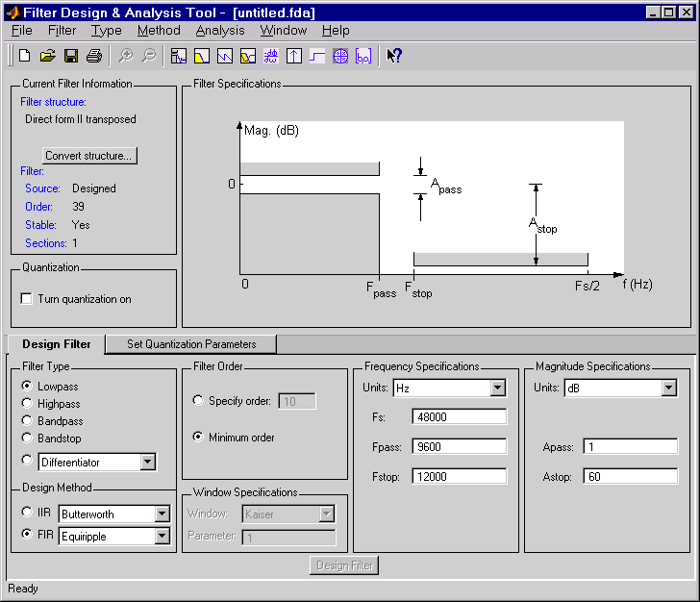
Filter Design with FDATool
Import filter coefficients or design filter
Analysis method for analyzing filter design
Quantize current filter using Filter Design Toolbox
Set quantization parameters for Filter Design Toolbox
Type of filter to design and method to use
Filter specifications
fdatool
Notes:
Filter Design with FDATool
>>fdatool
The FDATool is a graphical user interface for the analysis and design of digital filters. It is a convenient alternative to the command line filter design functions, where it gives you access to all of the filter design methods in the Signal Processing Toolbox.
The FDATool operates in different modes:
1)Design mode
2)Import mode
3)Quantize mode (requires Filter Design Toolbox)
Note: Not all filter design methods are available for all filter types. Once you choose your filter type, this may restrict the filter design methods available to you. Filter design methods that are not available for a selected filter type are dimmed in the Method menu, and removed from the Design Method region of the GUI.
Analysis method for analyzing filter design
Import filter coefficients or design filter
Set quantization parameters for Filter Design Toolbox
Filter specifications
Quantize current filter using Filter Design Toolbox
Type of filter to design & method to use
See: Signal Processing Toolbox User’s Guide
Pages: 5-5 to 5-12

Slide 22
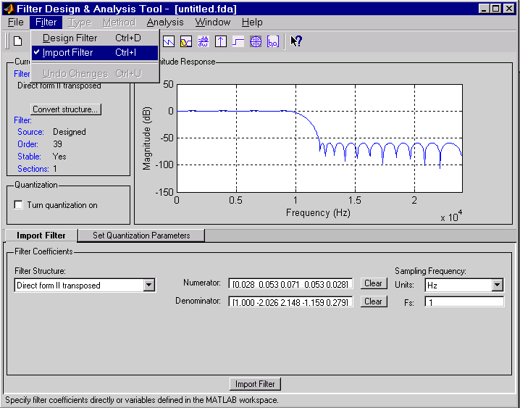
Importing Existing Designs
Notes:
Importing Existing Designs
See: Signal Processing Toolbox User’s Guide
Pages: 5-16

Slide 23
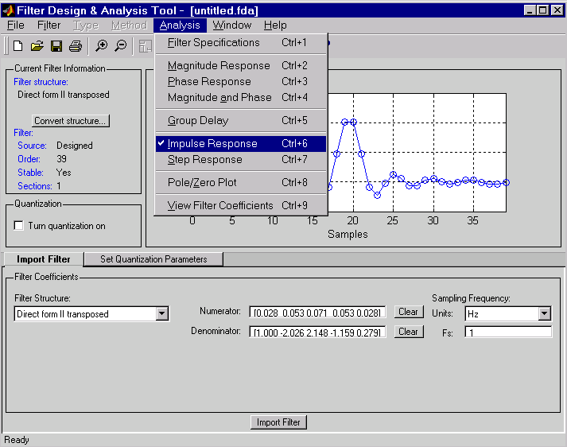
Analyze Filters with FDATool
Notes:
Analyze Filters with FDATool

Slide 24
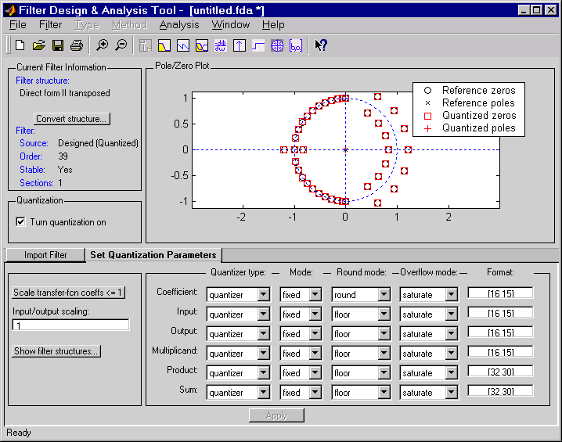
Filter Quantization with FDATool
Ability to
quantize
filters
Notes:
Filter Quantization with FDATool
Note: The Filter Design Toolbox is required in order to use the quantization option in the FDATool GUI.
The Filter Design Toolbox provides the functions you need to develop filters that meet the needs of fixed-point algorithms and electronics systems. In addition to offering tools for analyzing the effects of quantization on filter performance and signal processing performance, the toolbox offers filter structures for you to use to develop prototype filter designs. With structures ranging from finite impulse response (FIR) filters such as Direct Form to infinite impulse response (IIR) filters, you can investigate alternative fixed-point realizations of filters that might meet your goals.
Ability to
quantize
filters

Slide 25
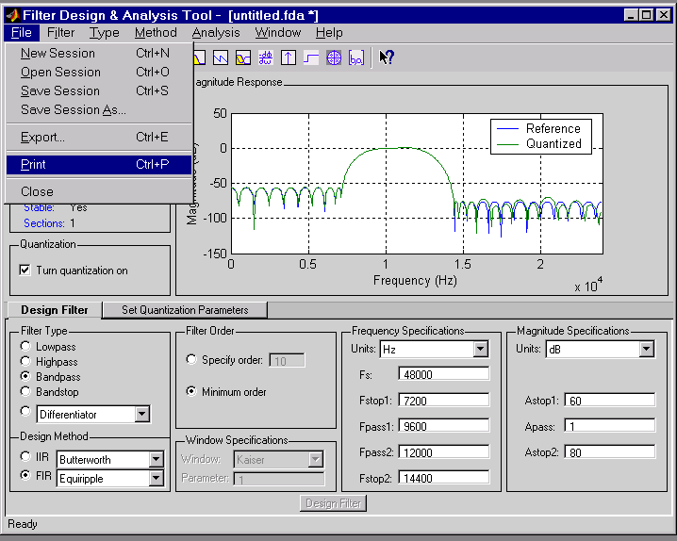
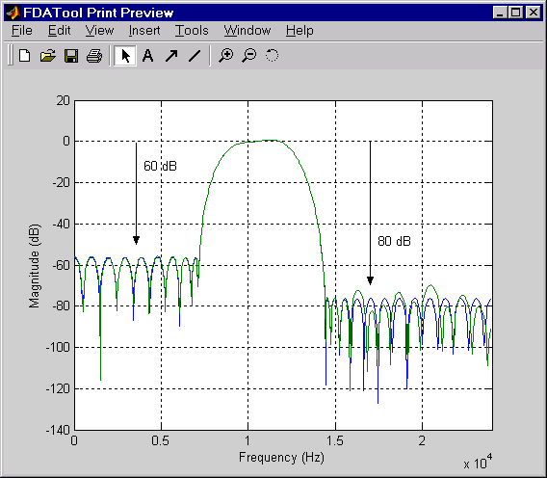
Print Preview and Annotation
Notes:
Print Preview and Annotation

Slide 26
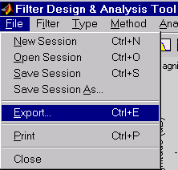
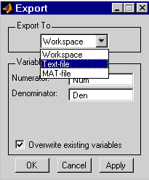
Convenient Exporting from FDATool
Notes:
Convenient Exporting from FDATool
See: Signal Processing Toolbox User’s Guide
Pages: 5-19, 5-20

Slide 27
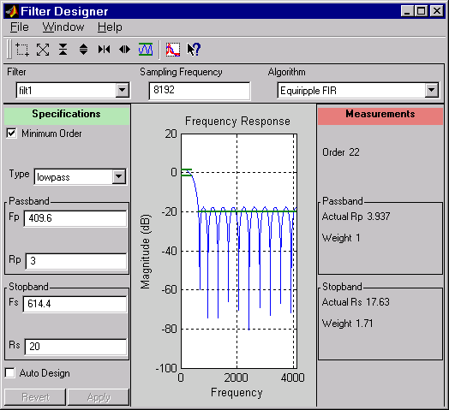
Filter Design in SPTool
Zoom controls
Design method
Filter type (lowpass,
bandpass, etc.)
Frequency
response
display and
controls
Design Criteria
numeric display
Notes:
Filter Design in SPTool
The Filter Designer is for designing or editing the following types of FIR and IIR digital filters:
Lowpass
Highpass
Bandpass
Bandstop
Most of the Signal Processing Toolbox filter design methods available at the command line are also available in the Filter Designer. Additionally, you can design a filter by using the Pole-Zero Editor to graphically place poles and zeros on the z-plane.
Zoom controls
Design method
Frequency
response
display and
controls

Slide 28
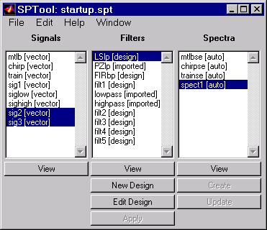
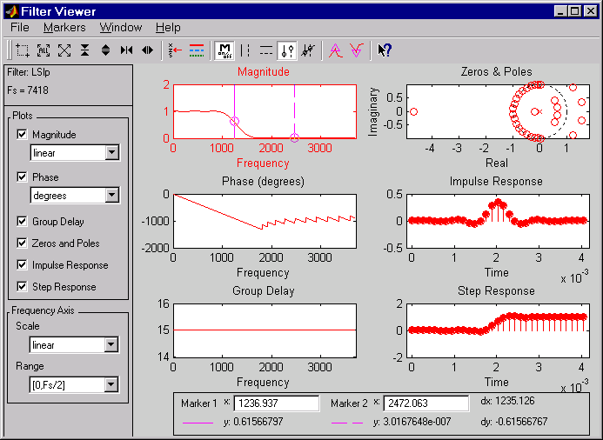
Filter Analysis with SPTool
Magnitude, phase, pole zero,impulse, step, group
Notes:
Filter Analysis with SPTool
Magnitude, phase, pole zero,impulse,
step, group
The Filter Viewer is for analyzing filter characteristics. You can analyze a filter's:
Magnitude response
Phase response
Group delay
Pole/zero plot
Impulse response
Step response

Slide 29
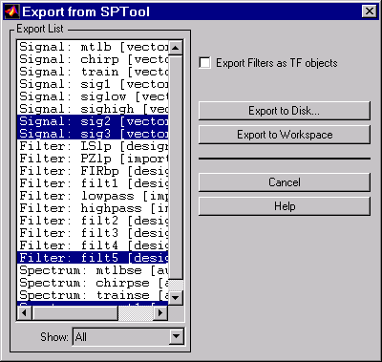
Exporting Data from SPTool
Exports objects to MATLAB workspace or file
Stored as structure
Export filters as objects that can be used with the Control System Toolbox
}
Destination
List of signals, filters, and spectra you want to export
Items to list
Notes:
Exporting Data from SPTool
Exports objects to MATLAB workspace
or file
Stored as structure
You can export SPTool signals, filters and spectra as structures to MATLAB workspace or to your disk.
1) Select the items in SPTool you want to export
2) Select Export from File menu
Destination
List of signals, filters, and spectra you want to export
Items to list
}
Export filters as objects that can be used with the Control System Toolbox
See: Signal Processing Toolbox User’s Guide
Pages: 6-31, 6-32

Slide 30
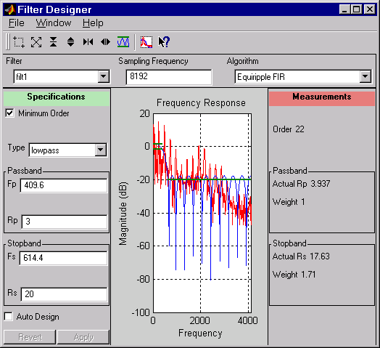
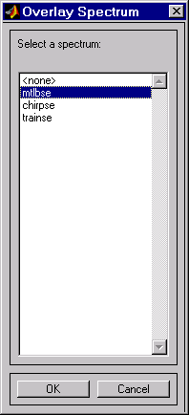
Overlay Spectra using SPTool
Overlay spectrum
Notes:
Overlay Spectra using SPTool
Overlay spectrum

Slide 31
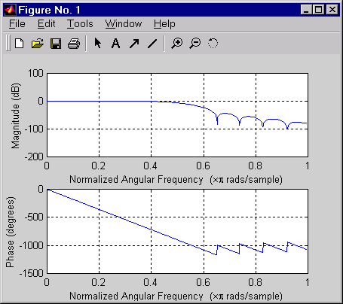
FIR Filter Design
FIR
  Features
  Windowing
    Inverse FFT to get h(n)
    Arbitrary response
  Other methods
Example
  b=fir1(20,0.5,hanning(21));
  freqz(b,1)
Notes:
FIR Filter Design
FIR
Features
Windowing
Inverse FFT to get h(n)
Arbitrary response
Other methods
Example
b=fir1(20,0.5,hanning(21));
freqz(b,1)
You may also want to use remez and gremez to design arbitrary response FIR filters. remez is a Parks-McClellan optimal equiripple FIR filter design. While gremez is a generalized remez FIR filter design
Try:
>>help fir1
>>help remez
>>help gremez

Slide 32
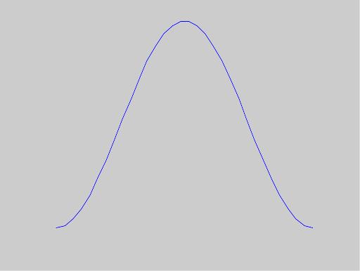
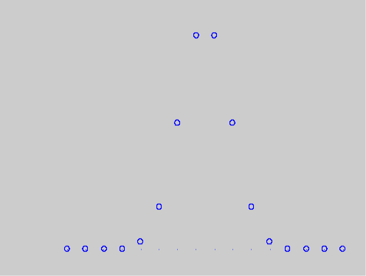
Windowing
Finite data length
Functions
  bartlett, blackman, boxcar, chebwin,
  hamming, hanning, kaiser, triang
  x=hanning(N);
Example
plot(hamming(32) stem(kaiser(16,30)
Notes:
Windowing
Finite data length
Functions
bartlett, blackman, boxcar, chebwin, hamming, hanning, kaiser, triang
x=hanning(N);
Example
plot(hamming(32));
stem(kaiser(16,30));
Try:
>>help bartlett
>>help blackman
>>help boxcar
>>help chebwin
>>help hamming
>>help hanning
>>help kaiser
>>help triang

Slide 33
Exercise: Remove a Note
With Fs=8192, create a 3 second signal containing the sum of three unity amplitude tones (sinusoids) 220Hz, 300Hz, 440Hz in the following time periods:
    220Hz 0<t<3
    300Hz 1<t<3
    440Hz 2<t<3
Play signal
Design an FIR Kaiser filter to remove the second tone
Play filtered signal
Notes:
Exercise: Remove a Note
With Fs=8192, create a 3 second signal containing the sum of three unity amplitude tones (sinusoids) 220Hz, 300Hz, 440Hz in the following time periods:
220Hz 0<t<3
300Hz 1<t<3
440Hz 2<t<3
Play signal
Design an FIR Kaiser filter to remove the second tone
Play filtered signal

Slide 34
Solution on Next Page

Slide 35
Solution: Remove a Note
Create signal
Fs=8192;
t=0:1/Fs:3;
a=[1 1 1];
f=[220;300;440];
mask(1,:)=ones(1,length(t));
mask(2,:)=t>1;
mask(3,:)=t>2;
x=a*(mask.*sin(2*pi*f*t));
plot(t,x)
sound(x,Fs);
remove_note
Notes:
Solution: Remove a Note
Create signal
Fs=8192;
t=0:1/Fs:3;
a=[1 1 1];
f=[220;300;440];
mask(1,:)=ones(1,length(t));
mask(2,:)=t>1;
mask(3,:)=t>2;
x=a*(mask.*sin(2*pi*f*t));
plot(t,x)
sound(x,Fs);
>>remove_note
Here’s another solution:
Fs = 8192;
t=0:1/Fs:3;
h1=220;
h2=300;
h3=440;
x1=sin(t*2*pi*h1);
x2=[zeros(1,1*8192) sin(2*pi*h2*(1:1/Fs:3))];
x3=[zeros(1,2*8192) sin(2*pi*h3*(2:1/Fs:3))];
xfinal=x1+x2+x3;
plot(t,xfinal)

Slide 36
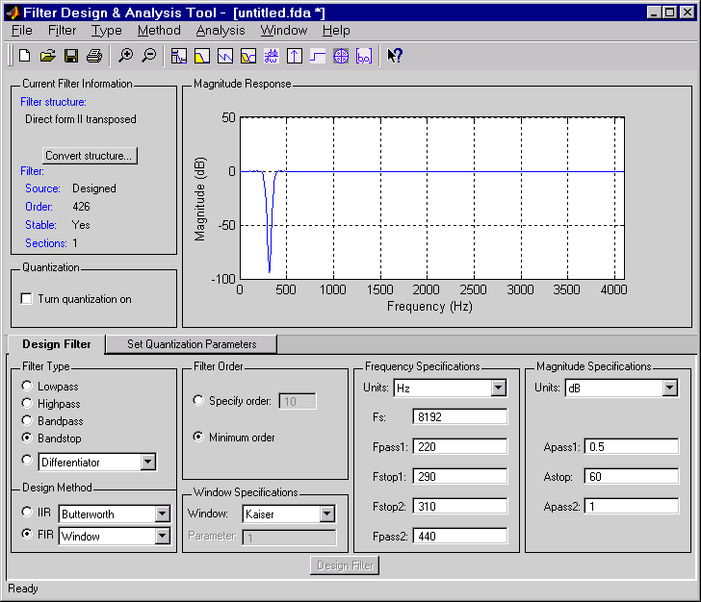
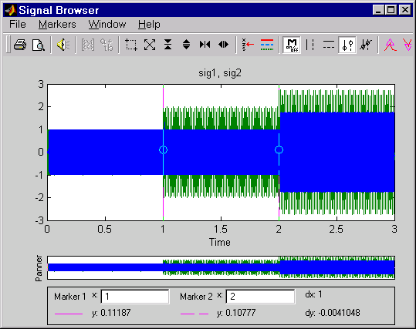
Solution
Design and apply filter using FDATool and SPTool
Notes:
Solution
Design and apply filter using FDATool and SPTool

Slide 37
Arbitrary Response FIR
Specify arbitrary magnitude response
Calculate FIR coefficients
Function
  b = fir2(order,freq_vec,mag_vec);
Example
  f = [0 0.6 0.6 1]; m = [1 1 0 0];
  b = fir2(30,f,m);
  freqz(b,1,128);
Notes:
Arbitrary Response FIR
Specify arbitrary magnitude response
Calculate FIR coefficients
Function
b = fir2(order,freq_vec,mag_vec);
Example
f = [0 0.6 0.6 1]; m = [1 1 0 0];
b = fir2(30,f,m);
freqz(b,1,128);
Try:
>>help fir2

Slide 38
Filter Design Tradeoffs
Reduced width of
transition band
<==>
Increased complexity
(higher order)
Lower Rp, Higher Rs
<==>
Increased complexity
(higher order)
FIR
Higher Order
Always Stable
Passband Phase
Linear
IIR
Lower Order
Can be Unstable
Non-linear Phase
Notes:
FIR
Higher Order
Always Stable
Passband Phase
Linear
IIR
Lower Order
Can be Unstable
Non-linear Phase
Filter Design Tradeoffs
Reduced width of
transition band
Increased complexity
(higher order)
<==>
Lower Rp, Higher Rs
Increased complexity
(higher order)
<==>

Slide 39
Impulse Response
Given a set of a and b coefficients
Calculate
  h=filter(b,a,[1 zeros(1,9)]);
Calculate and plot
  impz(b,a,10);
Notes:
Impulse Response
Given a set of a and b coefficients
Calculate
h=filter(b,a,[1 zeros(1,9)]);
Calculate and plot
impz(b,a,10);
Try:
>>help impz

Slide 40
Frequency Domain Filtering
Filtering in time domain
  conv, filter
Filtering in frequency domain
  fftfilt
  Efficient for long signals
Notes:
Frequency Domain Filtering
Filtering in time domain
conv, filter
Filtering in frequency domain
fftfilt
Efficient for long signals
Try:
>>help fftfilt

Slide 41
Summary
Implement real world filter using filter
Create LTI systems with specific magnitude response
Filter passband types
Filter specification
IIR Filter Design
Filter Design and Analysis Tool (FDATool)
Filter Analysis with SPTool
FIR Filter Design
Filter in time domain
Notes:
Summary
Implement real world filter using filter
Create LTI systems with specific magnitude response
Filter passband types
Filter specification
IIR Filter Design
FIR Filter Design
Filter Design and Analysis Tool (FDATool)
Filter Analysis with SPTool
Filter in time domain

