Slide 1

MATLAB for Signal Processing
Spectral Analysis
The MathWorks Inc.
Natick,
USA

Slide 2
Spectral Analysis Outline
Statistical Signal Processing
Spectral Analysis Theory
Spectral Analysis Methods
Spectral Analysis Functions
Spectrum Viewer in SPTool
Time Varying Spectrum
Resampling Signals
Notes:
Spectral Analysis Outline
Statistical Signal Processing
Spectral Analysis Theory
Spectral Analysis Methods
Spectral Analysis Functions
Spectrum Viewer in SPTool
Time Varying Spectrum
Resampling Signals

Slide 3

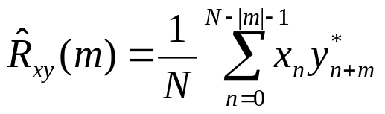
Statistical Signal Processing
Simple
  Standard deviation std(x), mean mean(x)
Correlation
  True
  Estimate
  xcorr(x,y,’coeff’)
Autocorrelation
  xcorr(x)
Covariance
  xcov(x,’biased’), xcov(x,y,’none’)
Notes:
Statistical Signal Processing
Simple
Standard deviation std(x), mean
mean(x)
Correlation
True
Estimate
xcorr(x,y,’coeff’)
Autocorrelation
xcorr(x)
Covariance
xcov(x,’biased’)
xcov(x,y,’none’)
The Signal Processing Toolbox provides tools for estimating important properties of random signals. In particular, it includes tools to estimate correlation and covariance sequences and spectral density functions of discrete signals.
xcorr and xcov estimate the cross-correlation and cross-covariance sequences of random processes. They also handle autocorrelation and autocovariance.
Try:
>>help std
>>help mean
>>help xcorr
>>help xcov
See: Signal Processing Toolbox User’s Guide
Pages: 3-2 to 3-4

Slide 4
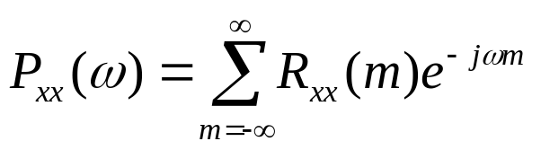
Spectral Analysis Theory
Power spectrum of signal
Normally computed directly from signal
Notes:
Spectral Analysis Theory
Power spectrum of signal
Normally computed directly from signal
Spectral analysis seeks to describe the frequency content of a signal, random process, or system, based on a finite set of data. Estimation of power spectra is useful in a variety of applications, including the detection of signals buried in wide-band noise.
See: Signal Processing Toolbox User’s Guide
Pages: 3-5, 3-6

Slide 5
Spectral Analysis Methods
Non-Parametric
Parametric
Welch
(pwelch)
Multitaper
(pmtm)
Maximum
Entropy (pmem)
MUSIC
(pmusic)
Non-parametric techniques
involve calculation of DFT
directly (using FFT.)
Parametric techniques involve
estimation of equivalent noise
filtering systems.
Notes:
Spectral Analysis Methods

Slide 6
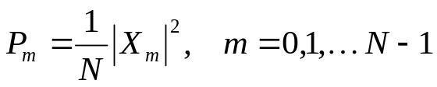
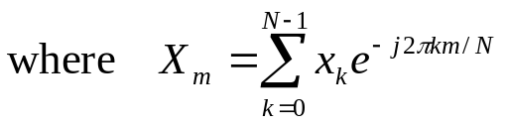
Spectral Analysis Functions
Periodogram
  Basis vectors
  X=(abs(fft(x)).^2)/length(x);
Averaged Periodogram (welsh)
  [Pxx,f]=pwelch(x,[],[],[],Nfft,fs)
  pwelch(x,[],[],[],Nfft,fs)
Notes:
See: Signal Processing Toolbox User’s Guide
Pages: 3-7
Spectral Analysis Functions
Periodogram
Basis vectors
X=(abs(fft(x)).^2)/length(x);
Averaged Periodogram (welsh)
[Pxx,f]=pwelch(x,[],[],[],Nfft,fs)
pwelch(x,[],[],[],Nfft,fs)
One way of estimating the power spectrum of a process is to simplyfind the discrete-time Fourier transform of the samples of the process and take the magnitude squared of the result.
A crude estimate of the PSD of x is what is called a periodogram. The problem with a periodogram estimate is that its variance is large and does not decrease as the number of samples increase. To quickly visualize the PSD of your signal, use psdplot.
Try:
>>help pwelch
>>help psdplot

Slide 7
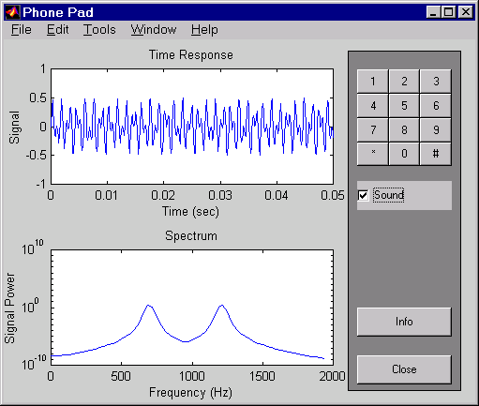
Example: phone
phone
Notes:
Example: phone
>>phone
The touch-tone system on the telephone uses signals of different frequencies to indicate which key has been pushed. The DTFT of a sampled telephone signal can be used to identify these frequencies. The sound you hear when you push a key is the sum of two sinusoids. The higher frequency sinusoid indicates the column of the key on the touch-pad and the lower frequency sinusoid indicates the row of the key on the touch-pad.

Slide 8
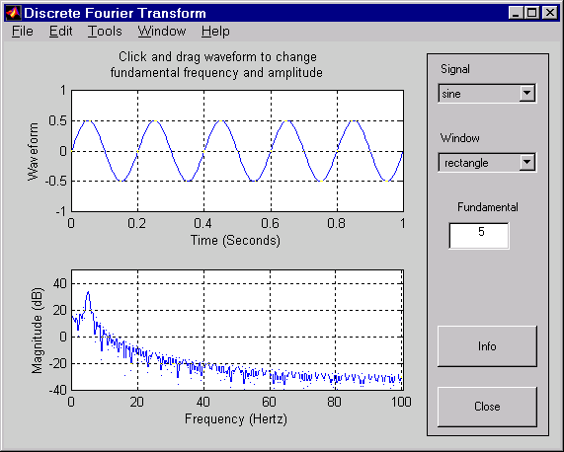
Example: sigdemo1
sigdemo1
Notes:
Example: sigdemo1
>>sigdemo1
The upper plot represents the discrete samples of a periodic waveform. The absolute value of its discrete Fourier transform (DFT), obtained using a fast Fourier transform (FFT) algorithm is represented on the lower plot.
In the lower plot, frequencies from 0 to 100 Hz are displayed. The DFT at negative frequencies is a mirror image of the DFT at positive frequencies. The sampling rate is 200 Hz, which means the "Nyquist frequency” is 100 Hz. The DFT at frequencies above the Nyquist frequency is the same as the DFT at lower (negative) frequencies.
Click and drag a point on the waveform shown in the upper plot to move that point to a new location. This sets a new fundamental frequency and amplitude. The Signal pop-up menu lets you change the shape of the waveform.
The Window menu lets you select a window function. This window is multiplied by the time waveform prior to taking the DFT.
The fundamental frequency of the waveform is given in the text box. You can change it by clicking in the text box, editing the number there, and pressing enter. You can also change it by clicking and dragging on the waveform.

Slide 9
Exercise: Colored Noise
Create 3 seconds of colored noise at Fs=1kHz
  Normally distributed noise
  Filter with lowpass elliptic order 6, cut-off 400Hz, Rp=3dB, Rs=40dB
Plot power spectrum
  Plot frequency response of filter
  Plot power spectrum of filtered signal
Notes:
Exercise: Colored Noise
Create 3 seconds of colored noise at Fs=1kHz
Normally distributed noise
Filter with lowpass elliptic order 6,
cut-off 400Hz, Rp=3dB, Rs=40dB
Plot power spectrum
Plot frequency response of filter
Plot power spectrum of filtered signal

Slide 10
Solution on Next Page

Slide 11
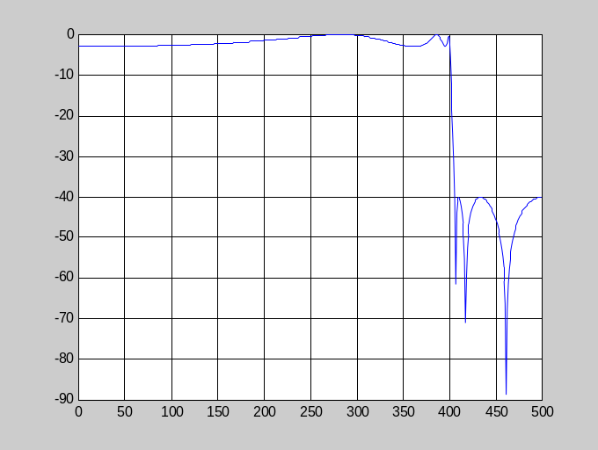
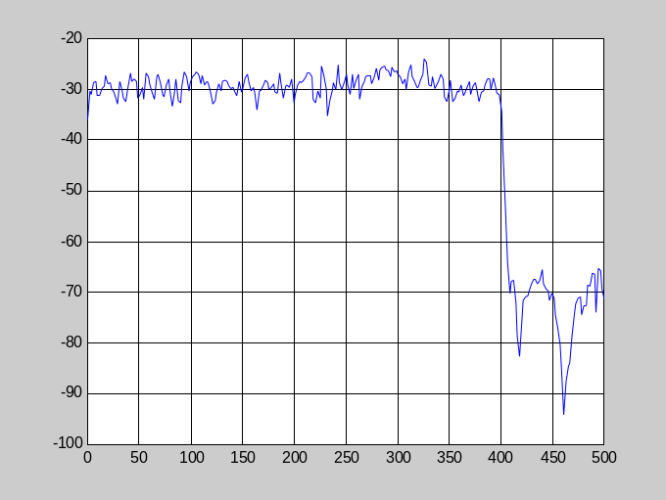
Solution: Colored Noise
fs=1000;
[b,a]=ellip(6,3,40.0.8)
[h,f]=freqz(b,a,512,fs);
plot(f,20*log10(abs(h)));
grid
x=randn(1,fs*3);
y=filter(b,a,x);
pwelch(y,[],[],[],512,fs);
colored_noise
Notes:
Solution: Colored Noise
fs=1000;
[b,a]=ellip(6,3,40.0.8)
[h,f]=freqz(b,a,512,fs);
plot(f,20*log10(abs(h)));
grid
x=randn(1,fs*3);
y=filter(b,a,x);
pwelch(y,[],[],[],512,fs);
>>colored_noise

Slide 12
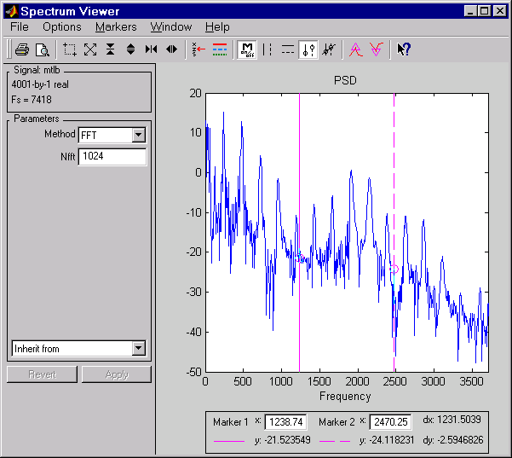
Spectrum Viewer in SPTool
Select signal in SPTool
Choose “Create Spectra”
Zoom
controls
Display
window
Spectra selection
Analysis method
Parameters
(change with
method)
Notes:
See: Signal Processing Toolbox User’s Guide
Pages: 6-28, 6-29
Spectrum Viewer in SPTool
Select signal in SPTool
Choose Create Spectra
Use the View button in the spectrum panel in the SPTool GUI to display one or more selected spectra.
Display
window
Zoom
controls
Analysis method

Slide 13
Exercise: Notes Spectrum
View spectrum of original signal and filtered signal in note filtering exercise, see the Filter Design section 4-30 for more detail or remove_note
Notes:
Exercise: Notes Spectrum
View spectrum of original signal and
filtered signal in note filtering exercise, see the Filter Design section 4-30 for more detail or remove_note

Slide 14
Solution on Next Page

Slide 15
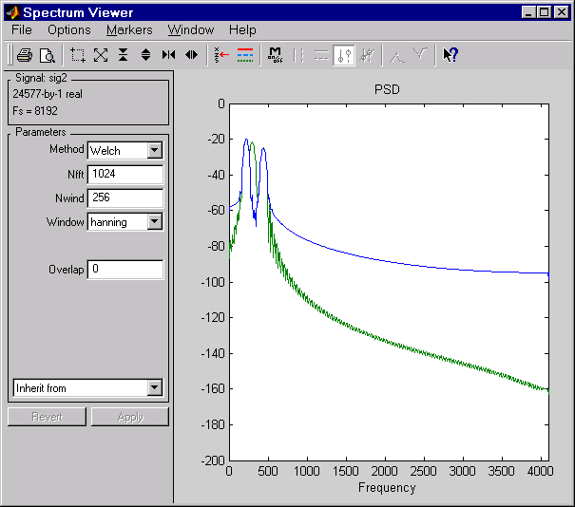
Solution: Notes Spectrum
notes_spectrum
Notes:
Solution: Notes Spectrum
>> notes_spectrum

Slide 16
Time Varying Spectrum
Time dependant power spectrum
Power spectrum of moving window
Function
  [B,f,t]=specgram(x,Nfft,fs)
Notes:
See: Signal Processing Toolbox User’s Guide
Pages: 7-394 to 7-396
Time Varying Spectrum
Time dependant power spectrum
Power spectrum of moving window
Function
[B,f,t]=specgram(x,Nfft,fs)
Time-dependent analysis (spectrum) computes the windowed discrete-time Fourier transform of a signal using a sliding window. Spectogram is the magnitude of this function. specgram returns the frequency and time vectors (f, t) respectively. t is a column vector of scaled times with the length equal to the number of columns of B.
Try:
>>help specgram

Slide 17
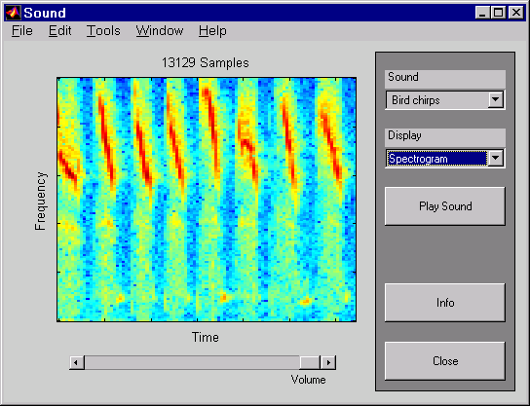
Example: xpsound
xpsound
Notes:
Example: xpsound
>>xpsound
xpsound demonstrates MATLAB's sound capability. MATLAB is useful for exploring audio data. Sounds can be thought of as one-dimensional arrays, or vectors. This window allows you to choose a sound and view its audio data graphically. If your computer has sound capability, you can play the sound and choose the volume.
You may view the audio graphically in three ways:
The time sequence is a two-dimensional plot of the data as a function of time.
The spectrum is an average of the signal's frequency content for the duration of the sound. The spectrum shows the signal's power as a function of frequency.
The spectrogram is a view of the frequency content of the signal as a function of time.
Time increases from left to right, and frequency increases from bottom to top.

Slide 18
Exercise: Waveform Spectrogram
Load eschertone.mat
  Listen to it
  Plot power spectrum
  Plot spectrogram
Notes:
Exercise: Waveform Spectrogram
Load eschertone.mat
Listen to it
Plot power spectrum
Plot spectrogram

Slide 19
Solution on Next Page

Slide 20
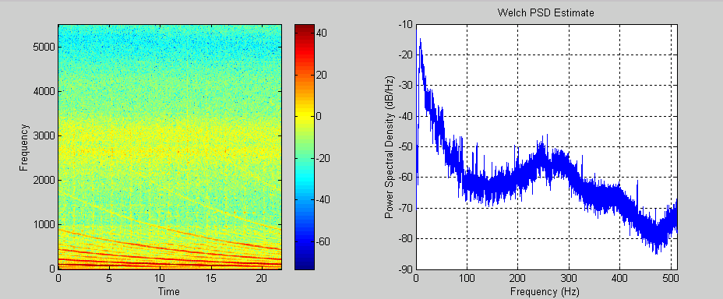
Solution: Waveform Spectrogram
load eschertone % Load the data
sound(u,fs) % Play waveform
specgram(u,1024,fs) % Spectrogram
colorbar % Display color scale
pwelch(u,[],[],[],1024,fs) % Plot spectrum
wave_spec
Notes:
Solution: Waveform Spectrogram
load eschertone % Load the data
sound(u,fs) % Play waveform
specgram(u,1024,fs) % Spectrogram
colorbar % Display color scale
pwelch(u,[],[],[],1024,fs) % Plot spectrum
>>wave_spec

Slide 21
Resampling
Change by integer value
  x2=x1(1:p:end), fs=fs/p;
Change by integer ratio
  x2=resample(x1,p,q), fs=fs*p/q;
  interp, decimate
Notes:
Resampling
Change by integer value
x2=x1(1:p:end), fs=fs/p;
Change by integer ratio
x2=resample(x1,p,q)
fs=fs*p/q;
interp, decimate
The Signal Processing Toolbox provides a number of functions that resample a signal at a higher and lower rate.
resample resamples the signal at a new rate ratio of two integers p and q, while interp interpolates the signal and decimate resamples the data at a lower rate after lowpass filtering.
Try:
>>help resample
>>help interp
>>help decimate
See: Signal Processing Toolbox User’s Guide
Pages: 4-20 to 4-22

Slide 22
Exercise: Reduce Sampling Rate
Confirm eschertone signal power is mainly below 2kHz. (Fs=11025)
Reduce sampling rate to 4410Hz, ( 2/5 *Fs)
Compare length, sound, spectrum and spectrogram of old and new signals
Notes:
Exercise: Reduce Sampling Rate
Confirm escertone signal power is mainly below 2kHz. (Fs=11025)
Reduce sampling rate to 4410Hz, ( 2/5 *Fs)
Compare length, sound, spectrum and spectrogram of old and new signals

Slide 23
Solution on Next Page

Slide 24
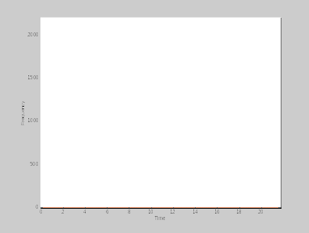
Solution: Reduce Sampling Rate
load eschertone;
length(u) % Length
sound(u,fs); % Sound
psd(u,1024,fs); % Spectrum
specgram(u,1024,fs); % Specgram
u=resample(u,2,5); % Change sample rate by 2/5
fs=fs*2/5; % New sample rate
length(u) % Length
sound(u,fs); % Sound
psd(u,1024,fs); % Spectrum
specgram(u,1024,fs); % Specgram
reduce_sampling
Notes:
Solution: Reduce Sampling Rate
load eschertone;
length(u) % Length
sound(u,fs); % Sound
psd(u,1024,fs); % Spectrum
specgram(u,1024,fs); % Specgram
u=resample(u,2,5); % Change sample rate by 2/5
fs=fs*2/5; % New sample rate
length(u) % Length
sound(u,fs); % Sound
psd(u,1024,fs); % Spectrum
specgram(u,1024,fs); % Specgram
>>reduce_sampling

Slide 25
Summary
Signal processing
MATLAB and Signal Processing Toolbox
Topics
  Signals
    Representation and manipulation
  Linear systems
    Representation and manipulation
    Applying to signals
  Filter design
  Spectral analysis
Notes:
5 - <number>
Summary
Signal processing
MATLAB and Signal Processing Toolbox
Topics
Signals
Representation and manipulation
Linear systems
Representation and manipulation
Applying to signals
Filter design
Spectral analysis

