Slide 1
EEM312 Laboratory
Lab assistants are: Dilara Değerliyurt–Süleyman Burak Çelik
Labs are divided into two sections (same as course sections). Verify your section as soon as possible.
Lab homepage: http://www.baskent.edu.tr/~ddegerliyurt
http://www.baskent.edu.tr/~sbcelik
If necessary, our document open password is 312lab

Slide 2
EEM312 Laboratory
Contents of the lab
Rise time, fall time, noise margin and delay measurements both in HW and SW labs
Datasheet comparisons with the real measurements
Regenerative property of logic gates
Ring oscillators
Diodes and diode based logic gates
MOSFET models
Mosfets and measurements and comparisons
NMOS PMOS CMOS comparisons
Power dissipation of inverters
Domino logic implementation in Spice
Pass transistors logic implementations
Transmission gates and logics

Slide 3
WinSpice
Circuit Simulation Program

Slide 4
INTRODUCTION
WinSpice3 is a general-purpose circuit simulation program for non-linear DC, non-linear transient, and linear AC analyses
Circuits may contain resistors, capacitors, inductors, mutual inductors, independent voltage and current sources, four types of dependent sources, lossless and lossy transmission lines, switches, uniform distributed RC lines, and the four most common semiconductor devices: diodes, BJTs, JFETs, and MOSFETs

Slide 5
INTRODUCTION
Installation:
You may download program at
http://www.baskent.edu.tr/~ddegerliyurt
Follow the links for the related materials

Slide 6
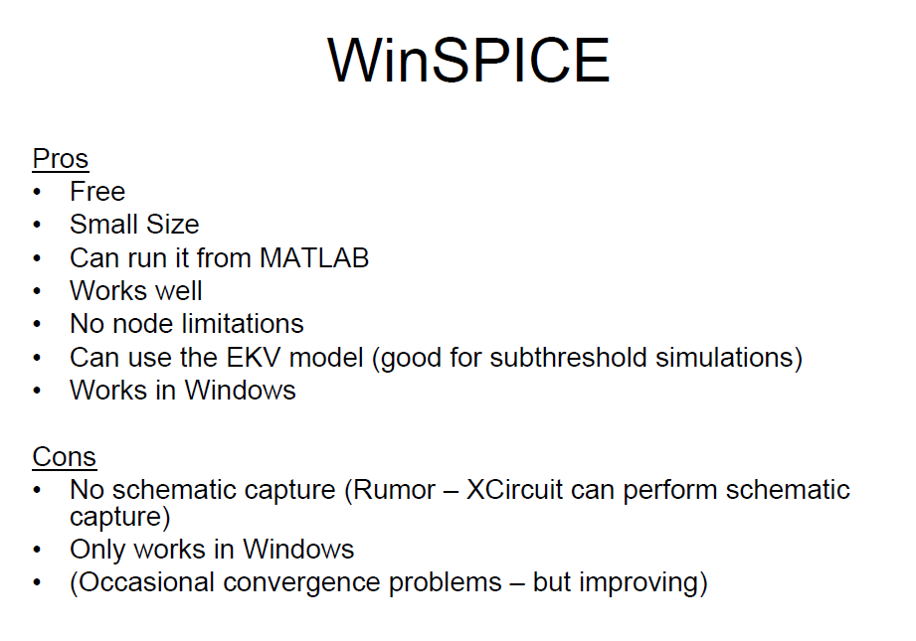

Slide 7
TYPES OF ANALYSIS
DC Analysis
AC Small-Signal Analysis
Transient Analysis
Pole-Zero Analysis
Small-Signal Distortion Analysis
Sensitivity Analysis
Noise Analysis
Analysis At Different Temperatures

Slide 8
Writing WinSpice
WinSpice Deck/Netlist is a text description of a circuit consists of the following parts
Header
Circuit connections
Subcircuit descriptions (if needed)
Model descriptions (if needed – usually only for
transistors)
Analyses to be performed
Outputs to be saved / displayed

Slide 11
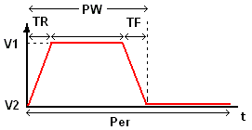
Pulse
PULSE(V2 V1 TD TR TF PW PER)
EX:
VIN 3 0 PULSE(-1 1 2NS 2NS 2NS 50NS 100NS)
parameter | default value | units
V1 (initial value) |  | Volts or Amps
V2 (pulsed value) |  | Volts or Amps
TD (delay time) | 0.0 | seconds
TR (rise time) | TSTEP | seconds
TF (fall time) | TSTEP | seconds
PW (pulse width) | TSTOP | seconds
PER(period) | TSTOP | seconds

Slide 12
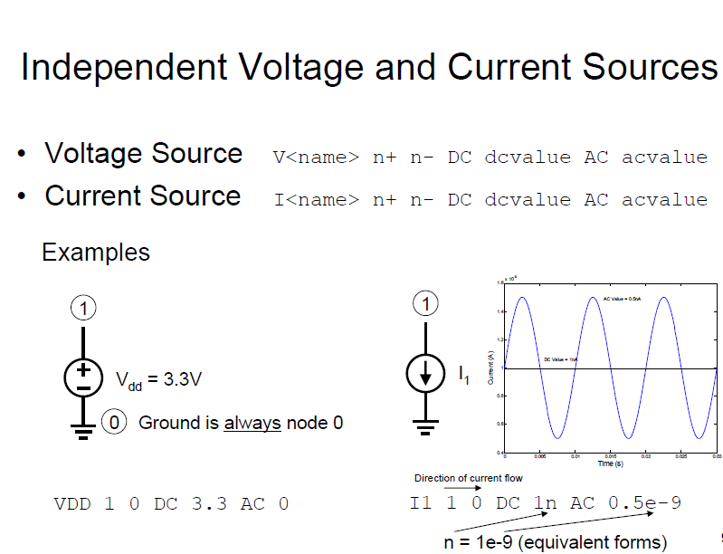

Slide 17
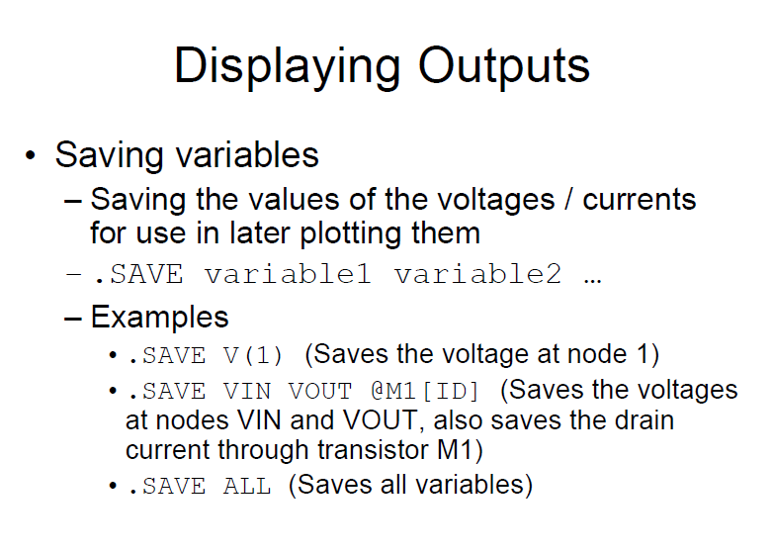

Slide 18
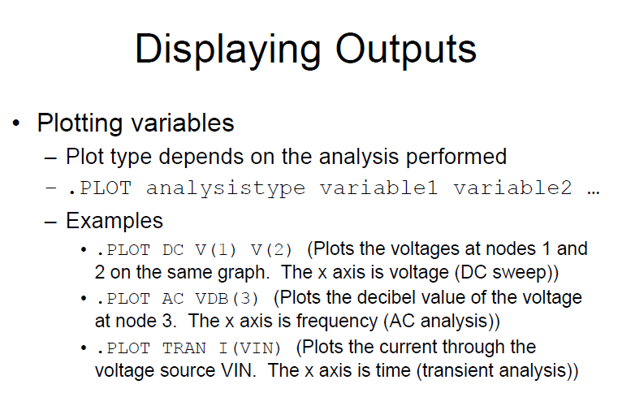

Slide 20
