Slide 1
ECE 4115
Control Systems Lab 1
Spring 2005
Chapter 4
Case Study of a Motor Speed Control
Prepared by: Nisarg Mehta

Slide 2
Matlab
Start → Run → \\laser\apps
Open MatlabR14 and double click on MATLAB 7.0.1

Slide 3
Summary of Course
Introduction to MATLAB
Chapter 1: System Models
Chapter 2: Time Response of Systems
Chapter 3: Frequency Domain Analysis and Design
Case Study: of a Motor Speed Control

Slide 4
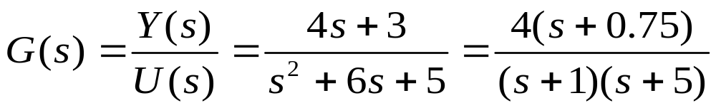
Summary of Chapter 1
System Models
Basic types of LTI models
  Transfer Function: tf, tfdata
  Zero-pole-gain model: zpk, zpkdata
Conversion between models
Model dynamics pzmap, pole, eig, zero, dcgain

Slide 5
Summary of Chapter 2
Time Response of System
Impulse response: Impulse
Step response: Step
General time response: lsim
Polynomial multiplication: conv
Polynomial division: deconv
Partial fraction expansion: residue

Slide 6
Summary of Chapter 3
Frequency Domain Analysis and Design
Root locus analysis (rlocus, rlocfind)
Frequency response plots
  Bode (bode)
    Gain Margin (margin)
    Phase Margin (margin)
  Nyquist (nyquist)

Slide 7
Presentations
http://www.egr.uh.edu/courses/ECE/

Slide 8
Case Study:
Motor Speed Control
Modeling
Time response
PID controller design
Root locus controller design
Frequency based controller design

Slide 9
Programs
Open_loop_response
P_response
PI_response
PID_response
Open_loop_rootlocus
PID_rootlocus
Open_loop_bode
PID_bode

Slide 10
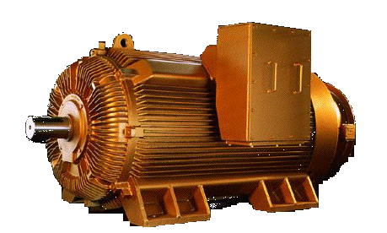
Motor Speed Control
A DC motor has second order speed dynamics
Mechanical properties such as inertia (J) and damping (b)
Electrical properties such as inductance (L) and resistance (R)
Controller's objective is to maintain the speed of rotation of the motor shaft with a particular step response

Slide 11
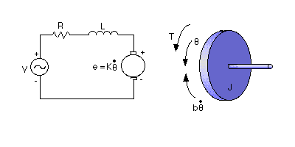
Modeling
The electric circuit of the armature and the free body diagram of the rotor are shown

Slide 12
Modeling
moment of inertia of the rotor (J) = 0.01 kg.m^2/s^2
damping ratio of the mechanical system (b) = 0.1 Nms
electromotive force constant (K=Ke=Kt) = 0.01 Nm/Amp
electric resistance (R) = 1 ohm
electric inductance (L) = 0.5 H
input (V): Source Voltage
output (theta): position of shaft
The rotor and shaft are assumed to be rigid

Slide 13

Modeling
The motor torque, T, is related to the armature current, i, by a constant factor Kt
The back emf, e, is related to the rotational velocity by the following equations

Slide 14

Modeling Transfer Function
Based on Newton's law combined with Kirchhoff's law

Slide 15


Modeling Transfer Function
Using Laplace Transforms

Slide 16
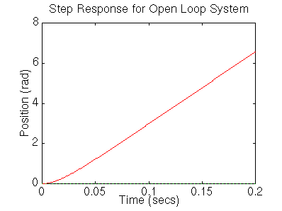
Open Loop Response

Slide 17
Open Loop Response
1 volt is applied to the system, the motor position changes by 70 radians in 2 seconds
Motor doesn't reach a steady state

Slide 18
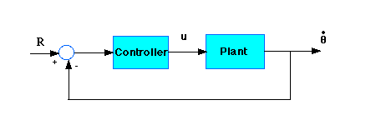
PID Design Method
With a 1 rad/sec step input, the design criteria are:
Settling time less than 0.04 seconds
Overshoot less than 16%
No steady-state error

Slide 19

PID Controller
Proportional Controller with gain Kp = 100
PID controller with gains Kp = 100, Ki = 1 and Kd =1
Tune the gain Ki = 200
Increase Kd to reduce over shoot Kd = 10

Slide 20
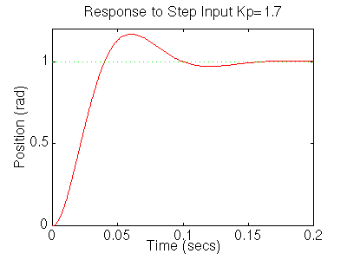
Proportional Gain (Kp = 1.7)

Slide 21
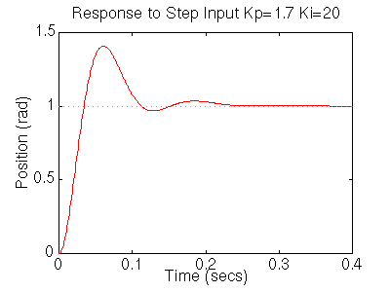
Proportinal-Integral Controller
(Kp = 1.7, Ki = 20)

Slide 22
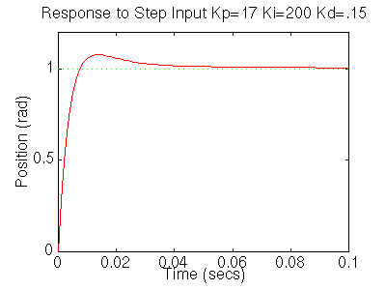
Proportional-Integral-Derivative Controller

Slide 23
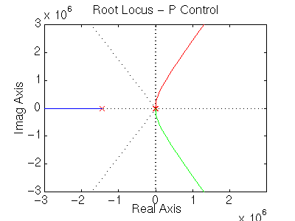
Open loop Root Locus

Slide 24
Root Locus Design
With a 1 rad/sec step reference, the design criteria are:
Settling time less than 0.04 seconds
Overshoot less than 16%
No steady-state error

Slide 25
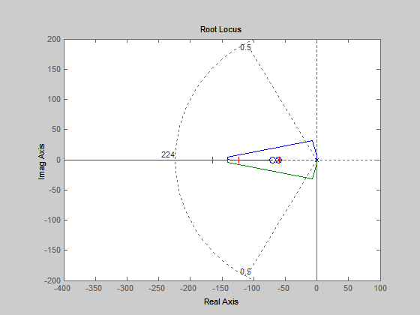
Finding the gain

Slide 26
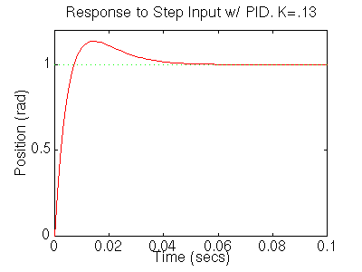
Plot the step response

Slide 27
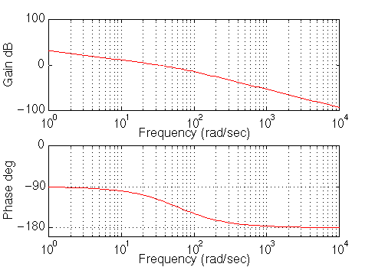
Drawing the original Bode plot

Slide 28
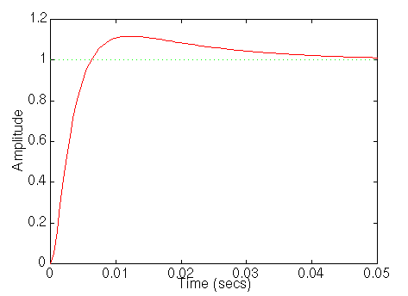
Frequency Design Method for DC Motor Speed Control

Slide 29
Summary of Case Study:
DC Motor Control
Modeling of DC Motor
Design of PID controller
Design of Controller using Rootlocus
Design of Controller using Frequency response

Slide 30
Summary of Course
Introduction to MATLAB
Chapter 1: System Models
Chapter 2: Time Response of Systems
Chapter 3: Frequency Domain Analysis and Design
Case Study: of a Motor Speed Control

Slide 31
Project: Model Reduction and Control systems Design
Abstract
Introduction
Theoretical Development
Illustrative Examples
  Model Reduction
  Control System Design
Conclusion and Discussion
References

Slide 32
Thank you…
Homework #3 and Final Project
Due on April 20th

