Slide 1
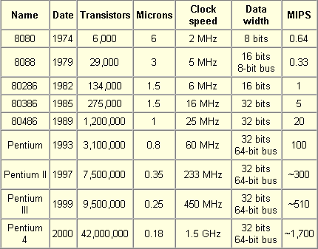
History
8086 Microprocessor
1959: first IC's
1971: µP 4004 4Bit Intel (~2000 Tr.)
1972: µP 8008 8Bit Intel (~5000 Tr.)
1974: µP 8080 8Bit Intel (~6000 Tr.)
1974: µP 6800 8Bit Motorola
1975: µP Z80 8Bit Zilog
1976: µP 9900 16Bit Texas Instruments
1978: µP 8086 16Bit Intel (50.000 Tr)
1982: µP 8286 16Bit Intel (100.000 Tr.)
1985: µP 80386 16Bit Intel (300.000 Tr.)
1989: µP 80486 16Bit Intel (10⁶ Tr.)
1993: µP 80586 16Bit Intel (5·10⁶ Tr.)
...

Slide 2
History of Intel’s Microprocessors
Intel 4004
  1971, 4-bit
Intel 8008
  1972, 8-bit
  Originally designed for Datapoint Corp. as a CRT display controller
Intel 8080
  1974, April - Altair 8800, 1975, MITS( 256 bytes of Mem, $395)
  Apple II -- Steve Jobs and Steve Wozniak 1976, Apple 사 설립
  Bill Gates and a fellow student : BASIC, 1975 --> Microsoft
Intel 8086/8088
  1978, 16 bit: 8088, 1979, 8-bit external bus
IBM PC ; 1981
  29,000 Trs
Intel 80286
  1982, 16-bit architecture
  24-bit addressing, memory protection and virtual memory
  16 MB of physical MEM and 1 GB of virtual mem
  130,000 Trs onto a single chip
  IBM PC/AT in 1984, IBM PS/2 Model 50 and 60

Slide 3
Intel 80386
  1985, 32 bits
  3~5 MIPS (7 MIPS on the 25 MHz chip)
  memory paging and enhanced I/O permission features
  4GB programming model
Intel 80486
  1989 Spring COMDEX show -> 1990 June : actual release
  1,200,000 Trs
  386+387+8K data and instruction cache, paging and MMU
Pentium
  1993
  110 MIPS on 66 Mhz Chip
  16 KB on-chip cache and 64 bit data bus
  superscalar technology (two instructions/clock)
  3.1 million transistors

Slide 4
Pentium Pro
  1995, Superscalar(three-way issue)
  5.5 million Trs in the CPU core + 15.5 million Trs in the secondary cache 8K data, 8K instr cache
  256 KB SRAM secondary cache
  200 SPECint92 at 133 MHz
  2.9 V, 0.6 micron BICMOS
Pentium II
  Pentium Pro + MMX, 1997
  233, 266, upto 450 MHz
  7.5 million Trs in CPU
  512KB in secondary cache
Pentium III
  1999
  Pentium Pro + MMX + Internet Streaming SIMD Instructions
  0.25 micron, 9.5 million Trs
  600 MHz, 550 MHz,...
  32 K(16K/16K) non-blocking level 1 cache

Slide 5
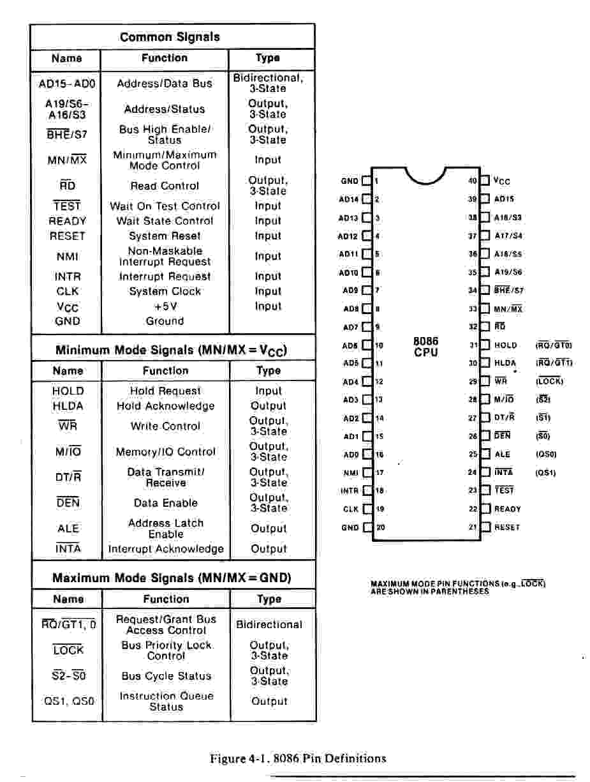
8086 Microprocessor

Slide 6
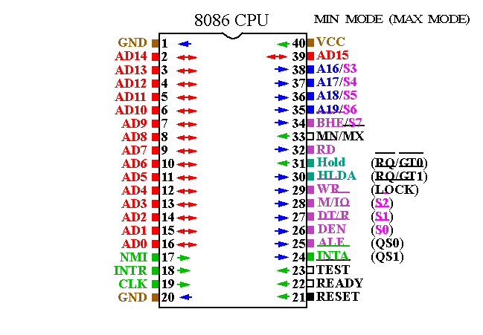
16-bit Arithmetic Logic Unit
• 16-bit data bus (8088 has 8-bit data bus)
• 20-bit address bus - 220 = 1,048,576 = 1 meg

Slide 7
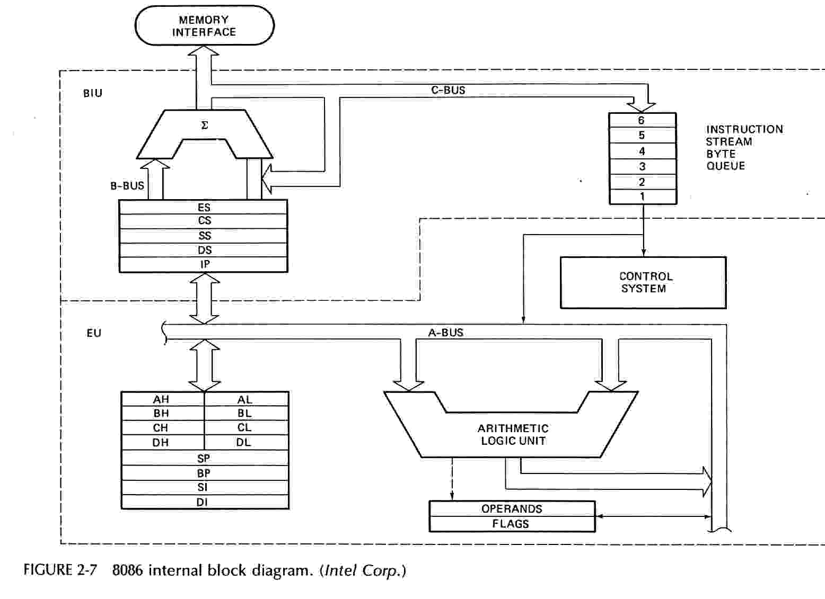
8086 Architecture
  • The 8086 has two parts, the Bus Interface Unit (BIU) and the
  Execution Unit (EU).
  • The BIU fetches instructions, reads and writes data, and computes the
  20-bit address.
  • The EU decodes and executes the instructions using the 16-bit ALU.
  • The BIU contains the following registers:
    IP - the Instruction Pointer
    CS - the Code Segment Register
    DS - the Data Segment Register
    SS - the Stack Segment Register
    ES - the Extra Segment Register
The BIU fetches instructions using the CS and IP, written CS:IP, to contruct
the 20-bit address. Data is fetched using a segment register (usually the DS)
and an effective address (EA) computed by the EU depending on the
addressing mode.

Slide 9
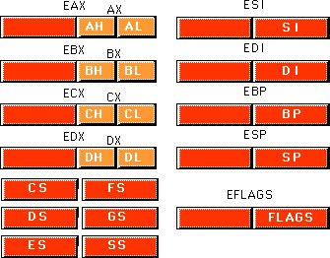
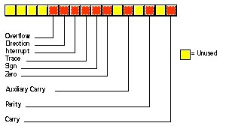
80386/80486/Pentium Registers
32 bits
The ax, bx, cx, dx, si, di, bp, sp, flags, and ip registers of the 8068 were all extended to 32 bits.
The 80386 calls these new 32 bit versions EAX, EBX, ECX, EDX, ESI, EDI, EBP, ESP, EFLAGS, and EIP
Memory segments can be as large as 4GB

Slide 10
8086 Programmer’s Model
ES
Extra Segment
_{BIU registers}
_{(20 bit adder)}
CS
Code Segment
SS
Stack Segment
DS
Data Segment
IP
Instruction Pointer
AX
AH
AL
Accumulator
BX
BH
BL
Base Register
CX
CH
CL
Count Register
DX
DH
DL
Data Register
SP
Stack Pointer
BP
Base Pointer
SI
Source Index Register
DI
Destination Index Register
FLAGS

Slide 11
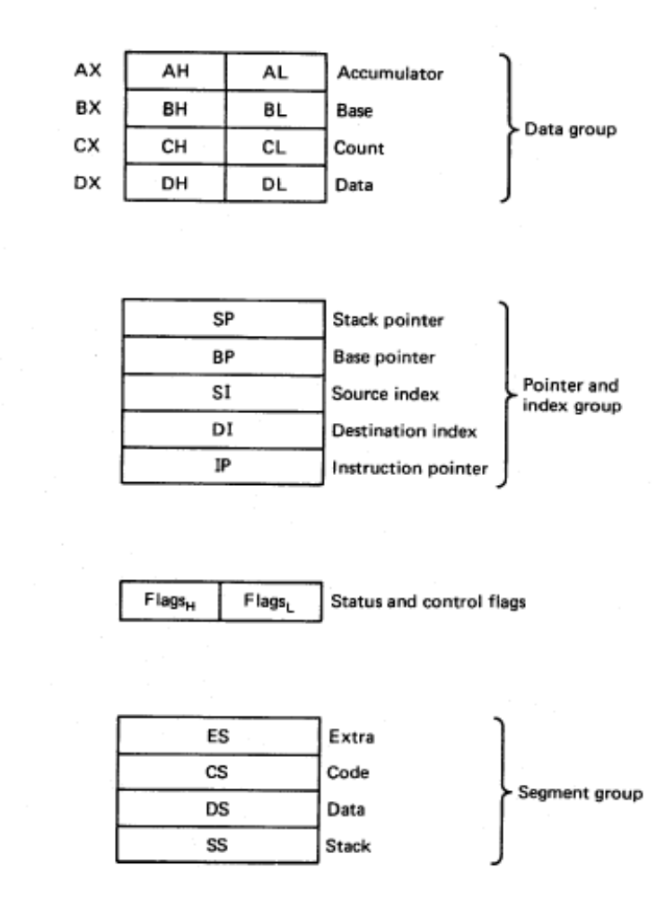
8086/88 internal registers 16 bits (2 bytes each)
AX, BX, CX and DX are two
bytes wide and each byte can
be accessed separately
These registers are used as
memory pointers.
Flags will be discussed later
Segment registers are used
as base address for a segment
in the 1 M byte of memory

Slide 12
The 8086/8088 Microprocessors: Registers
Registers
  Registers are in the CPU and are referred to by specific names
  Data registers
    Hold data for an operation to be performed
    There are 4 data registers (AX, BX, CX, DX)
  Address registers
    Hold the address of an instruction or data element
    Segment registers (CS, DS, ES, SS)
    Pointer registers (SP, BP, IP)
    Index registers (SI, DI)
  Status register
    Keeps the current status of the processor
    On an IBM PC the status register is called the FLAGS register
  In total there are fourteen 16-bit registers in an 8086/8088

Slide 13
Data Registers: AX, BX, CX, DX
Instructions execute faster if the data is in a register
AX, BX, CX, DX are the data registers
Low and High bytes of the data registers can be accessed separately
  AH, BH, CH, DH are the high bytes
  AL, BL, CL, and DL are the low bytes
Data Registers are general purpose registers but they also perform special functions
AX
  Accumulator Register
  Preferred register to use in arithmetic, logic and data transfer instructions because it generates the shortest Machine Language Code
  Must be used in multiplication and division operations
  Must also be used in I/O operations

Slide 14
BX
  Base Register
  Also serves as an address register
  Used in array operations
  Used in Table Lookup operations (XLAT)
CX
  Count register
  Used as a loop counter
  Used in shift and rotate operations
DX
  Data register
  Used in multiplication and division
  Also used in I/O operations

Slide 15
Pointer and Index Registers
Contain the offset addresses of memory locations
Can also be used in arithmetic and other operations
SP: Stack pointer
  Used with SS to access the stack segment
BP: Base Pointer
  Primarily used to access data on the stack
  Can be used to access data in other segments
SI: Source Index register
  is required for some string operations
  When string operations are performed, the SI register points to memory locations in the data segment which is addressed by the DS register. Thus, SI is associated with the DS in string operations.

Slide 16
DI: Destination Index register
  is also required for some string operations.
  When string operations are performed, the DI register points to memory locations in the data segment which is addressed by the ES register. Thus, DI is associated with the ES in string operations.
The SI and the DI registers may also be used to access data stored in arrays

Slide 17
Segment Registers - CS, DS, SS and ES
Are Address registers
Store the memory addresses of instructions and data
Memory Organization
  Each byte in memory has a 20 bit address starting with 0 to 2²⁰-1 or 1 meg of addressable memory
  Addresses are expressed as 5 hex digits from 00000 - FFFFF
  Problem: But 20 bit addresses are TOO BIG to fit in 16 bit registers!
  Solution: Memory Segment
    Block of 64K (65,536) consecutive memory bytes
    A segment number is a 16 bit number
    Segment numbers range from 0000 to FFFF
    Within a segment, a particular memory location is specified with an offset
    An offset also ranges from 0000 to FFFF

Slide 18
Memory Address Generation
Intel
The BIU has a dedicated adder for determining physical memory addresses
If the data segment starts at location 1000h and a data reference
contains the address 29h where is the actual data?
Offset Value (16 bits)
Segment Register (16 bits)
0 0 0 0
2
9
Adder
Offset:
0 0 0 0 0 0 0 0 0 0 1 0 1 0 0 1
Segment:
0 0 0 1 0 0 0 0 0 0 0 0 0 0 0 0
0 0 0 0
Address:
Physical Address (20 Bits)
0 0 0 1 0 0 0 0 0 0 0 0 0 0 1 0
1 0 0 1

Slide 19
Segments
Address
0H
Segment Starting address is segment
register value shifted 4 places to the left.
CODE
64K Data
Segment
STACK
DATA
EXTRA
← CS:0
64K Code
Segment
Segment
Registers
Segments are < or = 64K,
can overlap, start at an address
that ends in 0H.
0FFFFFH
MEMORY

Slide 20
The Code Segment
_{0H}
4000H
CS:
0400H
IP
0056H
4056H
CS:IP = 400:56
Logical Address
Memory
0400
0
Segment Register
Offset
Physical or
Absolute Address
+
0056
04056H
_{0FFFFFH}
The offset is the distance in bytes from the start of the segment.
The offset is given by the IP for the Code Segment.
Instructions are always fetched with using the CS register.
The physical address is also called the absolute address.

Slide 21
The Data Segment
_{0H}
05C00H
DS:
05C0
05C50H
EA
0050
DS:EA
Memory
05C0
0
Segment Register
Offset
Physical Address
+
0050
_{0FFFFFH}
05C50H
Data is usually fetched with respect to the DS register.
The effective address (EA) is the offset.
The EA depends on the addressing mode.

Slide 22
The Stack Segment
0A000H
_{0H}
SS:
0A00
0A100H
SP
0100
SS:SP
Memory
0A00
0
Segment Register
Offset
Physical Address
+
0100
0A100H
_{0FFFFFH}
The offset is given by the SP register.
The stack is always referenced with respect to the stack segment register.
The stack grows toward decreasing memory locations.
The SP points to the last or top item on the stack.
Logical Address is specified as segment:offset
Physical address is obtained by shifting the segment address 4 bits to the left and adding the offset address
Thus the physical address of the logical address A4FB:4872 is A4FB0+ 4872 = A9822

Slide 23
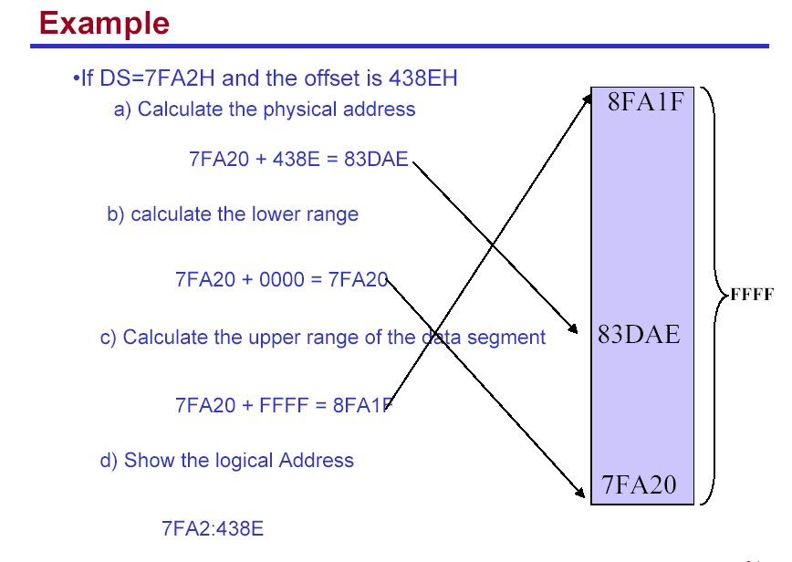

Slide 24
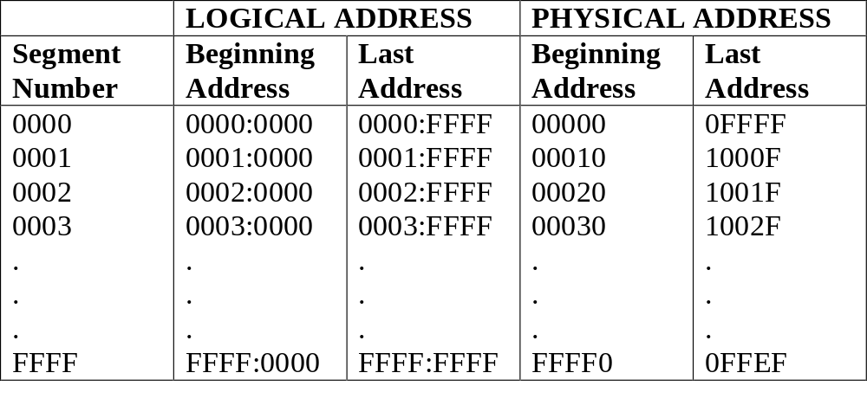

Slide 25
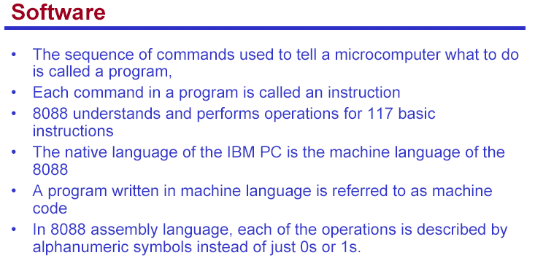
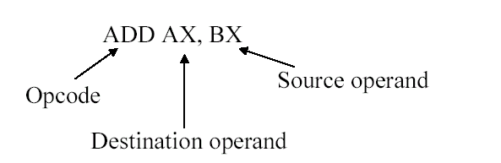

Slide 26
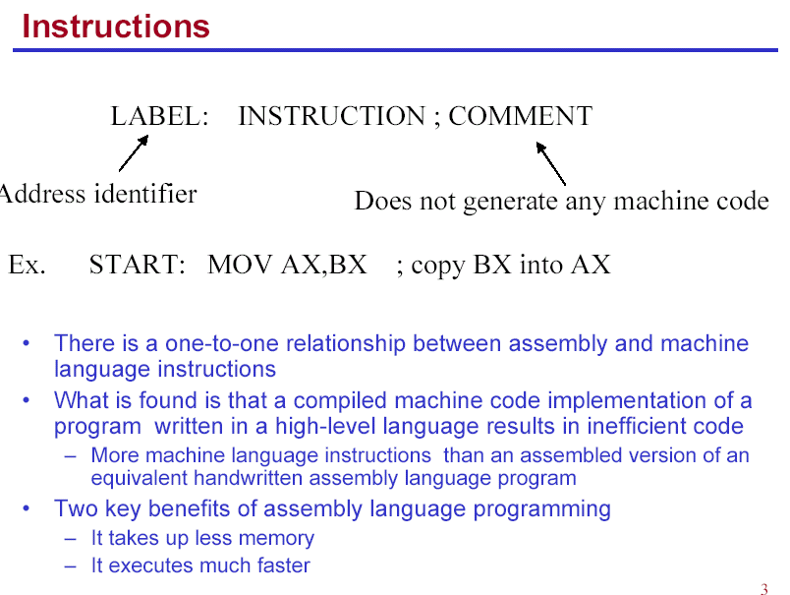

Slide 27
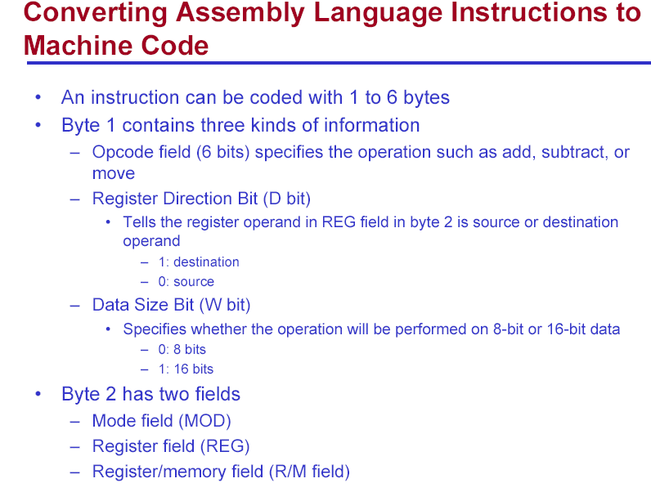

Slide 28
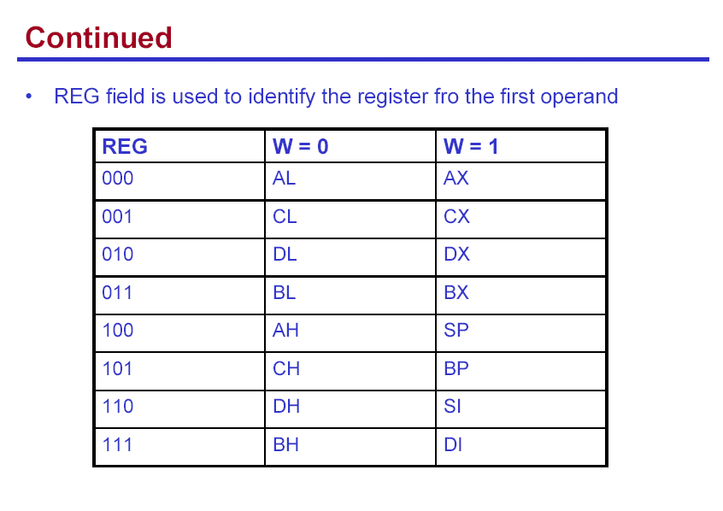

Slide 29
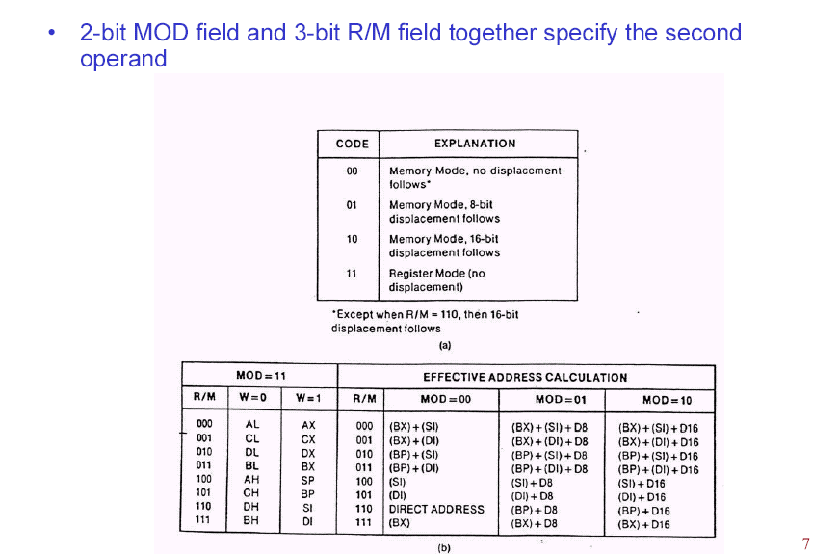

Slide 30
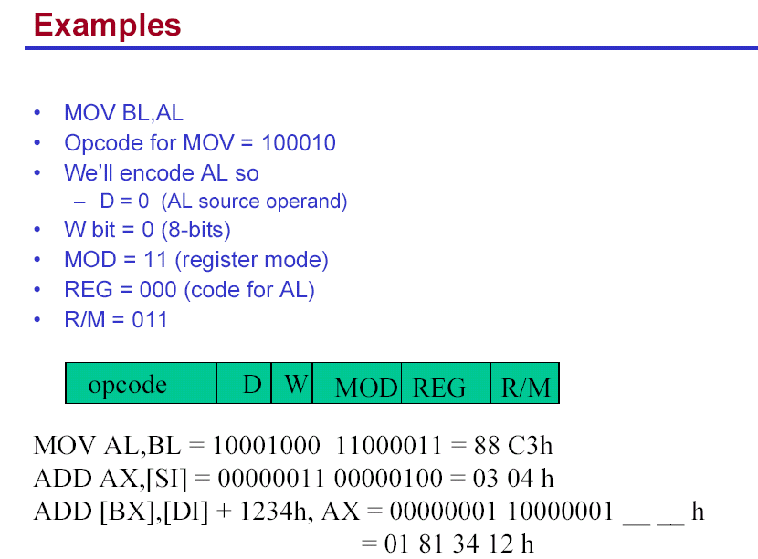

Slide 31
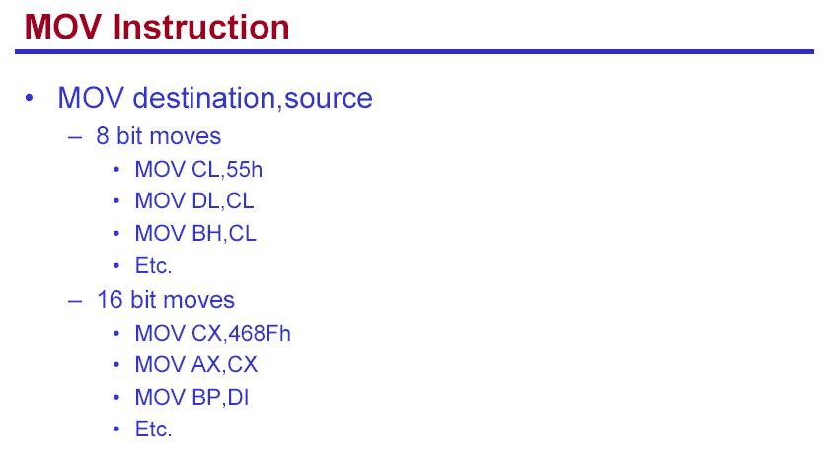

Slide 32
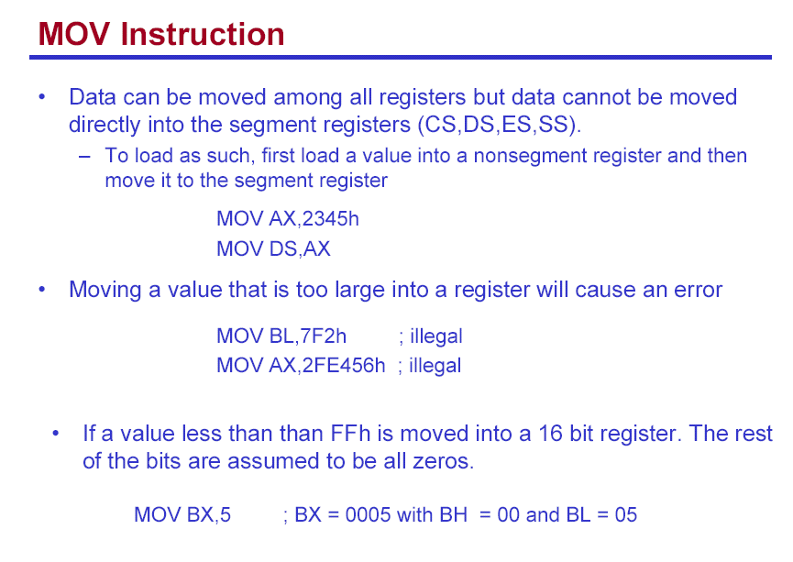

Slide 33
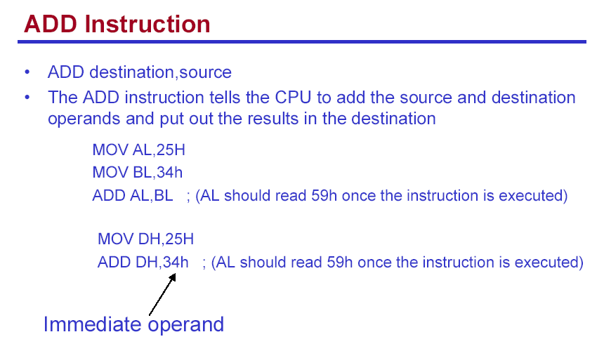

Slide 34
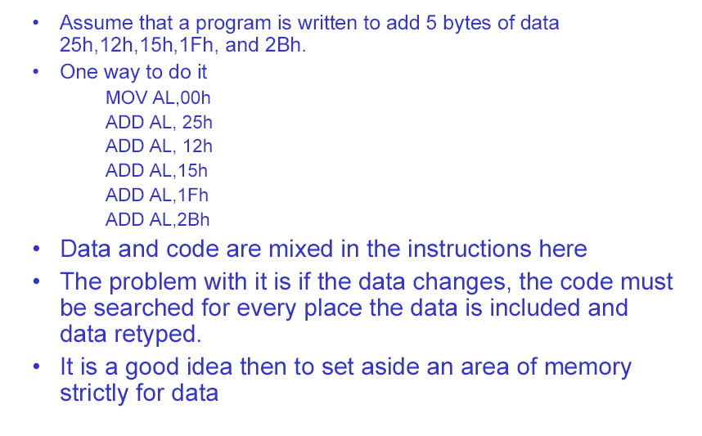

Slide 35
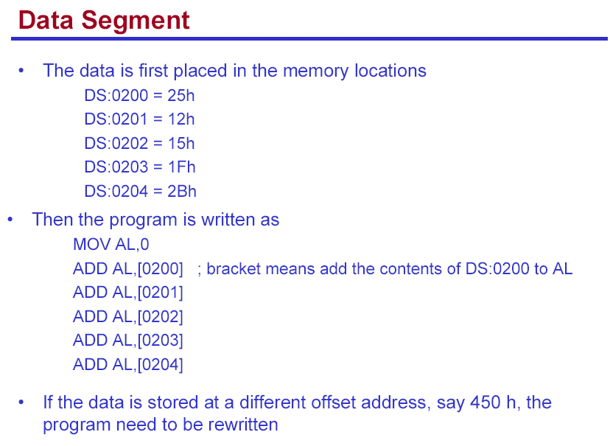

Slide 36
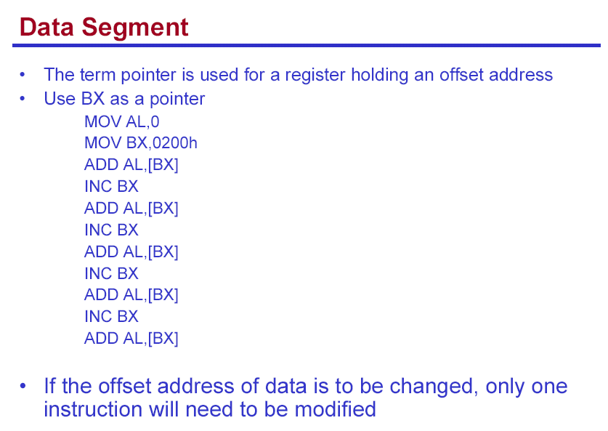

Slide 37
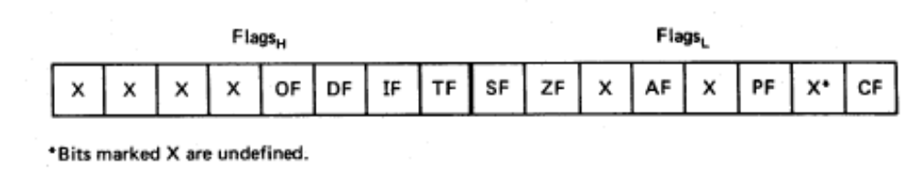
Flags in flag register
Carry flag
Overflow
Direction
Parity flag
Interrupt enable
Auxiliary flag
Trap
Zero
Sign
6 are status flags
3 are control flag

Slide 38
Flag Register
Conditional flags:
  They are set according to some results of arithmetic operation. You do not need to alter the value yourself.
Control flags:
  Used to control some operations of the MPU. These flags are to be set by you in order to achieve some specific purposes.
Flag |  |  |  |  | O | D | I | T | S | Z |  | A |  | P |  | C
Bit no. | 15 | 14 | 13 | 12 | 11 | 10 | 9 | 8 | 7 | 6 | 5 | 4 | 3 | 2 | 1 | 0
CF (carry) Contains carry from leftmost bit following arithmetic, also contains last bit from a shift or rotate operation.

Slide 39
Flag Register
OF (overflow) Indicates overflow of the leftmost bit during arithmetic.
DF (direction) Indicates left or right for moving or comparing string data.
IF (interrupt) Indicates whether external interrupts are being processed or ignored.
TF (trap) Permits operation of the processor in single step mode.

Slide 40
SF (sign) Contains the resulting sign of an arithmetic operation (1=negative)
ZF (zero) Indicates when the result of arithmetic or a comparison is zero. (1=yes)
AF (auxiliary carry) Contains carry out of bit 3 into bit 4 for specialized arithmetic.
PF (parity) Indicates the number of 1 bits that result from an operation.

Slide 41
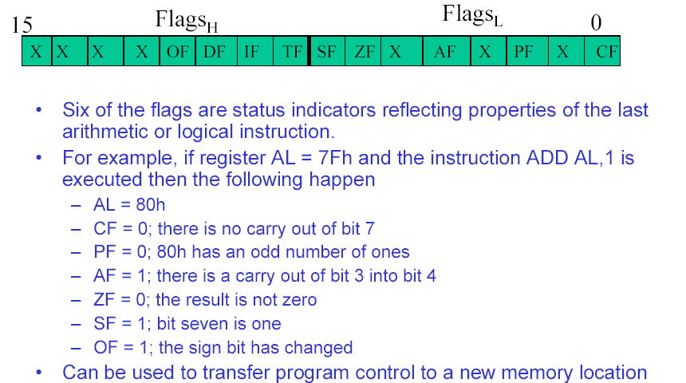

Slide 42
