Slide 1
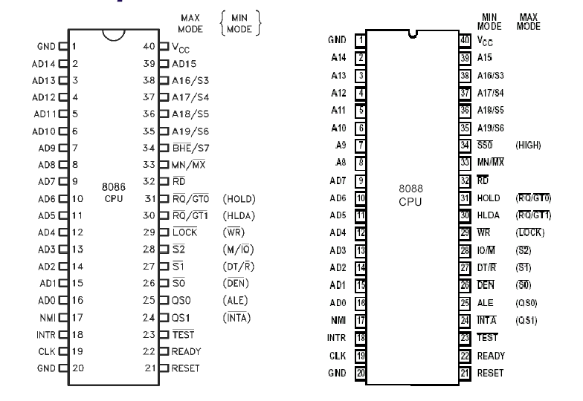
8086 Hardware design
The 8086 and 8088 microprocessors can be configured to work in either of two modes:
The minimum mode -
The maximum mode -
The mode selection feature lets the 8088 or 8086 better meet the needs of a wide variety of system requirement. Minimum mode 8088/8086 systems are typically smaller and contain a single processor. Depending on the mode of operation selected, the assignment for a number of the pins on the microprocessor package are changed.

Slide 2
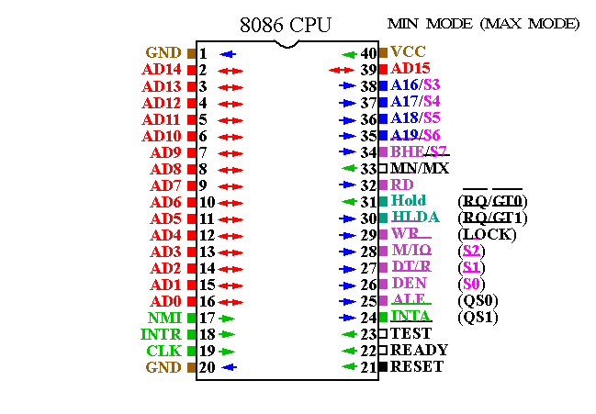
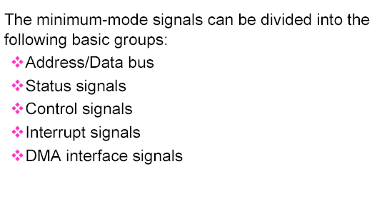

Slide 3
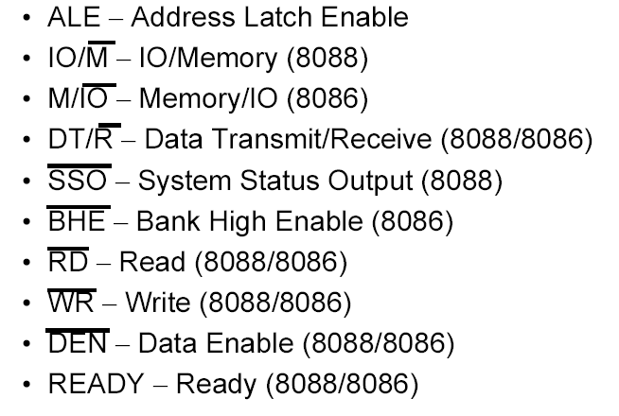
Minimum-Mode Interface
Address/Data bus
The address bus is used to carry address information to the memory and I/O ports. The address bus is 20-bit long and consists of signal lines A0 through A19. A 20-bit address gives the 8088 a 1 Mbyte memory address space. Only address line A0 through A15 are used when
addressing I/O. This give an I/O address space 64 Kbytes. The 8088 has 8 multiplexed address/data bus lines (A0~A7) while 8086 has 16 multiplexed address/data bus lines (A0~A15).
Control signals:
The control signals are provided to support the memory and I/O interfaces of the 8088 and 8086.
  RESET : Microprocessor resets if this pin is held high for 4 clock periods.

Slide 4
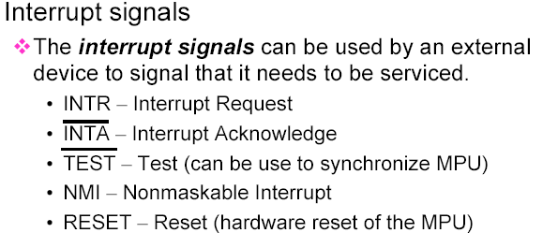
8.6 System Clock
The time base for synchronization of the internal and external operations of the microprocessor in a microcomputer system is provided by the clock (CLK) input signal.
The standard 8088 operates at 5 MHz and the 8088- 2 operates at 8 MHz.
The 8086 is manufactured in three speeds: 5-MHz
8086, 8-MHz 8086-2, and the 10-MHz 8086-1.
The CLK is externally generated by the 8284 clock
generator and driver IC.

Slide 5
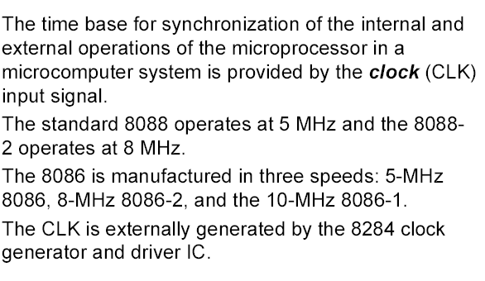
System Clock

Slide 6
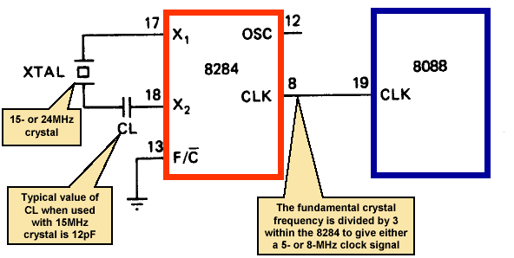
System Clock
Connecting the 8284 to the 8088
8.7 Bus Cycle and Time States
A bus cycle defines the basic operation that a microprocessor performs to communicate with external devices.
Examples of bus cycles are the memory read, memory write, input/output read, and input/output write.
The bus cycle of the 8088 and 8086 microprocessors consists of at least four clock periods. If no bus cycles are required, the microprocessor
performs what are known as idle states. When READY is held at the 0 level, wait states are inserted between states T3 and T4 of the bus cycle.

Slide 7
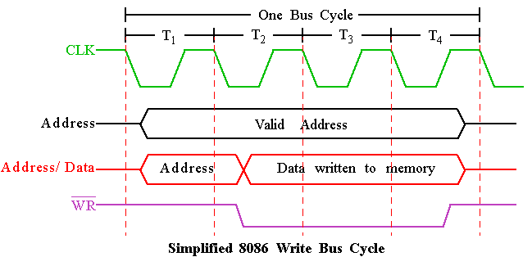
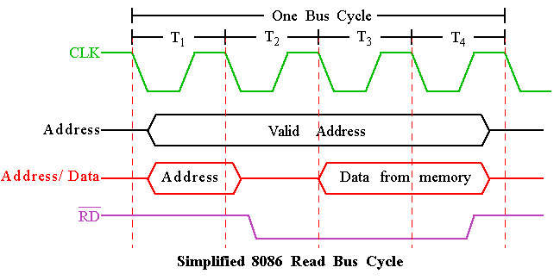
Bus Cycle:

Slide 8
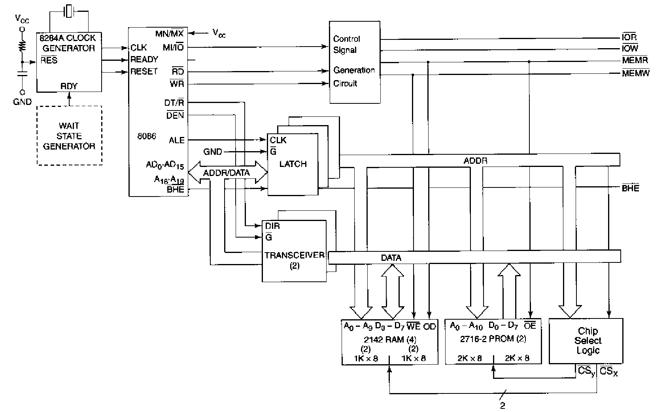
Memory Interface Circuit (Latch circuit)

Slide 9
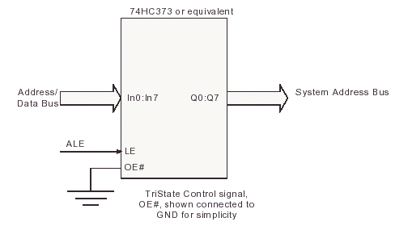
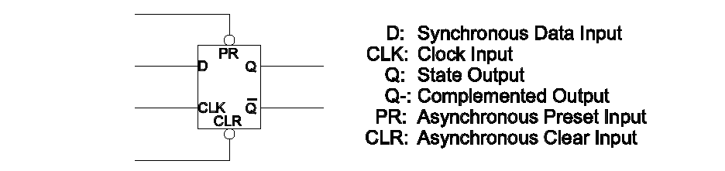
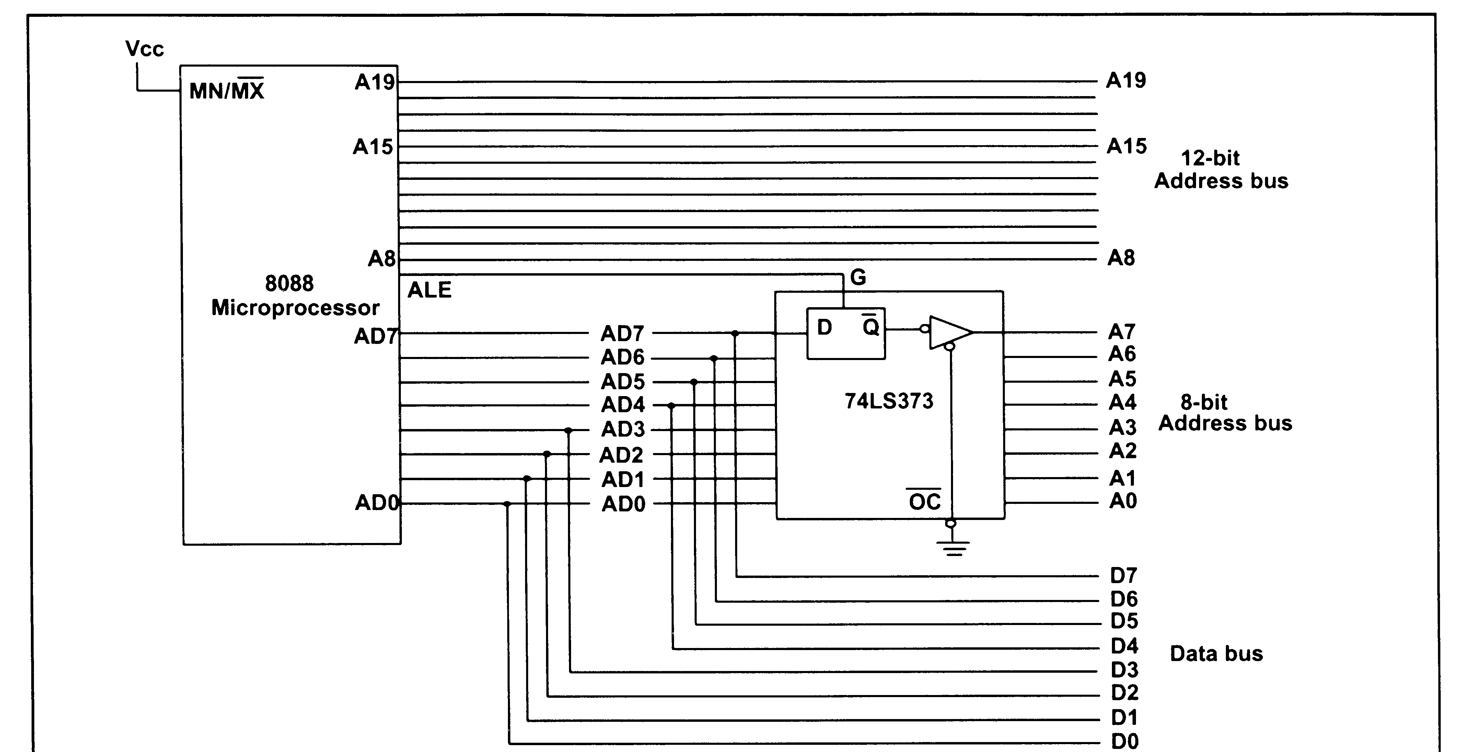
Adress latching:
Using the 74LS373 Address Latch

Slide 10
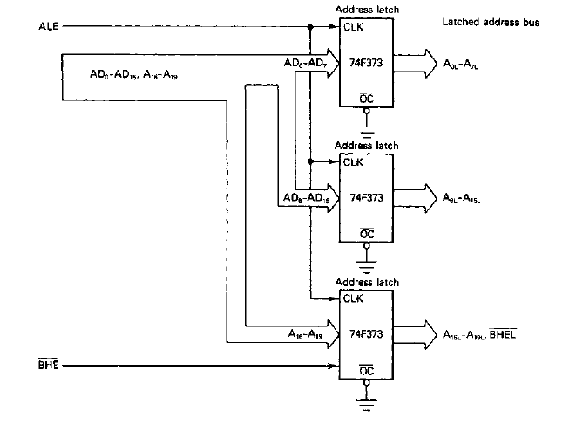
Memory Interface Circuit (Latch circuit)

Slide 11

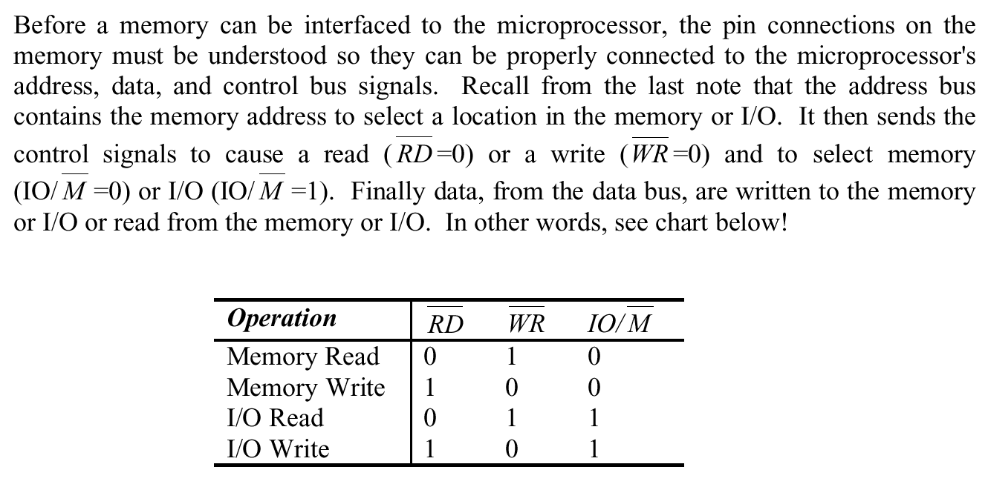

Slide 12

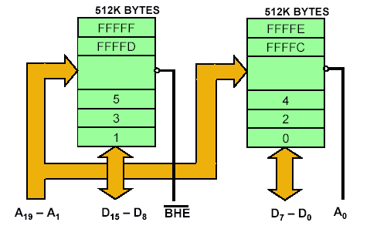
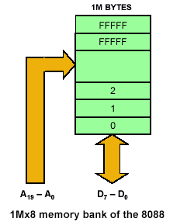
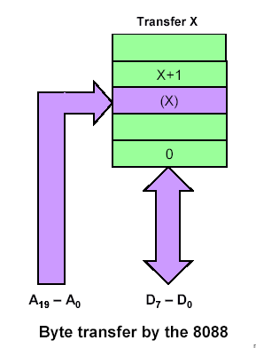
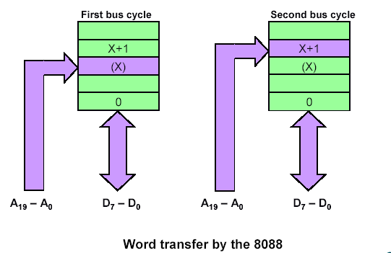

Slide 13
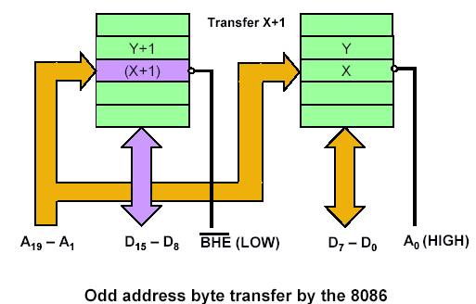
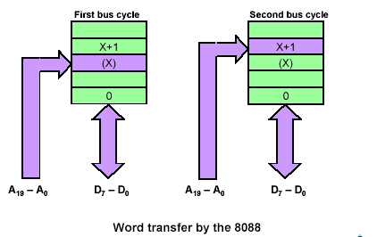
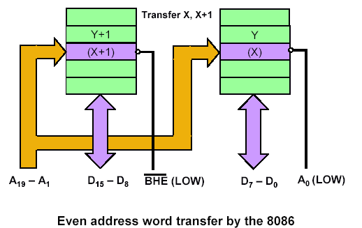
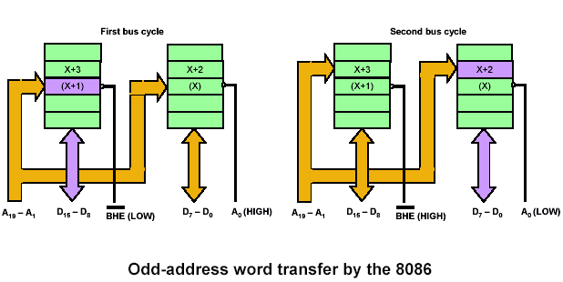

Slide 14
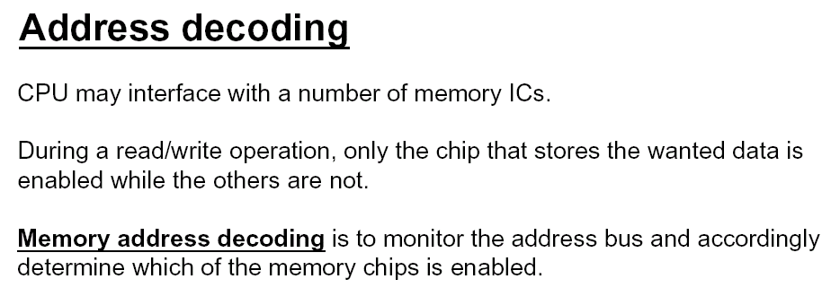
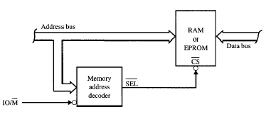
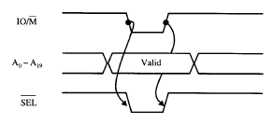
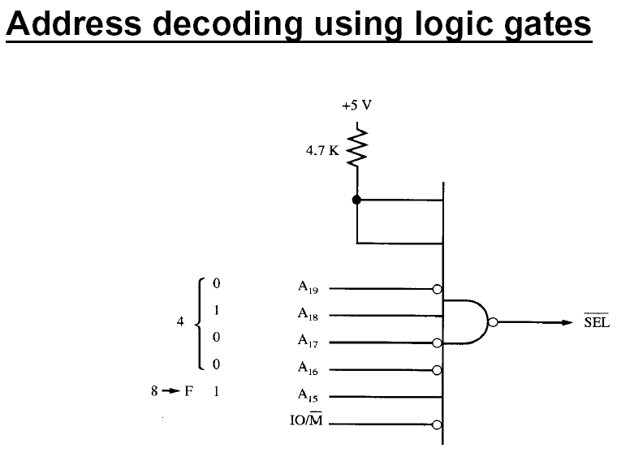

Slide 15
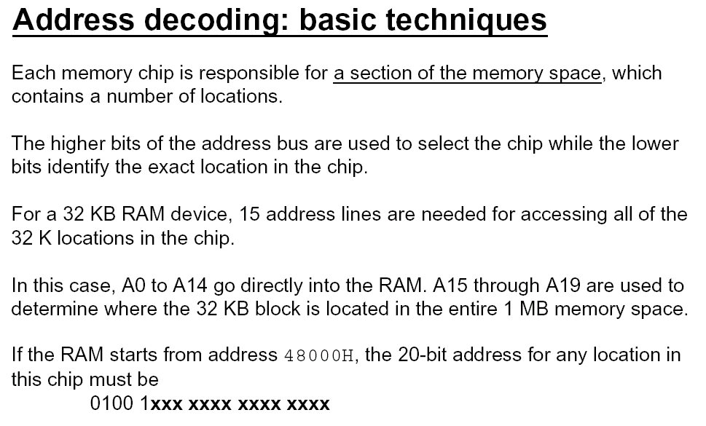

Slide 16
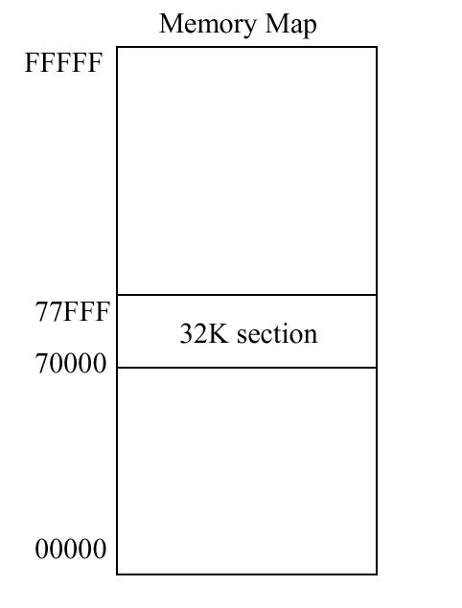


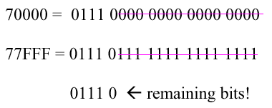
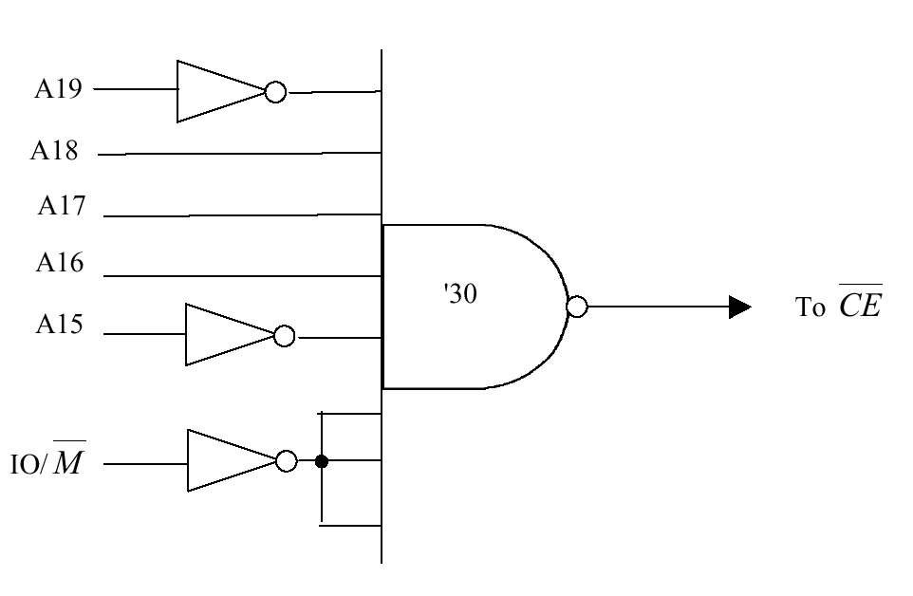
For 32 K byte chip

Slide 17
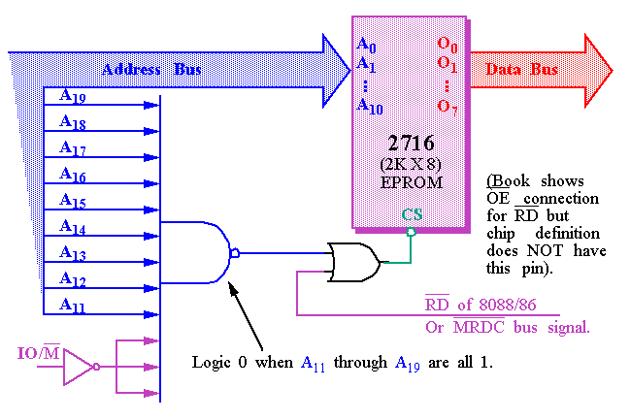
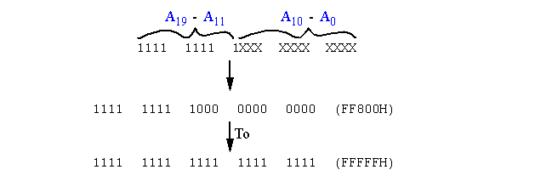
For 2 K byte chip

Slide 18
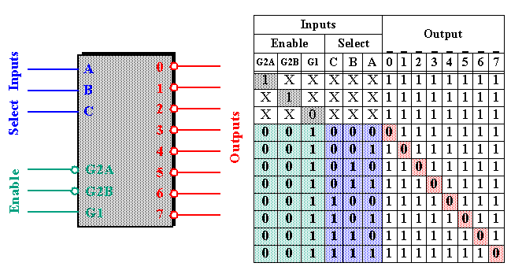
74LS 3x8 decoder chip
Note that all three Enables (G2A, G2B, and G1) must be active, e.g. low, low and high, respectively.
Each output of the decoder can be attached to an 2764 EPROM ( 8K X 8 ).

Slide 19
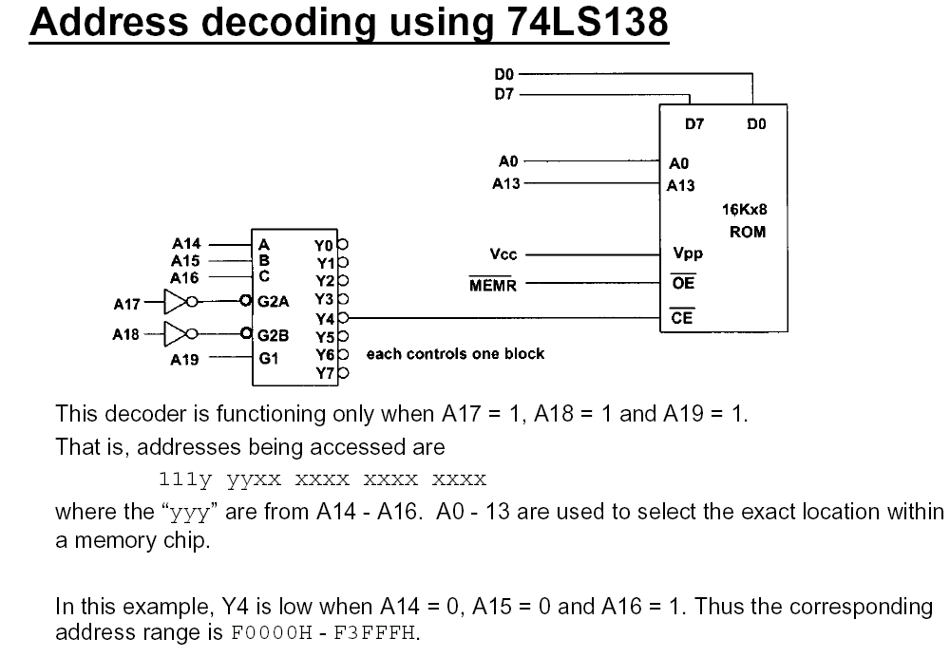

Slide 20
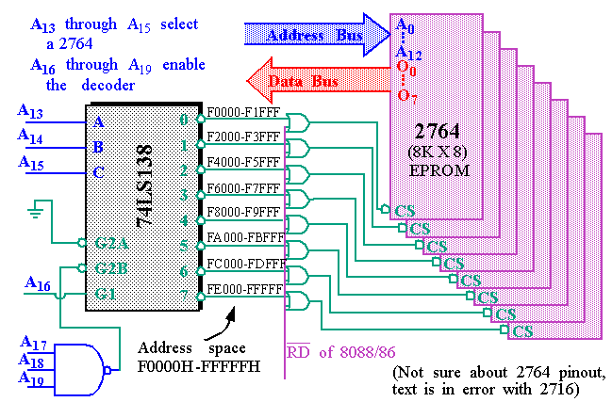

Slide 21
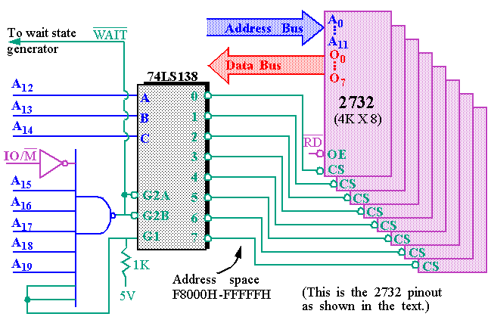

Slide 22
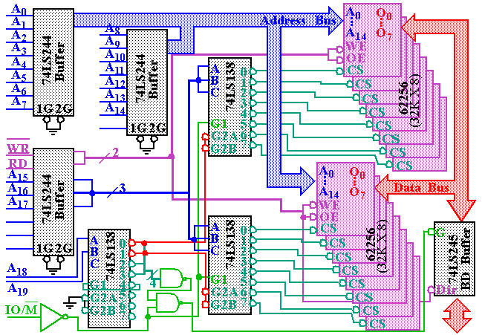

Slide 23
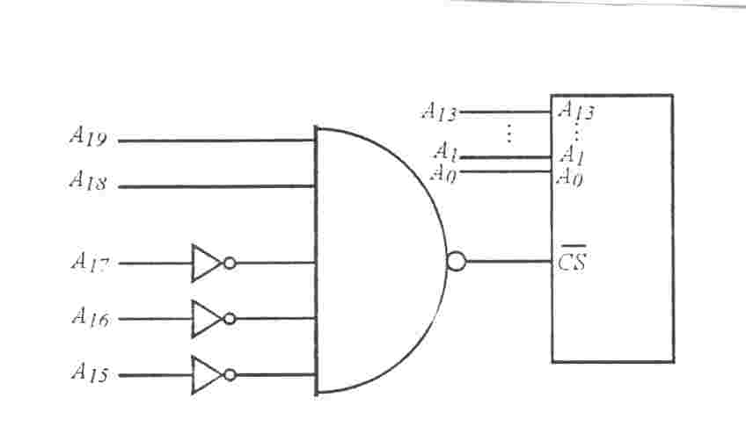
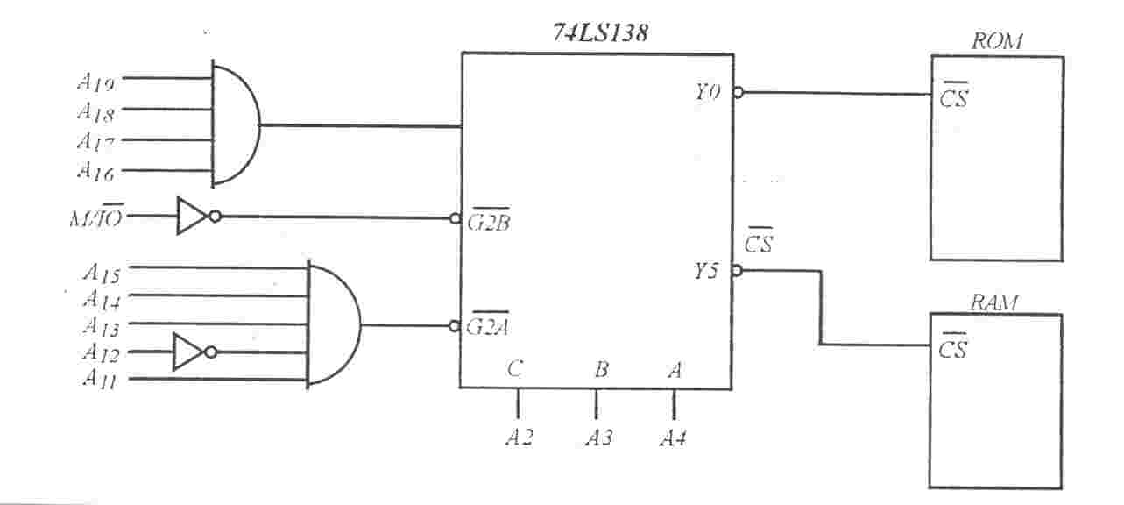
A14
A14

Slide 24
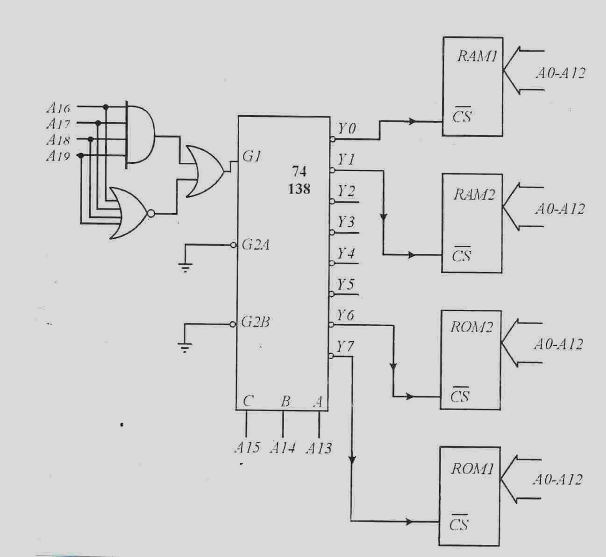
Rom1 FFFFFH-FE000H
Rom1 FDFFFH-FC000H
Ram2 03FFFH-02000H
Ram1 01FFFH-00000H

Slide 25
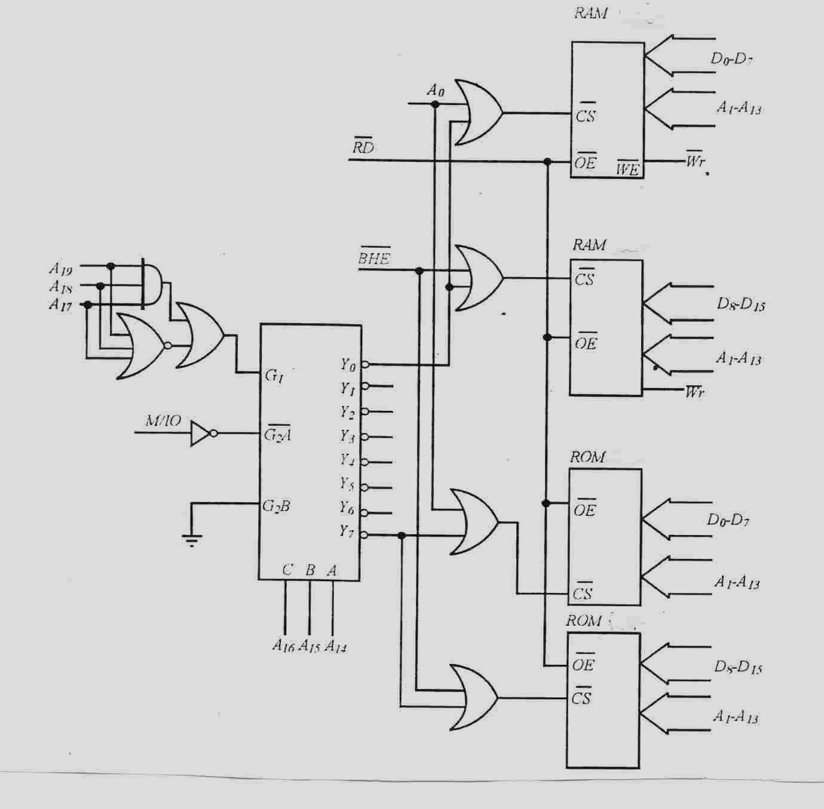
Rom1 FFFFFH-FE000H
Rom1 FDFFFH-FC000H
Ram2 03FFFH-02000H
Ram1 01FFFH-00000H

Slide 26
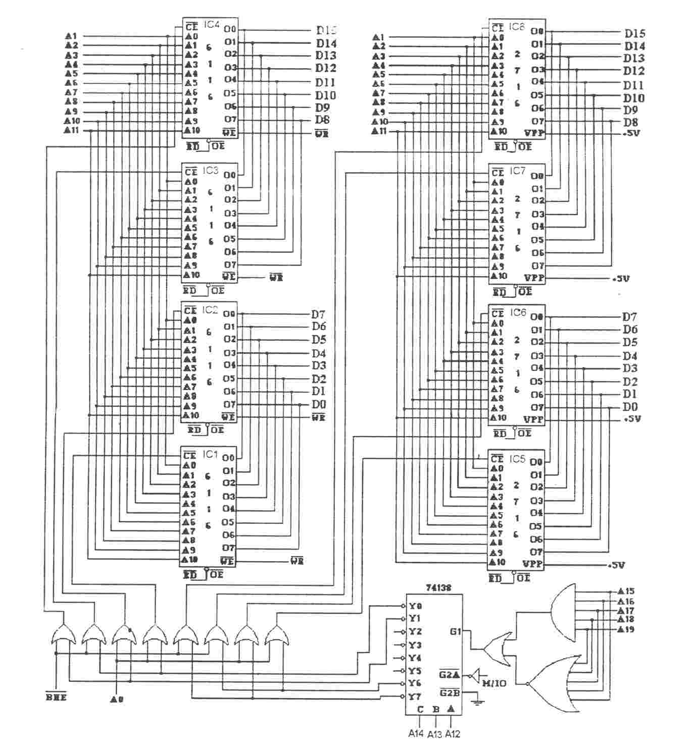
4 ROM memory and 4 RAM memory chip are used for total memory . Each memory chip is 2 kbyte
Ao and A10 are used as adress bus
IC1......IC4 Ram
IC5,.....IC8 ROM

