Slide 1
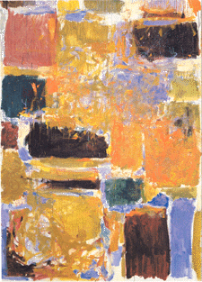
Digital Integrated Circuits
A Design Perspective
Jan M. Rabaey
Anantha Chandrakasan
Borivoje Nikolic
Arithmetic Circuits
January, 2003

Slide 2
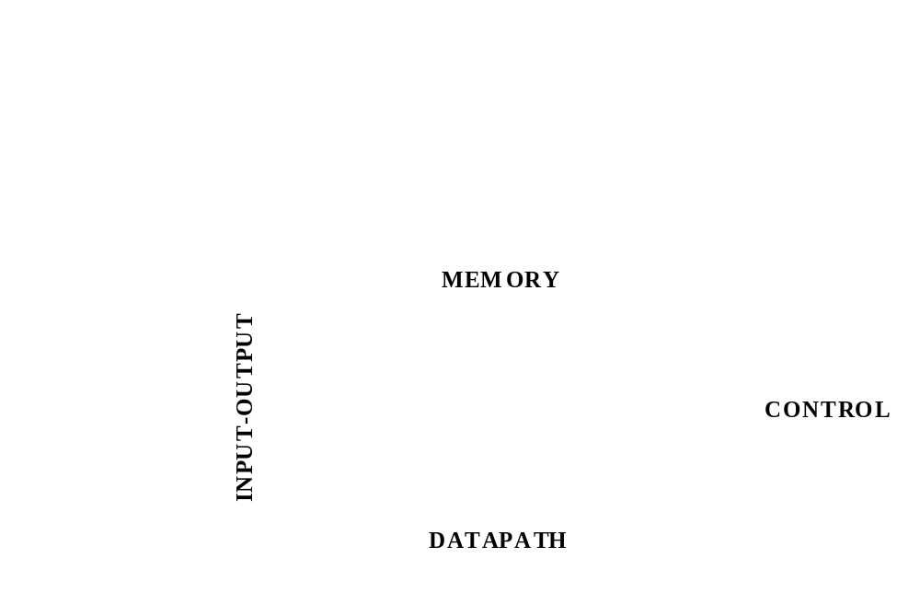
A Generic Digital Processor

Slide 3
Building Blocks for Digital Architectures
Arithmetic unit
-
Bit-sliced datapath
(adder, multiplier, shifter, comparator, etc.)
Memory
- RAM, ROM, Buffers, Shift registers
Control
- Finite state machine (PLA, random logic.)
- Counters
Interconnect
- Switches
- Arbiters
- Bus

Slide 4
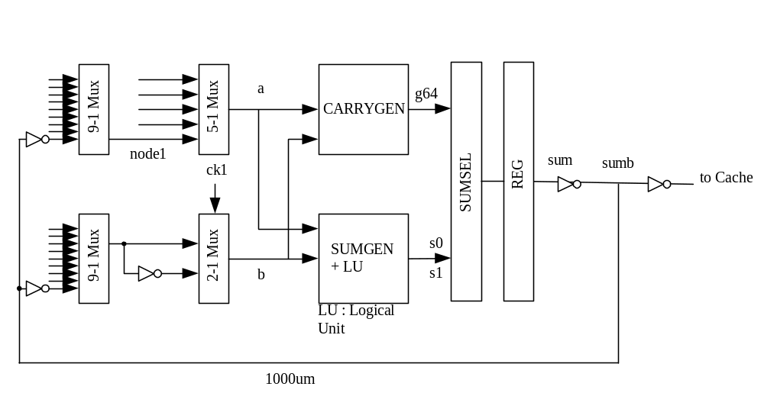
An Intel Microprocessor
Itanium has 6 integer execution units like this

Slide 5
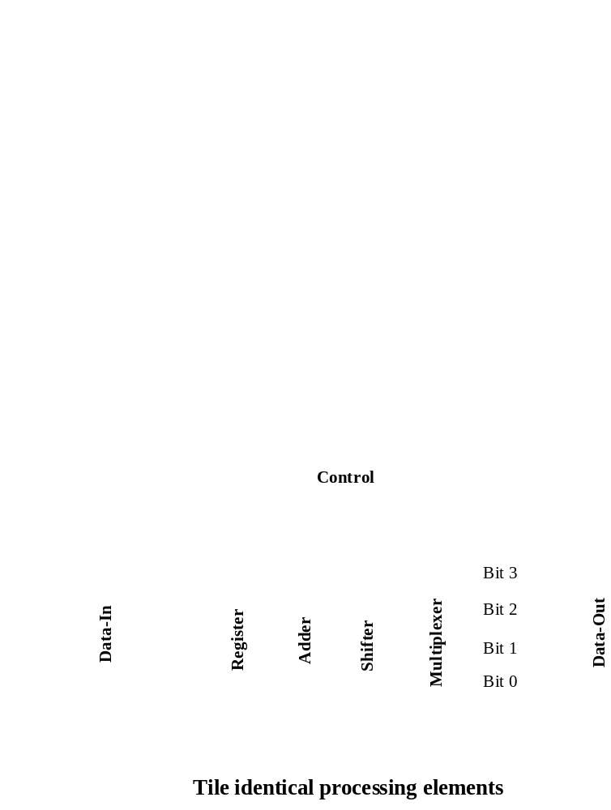
Bit-Sliced Design

Slide 6
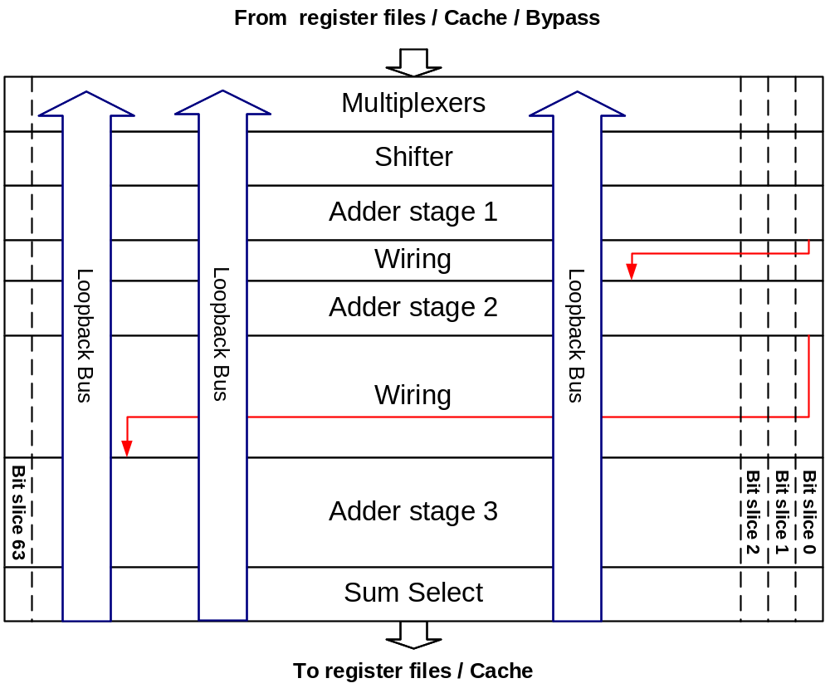
Bit-Sliced Datapath

Slide 7
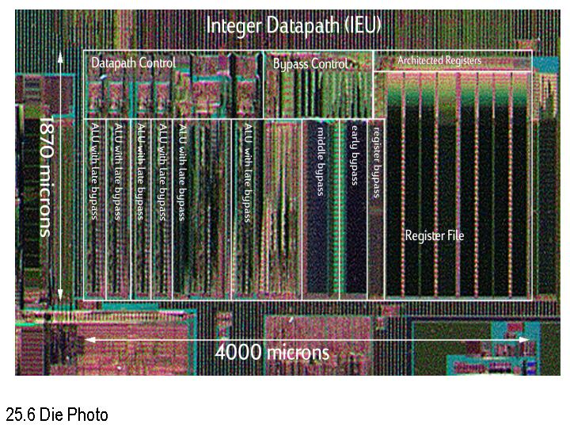
Itanium Integer Datapath
Fetzer, Orton, ISSCC’02

Slide 8
Adders

Slide 9
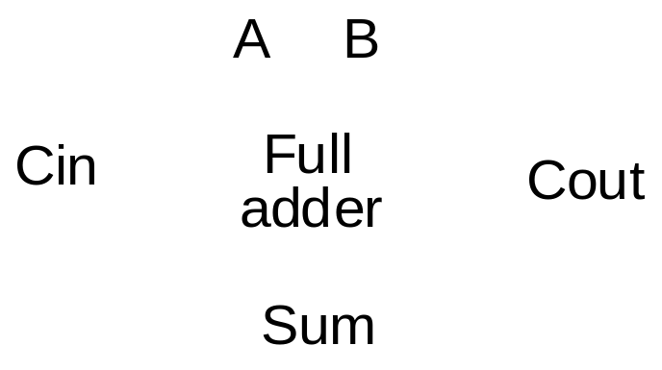
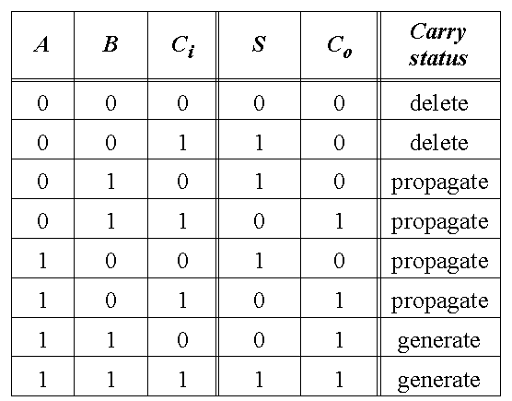
Full-Adder

Slide 10
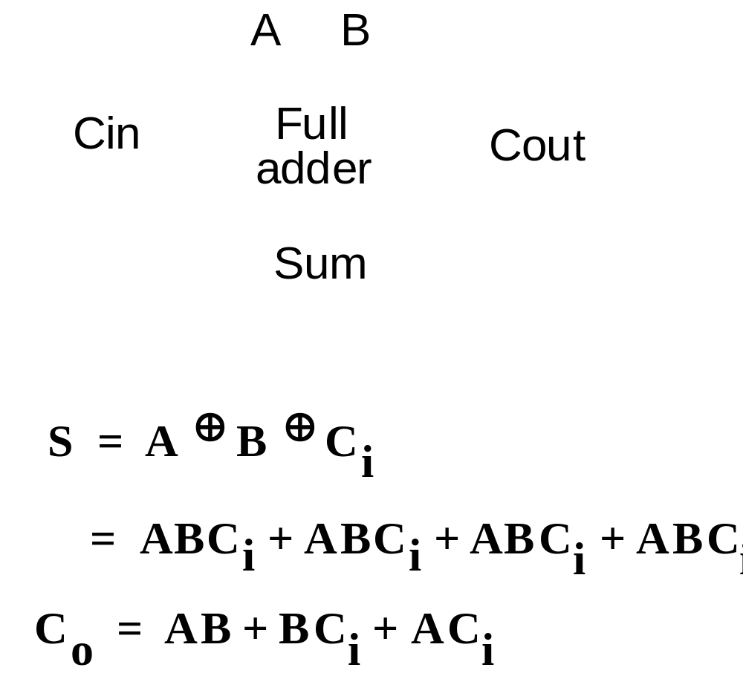
The Binary Adder

Slide 11
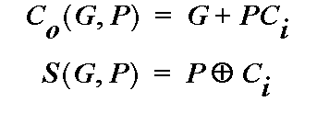
Express Sum and Carry as a function of P, G, D
Define 3 new variable which ONLY depend on A, B
Generate (G) = AB
Propagate (P) = A
⊕
B
Delete =
A
B
Can also derive expressions for
S
and
C
o
based on
D and P
Note that we will be sometimes using an alternate definition for
Propagate (P) = A
+
B

Slide 12
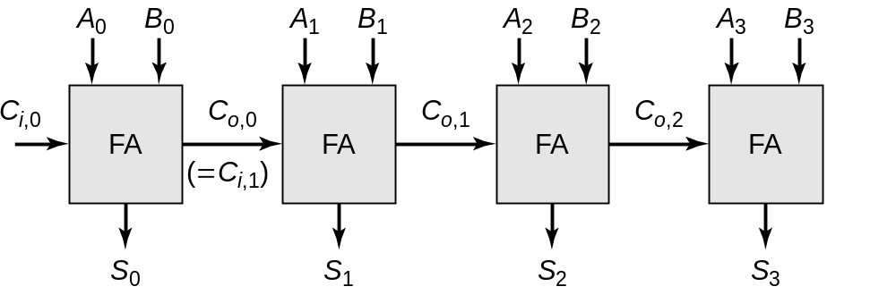
The Ripple-Carry Adder
Worst case delay linear with the number of bits
t_{d} = O(N)
t_{adder} = (N-1)t_{carry} + t_{sum}
Goal: Make the fastest possible carry path circuit

Slide 13
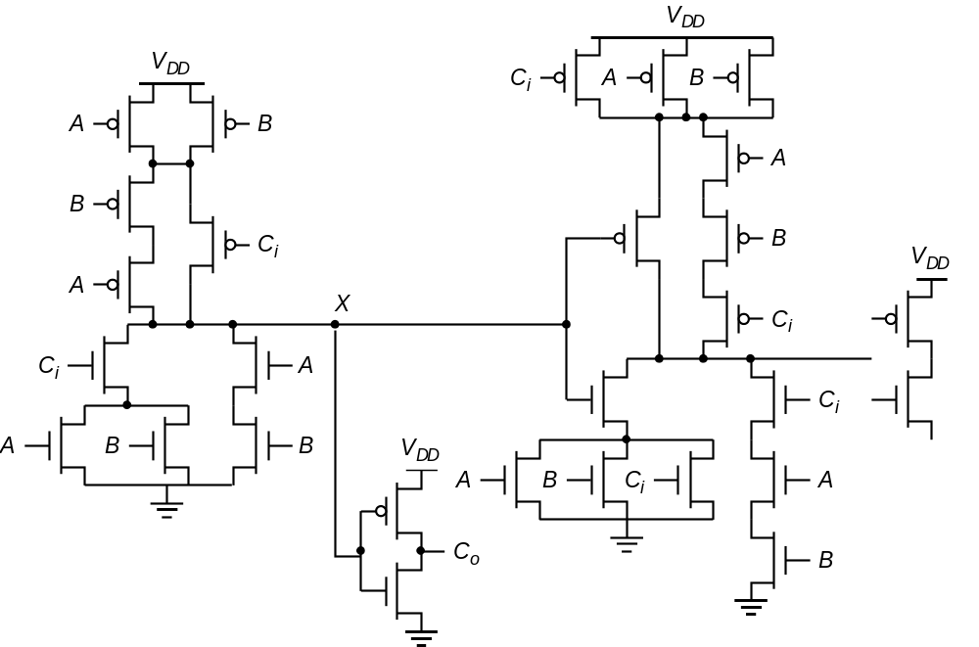
Complimentary Static CMOS Full Adder
28 Transistors

Slide 14
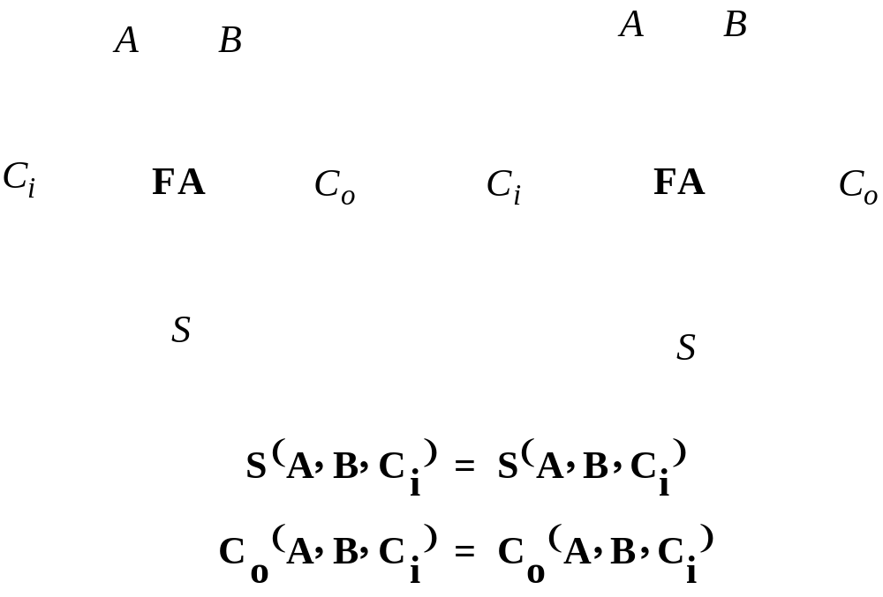
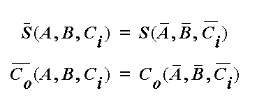
Inversion Property

Slide 15
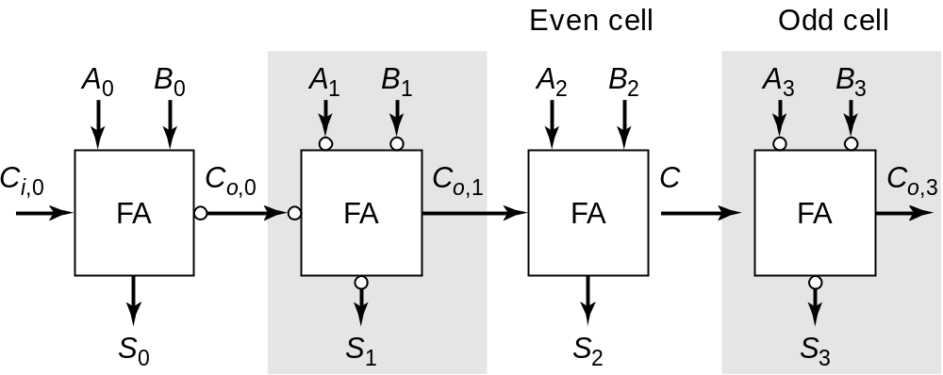
Minimize Critical Path by Reducing Inverting Stages
Exploit Inversion Property

Slide 16
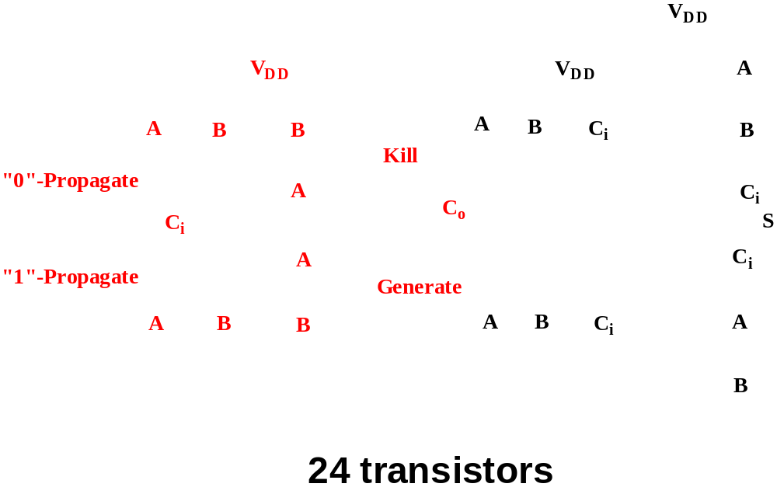
A Better Structure: The Mirror Adder

Slide 17
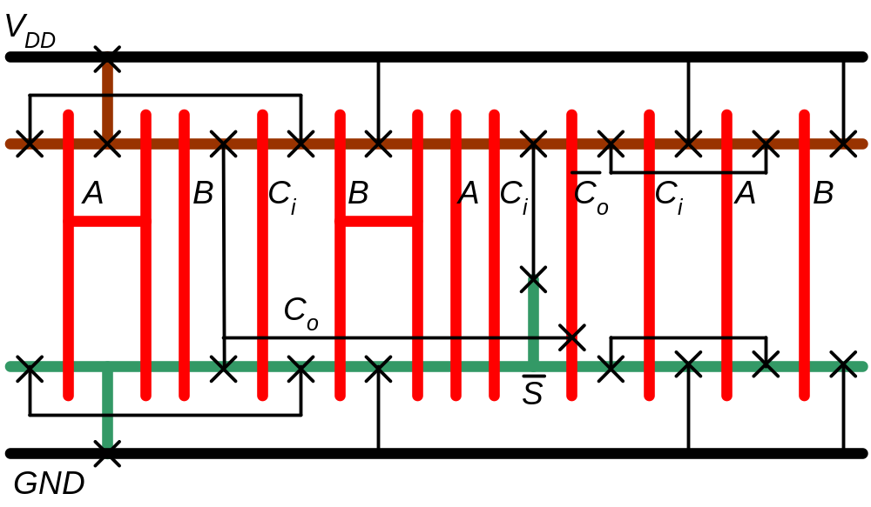
Mirror Adder
Stick Diagram

Slide 18
The Mirror Adder
    The NMOS and PMOS chains are completely symmetrical.
    A maximum of two series transistors can be observed in the carry-generation circuitry.
    When laying out the cell, the most critical issue is the minimization of the capacitance at node C_{o}. The reduction of the diffusion capacitances is particularly important.
    The capacitance at node C_{o} is composed of four diffusion capacitances, two internal gate capacitances, and six gate capacitances in the connecting adder cell .
    The transistors connected to C_{i} are placed closest to the output.
    Only the transistors in the carry stage have to be optimized for optimal speed. All transistors in the sum stage can be minimal size.

Slide 19
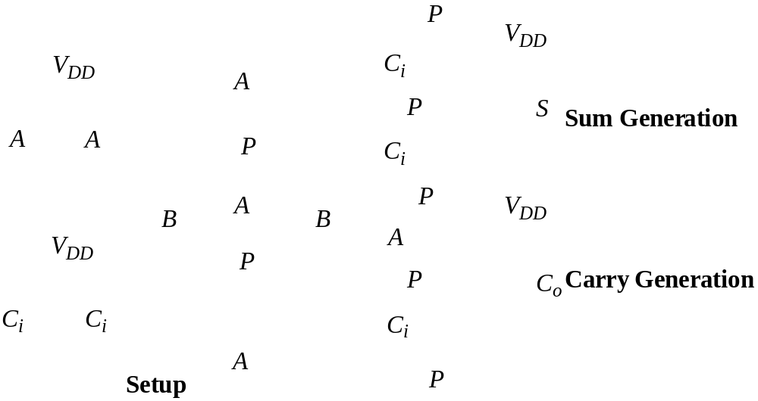
Transmission Gate Full Adder

Slide 20
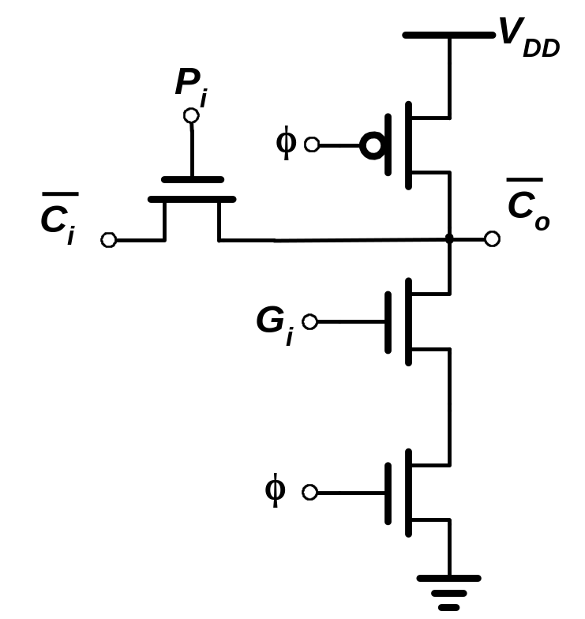
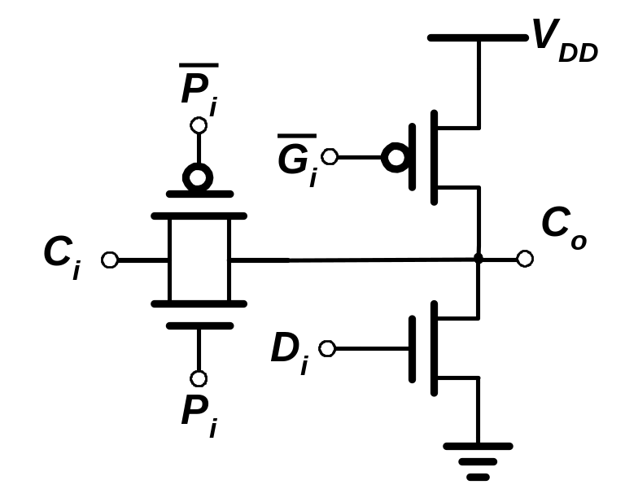
Manchester Carry Chain

Slide 21
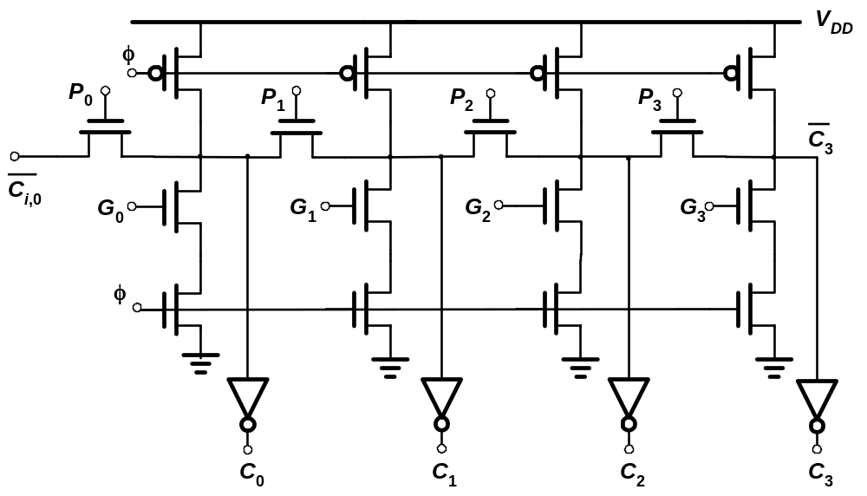
Manchester Carry Chain

Slide 22
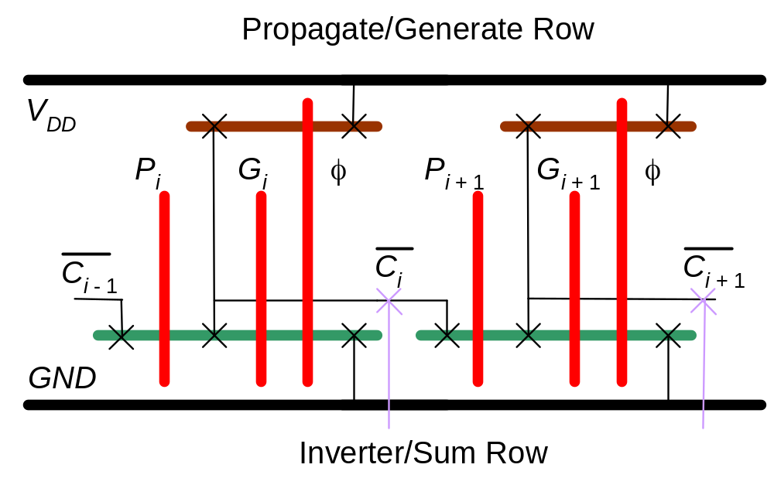
Manchester Carry Chain
Stick Diagram

Slide 23
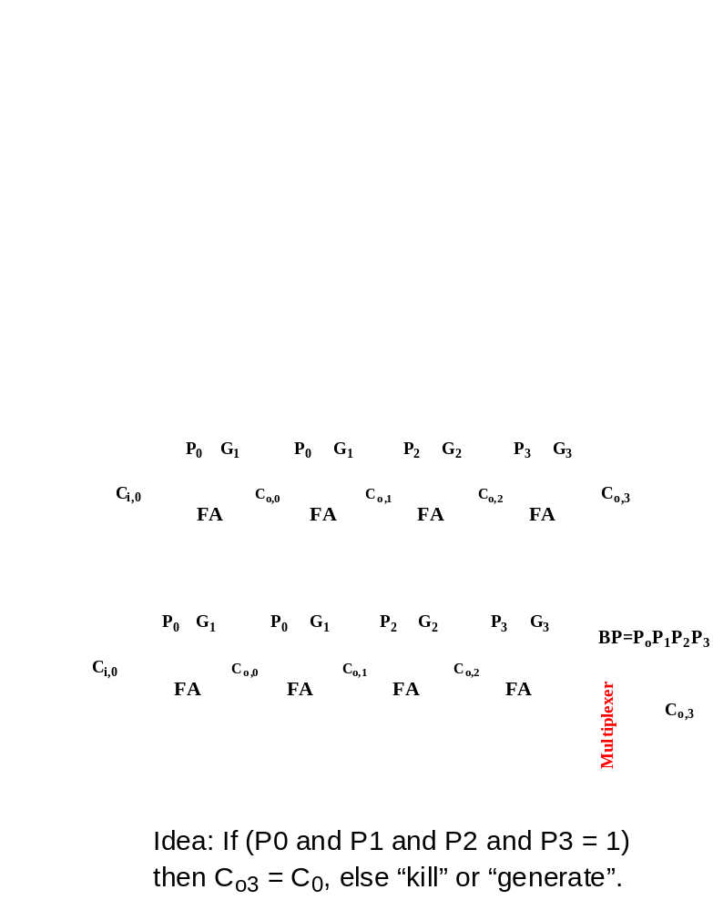
Carry-Bypass Adder
Also called
Carry-Skip

Slide 24
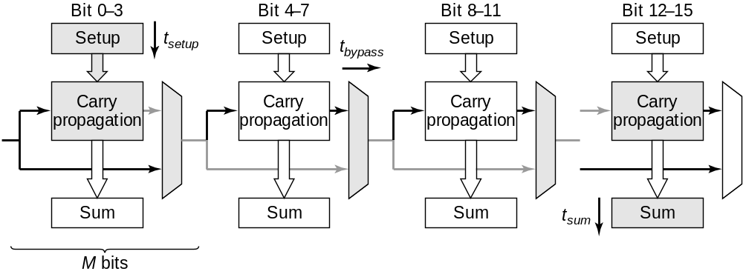
Carry-Bypass Adder (cont.)
t_{adder} = t_{setup} + M_{tcarry} + (N/M-1)t_{bypass} + (M-1)t_{carry} + t_{sum}

Slide 25
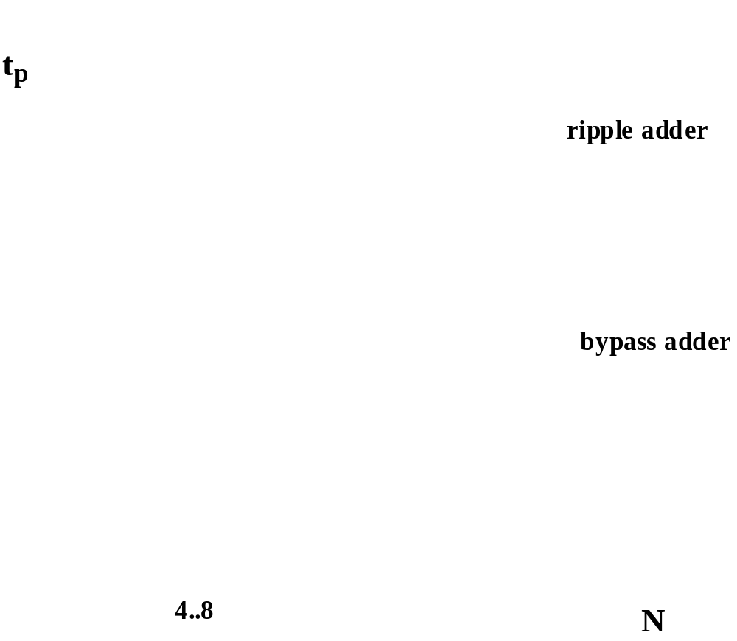
Carry Ripple versus Carry Bypass

Slide 26
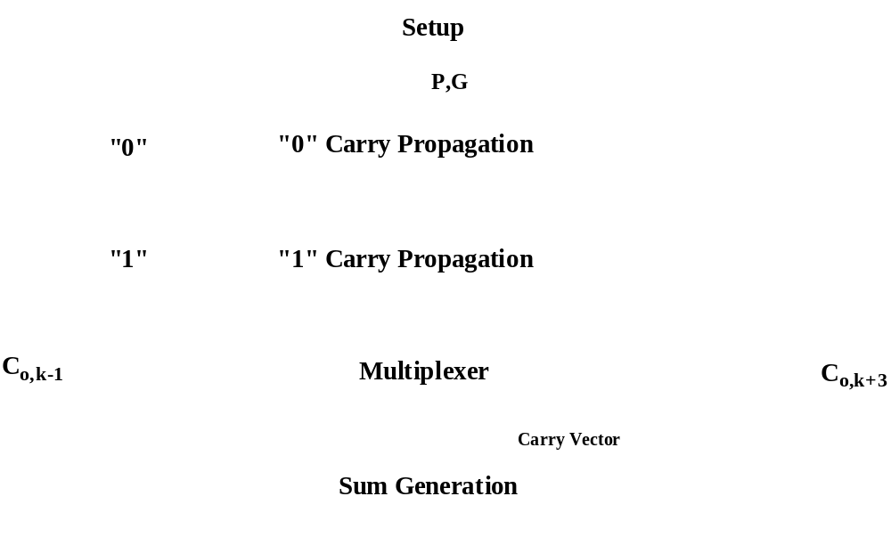
Carry-Select Adder

Slide 27
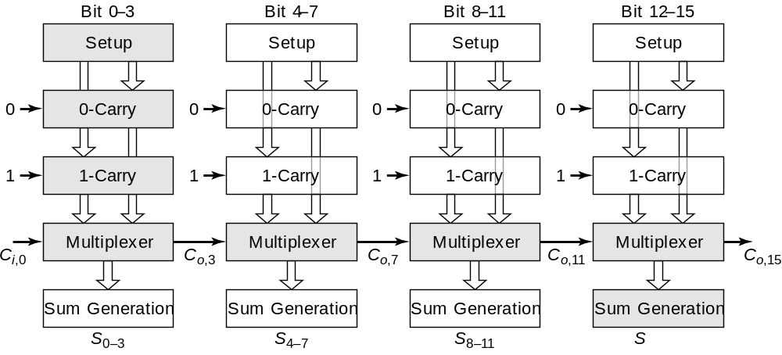
Carry Select Adder: Critical Path

Slide 28
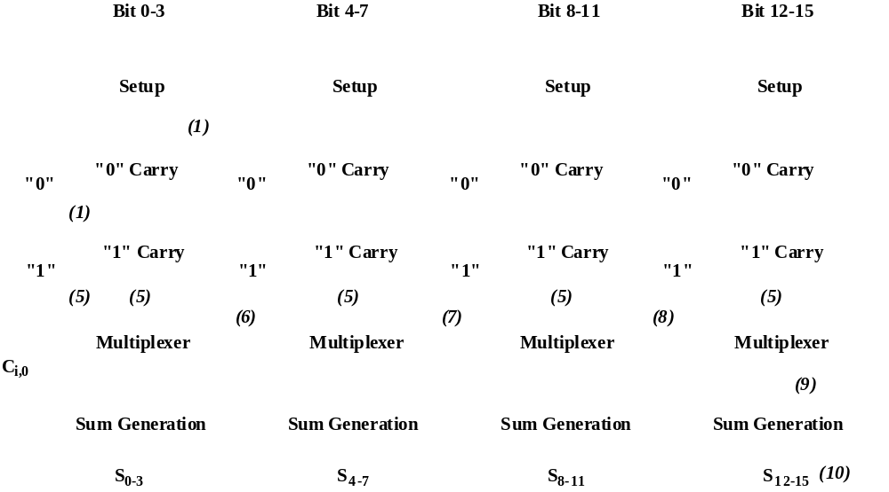
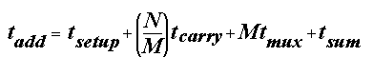
Linear Carry Select

Slide 29
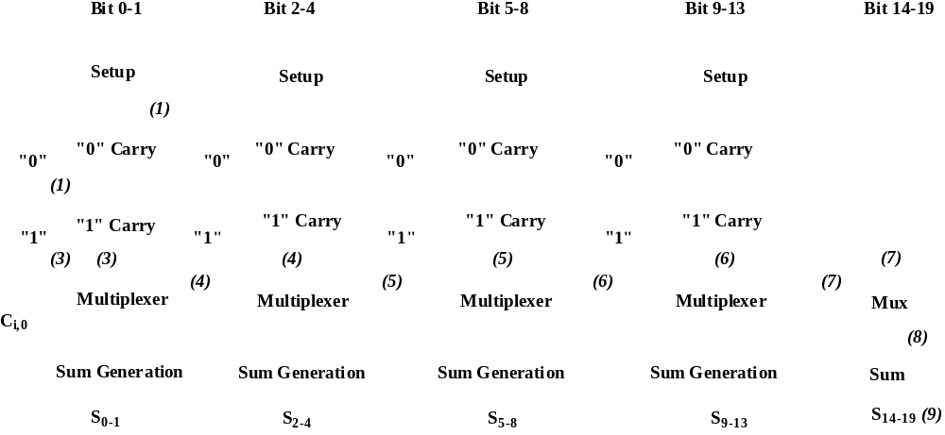
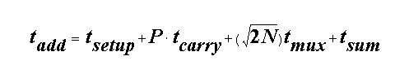
Square Root Carry Select

Slide 30
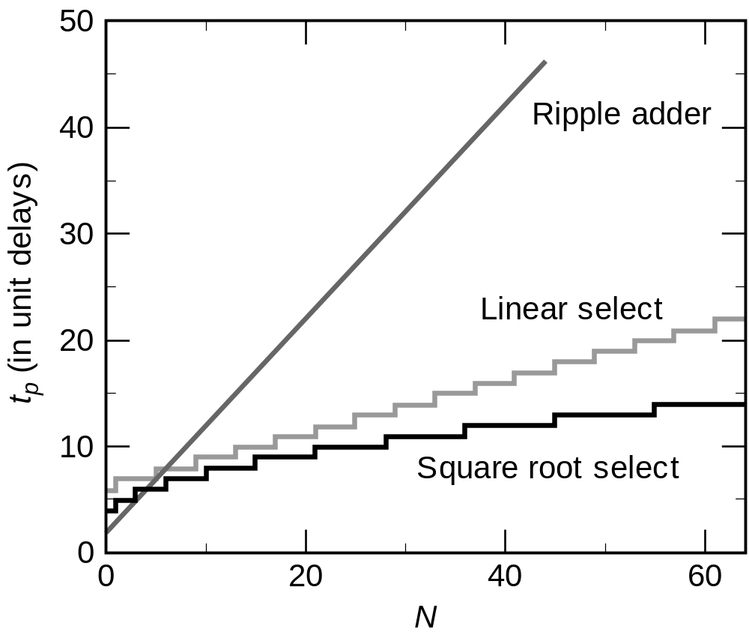
Adder Delays - Comparison

Slide 31
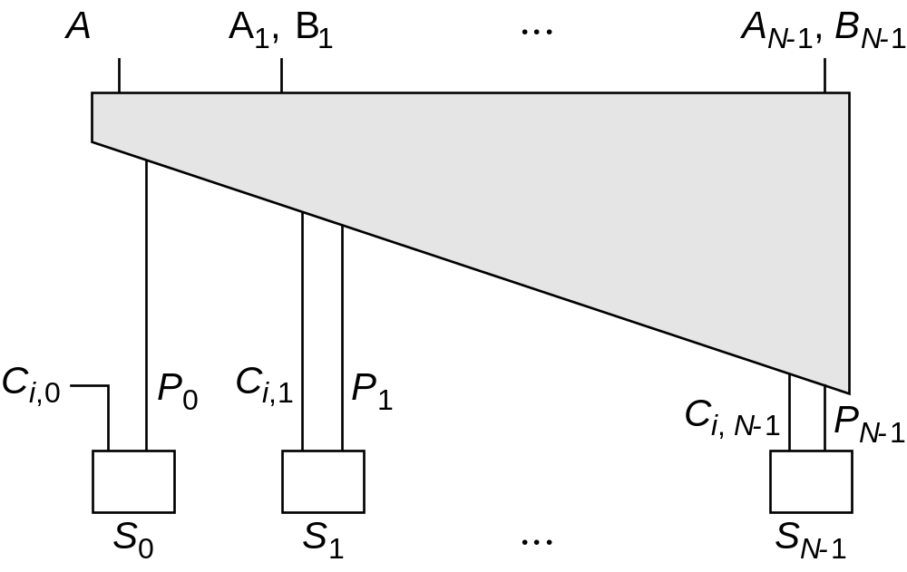
LookAhead - Basic Idea

Slide 32
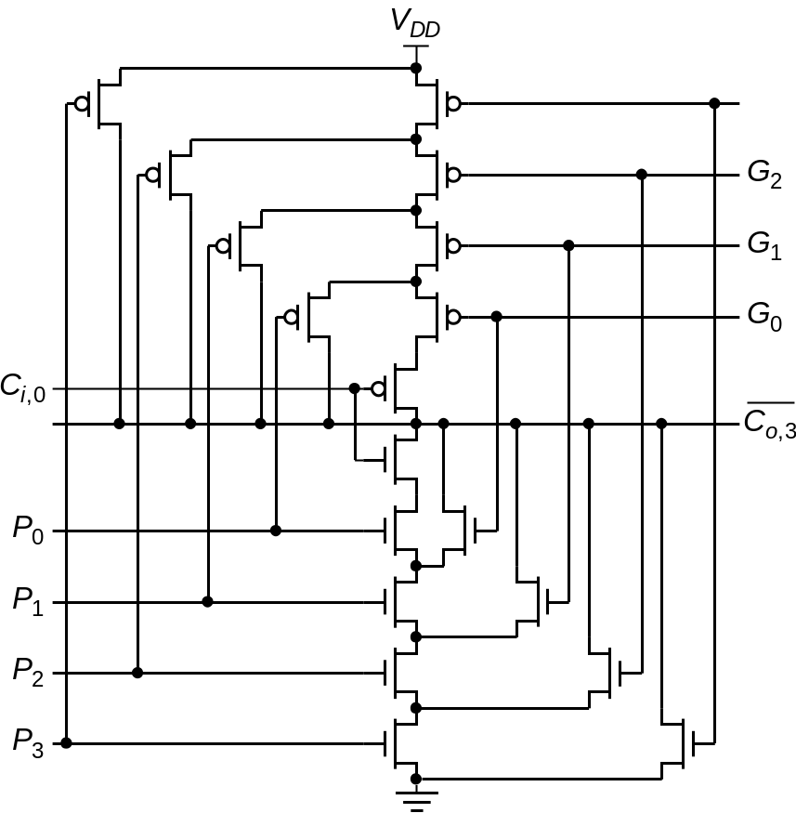
Look-Ahead: Topology
Expanding Lookahead equations:
All the way:

Slide 33
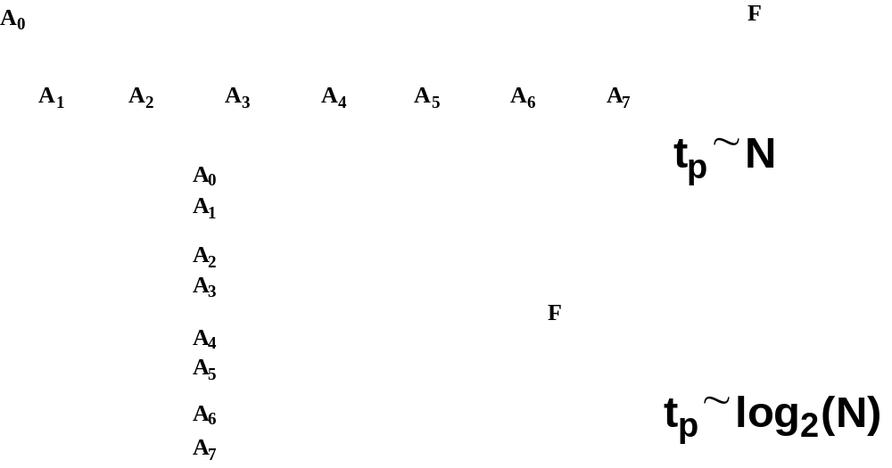
Logarithmic Look-Ahead Adder

Slide 34
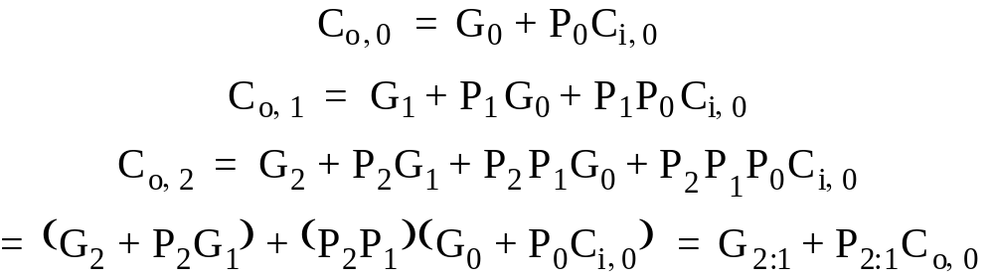
Carry Lookahead Trees
Can continue building the tree hierarchically.

Slide 35
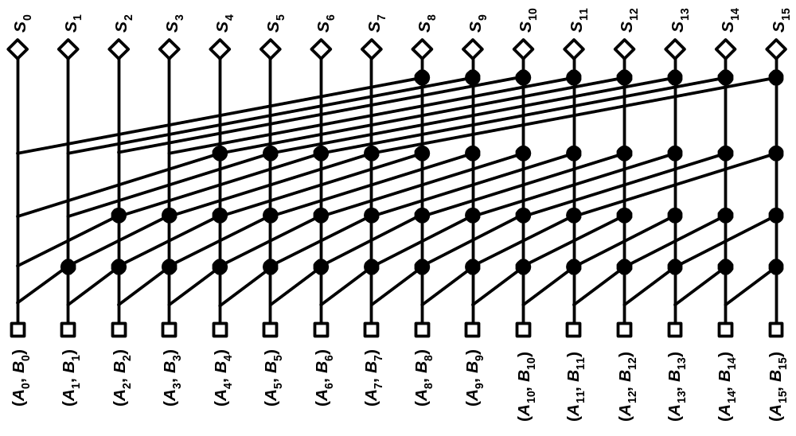
Tree Adders
16-bit radix-2 Kogge-Stone tree

Slide 36
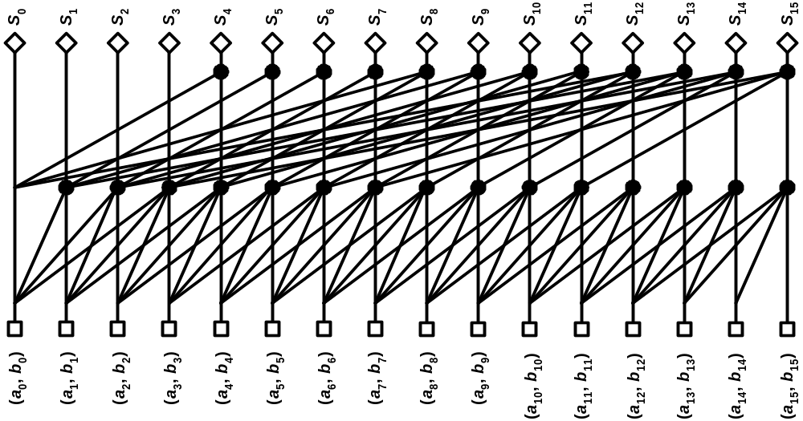
Tree Adders
16-bit radix-4 Kogge-Stone Tree

Slide 37
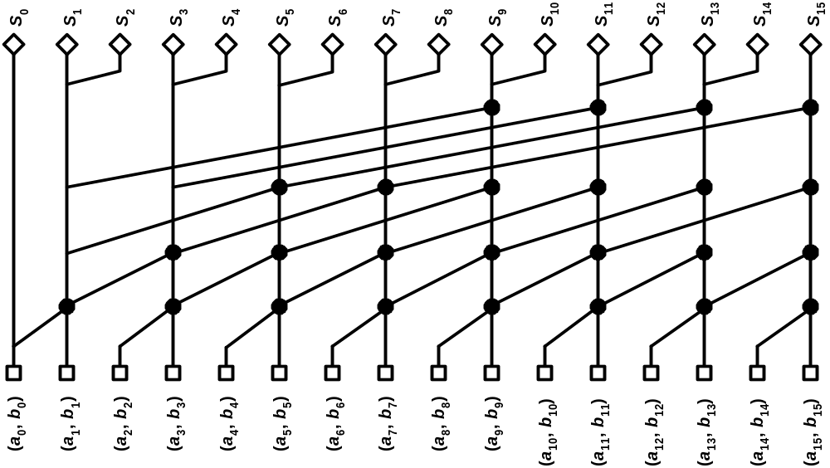
Sparse Trees
16-bit radix-2 sparse tree with sparseness of 2

Slide 38
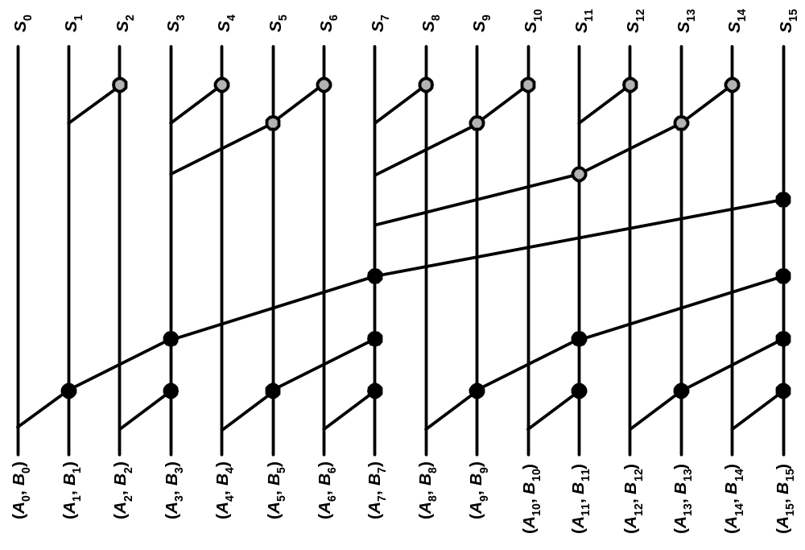
Tree Adders
Brent-Kung Tree

Slide 39
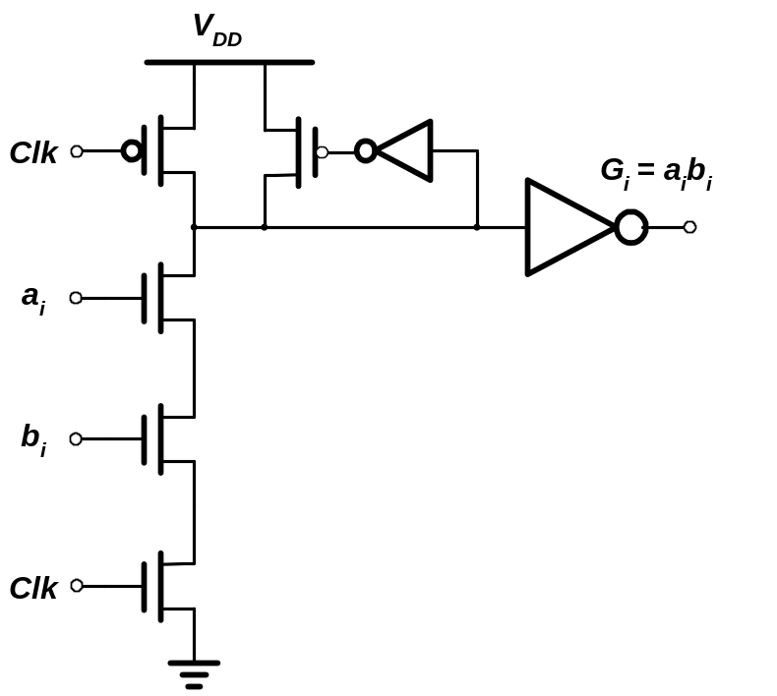
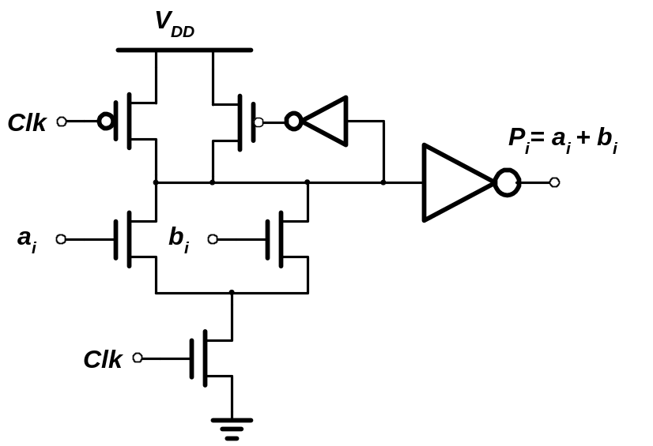
Example: Domino Adder
Propagate
Generate

Slide 40
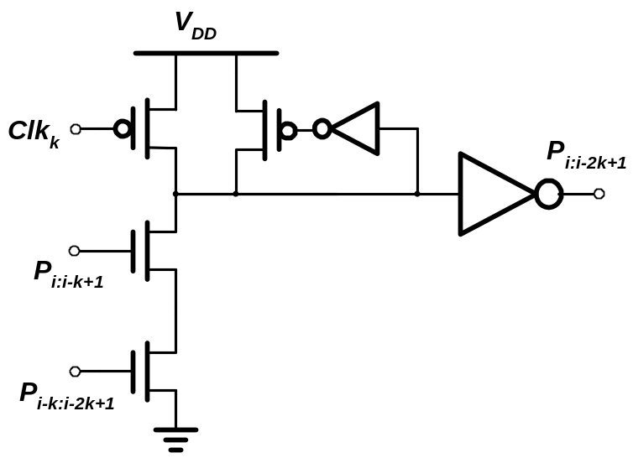
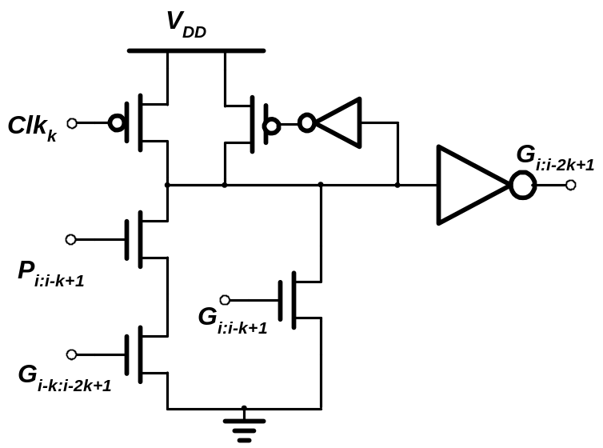
Example: Domino Adder
Propagate
Generate

Slide 41
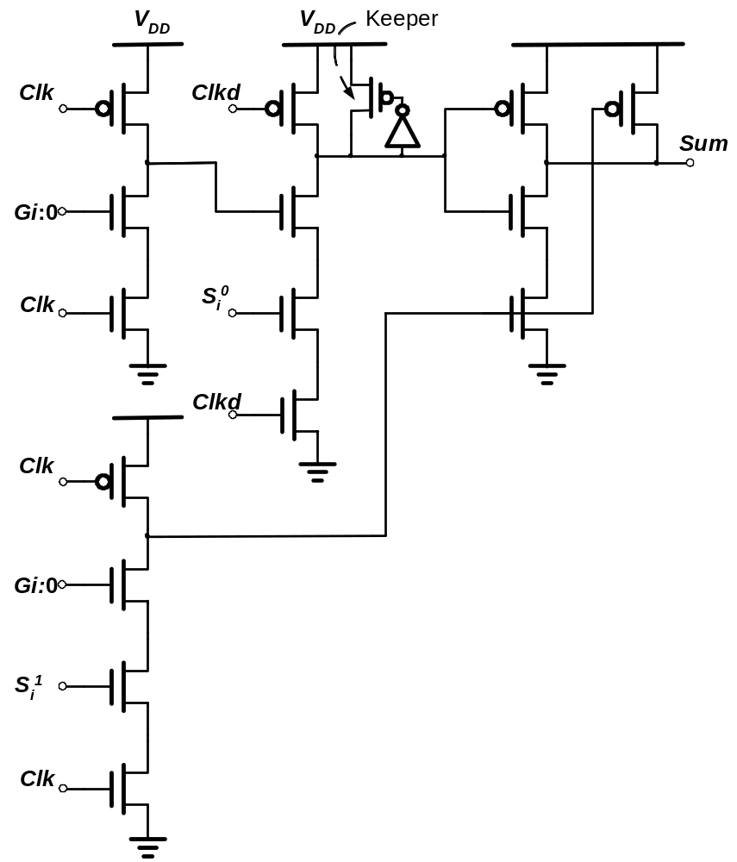
Example: Domino Sum

Slide 42
Multipliers

Slide 43
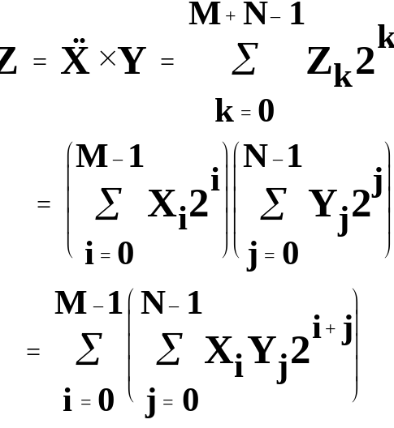

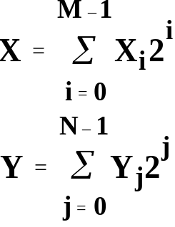
The Binary Multiplication

Slide 44
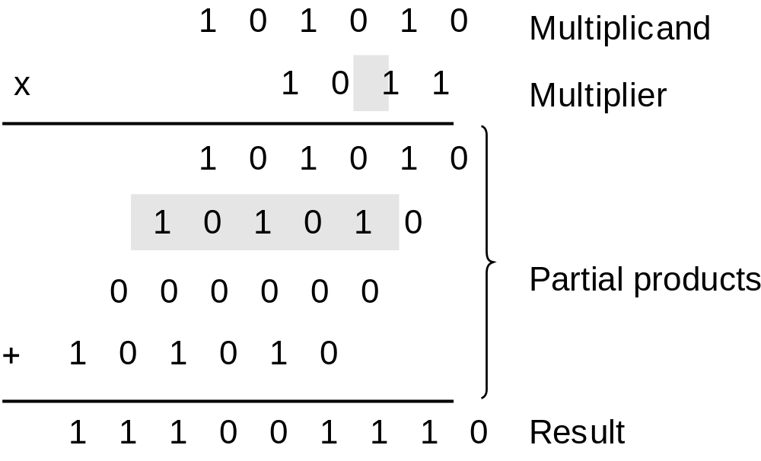
The Binary Multiplication

Slide 45
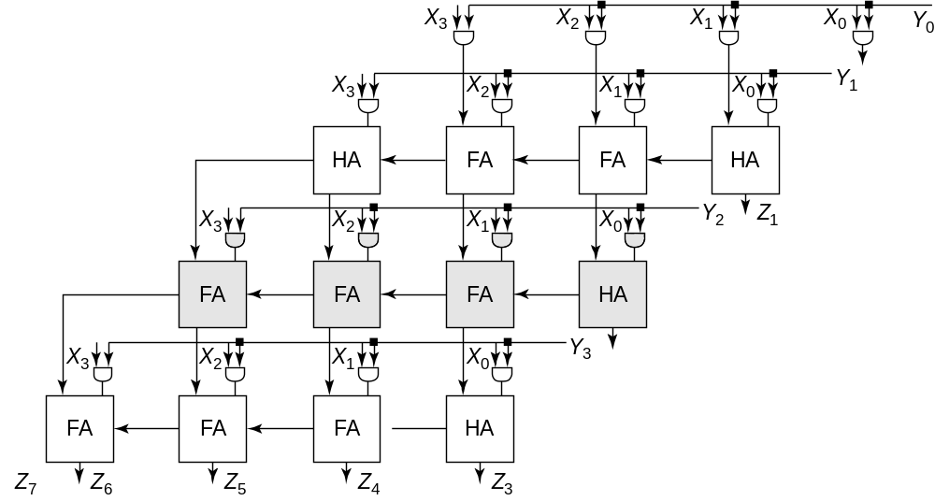
The Array Multiplier

Slide 46
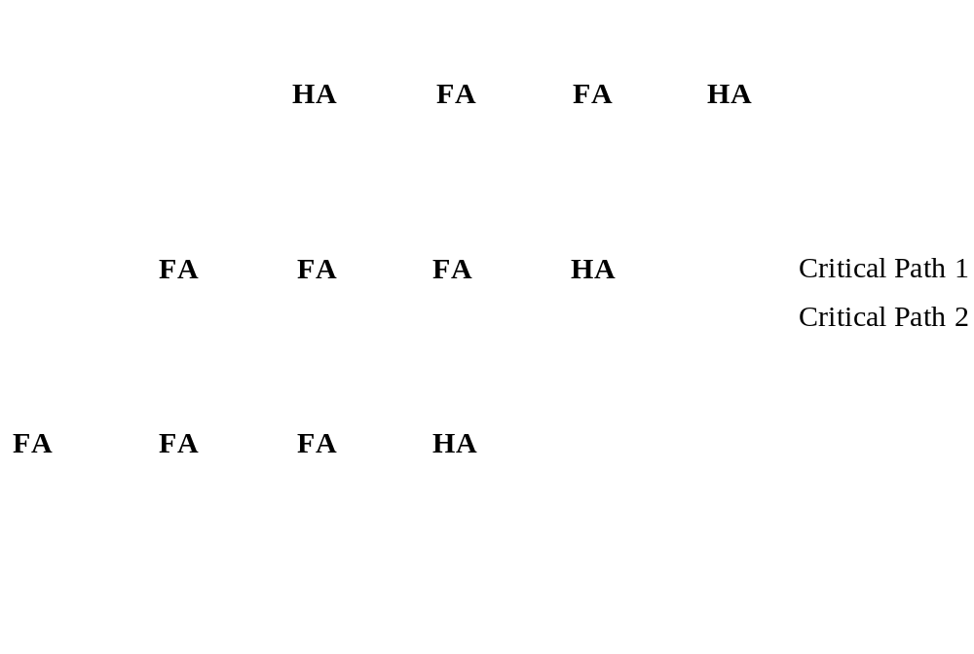

The MxN Array Multiplier
— Critical Path
Critical Path 1 & 2

Slide 47


Carry-Save Multiplier

Slide 48

Multiplier Floorplan

Slide 49

Wallace-Tree Multiplier

Slide 50

Wallace-Tree Multiplier

Slide 51

Wallace-Tree Multiplier

Slide 52

Multipliers —Summary

Slide 53
Shifters

Slide 54

The Binary Shifter

Slide 55

The Barrel Shifter
Area Dominated by Wiring

Slide 56


4x4 barrel shifter
Width_{barrel} ~ 2 p_{m} M

Slide 57

Logarithmic Shifter

Slide 58

0-7 bit Logarithmic Shifter
A
3
Out3
A
2
Out2
A
1
Out1
A
0
Out0

