Slide 1

Digital Integrated Circuits
A Design Perspective
Jan M. Rabaey
Anantha Chandrakasan
Borivoje Nikolic
The Devices
July 30, 2002

Slide 2
Goal of this chapter
Present intuitive understanding of device operation
Introduction of basic device equations
Introduction of models for manual analysis
Introduction of models for SPICE simulation
Analysis of secondary and deep-sub-micron effects
Future trends

Slide 3
The Diode
B
Al
A
SiO
2
p
n
Cross-section of
pn
-junction in an IC process
A
Al
p
A
n
B
B
One-dimensional
representation
diode symbol
Mostly occurring as parasitic element in Digital ICs

Slide 4
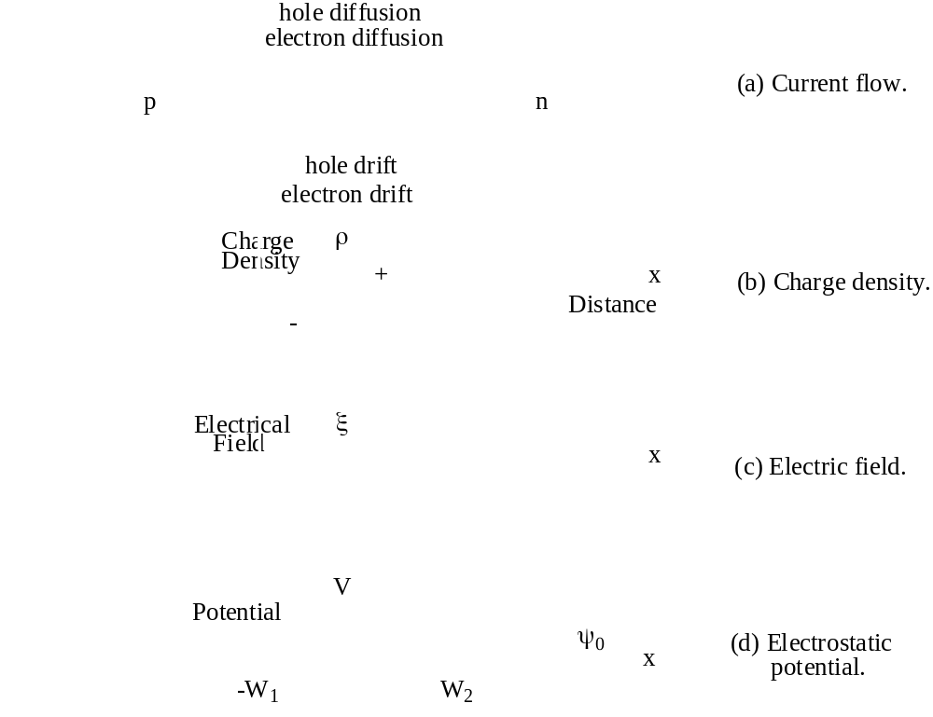
Depletion Region

Slide 5
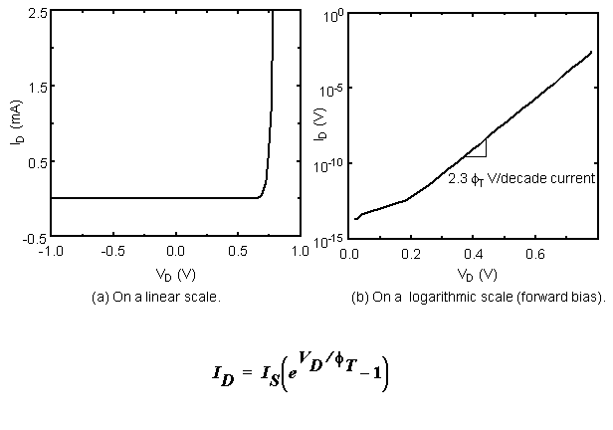
Diode Current

Slide 6
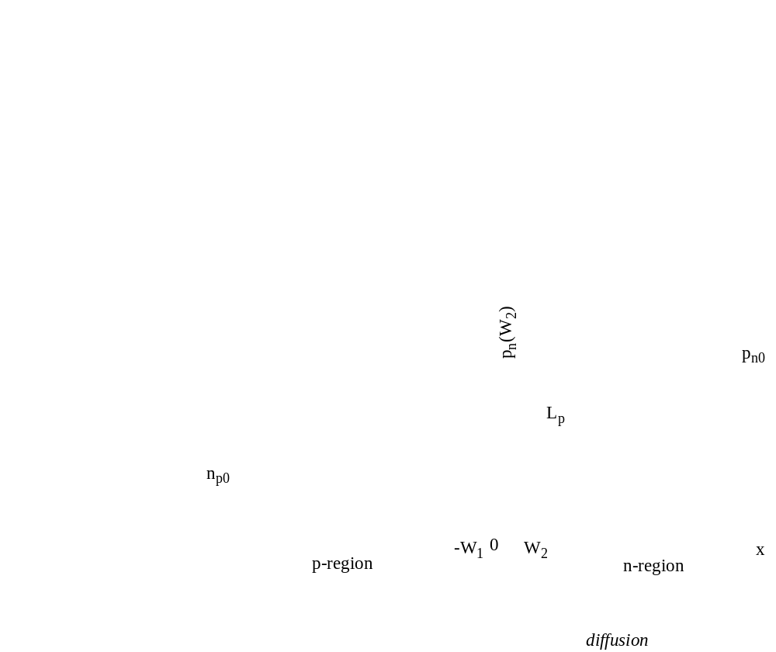
Forward Bias
Typically avoided in Digital ICs

Slide 7
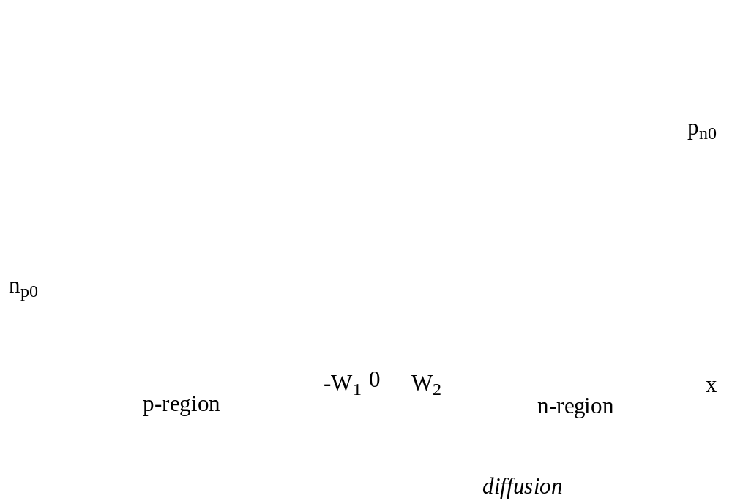
Reverse Bias
The Dominant Operation Mode

Slide 8
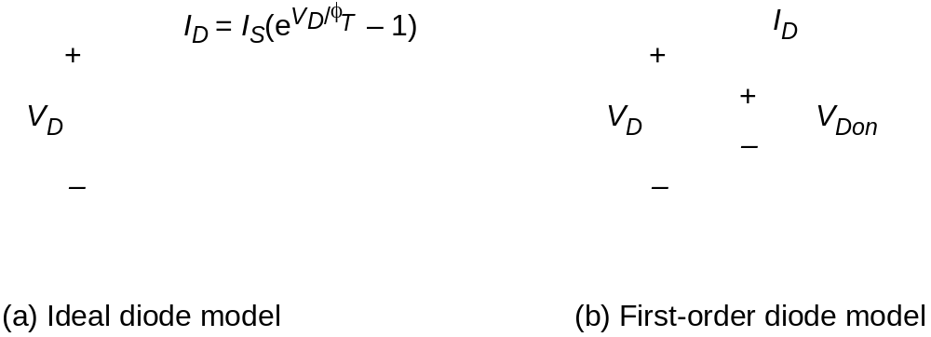
Models for Manual Analysis

Slide 9
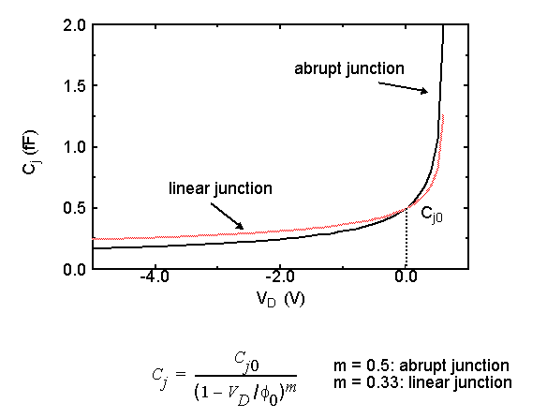
Junction Capacitance

Slide 10
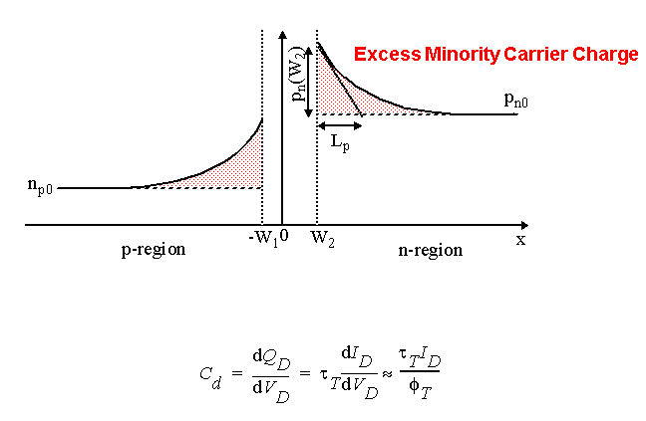
Diffusion Capacitance

Slide 11
Secondary Effects
0.1
)
A
(
0
I
D
–0.1
–25.0
–15.0
–5.0
0
5.0
V
D
(V)
Avalanche Breakdown

Slide 12
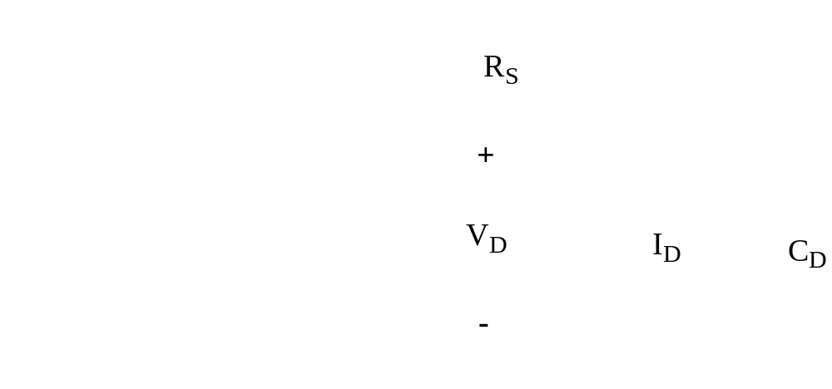
Diode Model

Slide 13
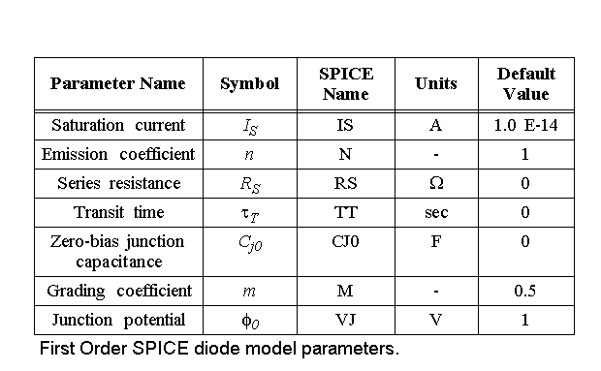
SPICE Parameters

Slide 14
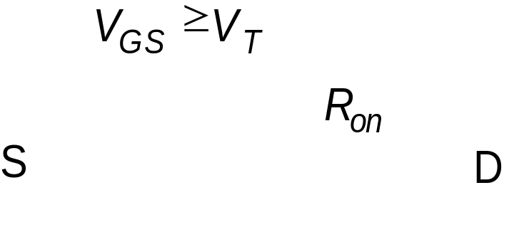
What is a Transistor?
A Switch!
An MOS Transistor
|V
GS
|

Slide 15
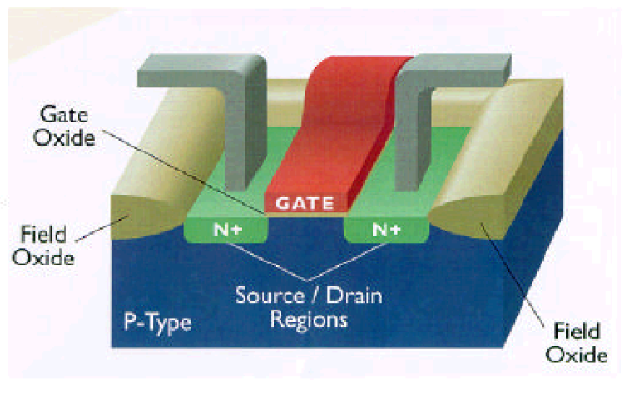
The MOS Transistor
Polysilicon
Aluminum

Slide 16
MOS Transistors -
Types and Symbols
D
D
G
G
S
S
NMOS
Enhancement
NMOS
Depletion
D
D
G
G
B
S
S
PMOS
Enhancement
NMOS with
Bulk Contact

Slide 17
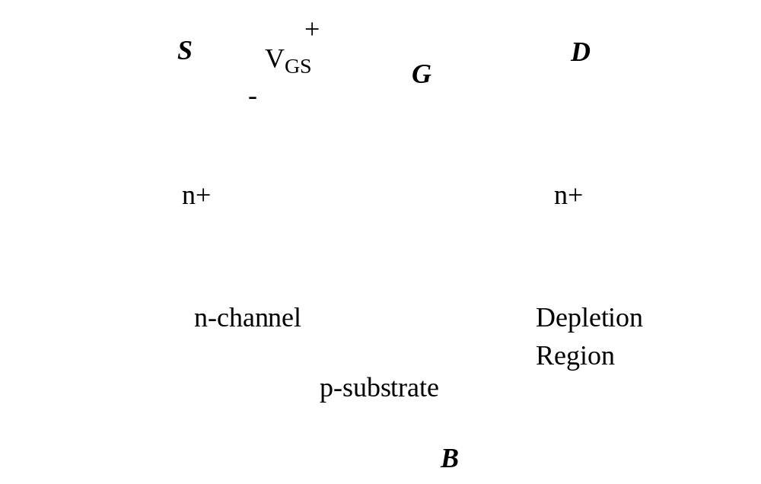
Threshold Voltage: Concept

Slide 18
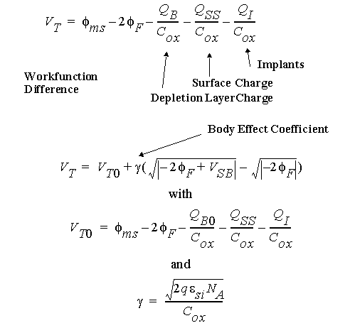
The Threshold Voltage

Slide 19
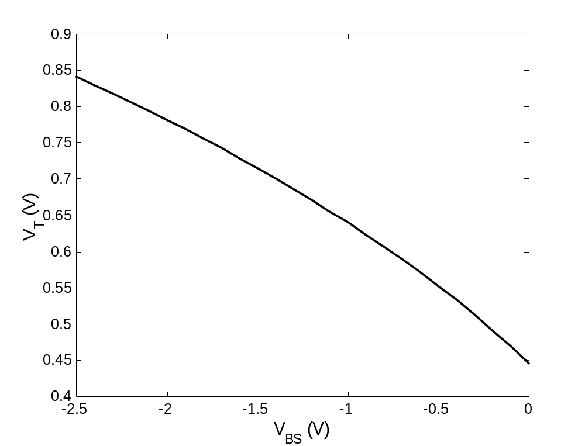
The Body Effect

Slide 20
Current-Voltage Relations
A good ol’ transistor
x 10
-4
6
VGS= 2.5 V
5
Resistive
Saturation
4
VGS= 2.0 V
(A)
3
Quadratic
Relationship
I
D
V_{DS} = V_{GS} - V_{T}
2
VGS= 1.5 V
1
VGS= 1.0 V
0
0
0.5
1
1.5
2
2.5
V
DS
(V)

Slide 21
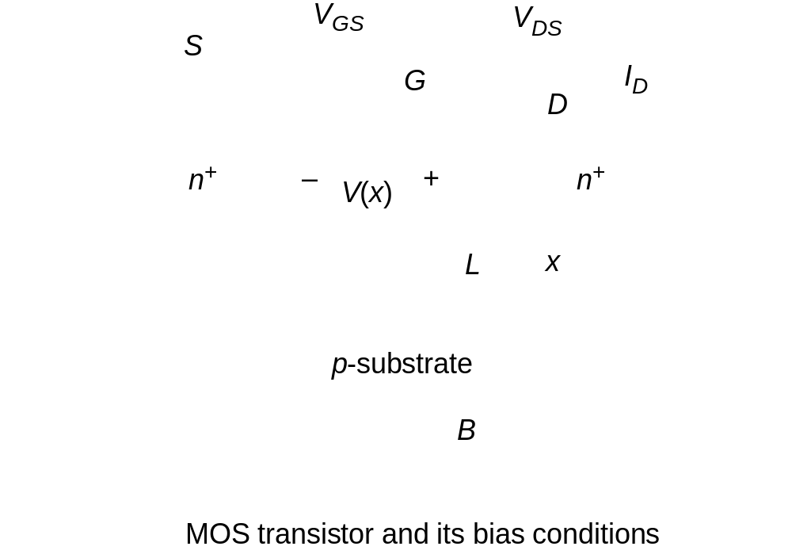
Transistor in Linear

Slide 22
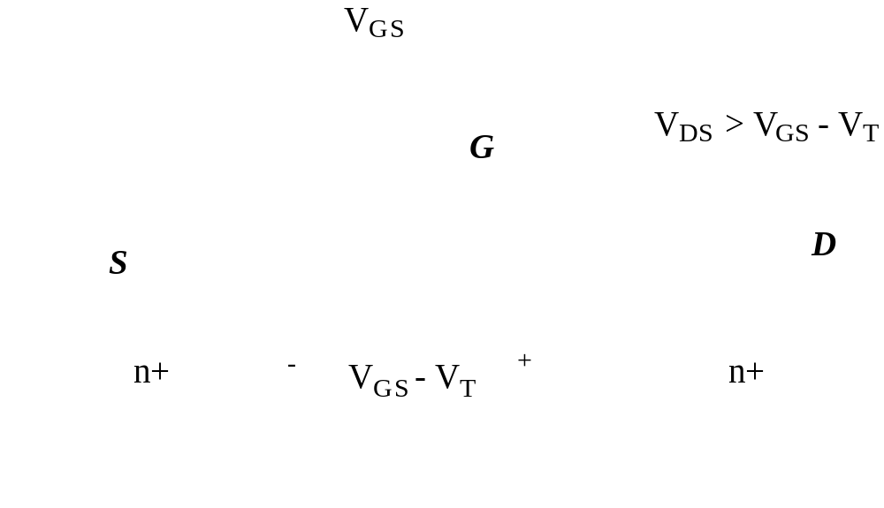
Transistor in Saturation
Pinch-off

Slide 23
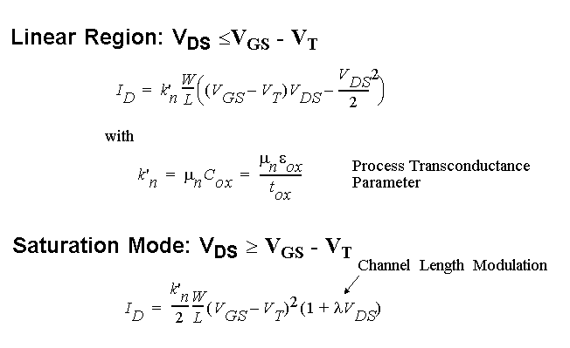
Current-Voltage Relations
Long-Channel Device

Slide 24
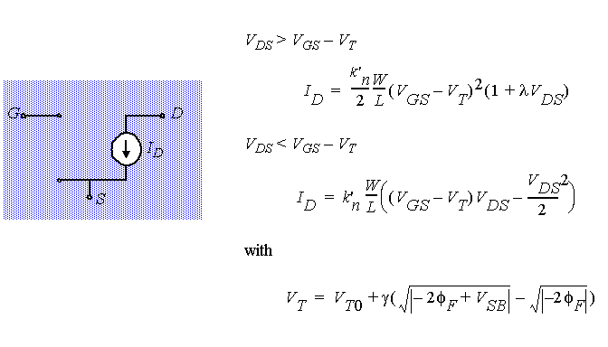
A model for manual analysis

Slide 25
Current-Voltage Relations
The Deep-Submicron Era
x 10
-4
2.5
Early Saturation
VGS= 2.5 V
2
VGS= 2.0 V
1.5
(A)
Linear
Relationship
I
D
VGS= 1.5 V
1
0.5
VGS= 1.0 V
0
0
0.5
1
1.5
2
2.5
V
DS
(V)

Slide 26
Velocity Saturation
)
s
/
m
(
υ
= 10
5
n
sat
υ
Constant velocity
Constant mobility (slope = µ)
ξ
= 1.5
ξ
(V/µm)
c

Slide 27
Perspective
I
D
Long-channel device
V
= V
GS
DD
Short-channel device
V
V
- V
V
DSAT
GS
T
DS

Slide 28
I_{D} versus V_{GS}
-4
x 10
-4
6
2.5
x 10
5
2
linear
4
quadratic
1.5
(A)
3
(A)
I
D
I
D
1
2
1
0.5
quadratic
0
0
0.5
1
1.5
2
2.5
0
0
0.5
1
1.5
2
2.5
V
GS
(V)
V
GS
(V)
Long Channel
Short Channel

Slide 29
I_{D} versus V_{DS}
-4
-4
6
x 10
2.5
x 10
VGS= 2.5 V
VGS= 2.5 V
5
2
Resistive
Saturation
4
VGS= 2.0 V
VGS= 2.0 V
1.5
(A)
3
(A)
I
D
V_{DS} = V_{GS} - V_{T}
I
D
VGS= 1.5 V
1
2
VGS= 1.5 V
1
0.5
VGS= 1.0 V
VGS= 1.0 V
0
0
0.5
1
1.5
2
2.5
0
0
0.5
1
1.5
2
2.5
V
DS
(V)
V
DS
(V)
Long Channel
Short Channel

Slide 30
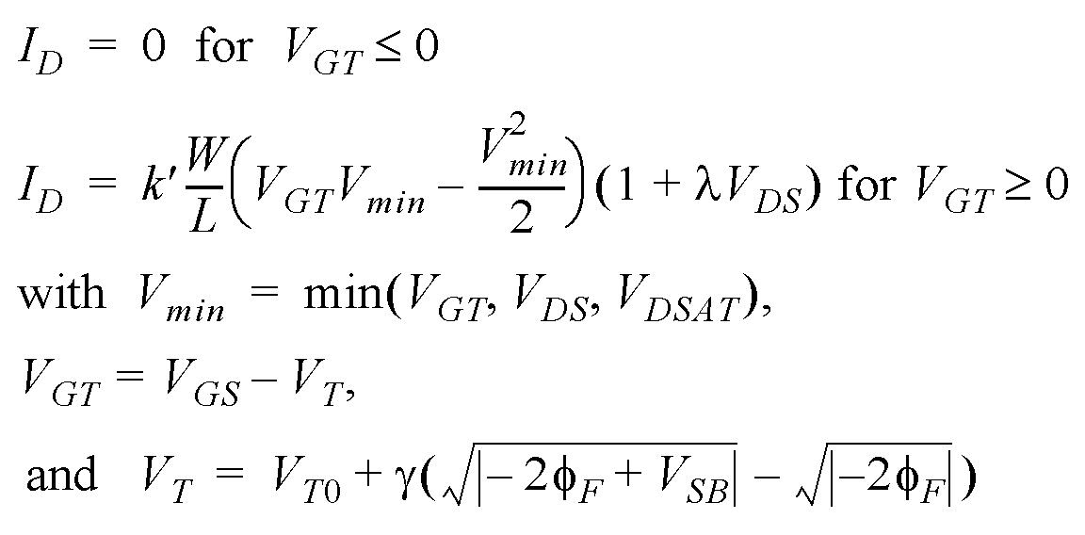
A unified model for manual analysis
G
S
D
B

Slide 31
Simple Model versus SPICE
x 10
-4
2.5
V_{DS}=V_{DSAT}
2
Velocity
Saturated
1.5
(A)
Linear
I
D
1
V_{DSAT}=V_{GT}
0.5
V_{DS}=V_{GT}
Saturated
0
0
0.5
1
1.5
2
2.5
V
DS
(V)

Slide 32
A PMOS Transistor
x 10
-4
0
VGS = -1.0V
-0.2
VGS = -1.5V
-0.4
(A)
I
D
VGS = -2.0V
Assume all variables
negative!
-0.6
-0.8
VGS = -2.5V
-1
-2.5
-2
-1.5
-1
-0.5
0
V
DS
(V)

Slide 33
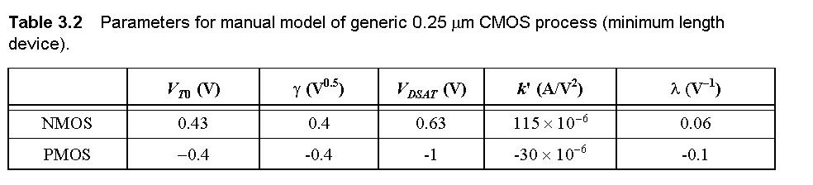
Transistor Model for Manual Analysis

Slide 34
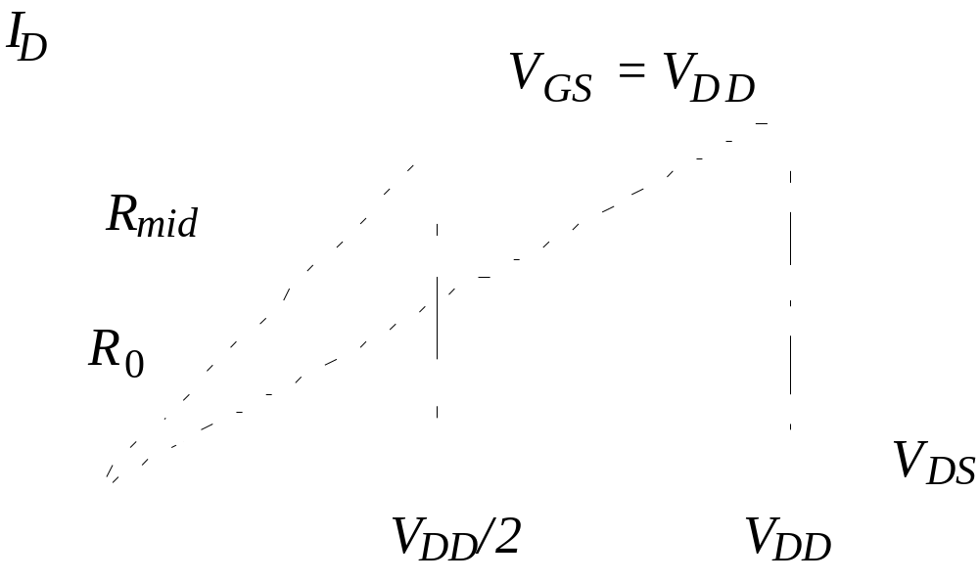
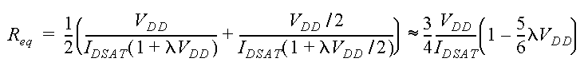
The Transistor as a Switch

Slide 35
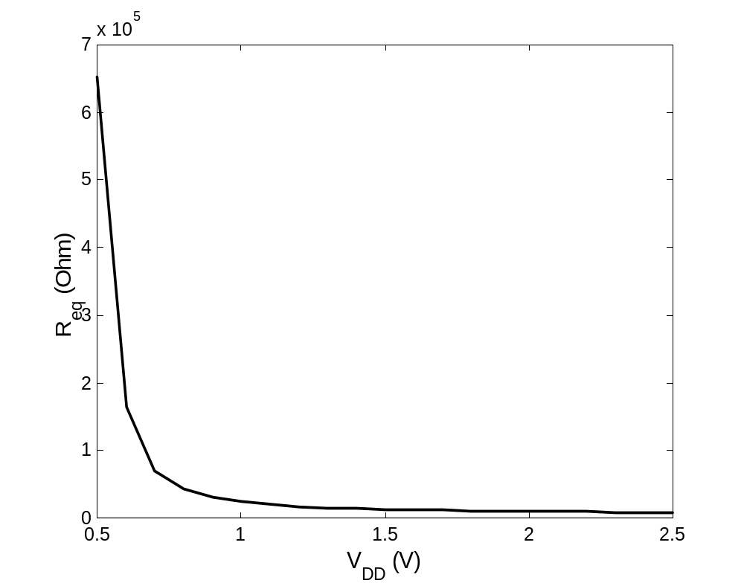
The Transistor as a Switch

Slide 36
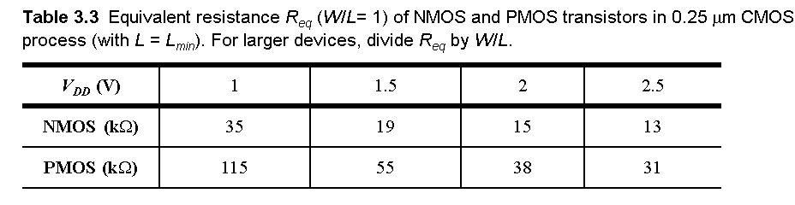
The Transistor as a Switch

Slide 37
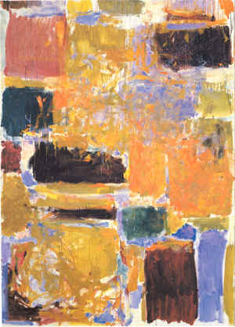
MOS Capacitances
Dynamic Behavior

Slide 38
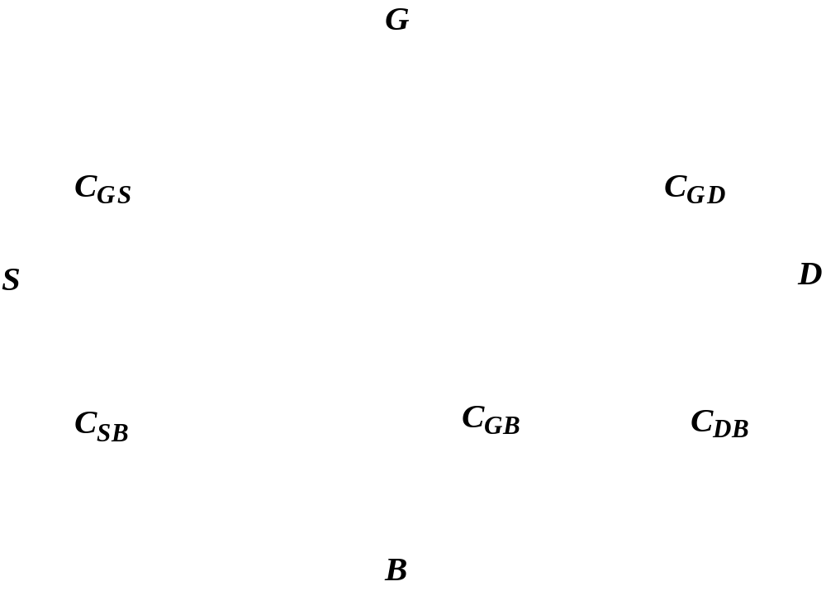
Dynamic Behavior of MOS Transistor

Slide 39
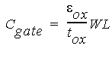
The Gate Capacitance
Polysilicon gate
Source
Drain
W
n
+
x
d
x
d
n
+
L
Gate-bulk
d
overlap
Top view
Gate oxide
t
ox
n
+
L
n
+
Cross section

Slide 40
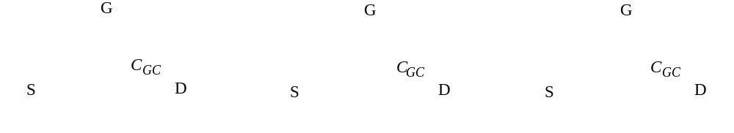
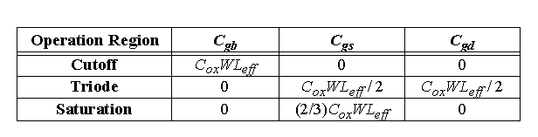
Gate Capacitance
Cut-off
Resistive
Saturation
Most important regions in digital design: saturation and cut-off

Slide 41
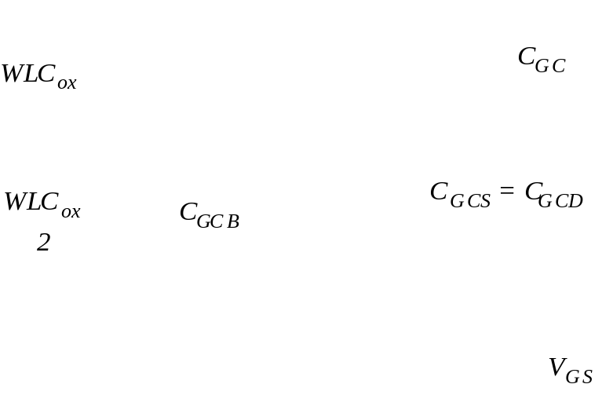
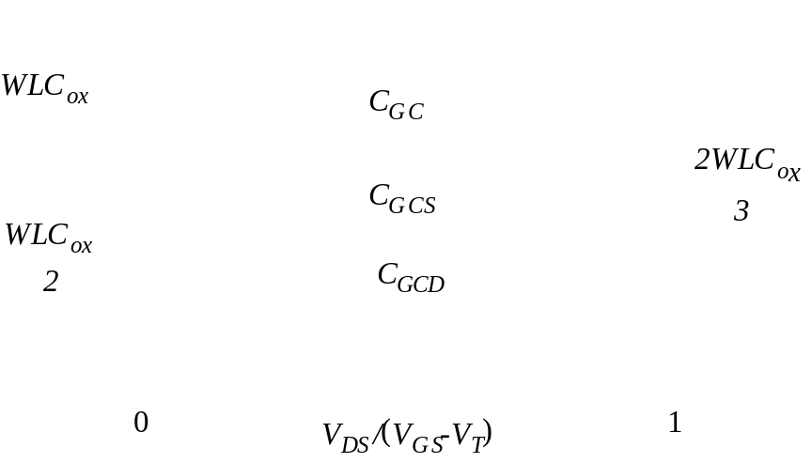
Gate Capacitance
Capacitance as a function of VGS
(with VDS = 0)
Capacitance as a function of the
degree of saturation

Slide 42
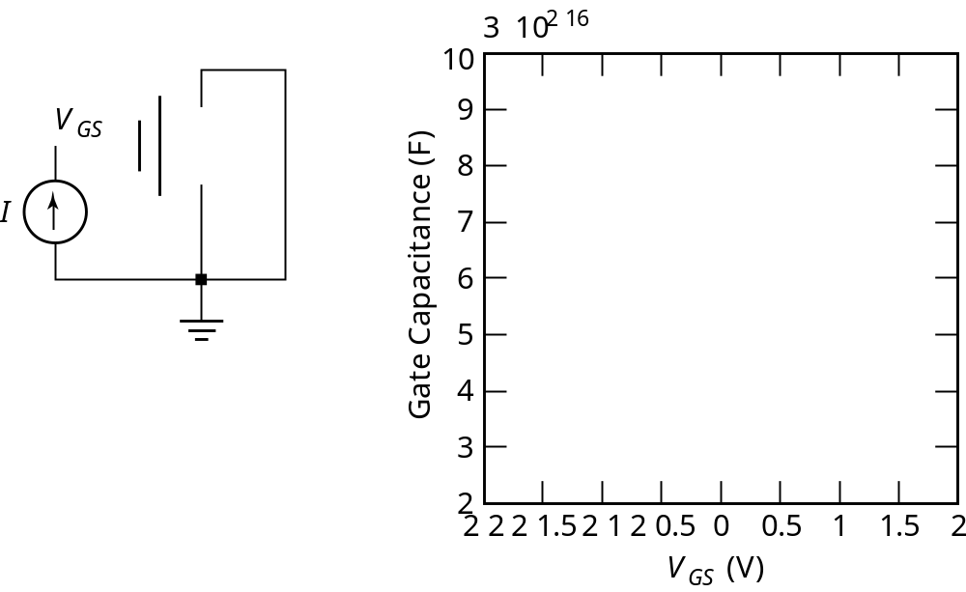
Measuring the Gate Cap

Slide 43

Diffusion Capacitance
Channel-stop implant
N
A
1
Side wall
W
Source
N
D
Bottom
x
j
Side wall
Channel
L
S
Substrate
N
A

Slide 44
Junction Capacitance

Slide 45
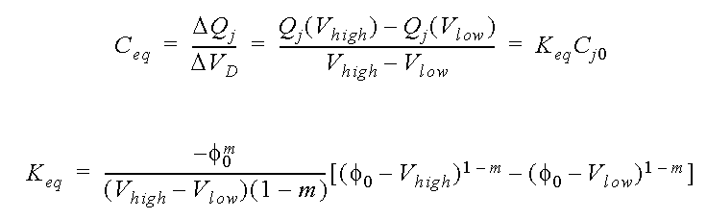
Linearizing the Junction Capacitance
Replace non-linear capacitance by
large-signal equivalent linear capacitance
which displaces equal charge
over voltage swing of interest

Slide 46
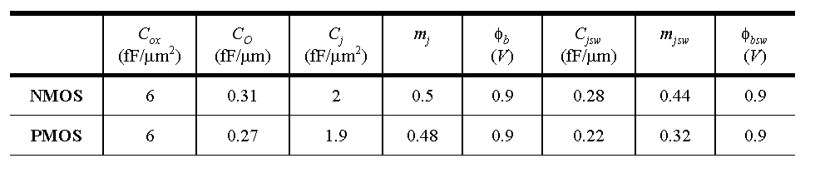
Capacitances in 0.25 μm CMOS process

Slide 47
The Sub-Micron MOS Transistor
Threshold Variations
Subthreshold Conduction
Parasitic Resistances

Slide 48
Threshold Variations
V
T
V
T
Long-channel threshold
Low
V
DS
threshold
V_{DS}
L
Threshold as a function of
Drain-induced barrier lowering
the length (for low
V
DS
)
(for low
L
)

Slide 49
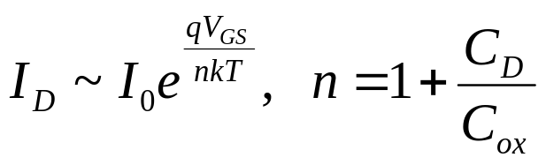
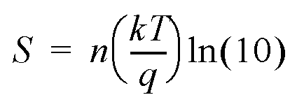
Sub-Threshold Conduction
10
-2
The Slope Factor
Linear
10
-4
10
-6
Quadratic
S is ΔV_{GS} for I_{D2}/I_{D1} =10
(A)
I
D
10
-8
Exponential
10
-10
V_{T}
Typical values for S:
60 .. 100 mV/decade
10
-12
0
0.5
1
1.5
2
2.5
V
GS
(V)

Slide 50
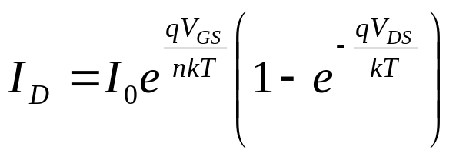
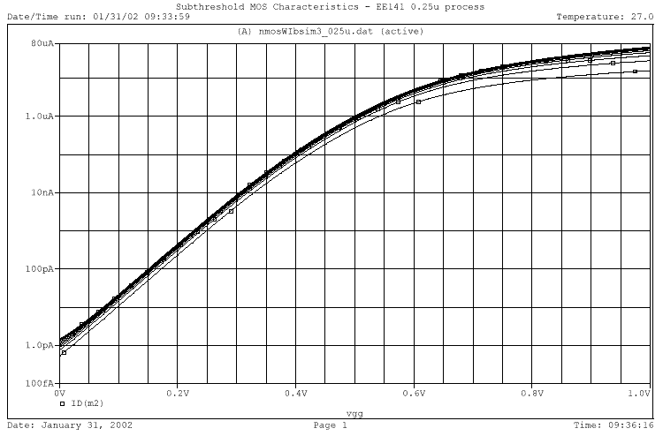
Sub-Threshold I_{D} vs V_{GS}
V_{DS} from 0 to 0.5V

Slide 51
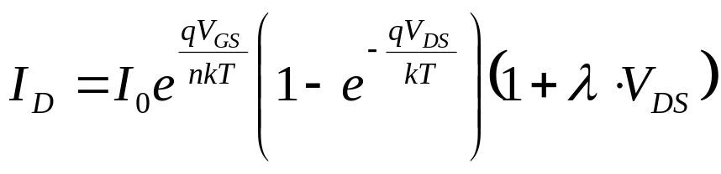
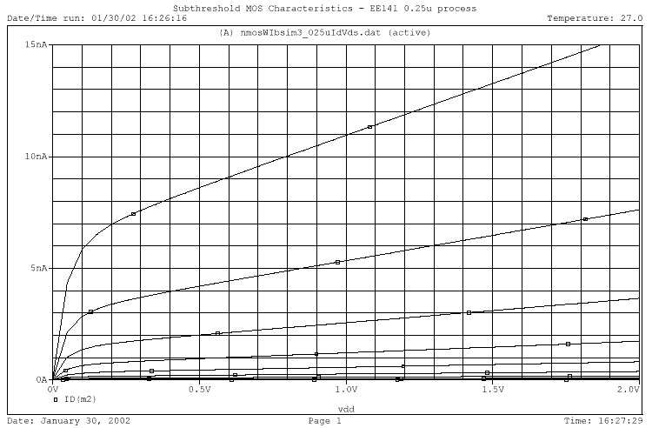
Sub-Threshold I_{D} vs V_{DS}
V_{GS} from 0 to 0.3V

Slide 52
Summary of MOSFET Operating Regions
Strong Inversion V_{GS} > V_{T}
  Linear (Resistive) V_{DS} < V_{DSAT}
  Saturated (Constant Current) V_{DS} ≥ V_{DSAT}
Weak Inversion (Sub-Threshold) V_{GS} ≤ V_{T}
  Exponential in V_{GS} with linear V_{DS} dependence

Slide 53
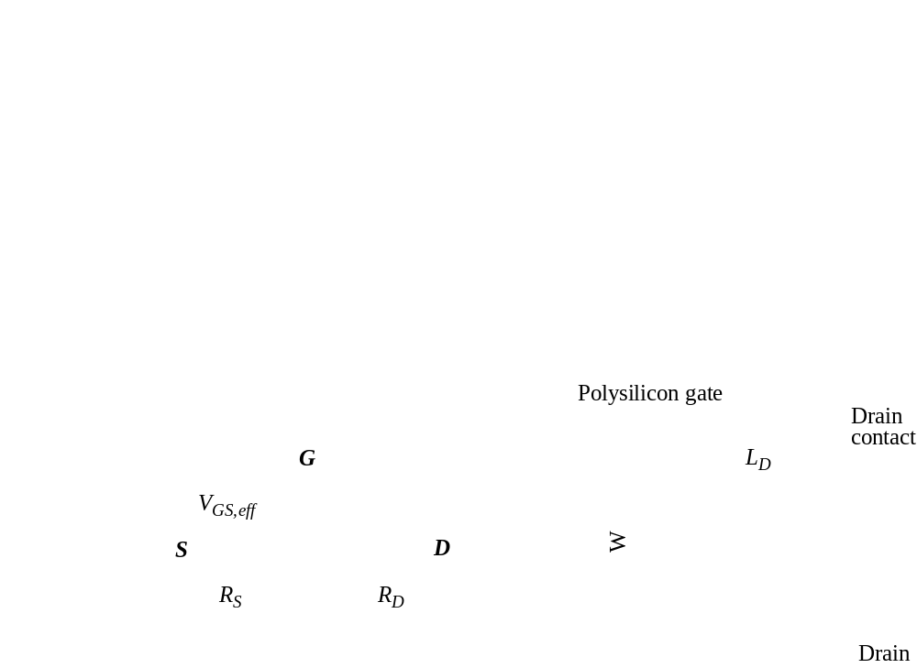
Parasitic Resistances

Slide 54
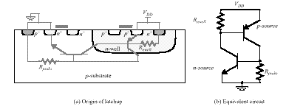
Latch-up

Slide 55
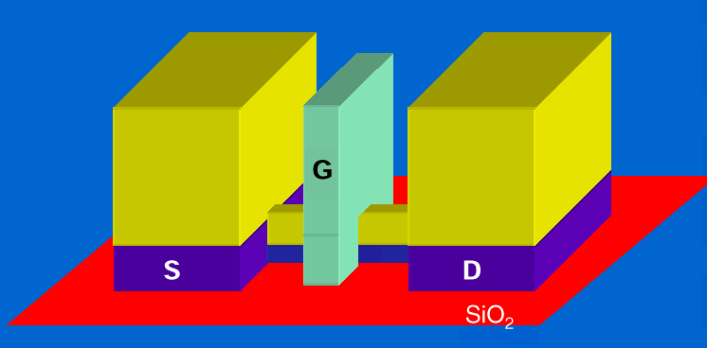
Future Perspectives
25 nm FINFET MOS transistor

