Slide 1

Digital Integrated Circuits
A Design Perspective
Jan M. Rabaey
Anantha Chandrakasan
Borivoje Nikolic
The Inverter
July 30, 2002

Slide 2
The CMOS Inverter: A First Glance
V
DD
V
V
in
out
C
L

Slide 3
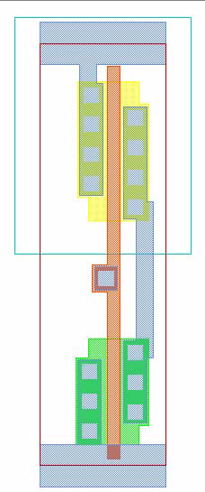
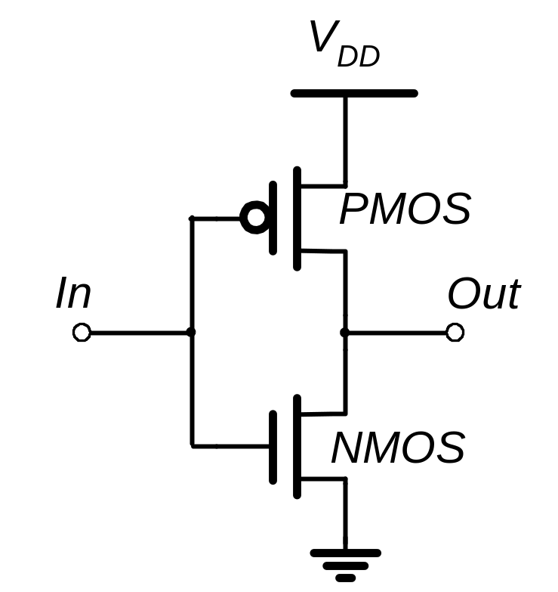
CMOS Inverter
N Well
V
DD
PMOS
2λ
Contacts
In
Out
Metal 1
Polysilicon
NMOS
GND

Slide 4
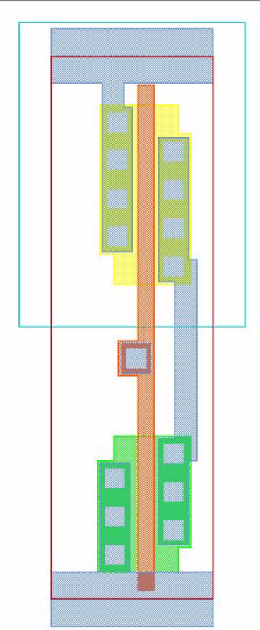
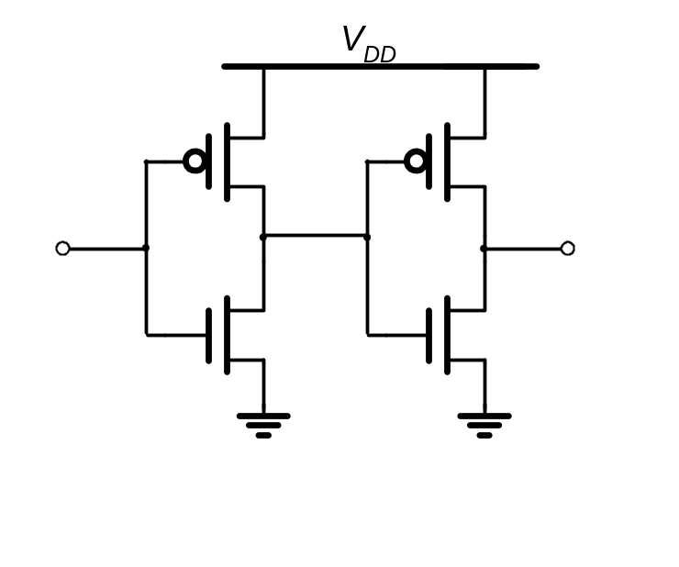
Two Inverters
Share power and ground
Abut cells
Connect in Metal

Slide 5
CMOS Inverter
First-Order DC Analysis
V
DD
V
DD
V_{OL} = 0
V_{OH} = V_{DD}
V_{M} = f(R_{n}, R_{p})
R
p
V
out
V
out
R
n
V
in
5
V
DD
V
in
5
0

Slide 6
CMOS Inverter: Transient Response
V
DD
V
DD
R
t
pHL
= f(R
on
.C
L
)
p
= 0.69 R
on
C
L
V
out
V
out
C
L
C
L
R
n
V
in
5
0
V
in
5
V
DD
(a) Low-to-high
(b) High-to-low

Slide 7
Voltage Transfer
Characteristic

Slide 8
PMOS Load Lines
I
Dn
V
in
= V
DD
+V
GSp
I
Dn
= - I
Dp
V
out
= V
DD
+V
DSp
V
out
I
Dp
I
Dn
I
Dn
V
in
=0
V
in
=0
V
in
=1.5
V
in
=1.5
V
DSp
V
DSp
V
out
V
GSp
=-1
V
GSp
=-2.5
V
= V
+V
V
= V
+V
in
DD
GSp
out
DD
DSp
I
Dn
= - I
Dp

Slide 9
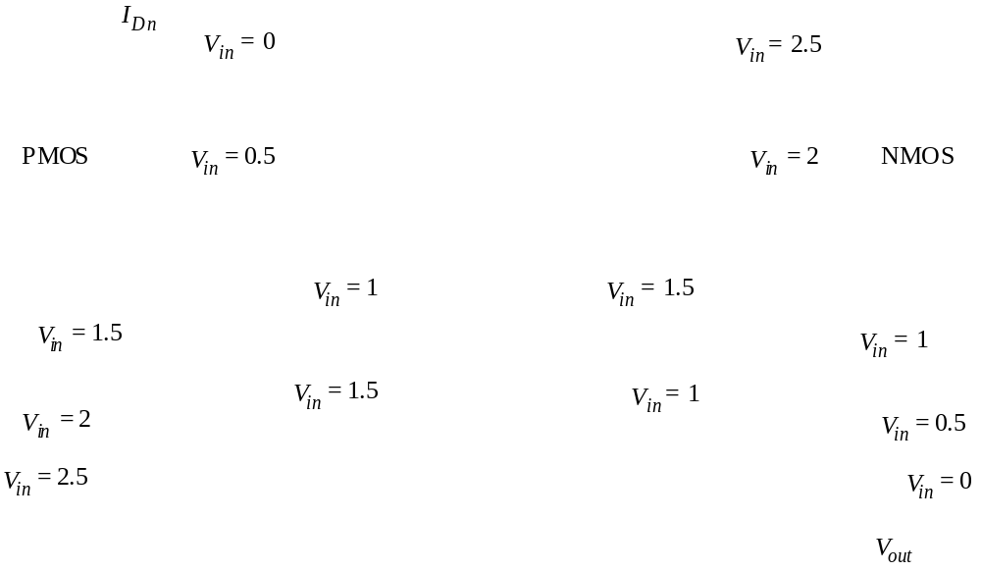
CMOS Inverter Load Characteristics

Slide 10
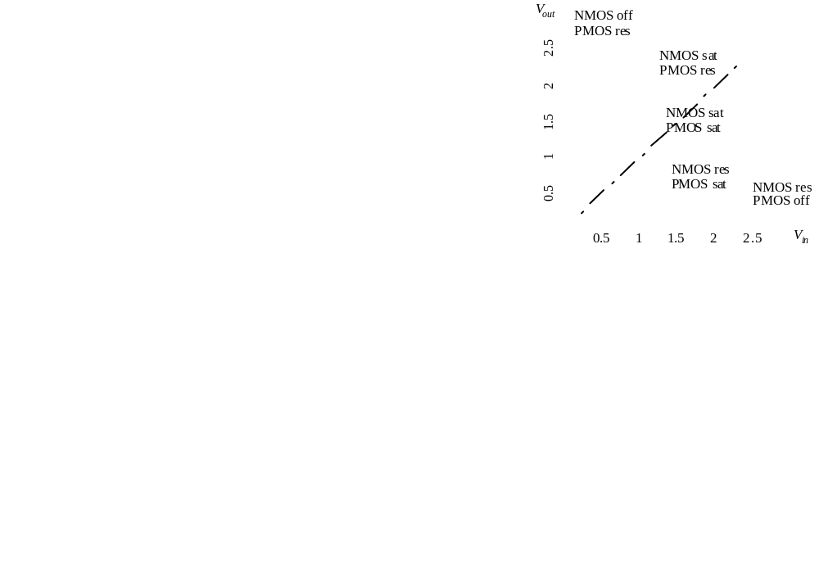
CMOS Inverter VTC

Slide 11
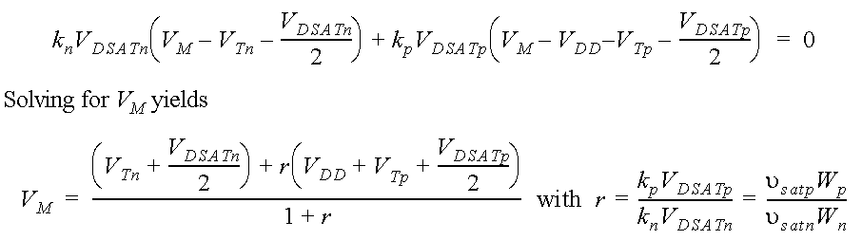
Switching Threshold as a function of Transistor Ratio
1.8
1.7
1.6
1.5
1.4
(V)
1.3
V
M
1.2
1.1
1
0.9
0.8
0
1
10
10
W
p
/W
n

Slide 12
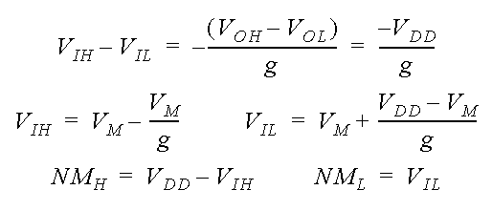
Determining V_{IH} and V_{IL}
V
out
V
OH
V
M
V
in
V
OL
V
IL
V
IH
A simplified approach

Slide 13
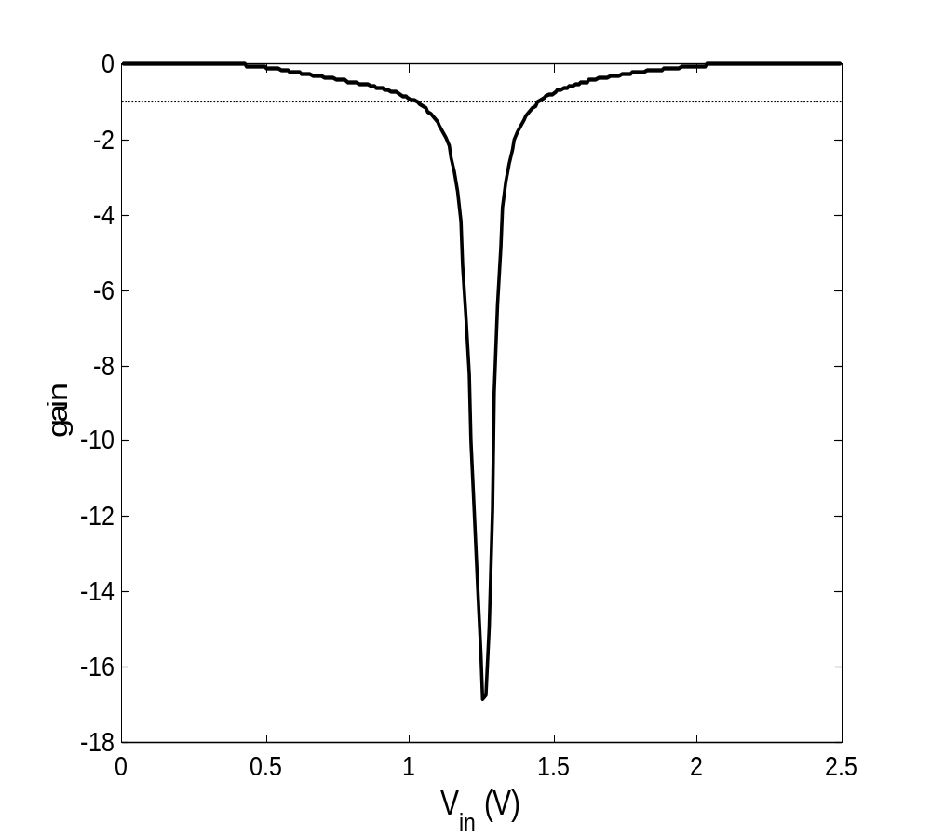
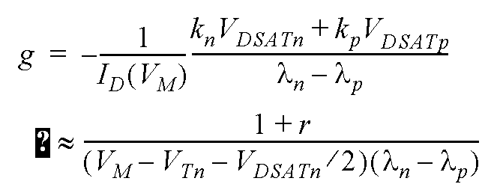
Inverter Gain

Slide 14
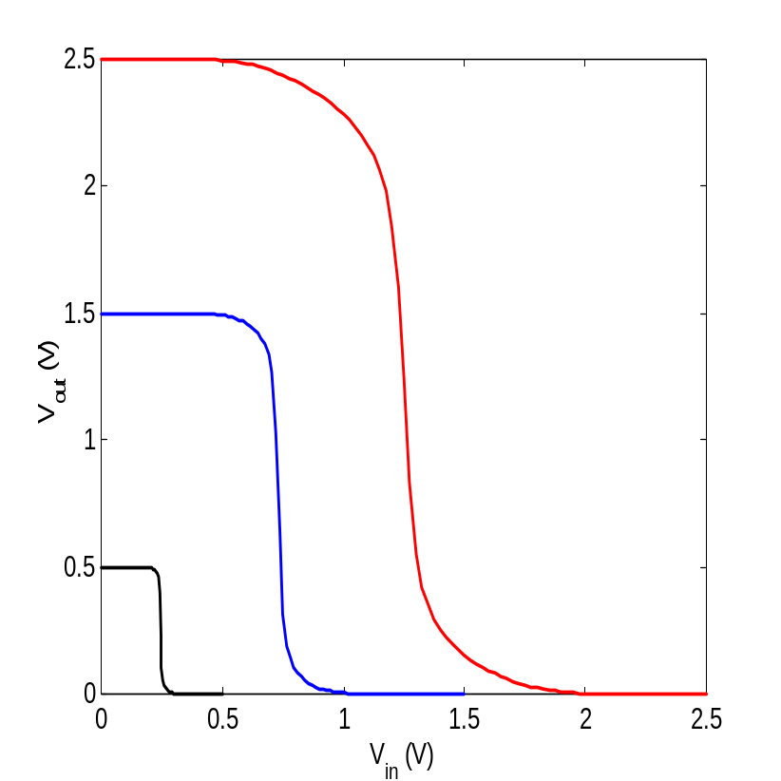
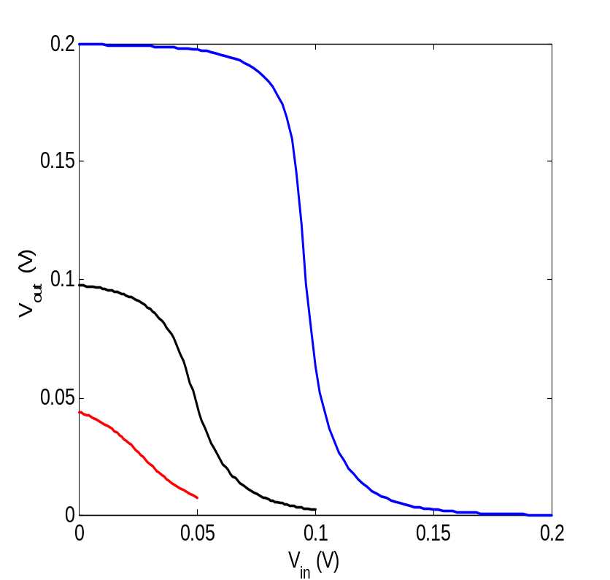
Gain as a function of VDD
Gain=-1

Slide 15
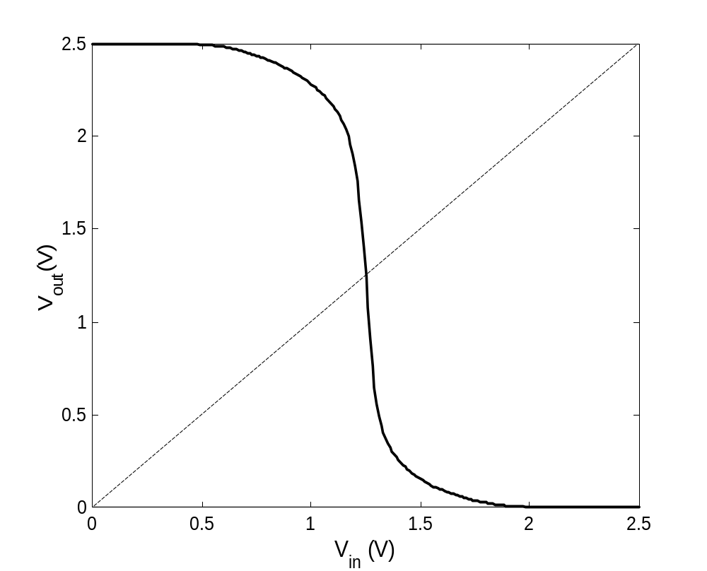
Simulated VTC

Slide 16
Impact of Process Variations
2.5
2
Good PMOS
Bad NMOS
1.5
(V)
Nominal
out
Good NMOS
Bad PMOS
V
1
0.5
0
0
0.5
1
1.5
2
2.5
V
(V)
in

Slide 17
Propagation Delay

Slide 18
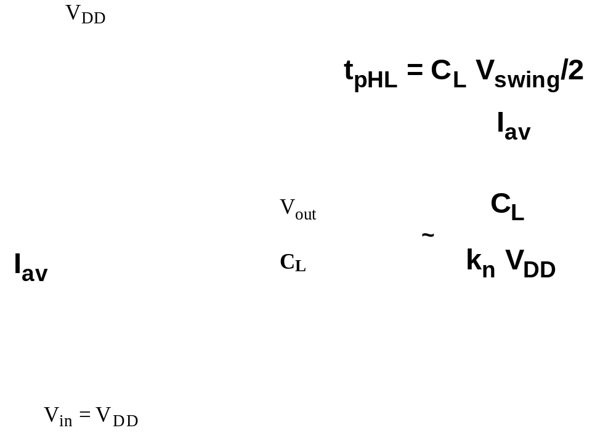
CMOS Inverter Propagation Delay
Approach 1

Slide 19
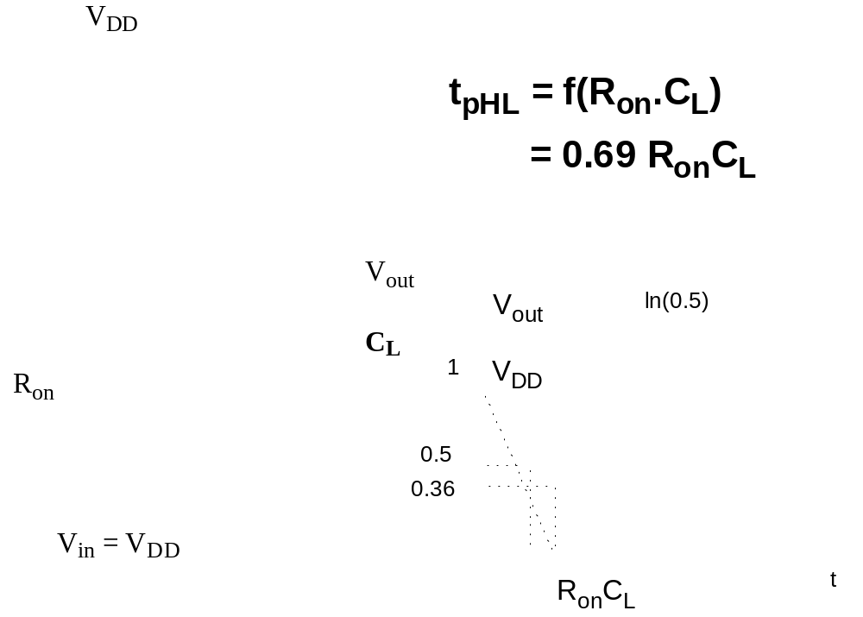
CMOS Inverter Propagation Delay
Approach 2

Slide 20

CMOS Inverters
V
DD
PMOS
1.2
μ
m
=2λ
Out
In
Metal1
Polysilicon
NMOS
GND

Slide 21
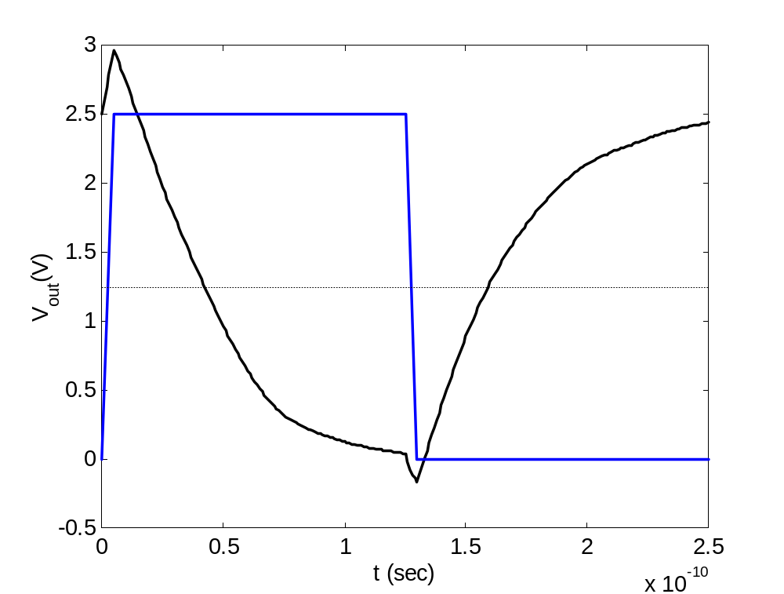
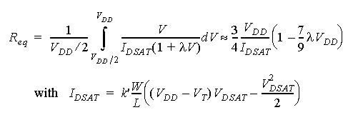
Transient Response
?
t_{p} = 0.69 C_{L} (R_{eqn}+R_{eqp})/2
t_{pLH}
t_{pHL}

Slide 22
Design for Performance
Keep capacitances small
Increase transistor sizes
  watch out for self-loading!
Increase V_{DD} (????)

Slide 23
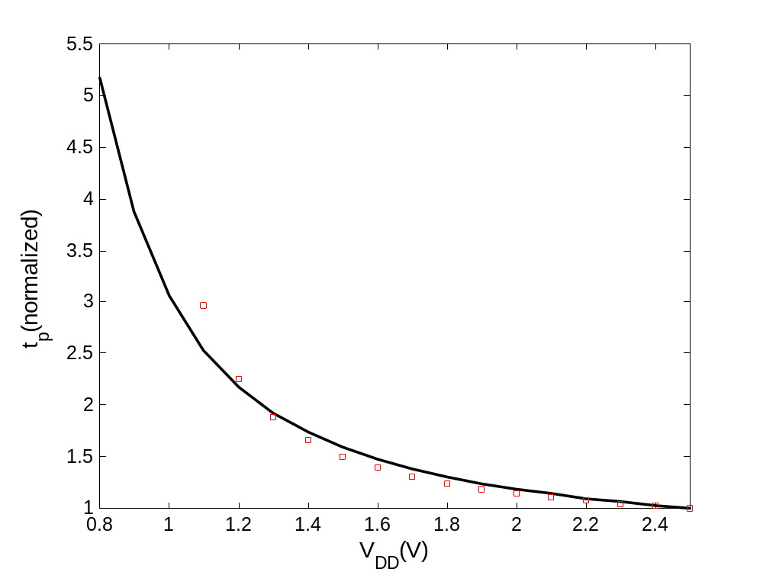
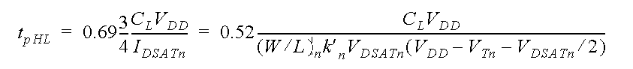
Delay as a function of V_{DD}

Slide 24
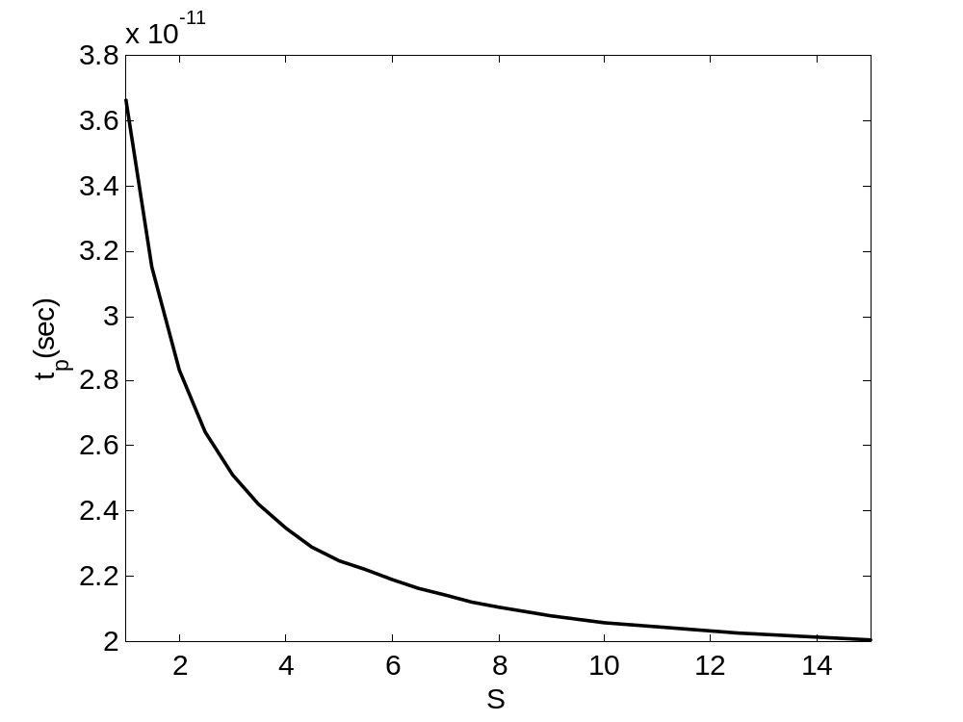
Device Sizing
(for fixed load)
Self-loading effect:
Intrinsic capacitances
dominate

Slide 25
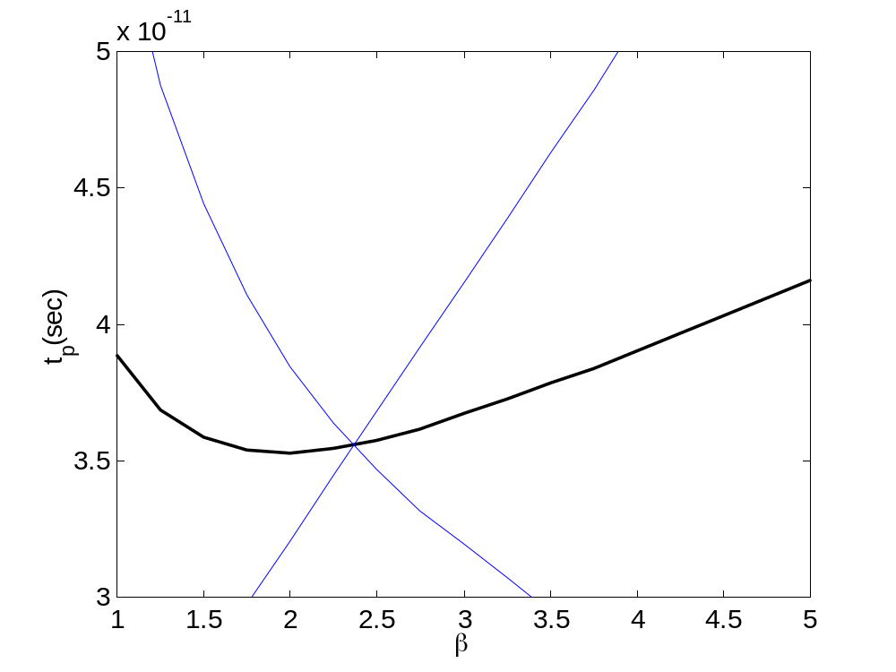
NMOS/PMOS ratio
tpLH
tpHL
tp
β = W_{p}/W_{n}

Slide 26
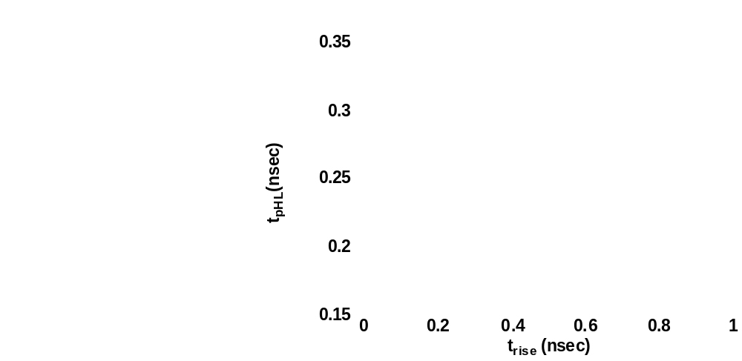
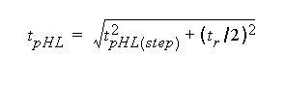
Impact of Rise Time on Delay

Slide 27
Inverter Sizing

Slide 28
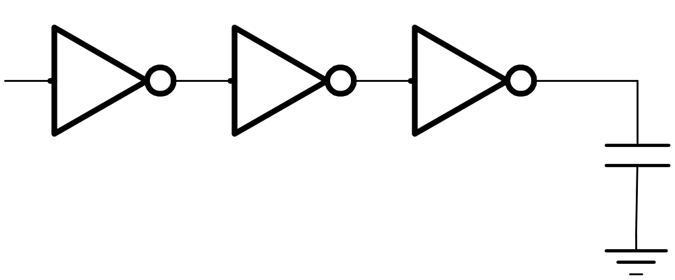
Inverter Chain
In
Out
C_{L}
If C_{L} is given:
How many stages are needed to minimize the delay?
How to size the inverters?
May need some additional constraints.

Slide 29
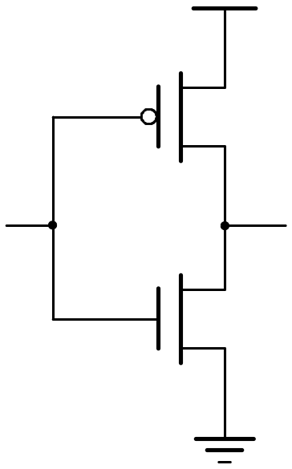
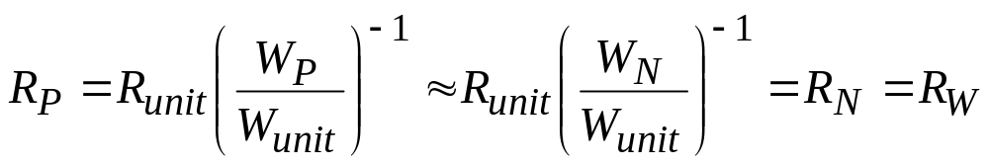
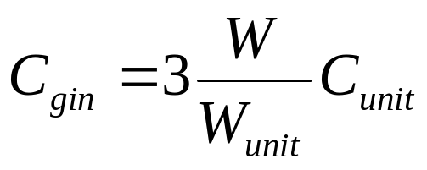
Inverter Delay
Minimum length devices, L=0.25μm
Assume that for W_{P} = 2W_{N} =2W
  same pull-up and pull-down currents
  approx. equal resistances R_{N} = R_{P}
  approx. equal rise t_{pLH} and fall t_{pHL} delays
Analyze as an RC network
2W
W
Delay (D):
t_{pHL} = (ln 2) R_{N}C_{L}
t_{pLH} = (ln 2) R_{P}C_{L}
Load for the next stage:

Slide 30
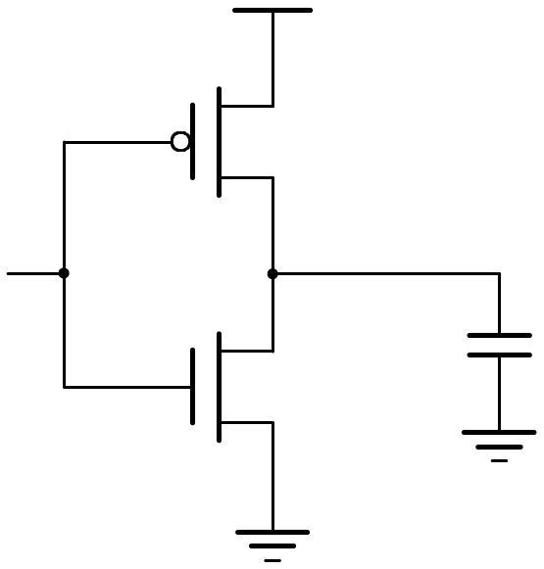
Inverter with Load
Delay
R_{W}
C_{L}
R_{W}
Load (C_{L})
t_{p} = k R_{W}C_{L}
k is a constant, equal to 0.69
Assumptions: no load -> zero delay
W_{unit} = 1

Slide 31
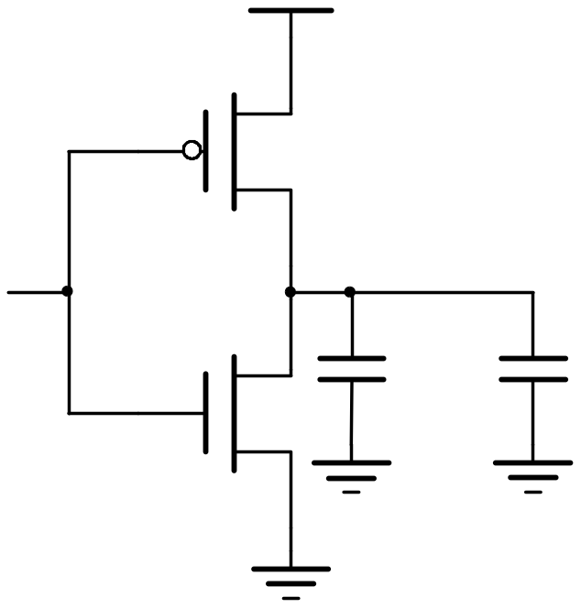
Inverter with Load
C_{P} = 2C_{unit}
Delay
2W
W
C_{int}
C_{L}
C_{N} = C_{unit}
Load
Delay = kR_{W}(C_{int} + C_{L}) = kR_{W}C_{int} + kR_{W}C_{L} = kR_{W} C_{int}(1+ C_{L} /C_{int})
= Delay (Internal) + Delay (Load)

Slide 32
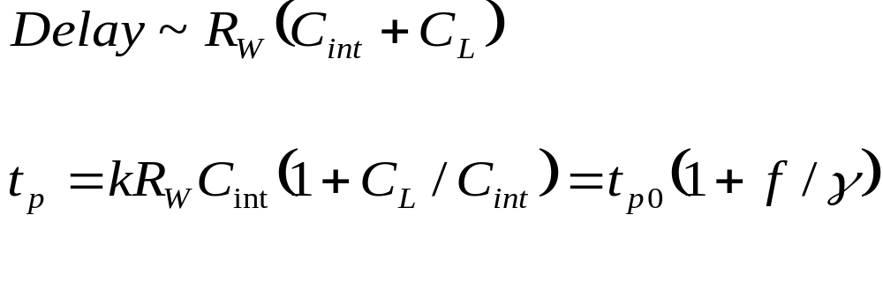
Delay Formula
C_{int} = γC_{gin} with γ ≈ 1
f = C_{L}/C_{gin} - effective fanout
R = R_{unit}/W ; C_{int} =WC_{unit}
t_{p0} = 0.69R_{unit}C_{unit}

Slide 33
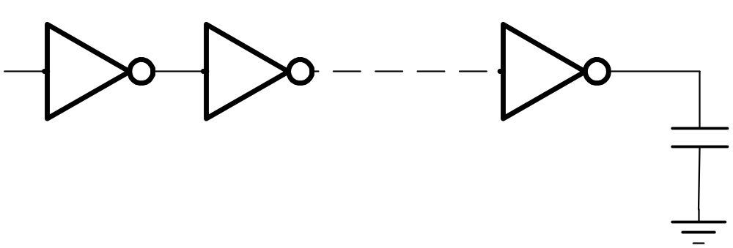
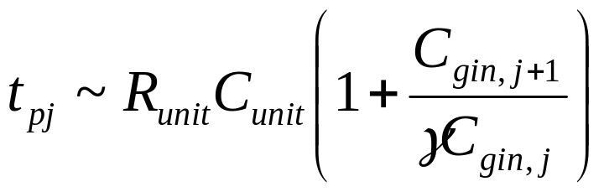
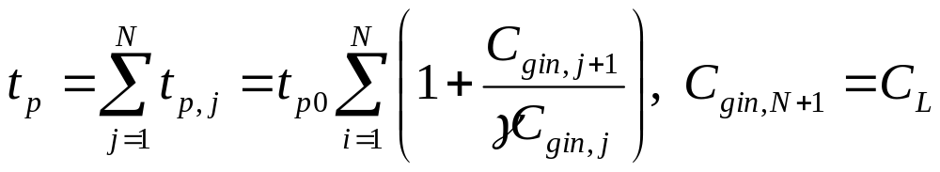
Apply to Inverter Chain
In
Out
1
2
N
C_{L}
t_{p} = t_{p1} + t_{p2} + …+ t_{pN}

Slide 34
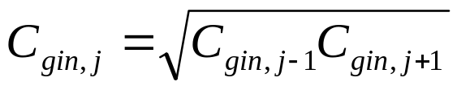
Optimal Tapering for Given N
Delay equation has N - 1 unknowns, C_{gin,2} – C_{gin,N}
Minimize the delay, find N - 1 partial derivatives
Result: C_{gin,j+1}/C_{gin,j} = C_{gin,j}/C_{gin,j-1}
Size of each stage is the geometric mean of two neighbors
each stage has the same effective fanout (C_{out}/C_{in})
each stage has the same delay

Slide 35
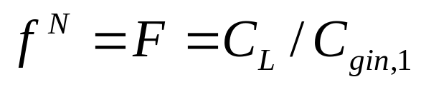
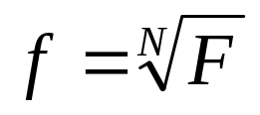
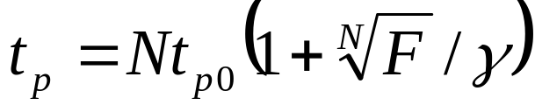
Optimum Delay and Number of Stages
When each stage is sized by f and has same eff. fanout f:
Effective fanout of each stage:
Minimum path delay

Slide 36
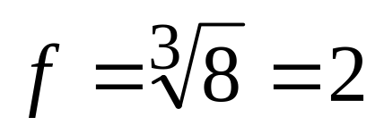
Example
In
Out
1
f
f²
C_{L}= 8 C₁
C₁
C_{L}/C₁ has to be evenly distributed across N = 3 stages:

Slide 37
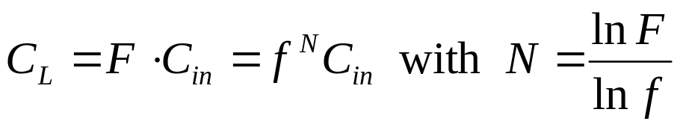
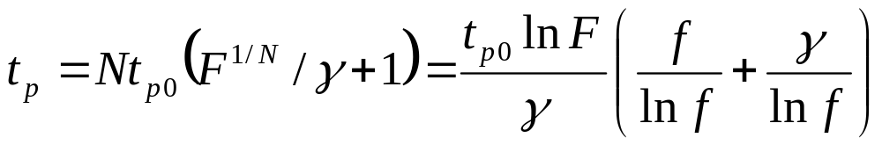
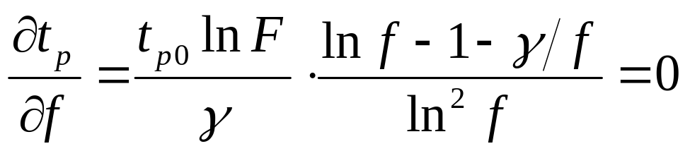
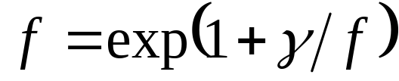
Optimum Number of Stages
For a given load, C_{L} and given input capacitance C_{in}
Find optimal sizing f
For γ = 0, f = e, N = lnF

Slide 38
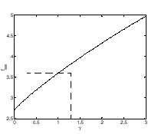
Optimum Effective Fanout f
Optimum f for given process defined by γ
f_{opt} = 3.6
for γ=1

Slide 39
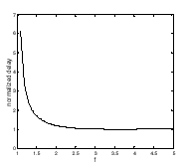
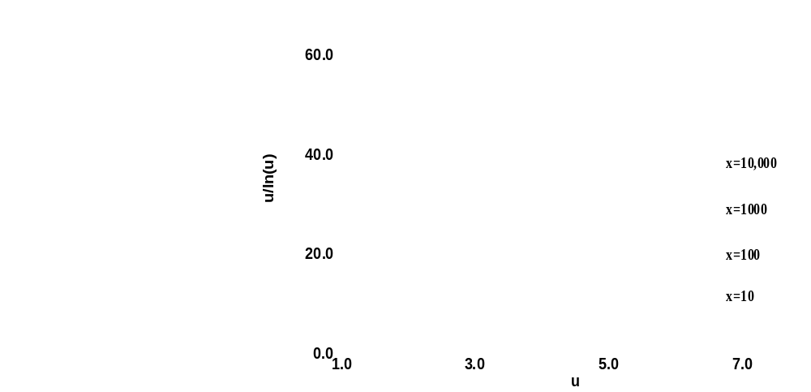
Impact of Self-Loading on tp
No Self-Loading, γ=0
With Self-Loading γ=1

Slide 40

Normalized delay function of F

Slide 41

Buffer Design
N f t_{p}
1 64 65
2 8 18
3 4 15
4 2.8 15.3
1
64
1
8
64
1
4
16
64
1
22.6
64
2.8
8

Slide 42
Power Dissipation

Slide 43
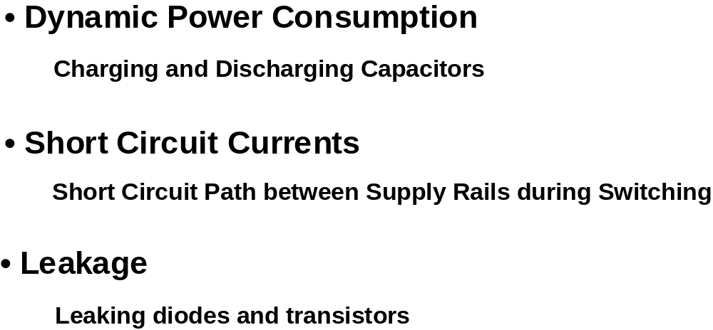
Where Does Power Go in CMOS?

Slide 44
Dynamic Power Dissipation
Vdd
Vin
Vout
C
L
Energy/transition = C
* V
2
L
dd
Power = Energy/transition *
f =
C
* V
2
* f
L
dd
Not a function of transistor sizes!
Need to reduce C
L
, V
dd
, and
f
to reduce power.

Slide 45
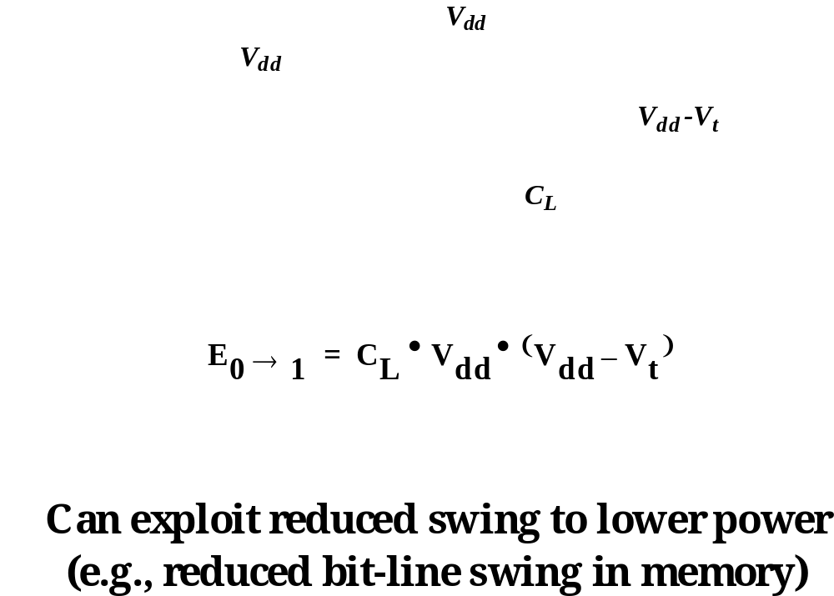
Modification for Circuits with Reduced Swing

Slide 46
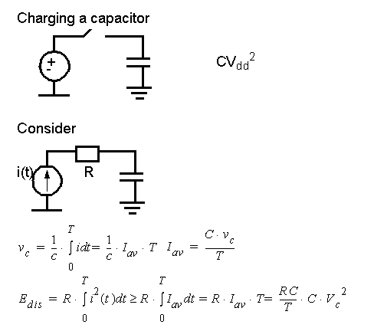
Adiabatic Charging
2
2
2

Slide 47
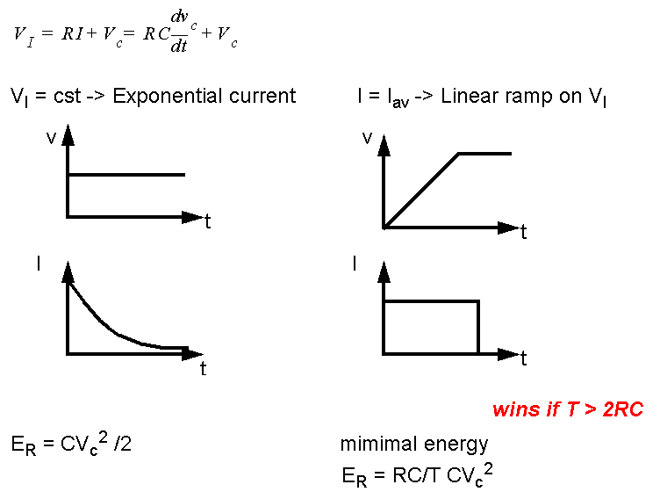
Adiabatic Charging

Slide 48
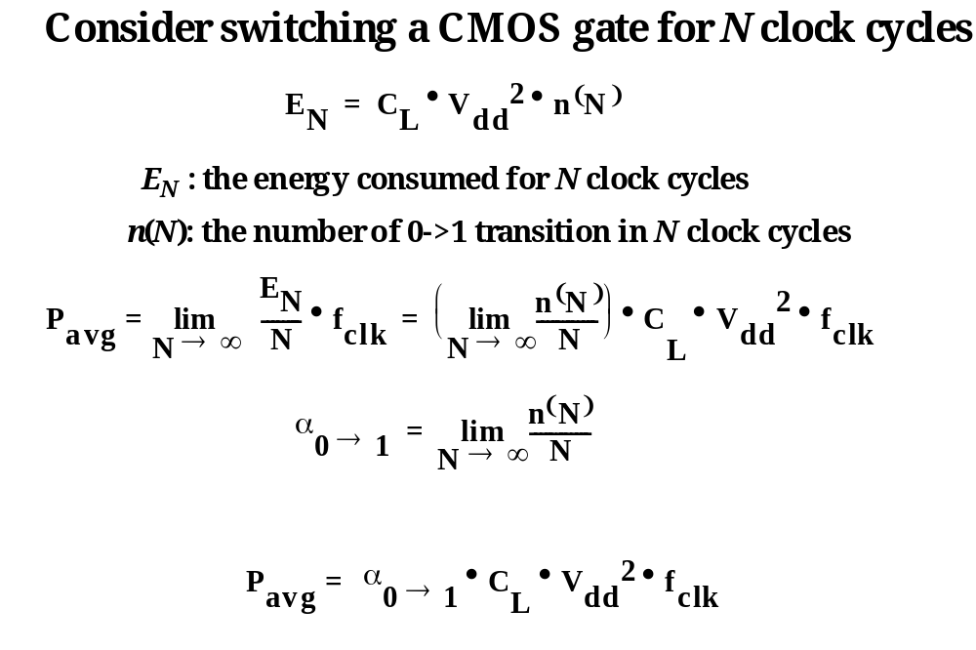
Node Transition Activity and Power

Slide 49


Transistor Sizing for Minimum Energy
Goal: Minimize Energy of whole circuit
  Design parameters: f and V_{DD}
  tp ≤ tpref of circuit with f=1 and V_{DD} =V_{ref}

Slide 50


Transistor Sizing (2)
Performance Constraint (γ=1)
Energy for single Transition

Slide 51

Transistor Sizing (3)
V_{DD}=f(f)
E/E_{ref}=f(f)
F=1
2
5
10
20

Slide 52

Short Circuit Currents

Slide 53


How to keep Short-Circuit Currents Low?
Short circuit current goes to zero if t_{fall} >> t_{rise},
but can’t do this for cascade logic, so ...

Slide 54


Minimizing Short-Circuit Power
Vdd =3.3
Vdd =2.5
Vdd =1.5

Slide 55

Leakage
Sub-threshold current one of most compelling issues
in low-energy circuit design!

Slide 56

Reverse-Biased Diode Leakage
JS = 10-100 pA/μm2 at 25 deg C for 0.25μm CMOS
JS doubles for every 9 deg C!

Slide 57

Subthreshold Leakage Component

Slide 58

Static Power Consumption
Wasted energy …
Should be avoided in almost all cases,
but could help reducing energy in others (e.g. sense amps)

Slide 59
Principles for Power Reduction
Prime choice: Reduce voltage!
  Recent years have seen an acceleration in supply voltage reduction
  Design at very low voltages still open question (0.6 … 0.9 V by 2010!)
Reduce switching activity
Reduce physical capacitance
  Device Sizing: for F=20
    f_{opt}(energy)=3.53, f_{opt}(performance)=4.47

Slide 60
Impact of
Technology Scaling

Slide 61
Goals of Technology Scaling
Make things cheaper:
  Want to sell more functions (transistors) per chip for the same money
  Build same products cheaper, sell the same part for less money
  Price of a transistor has to be reduced
But also want to be faster, smaller, lower power

Slide 62
Technology Scaling
Goals of scaling the dimensions by 30%:
  Reduce gate delay by 30% (increase operating frequency by 43%)
  Double transistor density
  Reduce energy per transition by 65% (50% power savings @ 43% increase in frequency
Die size used to increase by 14% per generation
Technology generation spans 2-3 years

Slide 63

Technology Generations

Slide 64
Technology Evolution (2000 data)
International Technology Roadmap for Semiconductors
Year of Introduction
1999
2000
2001
2004
2008
2011
2014
Technology node [nm]
180
130
90
60
40
30
Supply [V]
1.5-1.8
1.5-1.8
1.2-1.5
0.9-1.2
0.6-0.9
0.5-0.6
0.3-0.6
Wiring levels
6-7
6-7
7
8
9
9-10
10
Max frequency [GHz],Local-Global
1.2
1.6-1.4
2.1-1.6
3.5-2
7.1-2.5
11-3
14.9
-3.6
Max μP power [W]
90
106
130
160
171
177
186
Bat. power [W]
1.4
1.7
2.0
2.4
2.1
2.3
2.5
Node years: 2007/65nm, 2010/45nm, 2013/33nm, 2016/23nm

Slide 65

Technology Evolution (1999)

Slide 66

ITRS Technology Roadmap Acceleration Continues

Slide 67

Technology Scaling (1)
Minimum Feature Size

Slide 68

Technology Scaling (2)
Number of components per chip

Slide 69

Technology Scaling (3)
t_{p} decreases by 13%/year
50% every 5 years!
Propagation Delay

Slide 70

Technology Scaling (4)
From Kuroda

Slide 71

Technology Scaling Models

Slide 72

Scaling Relationships for Long Channel Devices

Slide 73

Transistor Scaling
(velocity-saturated devices)

Slide 74

μProcessor Scaling
P.Gelsinger: μProcessors for the New Millenium, ISSCC 2001

Slide 75

μProcessor Power
P.Gelsinger: μProcessors for the New Millenium, ISSCC 2001

Slide 76

μProcessor Performance
P.Gelsinger: μProcessors for the New Millenium, ISSCC 2001

Slide 77
2010 Outlook
Performance 2X/16 months
  1 TIP (terra instructions/s)
  30 GHz clock
Size
  No of transistors: 2 Billion
  Die: 40*40 mm
Power
  10kW!!
  Leakage: 1/3 active Power
P.Gelsinger: μProcessors for the New Millenium, ISSCC 2001

Slide 78
Some interesting questions
What will cause this model to break?
When will it break?
Will the model gradually slow down?
  Power and power density
  Leakage
  Process Variation

