Slide 1

Digital Integrated Circuits
A Design Perspective
Jan M. Rabaey
Anantha Chandrakasan
Borivoje Nikolić
Designing Combinational
Logic Circuits
November 2002.

Slide 2
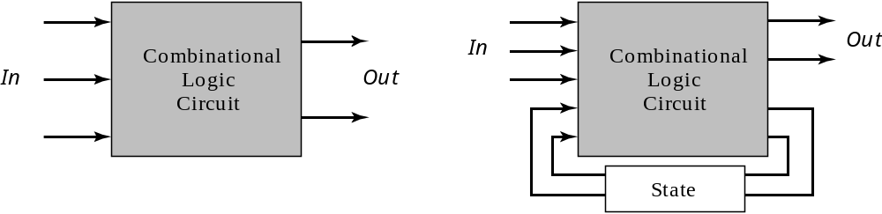
Combinational vs. Sequential Logic
Combinational
Sequential
Output =
f
(
In
)
Output =
f
(
In, Previous In
)

Slide 3
Static CMOS Circuit
At every point in time (except during the switching
transients) each gate output is connected to either
V
or
V
via a low-resistive path.
DD
ss
The outputs of the gates assume at all times the value
of the Boolean function, implemented by the circuit
(ignoring, once again, the transient effects during
switching periods).
This is in contrast to the
dynamic
circuit class, which
relies on temporary storage of signal values on the
capacitance of high impedance circuit nodes.

Slide 4
Static Complementary CMOS
V_{DD}
In1
PMOS only
In2
…
PUN
InN
F(In1,In2,…InN)
In1
In2
…
PDN
NMOS only
InN
PUN and PDN are dual logic networks
Notes:
One and only one of the networks (PUN or PDN) is conducting in steady state

Slide 5
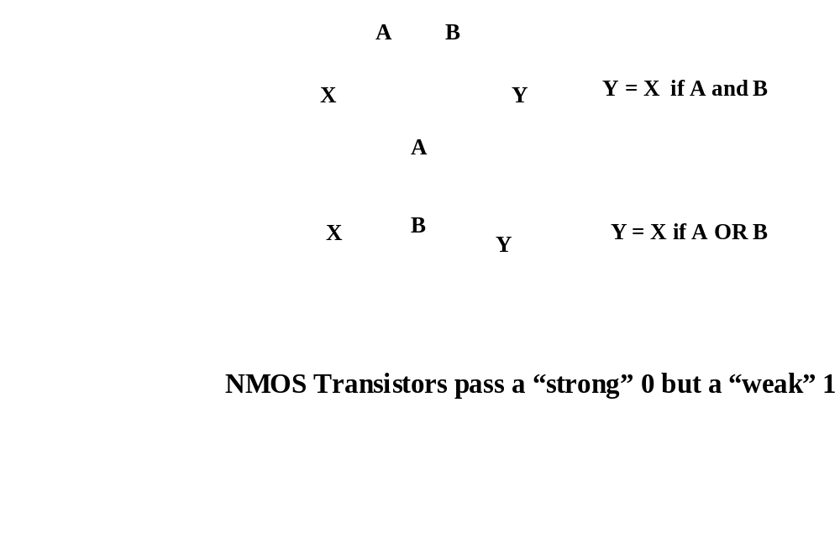
NMOS Transistors in Series/Parallel Connection
    Transistors can be thought as a switch controlled by its gate signal
    NMOS switch closes when switch control input is high

Slide 6
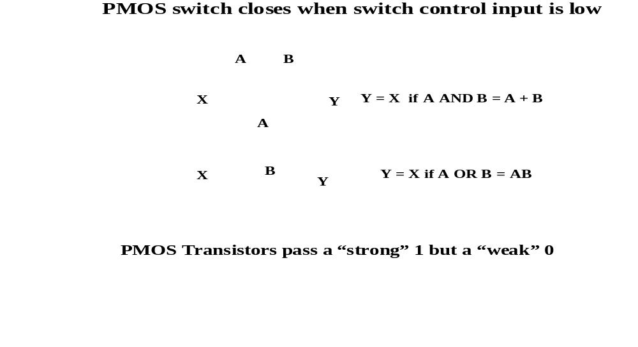
PMOS Transistors in Series/Parallel Connection

Slide 7
Threshold Drops
V_{DD}
V_{DD}
PUN
S
D
V_{DD}
D
0 → V_{DD}
S
0 → V_{DD} - V_{Tn}
V_{GS}
C_{L}
C_{L}
PDN
V_{DD} → 0
V_{DD} → |V_{Tp}|
V_{GS}
D
C_{L}
S
C_{L}
V_{DD}
S
D
Notes:
Why PMOS in PUN and NMOS in PDN … threshold drop
NMOS transistors produce strong zeros; PMOS transistors generate strong ones

Slide 8
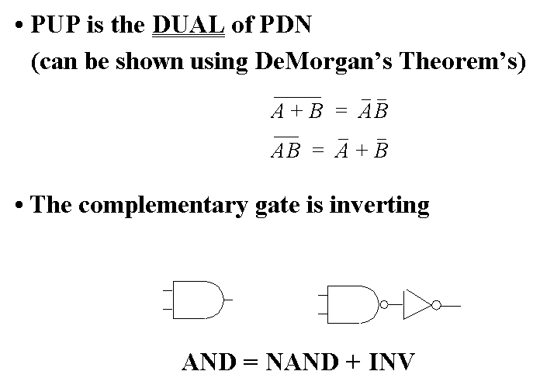
Complementary CMOS Logic Style

Slide 9
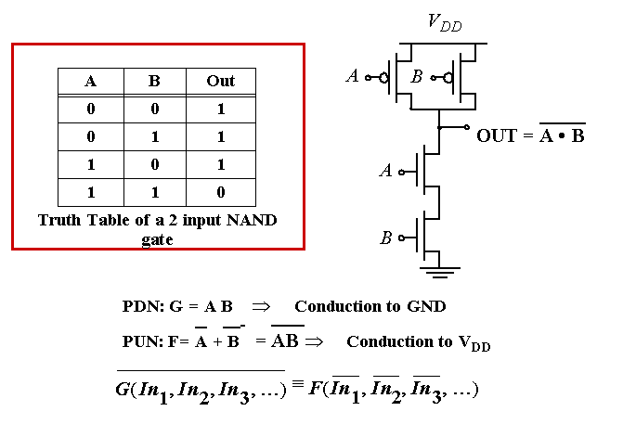
Example Gate: NAND

Slide 10
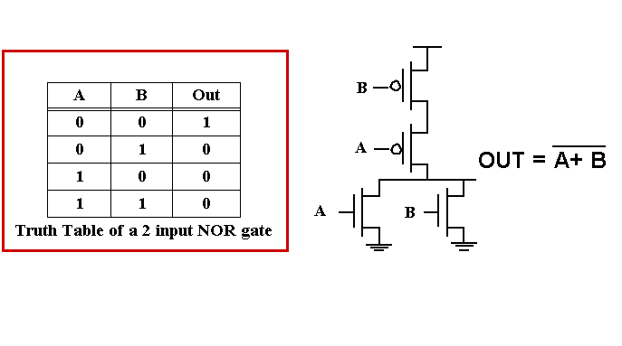
Example Gate: NOR

Slide 11
Complex CMOS Gate
B
A
C
D
OUT = D + A • (B + C)
A
D
B
C
Notes:
Shown synthesis of pull up from pull down structure

Slide 12
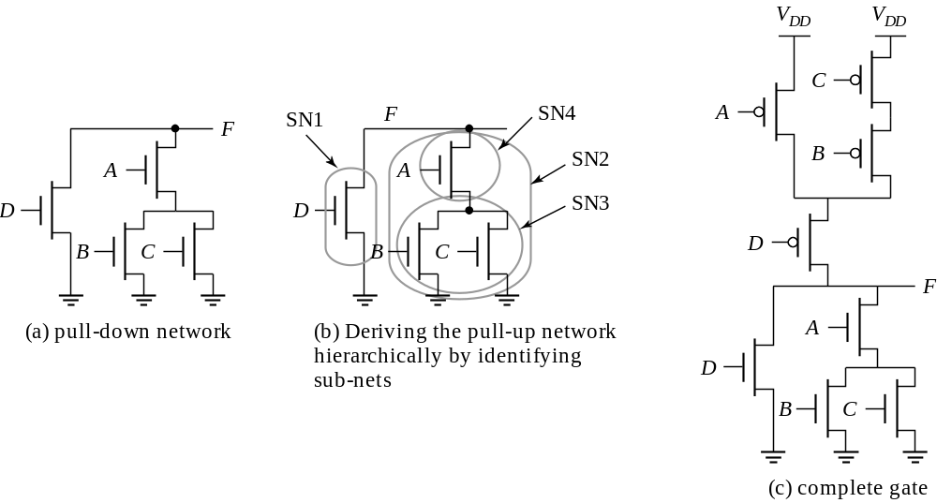
Constructing a Complex Gate

Slide 13
Cell Design
Standard Cells
  General purpose logic
  Can be synthesized
  Same height, varying width
Datapath Cells
  For regular, structured designs (arithmetic)
  Includes some wiring in the cell
  Fixed height and width

Slide 14
Standard Cell Layout Methodology – 1980s
Routing
channel
V_{DD}
signals
GND
Notes:
Contacts and wells not shown.
What does this implement??

Slide 15
Standard Cell Layout Methodology – 1990s
Mirrored Cell
No Routing
channels
V_{DD}
V_{DD}
M2
M3
GND
Mirrored Cell
GND
Notes:
Contacts and wells not shown.
What does this implement??

Slide 16
Standard Cells
N Well
Cell height 12 metal tracks
Metal track is approx. 3λ + 3λ
Pitch =
repetitive distance between objects
Cell height is “12 pitch”
V
DD
Out
2λ
In
Rails ~10λ
GND
Cell boundary

Slide 17
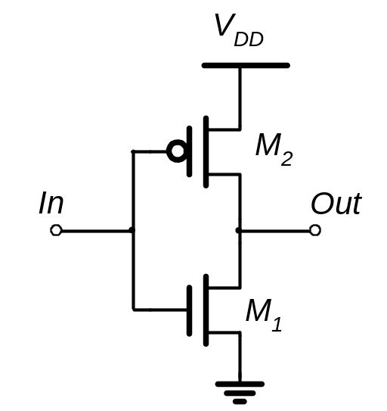
Standard Cells
With minimal
diffusion
routing
V
DD
With silicided
diffusion
V
DD
Out
In
Out
In
GND
GND

Slide 18
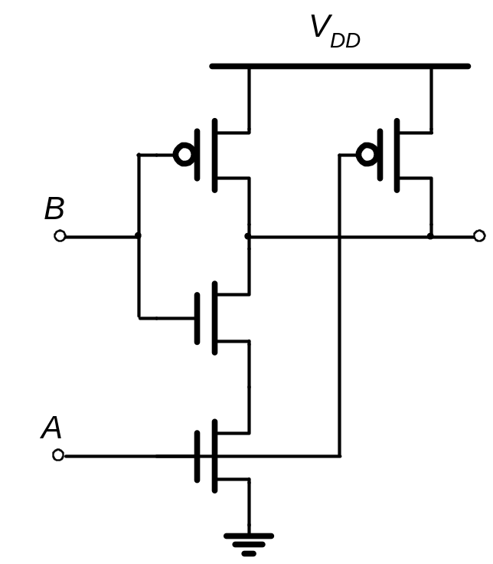
Standard Cells
V
2-input NAND gate
DD
A
B
Out
GND

Slide 19
Stick Diagrams
Contains no dimensions
Represents relative positions of transistors
V
DD
V
DD
Inverter
NAND2
Out
Out
In
A
B
GND
GND

Slide 20
Stick Diagrams
Logic Graph
X
A
PUN
j
C
B
C
X
i
V_{DD}
X = C • (A + B)
C
i
B
j
A
A
B
PDN
A
GND
B
C
Notes:
Systematic approach to derive order of input signal wires so gate can be laid out to minimize area
Note PUN and PDN are duals (parallel <-> series)
Vertices are nodes (signals) of circuit, VDD, X, GND and edges are transitions

Slide 21
Two Versions of C • (A + B)
A
C
B
A
B
C
V_{DD}
V_{DD}
X
X
GND
GND
Notes:
Line of diffusion layout – abutting source-drain connections
Note crossover eliminated by A B C ordering

Slide 22
Consistent Euler Path
X
C
X
i
V_{DD}
B
j
A
GND
A
B
C
Notes:
A path through all nodes in the graph such that each edge is visited once and only once.
The sequence of signals on the path is the signal ordering for the inputs.
PUN and PDN Euler paths are (must be) consistent (same sequence)
If you can define a Euler path then you can generate a layout with no diffusion breaks
A B C
C A B
B C A → no PDN
B A C
A C B -> no PDN
C B A

Slide 23
OAI22 Logic Graph
X
PUN
A
C
B
D
D
C
X
V_{DD}
X = (A+B)•(C+D)
C
D
B
A
A
B
PDN
A
GND
B
C
D

Slide 24
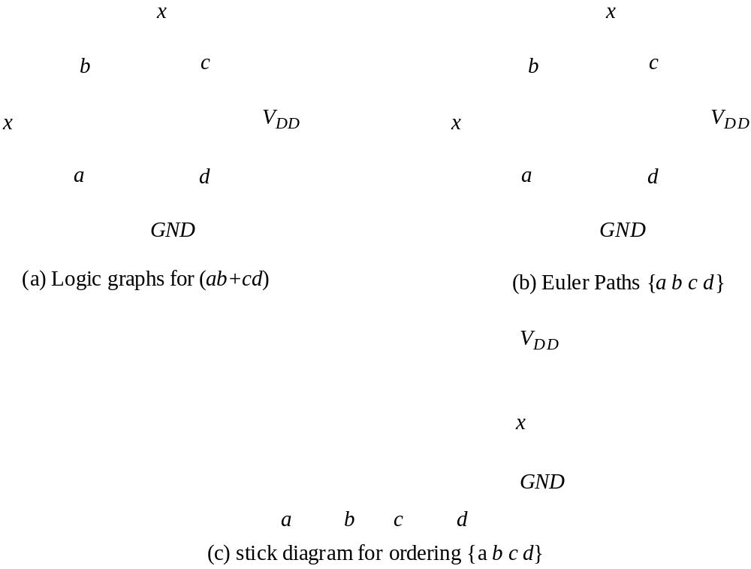
Example: x = ab+cd

Slide 25
Multi-Fingered Transistors
One finger
Two fingers (folded)
Less diffusion capacitance

Slide 26
Properties of Complementary CMOS Gates Snapshot
High noise margins
:
V
and
V
are at
V
and
GND
, respectively.
OH
OL
DD
No static power consumption
:
There never exists a direct path between
V
and
DD
V
(
GND
) in steady-state mode
.
SS
Comparable rise and fall times:
(under appropriate sizing conditions)

Slide 27
CMOS Properties
Full rail-to-rail swing; high noise margins
Logic levels not dependent upon the relative device sizes; ratioless
Always a path to Vdd or Gnd in steady state; low output impedance
Extremely high input resistance; nearly zero steady-state input current
No direct path steady state between power and ground; no static power dissipation
Propagation delay function of load capacitance and resistance of transistors

Slide 28
Switch Delay Model
A
R_{eq}
A
R_{p}
R_{p}
R_{p}
B
A
B
R_{p}
R_{p}
A
R_{p}
A
C_{int}
R_{n}
C_{L}
A
B
R_{n}
C_{L}
A
R_{n}
R_{n}
C_{L}
R_{n}
C_{int}
A
B
A
NOR2
NAND2
INV
Notes:
Note capacitance on the internal node – due to the source grain of the two fets in series and the overlap gate capacitances of the two fets in series

Slide 29
Input Pattern Effects on Delay
Delay is dependent on the pattern of inputs
Low to high transition
  both inputs go low
    delay is 0.69 R_{p}/2 C_{L}
  one input goes low
    delay is 0.69 R_{p} C_{L}
High to low transition
  both inputs go high
    delay is 0.69 2R_{n} C_{L}
R_{p}
R_{p}
A
B
R_{n}
C_{L}
B
R_{n}
C_{int}
A

Slide 30
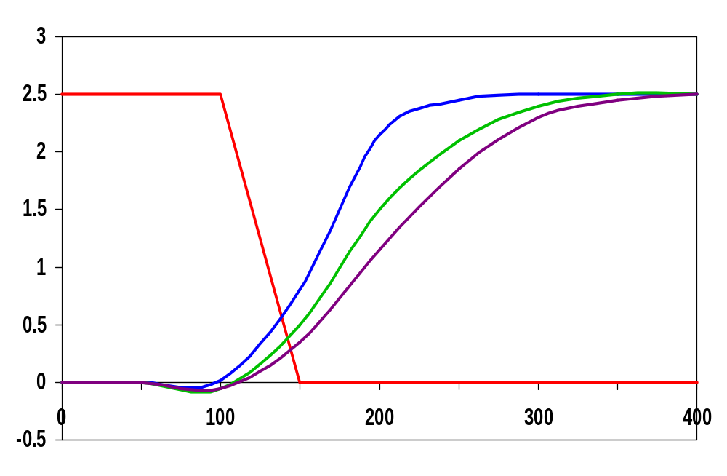
Delay Dependence on Input Patterns
Input Data Pattern | Delay (psec)
A=B=0→1 | 67
A=1, B=0→1 | 64
A= 0→1, B=1 | 61
A=B=1→0 | 45
A=1, B=1→0 | 80
A= 1→0, B=1 | 81
A=B=1→0
A=1 →0, B=1
Voltage [V]
A=1, B=1→0
time [ps]
NMOS = 0.5μm/0.25 μm
PMOS = 0.75μm/0.25 μm
C_{L} = 100 fF
Notes:
Gate sizing should result in approximately equal worst case rise and fall times.
Reason for difference in the last two delays is due to internal node capacitance of the pulldown stack. When A transitions, the pullup only has to charge CL; when A=1 and B transitions pullup have to charge up both CL and Cint.
For high to low transitions (first three cases) delay depends on state of internal node. Worst case happens when internal node is charged up to VDD – VTn.
Conclusions: Estimates of delay can be fairly complex – have to consider internal node capacitances and the data patterns.

Slide 31
Transistor Sizing
R_{p}
R_{p}
R_{p}
2
A
B
2
4
4
B
R_{n}
R_{p}
C_{int}
C_{L}
2
2
A
B
R_{n}
R_{n}
R_{n}
C_{L}
C_{int}
1
A
A
B
1
Notes:
Assumes Rp = Rn

Slide 32
Transistor Sizing a Complex CMOS Gate
B
8
6
A
4
3
C
8
6
D
4
6
OUT = D + A • (B + C)
A
2
D
1
B
2
C
2
Notes:
For class lecture.
Red sizing assuming Rp = Rn
Follow short path first; note PMOS for C and B 4 rather than 3 – average in pull-up chain of three – (4+4+2)/3 = 3
Also note structure of pull-up and pull-down to minimize diffusion cap at output (e.g., single PMOS drain connected to output)
Green for symmetric response and for performance (where Rn = 3 Rp)
Sizing rules of thumb
PMOS = 3 * NMOS
1 in series = 1
2 in series = 2
3 in series = 3
etc.

Slide 33
Fan-In Considerations
A
B
C
D
A
C_{L}
Distributed RC model
(Elmore delay)
t_{pHL} = 0.69 R_{eqn}(C₁+2C₂+3C₃+4C_{L})
Propagation delay deteriorates rapidly as a function of fan-in – quadratically in the worst case.
B
C₃
C
C₂
D
C₁
Notes:
While output capacitance makes full swing transition (from VDD to 0), internal nodes only transition from VDD-VTn to GND
C1, C2, C3 on the order of 0.85 fF for W/L of 0.5/0.25 NMOS and 0.375/0.25 PMOS
CL of 3.2 fF with no output load (all diffusion capacitance – intrinsic capacitance of the gate itself).
To give a 80.3 psec tpHL (simulated as 86 psec)

Slide 34
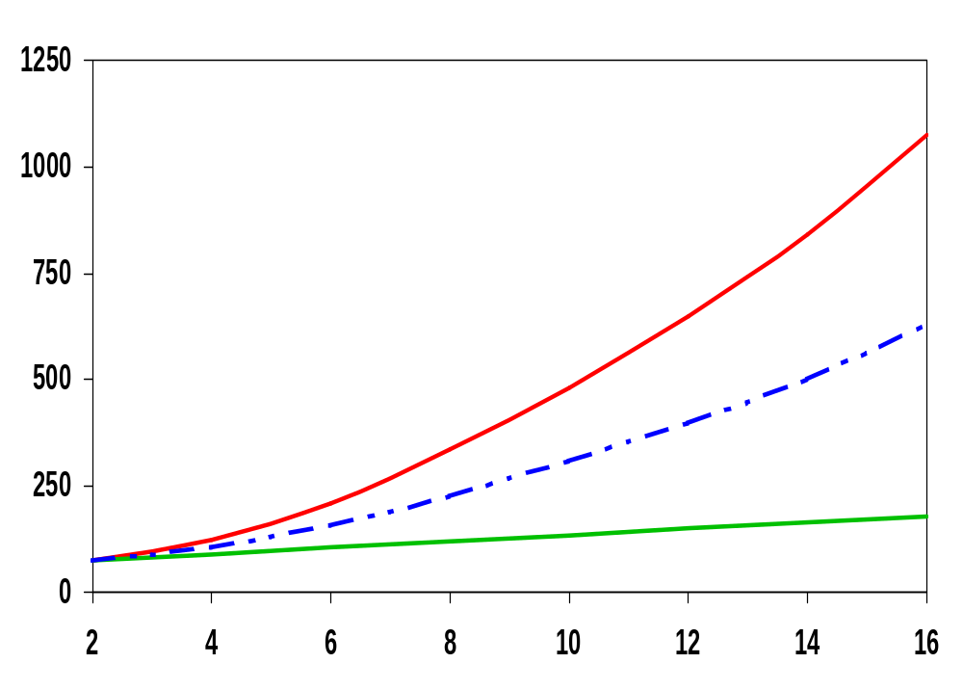
t_{p} as a Function of Fan-In
quadratic
Gates with a fan-in greater than 4 should be avoided.
t_{p} (psec)
t_{pHL}
t_{p}
t_{pLH}
linear
fan-in
Notes:
Fixed fan-out (NMOS 0.5 micrcon, PMOS 1.5 micron)
tpLH increases linearly due to the linearly increasing value of the diffusion capacitance
tpHL increase quadratically due to the simultaneous incrase in pull-down resistance and internal capacitance

Slide 35
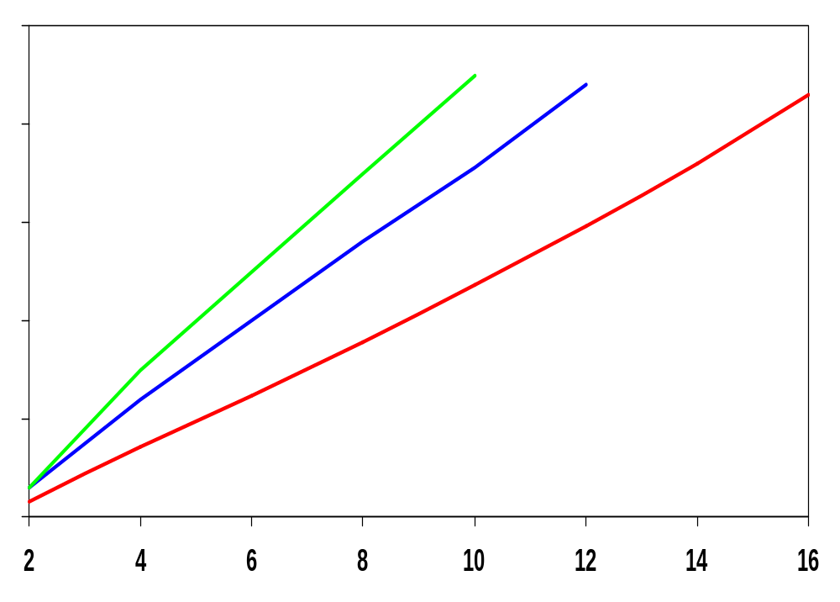
t_{p} as a Function of Fan-Out
All gates have the same drive current.
t_{p}NOR2
t_{p}NAND2
t_{p}INV
t_{p} (psec)
Slope is a function of “driving strength”
eff. fan-out
Notes:
slope is a function of the driving strength

Slide 36
t_{p} as a Function of Fan-In and Fan-Out
Fan-in: quadratic due to increasing resistance and capacitance
Fan-out: each additional fan-out gate adds two gate capacitances to C_{L}
t_{p} = a₁FI + a₂FI² + a₃FO
Notes:
a1 term is for parallel chain, a2 term is for serial chain, a3 is fan-out

Slide 37
Fast Complex Gates:
Design Technique 1
Transistor sizing
  as long as fan-out capacitance dominates
Progressive sizing
Distributed RC line
M1 > M2 > M3 > … > MN
(the fet closest to the
output is the smallest)
In_{N}
MN
C_{L}
In₃
M3
C₃
In₂
M2
C₂
Can reduce delay by more than 20%; decreasing gains as technology shrinks
In₁
M1
C₁
Notes:
M1 have to carry the discharge current from M2, M3, … MN and CL so make it the largest
MN only has to discharge the current from MN (no internal capacitances)

Slide 38
Fast Complex Gates:
Design Technique 2
Transistor ordering
critical path
critical path
charged
0→1
charged
In₃
1
C_{L}
In₁
M3
C_{L}
M3
1
In₂
1
In₂
M2
C₂
charged
M2
C₂
discharged
In₃
1
discharged
In₁
M1
C₁
charged
M1
C₁
0→1
delay determined by time to discharge C_{L}, C₁ and C₂
delay determined by time to discharge C_{L}
Notes:
For lecture.
Critical input is latest arriving signal
Place latest arriving signal (critical path) closest to the output

Slide 39
Fast Complex Gates:
Design Technique 3
Alternative logic structures
F = ABCDEFGH
Notes:
Reduced fan-in -> deeper logic depth
Reduction in fan-in offsets, by far, the extra delay incurred by the NOR gate (second configuration).
Only simulation will tell which of the last two configurations is faster, lower power

Slide 40
Fast Complex Gates:
Design Technique 4
Isolating fan-in from fan-out using buffer insertion
C_{L}
C_{L}
Notes:
Reduce CL on large fan-in gates, especially for large CL, and size the inverters progressively to handle the CL more effectively

Slide 41
Fast Complex Gates:
Design Technique 5
Reducing the voltage swing
  linear reduction in delay
  also reduces power consumption
But the following gate is much slower!
Or requires use of “sense amplifiers” on the receiving end to restore the signal level (memory design)
t_{pHL} = 0.69 (3/4 (C_{L} V_{DD})/ I_{DSATn} )
= 0.69 (3/4 (C_{L} V_{swing})/ I_{DSATn} )

Slide 42
Sizing Logic Paths for Speed
Frequently, input capacitance of a logic path is constrained
Logic also has to drive some capacitance
Example: ALU load in an Intel’s microprocessor is 0.5pF
How do we size the ALU datapath to achieve maximum speed?
We have already solved this for the inverter chain – can we generalize it for any type of logic?

Slide 43
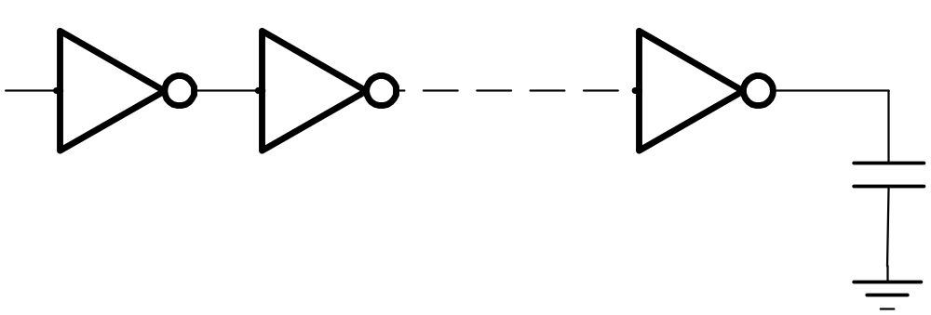
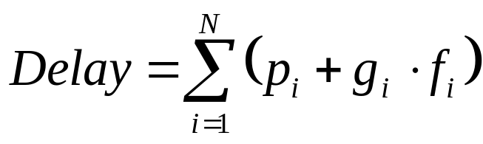
Buffer Example
In
Out
1
2
N
C_{L}
(in units of τ_{inv})
For given N: C_{i+1}/C_{i} = C_{i}/C_{i-1}
To find N: C_{i+1}/C_{i} ~ 4
How to generalize this to any logic path?

Slide 44
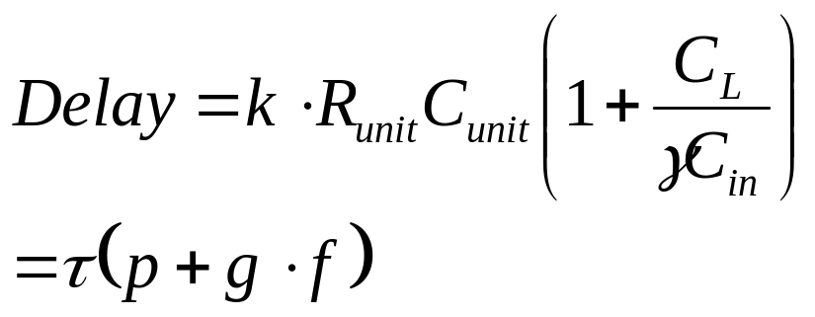
Logical Effort
p – intrinsic delay (3kR_{unit}C_{unit}γ) - gate parameter ≠ f(W)
g – logical effort (kR_{unit}C_{unit}) – gate parameter ≠ f(W)
f – effective fanout
Normalize everything to an inverter:
g_{inv} =1, p_{inv} = 1
Divide everything by τ_{inv}
(everything is measured in unit delays τ_{inv})
Assume γ = 1.

Slide 45
Delay in a Logic Gate
Gate delay:
d = h + p
effort delay
intrinsic delay
Effort delay:
h = g f
logical effort
effective fanout = C_{out}/C_{in}
Logical effort is a function of topology, independent of sizing
Effective fanout (electrical effort) is a function of load/gate size

Slide 46
Logical Effort
Inverter has the smallest logical effort and intrinsic delay of all static CMOS gates
Logical effort of a gate presents the ratio of its input capacitance to the inverter capacitance when sized to deliver the same current
Logical effort increases with the gate complexity

Slide 47
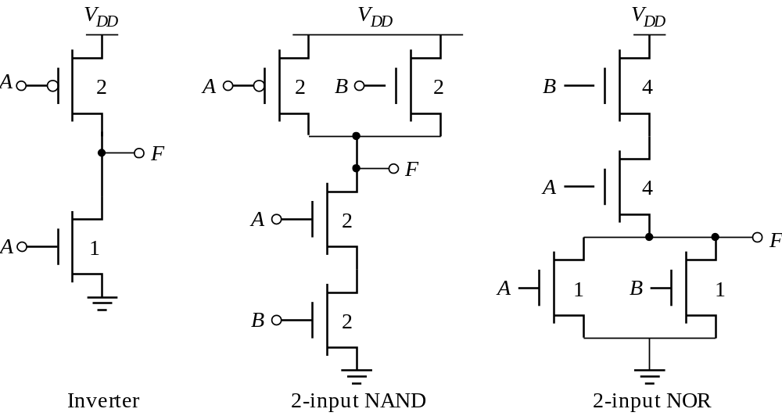
Logical Effort
Logical effort is the ratio of input capacitance of a gate to the input
capacitance of an inverter with the same output current
g = 1
g = 4/3
g = 5/3

Slide 48
Logical Effort of Gates
t
pNAND
g =
p =
d =
t
pINV
Normalized delay (d)
g =
p =
d =
F(Fan-in)
1
2
3
4
5
6
7
Fan-out (h)

Slide 49
Logical Effort of Gates
t
pNAND
g = 4/3
p = 2
d = (4/3)h+2
t
pINV
Normalized delay (d)
g = 1
p = 1
d = h+1
F(Fan-in)
1
2
3
4
5
6
7
Fan-out (h)

Slide 50
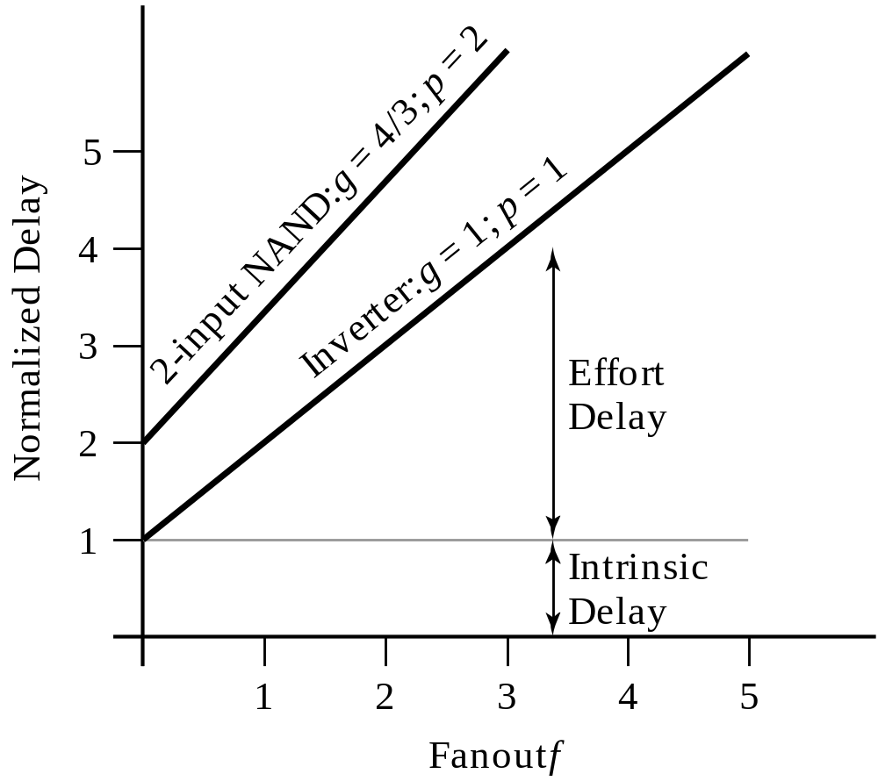
Logical Effort of Gates

Slide 51
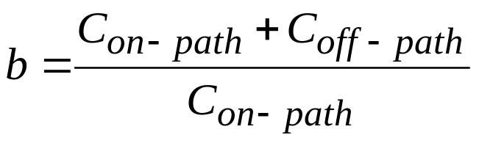
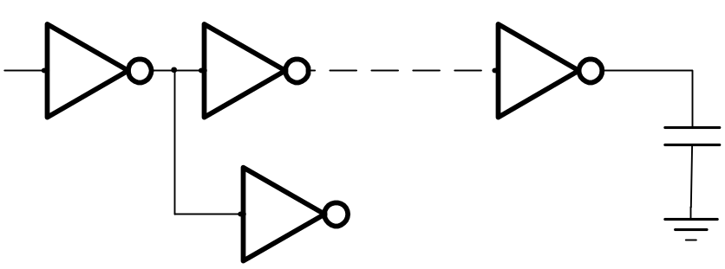
Add Branching Effort
Branching effort:

Slide 52
Multistage Networks
Stage effort: h_{i} = g_{i}f_{i}
Path electrical effort: F = C_{out}/C_{in}
Path logical effort: G = g₁g₂…g_{N}
Branching effort: B = b₁b₂…b_{N}
Path effort: H = GFB
Path delay D = Σd_{i} = Σp_{i} + Σh_{i}

Slide 53

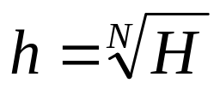
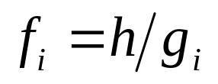
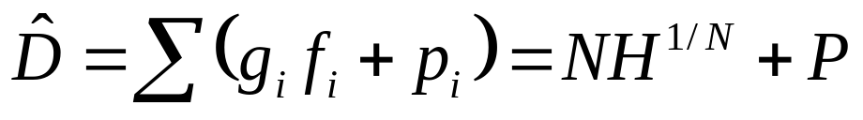
Optimum Effort per Stage
When each stage bears the same effort:
Stage efforts: g₁f₁ = g₂f₂ = … = g_{N}f_{N}
Effective fanout of each stage:
Minimum path delay

Slide 54
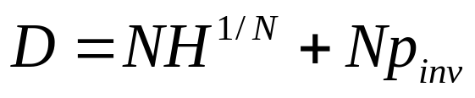
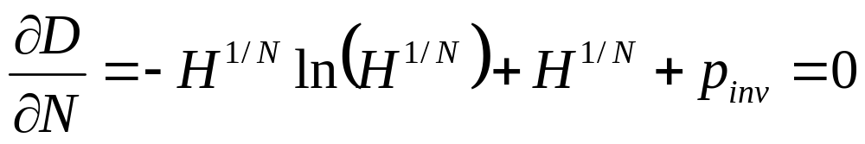
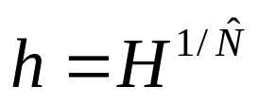
Optimal Number of Stages
For a given load,
and given input capacitance of the first gate
Find optimal number of stages and optimal sizing
Substitute ‘best stage effort’

Slide 55
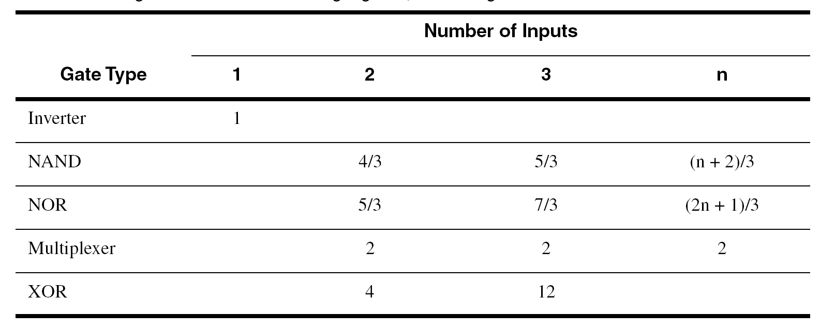
Logical Effort
From Sutherland, Sproull

Slide 56
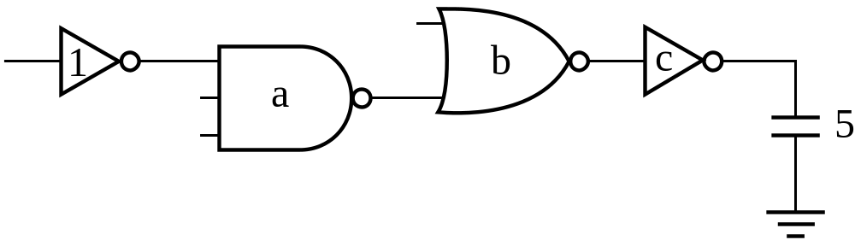
Example: Optimize Path
g = 1
f = a
g = 5/3
f = b/a
g = 5/3
f = c/b
g = 1
f = 5/c
Effective fanout, F =
G =
H =
h =
a =
b =

Slide 57
Example: Optimize Path
g = 1
f = a
g = 5/3
f = b/a
g = 5/3
f = c/b
g = 1
f = 5/c
Effective fanout, F = 5
G = 25/9
H = 125/9 = 13.9
h = 1.93
a = 1.93
b = ha/g₂ = 2.23
c = hb/g₃ = 5g₄/f = 2.59

Slide 58
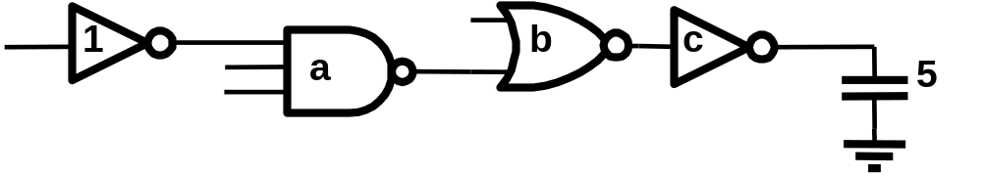
Example: Optimize Path
g₁ = 1
g₂ = 5/3
g₃ = 5/3
g₄ = 1
Effective fanout, H = 5
G = 25/9
F = 125/9 = 13.9
f = 1.93
a = 1.93
b = fa/g₂ = 2.23
c = fb/g₃ = 5g₄/f = 2.59

Slide 59
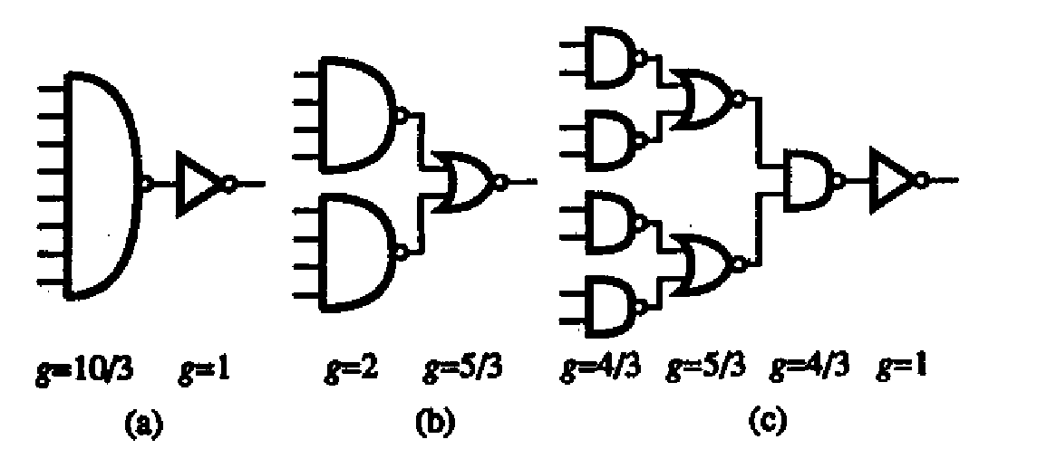
Example – 8-input AND

Slide 60
Method of Logical Effort
Compute the path effort: F = GBH
Find the best number of stages N ~ log₄F
Compute the stage effort f = F^{1/N}
Sketch the path with this number of stages
Work either from either end, find sizes:
C_{in} = C_{out}*g/f
Reference: Sutherland, Sproull, Harris, “Logical Effort, Morgan-Kaufmann 1999.

Slide 61
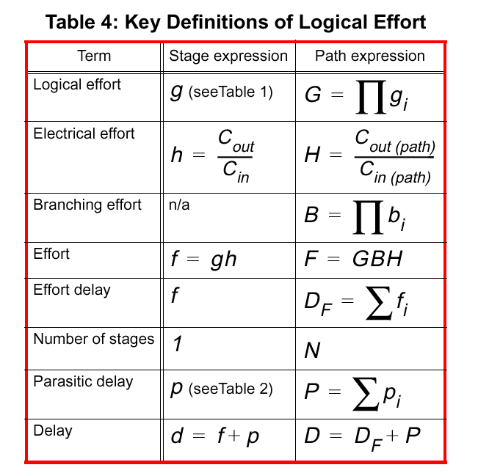
Summary
Sutherland,
Sproull
Harris

Slide 62
Ratioed Logic

Slide 63
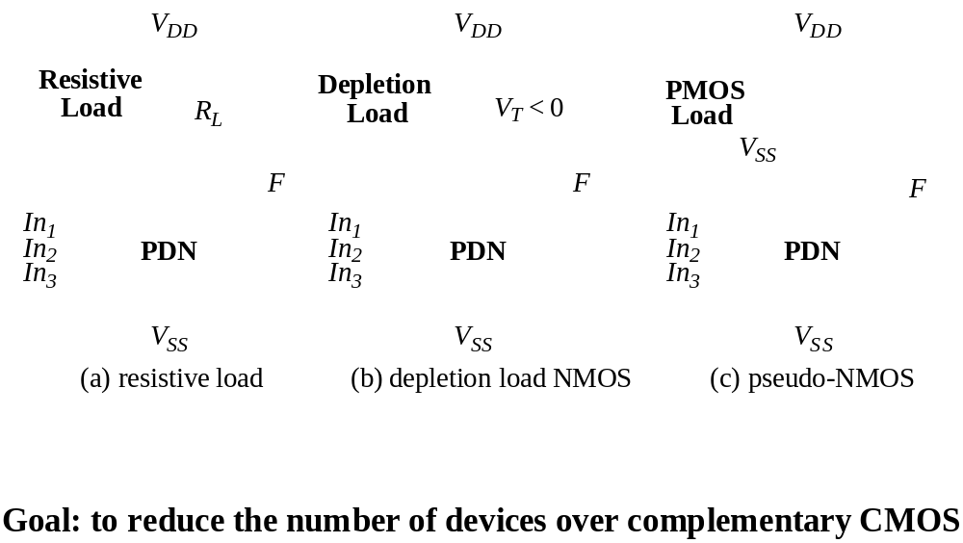
Ratioed Logic

Slide 64
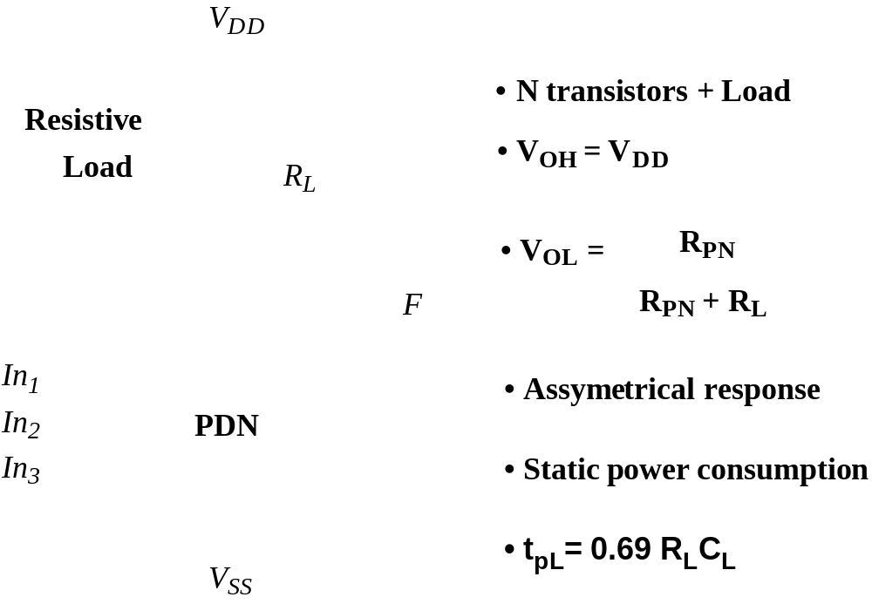
Ratioed Logic

Slide 65
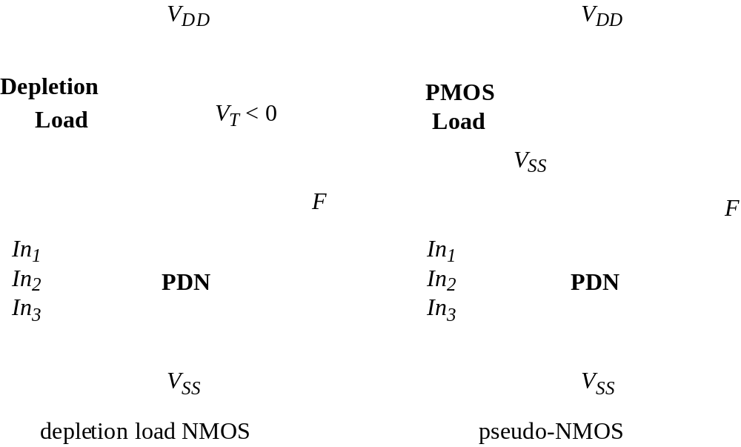
Active Loads

Slide 66
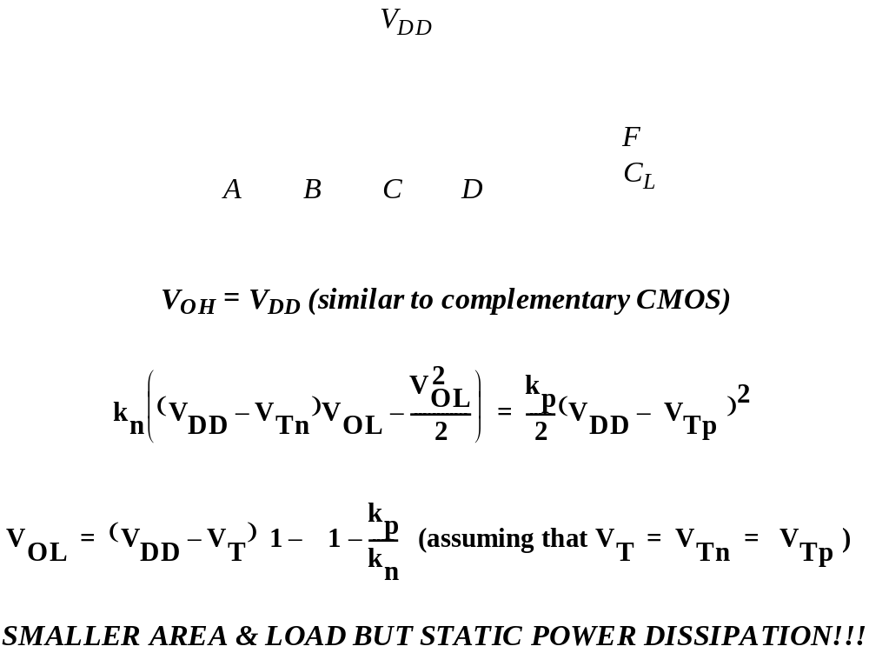
Pseudo-NMOS

Slide 67
Pseudo-NMOS VTC
3.0
2.5
2.0
W/L
p
= 4
[V]
1.5
t
W/L
= 2
u
p
V
o
1.0
W/L
p
= 0.5
W/L
= 1
0.5
p
W/L
p
= 0.25
0.0
0.0
0.5
1.0
1.5
2.0
2.5
V
in
[V]

Slide 68
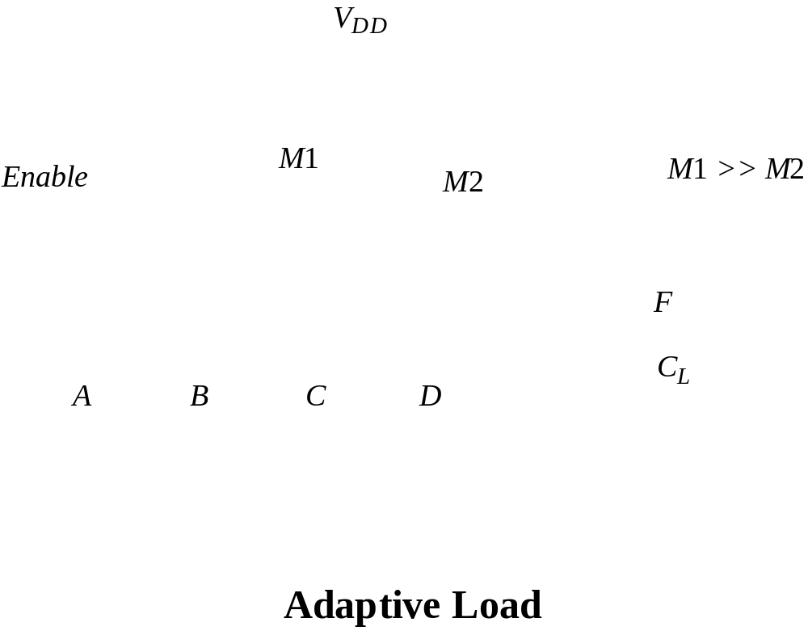
Improved Loads

Slide 69
Improved Loads (2)
V
DD
V
DD
M1
M2
Out
Out
A
A
PDN1
PDN2
B
B
V
SS
V
SS
Differential Cascode Voltage Switch Logic (DCVSL)

Slide 70
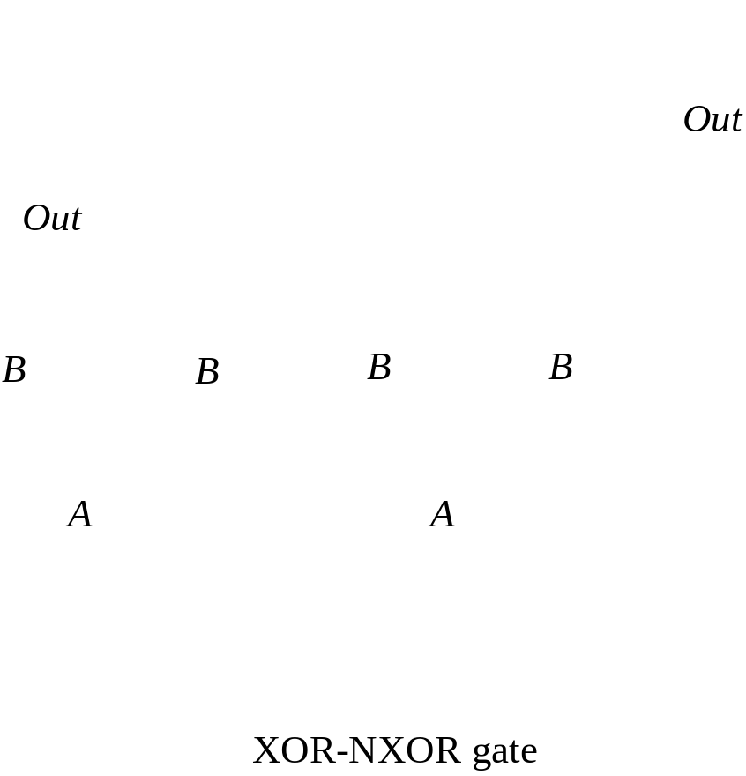
DCVSL Example

Slide 71
DCVSL Transient Response
2.5
A B
[V]
1.5
e
A B
g
a
t
l
o
A
,
B
V
0.5
A,B
-0.5
0
0.2
0.4
0.6
0.8
1.0
Time [ns]

Slide 72
Pass-Transistor
Logic

Slide 73
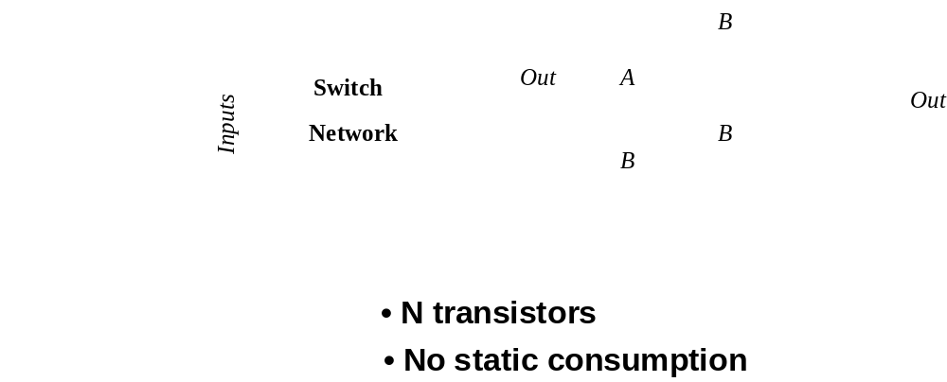
Pass-Transistor Logic

Slide 74
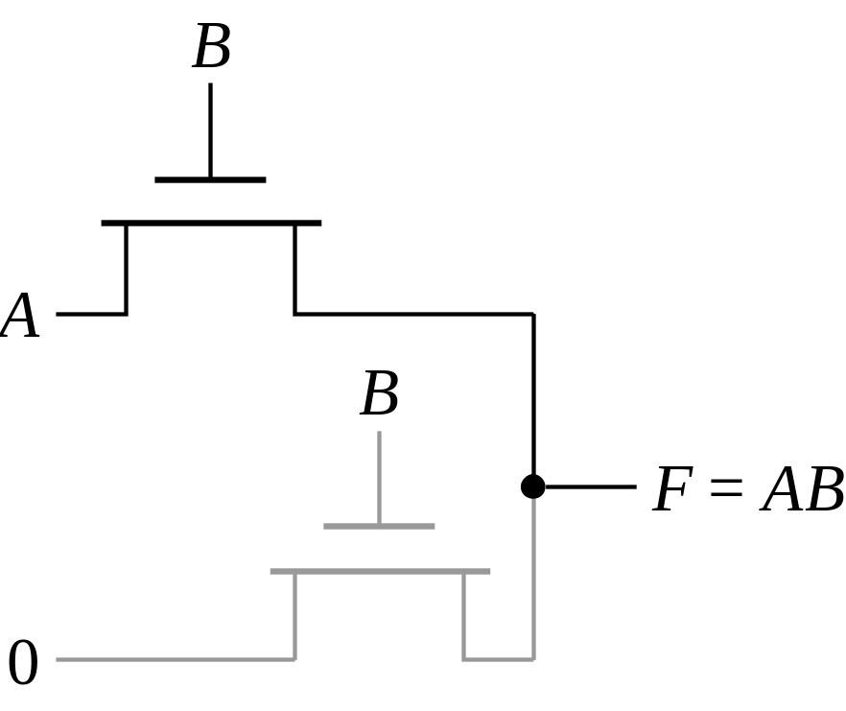
Example: AND Gate

Slide 75
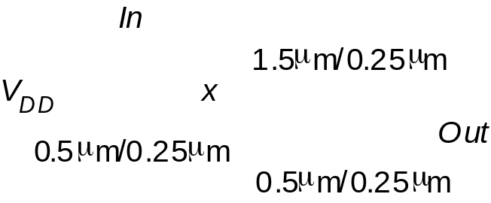
NMOS-Only Logic
3.0
In
Out
[V]
2.0
x
e
g
a
t
l
o
V
1.0
0.0
0
0.5
1
1.5
2
Time [ns]

Slide 76
NMOS-only Switch
C =
2.5
V
C =
2.5 V
M
2
A =
2.5 V
A =
2.5 V
B
B
M
n
C
M
1
L
V
B
does not pull up to 2.5V, but 2.5V -
V
TN
Threshold voltage loss causes
static power consumption
NMOS has higher threshold than PMOS (body effect)

Slide 77
NMOS Only Logic:
Level Restoring Transistor
V
DD
Level Restorer
V
DD
M
r
B
M
2
X
A
M
n
Out
M
1
• Advantage: Full Swing
• Restorer adds capacitance, takes away pull down current at X
• Ratio problem

Slide 78
Restorer Sizing
3.0
Upper limit on restorer size
Pass-transistor pull-down
can have several transistors in
stack
[V]
2.0
W
/
L
=1.75/0.25
r
e
W
/
L
=1.50/0.25
g
r
a
t
l
o
V
1.0
W
/
L
=1.0/0.25
W
/
L
r
=1.25/0.25
r
0.0
0
100
200
300
400
500
Time [ps]

Slide 79
Solution 2: Single Transistor Pass Gate with V_{T}=0
V
DD
V
DD
0V
2.5V
V
0V
Out
DD
2.5V
WATCH OUT FOR LEAKAGE CURRENTS

Slide 80
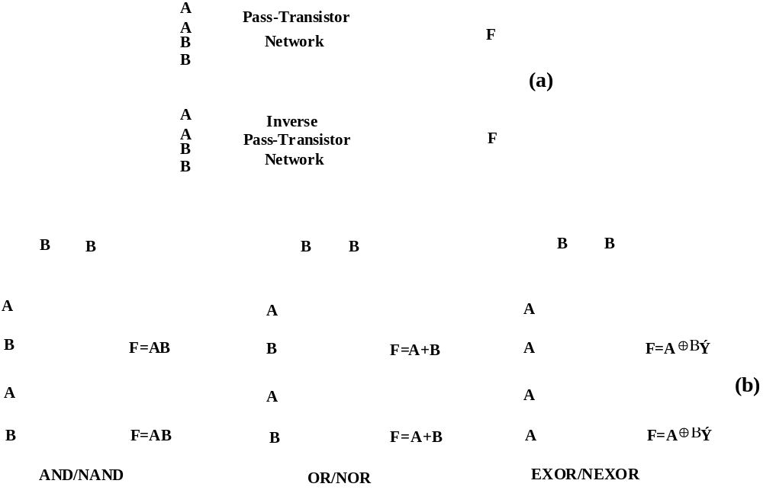
Complementary Pass Transistor Logic

Slide 81
Solution 3: Transmission Gate
C
C
A
B
A
B
C
C
C =
2.5 V
A =
2.5 V
B
C
L
C
= 0 V

Slide 82
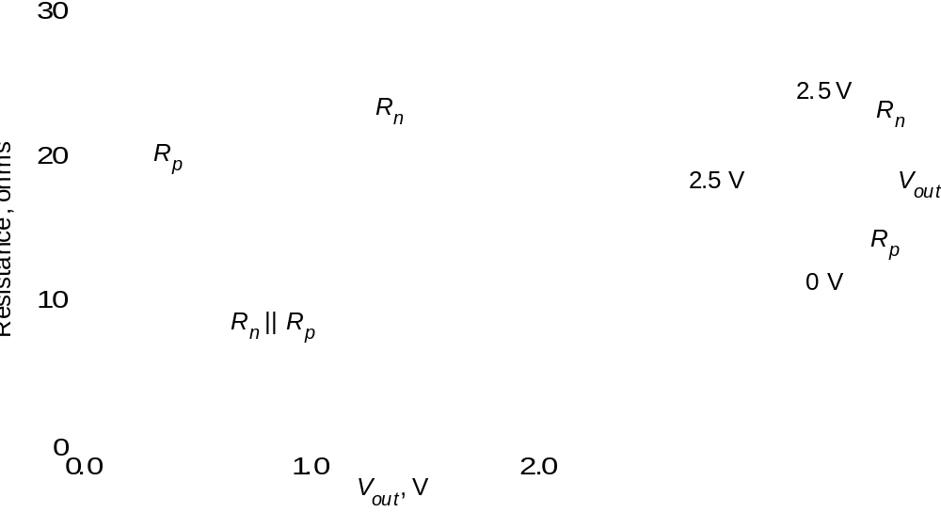
Resistance of Transmission Gate

Slide 83
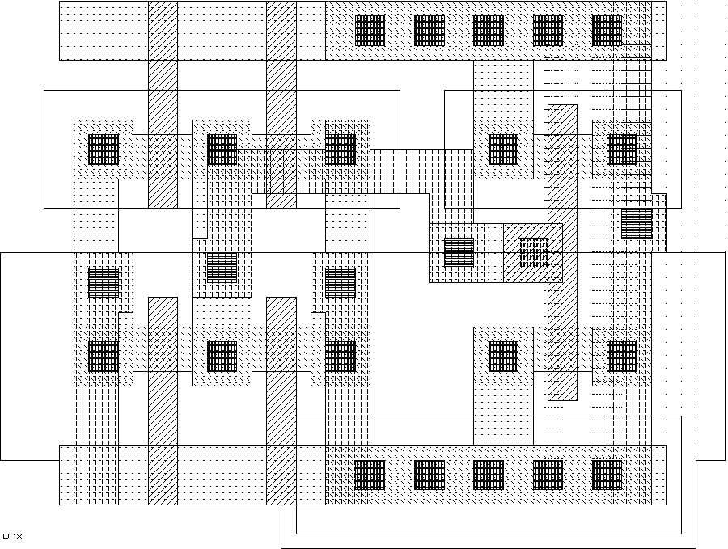
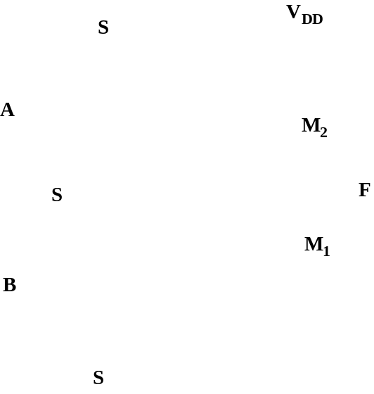
Pass-Transistor Based Multiplexer
S
S
V_{DD}
GND
In₁
S
S
In₂

Slide 84
Transmission Gate XOR
B
B
M2
A
A
F
M1
M3/M4
B
B

Slide 85
Delay in Transmission Gate Networks
2.5
2.5
2.5
2.5
In
V
1
V
i-1
V
i
V
i+1
V
n-1
V
n
0
C
0
C
0
C
C
0
C
(a)
R
eq
V
R
eq
V
R
eq
V
V
R
eq
V
In
1
i
i+1
n-1
n
C
C
C
C
C
(b)
m
R
eq
R
eq
R
eq
R
eq
R
eq
R
eq
In
C
C
C
C
C
C
C
C
(c)

Slide 86
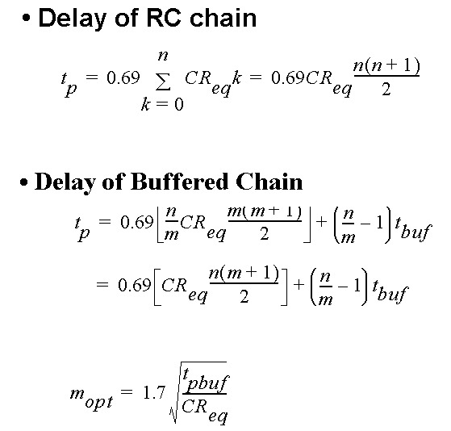
Delay Optimization

Slide 87
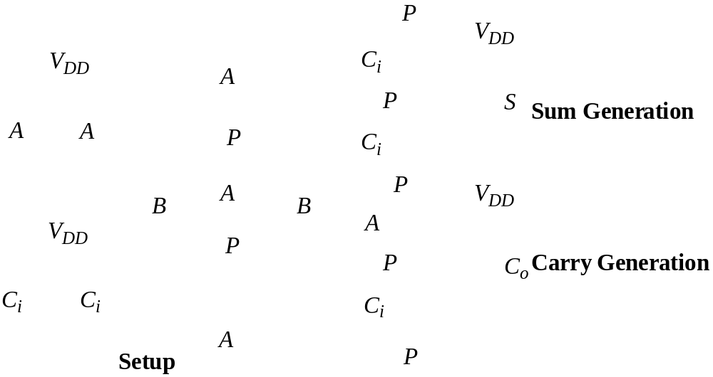
Transmission Gate Full Adder
Similar delays for sum and carry

Slide 88
Dynamic Logic

Slide 89
Dynamic CMOS
In static circuits at every point in time (except when switching) the output is connected to either GND or V_{DD} via a low resistance path.
  fan-in of n requires 2n (n N-type + n P-type) devices
Dynamic circuits rely on the temporary storage of signal values on the capacitance of high impedance nodes.
  requires on n + 2 (n+1 N-type + 1 P-type) transistors

Slide 90
Dynamic Gate
Clk
M_{p}
Clk
M_{p}
Out
Out
In₁
C_{L}
A
In₂
PDN
C
In₃
B
Clk
M_{e}
Clk
M_{e}
Two phase operation
Precharge (CLK = 0)
Evaluate (CLK = 1)
Notes:
For class handout

Slide 91
Dynamic Gate
off
Clk
M_{p}
Clk
M_{p}
on
1
Out
Out
In₁
C_{L}
((AB)+C)
A
In₂
PDN
C
In₃
B
Clk
M_{e}
off
Clk
M_{e}
on
Two phase operation
Precharge (Clk = 0)
Evaluate (Clk = 1)
Notes:
For lecture
Evaluate transistor, Me, eliminates static power consumption

Slide 92
Conditions on Output
Once the output of a dynamic gate is discharged, it cannot be charged again until the next precharge operation.
Inputs to the gate can make at most one transition during evaluation.
Output can be in the high impedance state during and after evaluation (PDN off), state is stored on C_{L}
Notes:
This behavior is fundamentally different than the static counterpart that always has a low resistance path between the output and one of the power rails.

Slide 93
Properties of Dynamic Gates
Logic function is implemented by the PDN only
  number of transistors is N + 2 (versus 2N for static complementary CMOS)
Full swing outputs (V_{OL} = GND and V_{OH} = V_{DD})
Non-ratioed - sizing of the devices does not affect the logic levels
Faster switching speeds
  reduced load capacitance due to lower input capacitance (C_{in})
  reduced load capacitance due to smaller output loading (Cout)
  no I_{sc}, so all the current provided by PDN goes into discharging C_{L}
Notes:
CL being lower also contributes to power savings

Slide 94
Properties of Dynamic Gates
Overall power dissipation usually higher than static CMOS
  no static current path ever exists between V_{DD} and GND (including P_{sc})
  no glitching
  higher transition probabilities
  extra load on Clk
PDN starts to work as soon as the input signals exceed V_{Tn}, so V_{M}, V_{IH} and V_{IL} equal to V_{Tn}
  low noise margin (NM_{L})
Needs a precharge/evaluate clock

Slide 95
Issues in Dynamic Design 1: Charge Leakage
CLK
Clk
M_{p}
Out
A
C_{L}
V_{Out}
Evaluate
Clk
M_{e}
Precharge
Leakage sources
Dominant component is subthreshold current
Notes:
leakage sources are reverse-biased diode and the sub-threshold leakage of the NMOS pulldown device.
Charge stored on CL will leak away with time (input in low state during evaluation)
Requires a minimum clock rate - so not good for low performance products such as watches (or when have conditional clocks)
PMOS precharge device also contributes some leakage due to reverse bias diode and subthreshold conduction that, to some extent, offsets the leakage due to the pull down paths.

Slide 96
Solution to Charge Leakage
Keeper
Clk
M_{p}
M_{kp}
A
Out
C_{L}
B
Clk
M_{e}
Same approach as level restorer for pass-transistor logic
Notes:
During precharge, Out is VDD and inverter out is GND, so keeper is on
During evaluation if PDN is off, the keeper compensates for drained charge due to leakage.
If PDN is on, there is a fight between the PDN and the PUN - circuit is ratioed so PDN wins, eventually
Note Psc during switching period when PDN and keeper are both on simultaneously

Slide 97
Issues in Dynamic Design 2: Charge Sharing
Charge stored originally on C_{L} is redistributed (shared) over C_{L} and C_{A} leading to reduced robustness
Clk
M_{p}
Out
A
C_{L}
B=0
C_{A}
Clk
M_{e}
C_{B}
Notes:
CA initially discharged and CL fully charged.

Slide 98
Charge Sharing Example
Clk
Out
A
A
C_{L}=50fF
C_{a}=15fF
B
B
B
!B
C_{b}=15fF
C_{c}=15fF
C
C
C_{d}=10fF
Clk
Notes:
Out = A xor B xor C
What is the worst case change in voltage on node Out - assume all inputs are low during precharge and all internal capacitances are initially 0V
Worst case is obtained by exposing the maximum amount of internal capacitance to the output node during evaluation. This happens when !A B C or A !B C
30/(30+50) * 2.5 V = 0.94 V so the output drops to 2.5 - 0.94 = 1.56 V

Slide 99
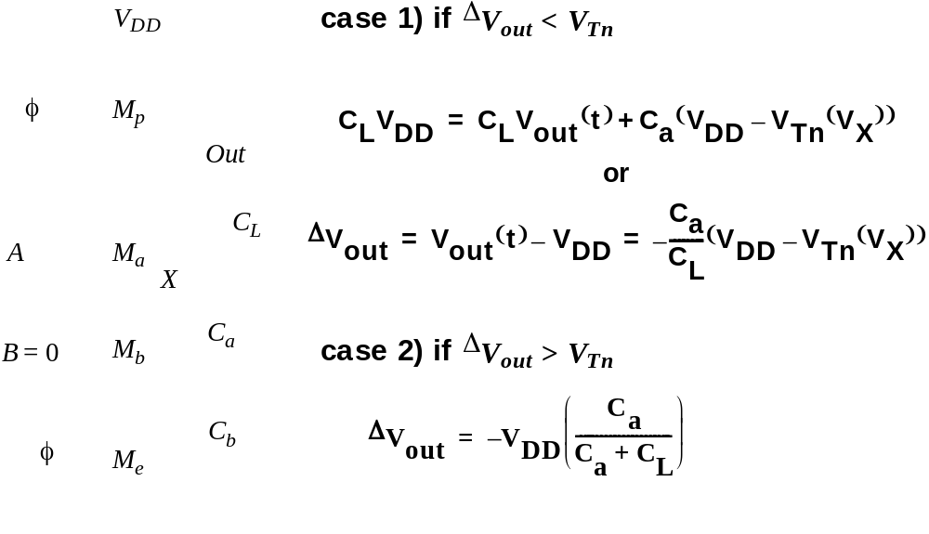
Charge Sharing
V
DD
Clk
M
p
Out
C
L
A
M
a
X
C
a
B
=
0
M
b
C
b
Clk
M
e

Slide 100
Solution to Charge Redistribution
Clk
M_{p}
M_{kp}
Clk
Out
A
B
Clk
M_{e}
Precharge internal nodes using a clock-driven transistor (at the cost of increased area and power)

Slide 101
Issues in Dynamic Design 3: Backgate Coupling
Clk
M_{p}
Out1
=1
Out2
=0
A=0
In
C_{L1}
C_{L2}
B=0
Clk
M_{e}
Dynamic NAND
Static NAND
Notes:
Due to capacitive backgate coupling between the internal and output node of the static gate and the output of the dynamic gate, Out1 voltage reduces

Slide 102
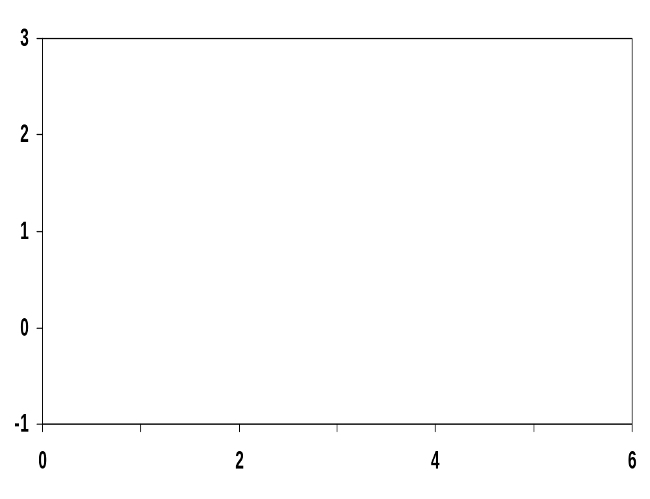
Backgate Coupling Effect
Out1
Voltage
Clk
In
Out2
Time, ns
Notes:
Out1 overshoots Vdd (2.5V) due to clock feedthrough
And Out2 never quite makes it to GND

Slide 103
Issues in Dynamic Design 4: Clock Feedthrough
Coupling between Out and Clk input of the precharge device due to the gate to drain capacitance. So voltage of Out can rise above V_{DD}. The fast rising (and falling edges) of the clock couple to Out.
Clk
M_{p}
Out
A
C_{L}
B
Clk
M_{e}
Notes:
Danger is that signal levels can rise enough above VDD that the normally reverse-biased junction diodes become forward-biased causing electrons to be injected into the substrate.

Slide 104
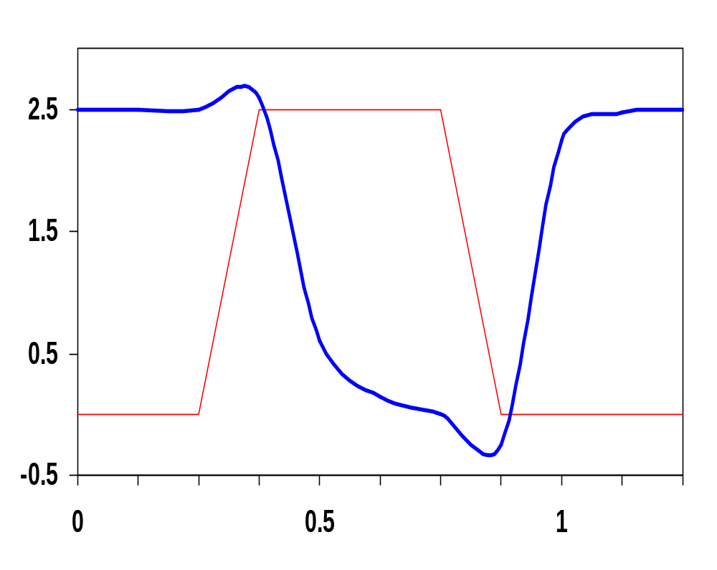
Clock Feedthrough
Clock feedthrough
Clk
Out
In₁
In₂
In₃
Voltage
In &
Clk
In₄
Out
Clk
Time, ns
Clock feedthrough

Slide 105
Other Effects
Capacitive coupling
Substrate coupling
Minority charge injection
Supply noise (ground bounce)

Slide 106
Cascading Dynamic Gates
V
Clk
Clk
Clk
M_{p}
M_{p}
Out2
Out1
In
In
Clk
Clk
V_{Tn}
M_{e}
M_{e}
Out1
ΔV
Out2
t
Only 0 → 1 transitions allowed at inputs!
Notes:
Out2 should remain at VDD since Out1 transitions to 0 during evaluation. However, since there is a finite propagation delay for the input to discharge Out1 to GND, the second output also starts to discharge.
The second dynamic inverter turns off (PDN) when Out1 reaches VTn.
Setting all inputs of the second gate to 0 during precharge will fix it.
Correct operation is guaranteed (ignoring charge redistribution and leakage) as long as the inputs can only make a single 0 -> 1 transition during the evaluation period

Slide 107
Domino Logic
Clk
M_{p}
Clk
M_{p}
M_{kp}
Out1
Out2
1 → 1
1 → 0
0 → 0
0 → 1
In₁
In₂
PDN
In₄
PDN
In₃
In₅
Clk
M_{e}
Clk
M_{e}
Notes:
Ensures all inputs to the Domino gate are set to 0 at the end of the precharge period. Hence, the only possible transition during evaluation is 0 -> 1

Slide 108
Why Domino?
Clk
In_{i}
PDN
In_{i}
PDN
In_{i}
PDN
In_{i}
PDN
In_{j}
In_{j}
In_{j}
In_{j}
Clk
Like falling dominos!

Slide 109
Properties of Domino Logic
Only non-inverting logic can be implemented
Very high speed
  static inverter can be skewed, only L-H transition
  Input capacitance reduced – smaller logical effort
Notes:
First 32 bit micro (BellMAC 32) was designed in Domino logic
Now a rather rare design style due to non-inverting logic only

Slide 110
Designing with Domino Logic
V
DD
V
DD
V
DD
Clk
M
p
Clk
M
p
M
r
Out1
Out2
In
1
In
2
PDN
In
PDN
4
In
3
Can be eliminated!
Clk
M
e
Clk
M
e
Inputs = 0
during precharge

Slide 111
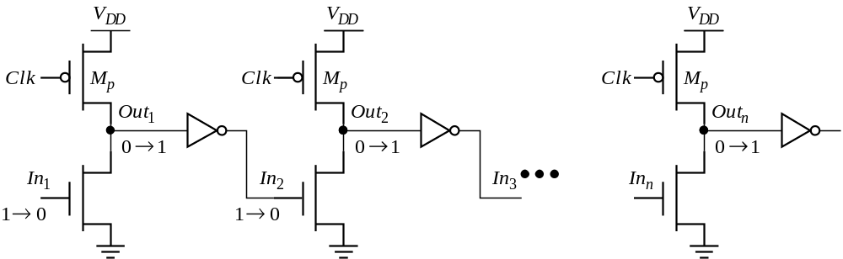
Footless Domino
The first gate in the chain needs a foot switch
Precharge is rippling – short-circuit current
A solution is to delay the clock for each stage

Slide 112
Differential (Dual Rail) Domino
off
on
Clk
M_{p}
M_{kp}
M_{kp}
M_{p}
Clk
Out = AB
Out = AB
1 0
1 0
A
!A
!B
B
Clk
M_{e}
Solves the problem of non-inverting logic
Notes:
AND/NAND differential logic gate. The inputs and their complements come from other differential DR gates and thus all inputs are low during precharge and make a conditional transition from 0 to 1.
Annotations show state during evaluate cycle (CLK = 1)
Expensive - but can implement any arbitrary function.
Use significant power since they have a guaranteed transition every single clock cycle (regardless of signal statistics, since either Out or !Out will transition from 0 to 1).
Not ratioed (even though have a cross-coupled PMOS pair)

Slide 113
np-CMOS
Clk
M_{p}
Clk
M_{e}
Out1
1 → 1
1 → 0
In₁
In₄
PUN
In₂
PDN
In₅
In₃
0 → 0
0 → 1
Out2
(to PDN)
Clk
M_{e}
Clk
M_{p}
Only 0 → 1 transitions allowed at inputs of PDN Only 1 → 0 transitions allowed at inputs of PUN
Notes:
Also called zipper logic - In4 and In5 must be from PDN’s
DEC alpha uses np-CMOS logic (Dobberpuhl)
Have to size the PUN’s to equalize the delay to that of the PDN’s
Really dense layouts and very high speed (20% faster than domino with the correct sizing)
Reduced noise margin (as with any dynamic gate)
Have two clock signals to generate and route - CLK and !CLK

Slide 114
NORA Logic
Clk
M_{p}
Clk
M_{e}
Out1
1 → 1
1 → 0
In₁
In₄
PUN
In₂
PDN
In₅
In₃
0 → 0
0 → 1
Out2
(to PDN)
Clk
M_{e}
Clk
M_{p}
to other
PDN’s
to other
PUN’s
WARNING: Very sensitive to noise!
Notes:
NORA - no race CMOS

