Slide 1

Digital Integrated Circuits
A Design Perspective
Jan M. Rabaey
Anantha Chandrakasan
Borivoje Nikolic
Coping with
Interconnect
December 15, 2002

Slide 2
Impact of Interconnect Parasitics
• Reduce Robustness
• Affect Performance
  Increase delay
  Increase power dissipation
Classes of Parasitics
• Capacitive
• Resistive
• Inductive

Slide 3
INTERCONNECT
Dealing with Capacitance

Slide 4
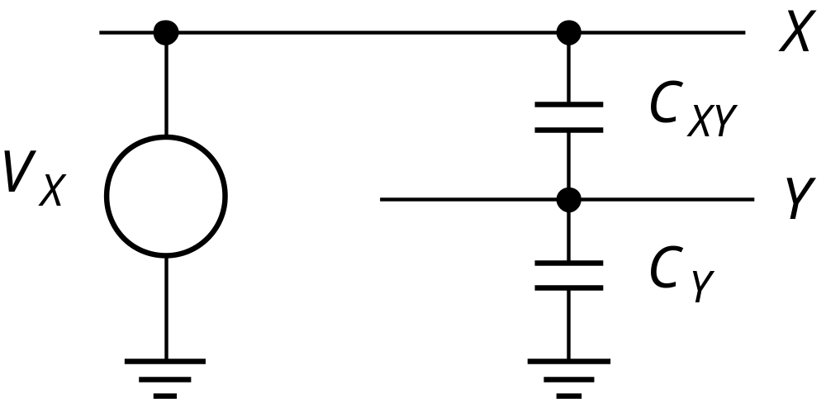
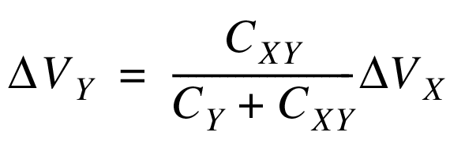
Capacitive Cross Talk

Slide 5
Capacitive Cross Talk
Dynamic Node
V
DD
CLK
C
XY
Y
C
Y
In
1
X
In
2
PDN
In
2.5 V
3
0 V
CLK
3 x 1 μm overlap: 0.19 V disturbance

Slide 6
Capacitive Cross Talk
Driven Node
0.5
0.45
0.4
t_{r}↑
X
0.35
R
C
XY
0.3
V
Y
X
Y
0.25
τ_{XY} = R_{Y}(C_{XY}+C_{Y})
C
Y
0.2
V (Volt)
0.15
0.1
0.05
0
0
0.2
0.4
0.6
0.8
1
t (nsec)
Keep time-constant smaller than rise time

Slide 7
Dealing with Capacitive Cross Talk
Avoid floating nodes
Protect sensitive nodes
Make rise and fall times as large as possible
Differential signaling
Do not run wires together for a long distance
Use shielding wires
Use shielding layers

Slide 8
Shielding
Shielding
wire
GND
V
Shielding
DD
layer
GND
Substrate (
GND
)

Slide 9
Cross Talk and Performance
- When neighboring lines switch in opposite direction of victim line, delay increases
DELAY DEPENDENT UPON ACTIVITY IN NEIGHBORING WIRES
C_{c}
Miller Effect
- Both terminals of capacitor are switched in opposite directions
(0 → V_{dd}, V_{dd} → 0)
- Effective voltage is doubled and additional charge is needed
(from Q=CV)

Slide 10
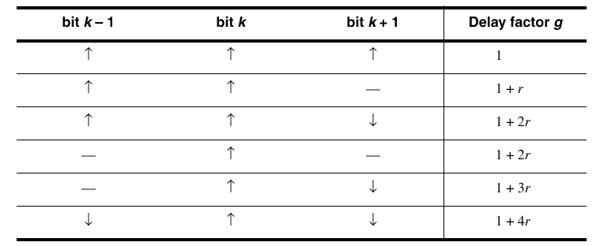
Impact of Cross Talk on Delay
r is ratio between capacitance to GND and to neighbor

Slide 11
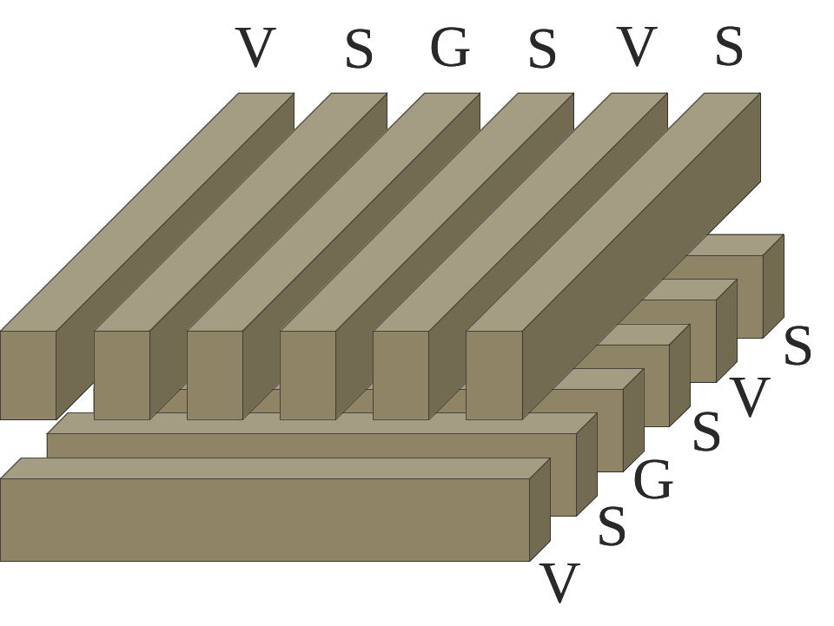
Structured Predictable Interconnect
Example: Dense Wire Fabric ([Sunil Kathri])
Trade-off:
Cross-coupling capacitance 40x lower, 2% delay variation
Increase in area and overall capacitance
Also: FPGAs, VPGAs

Slide 12
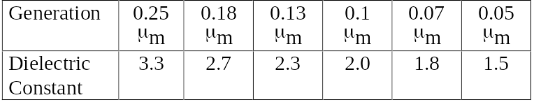
Interconnect Projections
Low-k dielectrics
Both delay and power are reduced by dropping interconnect capacitance
Types of low-k materials include: inorganic (SiO₂), organic (Polyimides) and aerogels (ultra low-k)
The numbers below are on the
conservative side of the NRTS roadmap
ε

Slide 13
Encoding Data Avoids Worst-Case
Conditions
In
Encoder
Bus
Decoder
Out

Slide 14
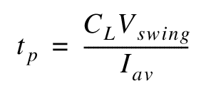
Driving Large Capacitances
V
DD
V
in
V
out
C
L
Transistor Sizing
Cascaded Buffers

Slide 15
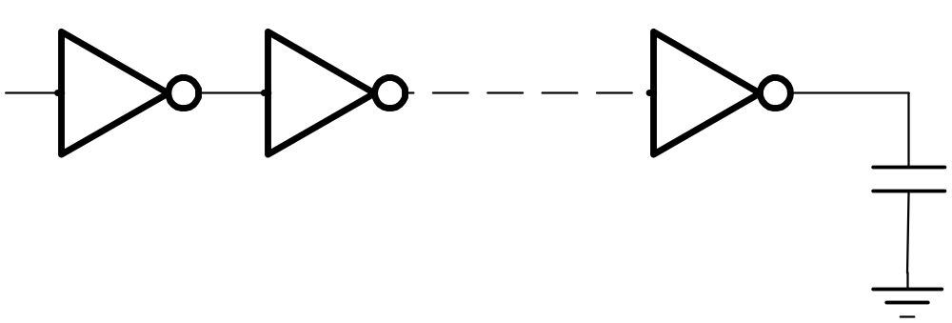
Using Cascaded Buffers
In
Out
1
2
N
C_{L} = 20 pF
0.25 μm process
Cin = 2.5 fF
tp0 = 30 ps
F = CL/Cin = 8000
fopt = 3.6 N = 7
tp = 0.76 ns
(See Chapter 5)

Slide 16
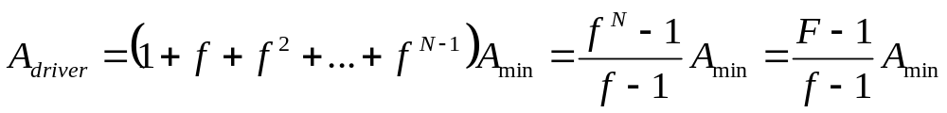
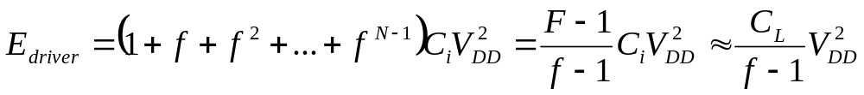
Output Driver Design
Trade off Performance for Area and Energy
Given t_{pmax} find N and f
Area
Energy

Slide 17
Delay as a Function of F and N
10,000
F
=
10,000
1000
t_{p}/t_{p0}
0
t
p
/
p
t
100
F
=
1000
F
=
100
10
1
3
5
7
9
11
Number of buffer stages N

Slide 18
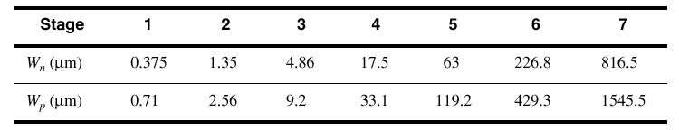
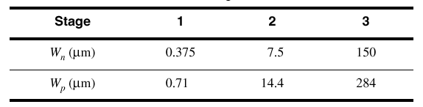
Output Driver Design
0.25 μm process, C_{L} = 20 pF
Transistor Sizes for optimally-sized cascaded buffer t_{p} = 0.76 ns
Transistor Sizes of redesigned cascaded buffer t_{p} = 1.8 ns

Slide 19
How to Design Large Transistors
D(rain)
Reduces diffusion capacitance
Reduces gate resistance
Multiple
Contacts
S(ource)
G(ate)
small transistors in parallel

Slide 20
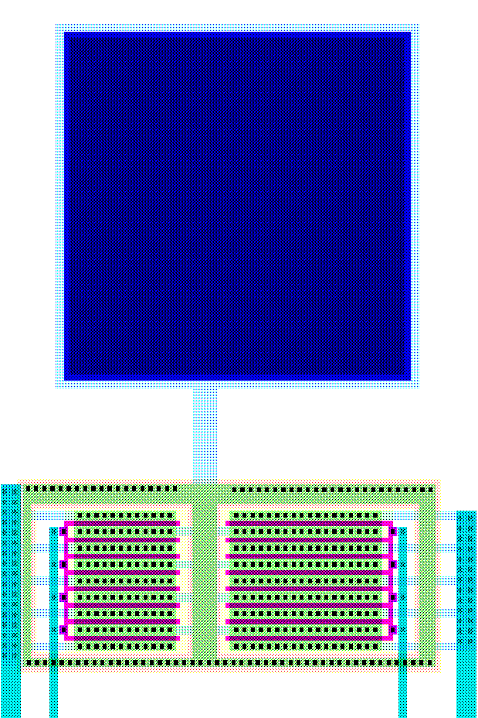
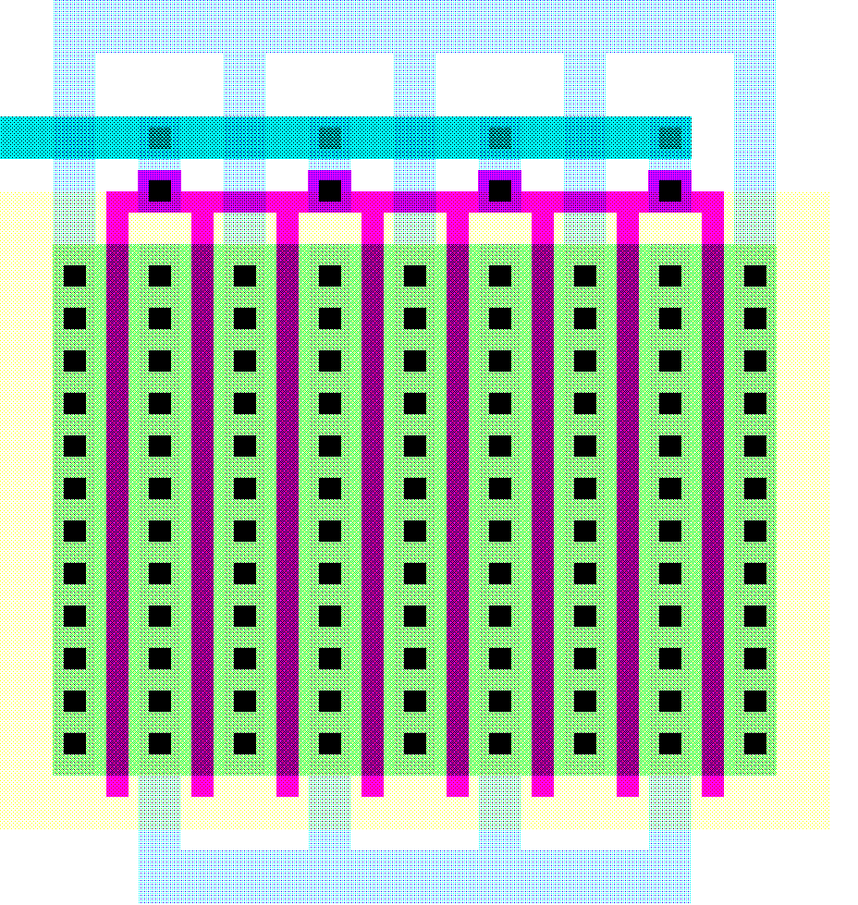
Bonding Pad Design
Bonding Pad
GND
100 μm
Out
V_{DD}
Out
In
GND

Slide 21
ESD Protection
When a chip is connected to a board, there is unknown (potentially large) static voltage difference
Equalizing potentials requires (large) charge flow through the pads
Diodes sink this charge into the substrate – need guard rings to pick it up.

Slide 22
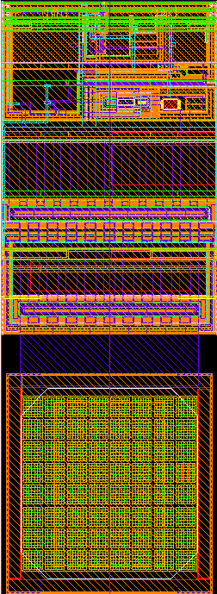
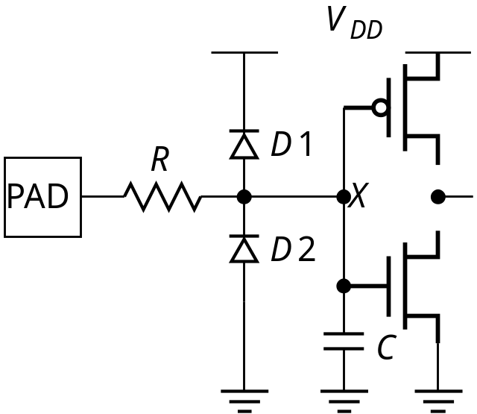
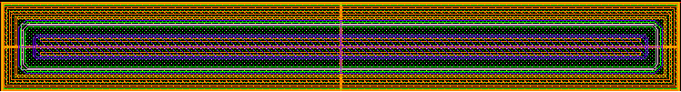
ESD Protection
Diode

Slide 23
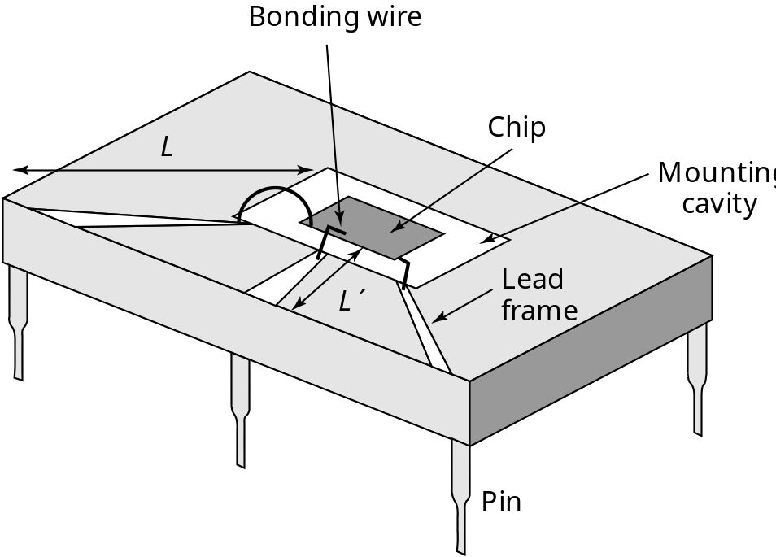
Chip Packaging
Bond wires (~25μm) are used
to connect the package to the chip
Pads are arranged in a frame
around the chip
Pads are relatively large
(~100μm in 0.25μm technology),
with large pitch (100μm)
Many chips areas are ‘pad limited’

Slide 24
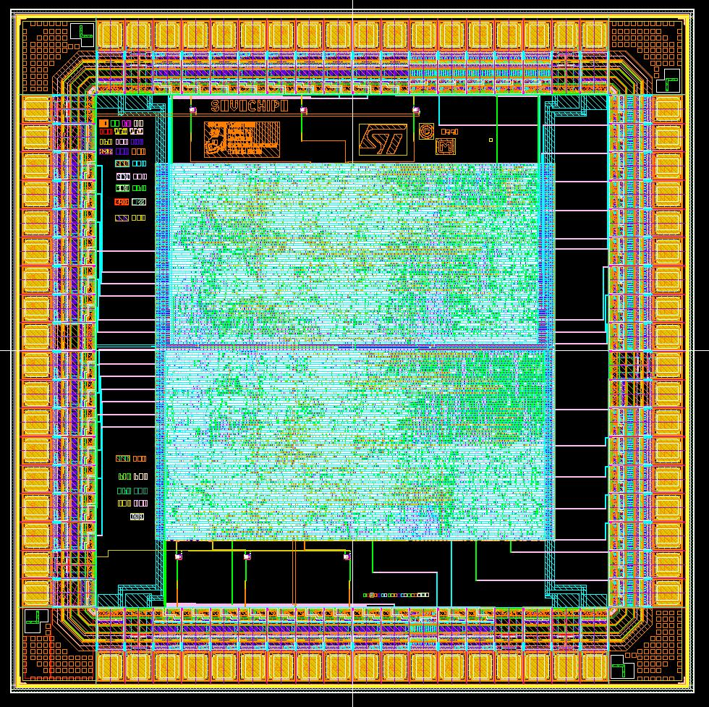
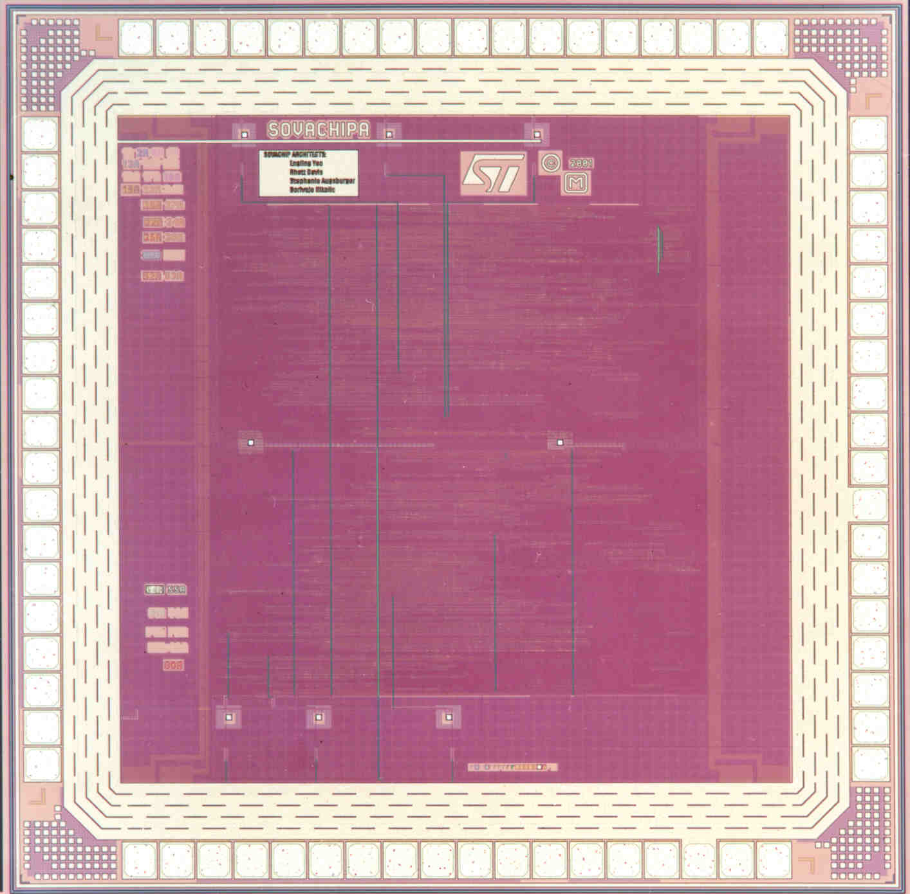
Pad Frame
Layout
Die Photo

Slide 25
Chip Packaging
An alternative is ‘flip-chip’:
  Pads are distributed around the chip
  The soldering balls are placed on pads
  The chip is ‘flipped’ onto the package
  Can have many more pads

Slide 26
Tristate Buffers
V
DD
V
DD
En
En
Out
In
Out
En
In
En
Increased output drive
Out = In.En + Z.En

Slide 27
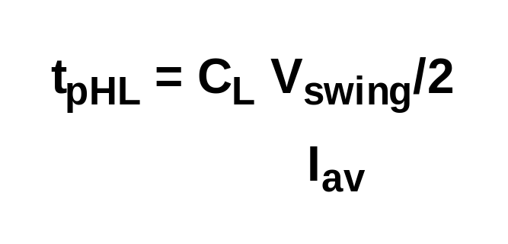
Reducing the swing
Reducing the swing potentially yields linear
reduction in delay
Also results in reduction in power dissipation
Delay penalty is paid by the receiver
Requires use of “sense amplifier” to restore signal level
Frequently designed differentially (e.g. LVDS)

Slide 28
Single-Ended Static Driver and Receiver
VDD
VDD
VDD
VDD
L
Out
Out
VDD
L
In
C
L
driver
receiver

Slide 29
Dynamic Reduced Swing Network
V
DD
V
DD
f
M
M
2
4
Bus
Out
In
.
M
In
.
C
bus
M
C
out
1
f
1
2
f
3
2.5
2
V
asym
V
bus
1.5
V
sym
V(Volt)
f
1
0.5
0
0
2
4
6
8
10
12
time (ns)

Slide 30
INTERCONNECT
Dealing with Resistance

Slide 31
Impact of Resistance
We have already learned how to drive RC interconnect
Impact of resistance is commonly seen in power supply distribution:
  IR drop
  Voltage variations
Power supply is distributed to minimize the IR drop and the change in current due to switching of gates

Slide 32
RI Introduced Noise
V
DD
I
f
pre
V
2
D
V
9
R
9
DD
X
I
V
M
1
D
D
V
R

Slide 33
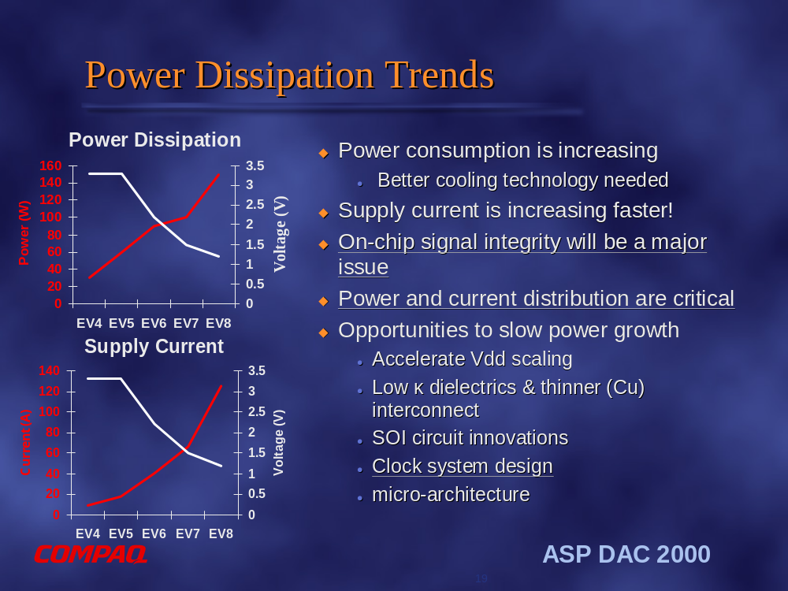

Slide 34
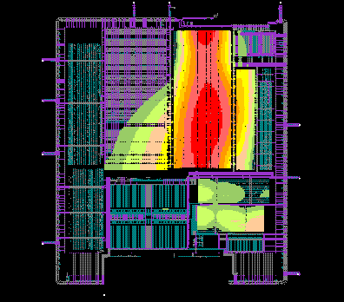
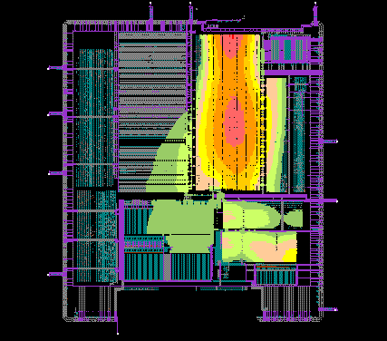
Resistance and the Power Distribution Problem
Before
After
Requires fast and accurate peak current prediction
Heavily influenced by packaging technology
Source: Cadence

Slide 35
Power Distribution
Low-level distribution is in Metal 1
Power has to be ‘strapped’ in higher layers of metal.
The spacing is set by IR drop, electromigration, inductive effects
Always use multiple contacts on straps

Slide 36
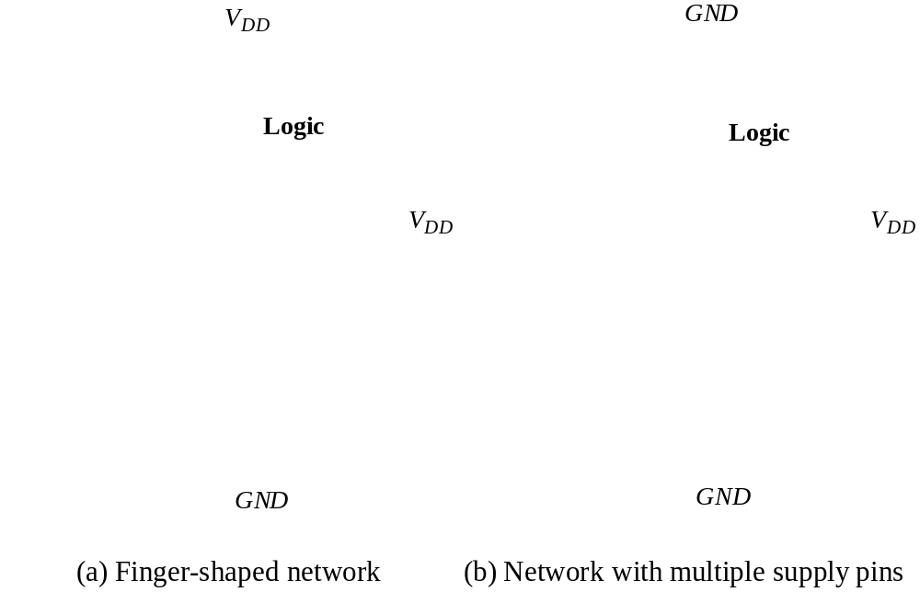
Power and Ground Distribution

Slide 37
3 Metal Layer Approach (EV4)
3rd “coarse and thick” metal layer added to the
technology for EV4 design
Power supplied from two sides of the die via 3rd metal layer
2nd metal layer used to form power grid
90% of 3rd metal layer used for power/clock routing
Metal 3
Metal 2
Metal 1
Courtesy Compaq

Slide 38
4 Metal Layers Approach (EV5)
4th “coarse and thick” metal layer added to the
technology for EV5 design
Power supplied from four sides of the die
Grid strapping done all in coarse metal
90% of 3rd and 4th metals used for power/clock routing
Metal 4
Metal 3
Metal 2
Metal 1
Courtesy Compaq

Slide 39
6 Metal Layer Approach – EV6
2 reference plane metal layers added to the
technology for EV6 design
Solid planes dedicated to Vdd/Vss
Significantly lowers resistance of grid
Lowers on-chip inductance
RP2/Vdd
Metal 4
Metal 3
RP1/Vss
Metal 2
Metal 1
Courtesy Compaq

Slide 40
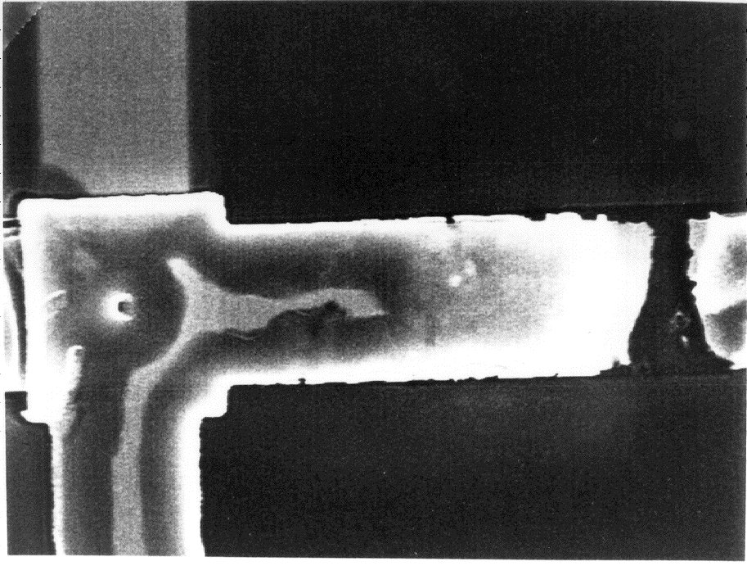
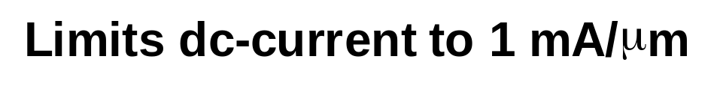
Electromigration (1)

Slide 41
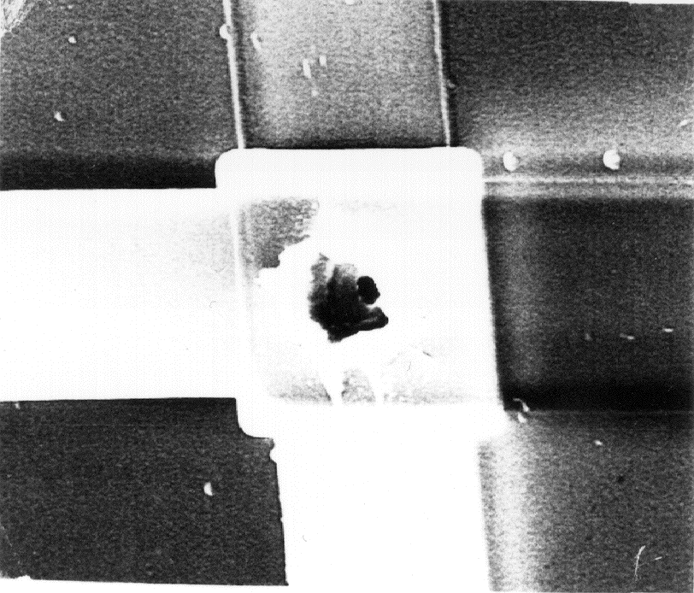
Electromigration (2)

Slide 42
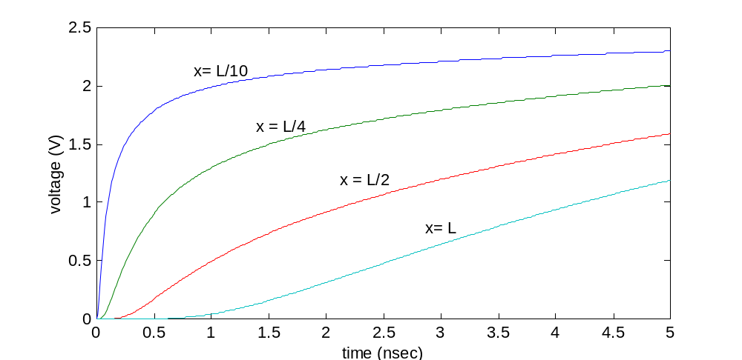
Resistivity and Performance
T_{r}
The distributed rc-line
R₁
R₂
R_{N-1} R_{N}
C₁
C₂
C_{N-1}
C_{N}
V_{in}
Diffused signal
propagation
Delay ~ L²

Slide 43
The Global Wire Problem
=
+
(
+
+
)
T
0
.
377
R
C
0
.
693
R
C
R
C
R
C
d
w
w
d
out
d
w
w
out
Challenges
No further improvements to be expected after the introduction of Copper (superconducting, optical?)
Design solutions
  Use of fat wires
  Insert repeaters — but might become prohibitive (power, area)
  Efficient chip floorplanning
Towards “communication-based” design
  How to deal with latency?
  Is synchronicity an absolute necessity?

Slide 44
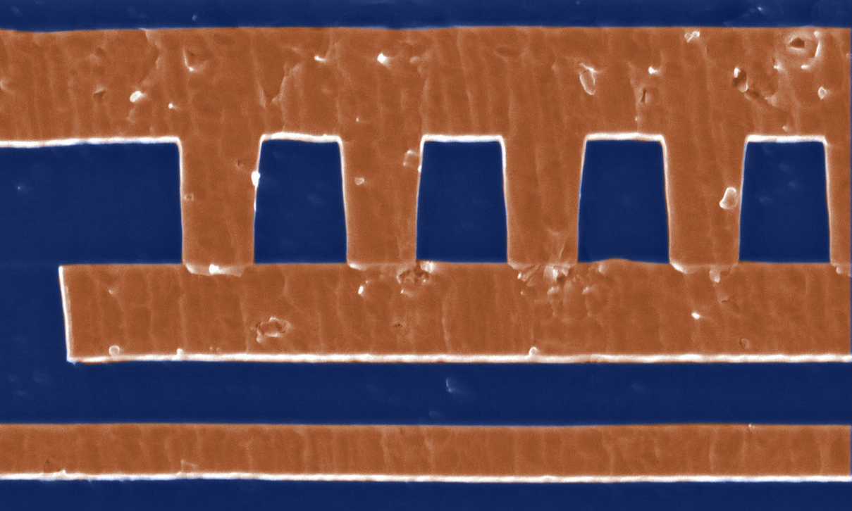
Interconnect Projections: Copper
Copper is planned in full sub-0.25 μm process flows and large-scale designs (IBM, Motorola, IEDM97)
With cladding and other effects, Cu ~ 2.2 μΩ-cm vs. 3.5 for Al(Cu) ⇒ 40% reduction in resistance
Electromigration improvement; 100X longer lifetime (IBM, IEDM97)
  Electromigration is a limiting factor beyond 0.18 μm if Al is used (HP, IEDM95)
Vias

Slide 45
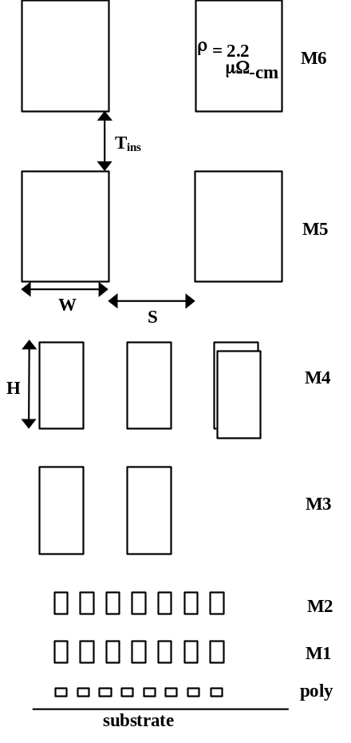
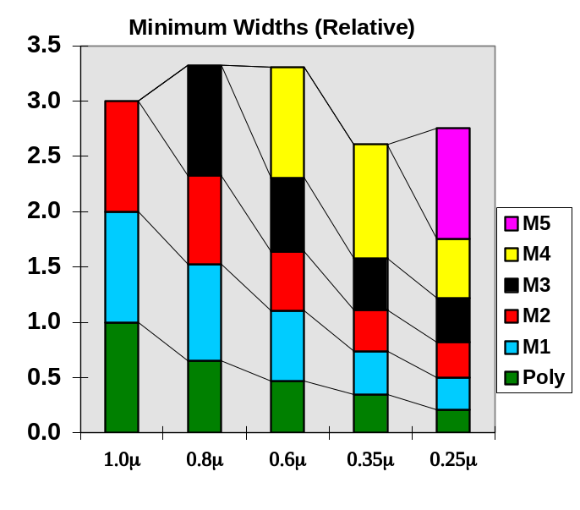
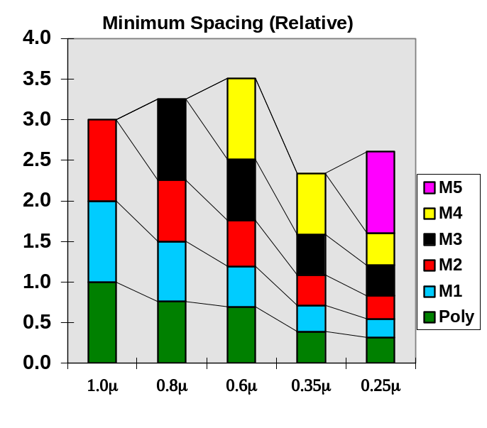
Interconnect:
# of Wiring Layers
# of metal layers is steadily increasing due to:
  Increasing die size and device count: we need more wires and longer wires to connect everything
  Rising need for a hierarchical wiring network; local wires with high density and global wires with low RC
0.25 μm wiring stack

Slide 46

Diagonal Wiring
destination
diagonal
y
source
x
Manhattan
20+% Interconnect length reduction
Clock speed
Signal integrity
Power integrity
15+% Smaller chips
plus 30+% via reduction
Courtesy Cadence X-initiative

Slide 47
Using Bypasses
Driver
WL
Polysilicon word line
Metal word line
Driving a word line from both sides
Metal bypass
WL
K
cells
Polysilicon word line
Using a metal bypass

Slide 48
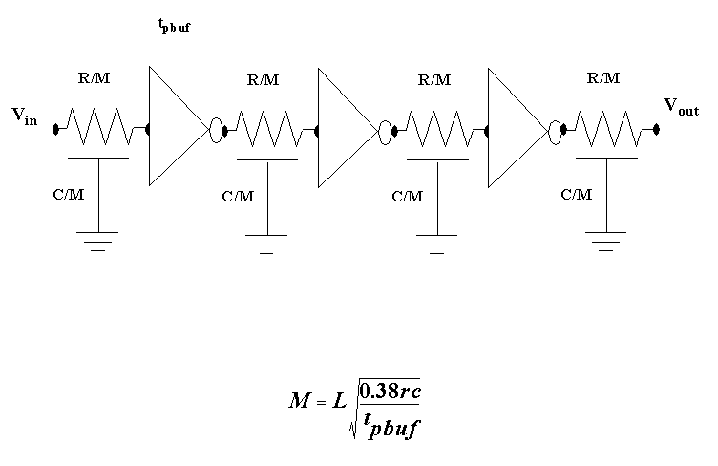
Reducing RC-delay
Repeater
(chapter 5)

Slide 49
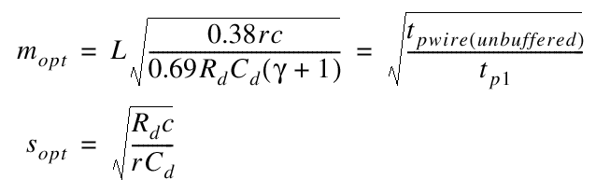
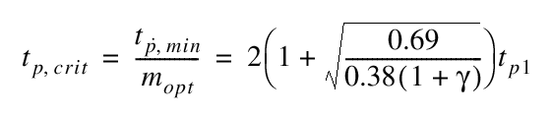
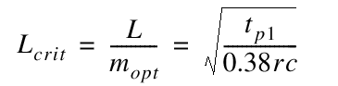
Repeater Insertion (Revisited)
Taking the repeater loading into account
For a given technology and a given interconnect layer, there exists an optimal length of the wire segments between repeaters. The delay of these wire segments is independent of the routing layer!

Slide 50
INTERCONNECT
Dealing with Inductance

Slide 51
L di/dt
V
DD
L
i
(
t
)
V
’
Impact of inductance on supply voltages:
Change in current induces a change in voltage
Longer supply lines have larger L
DD
V
V
out
in
C
L
GND
’
L

Slide 52
L di/dt: Simulation
2.5
2.5
2
2
(V)
1.5
1.5
V
out
1
1
0.5
0.5
0
0
0
0.5
1
1.5
2
0
0.5
1
1.5
2
x 10
-9
x 10
-9
Without inductors
0.04
With inductors
0.04
(A)
i
L
0.02
decoupled
0.02
0
0
0.5
1
1.5
2
0
0
0.5
1
1.5
2
1
x 10
-9
1
x 10
-9
(V)
0.5
0.5
V
L
0
0
0
0.5
1
1.5
2
0
0.5
1
1.5
2
time (nsec)
x 10
-9
time (nsec)
x 10
-9
Input rise/fall time: 50 psec
Input rise/fall time: 800 psec

Slide 53
Dealing with Ldi/dt
Separate power pins for I/O pads and chip core.
Multiple power and ground pins.
Careful selection of the positions of the power and ground pins on the package.
Increase the rise and fall times of the off-chip signals to the maximum extent allowable.
Schedule current-consuming transitions.
Use advanced packaging technologies.
Add decoupling capacitances on the board.
Add decoupling capacitances on the chip.

Slide 54

Choosing the Right Pin

Slide 55
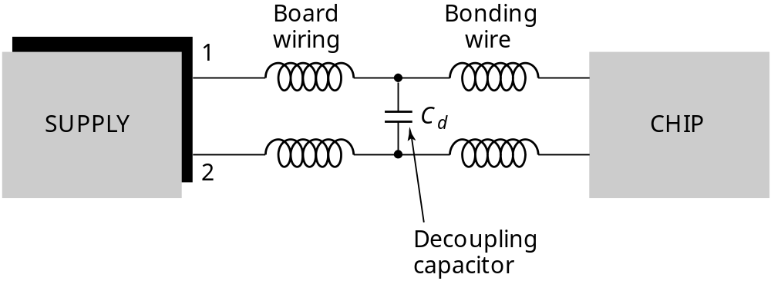
Decoupling Capacitors
Decoupling capacitors are added:
on the board (right under the supply pins)
on the chip (under the supply straps, near large buffers)

Slide 56
De-coupling Capacitor Ratios
EV4
  total effective switching capacitance = 12.5nF
  128nF of de-coupling capacitance
  de-coupling/switching capacitance ~ 10x
EV5
  13.9nF of switching capacitance
  160nF of de-coupling capacitance
EV6
  34nF of effective switching capacitance
  320nF of de-coupling capacitance -- not enough!
Source: B. Herrick (Compaq)

Slide 57
EV6 De-coupling Capacitance
Design for ΔIdd= 25 A @ Vdd = 2.2 V, f = 600 MHz
  0.32-µF of on-chip de-coupling capacitance was added
    Under major busses and around major gridded clock drivers
    Occupies 15-20% of die area
  1-µF 2-cm² Wirebond Attached Chip Capacitor (WACC) significantly increases “Near-Chip” de-coupling
    160 Vdd/Vss bondwire pairs on the WACC minimize inductance
Source: B. Herrick (Compaq)

Slide 58
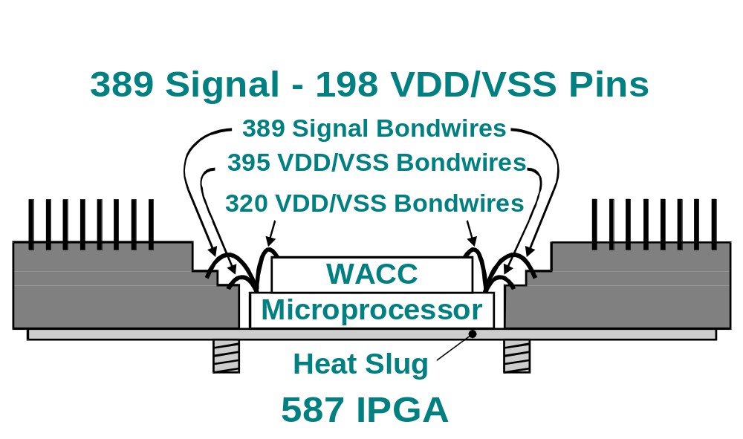
EV6 WACC
Source: B. Herrick (Compaq)

Slide 59
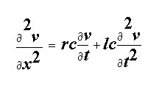
The Transmission Line
l
l
l
l
V
in
r
r
r
x
r
V
out
g
c
g
c
g
c
g
c
The Wave Equation

Slide 60
Design Rules of Thumb
Transmission line effects should be considered when the rise or fall time of the input signal (t_{r}, t_{f}) is smaller than the time-of-flight of the transmission line (t_{flight}).
  t_{r} (t_{f}) << 2.5 t_{flight}
Transmission line effects should only be considered when the total resistance of the wire is limited:
R < 5 Z₀
The transmission line is considered lossless when the total resistance is substantially smaller than the characteristic impedance,
R < Z₀/2

Slide 61
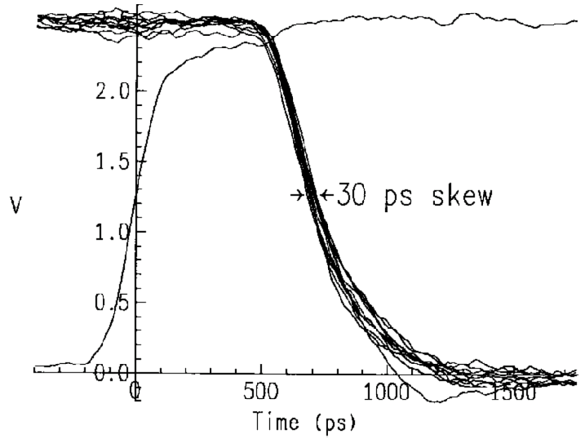
Should we be worried?
Transmission line effects cause overshooting and non-monotonic behavior
Clock signals in 400 MHz IBM Microprocessor
(measured using e-beam prober) [Restle98]

Slide 62
Matched Termination
Z
0
Z
Z
L
0
Series Source Termination
Z
S
Z
Z
0
0
Parallel Destination Termination

Slide 63
Segmented Matched Line Driver
In
VDD
Z
0
s
s
s
s
Z
L
0
1
2
n
GND
c
1
c
2
c
n

Slide 64
Parallel Termination─
Transistors as Resistors
V
dd
)
2
M
V
1.9
NMOS only
r
1.8
1.7
Out
1.6
PMOS only
1.5
1.4
V
dd
V
dd
1.3
NMOS-PMOS
1.2
Normalized Resistance (
PMOS with-1V bias
M
M
M
1.1
r
rp
rn
1
V
bb
0
0.5
1
1.5
2
2.5
V
R
(Volt)
Out
Out

Slide 65
Output Driver with Varying Terminations
4
V
3
d
V
V
in
2
s
V
DD
1
L
=
2.5 nH
Clamping
0
Diodes
V
DD
1
120
2.5 nH
Z
50
Ω
0
1
2
3
4
5
6
7
8
V
in
L
=
V
s
0
=
V
d
C
5 pF
C
Initial design
275
L
=
L
4
(V)
3
V
V
out
d
in
L
=
2.5 nH
V
2
V
s
1
0
(V)
1
out
0
1
2
3
4
5
6
7
8
V
time (sec)
Revised design with matched driver impedance

Slide 66
The “Network-on-a-Chip”
Embedded
Processors
Memory
Sub-system
Interconnect Backplane
Accelators
Configurable
Accelerators
Peripherals

