Slide 1
DC motor:

Slide 2
Driving a DC motor by a transistor or Mosfet.
OR→

Slide 3
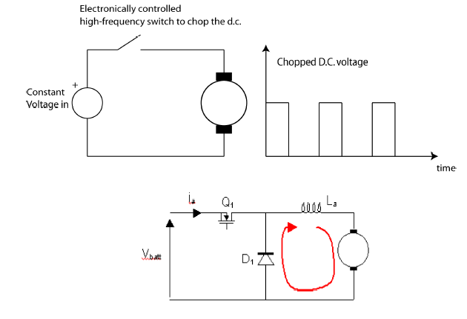
Appication example: DC motor control using PWM

Slide 4
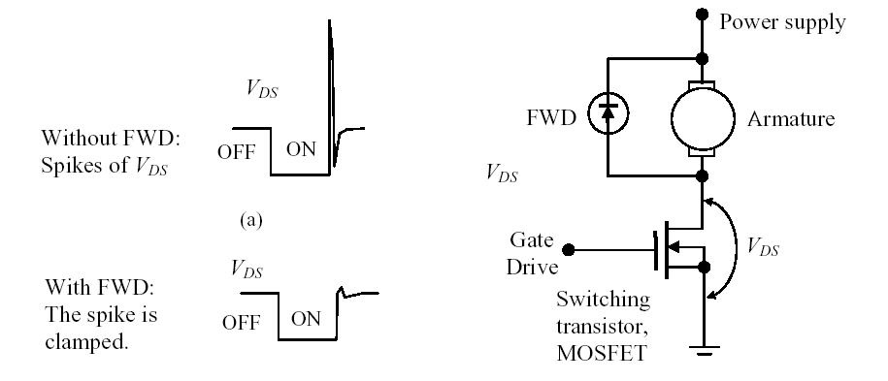
Using forward diode (Snubber diode)

Slide 5
Generation of A PWM pulse without using a PWM module: (Mnual method)

Slide 6
Duty cycle: Delay

Slide 7
Bidirectional DC motor control:

Slide 9
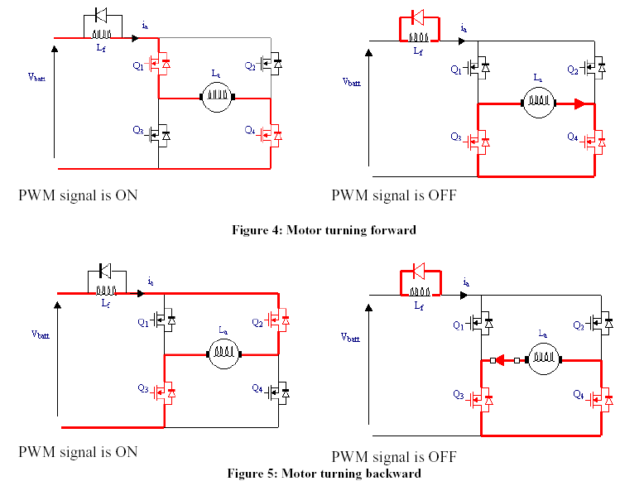

Slide 11
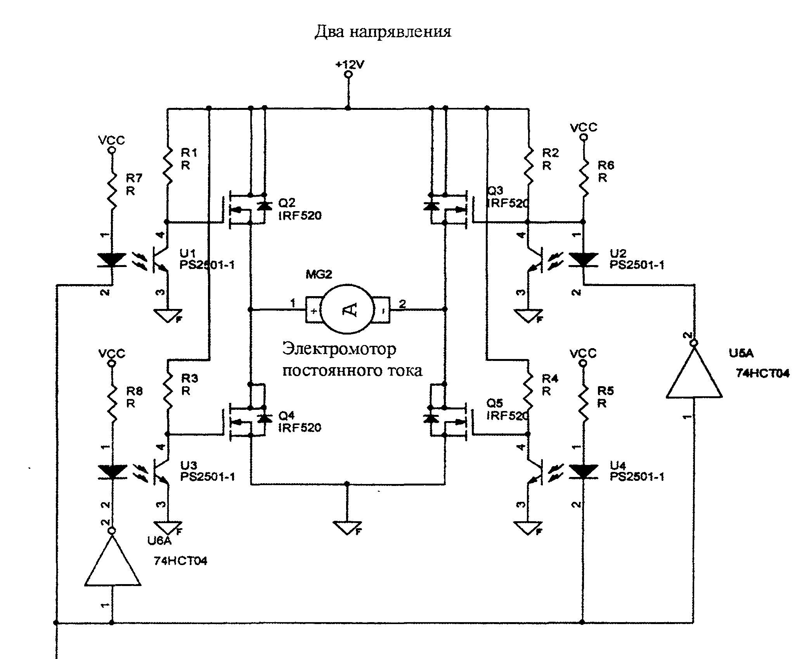

Slide 14
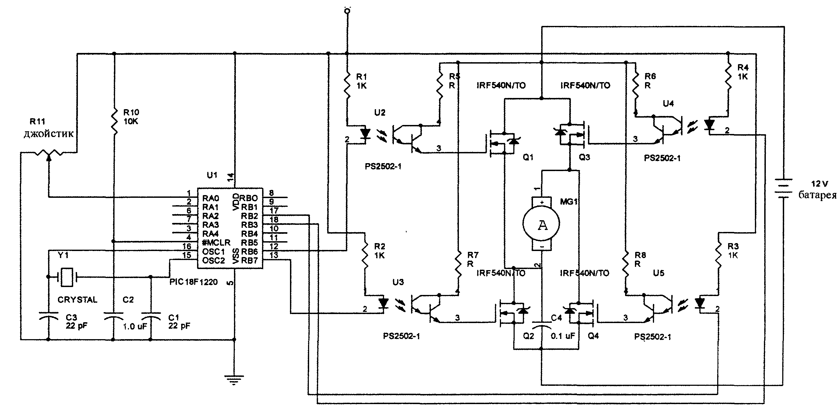
Jostick controlled DC motor

Slide 15
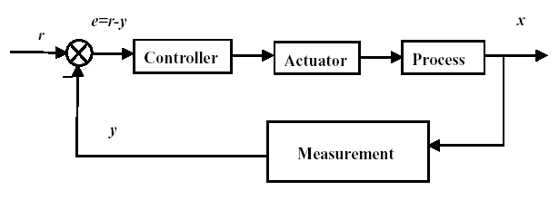
DC motor control: (speed- Torque- Position)

