Slide 1
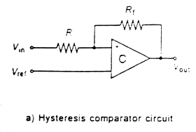
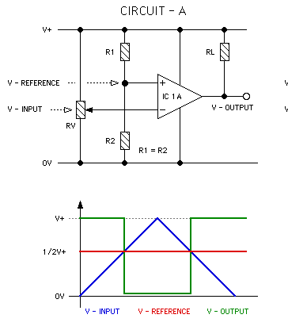
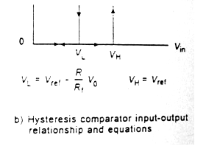

Slide 2
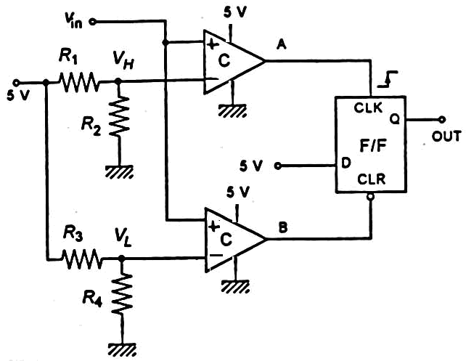
DEGIN DO FOREVER Measure T IF T < T_{ref}-ΔT Turn ON device ELSE IF T> T_{ref}+ΔT Turn OFF device END IF ENDDO

Slide 3
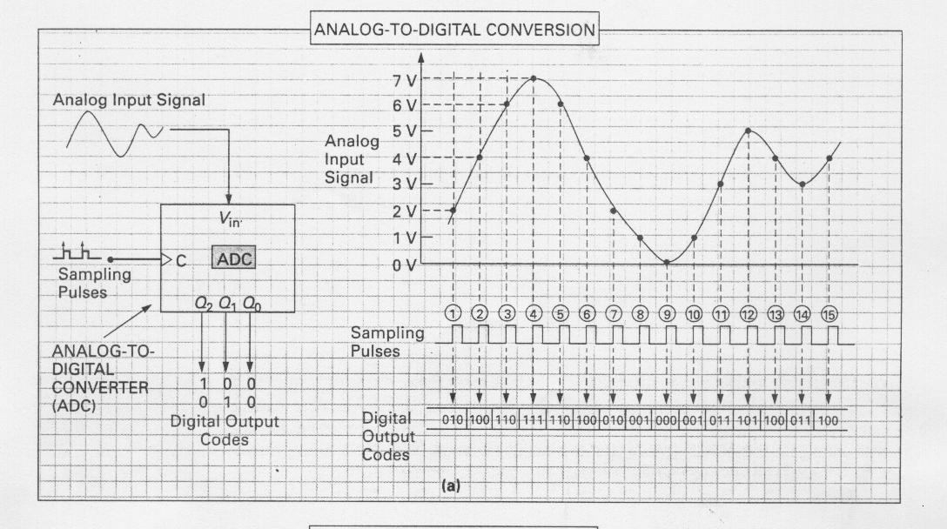

Slide 4
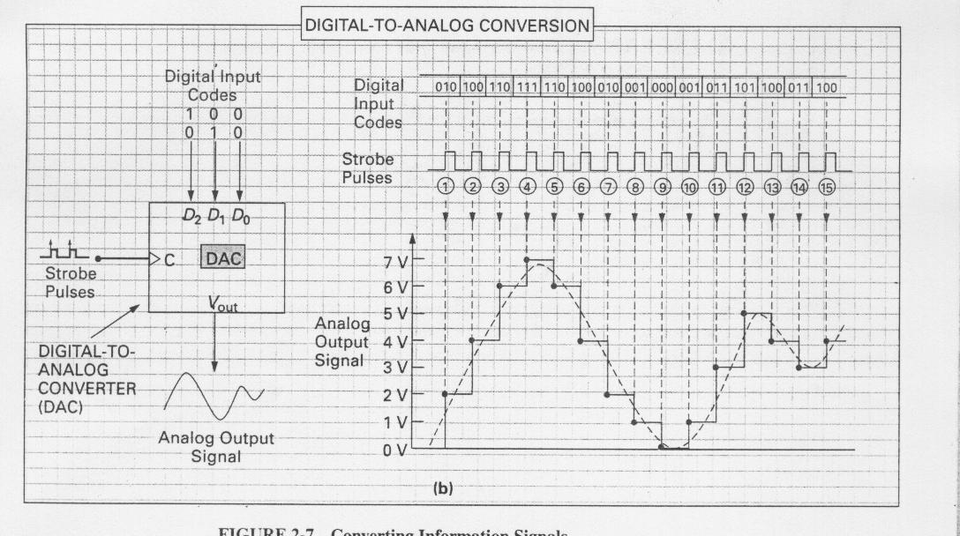

Slide 5
RESOLUTION
The ADC resolution is defined as the smallest incremental voltage that can be recognized and hence it causes a change in the digital output. It is usually expressed as the number of bit output by the ADC.
The smallest incremental voltage that can be recognized is expressed in terms of LSB
LSB= Step Size =ΔV_{out =} V_{R}2^{-n}
An ADC, which has ‘n’ bit digital output, provides 2^{n}digital values. It includes both 0 and 2^{n}-1
With a 5V reference voltage, the resolution is
5(volts) / 2¹⁰ = 5 (volts)/1024 = 4.88 mv
1LSB = (V_{AREF} - V_{SSA})/(2^{n}-1).
.

Slide 6
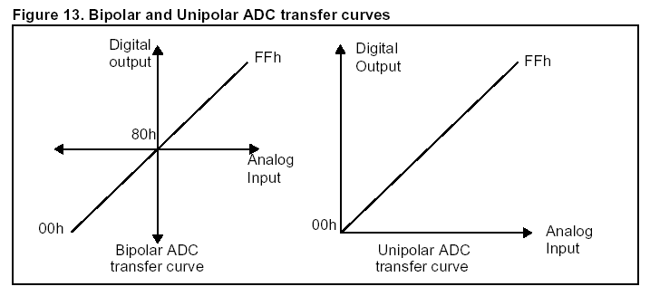


BIPOLAR AND UNIPOLAR ADC INPUT ( Microcontrollers ADC …. Unipolar)
The ADC will find a fractional binary number that gives the closets approximation to the fraction formed by the input voltage and reference.
where b₁b₂…b_{n} = n-bit digital output
V_{in} = analog input voltage
V_{R} = analog reference voltage

Slide 7
Example:
Find the digital word that result from a 3.127-volt input to a 5-bit ADC
with a 5-volt reference.
V_{in}∼V_{ref} [a₀2⁻¹ + a₁2⁻² + a₂2⁻³ + a₃2⁻⁴ + a₄2⁻⁵]
There fore, V_{in}/V_{ref} is represented as
0.6254 x 2 = 1.2508, gives a₀ = 1
0.2508 x 2 = 0.5016, a₁ = 0
0.5016 x 2 = 1.0032, a₂ = 1
0.0032 x 2 = 0.0064, a₃ = 0
0.0064 x 2 = 0.0128, a₄ = 0

Slide 8
Example:
The temperature is measured by a sensor with an output of 0.02 V/C.
Determine the required ADC reference and word size to measure 0º to
100º with 0.1 resolution.
(0.02 V/ºC)(100ºC) = 2 V so a 2-V reference is used. A change of 0.1ºC result in a voltage change of
(0.1ºC)(0.02 V/ºC) = 2mV so we need a word size where
0.002V = (2)(2^{-y})
choose a size n that is the integer part of y plus 1. Thus, solving with logarithms, we find y = 9.996 ≈ 10
so a 10-bit word is required for this resolution. A 10-bit word has a resolution of
V = (2) (2⁻¹⁰)
V = 0.00195 V ……………………0.02 V/C
Which is better than the minimum required resolution of 2mV. Notice that the output actually changes from 1111111110₂ to 1111111111₂ at a voltage of

Slide 9

Bipolar Operation
A bipolar ADC is one that accepts bipolar input
voltage for conversion into an appropriate digital
output. The most common bipolar ADCs provide
an output called offset-binary. This simply means
that the normal output is shifted by half scale
that all zeros corresponds to the negative
maximum voltage instead of zero.
From this equation, you can see that
if V_{in} = -V_{R}/2, the output is zero, N = 0.
If V_{in} = 0, the output is half of 2^{n}. T
he output will be the maximum count when the input is ( V_{R} / 2 ) - ( V_{R} / 2^{n} )
Unipolar Operation

Slide 10
For example: For 8 bits with a 10.0-V reference, the step size is
ΔV_{in} = (10)/2⁸ ≈ 0.039V. so look at the possible states;
V_{in} = -5.000 N = 00000000₂
V_{in} = -4.961 N = 00000001₂
: etc :
V_{in} = -0.039 N = 01111111₂
V_{in} = 0.000 N = 10000000₂
V_{in} = + 0.039 N = 10000001₂
: etc :
V_{in} = + 4.961 N = 11111111₂

Slide 12


Digital-to-Analog Converters (DACs):
DACs can be used whenever the computer or microcontroller needs to control a device, which needs a continuously variable electrical input.
A DAC accepts digital information and transforms it into an analog voltage. The digital information is in the form of a binary number with some fixed number of digits.
For a 4-bit word, 1111 has a maximal value of
= 0.9375V_{ref}
For an 8-bit word, 11111111 the maximal
output voltage becomes
= 0.9961V_{ref}

Slide 13
For example; Suppose an 8-bit converter with a 5.0-V reference has an input of 10100111₂, or A7H. If this input is converted to base 10, we get N = 167₁₀ and 2⁸ = 256. the output of the ADC will be
Bipolar DAC
Conversion Resolution :
The conversion resolution is a function of the reference voltage and the number of bits in the word. The more bits, the smaller the change in analog output for a 1-bit change in binary word, and hence the better the resolution. The smallest possible change is simply given by
ΔV_{out} = V_{R}2^{-n}

Slide 14
Determine how many bits a D/A converter must have to provide output increments of 0.04 V or less. The reference is 10 V.
ΔV = 0.04 = (10)(2^{-y})
log(0.04) = log[(10)(2^{-y})]
log(0.04) = log(10) – ylog2
Thus, a n = 8 will be satisfactory.
ΔV_{out} = (10)(2⁻⁸)
ΔV_{out} = 0.0390625V

Slide 15
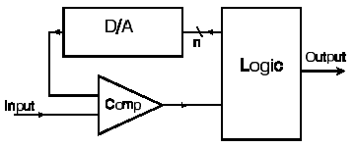
Structure of ADC:
Notice that the maximum allowed count rate is determined by the sum of the DAC settling time t_{da} , the comparator settling time ts and the logic reaction time tl

Slide 16
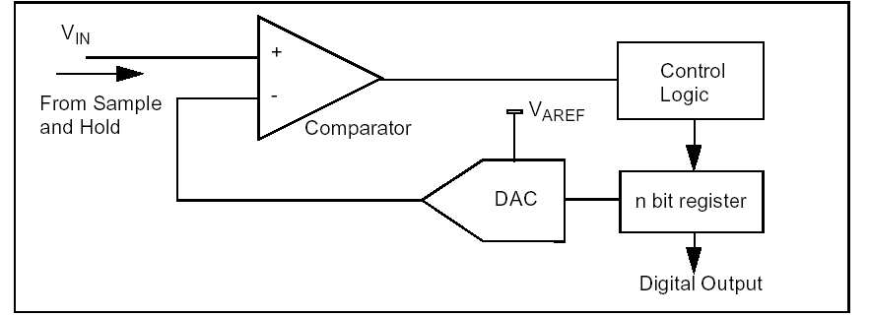
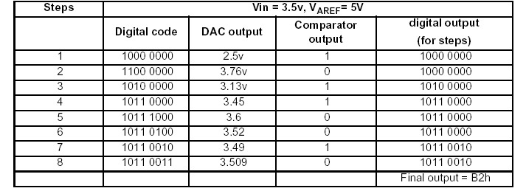
Successive Approximation Method in ADC:

Slide 17
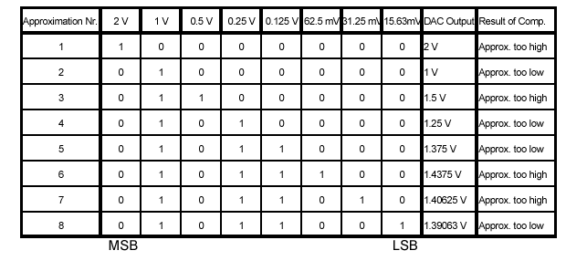
Successive Approximation A/D for V_{in} = 1,4 V

Slide 18
Example :
Find the successive approximation ADC output for a 4-bit converter to a 3.217-V input if the reference is 5 V.
Solution :
Following the procedure outlined, we have the following operations: let V_{x} = 3.217; then
(1) Set b₁ = 1 V_{F} = 5(2⁻¹) = 2.5 V
V_{x} > 2.5 leave b₁ = 1
(2) Set b₂ = 1 V_{F} = 2.5 + 5(2⁻²) = 3.75
V_{x}< 3.75 reset b₂ = 0
(3) Set b₃ = 1 V_{F} = 2.5 + 5(2⁻³) = 3.125
V_{x} > 3.125 leave b₃ = 1
(4) Set b₄ = 1 V_{F} = 3.125 + 5(2⁻⁴)
V_{x} < 3.4375 reset b₄ = 0
By this procedure, we find the output is a binary word of 1010₂.

Slide 19



Conversion-Time Consequences and
example, a 10-bit ADC with a 5.0-V reference and a 20-μs conversion time. According to Equation (9), the maximum rate of change of the input voltage for this converter would be
what frequency it would correspond to if the input were a sinusoidal voltage,
V_{in} = V₀sin (ωt)
V₀ = V_{R}

Slide 20
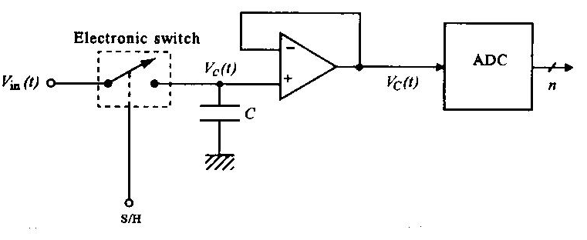
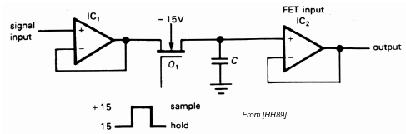
Conversion-Time Consequences and
Sample-and-Hold:
A Sample and hold (S/ H) circuit has two basic operating modes:
Sample mode : The output follows the input
Hold mode : The output is held constant until sample mode is resumed The main application of S/ H circuits is to hold the input signal to an ADC constant during conversion

Slide 21
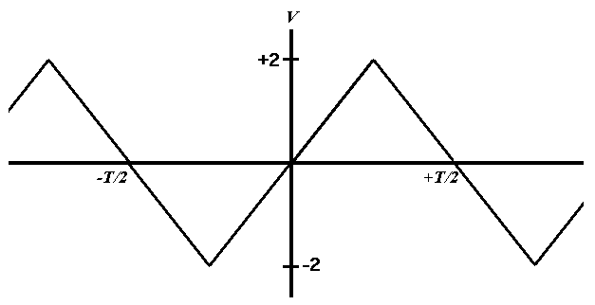
Example :
An 8-bit, bipolar ADC with a 5-V reference will be used to take samples of a triangular wave as shown in Figure . What is the maximum frequency of the wave if the ADC conversion time is 12μs?

Slide 22
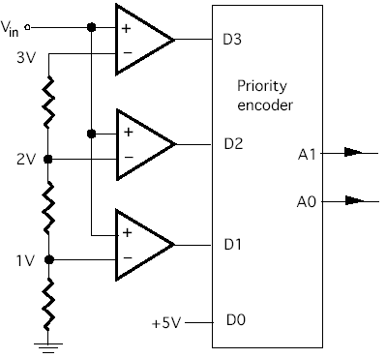
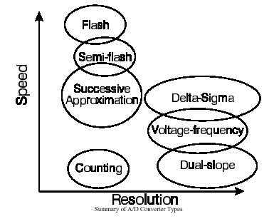
Parallel or Flash ADC

Slide 23
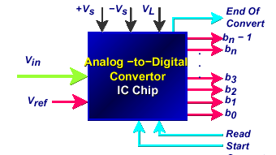
ADC Characteristics
The most common control lines are:
a. SC (Start-converter): This is a digital input to the ADC that starts the converter on the process of finding the correct digital outputs for the given analog voltage input. Typically, conversion starts on a falling edge. ⎤⎣
b. EOC (End-of-converter): This is a digital output from the ADC to receiving equipment, such as a computer. Typically, this line will be high during the conversion process. When the conversion is complete, the line will go low. Thus, the falling edge indicates that the conversion is complete.
RD (Read): Since the output is typically buffered with tri-states, even though the conversion is complete, the correct digital results do not appear on the output lines. The receiving equipment must take the RD line low to enable the tri-states and place the data on the output lines.

Slide 24
Microprocessor based ADCs: example : The ADC804 IC is an 8 bit analog-to-digital converter.
CS(chip select):
RD(read):
WR(write):
INTR(interrupt):

Slide 25
ADC process in microcontrollers: Example: ADC conversion in 18FX family:
The ADC peripheral of PIC18 has the following characteristics:
It has 10 bit ADC
The result of conversion is held by two register ,(ADRESL and ADRESH)
Vref can be selected by user ( select Vdd(Vcc) as reference value or select en external voltage source)
The conversion time is dedicated by Fosc. The conversion time can not be shorter then 1.6 μs.
The conversion time can be a portion of Fosc (Fosc/2,, Fosc/4, Fosc/8…)
For reduce the power consumption of the controller, the ADC feature is turned off when the controller is powered up.
The ADC module can be turned on by setting ADON bit in ADCCON register.

Slide 26
Steps in programming the A/D converter using polling
To program the A/D converter in PIC18, the following steps must be taken:
Turn on the ADC module
Make the pin for selected ADC as an input channel.
Select voltage reference
Select the conversion speed
Wait for the required acquisition time.
Active the start conversion bit(GO/DONE)
Wait for the conversion to be completed by polling the EOC (GO/DONE bit)
Read the result from relevant registers
Go to step 5
RD(read):
WR(write):
INTR(interrupt):

Slide 27
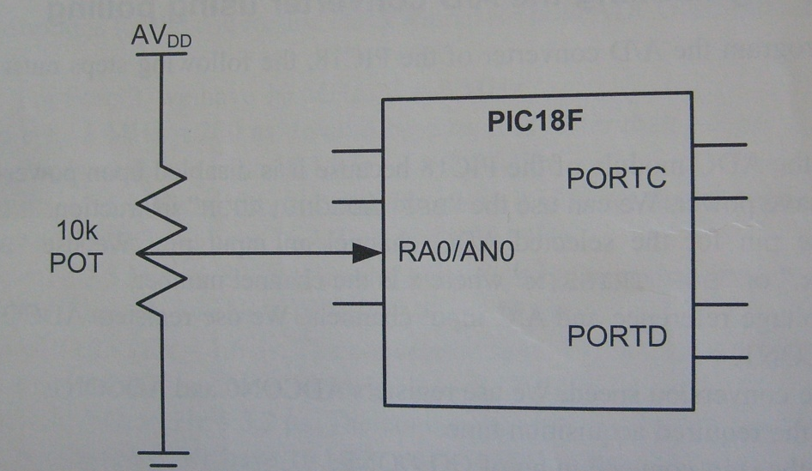
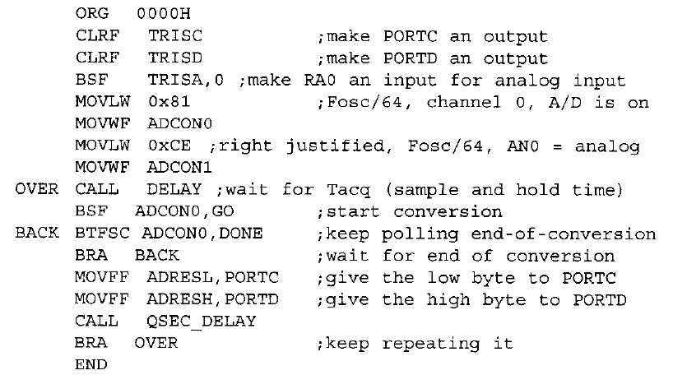
Example programs:
Programming ADC module in 18f458 :
Programming in assembly language: (Polling).
The steps of ADC conversion in assembly

Slide 28
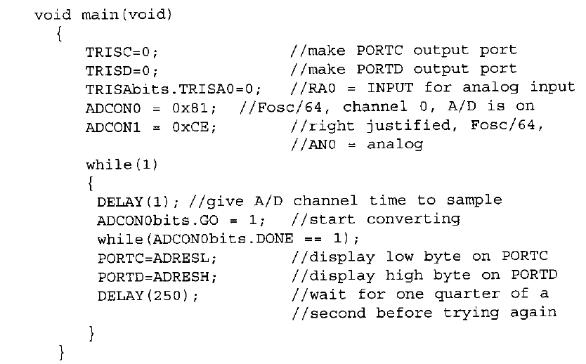
Programming in C language:

Slide 29
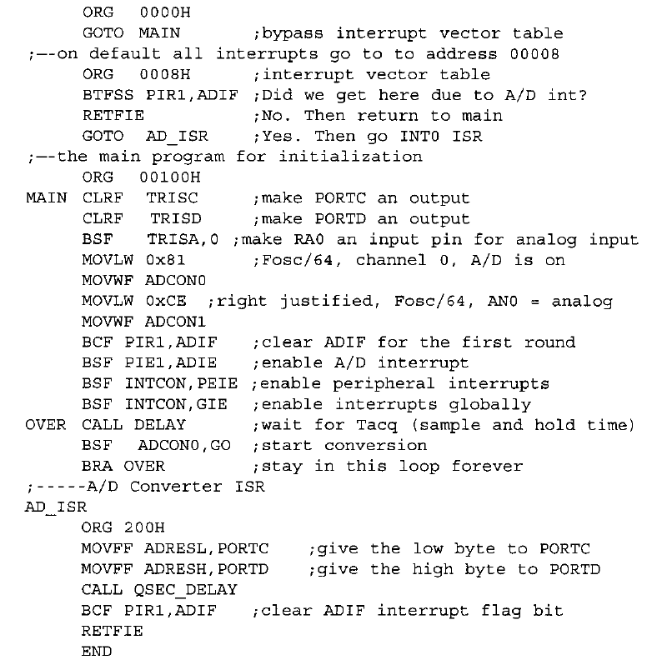
Programing ADC
in assembly
(Using interrupt)

Slide 30
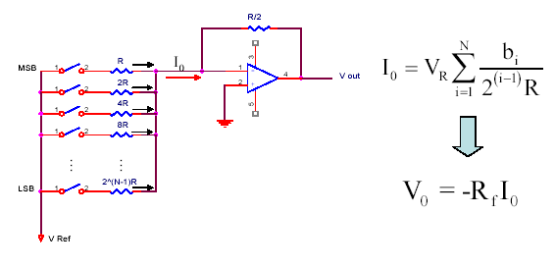
DAC structure: Types of DAC Circuits:
N-Bit Binary Weighted Resistor

Slide 31
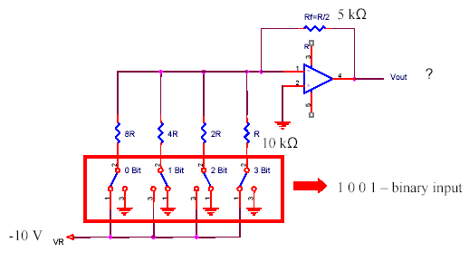
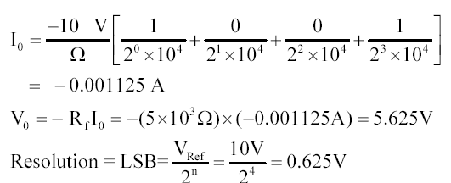
N-bit binary weighted Example
• Find output voltage, current, and resolution for a binary weighted resistor DAC of 4 bits
- given condition R = 10 k Ώ, Rf = 5 k Ώ, VR = -10 V .....Applied binary word is 1001

Slide 32
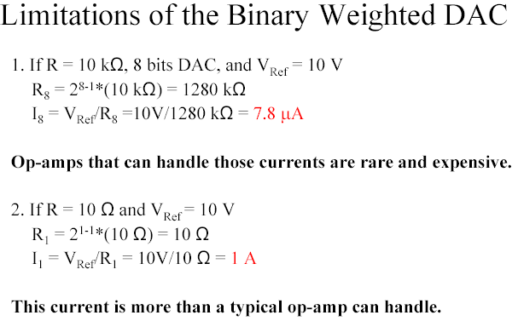
Limitations of the Binary Weighted DAC

Slide 33
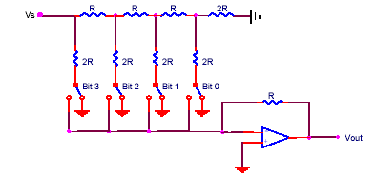
R-2R Resistor Ladder DAC

Slide 34
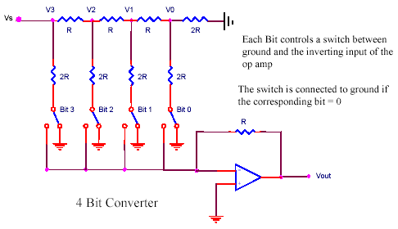
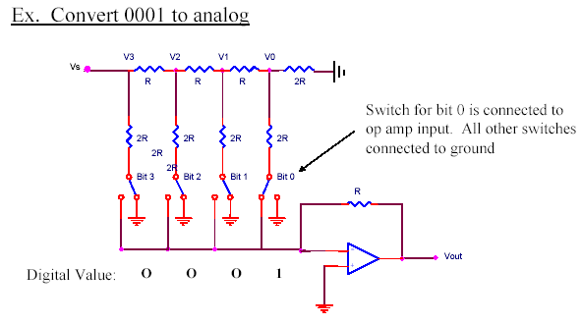

Slide 35
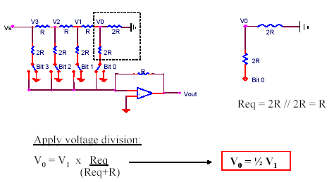
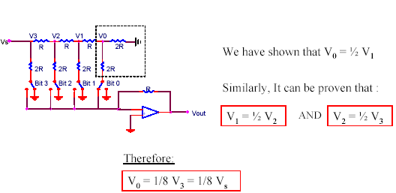

Slide 36
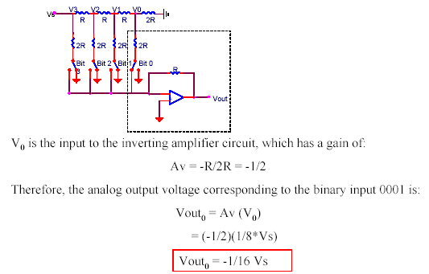

Slide 37
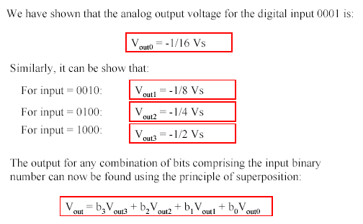

Slide 38
R-2R Resistor Ladder Flash DAC by using microcontroller for generation of sine wave

