Slide 1
EEM415 Lecture5

Slide 2


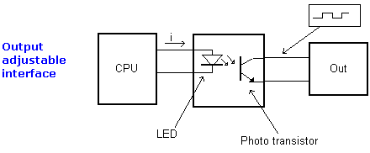
Isolation control and power circuits
and protection of processors
Transformer
Optoisolator
Relay (A "relay" is an electrically operated switch.)
IC package of optocoupler

Slide 3
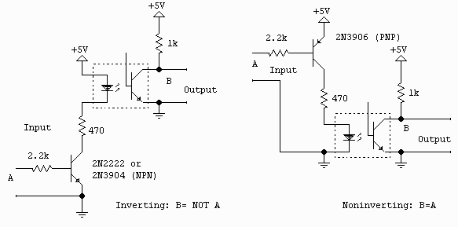

Slide 4
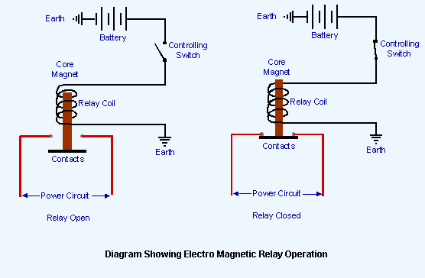
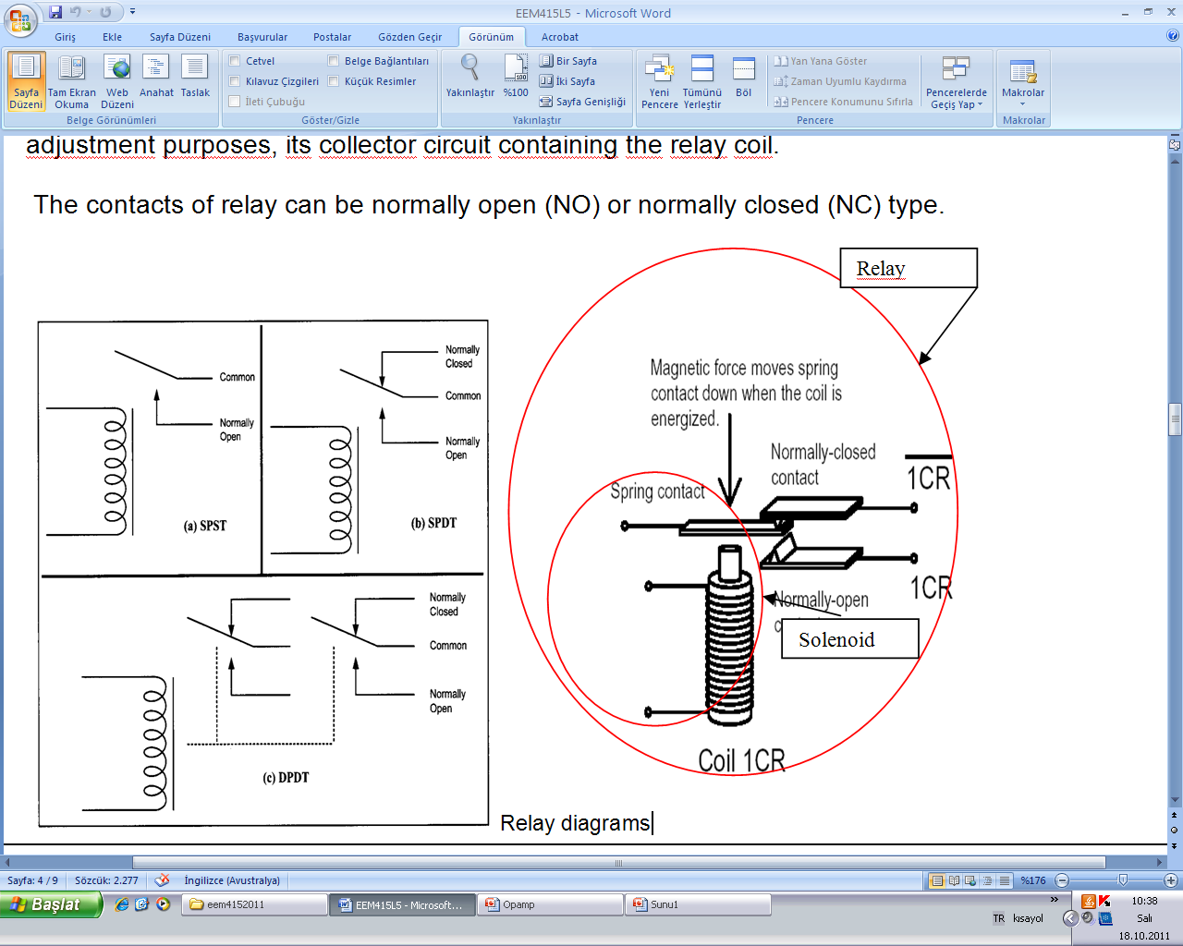
Relay: (Solenoid + contact)

Slide 5
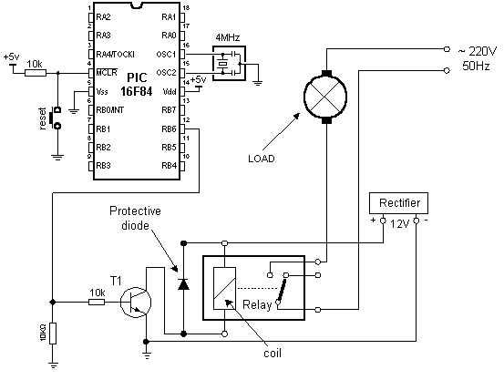
Application example:

Slide 6
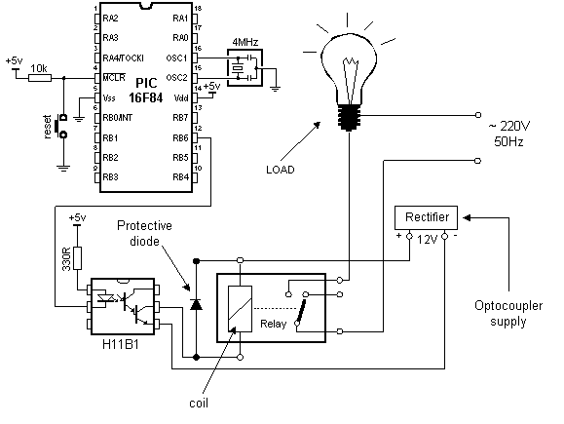

Slide 8
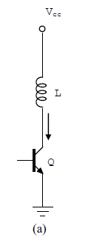
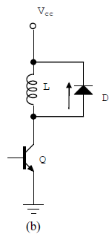
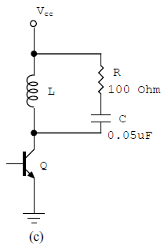

Switching Inductive Load (example): Relay) and switch Protection

Slide 9
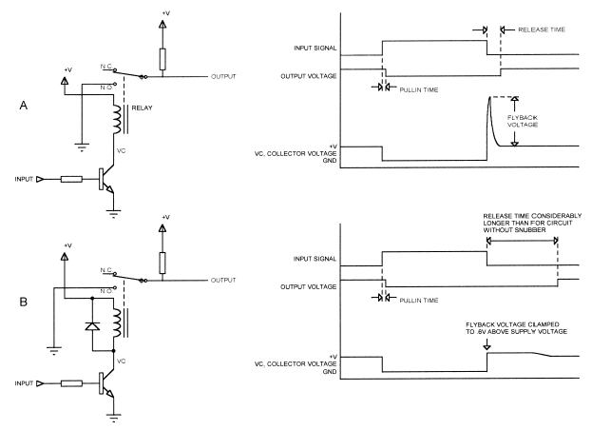

Slide 10
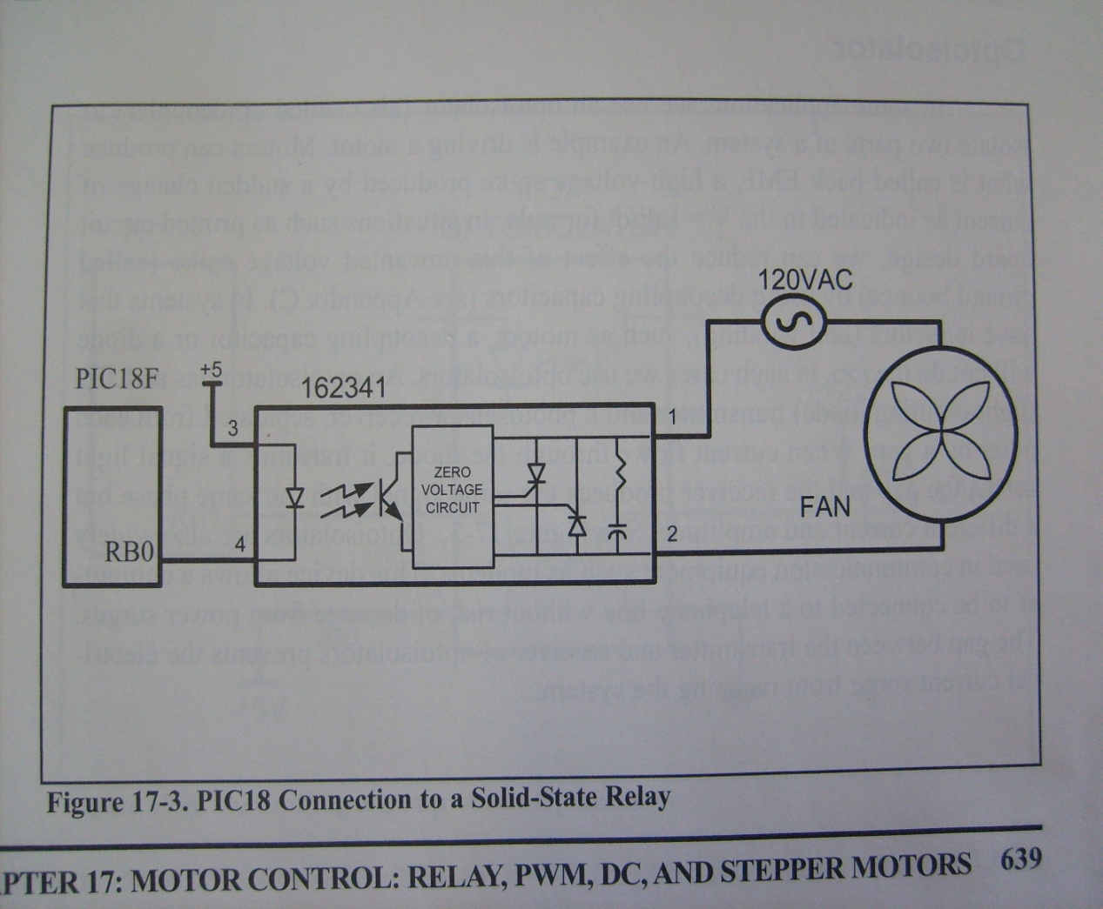
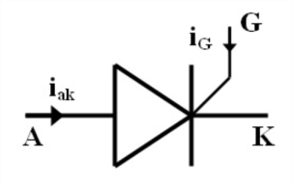
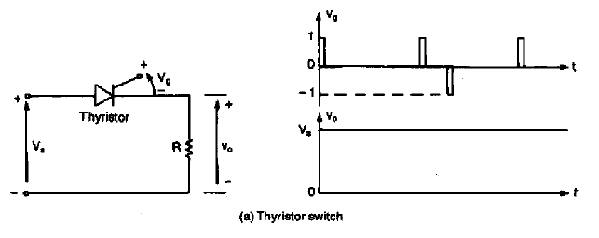
Solid State Relay:

Slide 11
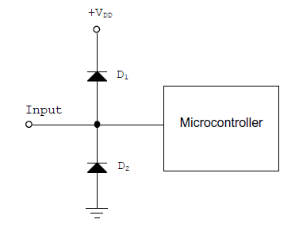
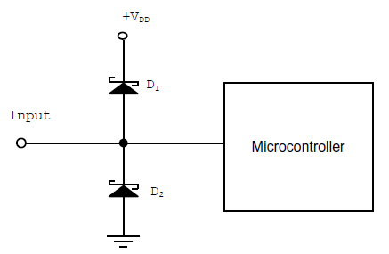
Protection of Microcontroller from Over-Voltage:

Slide 12
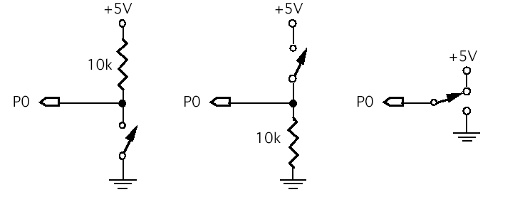
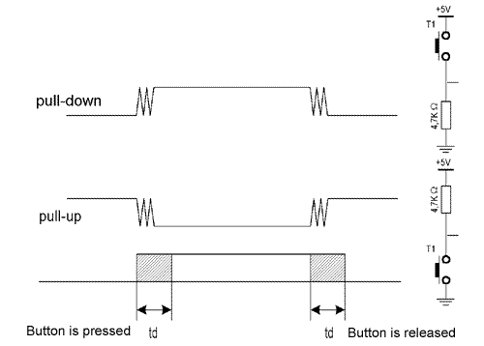
Keyboard Interfacing
Push Buttons

Slide 13
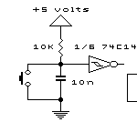

Hardware solution:

Slide 14
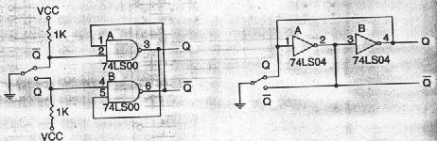
Hardware solution:

Slide 15
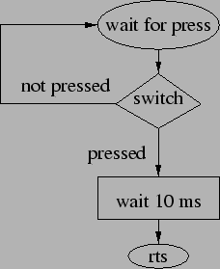
Software Solution for Debounce

Slide 17
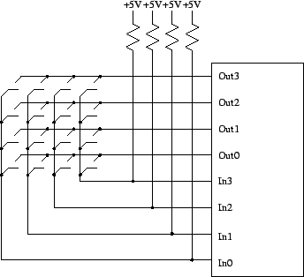
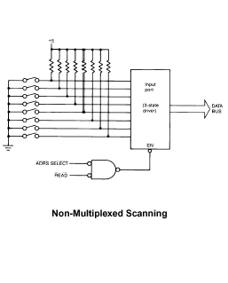

Slide 18
Interfacing the keyboard to microcontroller: In programming for keypad interfacing two processes must be considered.
Key press detection
b) Key identification
A microcontroller can perform key press detection by
a)Scanning method
b) The interrupt method (example: Port B change in 16 f877 and 18f45x)

Slide 19
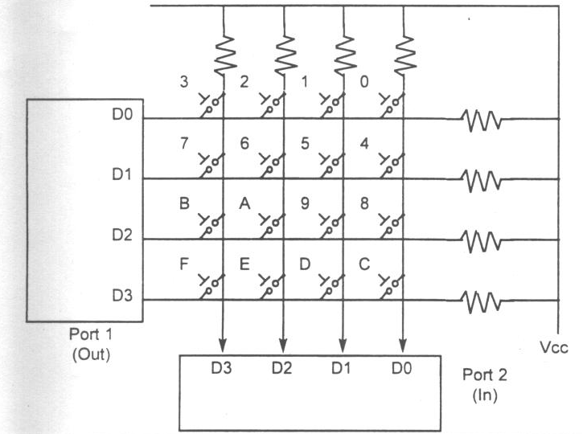
Scanned Interface for Multiple Switches: Basic Hardware

Slide 20
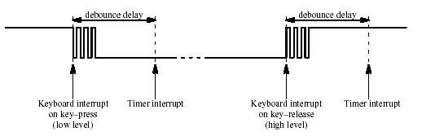
Keypad decoding with interrupt for one key

Slide 23
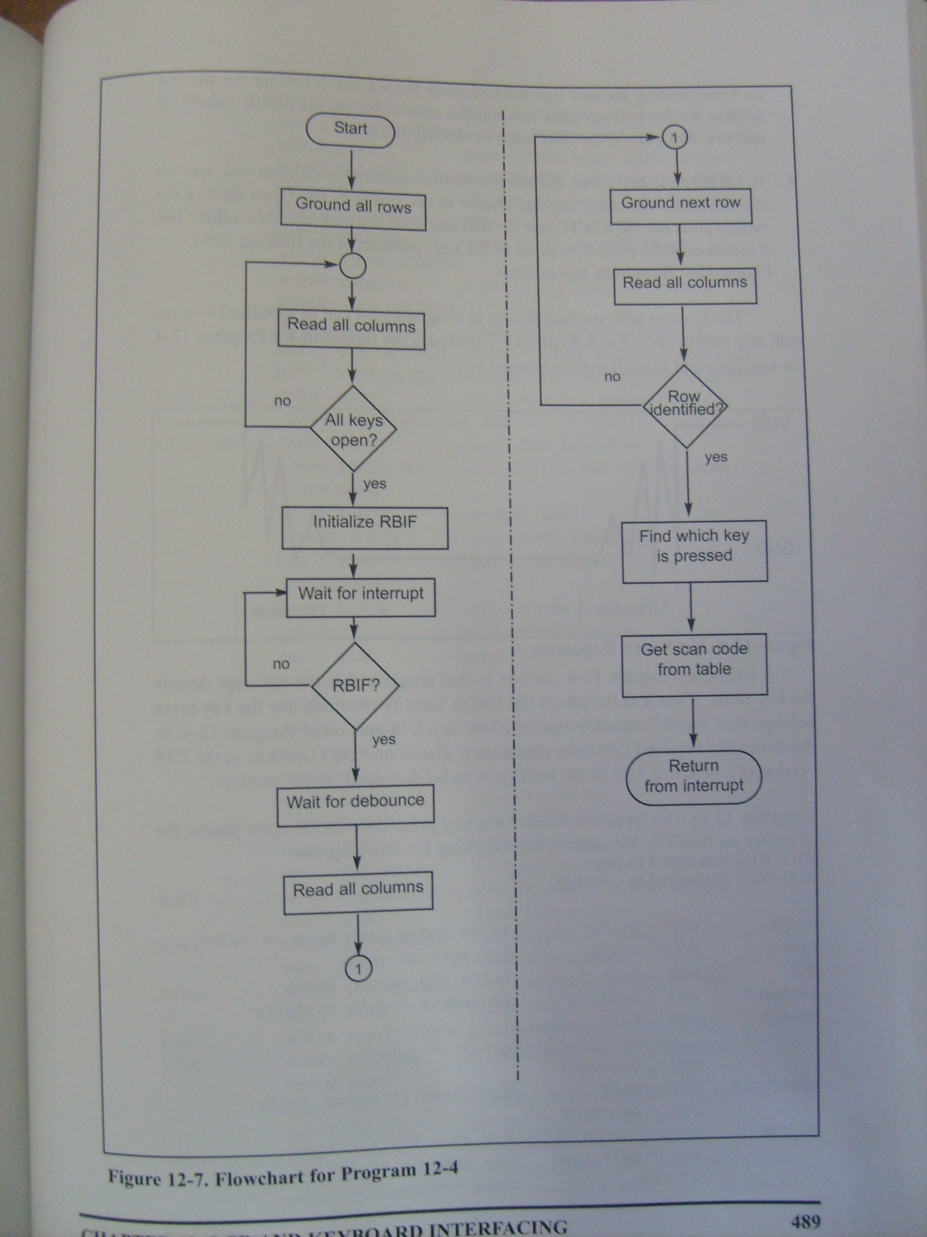
Interrupt method for key press detection

Slide 24
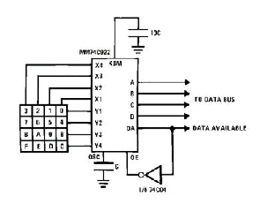

Slide 25
Power transfer:
Control of power average
Average of current
Average of voltage
Control of analog devices by digital circuit
Reduce energy consumption

Slide 26
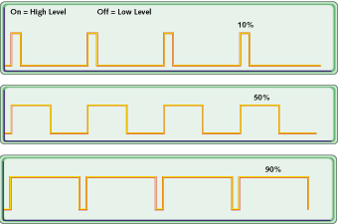
Constant frequency
Variable duty cycle
Power supply

Slide 27
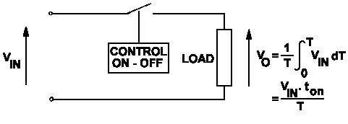

Slide 28
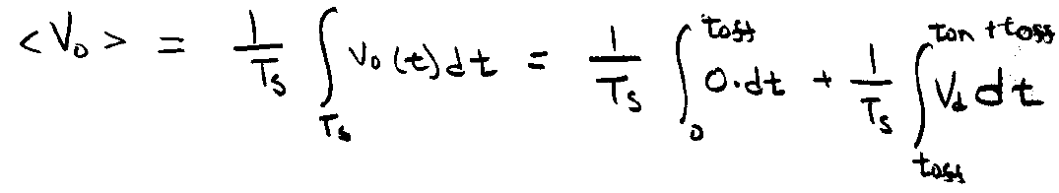

Slide 29
Vo depends on D not frequency: D can be changed by using PWM method:
T = Ton+ Toff
Switching frequency = 1/T, Ton changes regards to error.

Slide 31
Second example: Speed control of a permanent magnet DC motor with using PWM pulses. The speed of the motor is nearly proportional
with the applied DC voltage.
PWM pulses control the switching element and change the average voltage across the motor.

Slide 32
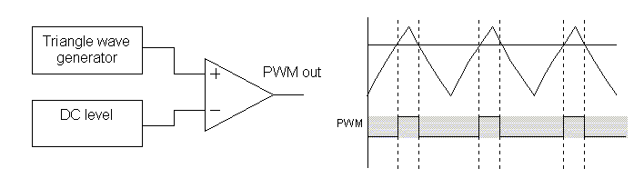
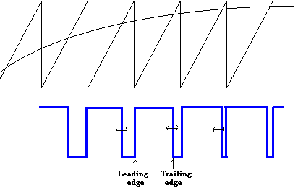
PWM pulses generation:
The PWM signals can be generated in a number of ways. There are several methods:
1. Analogue method
2. Digital method (By using timers in microcontrollers)
3. Mixed analog-digital circuits (OP-AMP+ Flip flop)
. Analogue method

Slide 33
PWM module in microcontrollers
(A timer based application)
PWM_Output is set to set to 1 (High)
The PWM_Counter (a register) is incremented in the Timer interrupt (ISR).
When the PWM_Counter value exceeds dutyCycleCount, the PWM_Output is
reset to 0. This is shown in figure
When the PWM_Counter value exceeds MAX_count, the PWM_Output is set to 1.
0 <= dutyCycleCount <= 256
As the PWM counter is 8 bit register, Resolution of the duty cycle is 1/256 (approximately 0.39%). PWM output is at one of the digital output port pin,

Slide 34
PWM frequency
The re-load value for the timer should be correctly calculated
Example: If Ttick = 10 μs, then,
To produce an interrupt at every 10μ s, what should be the reload value of Timer 0? Using a System Clock of 22.1184 MHz
So, the number of clock pulses required is:
Timer 0 reload value = 255 – 221 = 34 ( The time icounting from 255 to zero)

Slide 35
Varying the PWM Duty Ratio (DC motor speed control or output voltage of a voltage converter ) The ADC converter is 12 bit converter.

Slide 36
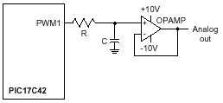
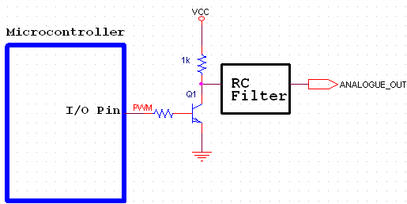
PWM as a simple DAC

Slide 37
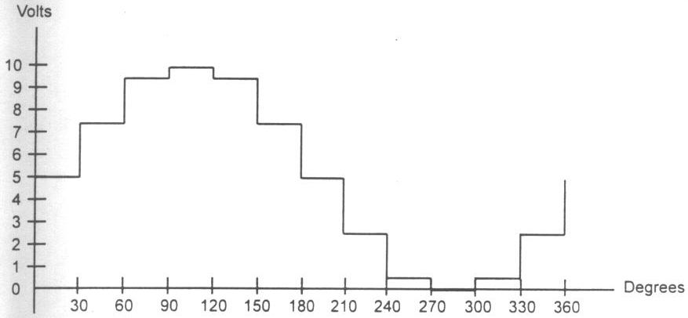
sine wave Generation by a microcontroller
8 bit
Microcontroller
DAC circuit
Sine wave

Slide 38
