Slide 1
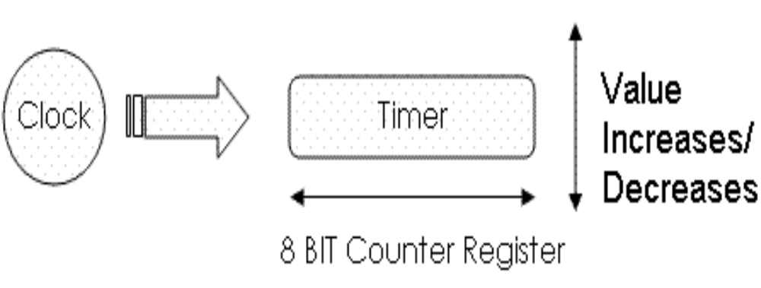
Timers:
A timer is a digital sequential circuit that can count at a precise and programmable frequency. A timer on a µC is simply a counter. The input clock to a timer can be internal or external. The input clock (internal) frequency to a timer can be prescaled so that it is some fraction of the system clock frequency.Auto Reload Timer. Compared to a standard timer, this timer automatically reloads its counting value when the count is over, therefore sparing a waste of CPU resource.

Slide 2
Timers:
A timeron a µC is simply a counter . The input clock frequency to a timer can be prescaledso that it is some fraction of the system clock frequency.
Timers can be used for:
Switch Debouncing (Delay)
Waveform Generation
Pulse Width Measurement
Generation of Pulse Width Modulation (PWM)
Period and Frequency Measurement
Speed Measurement by encoder
Delay Generation
Measuring time between events and Event counting
Timer ON-OFF bit
Timer is 8 bit or 16 bit
Timer clock source
Timer prescaler value
Timer postscaler value
Timer clock edge bit value
Each Timer has a interrupt flag bit. When timer reachs it Max Value

Slide 3
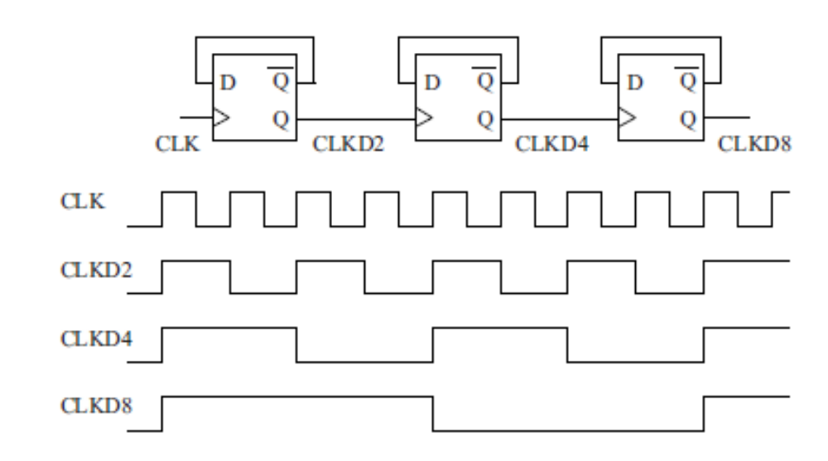
Timer0 includes a programmable prescaler that divides the timer input clock,
PIC18F452 has four independent timer circuits, which are called timer0, ... , timer3.
Timer1 and timer3 are especially coupled to capture/compare and pulse-width modulation circuits (CCP1 and CCP2). These timers can measure the timing of the external events precisely.
Timer2 is dedicated for the pulse-with-modulated output, to control the CCP circuitry.

Slide 4
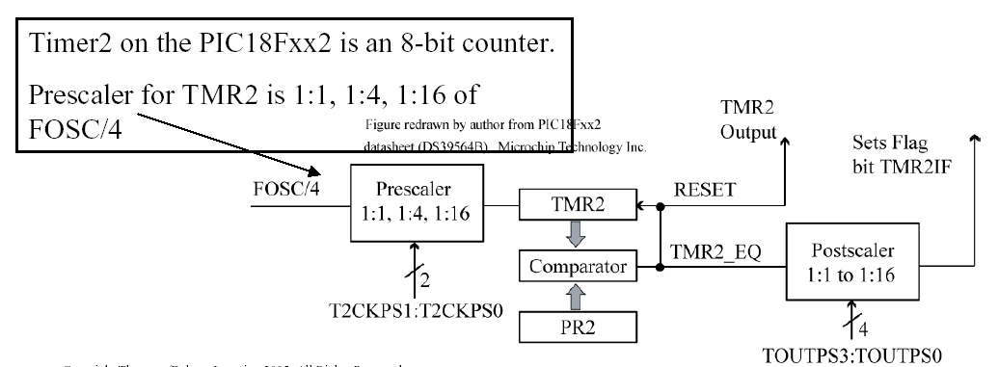
PIC18 Timer Summary
Timer0: software selectable as either 8-bit or 16-bit, has a prescaler, clocked by FOSC/4 or external clock.
Timer1: 16-bit, has a prescaler, used with capture/compare module, clocked by FOSC/4 or external clock (has dedicated oscillator circuit, so can support a second external crystal).
Timer2: 8-bit, has prescaler/period register /postscaler, used with pulse-width modulation module
Timer3: A duplicate of Timer 1, shares Timer1’s dedicated oscillator circuit.
?
?
?

Slide 5
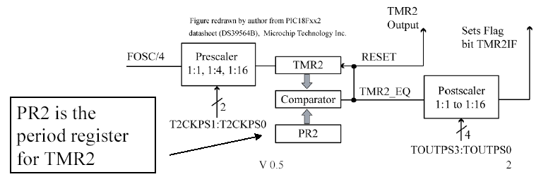
Period Register
A timer can be programmed to roll over at any point using the
Period Register
  –An 8-bit timer would typically roll over to 0x00 once it reached 0xFF.
  –However, if the period register is set to 0x7F, then timer will roll over to 0x00 once it increments past 0x7F.
Each timer has a control register, which sets timer operatiom modes:

Slide 6
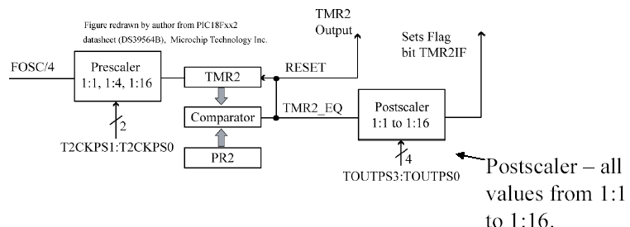
Postscaler
•A Postscaler is used as a second counter –only generate an interrupt after timer rolls over N times.

Slide 7
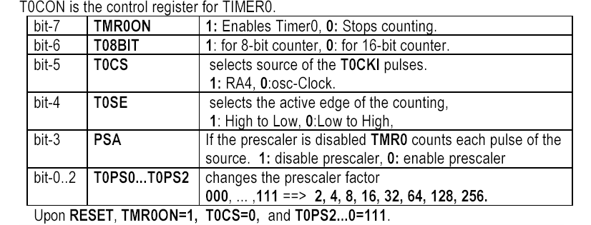
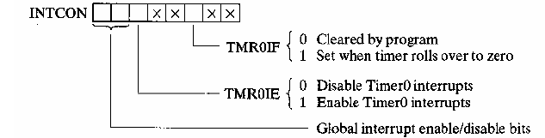
Timer0
Timer0: software selectable as either 8-bit or 16-bit, has a prescaler, clocked by FOSC/4 or external clock.
Can be used as either 8-bit or 16-bit timer. Picture shown is 16- bit mode.

Slide 8
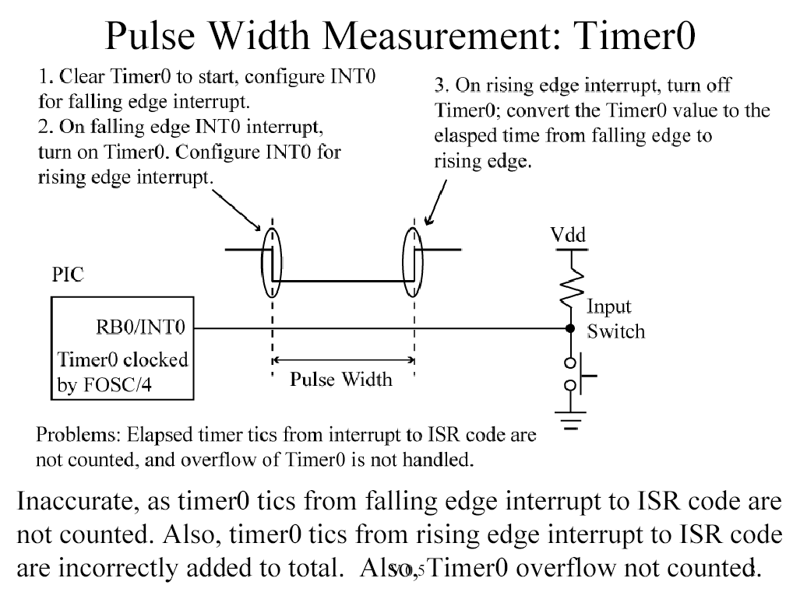
Pulse width measurement with using of Timer 0: The time between two edege (falling and rising edge)
Weakness of this measuring method: (low accuracy). The time from the falling edge to the timer byISR (interrupt..) is not counted as a part of the pulse width

Slide 9
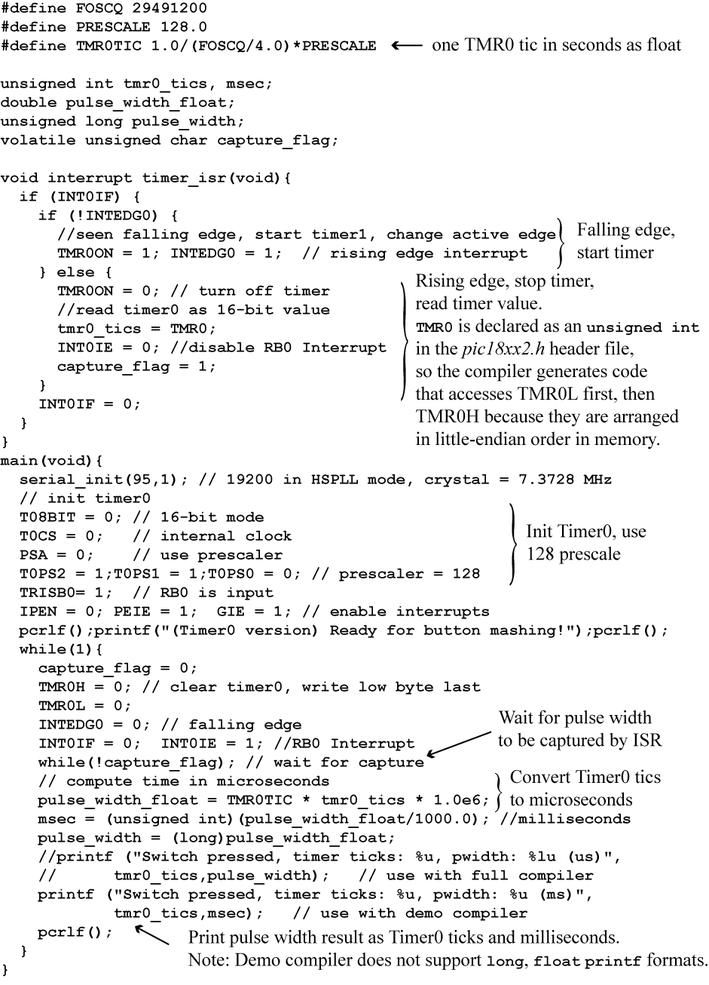
Pulse width measurement with Timer0

Slide 10
Pulse width measurement with Timer0 : continue

Slide 11
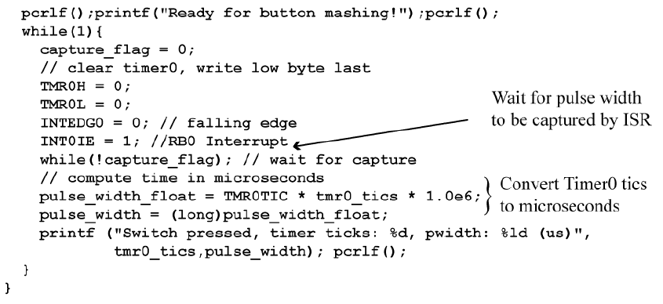
Pulse Width Measurement: Timer0 main
This works of for human activated pushbutton time measurement,
but if more accurate measurements are needed, then use the Capture module.

Slide 12
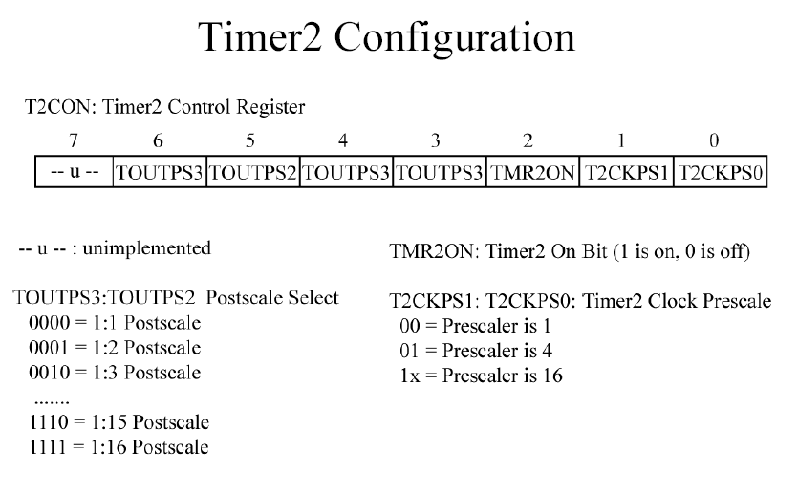

Slide 13
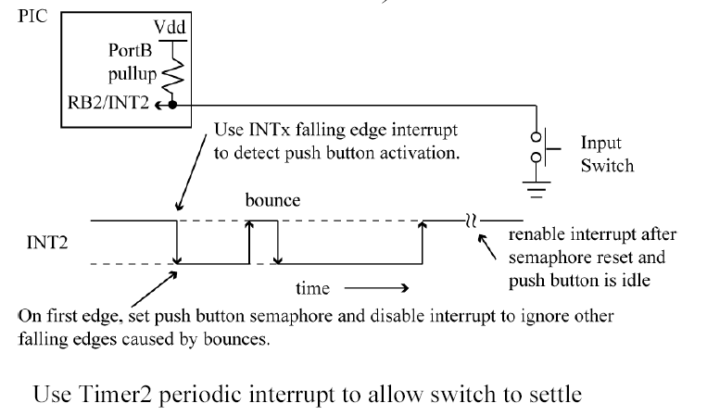
Switch DebounceUsing Timer2 (Chap. 10.9)

Slide 14
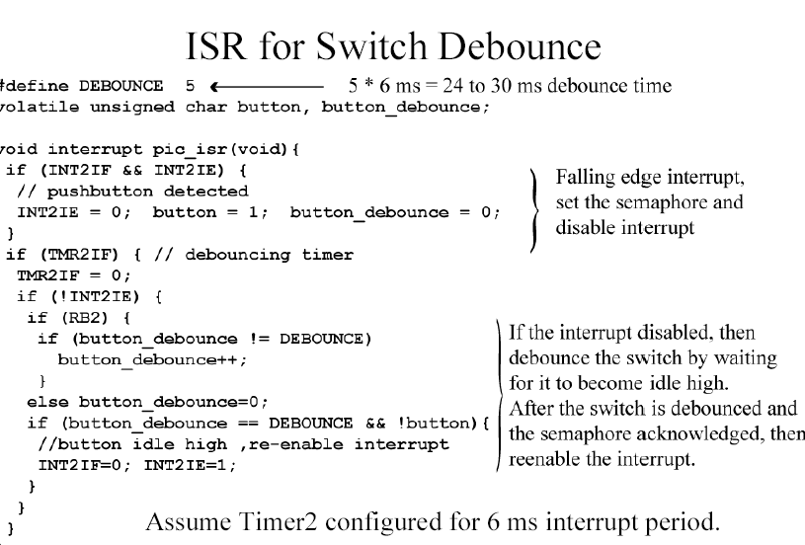
Debounce: İnterrupt+Timer

Slide 15
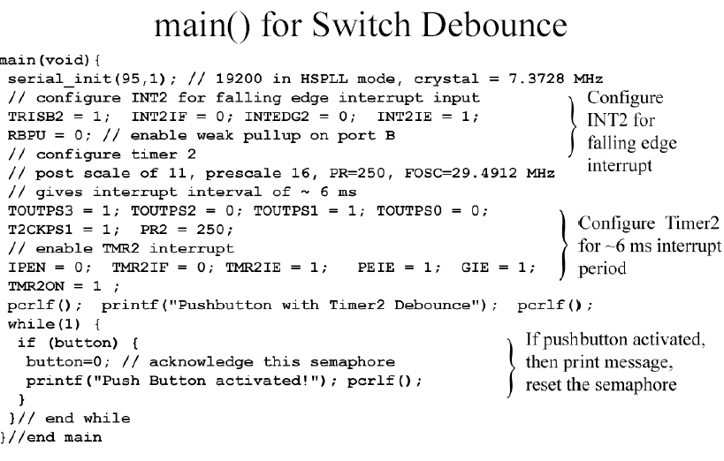

Slide 16
The (CCP) module: The (CCP) hardware module is software programmable to operate in one of three modes:
1. A Capture input
2. A Compare output
3. A Pulse Width Modulation (PWM) output
Capture/Compare module (18fxx)
  –16-bit capture register, 16-bit compare register
PWM Master/Slave Duty Cycle Register
Pulse Width Modulation (PWM) mode is used to produce a square wave without processor intervention ;Uses timer2 resource, and Compare register
  Square wave on output pin 100% hardware generated, no software intervention
  Can vary the duty cycle via the Timer2 PR2 register

Slide 17
Principles of CCP (Timer based)
A capture, compare, and PWM, module, or CCP for short, is designed into the Microcontroller to assist with measurement or control of time based pulse signals.
Capture mode causes the contents of an internal 16 bit timer, upon detecting an n’th rising or falling edge, to be written to on-board special function registers
Compare mode generates an interrupt, or change on output pin, when Timer matches a pre-set comparison value
PWM, or formally pulse width modulation, mode creates a re-configurable square wave duty cycle output at a user set frequency. The application software can change the duty cycle or period by modifying the value written to specific special
function register.

Slide 18
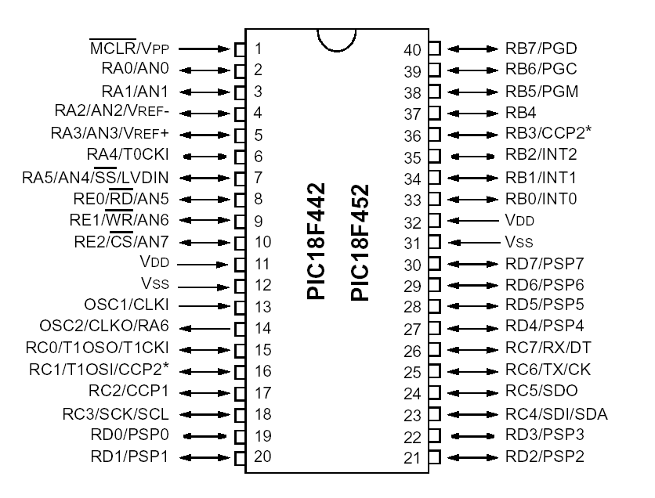
PIC18FXX Microcontroller Families

Slide 19
Initialization of CCP – Capture Mode
Set the TRIS bit for input pin operation
Signal transition at the input pin is sampled for the 1st, 4th, 16th rising edge or the first falling edge recorded causes a capture event
Timer 1 must be turned on to have a continuous clock source
CCP - Compare Mode Compare Mode
Initialization of CCP - Compare Mode
TRIS bit for CCP pin, configured for compare mode, must be cleared to place pin in output mode

Slide 20
Input Capture.
Application of Input Capture:
Generate interrupts
Measure period
Measure pulse width
Count pulses
Decode remote control (TV remote control)
Magnetic card reader
In capture mode, the CCP copies the 16-bit timer value to another register pair at the instant an input voltage changes (where n is 1 or 3).
CCP1 does the following copy in capture mode: TMRnH → CCPR1H and
TMRnL → CCPR1L
CCP2 does the following copy in capture mode: TMRnH → CCPR2H and
TMRnL → CCPR2L

Slide 21
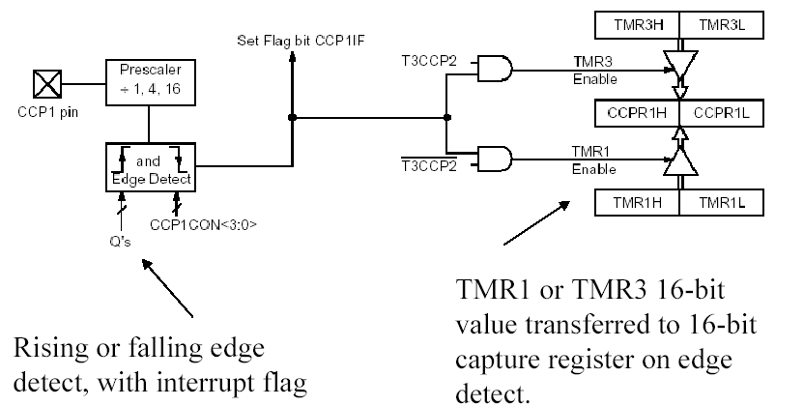
Capture In Mode of the CCP module is used for time measurement.

Slide 22
Remember
Weakness of this measuring method: (low accuracy). The time from the falling edge to the timer byISR (interrupt..) is not counted as a part of the pulse width

Slide 23
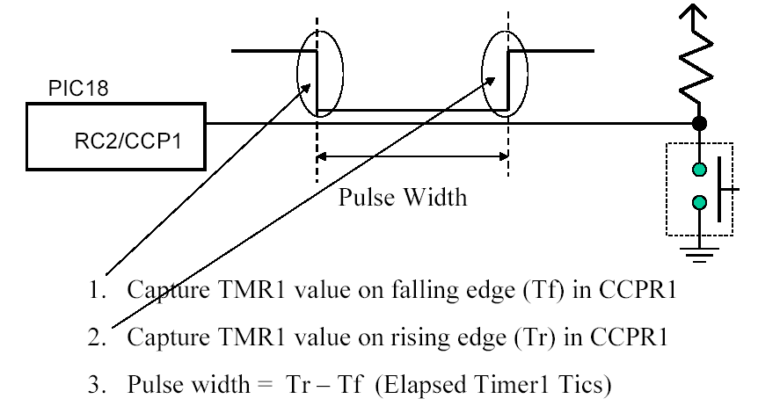
Measuring pushbutton pulse width (Capture input)Using CCP module
Use interrupt to save timer values.

Slide 24
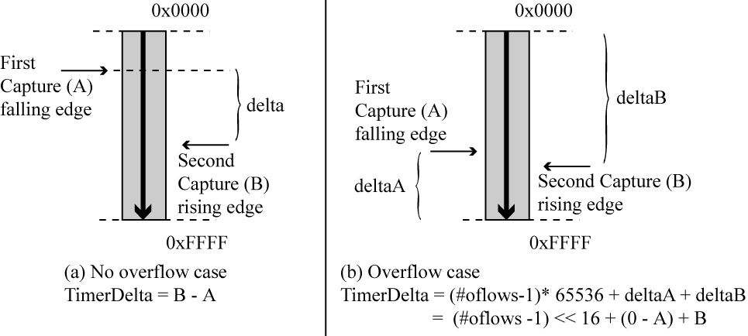
Computing Pulse Width (CCP interrupt)

Slide 25
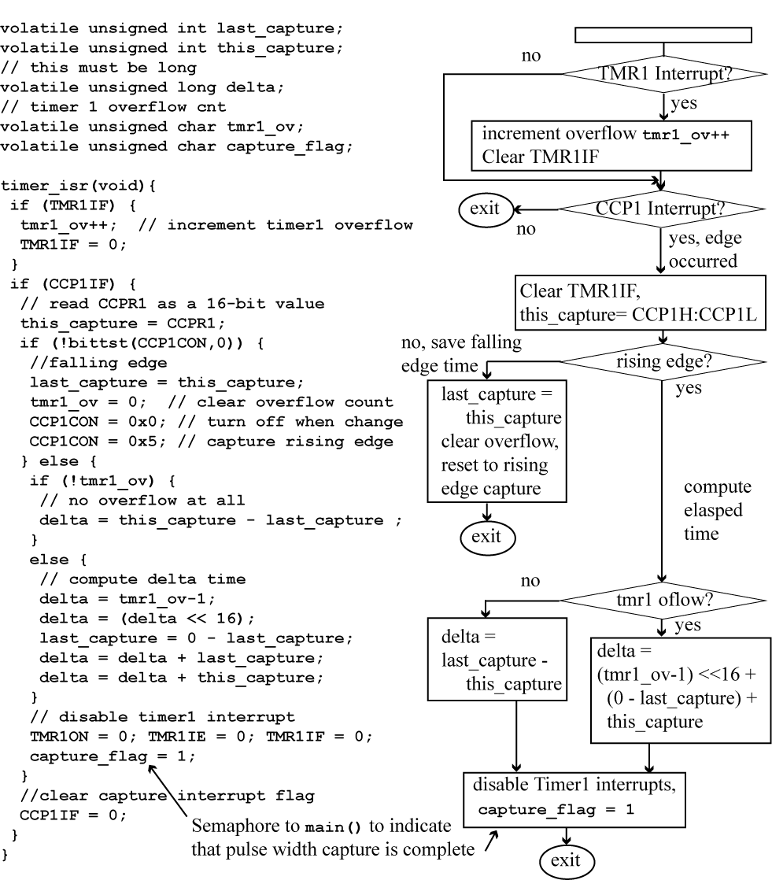
Computing Pulse Width (CCP interrupt)

Slide 26
Output Compare:
Application:
Generate periodic interrupts
Generate square waves
Generate pulse width encoded signals
•Pulse Width Modulation (PWM) mode is used to produce a square wave without processor intervention
  •Uses timer2 resource, and Compare register
  •Square wave on output pin 100% hardware generated, no software intervention
  •Can vary the duty cycle via the Timer2 PR2 register

Slide 27
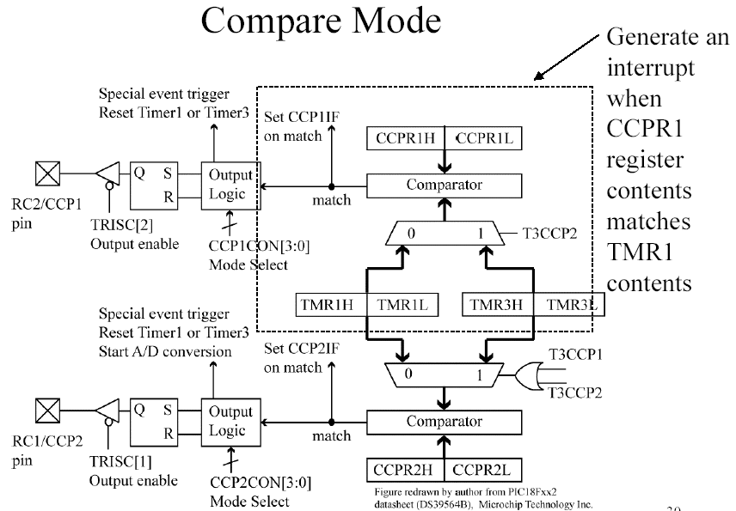

Slide 28
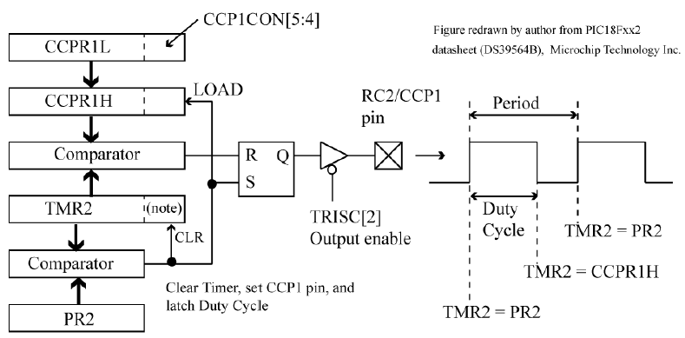
PWM works based on a timer
PIC18Fxx2 PWM
When TMR2=PR2, output SET, TMR2 reset to 0.
When TMR2 = CCPR1H, then output RESET
Note that when TMR2 is used for PWM, the postscaleris NOT used.
Period defined by PR2,

Slide 29
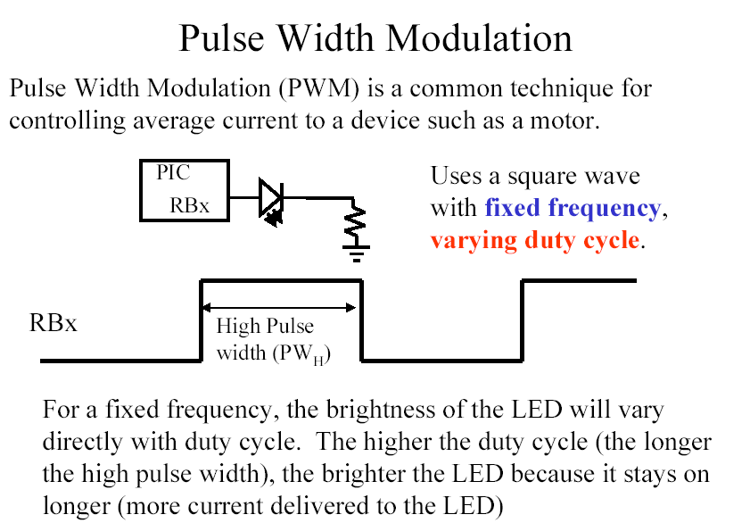
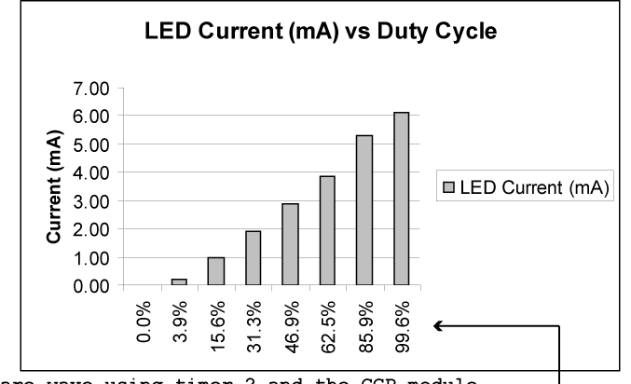

Slide 30
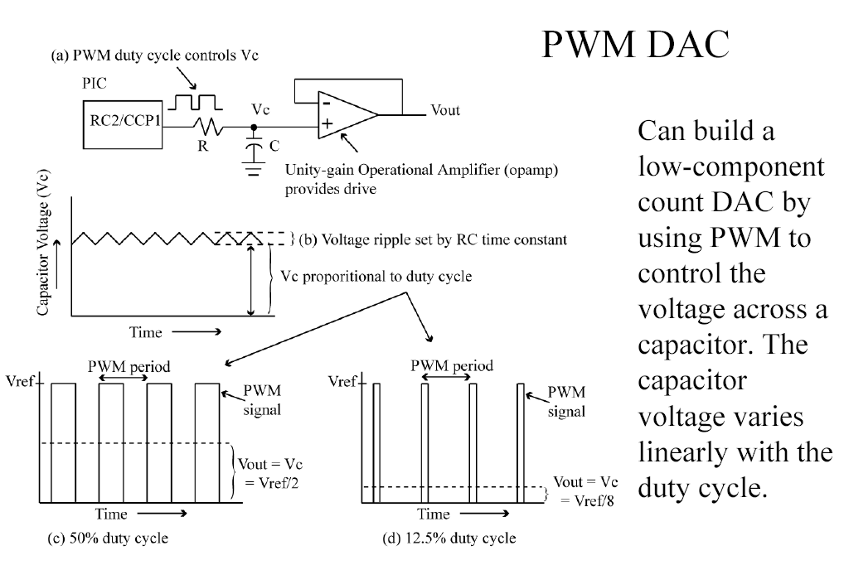

Slide 31
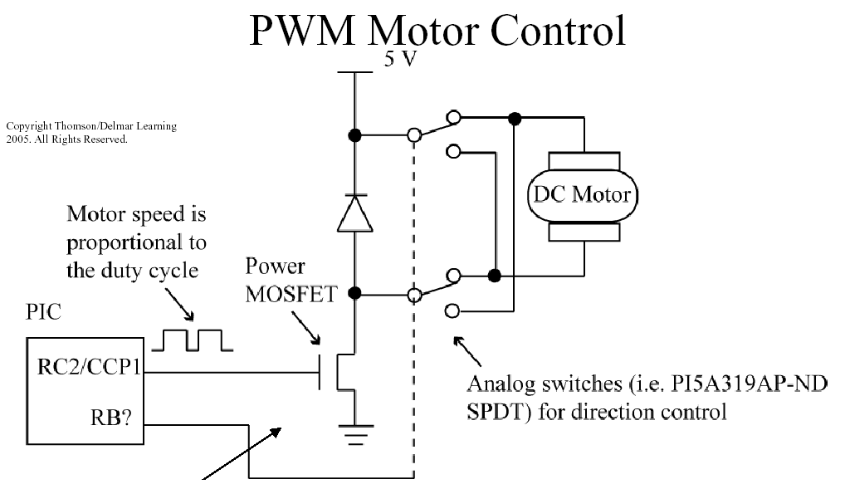
Control of DC motor: Direction and speed with one powe driver and two analoge switches.

Slide 32
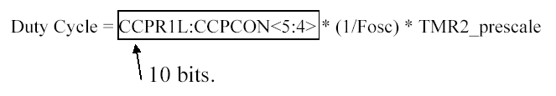
PWM registers setting: Period defined by PR2,
duty cycle by CCPR1L + 2 bits (10-bit value)
SETUP FOR PWM OPERATION:
Set the PWM period by writing to the PR2 register.
PWM duty cycle by writing to the CCPR1L register and CCP1CON<5:4> bits.
Make the CCP1 pin an output by clearing the TRISC<2> bit.
Set the TMR2 prescale value and enable Timer2 by writing to T2CON.
Configure the CCP1 module for PWM operation.

Slide 33
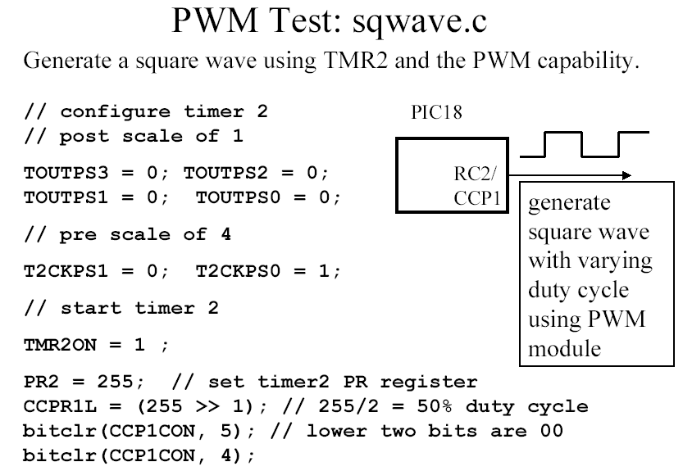

Slide 34
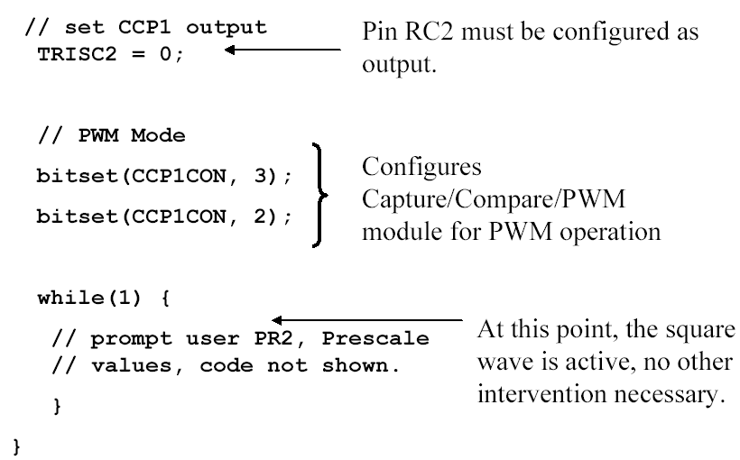

Slide 35
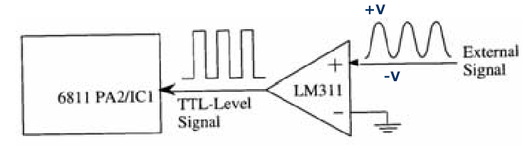
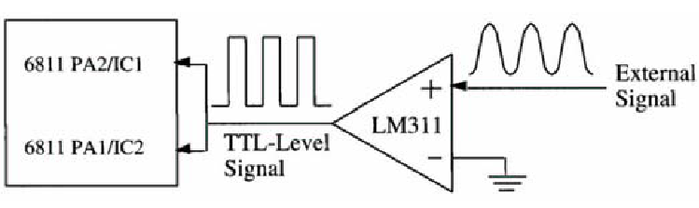
16-bit period measurement with 500 ns resolution using input capture (interrupt)
Pulse width measurement using two input capture channels(without interrupt)

Slide 36
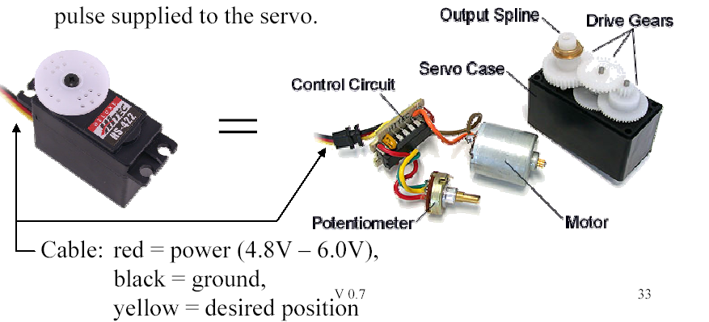
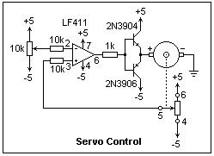
Servos Servos, widely used to steer model cars, airplanes, and boats, consist of a motor with gearing to reduce the output speed and increase output torque and a control circuit which spins the motor until the motor’s position measured by the potentiometer matches the desired position specified by a pulse supplied to the servo.

Slide 37
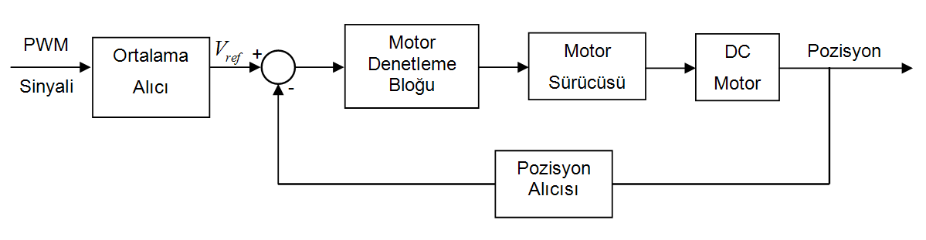
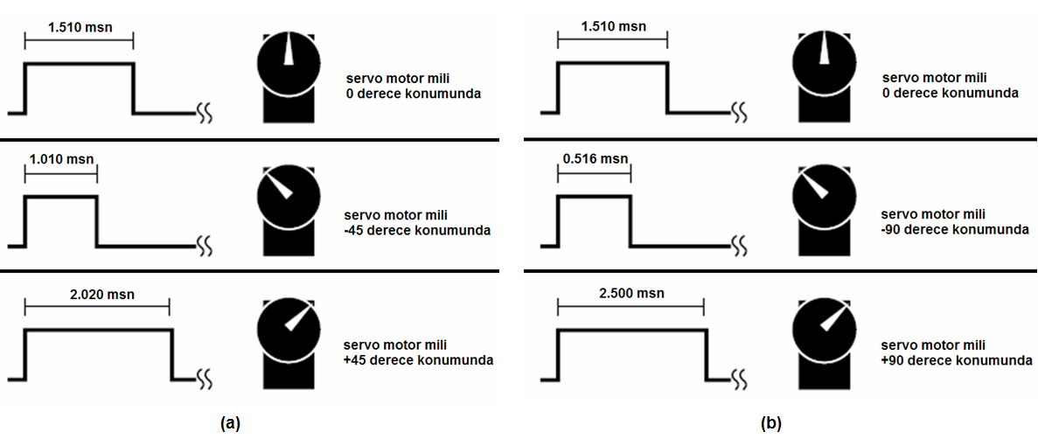

Slide 38
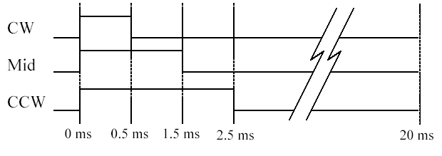
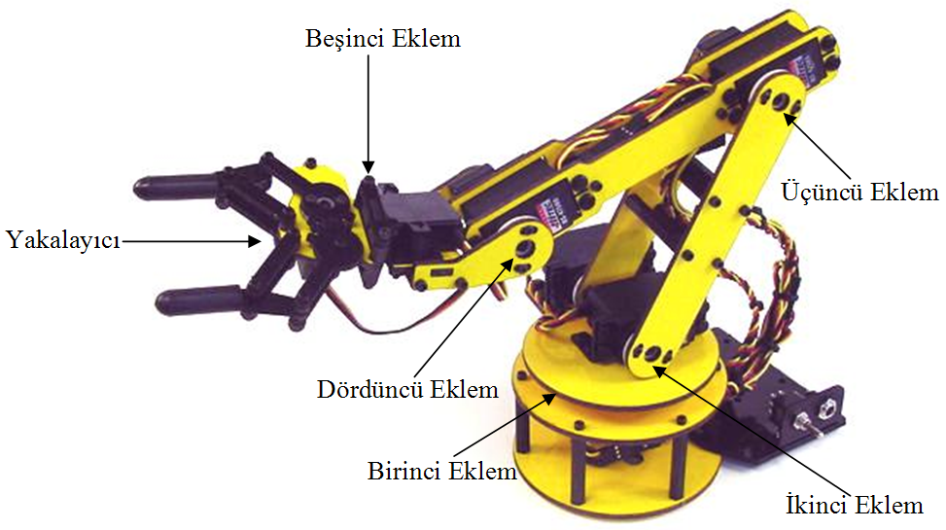
Controlling servos
The high time of a pulse gives the desired position of the servos. The pulse width must be 20 ms. A high time of 1.5 ms moves the servo to its center position; smaller or larger values moves it clockwise or counterclockwise from the center position. This is termed pulse code modulation (PCM).
Example:
Robot arm

Slide 39
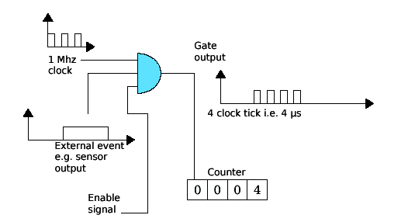
Time measurement:
Figure shows how a counter/timer can be used to measure time
periods. Suppose a microprocessor is required to measure the
duration of some external event. If it raises the “Enable” signal
shown to logic 1 AND, the external event signal is high then the gate
output will switch in accordance with the clock. When the event
signal goes low, the gate is effectively closed. The counter value
remains static and the number of pulses (microseconds) can be read
from the counter.
Period measurement using a timer/counter.

Slide 40
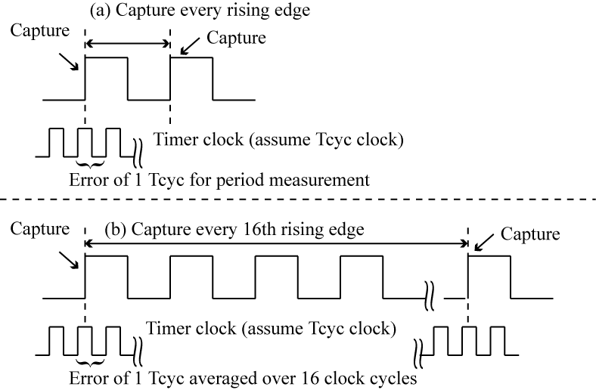
Using capture mode for freqency measurmnet
The captuer mode prescaler is set to perform capture evrey 16th rising edge

