Slide 1
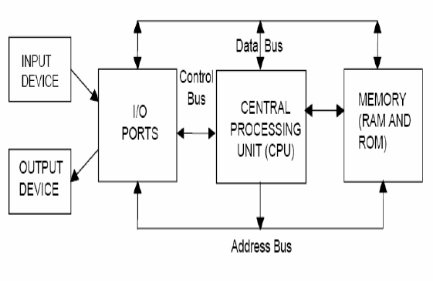
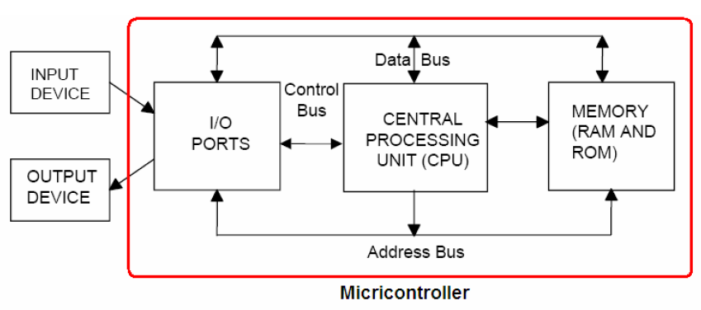
Microprocessor vs microcontroller
Microcontroller advantages
lower cost, more reliable, better performance,
may be less flexible for research and development projects

Slide 2
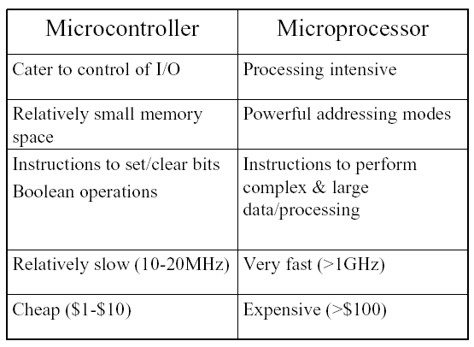
Microcontrollers:
A standard single-chip system incorporating a processor, memory, and I/O devices.
Program memory:
OTP ( 18Cxx)- Masked version, UV EPROM (20 min for erasing)
Flash memory (18fXX)

Slide 3
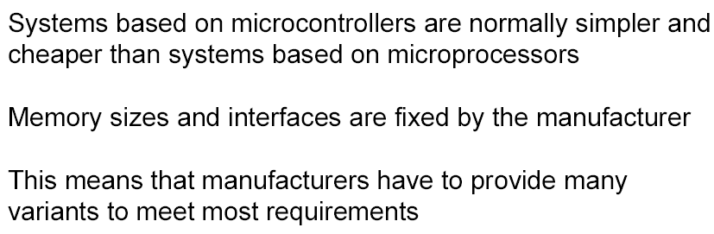


Slide 4
Microprocessor vs. Microcontroller
Microprocessor
CPU is stand-alone, RAM, ROM, I/O, timer are separate
designer can decide on the amount of ROM, RAM and I/O ports.
expansive
versatility
general-purpose
Microcontroller
CPU, RAM, ROM, I/O and timer are all on a single chip
fix amount of on-chip ROM, RAM, I/O ports
for applications in which cost, power and space are critical single-purpose

Slide 5
Selection of system components
Microcontroller
Manufacturers
Analog Devices
Atmel
Dallas Semiconductor
Freescale
Hitachi Semiconductor
Intel
Microchip
National Semiconductor
Renesas
STMicro
Texas Texas
Zilog Zilog
Adequacy of I/O and processor capabilities
Digital and analog input/output facilities.
Timers, PWM channels, encoder interfaces
Communication channels: I2C, RS232,
parallel, CAN, ethernet
Interrupt sources and configurability
Performance
Processor core speed (MIPS)
I/O overhead and performance
(i.e. acquisition speed, accuracy)
Dedicated hardware for communications
and timing operations
Requires:
device drivers and debugging tools,
Tool chain: compilers, debugging facilities
and performance evaluation tools

Slide 6
(Types of controllers (structure and instruction)
CISC - Complex Instruction Set Computer Many instructions which can perform involved operations: compact code
Can be many clock cycles per instruction, Large silicon area
RISC - Reduced Instruction Set Computer
One instruction executed per clock cycle > Very fast
DSP - Digital Signal Processor ; Specialized type of uP; Designed for real time mathematical manipulation of data streams
Radar image processing, audio/voice processing, ultrasound and photographic image processing ,Includes instructions designed for multiplication and accumulation
Criteria for selecting microcontroller:
1- It must meet the task at hand effciently and cost effectively. (8 ,16 or 32 bit controller is nedded for handling problem and computation
Speed , Packaging (40 pin, 20 pin ,..), RAM and ROM capacity
The number of I/O ports, Cost per unit
2- Development device (assembler, compiler, debugger..) and availibility

Slide 7
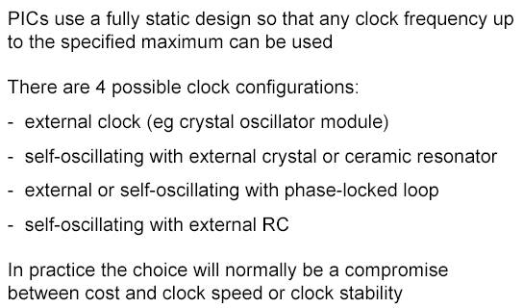
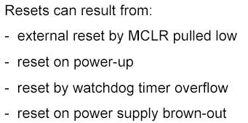
Clock:
Reset sourec:

Slide 8
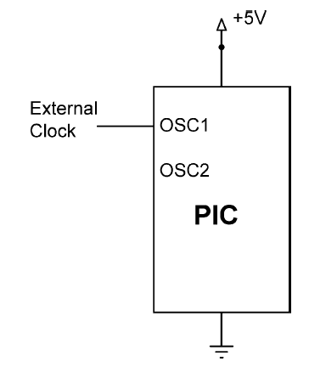
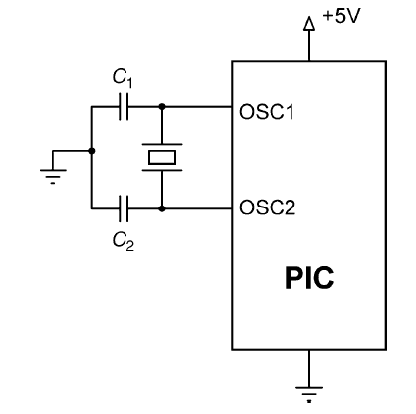
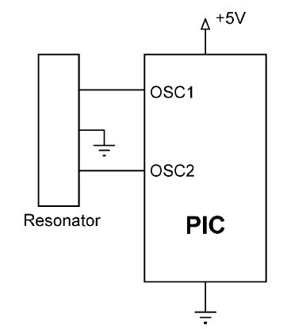
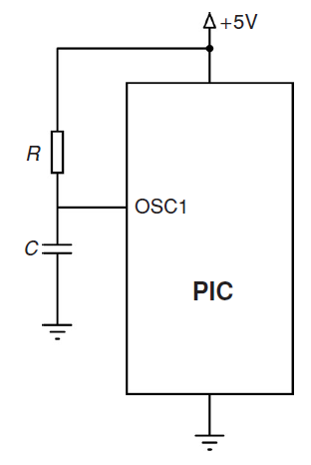
Clock pulse generation for internal CPU
Using a crystal
Using an external oscillator
Using a resonator
Some microcontrollers (e.g. PIC12C672) have built-in clock generation circuitry and do not require any external components to generate the clock pulses. The built-in oscillator is usually 4MHz and can be selected during the programming of the devices
Using an RC circuit

Slide 9
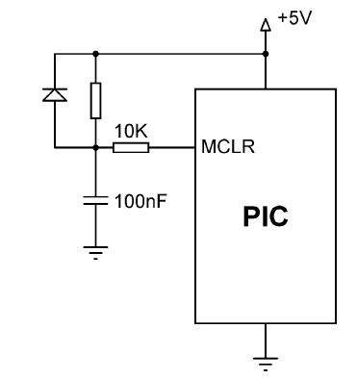
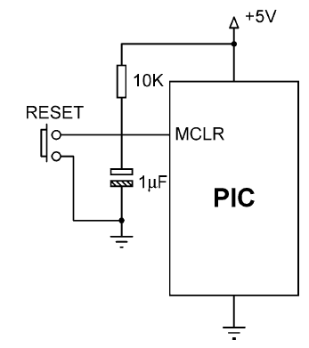
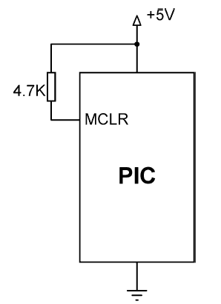
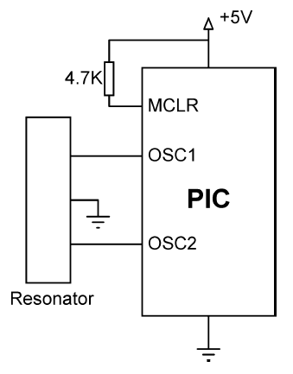
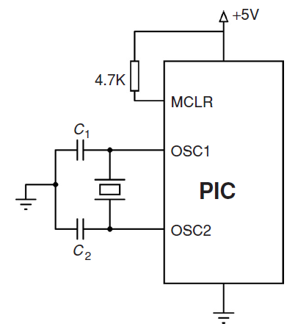
Reset of controller:
Push-button reset circuit
Simple reset circuit
Recommended reset circuit
Resonator based minimum PIC microcontroller system
Crystal based minimum PIC microcontroller system

Slide 10
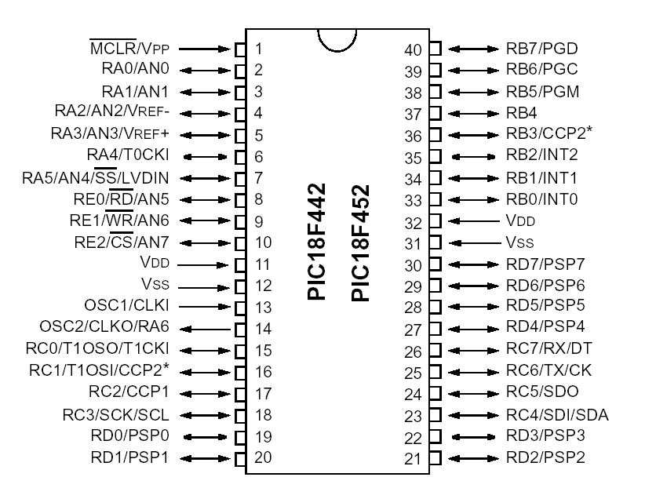
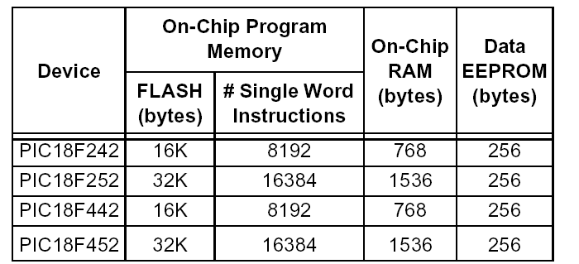
PIC18FXX Microcontroller Families

Slide 11
Vdd,Vss: These are power (Vdd) and ground (Vss) pins;
MCLR#: This input pin resets the device when brought low.
Vpp, PGD, PGC, PGM: These pins are used to download a program into the
device via an external programmer (see Appendix F).
OSC1, OSC2: These pins are used to provide the main clock source for the device
RAn, RBn, RCn: These bidirectional pins are parallel port IO pins
ANn, Vref-, Vref+: The ANn inputs are the analog inputs for the analog-todigital
converter subsystem
.
TX, RX: These pins are used for asynchronous serial transmit (TX) and receive
(RX) (see Chapter 9, “Asynchronous Serial IO”).
SCL, SDA: These pins implement the I2C synchronous serial data interface
SCK, SDI, SDO, SS#: These pins implement the serial peripheral interface
(SPI), which is a synchronous serial data transfer protocol
CCP1, CCP2: These pins are used by the capture and compare module, which
is useful for measuring time between external events and also square wave generation
INTn: These pins provide external interrupt sources to the PIC18

Slide 12
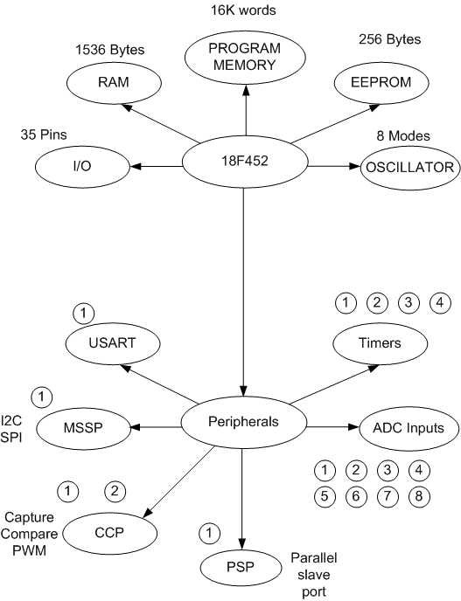
PIC 18F452 : Peripherals
The PIC 18F452 has the following peripherals:
Data ports:
A (6-Bits)
B, C and D (8-Bits)
E (3- bits)
Counter/Timer modules.
Modules 0,2 (8-Bits)
Modules 1,3 (16-Bits)
CCP Modules.
I2C/SPI serial port.
USART port.
ADC 10-bits with 8-way input multiplexer.
EEPROM 256 Bytes

Slide 13
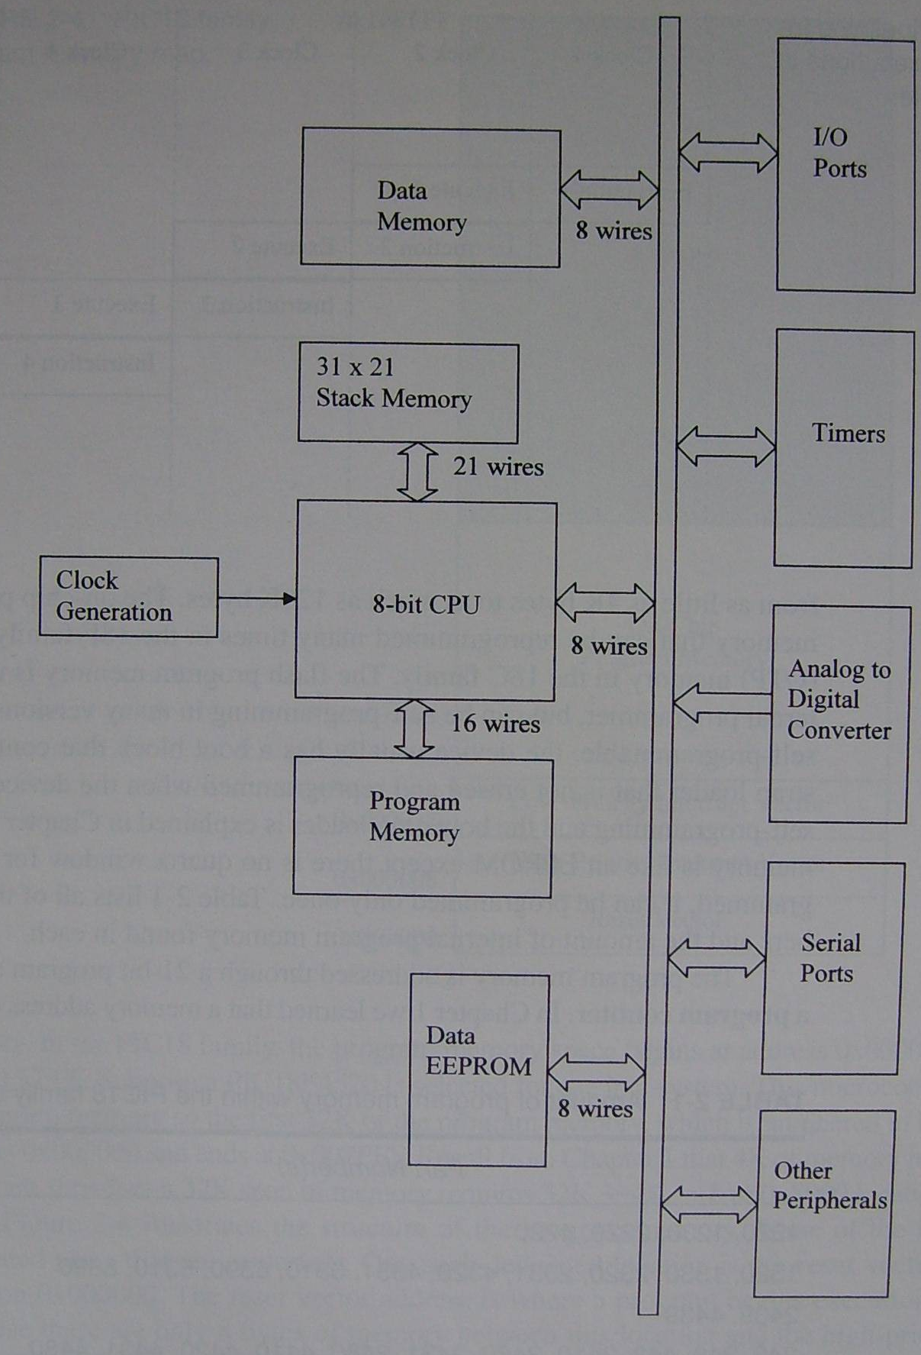
PIC18F452 Features
8-bit CPU
1536 bytes data RAM
16384 words of flash program memory
256 bytes data EEPROM
Hardware multiply
40-pin DIP package
4 timers
1 UART
1 8-channel A/D
SPI (serial)
I2C (serial)
Interrupt controller
33-pin digital I/O

Slide 14
Special Microcontroller Features: (18fxx)
• 100,000 erase/write cycle Enhanced FLASH program memory typical
• 1,000,000 erase/write cycle Data EEPROM
memory
• Watchdog Timer (WDT) with its own On-Chip RC
Oscillator for reliable operation
• Programmable code protection
• Power saving SLEEP mode
• 16-bit wide instructions, 8-bit wide data path
• Priority levels for interrupts
• 8 x 8 Single Cycle Hardware Multiplier
• High current sink/source 25 mA/25 mA
• Three external interrupt pins
Master Synchronous Serial Port (MSSP) module,

Slide 15
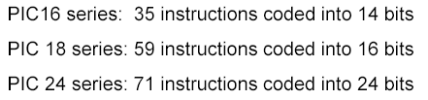

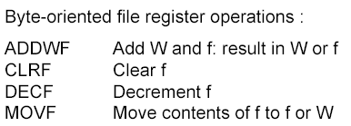
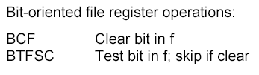
Instruction set:

Slide 16
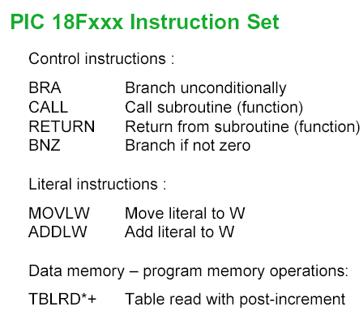

Slide 17
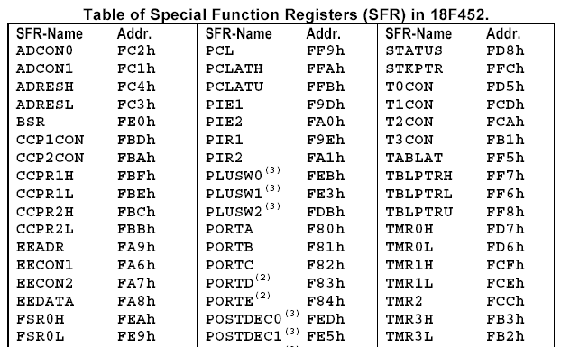
Special Registers:

Slide 18
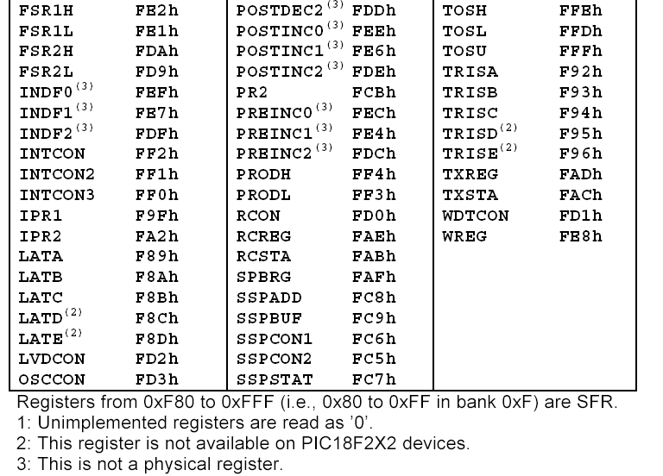

Slide 19
Registers associated with A/D conversion
ADCON0 – A/D Control0
ADCON1 – A/D Control1
ADRESH – A/D Result High
ADRESL – A/D Result Low
A/D Control Register 0:
ADCS1:ADCS0: Conversion clock select (bit 2 in ADCON1)
CHS2:CHS0: Channel select (1 of 8 multiplexer)
GO/#DONE: Start conversion
ADON: Enable A/D converter
A/D Control Register 1:
ADFM: Result format select (left or right justified)
ADCS2:CHS0: Channel select (1 of 8 multiplexer)
PCFG3:PCFG0: A/D Port Configuration

Slide 20
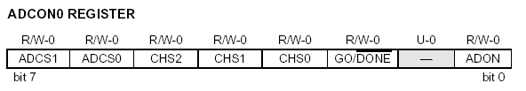
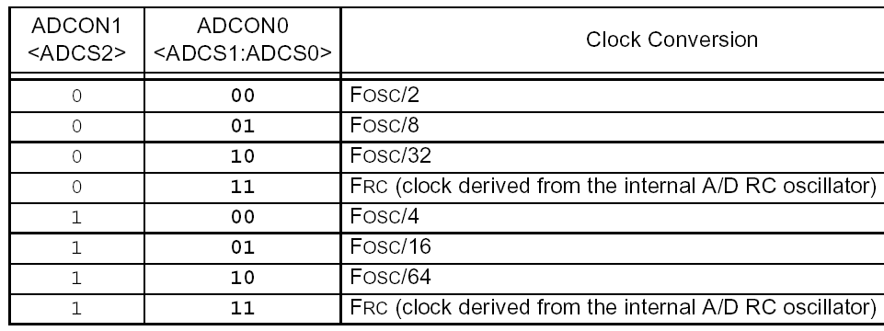
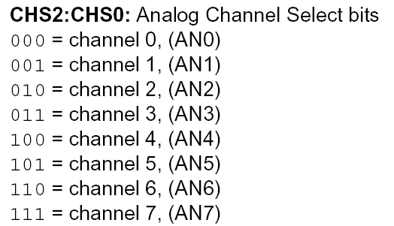
ADC Registers

Slide 21

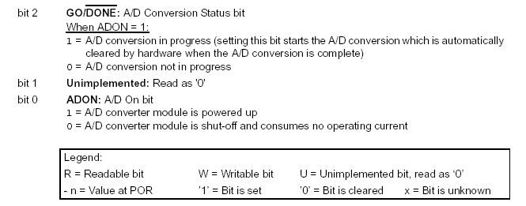
ADC Registers
The maximum recommended output impedance for analog sources is 2.5 kΩ.

Slide 22
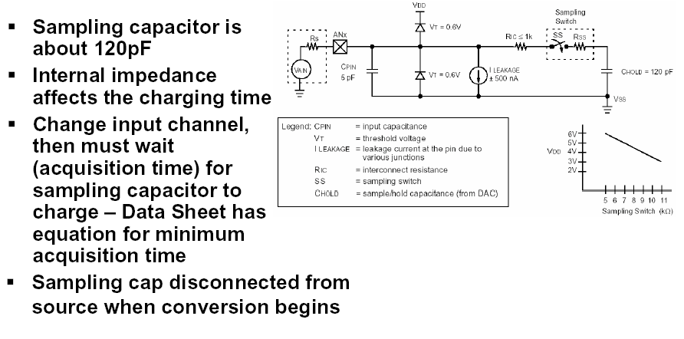
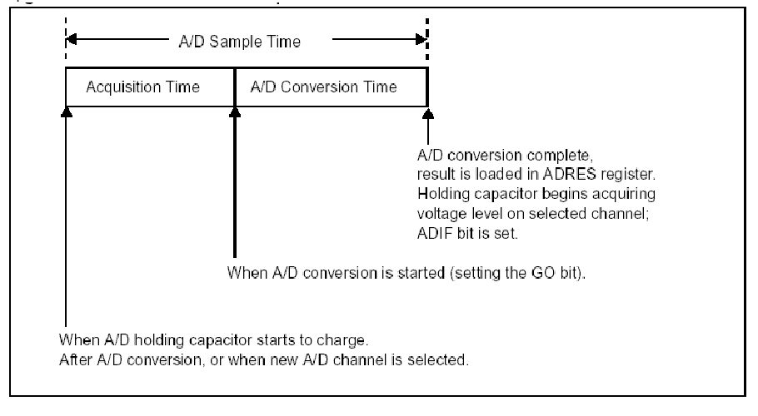
Input Clamping Diodes

Slide 23
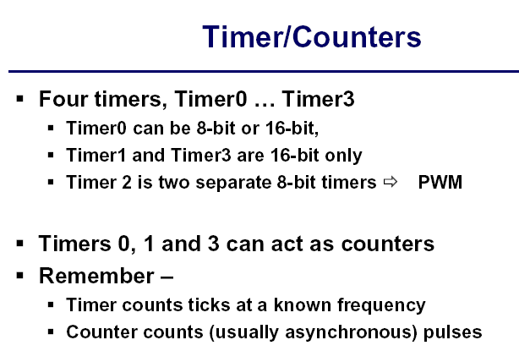

Slide 24
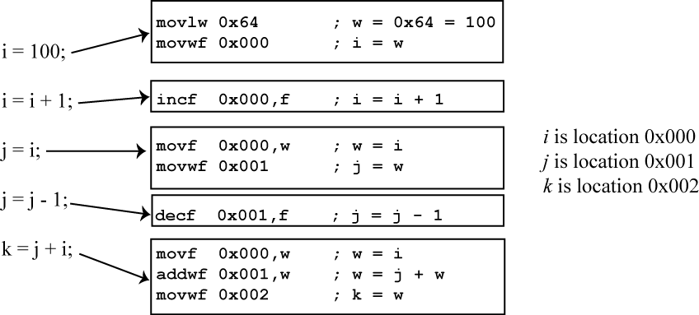
Program: Assembly and C compiler

Slide 25
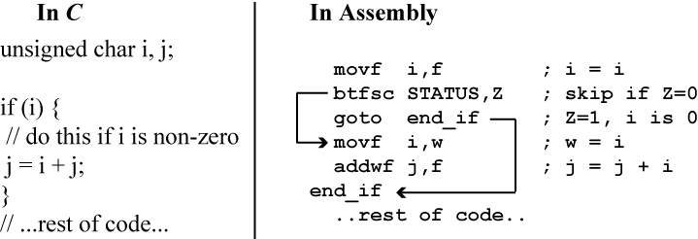
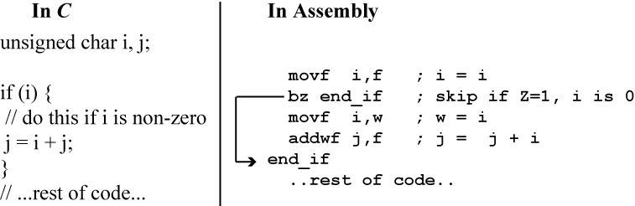
Nonezero condition test : Bnz: branch if not zero z =0, Bz = branch if zero, z=1)
Nonezero condition test : Bnz: branch if not zero z =0, Bz = branch if zero, z=1)

Slide 26
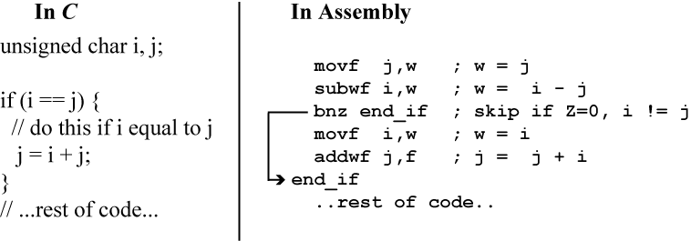
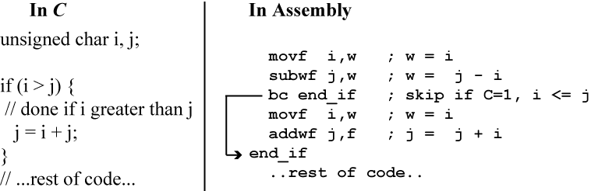
Eqality, ınequality condition test
Unsigned greather than (>)test

Slide 27
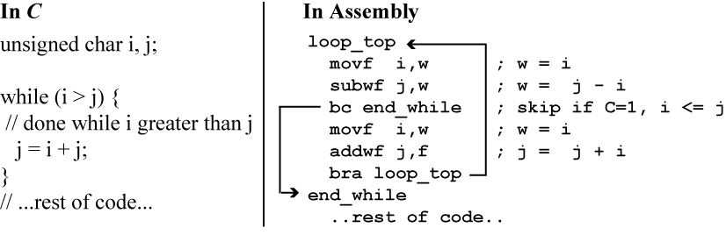
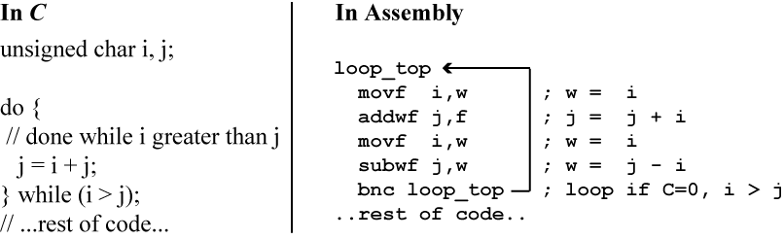
LOOP structure:

Slide 28
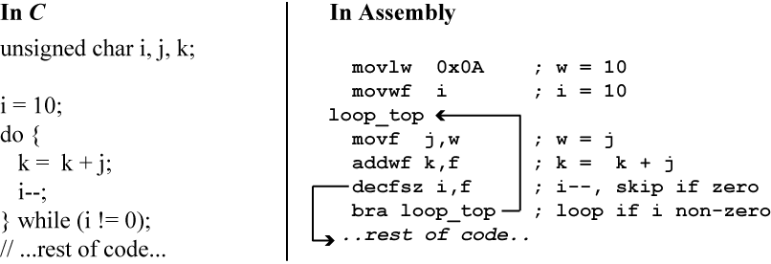
Counting loop:

Slide 29
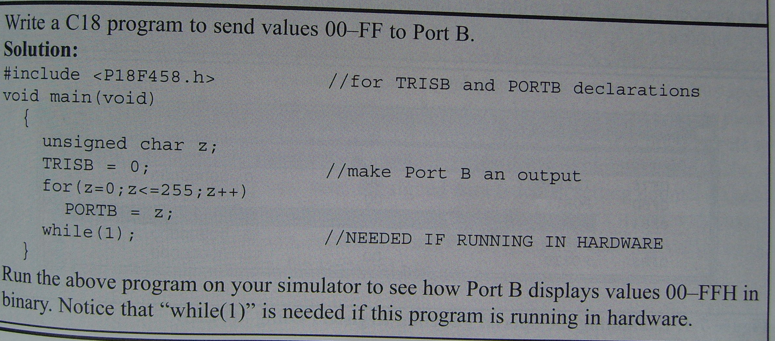
compiler fof Pic 18fXX:
C18 compiler, Hitec , CC5X copiler

Slide 30
A simple C program:
A simple program
in assembly

Slide 31
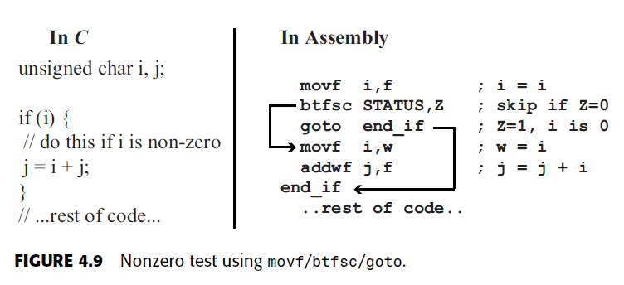
Zero, Nonzero Conditional Tests

Slide 32
Equality test using subwf/bnz.
Unsigned greater-than (>) test using subwf/bc.

Slide 33
USART - Universal Synchronous Asynchronous Receiver Transmitter
SCI - Serial Communication Interface
(asynchronous serial communication interface)
SPI - Serial Peripheral Interface
(synchronous serial communication interface)
I²C protocol or I²C Bus(Inter-Integrated Circuit Protocol)
PWM – Pulse Width Modulation
WDT - Watchdog timer
CCP - (Compare output, Capture input, PWM) relative to Timer
POR - Power-on Reset
PWRT - Power-up Timer :
The power up timer is a special timer that delays the start of program execution after the PIC has been reset on power up. This delay gives the PIC oscillator time to start and stabalise.
Start-up Timer
MCLR – Master Clear (Reset) input or programming voltage input. This pin is an active low RESET to the device.

