Slide 1
Microprocessors are by nature parallel machinesSerial communication vs. Parallel communication
Serial
• Cheap
•Slow
• Uses one line to transmit
and one to receive
• Longer transmission distance
Parallel
• Expensive
•Fast
• Requires multiple lines in order to simultaneously
transmit data bits
• Short transmission distance
Microprocessors are by nature parallel machines; that is, data moves from point to point within the machine in parallel data groups .The alternative is to move the data serially-one bit at a time

Slide 2
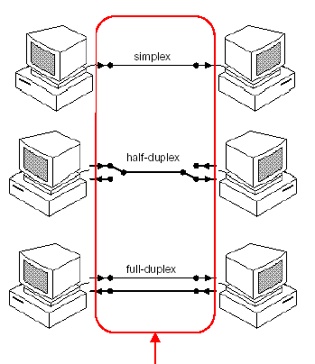
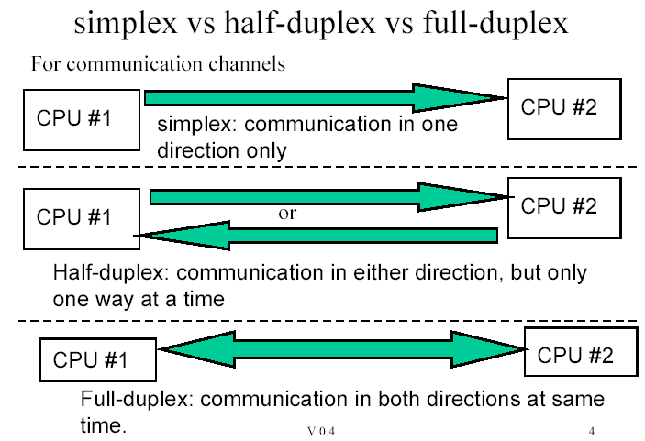
Transmisstion methods in Serial Communication
Simplex: Half Duplex: Full Duplex:

Slide 3
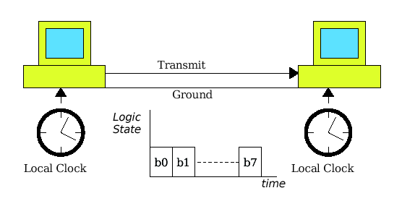
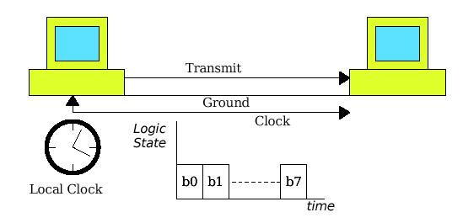
Time and clock:
Asynchronous serial transmission
Synchronous serial transmission

Slide 4
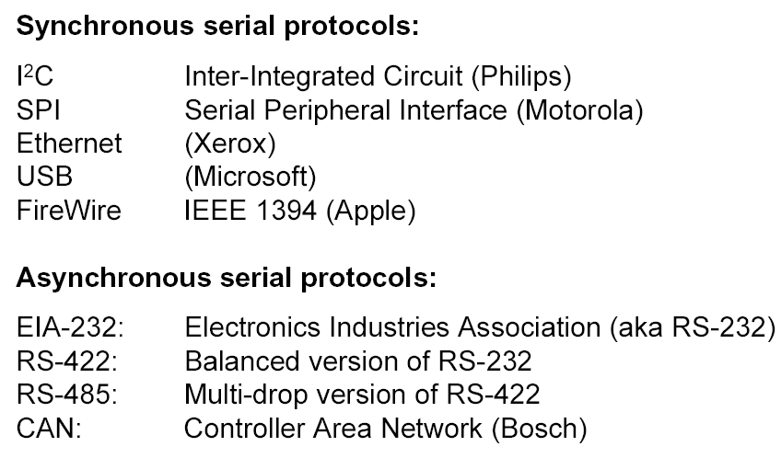
Microcontroller and Peripheral

Slide 5
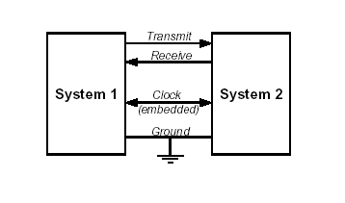

Synchronous transmission is typically used in high speed Applications
Synchronous Transmission:
In synchronous transmission, the clocks at the transmission and reception ends must be permanently synchronized
Sends the clock as a separate wire, or b) Receiver extracts clock from data stream.
Transmitting the clock signal on a separate wire (too expensive)
Embedding the clock signal in the data stream (preferred). An example of embedded clock is Phase Encoding From the received phase- encoded signal it is possible to recover both the data stream and the clock signal

Slide 6
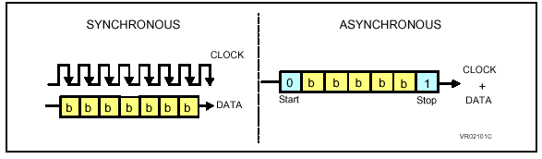
Synchronous Serial Data Transfer
_ In synchronous serial data transfer, the sending computer puts the data byte it
wants to send into an internal shift register.
_ The sending computer uses a clock to shift the 8 data bits out of the shift
register onto an external data pin.
_ The receiving computer puts the data from the sending computer on the input
of an internal shift register.
_ The receiving computer uses the clock from the sending computer to shift the
data into its shift register.
_ After 8 clock ticks, the data has been transfered from the sending computer
to the recieving computer.

Slide 7
Procedure Synchronous Transmission
To initiate transmission, the transmitter first sends out synchronization characters to the receiver
The receiver reads the synchronization bit pattern and compares it with a known sync pattern. Once they are identified as bieing the same, the receiver begins to read character data off the communications line
Transfer of data continues until the complete block of data is received or synchronization is lost
If large blocks of data are being sent, the synchronization characters may be periodically present to assure that synchronization is maintained

Slide 8
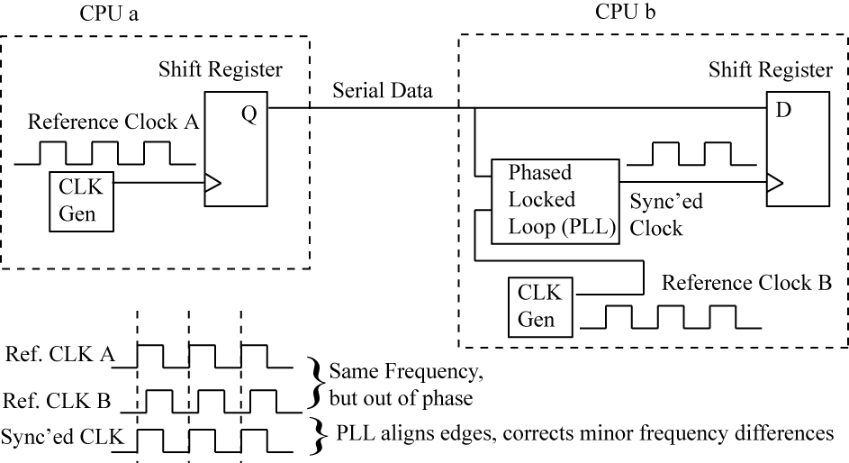
Clock in synchronous serial:
Clock as a separate signal
Clock is encoded in data stream,
so the receiver must extract
the clock (firewire)

Slide 9
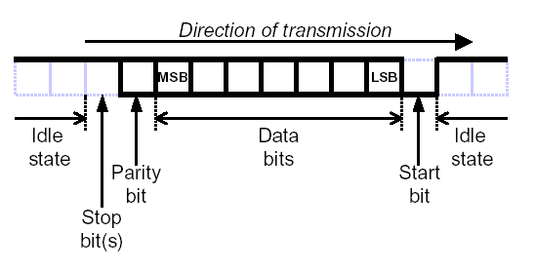
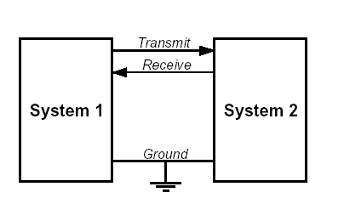
Asynchronous Transmission
In asynchronous transmission there is no need for the clocks to be synchronized
Data to be transmitted is sent one character at a time At the received end of the transmission synchronization is performed by examining synchronization bits that are included at the beginning and end of the character
–Common ground
–Transmit line (Tx)
–Receive line (Rx)
Data is both transmitted and received least significant bit (LSB) first

Slide 10
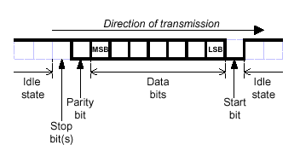
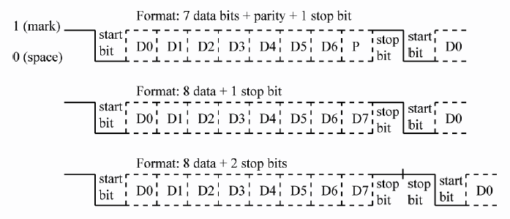
The format of a typical Asynchronous character is
the following ;
Data sent LSb to MSb

Slide 11
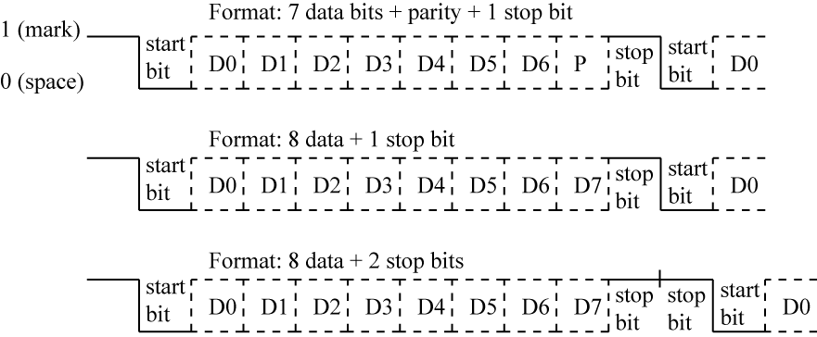
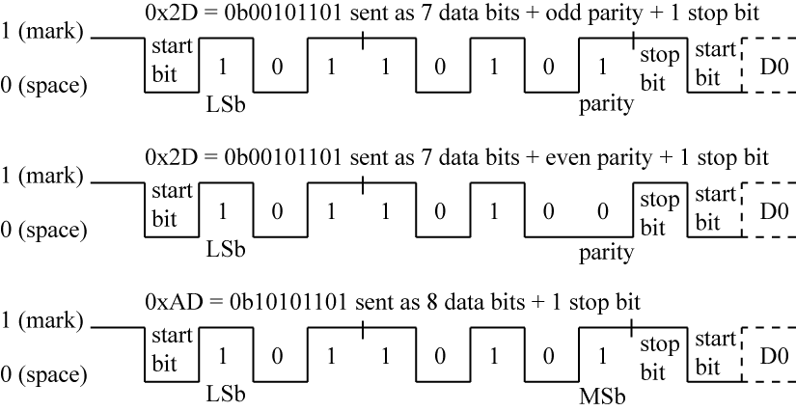

Slide 12

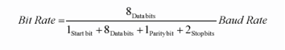
Bit Rate – number of bits per second
Baud Rate – number of signal units per
Serial data speed;
Serial data speed is the number of data bits transmitted per second (BPS). Baud rate is the total number of all bits transmitted, including parity and framing bits. Thus, baud rate is always greater than the data bit rate.

Slide 13
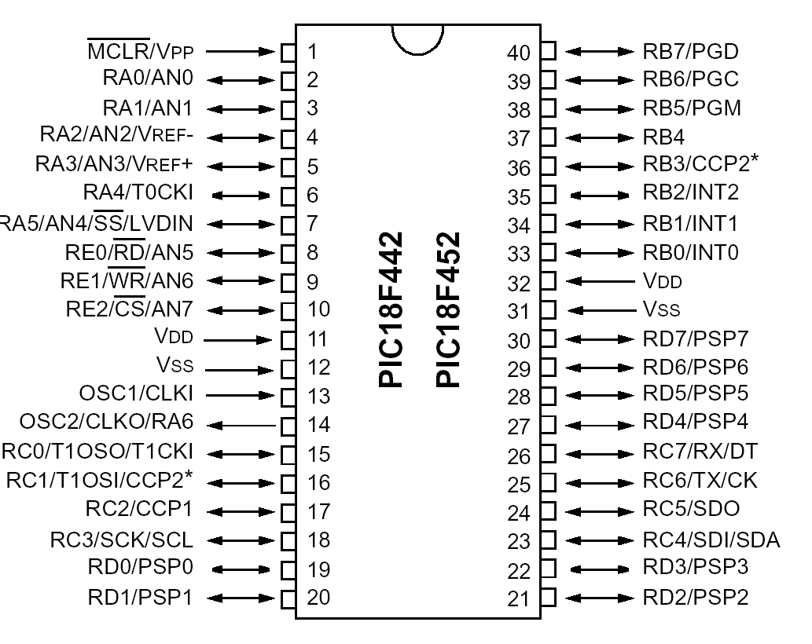

Slide 14
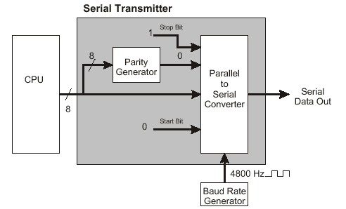
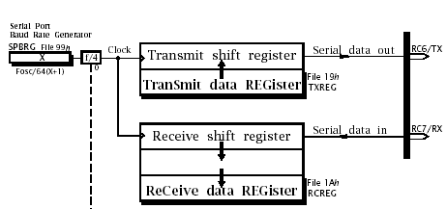
RC6/TX is transmitter pin and RC7/RX is reciever pin in a example microcontroller. There is two shift register for data.
Basic elements of uart chip: Hardware Operations
Parallel / serial conversion
Clock synchronization and Data sampling
Baud rate generator
Parity generator and checking

Slide 15
SCI Registers (General microcontroller)
There are four registers for the MCU SCI (in generally):
Baud Rate Control Register (BAUD)
SCI Control Registers (SCCR1, SCCR2)
SCI Status Register (SCSR)
SCI Data Register (SCDR)
USART Registers in 18fxx2:
• RCREG – holds a received character; read this to get character
• TXREG – write to this register to send a character
• RCSTA – contains status bits for received character
• SPBRG and TXSTA control baud rate
– TXSTA status bits also select between async/sync IO, enable TX transmission
• PIR1 register contains status bits
– TXIF (transmit interrupt flag), ‘1’ if TXREG is empty
– RCIF (receive interrupt flag), ‘1’ if RCREG is full

Slide 16
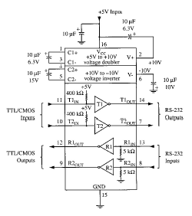
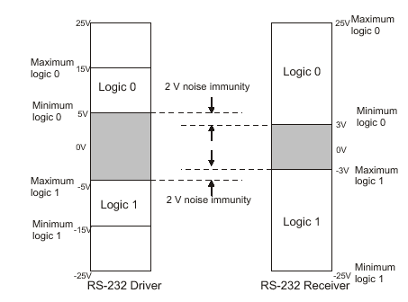
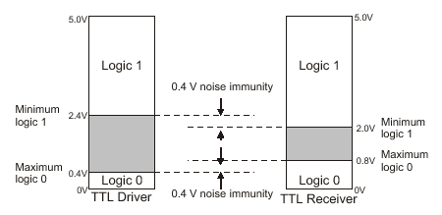
Connecting a microcontroller to a PC
adjust the level of the signals .The signal level on a PC is -10V for logic zero, and +10V for logic one
the signal level on the microcontroller is +5V for logic one, and 0V for logic zero ,One chip specially designed for this task is MAX232

Slide 17
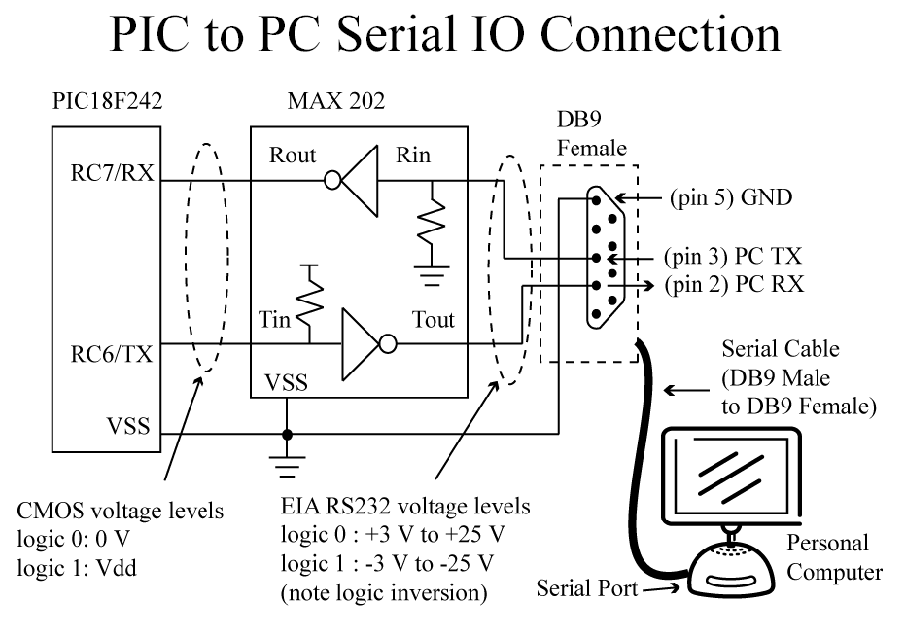

Slide 18
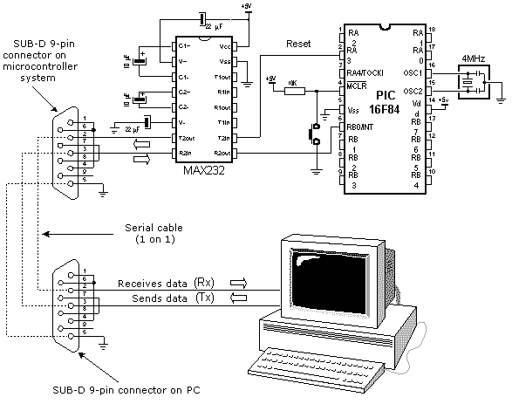
Interfacing with TTL. In order to interface RS-232 with TTL, special line drivers and receivers are required. The MAX232 accepts TTL-level inputs are provides RS-232 output levels. The MAX232does the opposite, converting the RS-232 levels on the transmission line to TTL levels for the receiving UART.

Slide 19
Programming the PIC18 to transfer data serially:
In the programming the PIC18 to transfer character bytes serially, the following steps must be taken:
1. The TXSTA register is loaded with the value 20H, indicating asynchronous mode with 8-bit data frame, and transmit enabled.
2. Make TX pin of PORTC (RC6) output for data to come out of the PIC.
3. The SPBRG is loaded with baud rate generator value. (Baud rate select)
4. SPEN bit in the RCSTA register is set HIGH to enable the serial port of the PIC18.
5. The character byte to be transmitted serially is written into the TXREG register.
6. Monitor the TXIF bit of the PIR1 register to make sure UART is ready for next byte.
7. To transfer the next character, go to Step 5.

Slide 20
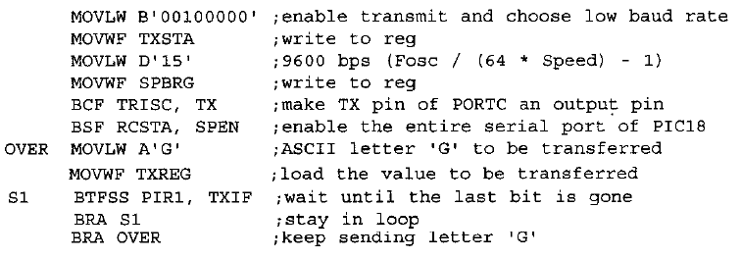

Slide 21
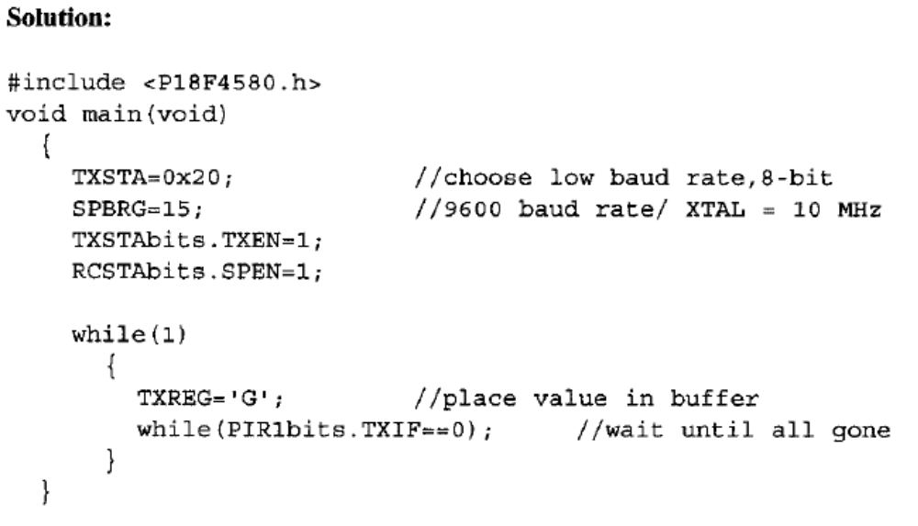

Slide 22
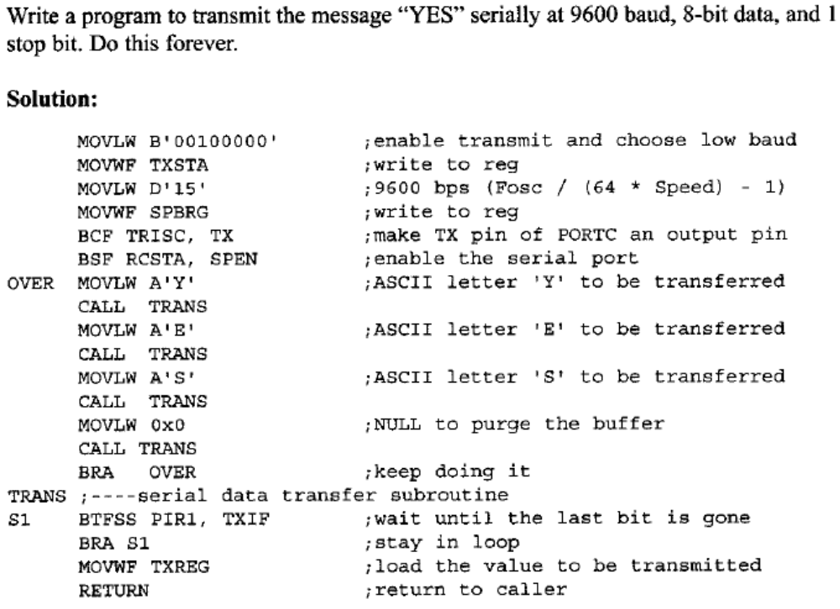

Slide 23
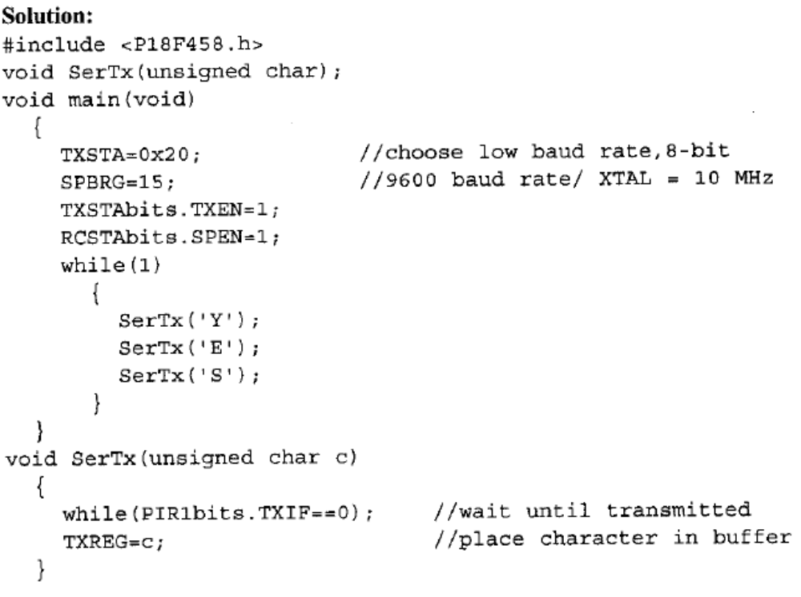

Slide 24
Importance of the TXIF flag:
To understand the importance of the role of TXIF, look at the following sequence of steps that the PIC18 goes through in transmitting a character via TX:
The byte character to be transmitted is written into the TXREG register.
The TXIF flag is set to 1 internally to indicate that TXREG has a byte and will not accept another byte until this one is transmitted.
The TSR (Transmit Shift Register) reads the byte from TXREG and begins to transfer the byte starting with the start bit.
The TXIF is cleared to indicate that the last byte is being transmitted and TXREG is ready to accept another byte.
The 8-bit character is transferred one bit at a time.
By monitoring the TXIF flag, we make sure that we are not overloading the TXREG register. If we write another byte into the TXREG register before the TSR has fetched the last one, the old byte could be lost before it is transmitted.

Slide 25
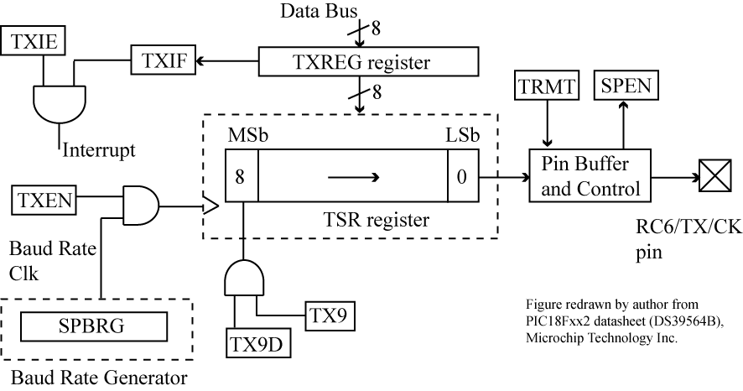

Slide 26
Programming the PIC18 to receive date serially:
In programming the PIC18 to receive character bytes serially, the following steps must be taken:
The RCSTA register is loaded with the value 90H, to enable the continuous receive in addition to the 8-bit data size option.
The TXSTA register is loaded with the value 00H, to choose the low baud rate option.
SPBRG is loaded with one of the values in Table 10-4 to set the baud rate (assuming XTAL = 10 MHZ). (Baud rate selection)
Make the RX pin of PORTC (RC7) an input for data to come into the PIC18.
The RCIF flag bit of the PIR 1 register is monitored for a HIGH to see if an entire character has been received yet.
When RCIF is raised, the RCREG register has the byte. Its contents are moved into a safe place.
To receive the next character, go to step 5.

Slide 27
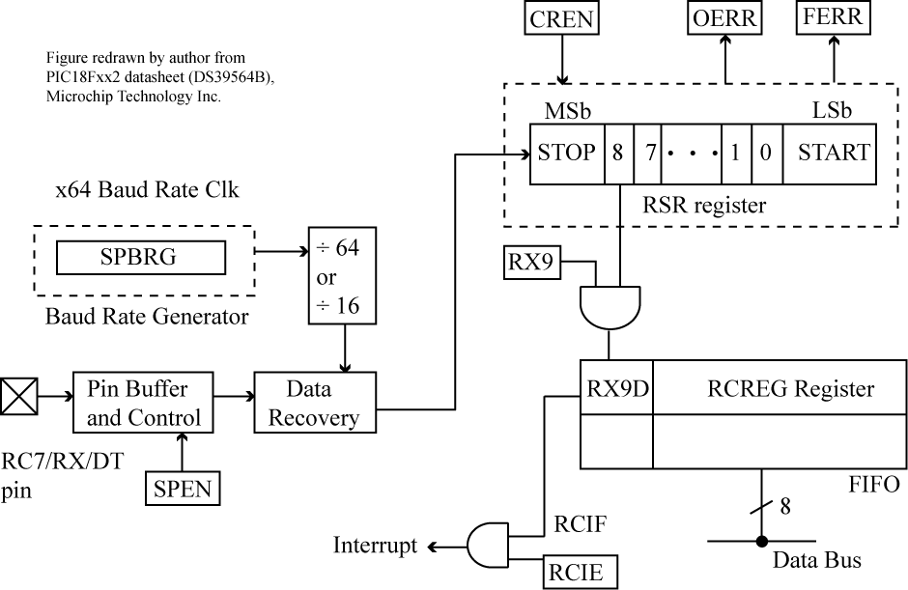

Slide 28
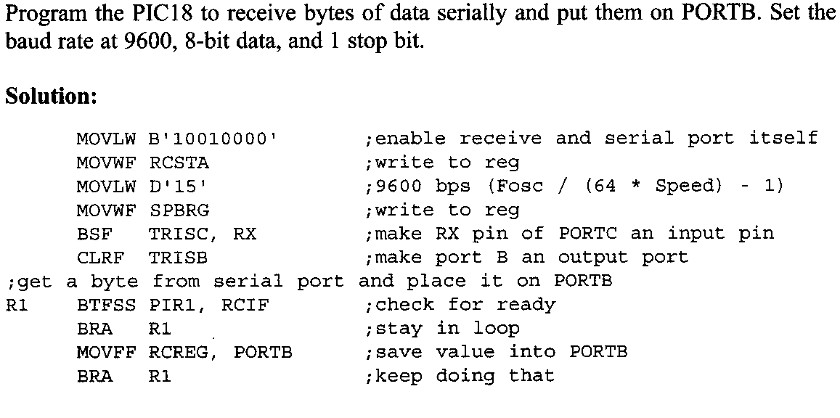

Slide 29
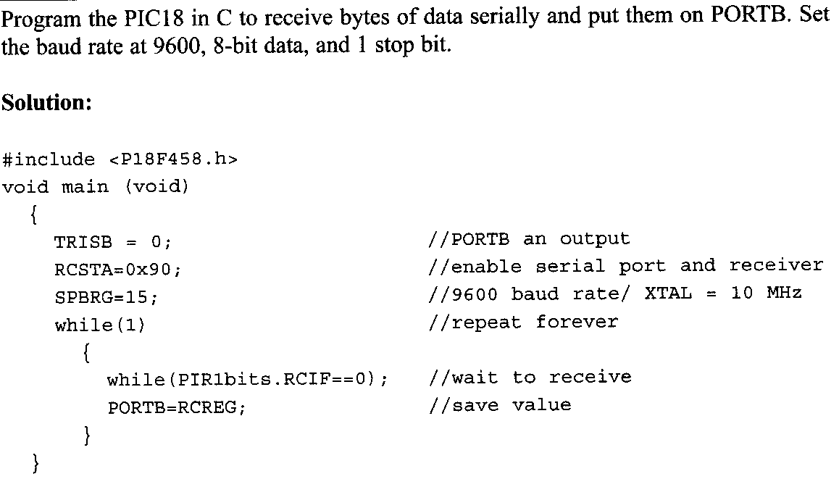

Slide 30
Importance of the RCIF flag bit
In receiving bits via its RX pin, the PIC18 goes through the following steps:
It receives the start bit indicating that the next bits is the first bit of the character byte it is about to receive.
The 8-bit character is received one bit at time. When the last bit is received, a byte is formed and placed in RCREG.
The stop bit is received. It is during receiving the stop bit that the PIC18 makes RCIF = 1, indicating that an entire character byte has been received and must be picked up before it gets overwritten by another incoming character.
By checking the RCIF flag bit when it is raised, we know that a character has been received and is sitting in the RCREG register. We copy the RCREG contents to a safe place in some other register or memory before it is lost
After the RCREG contents are read (copied) into a safe place, the RCIF flag bit is forced to 0 by the UART itself. This allows the next received character byte to be placed in RCREG, and also prevents the same byte from being picked up multiple times.

Slide 31
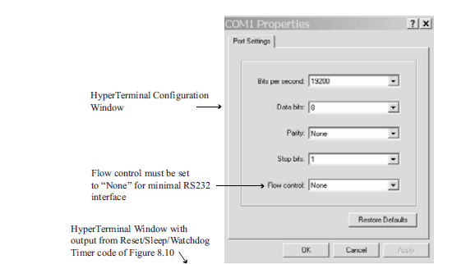
Transmit and recieve: (Communication with PC through Hyper terminal)Assum that the pic18 serial port is connected to the com port of PC, and we are using the hyper terminal program on PC to send and recieve data serially, Port D and B are connected to LED’s and switches. A) send the message “yes” once the PC screen, (b)gets data on switches and transmit to PC screen.(c)recieves any key pres from PC and shows on LEDs. Baud rate 9600, Xtal =10 MHZ

Slide 32
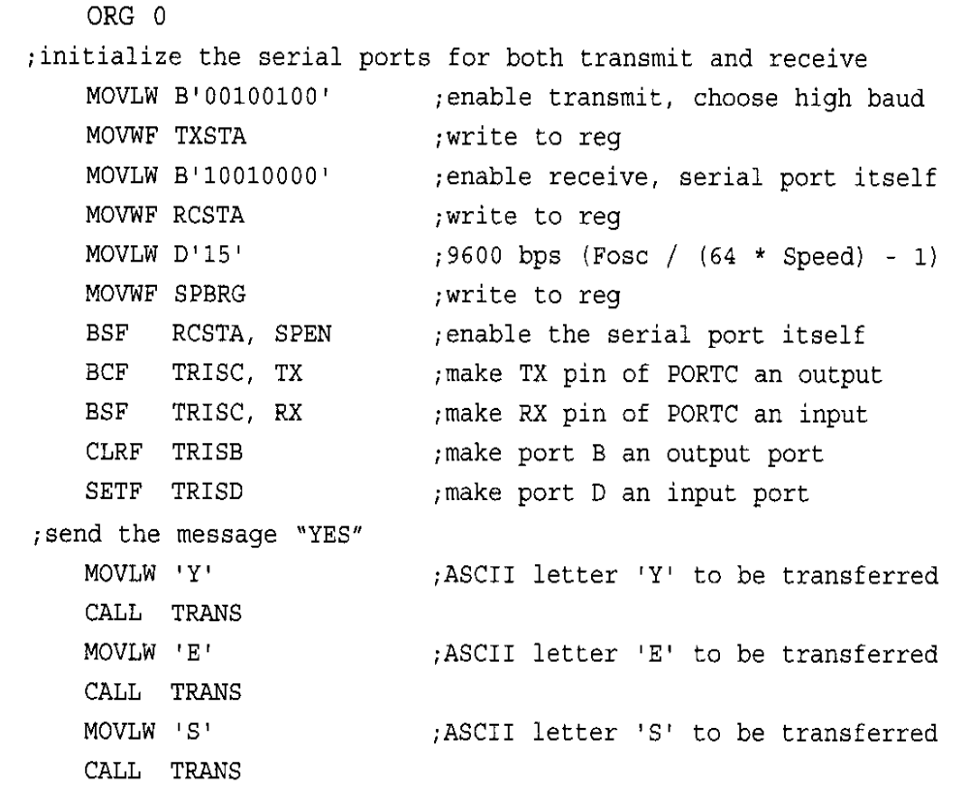

Slide 34
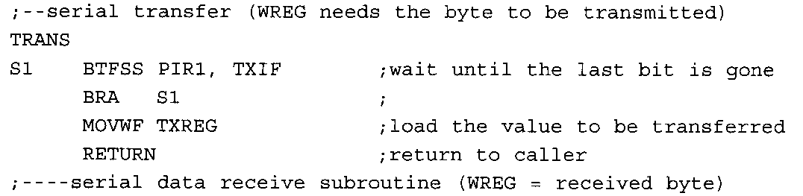
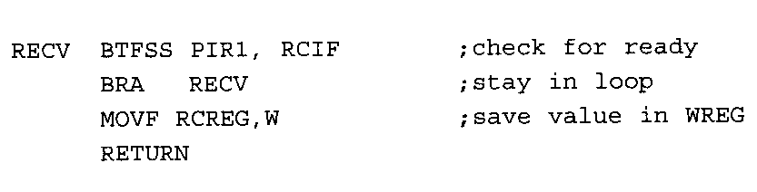

Slide 35
Synchrnous Serial IO (onboard application)
Synchronous Serial Port Peripherals
Serial EEPROM
Analog-to-Digital Converters
Digital-to-Analog Converters
Display Drivers
Real Time Clocks
Parallel I/O Ports
Other special function devices

Slide 36
Synchronous Interfaces in microcontrollers
synchronous interfaces are:
SPI (Serial Peripheral Interface), developed by Motorola,
MICROWIRE developed by National Semiconductor,
I2C (Inter Integrated Circuit) developed by Philips
1-WireTM ( Dallas Semiconductor)
Typical applications consist of one master device (usually a microcontroller) and one or multiple slave devices (usually peripheral functions, like A/D, EEPROM, display drivers, etc.).

Slide 37
Synchrnous Serial IO (onboard application)
PROTOCOLS:
A protocol is a set of rules which governs how data is sent from one point to another. In data communications, there are widely accepted protocols for sending data. Both the sender and receiver must use the same protocol when communicating,
Threre are 2 protocol for onboard synchrnous application:
• Send a separate clock line with data
I2C protocol or I2C Bus(Inter-Integrated Circuit Protocol)
SPI - Serial Peripheral Interface (synchronous serial communication interface

