Slide 1
Time Division Multiplexing

Slide 2
Time-Division Multiplexing
The message samples occupy the channel for only a fraction of the sampling interval on a periodic basis.
Some of the time interval between adjacent samples can be used by other message sources on a time-shared basis.
Thus, TDM enables the joint utilization of a common communication channel by a plurality of independent message sources without mutual interference among them.

Slide 3
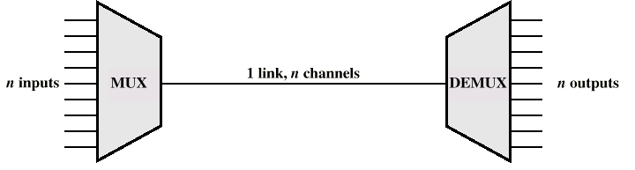
TDM
Digital multiplexing is based on the principle of interleaving symbols from two or more digital signals

Slide 4
TDM
Multiplexing is achieved by using bit-by-bit interleaving procedure:
  At the transmitter, a selector switch sequentially takes a bit from each incoming line and then applies it to the high-speed common line.
  At the receiver, the output of this common line is separated out its low-speed individual components and then delivered to their respective destinations.

Slide 5
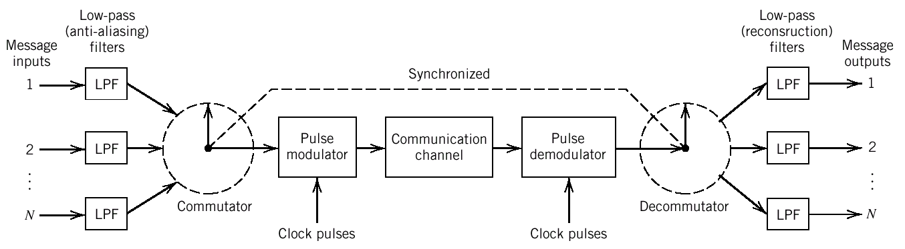
Block Diagram of TDM System
TDM is the time interleaving of samples from several sources so that the information from these sources can be transmitted serially over a single communication channel

Slide 6
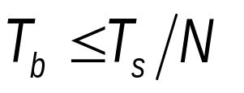
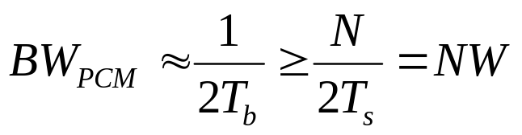
TDM
Use of TDM introduces a bandwidth expansion factor N:
  the scheme must squeeze N samples derived from N independent message sources, each bandlimited to W, into a time slot equal to one sampling interval, T_{s}∼1/2W (Shannon sampling theorem)..
  assuming that N users are multiplexed (a total of N bits are inserted in T_{s})
    bit duration:
    corresponding PCM bandwidth:

Slide 7
TDM
Synchronization is essential for a satisfactory operation of the system.
  Its implementation depends on the method of pulse modulation used to transmit the multiplexed sequence of samples.
TDM is
  highly sensitive to channel dispersion and requires equalization, but
  immune to channel nonlinearities (because, at a certain time, the channel is accessed only by a single user).

Slide 8
Synchronization
Since there is a limit on the duration of samples, it is necessary to restrict the number of independent message sources to be included within a time-division group.
Timing operations at the receiver must follow closely the corresponding operations at the transmitter,
  i.e., synchronization is necessary.
A code element or pulse of a given format, at the end of a frame, can be transmitted for achieving synchronization

Slide 9
Digital Multiplexers
In TDM, analog signals are sampled sequentially at a common sampling rate and then multiplexed over a common channel.
By multiplexing digital signals at different bit rates, several digital signals can be combined
  e.g., computer outputs, digitized voice/facsimile/TV signals,
into a single data stream at a considerably higher bit rate than any of the inputs.

Slide 10
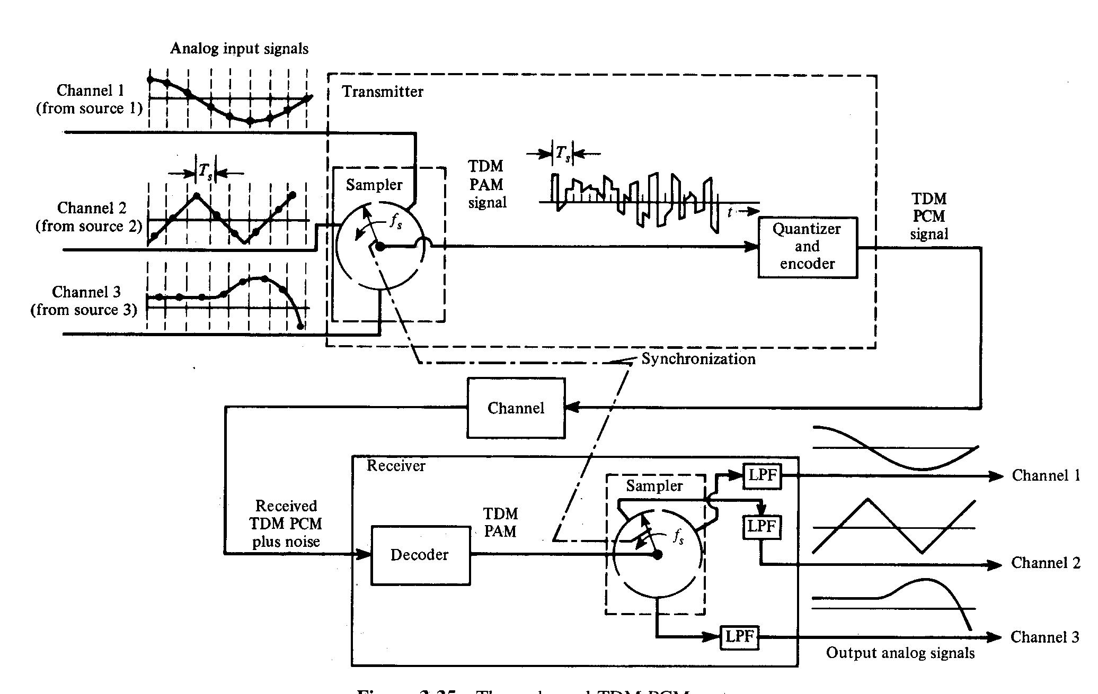
Three-Channel TDM PCM System
Multiplexing analog signals

Slide 11
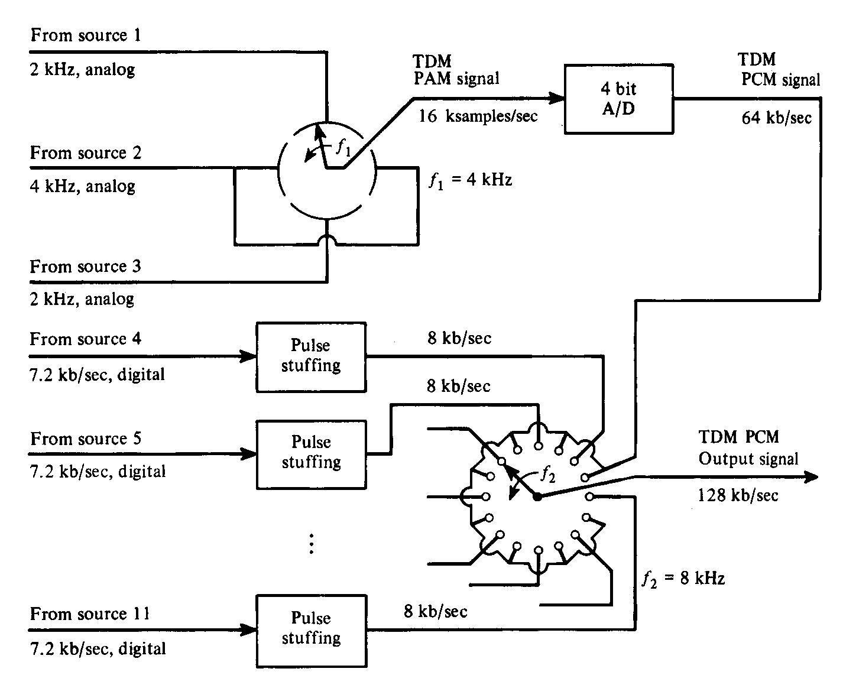
TDM with Analog and Digital Inputs
Multiplexing analog and digital signals

Slide 12
Categories of Digital Multiplexers
Low-bit rate data streams originating from digital computers are multiplexed for TDM transmissions over PSTN by using modems.
Digital multiplexers are used for data transmission services provided by telecommunication carriers such as AT&T.
  A digital hierarchy is used for TDM low-rate bit streams into much higher-rate bit streams.

Slide 13
American Digital TDM Hierarchy
DS0 Signal: Standard PCM representation of a voice signal at 64 kbps (8000 samples/s x 8 bits/sample).
First-level hierarchy combines 24 DS0 streams to obtain a digital signal one (DS1) at 1.544 Mbps (>24 x 64=1.536 Mbps) .
  These bit streams are called primary rate, because it is the lowest bit rate that exists outside a digital switch, which consists of memory and logic.

Slide 14
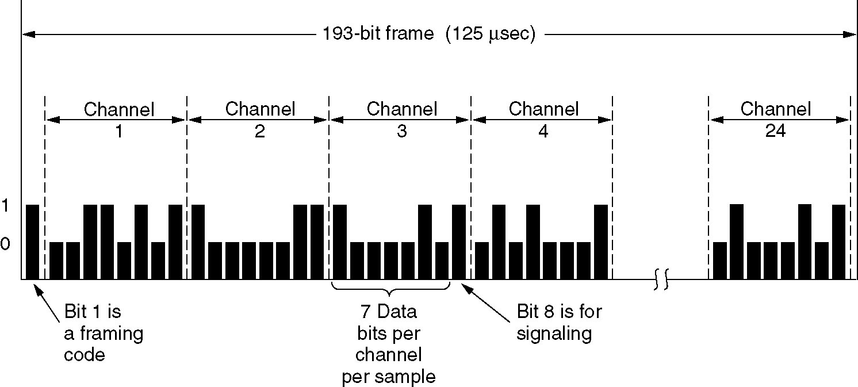
American Digital TDM Hierarchy
The T1 carrier (1.544 Mbps).
24 channels x 8 bits/channel+1bit framing code =193 bits
193 bits/125 μs=1.544 Mbits/s W∼1/(2T_{s})=1/250 μs ∼386 kHz
Frame rate: 8000 frames/s (8000 samples/s)
Spectral efficiency: R_{b}/W=1.544 Mbps/386 kHz=4 bps/Hz

Slide 15
American Digital TDM Hierarchy
The second-level multiplexer combines four DS1 bit streams to obtain a digital signal two (DS2) at 6.312 Mbps.
The third-level multiplexer combines seven DS2 bit streams to obtain a DS3 at 44.736 Mbps.
The fourth-level multiplexer combines six DS3 bit streams to obtain a DS4 at 274.176 Mbps.
The fifth-level multiplexer combines two DS4 bit streams to obtain a DS5 at 560.160 Mbps.

Slide 16
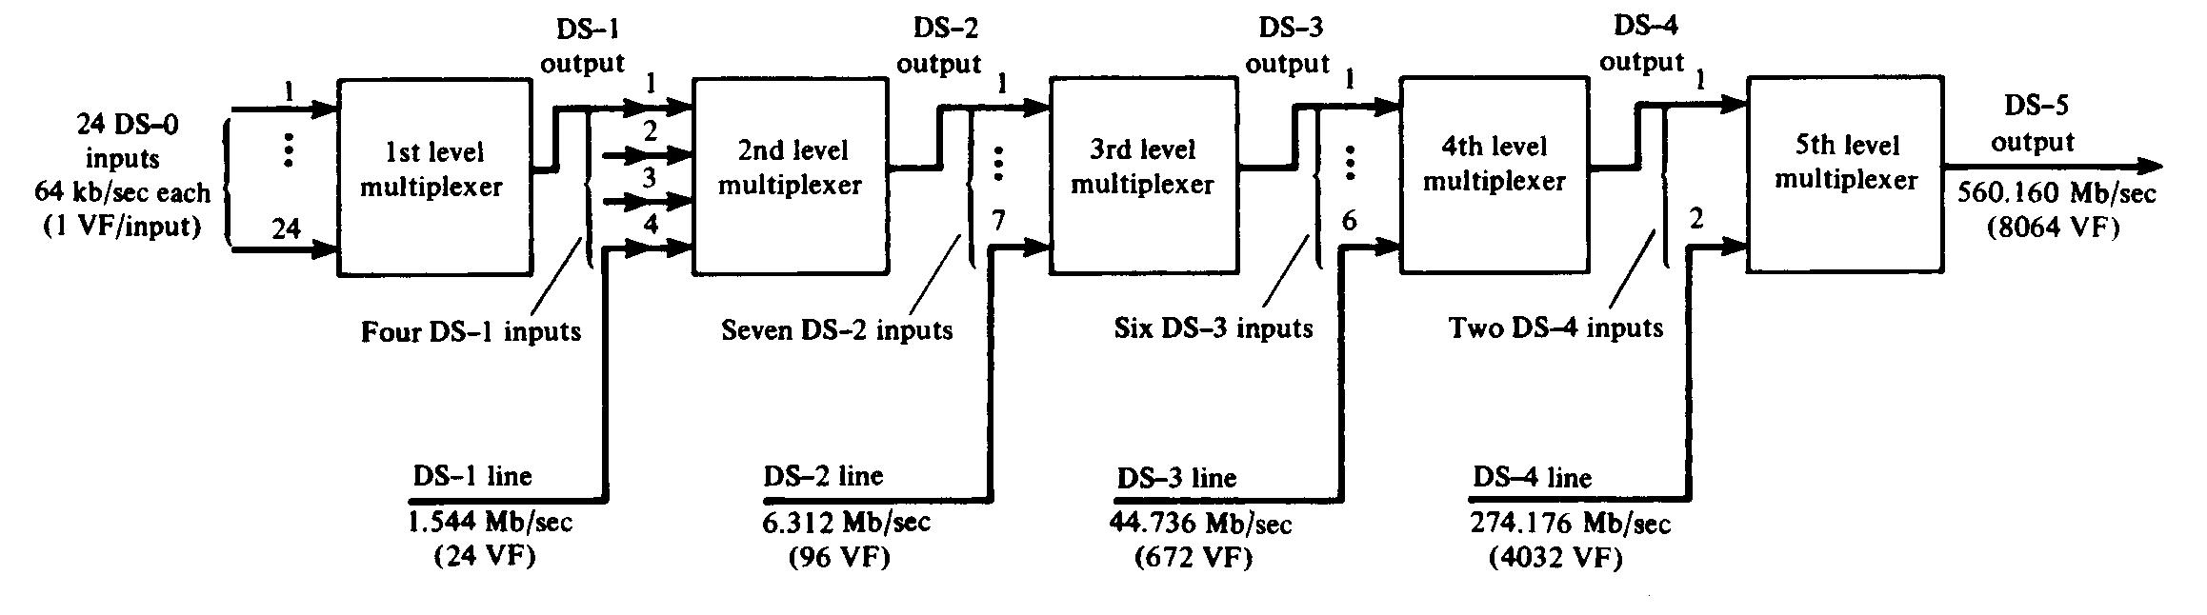
North American Digital TDM Hierarchy
Block diagram of the North American digital TDM hierarchy

Slide 17
American Digital TDM Hierarchy
The bit rate of a digital signal produced by any one of the multiplexers is slightly higher than the prescribed multiple of the incoming bit rate because of the bit stuffing built into the design of each multiplexer.
Bit streams are transmitted without interpreting what the bits themselves mean.
  However, digital switches do have a common understanding of how to interpret the bits within the stream.

Slide 18
TDM Hierarchy
 | AT&T (T1 signals) |  | CCIT (E1 signals)
 | Number of inputs | Output rate, Mbps | Number of inputs | Output rate, Mbps
First level | 24 | 1.544 | 30 | 2.048
Second level | 4 | 6.312 | 4 | 8.448
Third level | 7 | 44.736 | 4 | 34.368
Fourth level | 6 | 274.176 | 4 | 139.264
Notes:
Carlson (4th ed.), p.528

Slide 19
Problems in Digital Multiplexers
Incoming signals must be synchronized so that they can be properly interleaved.
  Interleaved digital signals can not be separated unless their bit rates are locked to a common clock.
The multiplexed signal must include some form of framing so that its individual components can be identified at the receiver.
Multiplexer has to handle small variations in the bit rates of incoming digital signals.

Slide 20
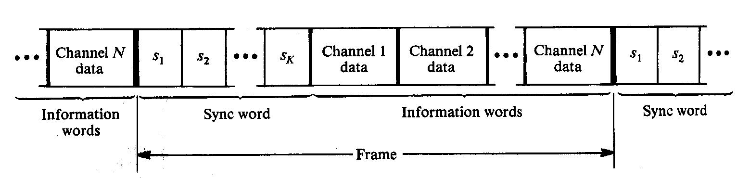
TDM Frame Synchronization Format
The structure of a frame

Slide 21
Example
Assume a transmission rate of R_{b}=300 Mbps over a cable of 1000 km. Data propagates, with velocity of light, a distance of 300 000 km/s. This implies the presence of R_{b} x 1000 km/ 300000 km/s=10⁶ pulses along the 1000 km long cable. A 0.01 % variation in the propagation delay, produced by a 1⁰ F decrease in temperature, will result in 100 fewer pulses in the cable. These pulses must be absorbed by the multiplexer.

Slide 22
Bit Stuffing
Bit stuffing is used for tailoring the requirements of synchronization and rate adjustment to accommodate small variations in the input data rates.
Outgoing bit rate of the multiplexer is made slightly higher than the sum of the maximum expected bit rates of the input channels by stuffing in additional non-information carrying pulses.

Slide 23
Bit Stuffing
All incoming digital signals are stuffed with a number of stuffing bits in order to raise each of their bit rates to equal to that of a locally generated clock
Elastic store is used for bit stuffing.
  A bit stream is stored in an elastic store so that the stream may be read out at a rate different from the rate at which it is read in.
At the demultiplexer, the stuffed bits are removed from the multiplexed signal.
A method is required to identify stuffed bits

Slide 24
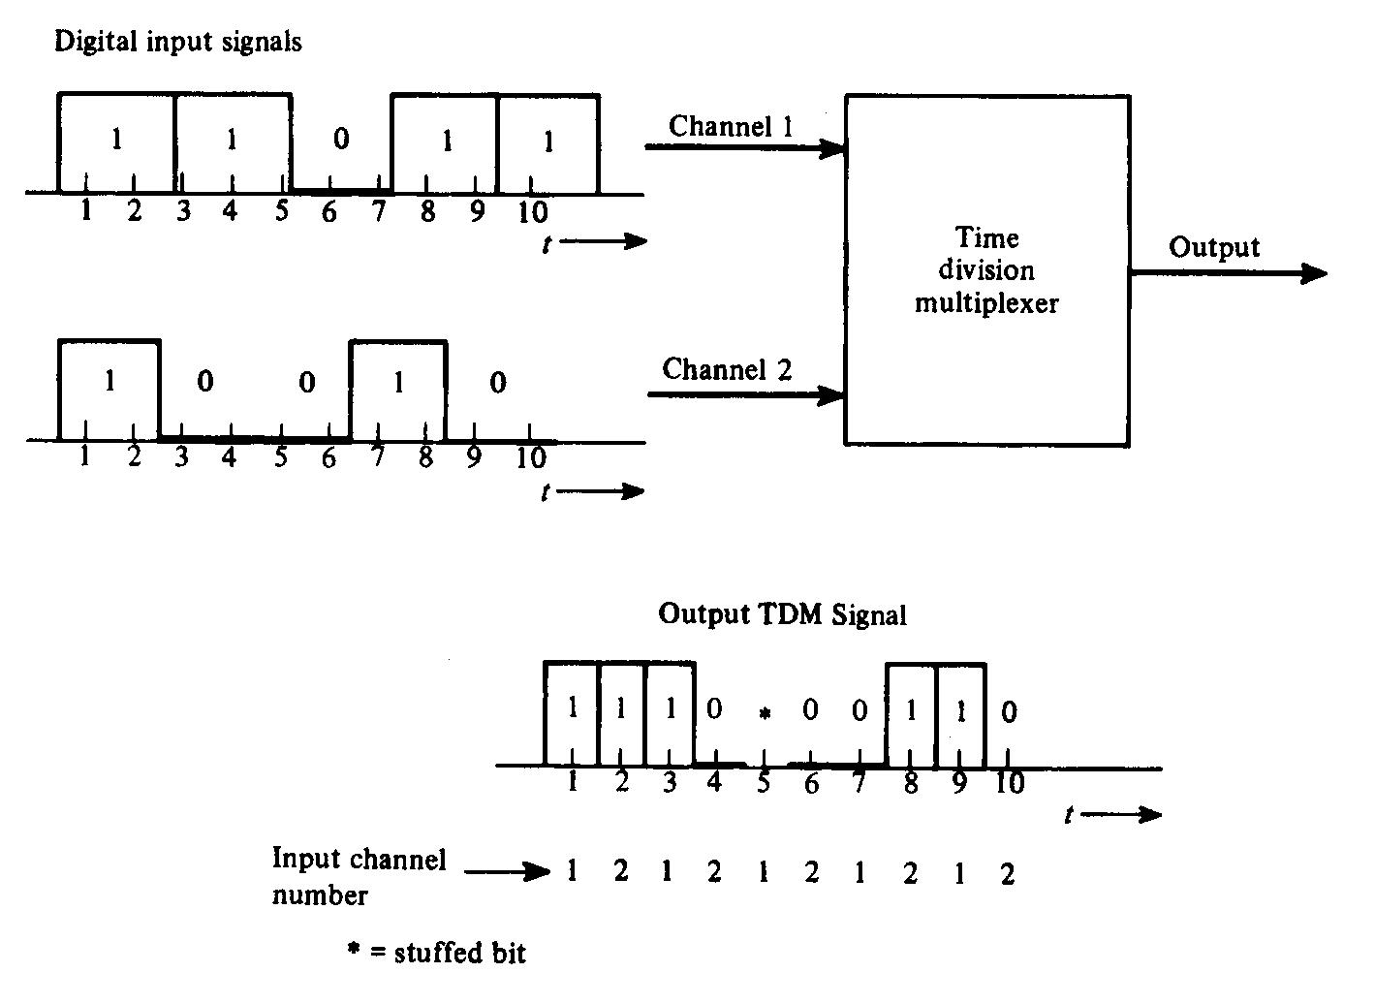
Two-Channel Bit-Interleaved TDM with Bit Stuffing

Slide 25
Example (Haykin, Problem 3.9)
12 different message signals, each with a bandwidth of 10 kHz, are to be multiplexed and transmitted. Determine the minimum bandwidth required for each method if the multiplexing/ modulation method used is
  FDM/SSB
  TDM/PAM

Slide 26
Solution
The bandwidth required for each SSB channel is 10 kHz.
  The total bandwidth for 12 channels is 120 kHz.
The Nyquist rate for each signal is 20 kHz. For 12 TDM signals, the total data rate is 240 kHz.
  By using a sinc pulse whose amplitude varies in accordance with the modulation, and with zero crossings at multiples of (1/240) ms, we need a minimum bandwidth of 120 kHz.

Slide 27
Delta Modulation

Slide 28
Delta Modulation
An incoming message signal is oversampled (higher than Nyquist rate) to purposely increase the correlation between adjacent samples.
  This allows the use of a simple (one-bit) quantizing strategy for constructing the encoded signal.
  DM provides a staircase approximation to the oversampled version of the message signal.
Achieves digital transmission of analog signals with very simple hardware compared to a PCM system.

Slide 29
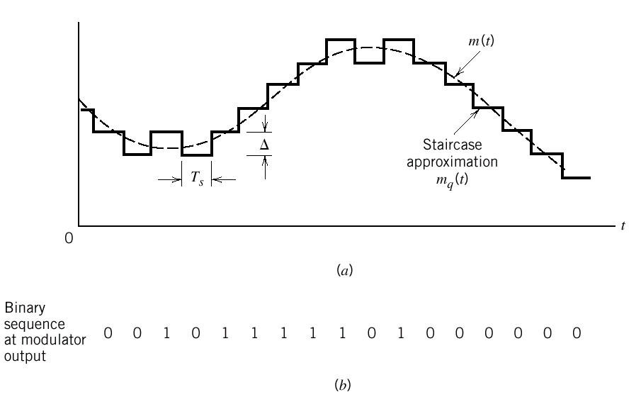
Delta Modulation
Rate of information transmission in a DM system, is equal to the sampling rate f_{s}=1/T_{s}.
  f_{s}>>2W (sampling rate is much higher than the Nyquist rate)

Slide 30
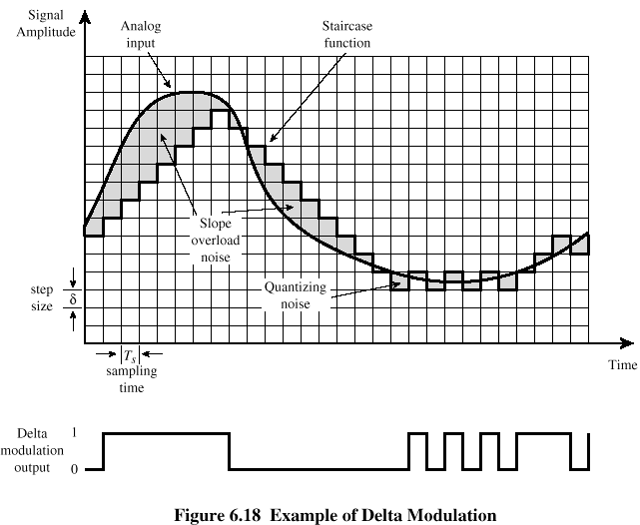
Delta Modulation

Slide 31
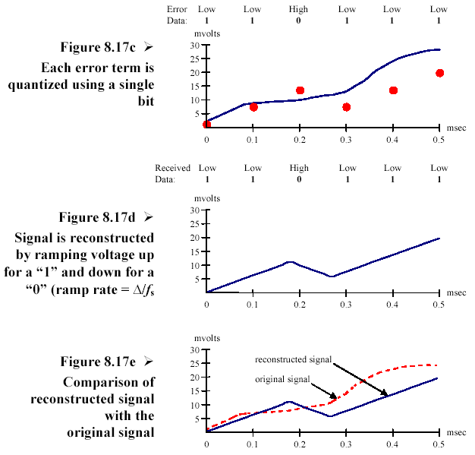
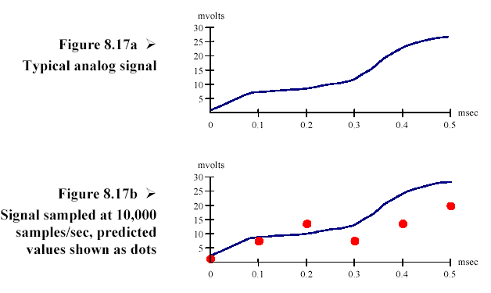
Delta Modulation
b

Slide 32
Delta Modulation
The difference between the input and the approximation is quantized into only two levels, ±Δ, corresponding to the positive and negative differences.
  If approximation<signal, increase it by Δ
  If approximation>signal, decrease it by Δ
If signal does not change too rapidly from sample to sample, approximation remains within ±Δ of the input signal.

Slide 33
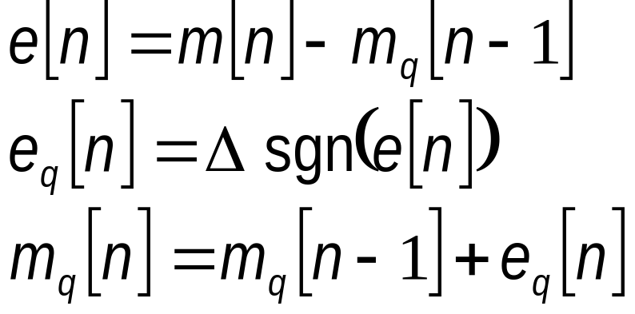
Delta Modulation
m(t): the input (message) signal
m_{q}(t): staircase approximation
m[n]=m(nT_{s}) sample of m(t) at t=nT_{s}
T_{s}: sampling period >>1/(2W)
Basic discrete-time relations for DM:
Error signal, e[n]:
Quantized e[n], e_{q}[n]:
Quantized m[n], m_{q}[n]:

Slide 34
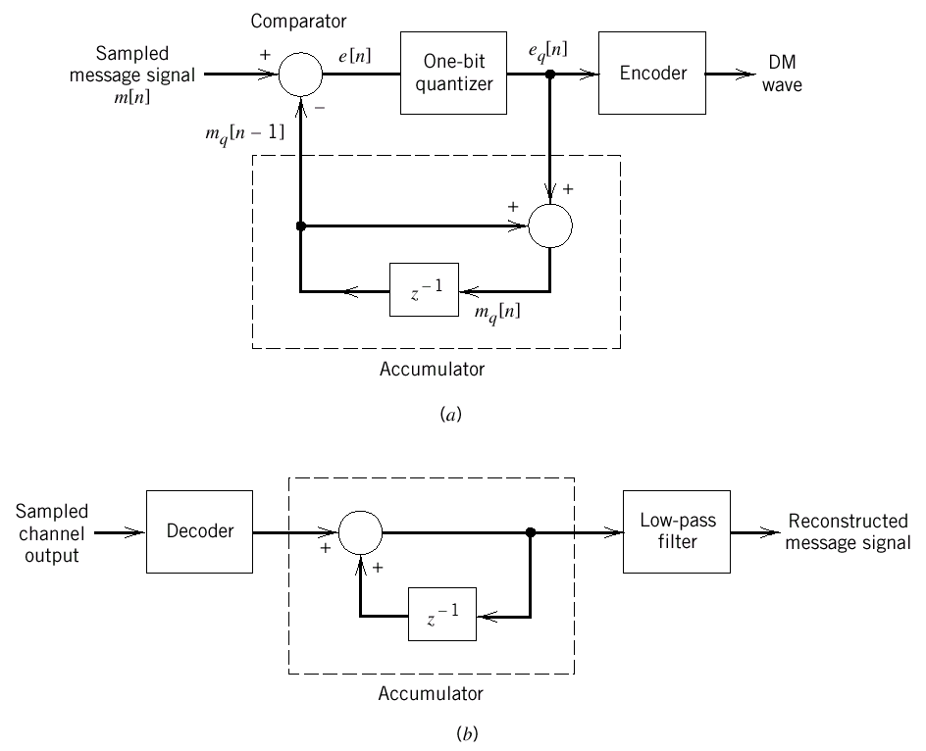
Delta Modulation
DM signals can be generated by applying the sampled version of the incoming message signal to a modulator that involves a comparator,
quantizer (hard limiter) and accumulator.
DM Transmitter
DM Receiver

Slide 35



Delta Modulation: Example
Let m[1]=0.9, m[2]=0.3, m[3]=1.2, m[4]=-0.2, m[5]=-0.8.
n | m[n] |  |  | e_{q}[n]
1 | 0.9 | 0 | +0.9 | +1 | 1
2 | 0.3 | 1 | -0.7 | -1 | 0
3 | 1.2 | 0 | +1.2 | +1 | 1
4 | -0.2 | 1 | -1.2 | -1 | 0
5 | -0.8 | 0 | -0.8 | -1 | -1

Slide 36
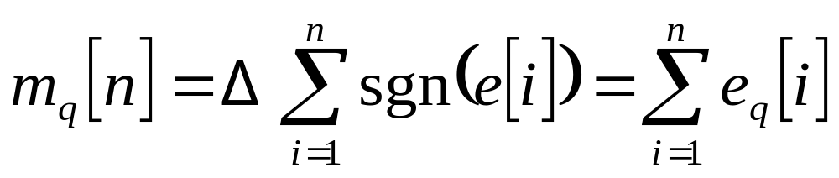
The DM Transmitter
When the quantizer output is applied to the accumulator, one has
Thus, at the sampling instant nT_{s}, the accumulator increments the approximation by a step Δ in a positive or negative direction depending on the sign of e[n].

Slide 37
The DM Receiver
The staircase approximation m_{q}(t) is reconstructed by passing the sequence of positive and negative pulses, produced at the decoder output, through an accumulator in a manner similar to that used in the T_{x}.
Out-of-band quantization noise in m_{q}(t) is rejected by passing it through a LPF, of a bandwidth equal to the message bandwidth.

Slide 38
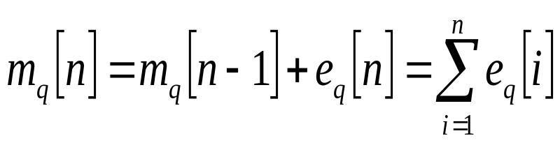
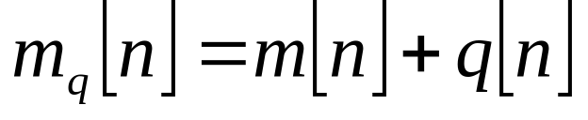
Slope Overload Distortion
Note that is the digital equivalent of integration, since it represents the the accumulation of positive and negative increments of magnitude Δ.
Denoting the quantization error by q[n],
the input to the quantizer can be written as

Slide 39
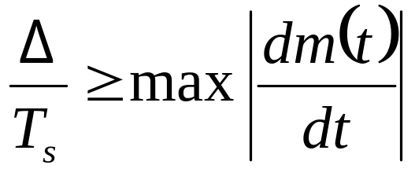
Slope Overload Distortion
Except for the quantization error q[n-1], the quantizer input is proportional to the derivative of the input signal.
  The sequence of samples {m_{q}[n]} can increase as fast as the input sequence of samples {m[n]} in a region of maximum slope if
  Otherwise, Δ is too small for m_{q}(t) to follow a steep segment of the input signal m(t) causing slope overload distortion.

Slide 40
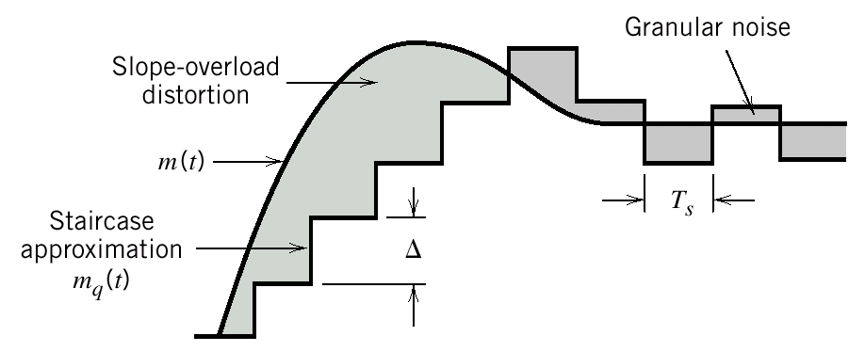
Slope Overload Distortion
Two different forms of quantization error in delta modulation

Slide 41
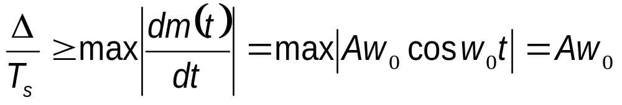
Example
Question: Find the step size Δ required to prevent slope overload noise for the case when the input signal is a sine wave.
Solution: For a sine wave input, m(t)=A sin w₀ t,
  For no slope overload, we require that Δ>A w₀/ f_{s}
  However, we do not want to make Δ too much larger than this value; otherwise the granular noise will become too large.

Slide 42
Granular Noise
Granular noise occurs when the step size Δ is too large relative to local slope of input signal m(t).
  Then, staircase approximation m_{q}(t) hunts around a relatively flat segment of m(t).
Granular noise is similar to the quantization noise in a PCM system.
Optimum step size compromises the slope overload distortion and granular noise.
There is a need for adaptive DM with variable step size.

Slide 43
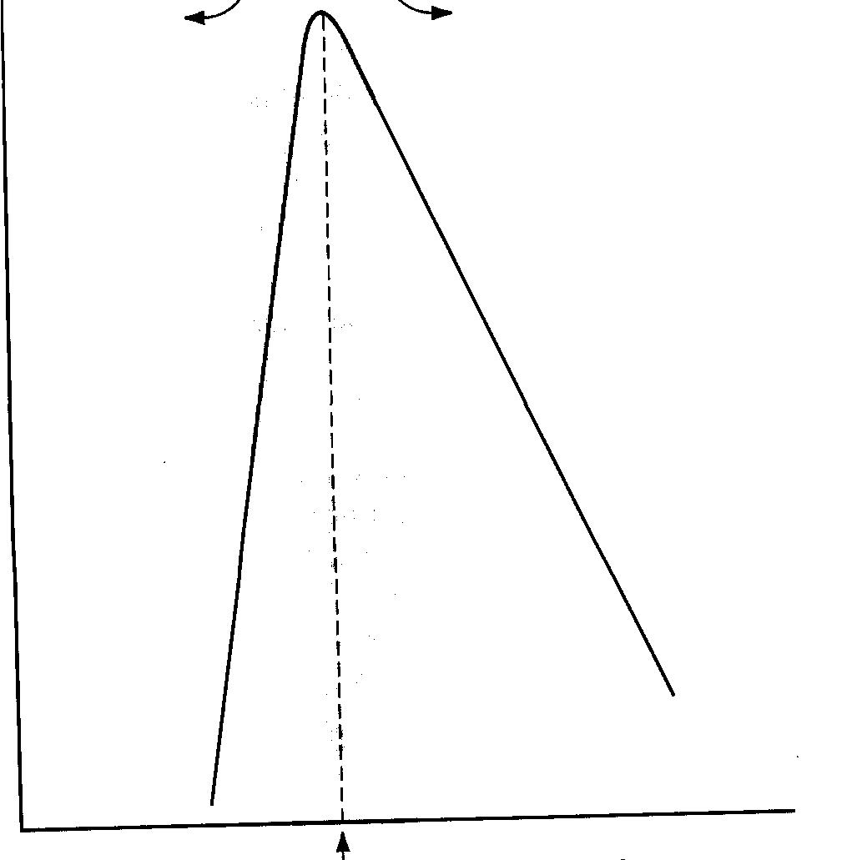
Signal-to Noise Ratio in DM
SNR
Slope overload dominates
Granular noise dominates
Optimum value of step size Δ

Slide 44
Adaptive Delta Modulation
ADM involves additional hardware designed to provide variable step size,
  thereby reducing slope overload effects without increasing the granular noise.
Slope overload appears in ε_{q}[i] as a sequence of pulses having the same polarity, whereas the polarity tends to alternate when m_{q}(t) tracks m(t).

Slide 45
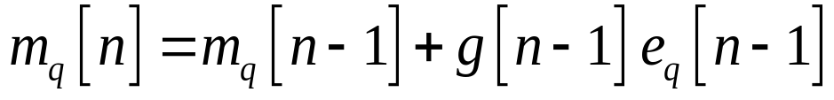
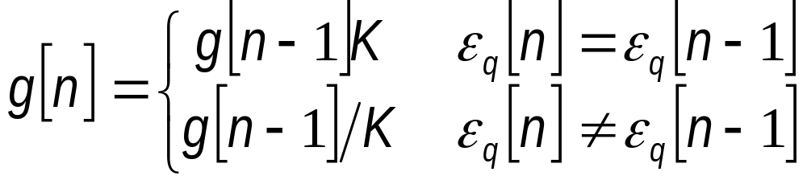
Adaptive Delta Modulation
Feedback loop is adjusted by a variable gain g(k) such that
The step-size controller carries out the adjustment algorithm
  K is a constant taken to be in the range 1<K<2
Effective step size increases by successive powers of K during slope overload conditions.

Slide 46
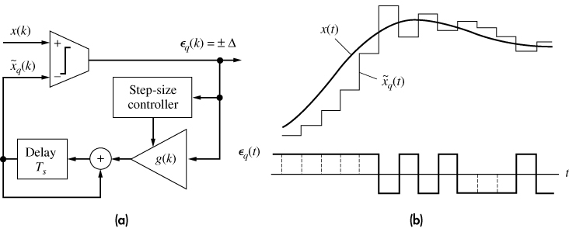
Adaptive Delta Modulation
Adaptive DM transmitter b) Waveforms

Slide 47
Adaptive Delta Modulation
The SNR of ADM is typically 8-14 dB better than ordinary DM.
Variable step size yields a wider dynamic range
Voice transmission bandwidth of 24-32 kHz.
Another scheme continuously variable slope delta modulation (CVSD) provides a continuous range of step-size adjustment instead of a set of discrete values.

Slide 48
Delta-Sigma Modulation
Quantizer input in DM is proportional to the derivative of the incoming message signal.
This leads to accumulation of noise power in the demodulated signal due to the presence of accumulator in the DM receiver.
This drawback can be overcome by integrating the message signal prior to DM at the transmitter

Slide 49
DM System
(a) Transmitter
(b) Receiver

Slide 50
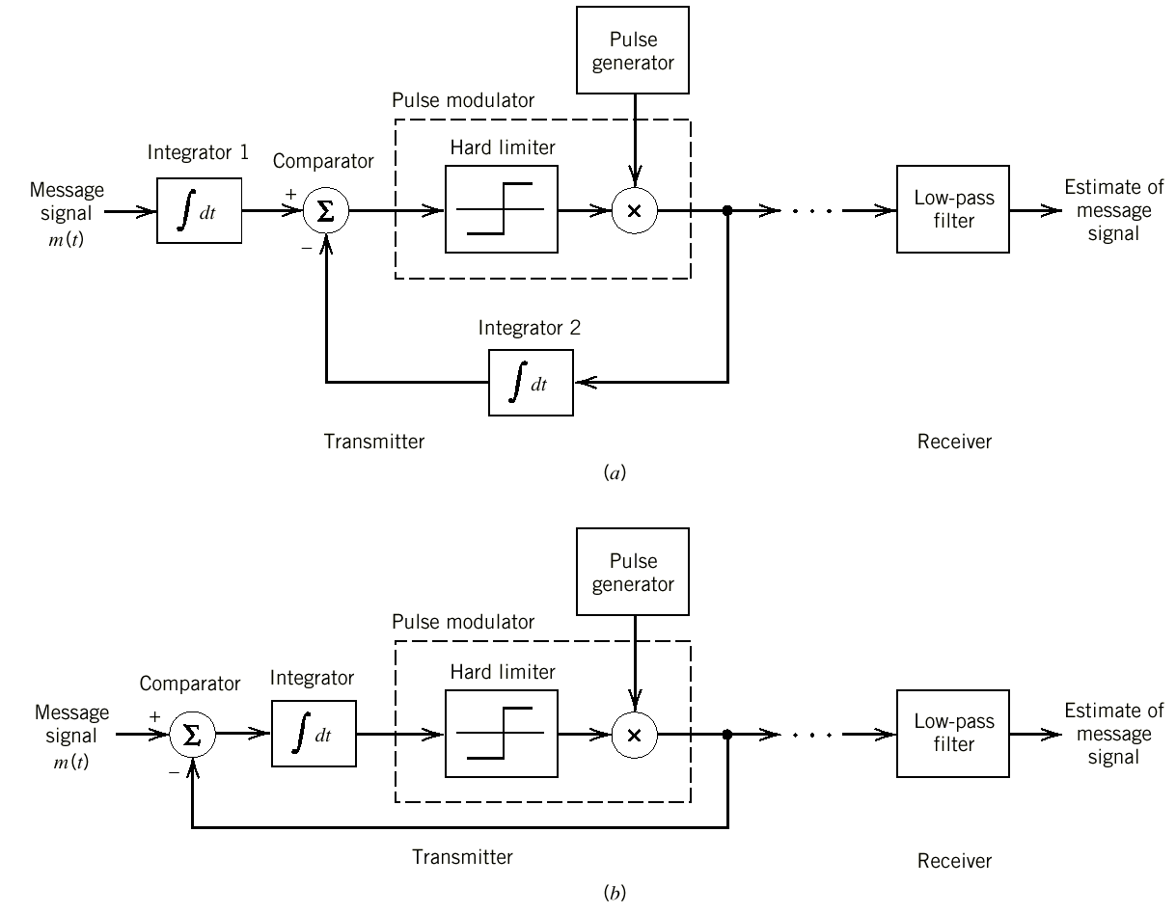
Delta-Sigma Modulation
Two equivalent versions of the delta-sigma modulation system

Slide 51
Delta-Sigma Modulation
Low-frequency content of the input signal is pre-emphasized.
  Correlation between adjacent samples of the DM input is increased.
  Thus, overall system performance is improved by reducing the variance of the error signal at the quantizer input.
Design of the receiver is simplified.

Slide 52
Delta-Sigma Modulation
Delta-sigma modulation is a version of DM that incorporates integration at its input.
Use of integration at the transmitter input requires differentiation at the receiver.
  The need for this differentiation is eliminated by removing the integrator in the conventional DM receiver.
  Thus, the receiver of a D-ΣM consists simply of a LPF, hence it is very simple.

Slide 53
Bandwidth Requirements of DM
Simplicity of implementation in T_{x} and R_{x} is achieved by using a sampling rate far in excess of that needed for PCM.
  Thus, the channel bandwidth is increased
If the channel bandwidth is scarce, then we may trade increased system complexity for a reduced channel bandwidth.
A signal-processing operation to achieve this objective is prediction.

Slide 54
Linear Prediction

Slide 55
Linear Prediction
Adaptive filter provides the best prediction (in some sense) of the present value of a random signal.
  The present value of the signal thus serves the purpose of a desired response for the adaptive filter.
  Past values of the signal supply the input applied to the filter.
Depending on the application of interest,
  the adaptive filter output (predictor) or
  the estimation (prediction) error (prediction-error filter)
  may serve as the system output.

Slide 56
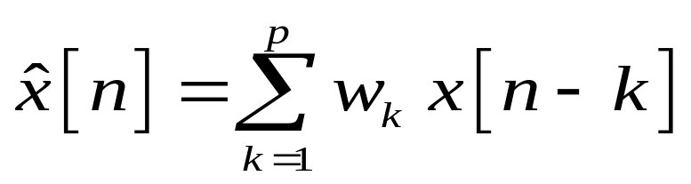
Linear Prediction (cont’d)
Consider a finite-duration impulse response (FIR) discrete-time filter.
The filter consists of p delay elements,
  i.e., with a prediction order of p.
The filter uses p previous time samples of the input signal, i.e., at x[n-p],…, x[n-2], x[n-1], to provide a linear prediction of the input x[n]:
w_{k} : filter coefficients

Slide 57
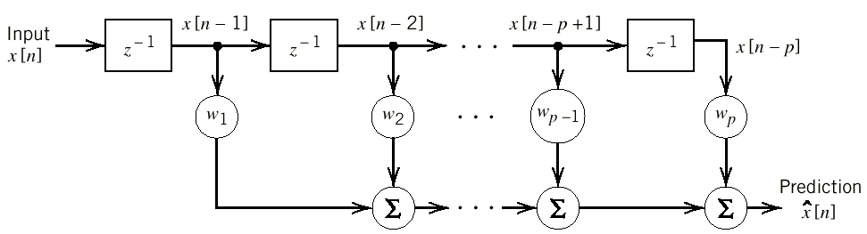
Linear Prediction (cont’d)
Block diagram of a linear prediction filter of order p

Slide 58
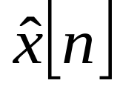
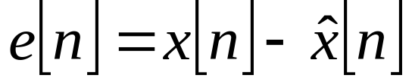
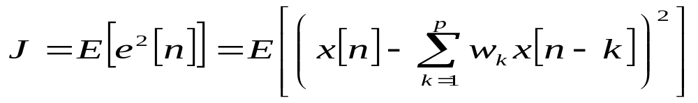
Linear Prediction (cont’d)
The predicted signal, , is desired to be as close as possible to the real signal x[n].
The prediction error:
There are several techniques to minimize the prediction error.
Choose the filter coefficients w₁,w₂,…,w_{p}, that minimizes the mean-square error (mse):

Slide 59
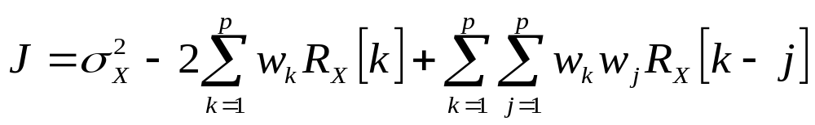
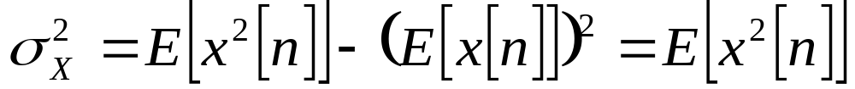
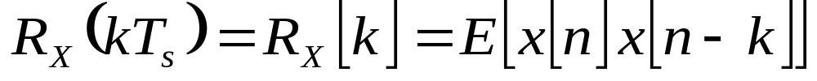
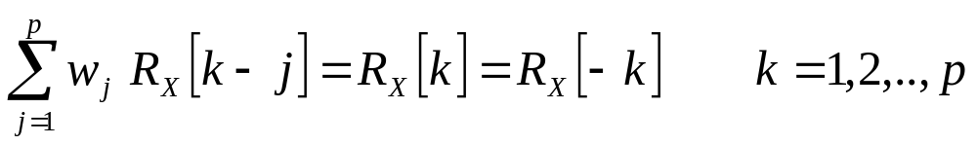
Linear Prediction (cont’d)
The mean-square error can be written as:
where
Autocorrelation function of X at time kT_{s}
Differentiate J w.r.t. w_{k} and equate to zero:
Wiener-Hopf equation for linear prediction

Slide 60
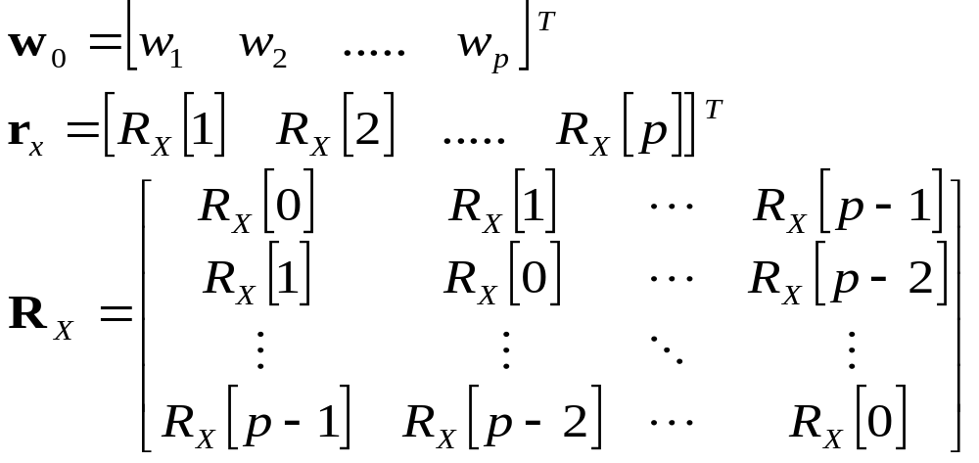
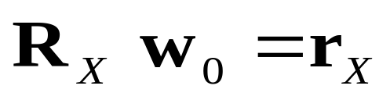
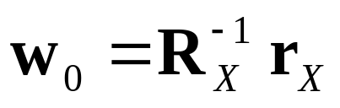
Linear Prediction (cont’d)
Let
Wiener-Hopf equation in matrix form:
Optimum solution:
R_{X} : Toeplitz matrix

Slide 61
Autocorrelation Matrix
To determine the weights, we need to know only r_{X}=[R[1], R[2]...R[p]] and R[0]=σ_{X}²;
  by measurements or a priori information
Autocorrelation matrix, R_{X}, is Toeplitz:
  It has σ_{X}² on the diagonal and the elements on any diagonal parallel to the main diagonal are also equal, thus symmetric, i.e., R_{X}=R_{X}^{T}.
  A Toeplitz matrix, such as R_{X}, is nonsingular and invertable.

Slide 62
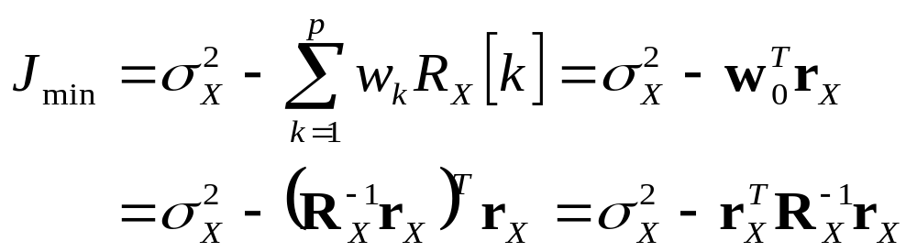
Minimum Prediction Error
To find the minimum prediction error, we insert
into
to get

Slide 63
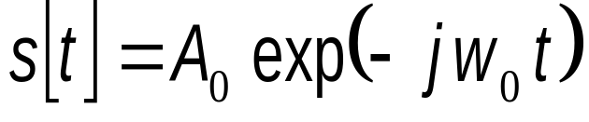
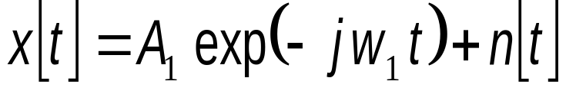
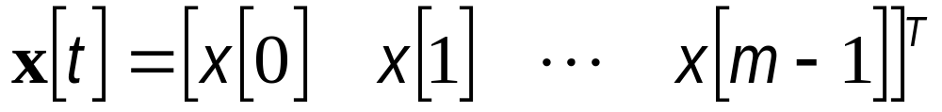
Example
A discrete-time radar signal is transmitted as
The sampled noisy received signals are represented as
  w₀ (w₁): transmit (received) signal frequency
  n[t]: AWGN with variance σ_{n}²
Let be a vector of received signal samples.

Slide 64
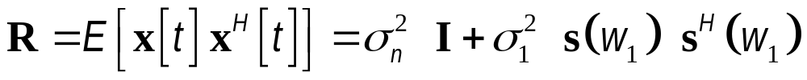

Example (cont’d)
Show that
The time series x[t] is applied to an FIR Wiener filter with m coefficients, in which the cross-correlation between x[t] and the desired signal d[t] is preset to .
Determine an expression for the tap-weight vector of the Wiener filter.

Slide 65
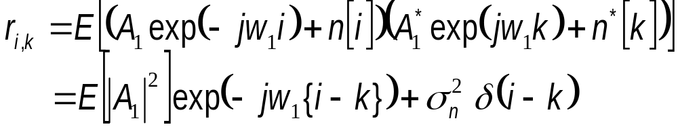
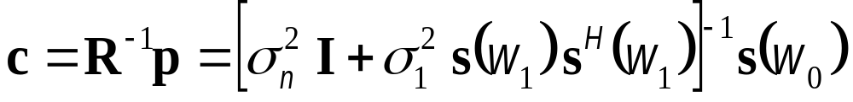
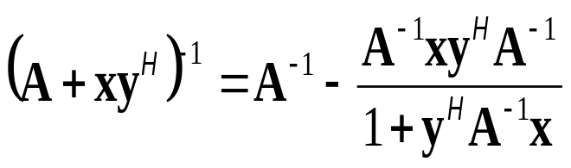
Example: Solution (cont’d)
The (i,k)th element of R=E[x[t] x^{H}[t]] is
Since the (i,k)th element of s(w₁)s(w₁)^{H} is exp(-jw₁{i-k}), one gets
The Wiener filter coefficients are
Matrix Inversion Lemma:

Slide 66
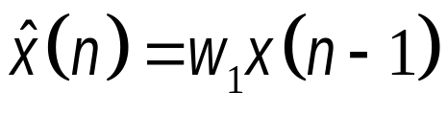
Example: Single-Tap Prediction
Consider a stationary stochastic signal sequence {X[n]} with zero mean and autocorrelation sequence R_{X}(0)=1, R_{X}(±1)=0.8 and R_{X}(±n)=0, n>1
Prediction coefficient of the first-order (single-tap) mmse predictor:
  By using the weight : w₁={1/R_{X}(0)}R_{X}(1)=0.8.
The prediction error is orthogonal to the prediction data:
  This leads to the same result: w₁=R_{X}(1)/R_{X}(0)=0.8.

Slide 67
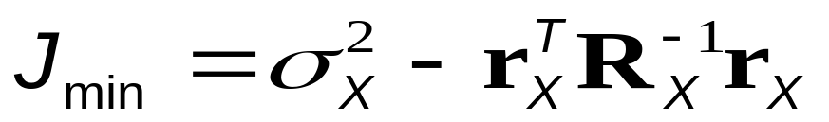
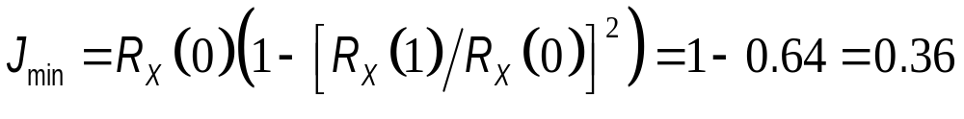
Example: Single-Tap Prediction
The corresponding minimum mean square error is found by using
  σ_{X}²= R_{X}(0), R_{X}= R_{X}(0), r_{X} =R_{X} (1).
Thus, the minimum mean square prediction error:
The predictor:

Slide 68
Example: Optimum Linear Predictor
Haykin, Problem 3.32
A stationary process X(t) has the following values for its autocorrelation function: R_{X}(0)=1, R_{X}(1)=0.8, R_{X}(2)=0.6, R_{X}(3)=0.4
  Calculate the coefficients of an optimum linear predictor involving 1,2 and 3 unit delays
  Calculate the variance of the resulting prediction error.
  Express the prediction of the input

Slide 69





Example (cont’d)
Haykin, Problem 3.32
Solution for 1-tap equalizer :
  Tap weights :
  Minimum prediction error:
  Prediction of the input :

Slide 70





Example (cont’d)
Haykin, Problem 3.32
Solution for 2-tap equalizer: Noting that
  Tap weights :
  Minimum prediction error:
  Prediction of the input :

Slide 71



Example (cont’d)
Haykin, Problem 3.32
Solution for 3-tap equalizer: Noting that
  Tap weights :
  Minimum prediction error:
  Prediction of the input :

Slide 72
Linear Adaptive Prediction
Linear prediction requires the knowledge of R[k], k=0,1,...,p, where p is prediction order.
Adaptive prediction can be used if R[k] is unknown, which is the case in practice:
  Tap weights, w_{k}, k=1,2,..,p, are computed in a recursive manner, i.e., starting from some arbitrary initial values.
  Algorithm used to adjust the tap weights operates solely on the basis of available data

Slide 73

Adaptive Prediction Algorithm
The algorithm aims to find the minimum point of the bowl-shaped error surface
  that describes the dependence of the cost function J on the tap weights.
Successive adjustments to the tap-weights of the predictor is made in the direction of the steepest descent of the error surface,
  i.e., in a direction opposite to the gradient vector in n^{th} iteration:

Slide 74

Variation of Mean-Square Error With Tap Weights

Slide 75

Adaptive Prediction Algorithm
If w_{k}[n] denotes k^{th} tap-weight at iteration n, then its updated value, w_{k}[n+1], at iteration n+1:
μ: step-size, controlling the speed of adaptation
  Small μ implies slow convergence but more accuracy
  Large μ implies rapid convergence and less accuracy

Slide 76


Adaptive Prediction Algorithm
To determine the values of g_{k}, we differentiate the cost function J
with respect to w_{k}, and find:

Slide 77

Adaptive Prediction Algorithm
Using instantaneous values as estimates of the autocorrelation function facilitates the adaptive process on a step-by-step basis:

Slide 78


Adaptive Prediction Algorithm
e[n] is called as the prediction error:
Thus,
This is the least-mean-square (LMS) algorithm for linear adaptive prediction.

Slide 79

Block Diagram Illustrating the Linear Adaptive Prediction Process

Slide 80

iteration number, n
_{Adaptive Predictor}

Slide 81
Differential PCM

Slide 82
Differential PCM (DPCM)
When signals are oversampled as in PCM, adjacent samples are highly correlated.
The difference between adjacent samples has a variance that is smaller than the variance of the signal itself.
The resulting encoded signal contains redundant information.
Differential PCM removes this redundancy,
  this results in a more efficient coding scheme.

Slide 83

DPCM
A smooth signal and its successive differences

Slide 84

DPCM
Notes:
Stern and Mahmoud, p. 410

Slide 85
DPCM
In DPCM, the difference in adjacent sample values is transmitted in order to
  remove the redundancy due to the correlation between the adjacent symbols, and
  reduce the transmission bandwidth.
At the receiver, the present sample value is regenerated by using the past values plus the update differential error
  A prediction filter is used in DPCM to estimate the present value from the past values.

Slide 86
DM System
(a) Transmitter
(b) Receiver

Slide 87

DPCM System
Transmitter
Receiver

Slide 88


DPCM System
The input signal to the quantizer (the prediction error):
  m[n] : unquantized input sample
  : prediction of m[n], by linear prediction filter
The prediction error will be reduced by using a better prediction filter (with higher prediction order).
  This will lead to lower transmit data rates
The simplest prediction filter is a simple delay element (as in DM), predicting the present sample with the previous one.

Slide 89

DPCM (cont’d)
The quantizer output:
  q[n]: quantization error
Assume L-level quantization with quantum levels at ±Δ, ±3Δ,......, ±(L-1)Δ.
Quantization error will be decreased as the number of quantization levels, L, increases.
  With increasing L, the number of bits per sample, log₂L, and the required transmission rate, R_{b}=f_{s} log₂L, will increase.

Slide 90


DPCM System
Quantized signal sample at t=nT:
Note that is obtained by the prediction filter having inputs m_{q}[n].

Slide 91



DPCM (cont’d)
Multilevel quantization of the prediction error provides better information for message reconstruction at R_{X} .
The prediction error is encoded as a binary word with log₂L bits, just like in binary PCM.
DPCM transmission requires
Since changes as much as ±(L-1)Δ from sample to sample, the slope tracking condition becomes
  f_{s}=1/T_{s}: sampling frequency

Slide 92

DPCM (cont’d)
Prediction filter input is, m_{q}[n], the quantized version of the input sample m[n]:
Irrespective of properties of the prediction filter, m_{q}[n] differs from m[n] by the quantization error q[n]
The prediction error, e[n], is determined by the prediction filter

Slide 93
DPCM (cont’d)
If prediction is good, variance of e[n], σ_{E}², will be less than the variance of m[n], σ_{M}².
A quantizer with a given number of levels, L, can be adjusted to produce a quantization error with variance, σ_{Q}², smaller than would be possible in the standard PCM, by choosing a suitable value for L.

Slide 94
DPCM Receiver
The decoder reconstructs the quantized error signal.
Quantized version of the original input is reconstructed from the decoder output using the same prediction filter used in the transmitter.
In the absence of channel noise, encoded signal at the receiver input is identical to the encoded signal at the transmitter output.
Corresponding receiver output is equal to m_{q}[n].

Slide 95
Differential PCM versus DM
DM is a special case of DPCM:
Quantizer:
DM: Two-level (one-bit)
DPCM: Multi-level
Prediction filter:
DM: Single-delay element (prediction order: p=0)
DPCM: Prediction filter (prediction order: p≥1)
DM and DPCM both suffer slope overload and quantization noise.

Slide 96






Processing Gain in DPCM
Output SNR:
Variance of the input sample m[n]
Variance of the quantization error q[n]
Variance of the prediction error
Signal-to-quantization noise ratio
Processing gain due to differential quantization >1
Optimum SNR_{o} advantage of DPCM over standard PCM is in the order of 4-11 dB.

Slide 97
Example: Haykin, Problem 3.34
A DPCM system uses a linear pedictor with a single tap. The normalized autocorrelation function of the input signal for a lag of one sampling interval is 0.8. The predictor is designed to minimize the predictor error variance. Determine the processing gain,G_{p}, attained by the use of this predictor. Note that G_{p} represents a gain in SNR that is due to differential quantization.

Slide 98
Example: Haykin, Problem 3.34 (cont’d)
Input signal variance : σ_{M}² = R_{X}(0)
Normalized autocorrelation of the input signal for a lag of one sample interval: ρ_{X}(1)=R_{X}(1)/R_{X}(0)= R_{X}(1)=0.8
Error variance:
σ_{E}² =J_{min}=R_{X}(0)-R_{X}(1)R_{X}⁻¹(0)R_{X}(1)=R_{X} (0)[1- ρ_{X}² (1)]
Processing gain:
G_{p} = σ_{M}² /σ_{E}² =1/(1-0.8²)=2.777 (4.437 dB)

Slide 99

Example Haykin, Problem 3.35
Consider a stationary process specified by the autocorrelation function: R_{X}(0)=1, R_{X}(1)=0.8, R_{X}(2)=0.6, R_{X}(3)=0.4. Calculate the improvement in G_{p} of a DPCM system using the optimized 2-tap and 3-tap linear predictor over that of the single-tap predictor of the previous example.
Solution:

Slide 100
Example Haykin, Problem 3.35
Single-tap predictor: G_{p}=2.7777 (4.44 dB)
Two-tap predictor: G_{p}=2.8571 (4.56 dB)
Three-tap predictor: G_{p}=2.8715 (4.58 dB)
The use of a two-tap predictor in the DPCM system results an improvement of 4.56-4.44=0.12 dB over the corresponding single-tap system.
Three-tap system provides 4.58-4.56=0.02 dB over the corresponding system using a two-tap predictor.

Slide 101
Example Haykin, Problem 3.36
For DPCM, we have 10log₁₀(SNR_{o}) =α+6n dB
where n is the number of quantization levels and -3< α <15. For n=8, 45 dB < SNR_{o} <63 dB.
For PCM, we have
10log₁₀(SNR_{o}) =4.77+6n-20log₁₀[ln(1+μ)] dB
For n=8 and μ=255, SNR=4.77+48-14.88=38 dB
SNR improvement resulting from the use of DPCM is in the range of 7 dB to 25 dB.

Slide 102
Example Haykin, Problem 3.36
Let us assume that n₁ bits/sample are used for DPCM and n bits/sample for PCM.
If α=15 dB, then 15+6n₁=6n-10. This yields n-n₁=(15+10)/6=4.18,
  this represents a saving of about 4 bits/sample due to the use of DPCM.
If α=-3 dB, then -3+6n₁=6n-10 implies n₁-n=1.01
  this represents a saving of about 1 bit/sample

Slide 103
Linear Predictive Coding (LPC)
LPC is a novel approach to digital representation of analog signals.
A transversal filter and some auxiliary components are used to synthesize the waveform in question.
Parameters of the waveform synthesizer (voice encoder, vocoder) are then encoded for transmission, instead of the actual signal.

Slide 104
LPC Codeword
A complete LPC codeword consists of 80 bits:
  1 bit for the voiced/unvoiced switch
  6 bits for the pitch frequency
  5 bits for the amplifier gain
  6 bits for each of the 10 tap gains
  A few bits for the error
Updating the parameters every 10-25 ms is equivalent to sampling at 40-100 Hz.
So, LPC requires a very modest bit rate in the vicinity of 3.2 kbps (80 bits/25 ms) - 8 kbps (80 bits/10 ms).

Slide 105
Comparison of Voice Encoding Methods
Encoding method | Sampling rate, kHz | Bits per sample | Bit rate, kbps
DM | 64-128 | 1 | 64-128
PCM | 8 | 7-8 | 56-64
ADM | 48-64 | 1 | 48-64
DPCM | 8 | 4-6 | 32-48
ADPCM | 8 | 3-4 | 24-32
LPC | 0.04-0.1 | ≈80 | 3-8

