Slide 1
Chapter 5
Signal-Space Analysis

Slide 2
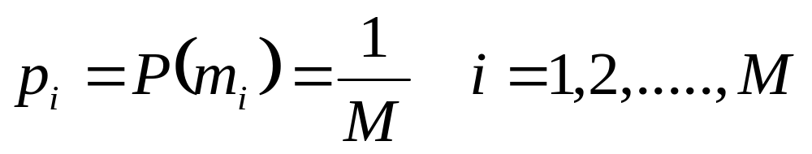
Introduction
A message source emits one symbol every T seconds
Symbols belong to an alphabet of M symbols, m₁, m₂,…, m_{M}
A priory probabilities p₁, p₂,…., p_{M} specify the message source output.
  Generally, M symbols of the alphabet are equally likely:

Slide 3
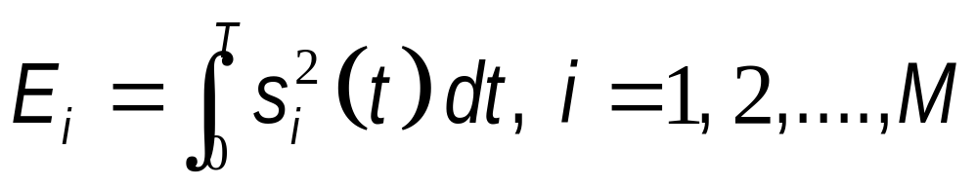
The Transmitter
Transmitter codes the message source output m_{i} into a distinct signal s_{i}(t), suitable for transmission over the channel.
The signal s_{i}(t) occupies the duration T alloted to m_{i} and is a real-valued energy signal:

Slide 4
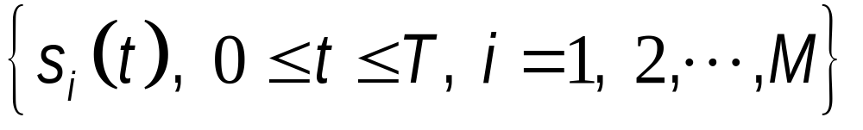
The transmitter
Assume that the digital information is transmitted by use of M signal waveforms (M-ary modulation)
Each waveform (symbol), s_{i}(t),
  is transmitted within the symbol duration T=kT_{b}
  carries k=log₂M bits (M=2^{k})
  has an energy E_{i}, i = 1,2,...,M

Slide 5
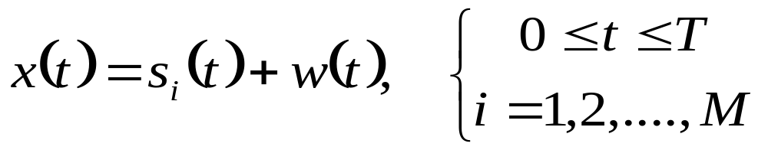
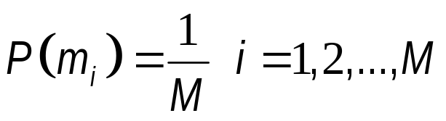
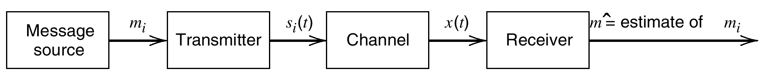
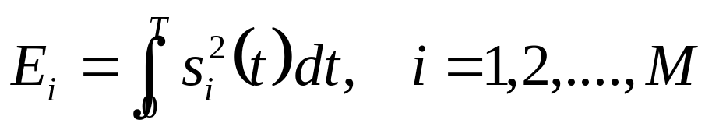
Block Diagram of a Generic Digital Communication System

Slide 6
The Channel
The channel is linear, with a bandwidth wide enough for transmission of s_{i}(t) with minimum distortion.
The channel noise, w(t), is a sample function of a zero-mean AWGN.
  Such a channel is called an AWGN channel
In an AWGN channel, the received signal is

Slide 7
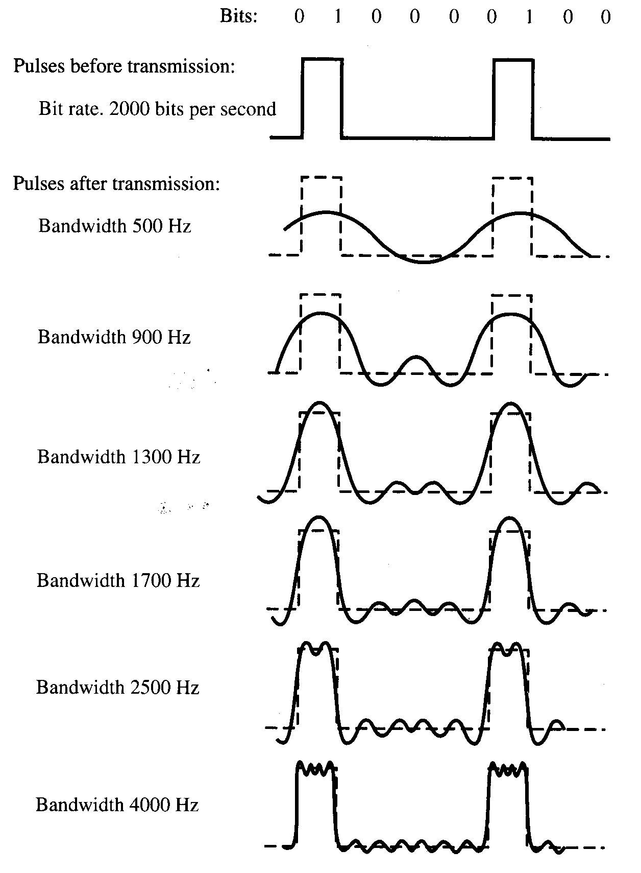
Effect of Bandwidth on a Digital Signal

Slide 8
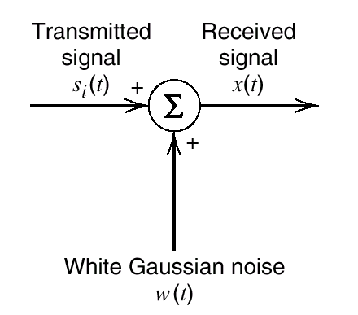
Additive White Gaussian Noise (AWGN) Model of a Channel
The channel
x(t)=s_{i}(t)+ w(t)
Model for received signal propagated through an AWGN channel

Slide 9
Optimum Receiver
We will consider the design and the performance characteristics of optimum receivers in an AWGN channel
In memoryless channels, the signals transmitted in successive symbol intervals are independent.
  coherent demodulation: the receiver knows the phase of the carrier signal induced by the channel.
  noncoherent demodulation: the carrier phase induced by the channel is unknown at the receiver and is treated as a random variable.

Slide 10
Optimum Receiver
The transmitted signal is said to have memory when the signals transmitted in successive symbol intervals are interdependent.
  When signal has no memory (memoryless), the symbol-by-symbol detector is optimum in the sense of minimizing the probability of a symbol error.
  When the transmitted signal has memory, the optimum detector is a detector that bases its decisions on observation of a sequence of received signals over successive signal intervals.

Slide 11
Optimum Receiver
Based on the observation of x(t) over the signal interval, we wish to design a receiver that is optimum in the sense that it minimizes the probability of making an error.
The receiver may be subdivided into two parts:
  The signal demodulator, and
  The detector

Slide 12
Optimum Receiver
x=[x₁ x₂ .....x_{N}]
Output
decision
Demodulator
Detector
Received signal
x(t)=s_{i}(t)+ w(t),
i=1,2,...,M
Correlator Matched-filter
Optimum in the sense that it minimizes BER
Receiver configuration

Slide 13
Optimum Receiver
The demodulator converts the received waveform x(t) into an N-dimensional vector x = [x₁ x₂ ..... x_{N}].
  N: the dimension of the transmitted signal waveforms
Two realizations of the signal demodulator:
  The signal correlator
  The matched filter
The detector decides which of the M possible signal waveforms was transmitted based on the vector x.
  The optimum detector is designed to minimize the probability of error.

Slide 14
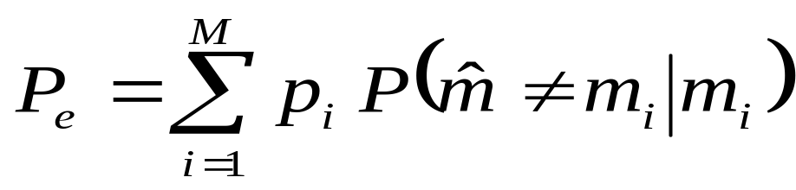
Optimum Receiver
Observes the received signal x(t) for T seconds and makes best estimate of the transmitted signal s_{i}(t) or equivalently, the symbol m_{i}.
Due to the presence of the channel noise, the receiver makes occasional errors.
Receiver should be designed to minimize the average probability of symbol error:

Slide 15
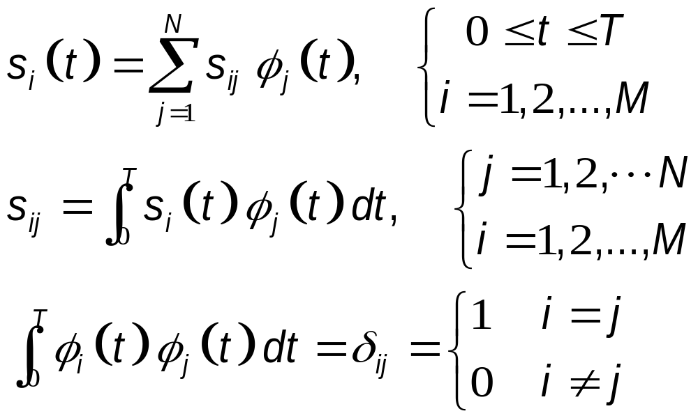
Geometric Representation of Signals
Represent any set of M energy signals {s_{i}(t)} as linear combinations of N orthonormal basis functions, {φ_{i}(t)}, where N≤M:

Slide 16
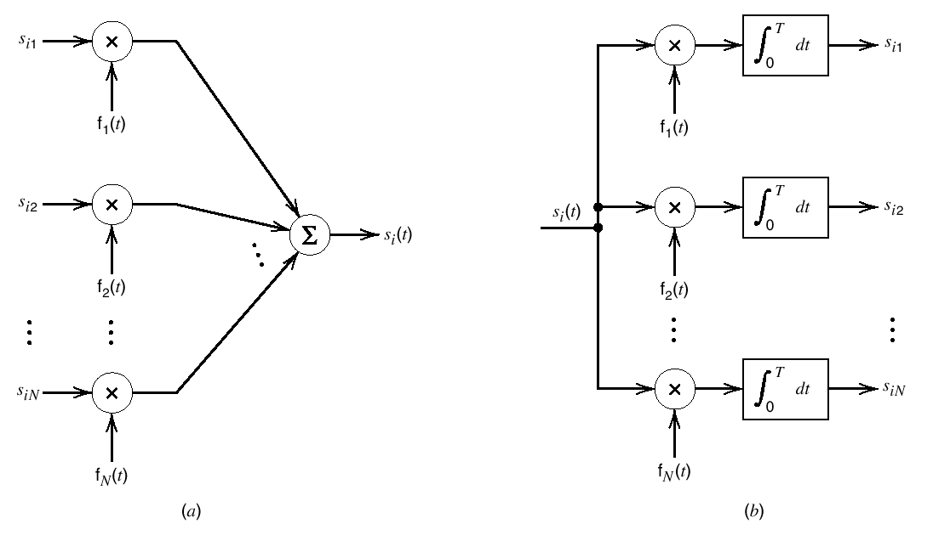
Geometric Representation of Signals
a) Synthesizer for generating the signal s_{i}(t).
b) Analyzer for generating the set of signal vectors {s_{i}}.

Slide 17
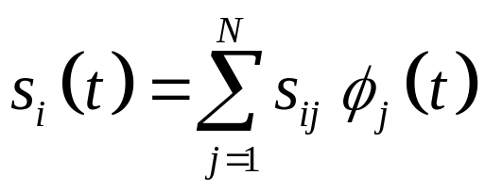
Signal Space
Each signal in the set {s_{i}(t)} is completely determined by the signal vector, s_{i}:
We may visualize the set of signal vectors {s_{i}, i=1,2,…,M} as defining a corresponding set of M points in an N-dimensional Euclidean (signal space) space, with N mutually perpendicular axes, φ₁, φ₂...,φ_{N.}.

Slide 18
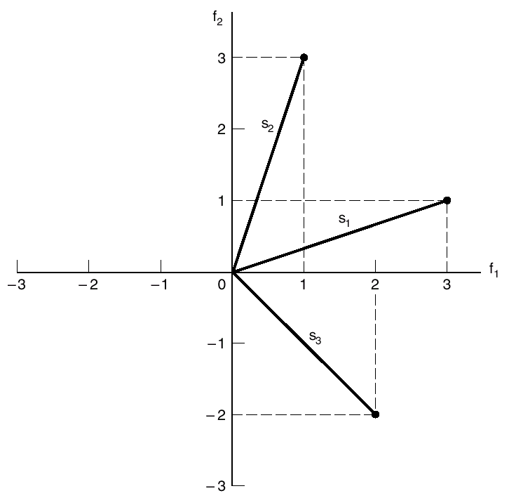

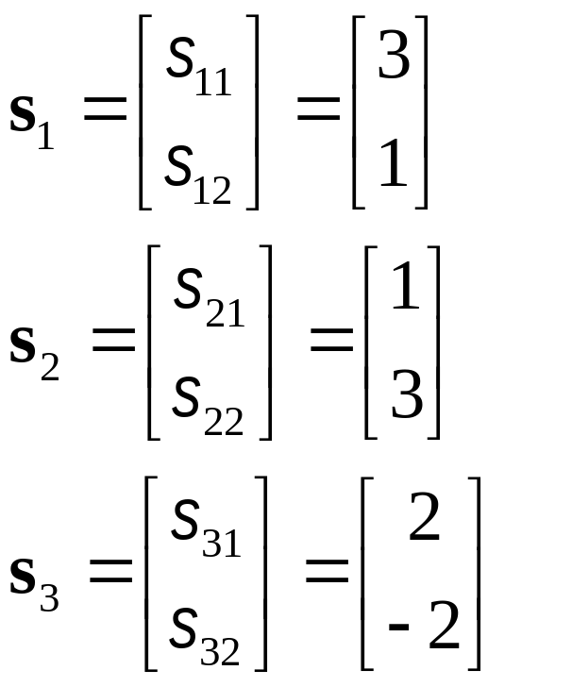

Signal Space
s₂₂
s₁₂
s₂₁ s₃₁ s₁₁
s₃₂
Illustrating the geometric representation of signals for the case when N = 2 and M = 3.

Slide 19
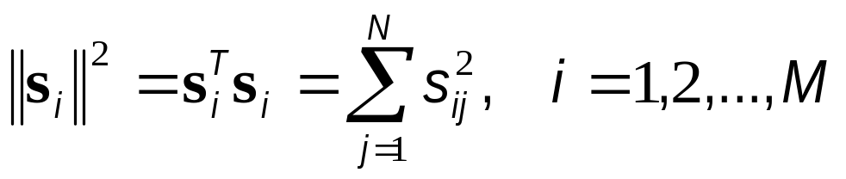
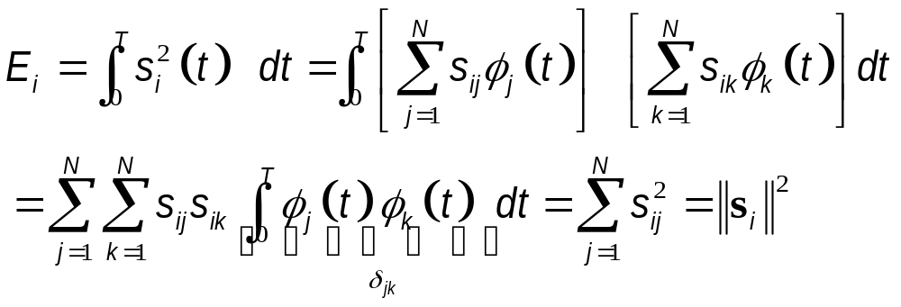
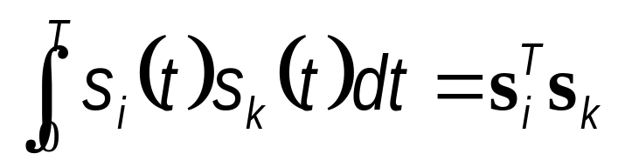
Definitions
Length (norm, absolute value) of a signal vector s_{i}
Energy of a signal:
Inner product:

Slide 20
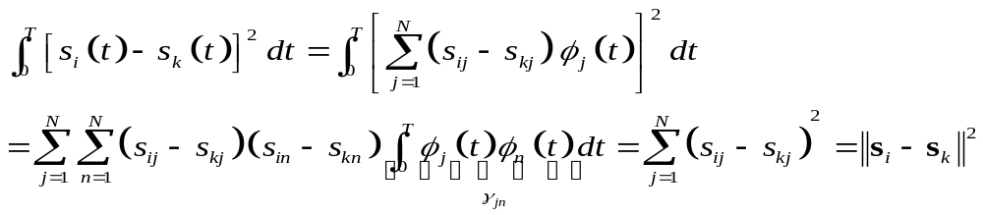
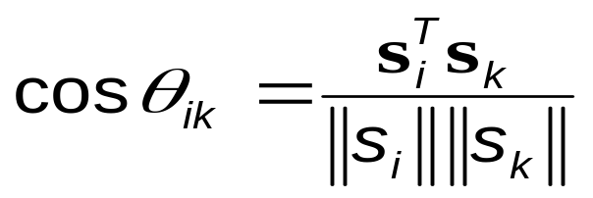
Definitions
Euclidean distance between two signals:
The angle θ_{ik} subtended between two signal vectors s_{i} and s_{k}:
Two signal vectors s_{i} and s_{k} are orthogonal (perpendicular to each other) if their inner product s_{i}^{T}s_{k} is zero, i.e., θ_{ik} =90 degrees.

Slide 21
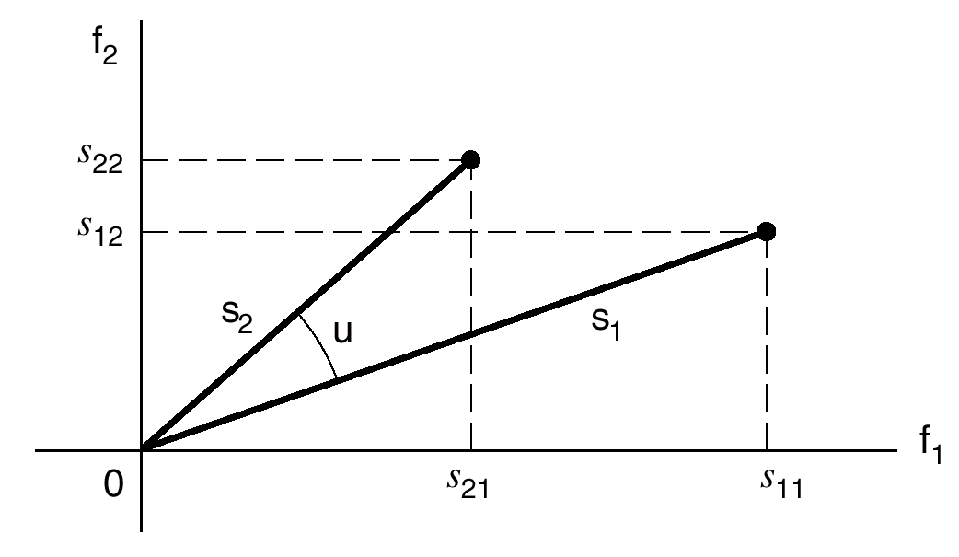
Definitions
Vector representations of signals s₁(t) and s₂(t)

Slide 22
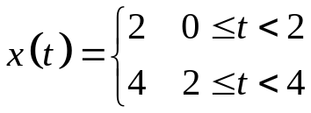
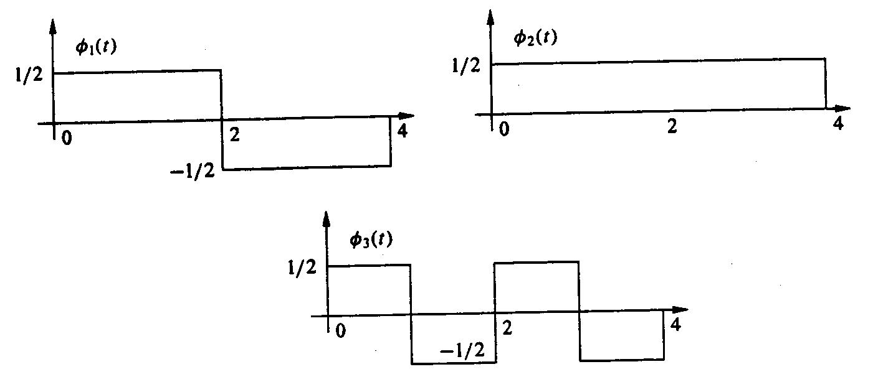
Example
Consider the three signal waveforms {φ₁(t), φ₂(t), φ₃(t)} shown in the figure below.
  Show that these waveforms are orthonormal
  Express the waveform as a linear combination of {φ_{i}(t)}, and find the coefficients.
  Determine the Euclidean distances between all the vector pairs
.

Slide 23
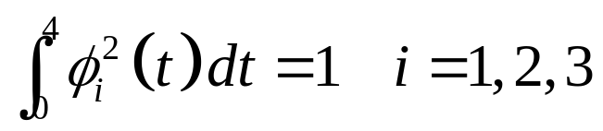
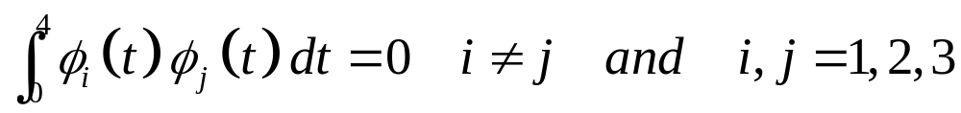
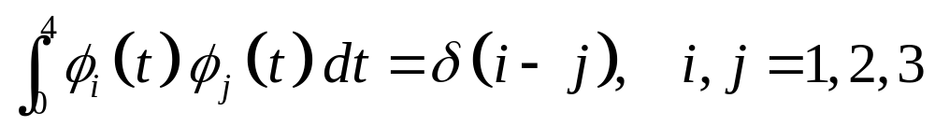
Example
The energies of the basis functions are normalized:
The basis functions are orthogonal:
Since the energies are normalized, they are orthonormal:
.

Slide 24
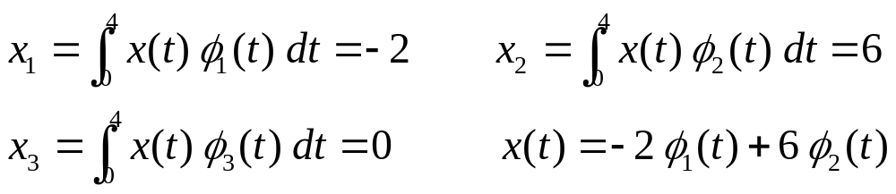
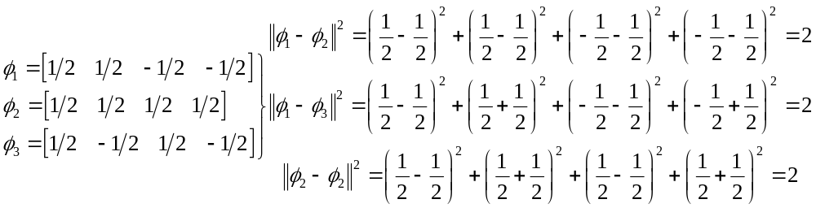
Example
The components of x(t) along the basis functions
Euclidean distances between the vector pairs:

Slide 25
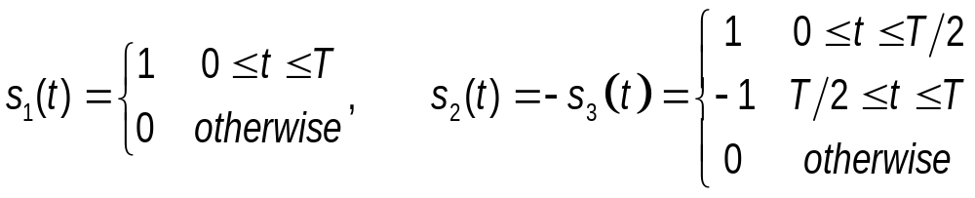
Example: Basis Functions
Three equiprobable messages m₁, m₂ and m₃ are to be transmitted over an AWGN channel with noise PSD N₀/2.
The messages are
  What is the dimensionality of the signal space?
  Find an appropriate basis for the signal space.
  Draw the signal constellation.
  Sketch the optimal decision regions Z₁, Z₂ and Z₃.
  Which of the three messages is more vulnerable to errors and why? In other words, which of Pr(error| s_{i} transmitted), for i=1,2,3 is larger?
Notes:
Handout_UU/ TutorialNo3 Exercise 4 signal-space (M=3) Final Exam 8 January 2009

Slide 26
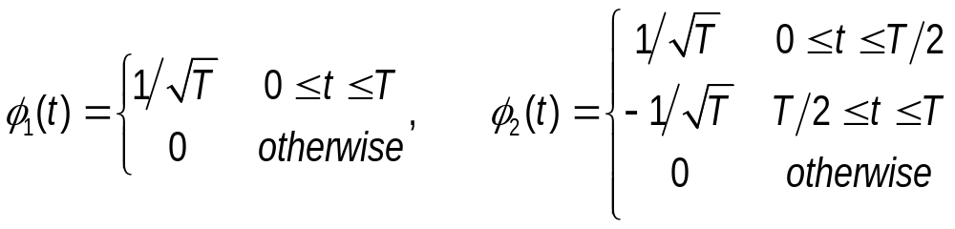
Example: Basis Functions
Observations:
  s₂(t) and s₃(t) are antipodal
  s₁(t) is orthogonal to s₂(t) and s₃(t)
We might choose a basis function parallel to s₁(t) and a second one parallel to s₂(t) and s₃(t):
The dimensionality is equal to N=2.
Notes:
Handout_UU/ TutorialNo3 Exercise 4 signal-space (M=3) Final Exam 8 January 2009

Slide 27





Example: Basis Functions
The symbols can be expressed in terms of basis functions as follows:
φ₁(t)
φ₁(t)
Z₁
s₁(t)
s₁(t)
s₃(t)
s₂(t)
s₃(t)
φ₂(t)
s₂(t)
φ₂(t)
Z₃
Z₂
Notes:
Handout_UU/ TutorialNo3 Exercise 4 signal-space (M=3) Final Exam 8 January 2009

Slide 28


Example: Basis Functions
The symbols s₂(t) and s₃(t) are equally vulnerable to errors.
s₁(t) is more vulnerable to errors since its decision region is narrower and the Euclidean distances is shorter than .
Thus,

Slide 29
Example: OFDM
Orthogonal Frequency Division Multiplexing (OFDM) is a multi-carrier transmission technique.
Consider a single-carrier system transmitting at a data rate of R, and having a symbol duration of 1/R.
However, each of the N subcarriers of an equivalent OFDM system (having the same bandwith) transmits at a rate of R/N; thus has an increased symbol duration of T=N/R.
OFDM is spectrum-efficient and is widely used in modern telecommunication systems such as ADSL, IEEE 802.11 (Wi-Fi) and DVB-T.
Notes:
SELF DESIGN, ELE 425 MIDTERM 2_2007

Slide 30
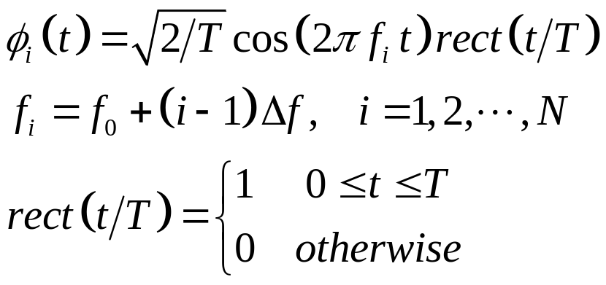
Example: OFDM
An OFDM subcarrier may be written as
  where f₀=k/T where k is a large integer.
The difference between consecutive subcarrier frequencies are separated from each other by an amount Δf, i.e., f_{i+1}-f_{i}=Δf=1/T.
Notes:
SELF DESIGN, ELE 425 MIDTERM 2_2007

Slide 31
Example: OFDM
Show that the subcarriers are orthonormal.
Determine the Fourier transform, Φ_{i}(f), of the subcarrier φ_{i}(t) and plot Φ_{i}(f), Φ_{i+1}(f) and Φ_{i+2}(f). Show that the spectra of the subcarriers overlap.
If the subcarriers remain orthogonal at the receiver, then they can be easily separated at the receiver without interfering to each other, even though they overlap in the frequency domain. Discuss how can the orthogonality of the subcarriers be destroyed by the channel and/or the transmitter/receiver?
Notes:
SELF DESIGN, ELE 425 MIDTERM 2_2007

Slide 32
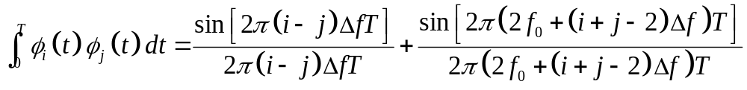
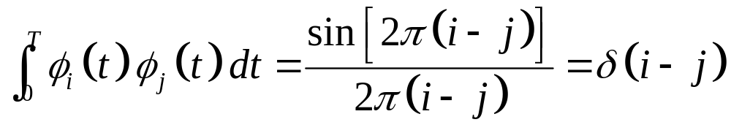
Example: OFDM
Using
one may show that
Noting that Δf T=1 and f₀=k/T, the second term above is identically equal to zero. Then
Thus, the sub-carriers are orthonormal.
Notes:
SELF DESIGN, ELE 425 MIDTERM 2_2007

Slide 33
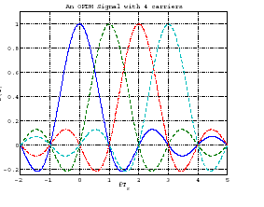
Example: OFDM
Δf
Orthogonal subcarriers
in OFDM

Slide 34
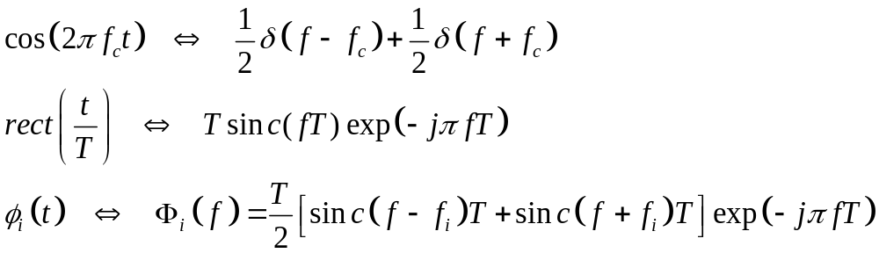
Example: OFDM
One may easily show that
Since and f_{i+1} -f_{i} =Δf and the first nulls of the sinc functions are displaced by Δf from their centre frequencies, the consecutive basis functions are located at the first nulls of the previous ones in the frequency domains. Hence, they overlap with each other.
Notes:
SELF DESIGN, ELE 425 MIDTERM 2_2007

Slide 35
Example: OFDM
Orthogonality may be destroyed
  by the Doppler shift in the channel
  when the clocks of the transmitter and receiver are not properly synchronized.
  when the synthesizers of the transmitter and/or receiver are not perfect; i.e., when they produce phase noise. Then the frequencies generated randomly change around its nominal value.
Notes:
SELF DESIGN, ELE 425 MIDTERM 2_2007

Slide 36
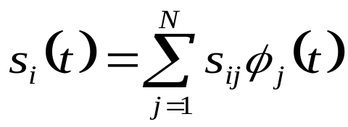
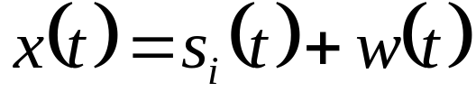
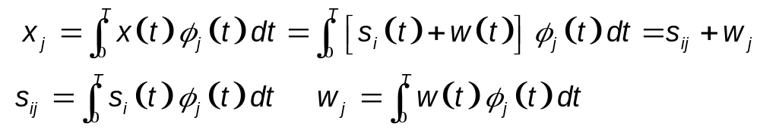
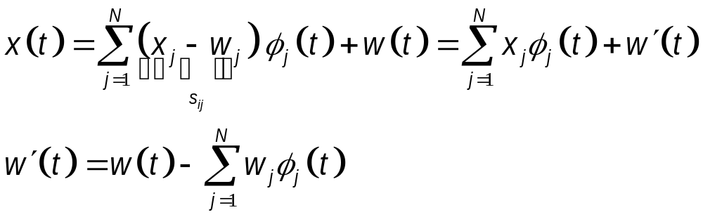
Vector Channel
Transmitted signal:
Received signal:
Output of j^{th} correlator :
Received
signal:
Remainder noise

Slide 37
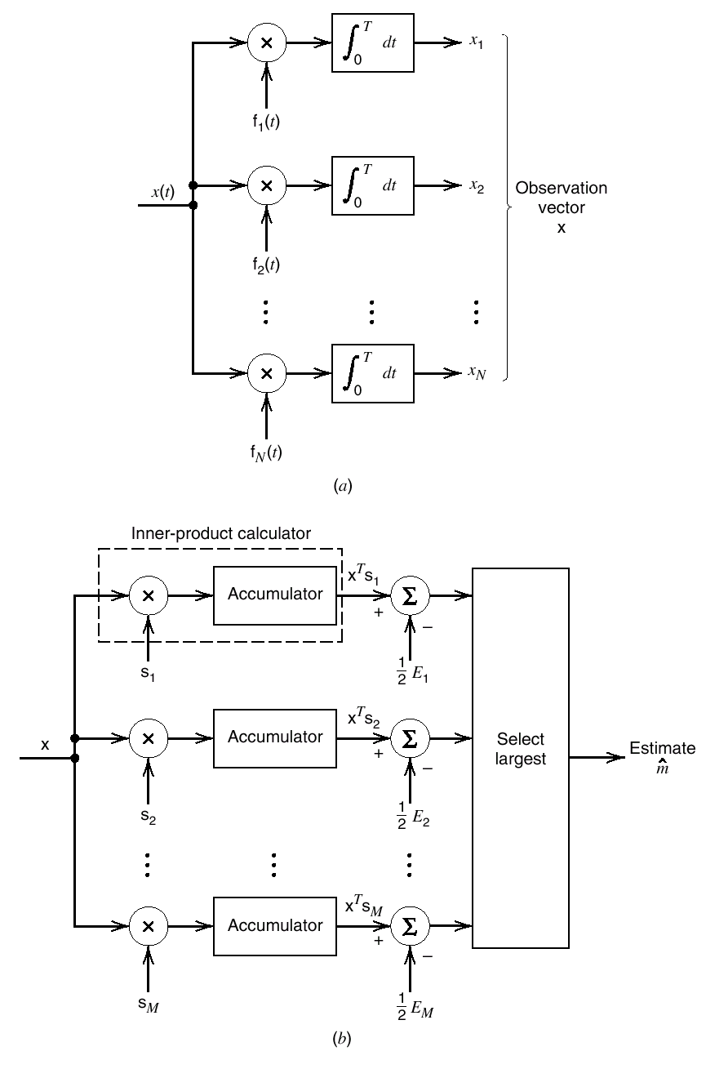


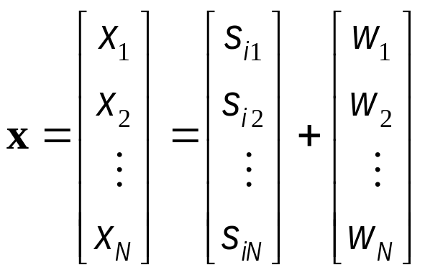


Vector Channel
x₁=s_{i1}+w₁
Detector or demodulator of a correlation receiver

Slide 38
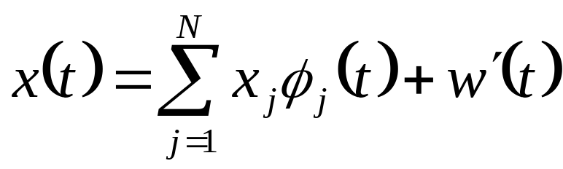
Effect of the Noise Term w´(t)
The random vector whose conditional pdf is found characterises the first term in the expression
The second term of x(t) is w′(t), and depends on the channel noise.
Since W(t) is Gaussian with zero-mean, W´(t) is also zero-mean Gaussian. If a Gaussian process is applied to a stable linear filter, its output is also Gaussian (see Haykin p.56).

Slide 39
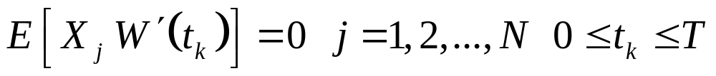
Effect of the Noise Term w´(t)
Any r. v. W´(t_{k}) derived from the noise process W´(t) by sampling it at time t_{k}, is statistically independent of the set of random variables {X_{j}}:
Since any r. v. based on W´(t) is independent of {X_{j}} as well as {s_{j}(t)}, W´(t_{k}) is irrelevant to decision as to which particular signal was actually transmitted.
Correlator outputs determined by the received signal, x(t), represent the sufficient statistics for the decision-making process.

Slide 40
Theorem of Irrelevance
For signal detection in an AWGN channel, only the projections of the noise onto the basis functions of the signal set affects the sufficient statistics of the detection problem; the remainder of the noise is irrelevant.

Slide 41
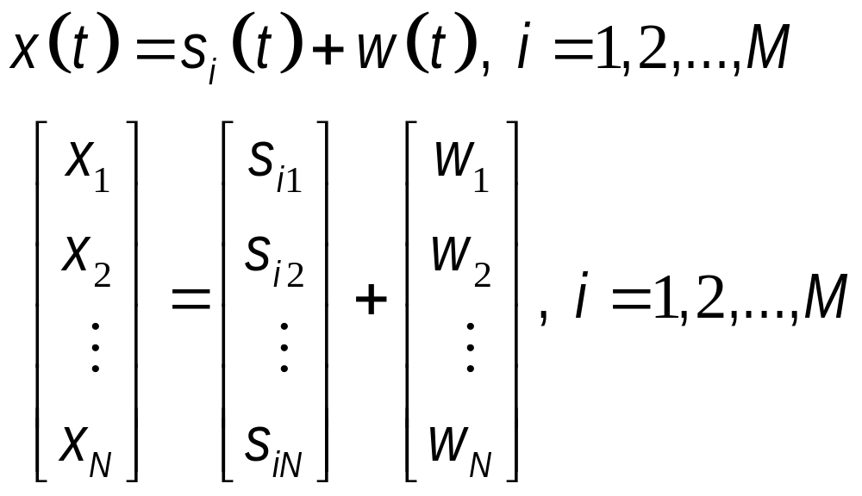
Corollary to Irrelevance Theorem
The AWGN channel is equivalent to an N dimensional vector channel, described by

Slide 42
Statistical Characterization of N Correlator Outputs
X(t) denotes a random process, and received signal x(t) is a sample function of X(t).
Since X(t) is a Gaussian random process, X_{j} denotes a Gaussian random variable whose sample value is represented by the correlator output x_{j}, j=1,2,…,N.
  X_{j} is characterised by its mean and variance.

Slide 43
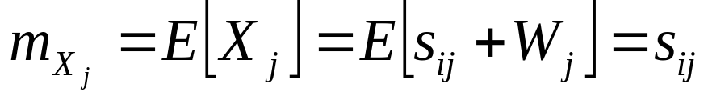
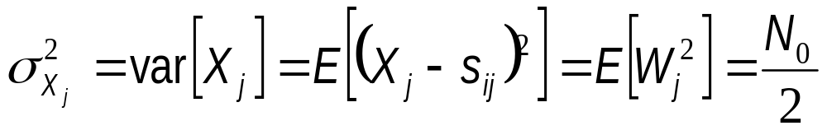
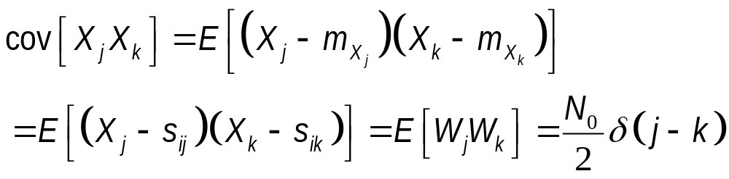
Mean and Variance of X_{j}
Mean:
Note that E[W_{j}]=0, since the noise process W(t) represented by w(t) in AWGN model has zero-mean by definition.
Variance:
Covariance:

Slide 44
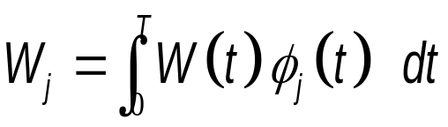
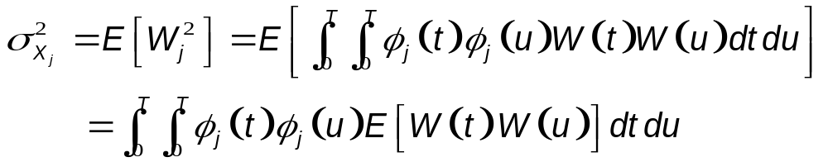
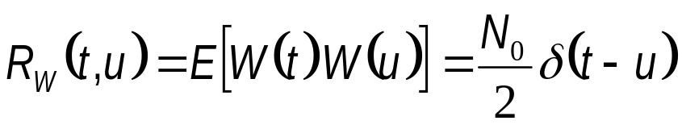

Details of the Derivation of var[X_{j}]
Noting that , one can write
Noting that one gets

Slide 45

Conditional pdf of Observation Vector
The observation vector X of N random variables
  X_{j}=s_{ij}+w_{j} where X_{j} are independent Gaussian random variables with mean s_{ij} and variance N₀/2.
The corresponding channel is memoryless.

Slide 46


Conditional pdf of Observation Vector
Conditional pdf of the vector X, given that the signal s_{i}(t), i.e., m_{i} was transmitted:
X_{j} is a Gaussian r.v. with mean s_{ij} and variance N₀/2, one has

Slide 47

Conditional pdf of Observation Vector
Consequently, the conditional pdf of the vector X, given that the signal s_{i}(t), i.e., m_{i} was transmitted:

Slide 48


Likelihood Functions
The conditional pdf’s
  characterise an AWGN channel, and
  show the pdf of the observation vector X, given the transmitted message symbol m_{i}.
Likelihood function is defined as

Slide 49


Likelihood Functions
Since pdf is always non-negative, likelihood function is also a non-negative quantity.
The logarithmic function is a monotonically increasing function of its argument.
Therefore, it is more convenient to use the log-likelihood function:
Log-likelihood function of an AWGN channel:

Slide 50
Coherent Detection of Signals in Noise
In each time slot of duration T seconds, one of M possible signals s₁(t),, s₂(t),…,s_{M}(t) is transmitted, each with a priori probability of p(s_{i}).
For geometric signal representation, s_{i}(t) is applied to a bank of correlators, with a common input and supplied with an appropriate set of N orthonormal basis functions.
  Resulting correlator outputs define the signal vector s_{i}=[s_{i1} s_{i2} ….s_{iN}]^{T}.

Slide 51
Maximum Likelihood Decoding
s_{i}(t) may be represented by a point in a Euclidean space of dimension N≤M. This point is called as the transmitted signal point or message point.
The set of message points {s_{i}(t)}, i=1,2,..,M is called the signal constellation.
Received signal x=s_{i}+w is perturbed by the presence of the additive noise vector w, whose orientation is completely random.
Noise vector w, uniquely characterised by the noise w(t), represents that portion of noise that interferes with detection process.

Slide 52
Decoding Process
Based on the observation vector x, the received signal x(t) may be represented by a point in the same Euclidean space as the transmitted signal. This is called the received signal point.
Received signal point wanders around the message point randomly, lying anywhere inside a Gaussian distributed cloud, centered on the message point.

Slide 53







Decoding Process
Illustrating the effect of noise perturbation, depicted in (a), on the location of the received signal point, depicted in (b).

Slide 54



Decoding Process
Given the observation vector x, perform a mapping from x to an estimate of the transmitted symbol, m_{i}, in a way that would minimize the probability of error in the decision-making process .
Given the observation vector x, probability of error in making the decision :

Slide 55


Optimum Decision Rule
Optimum decision rule minimizes the probability of error in mapping each given observation vector x into a decision:
Set if
This decision rule is referred as maximum a posteriori probability (MAP) rule.

Slide 56


MAP Rule
Bayes rule:
The MAP rule using a priori probabilities:
Set if
is maximum for k= i
p_{k}=p(m_{k}): a priori probability of the symbol m_{k}
f_{X}(x|m_{k}): conditional pdf of X, given m_{k}
f_{X}(x) : unconditional pdf of X.

Slide 57
Maximum Likelihood (ML) Decoding
The denominator term f_{X}(x) is independent of the transmitted symbol.
The a priori probability p_{k}=1/M for k=1,21,..,M, when all the source symbols are transmitted with equal probability
Then, the conditional pdf f_{X}(x|m_{k}) becomes the same as the likelihood function.
Decision rule in terms of the log-likelihood function l(m_{k})
Set if
the log-likelihood function l(m_{k}) is maximum for k=i

Slide 58
Maximum Likelihood (ML) Decoding
This decision is referred to as the maximum likelihood rule.
Its implementation is referred to as maximum likelihood decoder (MLD).
The MLD assumes equi-probable messages.
The MLD calculates log-likelihood functions as metrics for all the possible message points, compares them, and then decides in favor of the maximum.

Slide 59


Example : MAP Detection
A Bayes receiver is implemented by means of the likelihood ratio test for making a decision.
In case of bipolar signalling, as defined by
the likelihood ratio test can be written as

Slide 60



Example : MAP Detection
Since x is a Gaussian random variable, its pdf
The log-likelihood ratio then becomes
  This implies that
See Chapter 4 Matched Filter

Slide 61


Example : MAP Detection
The (MLD) test reduces to
  This means that decide +A if x>λ, and decide –A if x<λ.
The probability of error can then be written as

Slide 62



Example : MAP Detection
Using the asymptotic approximation to Q(x),
one can easily show that, at the optimum threshold point, a posteriori probabilities are equal to each other:

Slide 63


Example : MAP Detection
At the optimum threshold point, one can show that
If we assume p₀=0.3, p₁=0.7 and A/σ=5, then

Slide 64


Example : MAP Detection
Special case, p₀=p₁=1/2, the (MLD) test reduces to
The probability of error can then be written as

Slide 65
Example: MAP Decoder
Consider a binary symmetric channel with transition probability of p=0.2. The probability of transmitting 1 is p₁=P(m₁)=0.7 and the probability of transmitting 0 is p₀=P(m₀)=0.3.
  Design the optimal decoder; that is, find decoding regions for both symbols.
  What is the probability of decoder error for the optimal decoder of the first part.
  Determine the probability of receiving 1 and 0 and compare with the corresponding probabilities of transmitting 1 and 0.
Notes:
SELF DESIGN, ELE 425 MIDTERM 2_2007

Slide 66

Example: MAP Decoder
The following equations are used to construct the table below:
m | P(m) | r | P(r|m) | P(r,m) | P(r) | P(m|r)
0 1 | 0.3 0.7 | 0 0 | 1-p=0.8 p=0.2 | 0.24 0.14 | 0.38 | 0.632 0.368
0 1 | 0.3 0.7 | 1 1 | p=0.2 1-p=0.8 | 0.06 0.56 | 0.62 | 0.097 0.903
Notes:
SELF DESIGN, ELE 425 MIDTERM 2_2007

Slide 67


Example: MAP Decoder
Decoding rule (from the table):
  Decoder decides if r=0 is received.
  Decoder decides if r=0 is received.
Probability of decoding error:
P(r=1)=0.62 and P(r=0)=0.38.
  Compare these with probabilities of transmission (p₁=0.7 and p₀=0.3) and explain the differences.
Notes:
SELF DESIGN, ELE 425 MIDTERM 2_2007

Slide 68
Graphical Interpretation of MLD
Let Z denote the N-dimensional observation space of all possible observation vectors x.
The observation space is partitioned into M-decision regions, Z₁, Z₂,…, Z_{M}.
Restatement of decision rule:
Observation vector x lies in region Z_{i} if
l(m_{k}) is maximum for k=i.

Slide 69


Graphical Interpretation of MLD
Illustrating the partitioning of the observation space into decision regions for the case when N = 2 and M = 4.
It is assumed that the M transmitted symbols are equally likely.

Slide 70



MLD in AWGN Channel
Log-likelihood function
becomes maximum when
is minimized for k=i.
Decision rule:
Observation vector x lies in region Z_{i} if
is minimum for k=i.

Slide 71



MLD in AWGN Channel
Note that with
denoting the Euclidean distance between the received signal point and message point.
MLD decision rule:
Observation vector x lies in region Z_{i} if
the Euclidean distance is minimum for k=i.
  We thus simply choose the message point closest to the received signal point.

Slide 72



MLD in AWGN Channel
Noting that
The first term in expansion is ignored, since it is independent of the index k.
Energy of transmitted signal s_{k}:
Decision rule:
Observation vector x lies in region Z_{i} if
is maximum for k=i.

Slide 73
Correlation Receiver
Optimum correlation receiver consists of two subsystems:
The detector consists of a bank of M product-integrators.
The decoder is implemented in the form of a maximum likelihood decoder.

Slide 74



Correlation Receiver
Detector or demodulator

Slide 75


Correlation Receiver
Demodulator output:
Signal transmission decoder

Slide 76

Equivalence of Correlation and Matched Filter Receivers
Consider a LTI filter with impulse response h_{j}(t).
Filter output x_{j}(t) for the input signal x(t):
If impulse response h_{j}(t) of a LTI filter is matched to an input signal φ_{j}(t), then

Slide 77



Equivalence of Correlation and Matched Filter Receivers
The filter output:
Sampling filter output at time t=T:
Since φ_{j}(t) is zero outside the interval 0≤t≤T, x_{j}(T) is the j^{th} correlator output x_{j} produced by the received signal x(t):
Correlator output is equivalent to matched filter output only at time t=T.

Slide 78




Equivalence of Correlation and Matched Filter Receivers
The detector (demodulator) part of matched filter receiver

Slide 79


Probability of Error
Average probability of symbol error, P_{e}:
P_{e} in terms of likelihood function:

Slide 80
Invariance of P_{e} to Rotation
In MLD, P_{e} depends only on the relative Euclidean distances between the message points in the constellation.
The AWGN is spherically symmetric in all directions in the signal space.
Principle of Rotational Invariance: If a signal constellation is rotated by an orthonormal transformation, then the P_{e} incurred in ML signal detection over an AWGN channel is completely unchanged.

Slide 81




Principle of Rotational Invariance
2a
2a
A pair of signal constellations for illustrating the principle of rotational invariance

Slide 82

Principle of Translational Invariance
If a signal constellation is translated by a constant vector amount, then the probability of symbol error P_{e} incurred in maximum likelihood signal detection over an AWGN channel is completely unchanged.
A pair of signal constellations for illustrating the principle of translational invariance
s₁ s₂ s₃ s₄
s₁ s₂ s₃ s₄

Slide 83

Minimum Energy (Simplex) Signals
Using principle of translational invariance, a given signal constellation can be translated such that the average energy is minimized.
Given a signal constellation s_{i}, i=1,..,M, the corresponding signal constellation with minimum average energy is obtained by subtracting from each signal vector s_{i} in the given constellation by an amount equal to the constant vector

Slide 84

Union Bound on the P_{e}
Needed when exact calculation is difficult
Probability of error is upper-bounded by
  P₂(s_{i},s_{k}): pairwise error probability, defined as the probability of the receiver mistaking s_{k} for s_{i}
Consider two equally likely messages s_{k} for s_{i}.
  Decision boundary is represented by the bisector joining the message points.

Slide 85



Union Bound on the P_{e}
Pairwise error probability:
Euclidean distance between s_{i} and s_{k}:
Q function:

Slide 86

Union Bound on the P_{e}
Exact
Constellation of four message points.
Three constellations with a common message point and one other message point retained from the original constellation.

Slide 87


Upper Bound for P_{e}
Upper bound for the pairwise error probability:
Probability of symbol error, averaged over all the M symbols, is upper-bounded by
p_{i} : probability of transmitting symbol m_{i}

Slide 88



Special Cases
If the signal constellation is circularly symmetric about the origin, then P_{e}(m_{i}) is the same for all i:
  p_{i}=1/M is assumed
Using , one gets

Slide 89


Special Cases
Minimum distance of a signal constellation, d_{min}, is defined as the smallest Euclidean distance between any two transmitted signal points in the constellation:
Replacing d_{ik} by d_{min} implies that the corresponding pairwise error probability is increased.
The upper-bound on the average symbol error probability, is given as a function of the minimum distance

Slide 90



Special Cases
Q(x) is monotonically decreasing function of x
Similarly
Thus, upper bound on P_{e} is given by

Slide 91


Bit Error versus Symbol Error
Gray coding:
  Adjacent symbols in symbol space differ in only in one bit position.
  If there is a symbol error, then most probably nearest symbols are mistaken, thus causing a single bit error:
Binary coding:
  All symbol errors are assumed equally likely

