Slide 1
Chapter 6
Passband Data Transmission

Slide 2
Baseband versus Passband Transmission
In baseband pulse transmission, a data stream represented in the form of a discrete PAM signals is transmitted directly over a low-pass channel.
In digital passband transmission, the incoming data stream is modulated onto a carrier with fixed frequency limits imposed by a band-pass channel of interest.

Slide 3
Modulation
Modulation makes the transmission possible in a pass-band channel.
Modulation involves switching (keying) the amplitude, frequency or phase of a sinusoidal carrier in some fashion in accordance with the incoming data:
  Amplitude-shift keying (ASK),
  Frequency shift keying (FSK), and
  Phase-shift keying (PSK).

Slide 4
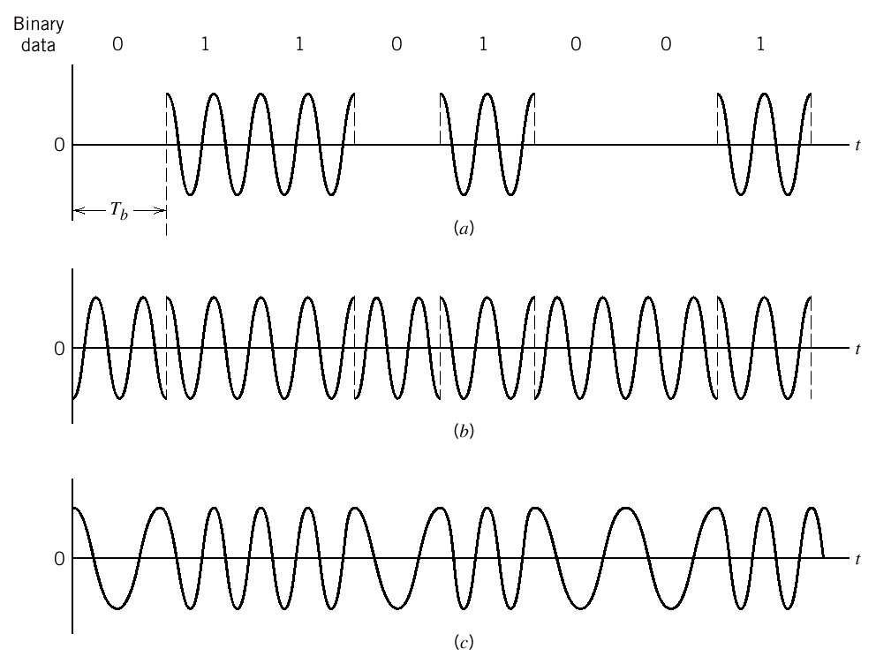
Modulation
Illustrative waveforms for the three basic forms of signaling binary information.
Amplitude-shift keying
Phase-shift keying
Frequency-shift keying with continuous phase.
ASK
PSK
FSK

Slide 5
Constant Envelope Modulation
For passband data transmission,
  PSK and FSK signals have constant envelope and are preferred over nonlinear channels,
  ASK does not have a constant envelope and is preferred in linear channels.
Each modulation scheme has its advantages and weaknesses:
  Choice is made between them depending on the specific application under consideration.

Slide 6
Coherent Demodulation
In coherent demodulation, the receiver is equipped with a phase-recovery circuit.
The phase-recovery circuit ensures that the oscillator supplying the locally generated carrier wave in the receiver is synchronized in both frequency and phase to the oscillator supplying the carrier wave used to originally modulate the incoming data stream in the transmitter.

Slide 7
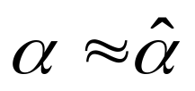
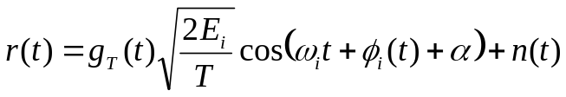
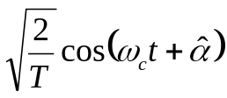
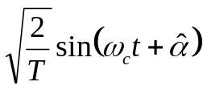
Coherent Demodulation
Circuits such as Phase-Locked-Loop (PLL) are implemented at the receiver for carrier phase estimation ( ).
I branch
PLL
Used by correlators
Oscillator
90 deg.
Q branch

Slide 8
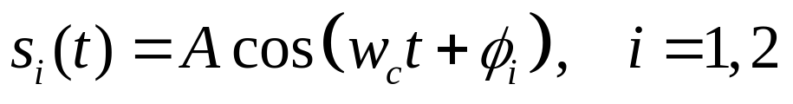
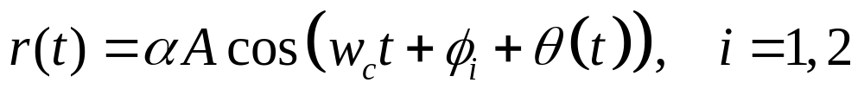
Coherent Demodulation
Transmitted signal:
  a binary 1 is transmitted by φ_{i}=0,
  a binary 0 is transmiited by φ_{i}=π.
The signal at the receiver input:
  θ(t) : the phase shift incurred by the channel
  α : the attenuation constant
If the receiver can estimate θ(t) accurately, then it can coherently demodulate the phase φ_{i} due to modulation.

Slide 9
Noncoherent Demodulation
In noncoherent demodulation, the receiver does not have the knowledge of the phase and the frequency of the carrier wave.
Noncoherent demodulation performs worse that coherent demodulation.
Noncoherent demodulation techniques are resorted whenever it is impractical to maintain carrier phase and/or frequency synchronization.

Slide 10
M-ary Modulation
In binary signalling, we send any one of two possible symbols s₁(t) or s₂(t), representing 1 and 0, during each signalling interval of bit duration T_{b}.
In M-ary signalling, any one of M possible signals s₁(t), s₂(t),…, s_{M}(t), is sent during each signaling interval of duration T, to represent one of the combinations of log₂M bits.
  Thus, the symbol duration is T=(log₂M) T_{b}.

Slide 11
M-ary Modulation
Principal M-ary modulation techniques: M-ary PSK, M-ary ASK and M-ary FSK.
  M-ary quadrature-amplitude modulation (QAM) is a combination of M-ary ASK and M-ary PSK and is used in linear channels.
M-ary signaling schemes provide a trade-off between conservation of bandwidth and the increase in transmitted power.
  The bandwidth in M-ary PSK:
  B_{M}=2/T= 2/(T_{b} log₂M)= B₂/(log₂ M) is decreased by a factor of log₂ M with respect to binary signaling.

Slide 12
M-ary Modulation
PSK, (FSK) and QAM are commonly used in coherent systems.
ASK and FSK are used in noncoherent systems whenever it is impractical to maintain carrier phase synchronization.
  Differential phase-shift keying (DPSK) is noncoherent version of PSK, i.e., communications without carrier phase information.
  M-ary FSK and M-ary DPSK are commonly used in noncoherent systems.

Slide 13
Probability of Symbol Error
Goal is to optimum design of the receiver so as to minimize the average probability of symbol error in the presence of AWGN.
Formulation is based on Chapter 5.
Exact formulas are derived for some simple methods such as binary PSK and binary coherent FSK.
Union bounds are provided for others.

Slide 14
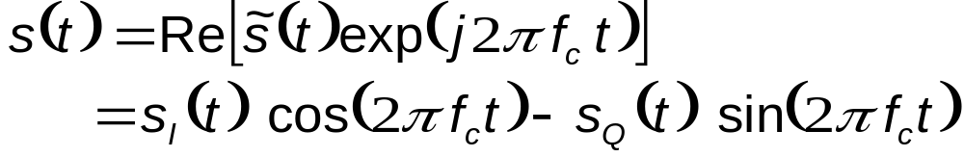
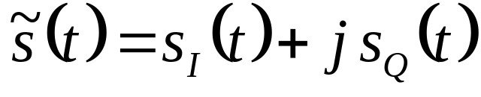
PSD of Bandpass Signals
Needed for understanding the occupancy of the channel bandwidth and cochannel interference in multiplexed systems.
A modulated signal can be written as:
Complex envelope, is the baseband version of modulated bandpass signal

Slide 15
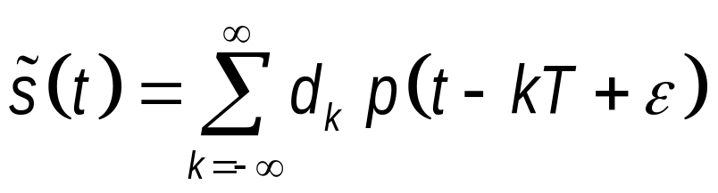
PSD of Bandpass Signals
The complex-envelope may be written as
  p(t-kT) pulse over kT < t < (k+1)T
  T symbol duration
  d_{k} sequence of independent, equally likely, complex random variables
    (d_{k}=±1 for BPSK, d_{k}= ±1 and ±j for QPSK )
  ε uniformly distributed r.v. over (0,π) due to clock errors

Slide 16
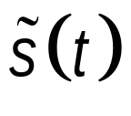
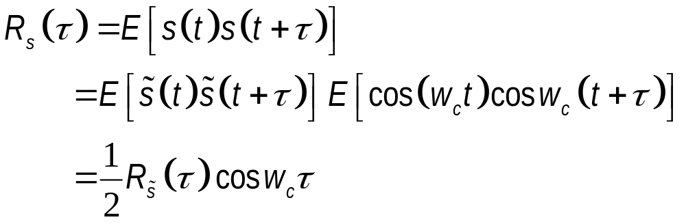
PSD of Bandpass Signals
Autocorrelation function of the bandpass signal, s(t):
  Assuming that and p(t) are real

Slide 17
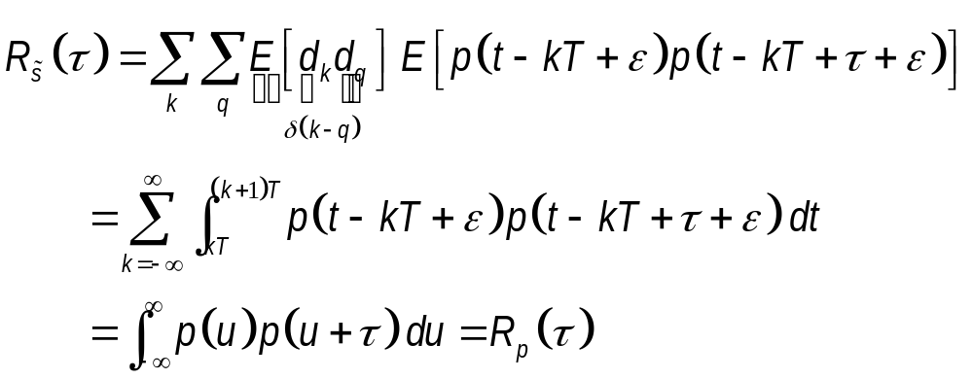
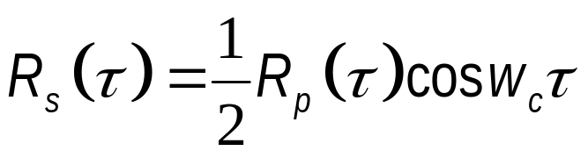
PSD of Bandpass Signals
Autocorrelation function of :
Autocorrelation function of s(t):

Slide 18
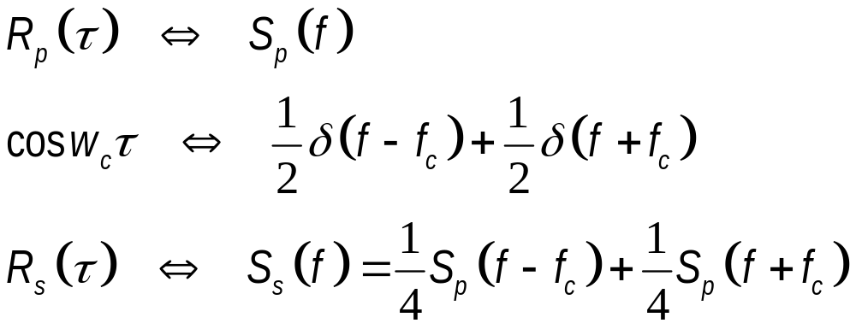
PSD of Bandpass Signals
Power spectral density, PSD, of s(t):
  Transmission bandwidth of s(t) is determined by that of the p(t).

Slide 19
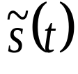
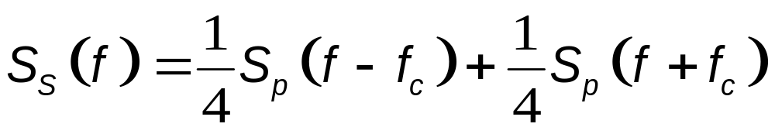
PSD of Bandpass Signal
s_{I}(t), s_{Q}(t) and are all low-pass signals and are uniquely related to the bandpass signal s(t) and the carrier frequency f_{c}.
If S_{p}(f) denotes the (baseband) power spectrum of the complex envelope , then the PSD, S_{S}(f), of the band-pass signal s(t) is a frequency shifted version of S_{p}(f):

Slide 20
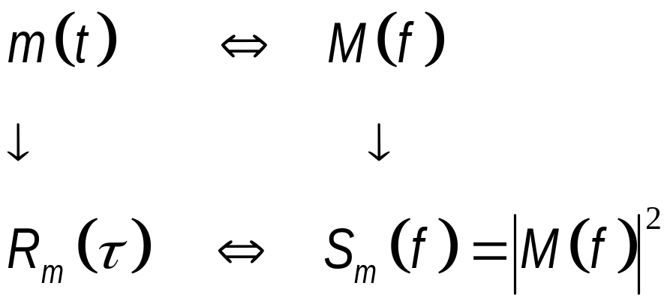
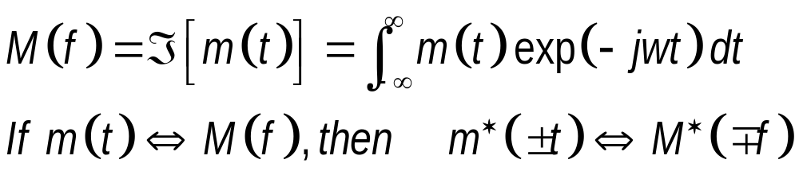
Example: How to find PSD?
Fourier transform
Autocorrelation
Square of the absolute value
Fourier transform
PSD
Fourier transform:

Slide 21
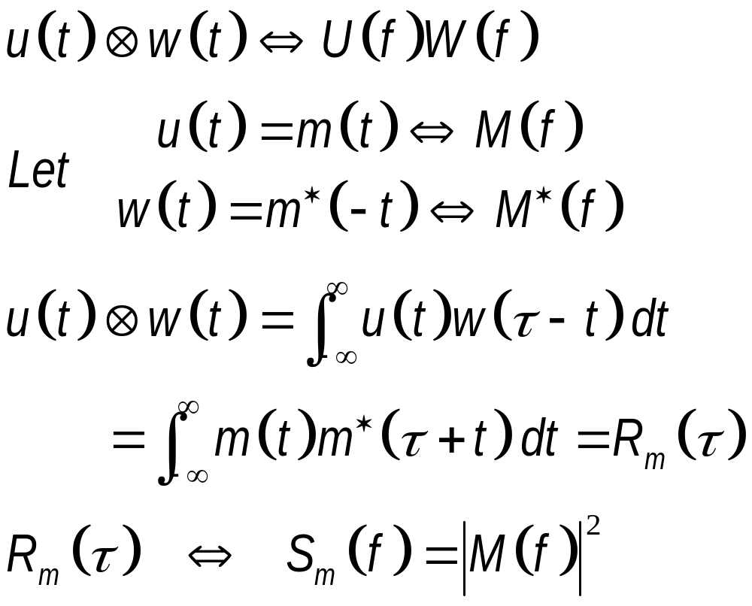
Example: How to find PSD?
Convolution:

Slide 22
Bandwidth Efficiency
Channel bandwidth and transmitted power are two primary communication resources.
Efficient utilization of resources calls for the search of spectrally efficient schemes.
To this aim, maximize the bandwidth efficiency
  Bandwidth efficiency is defined as the ratio of the data rate in bits per second to the effectively utilized channel bandwidth.

Slide 23
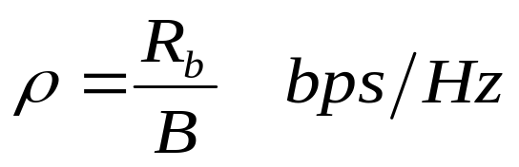
Bandwidth Efficiency
Bandwidth efficiency, ρ:
  R_{b}: data rate (a function of E_{b}/N₀ and BER)
  B: effective channel bandwidth
Bandwidth efficiency should be achieved at a minimum level of average signal power or a minimum practical expenditure of average signal to noise ratio, E_{b}/N₀.
Bandwidth efficiency can be improved by multilevel encoding (transmission of blocks of bits) and spectral (pulse) shaping.

Slide 24
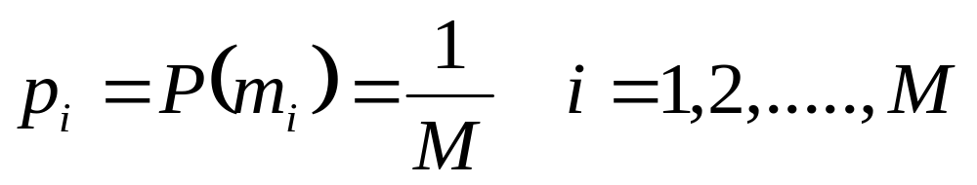
Passband Transmission Model
A message source emits one symbol every T seconds, with symbols belonging to an alphabet of M symbols, m₁, m₂,….,m_{M}.
A priory probabilities p₁, p₂,…., p_{M} specify the message source output.
  Generally, M symbols of the alphabet are equally likely:

Slide 25
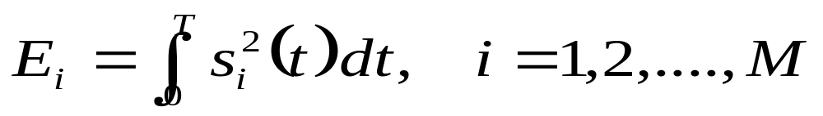
The Transmitter
Transmitter codes the message source output m_{i} into a distinct signal s_{i}(t), suitable for transmission over the channel.
The signal s_{i}(t) occupies the duration T alloted to m_{i} and is a real-valued energy signal
A sinusoidal carrier is modulated in phase, frequency or in amplitude in accordance with the signal s_{i}(t) to be transmitted.

Slide 26
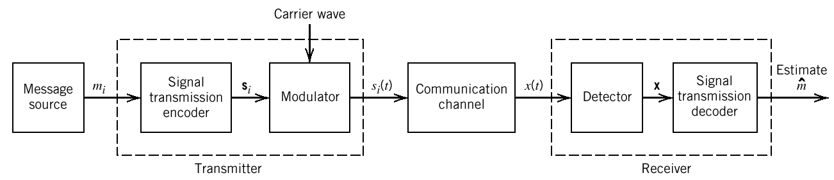
Functional Model of Passband Data Transmission System

Slide 27
The Bandpass Channel
The bandpass channel
  is assumed to be linear.
  has a bandwidth wide enough for the transmission of the modulated signal with negligible distortion.
The channel noise is a sample function of a white Gaussian noise process of zero mean and PSD N₀/2.

Slide 28

The Receiver
consists of a detector (demodulator) followed by a signal transmission decoder.
  The details of a receiver was studied in Chapter 5.
reverses the operations performed at the transmitter
minimizes the effect of channel noise on the estimate computed for the transmitted symbol m_{i}

Slide 29
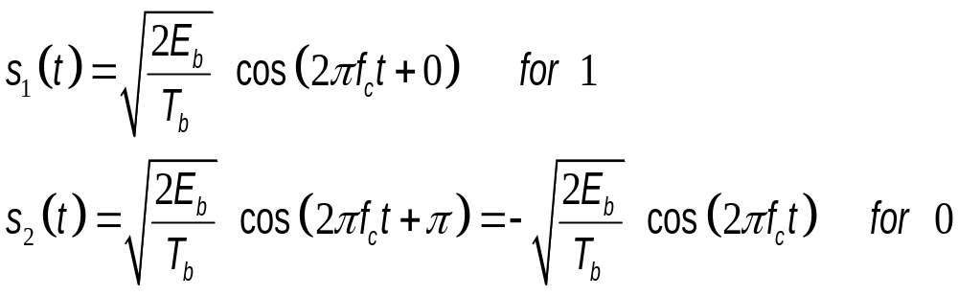
Binary Phase-Shift Keying
Antipodal signals are used to represent binary symbols 1 and 0, for 0 ≤ t ≤ T_{b},
  E_{b}: transmitted signal energy per bit.

Slide 30
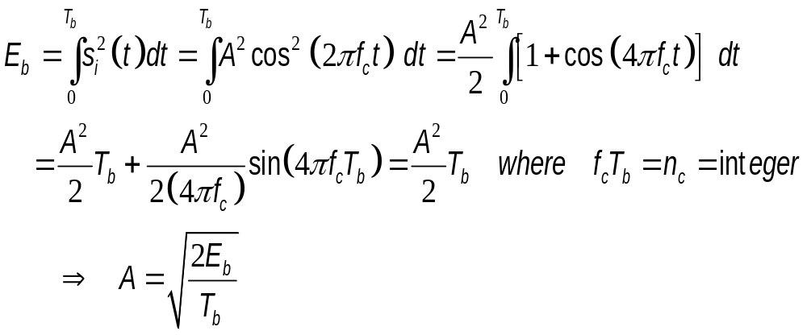
Binary Phase-Shift Keying
Bit energy, E_{b}, of a carrier s_{i}(t)=±A cos(w_{c}t).
Each transmitted bit contains an integral number of cycles of the carrier, i.e., f_{c}T_{b}= n_{c}=integer

Slide 31
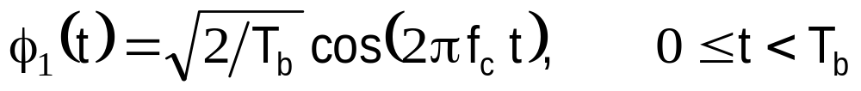
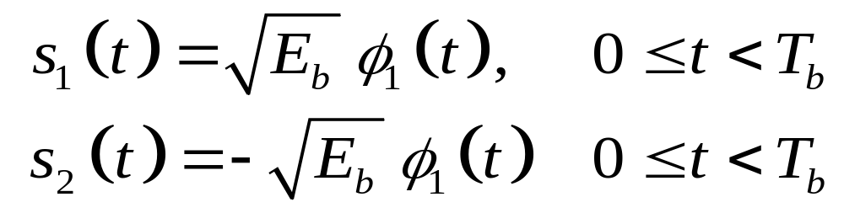
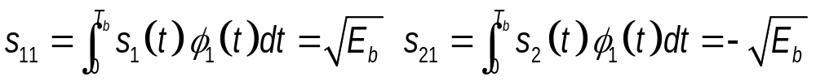
Geometric Representation
In binary PSK, there is only one basis function (N=1):
Transmitted signals (M=2):
Coordinates in signal-space with N=1, M=2:

Slide 32
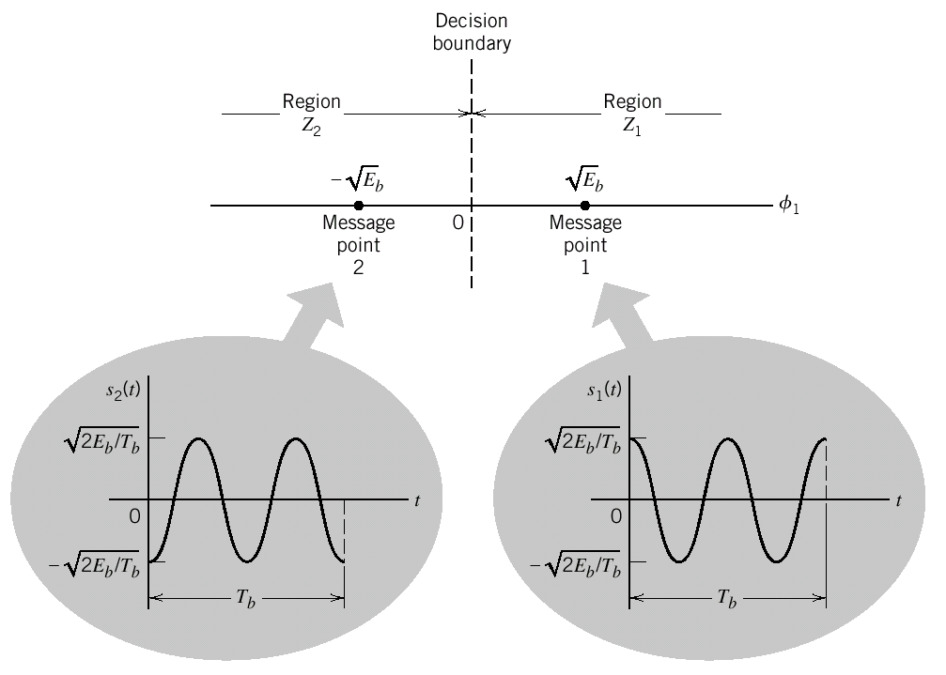
Geometric Representation
Signal-space diagram for coherent binary PSK system. The waveforms depicting the transmitted signals s₁(t) and s₂(t), displayed in the inserts, assume n_{c} = 2.

Slide 33
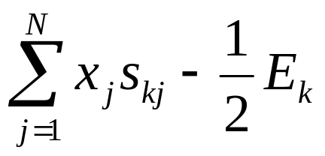
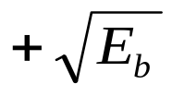
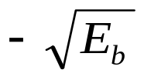
Error Probability of Binary PSK
To make a decision in favour of symbol 1 or symbol 0, we apply the rule:
Observation vector x lies in region Z_{i} if
is maximum for k=i.
Signal space is partitioned into two regions:
Set of points closer to message point 1,
Set of points closer to message point 2,

Slide 34
Decision Rule
Correct Decision:
  Decide that signal s₁(t) (i.e., binary symbol 1) was transmitted if the received signal falls in region Z₁.
  Decide that signal s₂(t) (i.e., binary symbol 0) was transmitted if the received signal falls in region Z₂.
Erroneous Decision:
  The decision is erroneous when the received signal point is in region Z₂ (Z₁), when the transmitted signal is s₁(t) (s₂(t)).

Slide 35
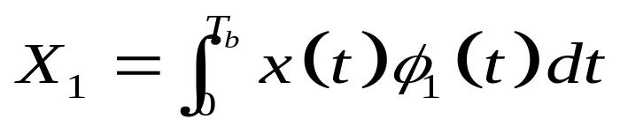
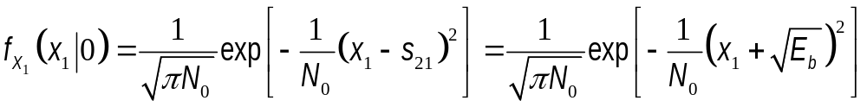
Decision Rule
Decision region associated with signal s₁(t): Z₁: 0<x₁<∞
where the observable element x₁ is related to the received signal x(t) by
Probability of error when s₂(t) is transmitted:
Conditional pdf of X₁ given that symbol 0, i.e., symbol s₂(t), was transmitted:

Slide 36
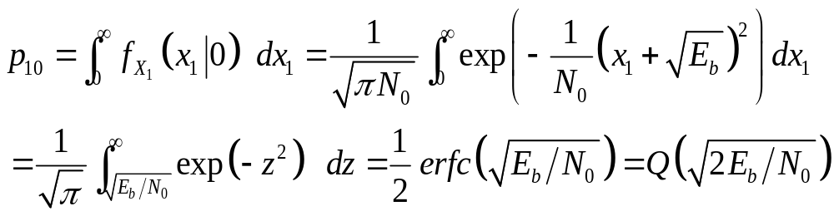
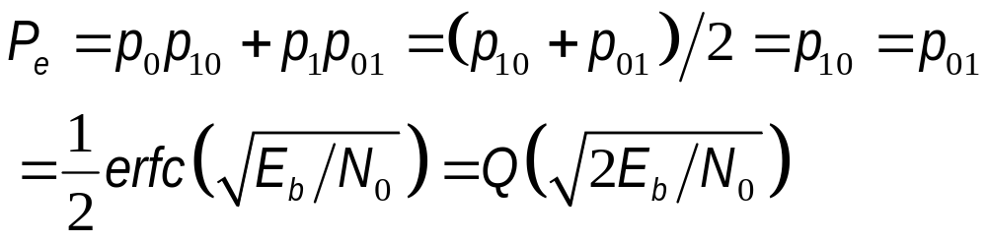
Decision Rule
The conditional probability of the receiver deciding in favor of symbol 1, given that symbol 0 was transmitted:
Average probability of symbol error:

Slide 37
Generation of BPSK
Input binary sequence in polar form with 1 and 0, is encoded by a polar nonreturn-to-zero (NRZ) level encoder with constant amplitude levels and .
The resulting binary wave and a sinusoidal carrier φ₁(t), of frequency f_{c}T_{b}=integer, are applied to a product modulator.
Carrier and timing pulses are usually extracted from a common master clock.

Slide 38
Detection of BPSK
Noisy PSK signal x(t) at the channel output is applied to a correlator, which is also supplied with a locally generated coherent reference signal φ₁(t).
The correlator output, x₁, is compared with a threshold of zero volts:
If x₁>0, receiver decides in favor of 1
If x₂<0, receiver decides in favor of 0

Slide 39

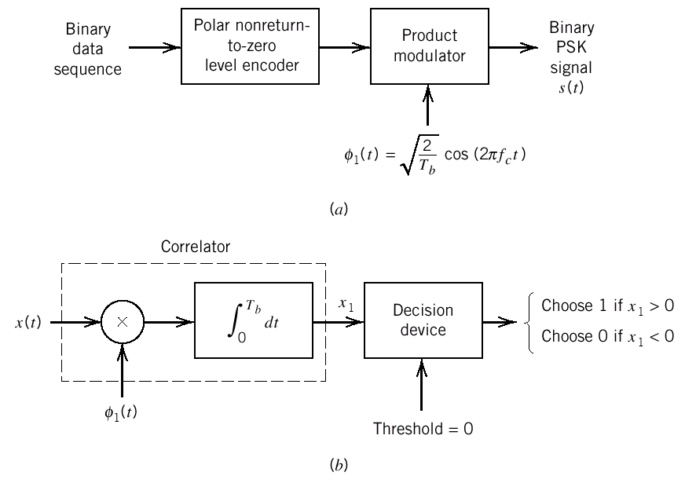
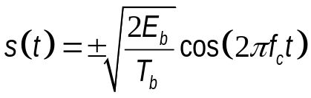


BPSK Transmitter and Receiver
{0,1}
Block diagrams for (a) binary PSK transmitter and (b) coherent binary PSK receiver.

Slide 40
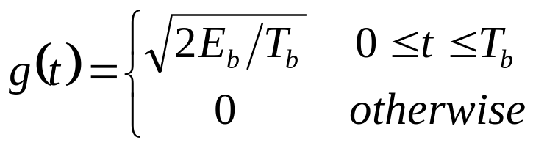
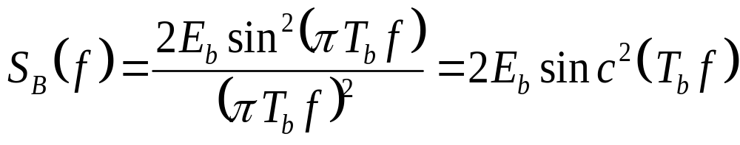
PSD of Binary PSK Signals
Depending on whether symbol 1 or 0 is sent during the signaling interval 0 ≤ t ≤ T_{b}, the complex envelope equals +g(t) or -g(t), where
  g(t): symbol shaping
  function
For equally probable sequence of 1s and 0s, baseband PSD (but not ESD) of binary PSK

Slide 41
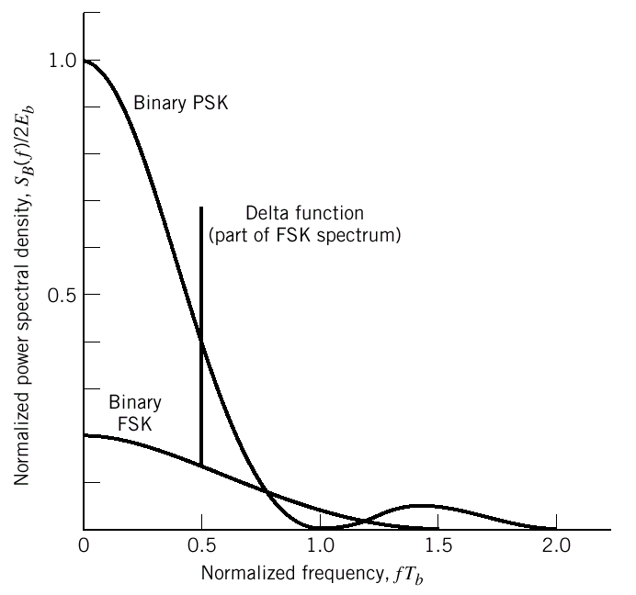
PSD of Binary PSK and FSK Signals

Slide 42
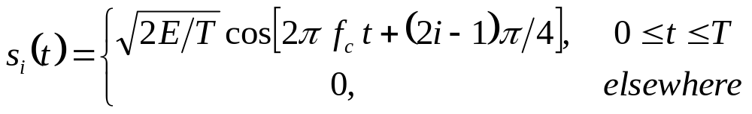
Quadriphase-Shift Keying (QPSK)
Efficient utilization of channel bandwidth by quadrature-carrier multiplexing.
The phase of the carrier takes one of the four equally spaced values, such as π/4, 3π/4, 5π/4, 7π/4, corresponding to one of the dibits, 00, 01,10 and 11.
E : symbol energy

Slide 43
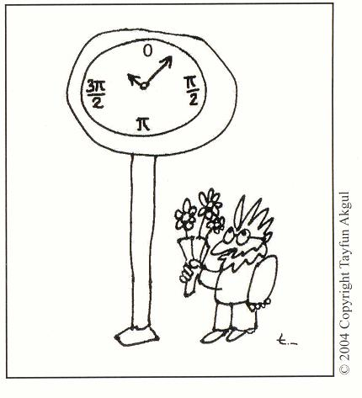
Quadriphase-Shift Keying (QPSK)
00
11
01
10
QPSK signal constellation in a clock

Slide 44
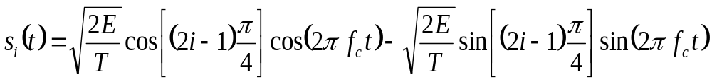
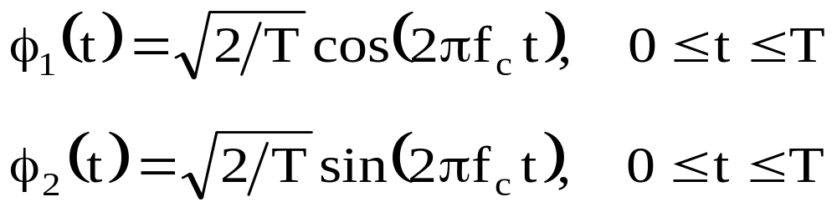
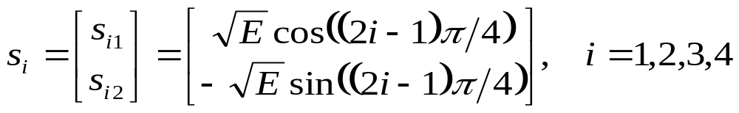
Signal-Space Diagram of QPSK
The QPSK signal can also be written as
Based on this, orthonormal basis functions:
Message points and associated signal vector

Slide 45
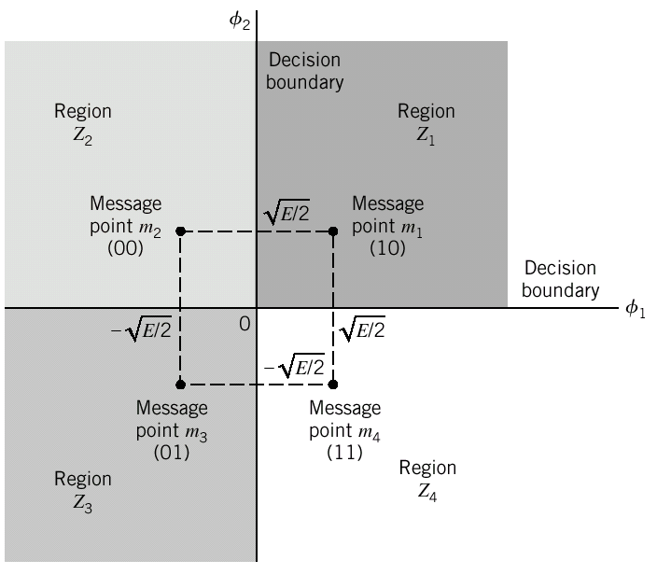

Signal-Space Diagram of Coherent QPSK System

Slide 46
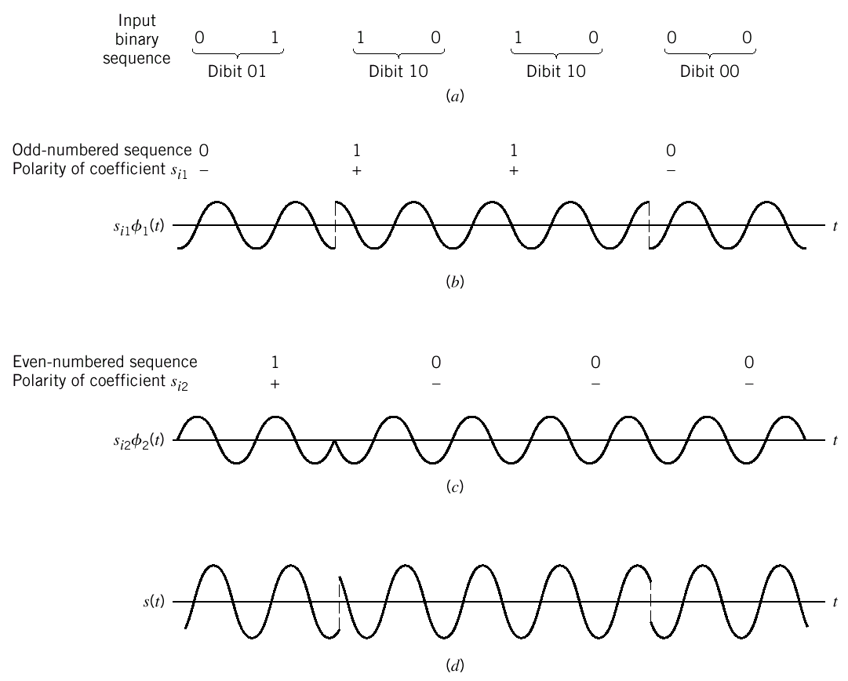
QPSK
Input binary sequence.
Odd-numbered bits of input sequence and associated binary PSK wave.
Even-numbered bits of input sequence and associated binary PSK wave.
QPSK waveform defined as s_{i}(t) = s_{i1}φ₁(t) + s_{i2}φ₂(t).

Slide 47
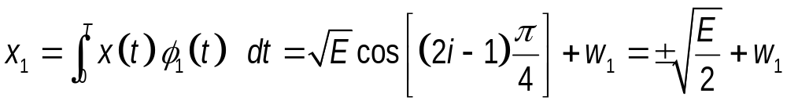



Error Probability of QPSK
The received signal:
The observation vector:
  Observable elements x₁ and x₂ are sample values of independent Gaussian r. v.’s with means and and variance N₀/2.

Slide 48
Error Probability of QPSK
Correct decision: Decide that s_{i}(t) was transmitted if the observation vector falls inside the region Z_{i}.
Erroneous decision will be made if the observation vector falls in region Z_{j}, when the signal s_{i}(t) is transmitted, with i≠j.
QPSK is equivalent to two binary PSK systems working in parallel and using two carriers in phase quadrature.

Slide 49

Samples of Matched Filter Output for QPSK and 8-PSK

Slide 50

Error Probability of QPSK
The two constituent binary PSK systems may be characterized as follows:
  The signal energy per bit is E/2=E_{b}.
  The noise PSD is N₀/2.
(See the observation vectors x₁ and x₂)
Hence, average bit error probability in each channel of the coherent QPSK system:

Slide 51


Error Probability of QPSK
Bit errors in in-phase and quadrature channels are statistically independent.
Average probability of a correct decision resulting from combined action of the two channels (in-phase and quadrature channels make a decision in one of the two bits):
Average probability of symbol error:

Slide 52

Error Probability of QPSK
When Gray encoding used for the input symbols, the bit error rate (BER) for QPSK:
The signal transmit power is equally divided between each BPSK channels:
  The received power by each channel is P/2.

Slide 53
Error Probability of QPSK
The bit duration in QPSK channels is doubled,
  since even and odd bits are transmitted at the same time in in-phase and quadrature channels:
Thus, in in-phase and quadrature channels E_{b}=(P/2)2T_{b}=PT_{b}, i.e., the same as in BPSK.
  The BER for BPSK and QPSK is the same.
  QPSK uses only half the channel bandwidth.

Slide 54
Error Probability of QPSK
If each channel of the QPSK carries the same bit rate as BPSK, bit rate in QPSK is twice that of the BPSK. Then,
  QPSK requires twice the transmit power as the BPSK system in order that the QPSK has the same BER as BPSK system, since E_{b}=(P/2)2T_{b}=PT_{b}.
  BPSK and QPSK occupy the same bandwidth, since the bandwidths of each QPSK channel overlap.

Slide 55
Error Probability of QPSK
For the same transmission bandwidth, a coherent QPSK system transmits information at twice the bit rate of a coherent binary PSK system.
Therefore, QPSK uses channel bandwidth better than binary PSK, which explains the preferred use of QPSK over binary PSK in practice.

Slide 56

Example:
Symbol Error Probability of QPSK
Average probability of symbol error:

Slide 57

Example:
Symbol Error Probability of QPSK
Probability of correct decision:

Slide 58


Example:
Symbol Error Probability of QPSK
Average probability of symbol error for QPSK:

Slide 59


Example
Consider a QPSK system, where the four symbols are located at , where E is the symbol energy. Determine the overbound on the probability of symbol error, assuming that the probability of transmitting each symbol is the same, and compare with the exact expression for the probability of symbol error, given by

Slide 60


Example
The signal-space diagram and the Euclidean distances:
The Euclidean distances:
The upper bound on the symbol error probability:

Slide 61


Example
If is taken, then the upper bound is
The upper bound on the symbol error probability is about 3/2 times higher than the exact symbol error probability.

Slide 62
Generation of QPSK
The incoming binary data sequence is first transformed into polar form by NRZ encoder, where symbols 1 and 0 are represented by and .
Demultiplexer separates binary waves of the odd- and even-numbered input bits, which are denoted by, a₁(t) and a₂(t) respectively.
Equal amplitude waves, a₁(t) and a₂(t), then modulate the quadrature carriers.

Slide 63

Block diagram of
(a) QPSK transmitter
Block diagram of (b) coherent QPSK receiver.

Slide 64
Detection of QPSK
QPSK receiver consists of a pair of correlators with a common input.
The two binary PSK signals in the two branches are detected independently due to orthogonality of φ₁(t) and φ₂(t).
The two binary sequences at the in-phase and quadrature channel outputs are combined in a multiplexer to reproduce the original binary sequence at the transmitter with minimum BER in an AWGN channel.

Slide 65

Power Spectra of QPSK Signals
Binary wave at modulator input is random, with symbols 1 and 0 being equally likely
Symbols transmitted during adjacent time slots are statistically independent.
Depending on the dibit sent during 0<t<2T_{b}, in-phase and quadrature components are ±g(t):

Slide 66

Power Spectra of QPSK Signals
Taking the FT of g(t) and squaring, the PSD of QPSK signals becomes E sinc²(fT).
In-phase and quadrature components are statistically independent.
  Their PSD’s are the same.
Thus, the baseband PSD is the sum of those of in-phase and quadrature components:

Slide 67

Power Spectra of QPSK and MSK Signals

Slide 68
Phase Changes in QPSK
The carrier phase changes by ±180 degrees whenever both in-phase and quadrature components of QPSK signal changes sign.
The carrier phase changes by ±90 degrees whenever the in-phase or quadrature component changes sign.
The carrier phase is unchanged when neither the in-phase nor the quadrature components changes sign.

Slide 69
The Effects of Phase Changes
Phase changes, particularly ±180 degree changes, are of particular concern when the QPSK signal is filtered during the course of transmission, prior to detection.
These shifts in the carrier phase can result in changes in the carrier amplitude (i.e., envelope of QPSK signal), thereby causing additional symbol errors on detection.

Slide 70

Offset QPSK
Offset QPSK reduces the extent of amplitude fluctuations exhibited by QPSK.
Basis functions of offset QPSK:
The phase transitions in offset QPSK are confined to ±90 degrees,
  which occur twice as frequently but with half the intensity encountered in QPSK.
Error probability remains the same.

Slide 71

Offset QPSK
Possible paths for switching between the message points in (a) QPSK (b) offset QPSK

Slide 72


M-ary PSK
Binary PSK and QPSK are special cases of M-ary PSK.
During each signalling interval of duration T, carrier phase takes on one of M possible values, namely , i=1,2,...,M.
Thus, one of the M possible signals is sent:
  E is the symbol energy and f_{c}T=integer.

Slide 73

M-ary PSK
0
1
010
011
001
100
000
01
111
101
110
10
00
Signal space diagrams for PSK signals.
Gray coding
Binary coding
11

Slide 74

M-ary PSK
Signal-space diagram for 8-PSK (i.e., M = 8). The decision boundaries are shown as dashed lines.
Signal-space diagram illustrating the application of the union bound for 8-PSK.

Slide 75

M-ary PSK
Each s_{i}(t) may be expanded in terms of the two basis functions φ₁(t) and φ₂(t).
The signal constellation of M-ary PSK for M>2 is therefore two-dimensional, i.e., N=2.
The M message points are equally spaced on a circle of radius and the centre at the origin.
  i.e., all symbols have the same energy

Slide 76






















Error probability for M-ary PSK
Coherent detection
of MPSK
“010”
“011”
“001”
“000”
8-PSK
“110”
“111”
“100”
“101”
Compute
Choose
smallest
Decision variable

Slide 77




Error Probability for M-ary PSK
Coherent detection of MPSK
The detector compares the phase of observation vector to M-1 thresholds.
Due to the circular symmetry of the signal space, we have:
where
It can be shown that
or

Slide 78




M-ary PSK
Since the signal-space diagram is circularly symmetric, the upper bound on the average symbol error probability
Since d_{ik}≥d_{min},
  For example for M=8,

Slide 79

M-ary PSK
Average probability of symbol error for coherent M-ary PSK:
  Approximation becomes tighter for large E/N₀ and for larger M.
  It reduces to the symbol error expression of QPSK for M=4.

Slide 80

Bit Error Probability for M-ary PSK

Slide 81



Probability of symbol error for M-PSK
Note!
“The same average symbol energy for different sizes of signal space”

Slide 82


PSD of M-ary PSK Signals
Symbol duration T of M-ary PSK signals is
where T_{b} denotes bit duration
Proceeding similarly as in QPSK, the baseband PSD of M-ary PSK signals:
  The required transmission bandwidth decreases with increasing values of M.

Slide 83

Power Spectra of M-PSK Signals

Slide 84


Bandwidth Efficiency
Null-to-null bandwidth of M-ary PSK is B=2/T.
  T denotes the symbol duration.
Since T=T_{b} log₂M,
Bandwidth Efficiency:
  As M is increased, ρ is improved at the expense of error performance.
M | 2 | 4 | 8 | 16 | 32 | 64
ρ (bps/Hz) | 0.5 | 1 | 1.5 | 2 | 2.5 | 3

Slide 85
Example (Proakis, p.328, Problem 5.27)
Consider the 4-PSK and 8-PSK signal constellations shown in the next vugraph.
  Determine the radii r₁ and r₂ of the circles such that the distance between two adjacent points in the two constellations is d. From this result, determine the additional transmitted energy required in the 8-PSK signal to achieve the same error probability as the 4-PSK at high SNR, where the probability of error is determined by errors in selecting adjacent points.
  Use the analytic expression for the symbol error probability for M-PSK to show that the result obtained above is correct

Slide 86

Example (Proakis, p.328, Problem 5.27)
For 4-PSK:
For 8-PSK:
The same distance d implies the same symbol error probability
d
r₁
r₂
d
M=4
M=8

Slide 87



Example (Proakis, p.328, Problem 5.27)
Additional transmitted signal power needed by 8-PSK:
to have the same probability of symbol error, thus the same minimum Euclidean distance
To have the same probability of symbol error, one has

Slide 88
Hybrid Amplitude/Phase Modulation
In M-ary PSK, in-phase and quadrature components of the modulated signal are interrelated such that the envelope is constant
  This means that the message points form a circular constellation; messages have equal energy.
In M-ary quadrature amplitude modulation (QAM), in-phase and quadrature components are independent from each other.
  Carrier thus experiences both AM and PM.

Slide 89
M-ary PSK Constellations
.
Signal space diagrams for PSK signals

Slide 90

Hybrid Amplitude/Phase Modulation
Examples of combined PAM-PSK signal space diagrams.

Slide 91

PSK vs QAM
Signal constellation for
M-ary PSK (M=16) b) M-ary QAM (M = 16)

Slide 92

Several signal space
diagrams for
rectangular QAM.

Slide 93


M-ary Quadrature Amplitude Modulation
QAM is a two-dimensional version of PAM
Two orthogonal passband basis functions:
In the (φ₁,φ₂) plane, the message point is denoted by (a_{k}d_{min}/2, b_{k}d_{min}/2), for k=1,2,3,…,M.
  minimum distance:
  E₀ is the energy of the signal with lowest amplitude

Slide 94

M-ary Quadrature Amplitude Modulation
M-ary QAM signal for symbol k:
The signal s_{k}(t) consists of two phase-quadrature carriers with each one being modulated by a set of discrete amplitudes.

Slide 95

QAM Square Constellations
Square constellation: number of bits/symbol is even
  With an even number of bits, b, per symbol, one may write , where L is a positive integer.
  Then, M-ary QAM can be viewed as the Cartesian product of a one-dimensional L-ary PAM constellation with itself.
Cross constellation: number of bits/symbol is odd

Slide 96


QAM Square Constellations
The ordered pair of coordinates then form a square matrix:
Special case: M=16: 4 bits/symbol (L=4)

Slide 97

QAM Square Constellations
Signal-space diagram of M-ary QAM for M = 16; the message points in each quadrant are identified with Gray-encoded 4 bits
(b) Signal-space diagram of the corresponding 4-PAM signal.

Slide 98

QAM Square Constellations
Illustrating the Gray encoding of the four quadrants and dibits in each quadrant for the V.32 modem. The dashed arrows illustrate the 90° rotational invariance.

Slide 99









Error Probability for M-ary PAM
Coherent detection of M-PAM
  Decision variable:
“00”
“01”
“11”
“10”
4-PAM
0
ML detector
(Compare with M-1 thresholds)

Slide 100






Error probability for M-ary PAM
Coherent detection of M-PAM ….
Error happens if the noise, , exceeds in amplitude one-half of the distance between adjacent symbols. For symbols on the border, error can happen only in one direction. Hence:
Gaussian pdf with
zero mean and variance

Slide 101















Symbol Error Probability for PAM Signals
Binary PAM
0
4-ary PAM
0
0
T
t

Slide 102

Probability of Symbol error for M-PAM
Note!
“The same average symbol energy for different sizes of signal space”

Slide 103



Error probability for M-ary QAM
Coherent detection of M-ary QAM
M-QAM can be viewed as the combination of two
modulations on I and Q branches, respectively.
No error occurs if no error is detected on either I and Q branches. Hence:
Considering the symmetry of the signal space and orthogonality of I and Q branches:
Average probability of
symbol error for

Slide 104





Symbol Error Probability for QAM
Probability of correct detection for M-ary QAM:
  : probability of symbol error for the corresponding L-ary PAM with (see Haykin, Problem 4-27):
Probability of symbol error for M-ary QAM

Slide 105


Symbol Error Probability for QAM
Transmitted energy in M-ary QAM depends on the particular symbol transmitted.
It is thus logical to express P_{e} in terms of the average value of the transmitted energy rather than E₀.
Assuming that L levels are equally likely
Average probability of symbol error:

Slide 106
QAM Cross Constellation
Cross constellations are used to generate M-ary QAM with an odd number of bits per symbol.
Procedure to generate cross constellation:
  Start with a QAM square constellation with n-1 bits per symbol.
  Extend each side by adding 2^{n-3} symbols.
  Ignore the corners in the extension

Slide 107

QAM Cross Constellation
Illustrating how a square QAM constellation can be expanded to form a QAM cross-constellation.

Slide 108

QAM Cross Constellation
It is not possible to express a QAM cross constellation as the product of a PAM constellation with itself.
Average probability of symbol error is approximately given by
It is not possible to perfectly Gray code a QAM cross constellation

Slide 109


Probability of a symbol error for QAM.

Slide 110

Probability of Symbol Error for M-QAM
Note!
“The same average symbol energy for different sizes of signal space”

Slide 111




Example: Haykin, Problem 6.15, p.470
Determine the transmission bandwidth reduction and average signal energy of 256-QAM compared to 64-QAM.
Since the bandwidth of M-QAM is given by
The average bit energy:
  E₀ denotes the energy of the signal with lowest amplitude.
For M=256, the bandwidth is decreased by a factor of ¾ while the average required bit energy is increased by 6 dB compared to for M=64.

Slide 112

Example: Haykin, Problem 6.16, p.470
Two passband data transmission systems are to be compared. One system uses 16-PSK, and the other uses 16-QAM. Both systems are required to produce an average probability of symbol error equal to 10⁻³. Compare the signal-to-noise ratio requirements of these two systems.
For 16-QAM
one finds E_{av}/N₀= 58 (17.6 dB)

Slide 113

Example: Haykin, Problem 6.16, p.470
For 16-PSK
one finds E_{b}/N₀ =142 (21.5 dB).
Hence, on the average, the 16-PSK demands 21.5 dB -17.6 dB = 3.9 dB more symbol energy than 16-QAM for P_{e}=10⁻³.
However, the channel must be linear in order to realize this advantage of the 16-QAM over the 16-PSK.

Slide 114


Coherent Binary Frequency-Shift Keying
Coherent frequency-shift keying (FSK) is a nonlinear method of passband transmission.
s₁(t) represents symbol 1
s₂(t) represents symbol 0:
  E_{b}: transmitted signal energy per bit
  Frequency:

Slide 115

Coherent Binary Frequency Shift Keying
In continuous phase FSK, phase continuity is always maintained, including the inter-bit switching times (continuous phase FSK, CPFSK).
s₁(t) and s₂(t) have an energy of E_{b}:

Slide 116

Coherent Binary Frequency Shift Keying
Condition for orthogonality between s₁(t) and s₂(t) for continuous phase FSK:

Slide 117




Coherent Binary Frequency Shift Keying
Since
Similarly, if we take
Consequently,
Thus, the condition for orthogonality:

Slide 118




Coherent Binary Frequency Shift Keying
Basis functions (N=2):
Because , coherent FSK is characterized by N=2 and M=2 with two message points defined by
  Euclidean distance between s₁ and s₂:

Slide 119

Coherent Binary Frequency Shift Keying
Signal-space diagram for binary FSK system.

Slide 120


Signal-Space Diagram for Binary FSK
Euclidean distance in PSK (antipodal):
Euclidean distance in FSK (orthogonal):
  d_{min} in PSK is times larger than in binary FSK
To maintain the same BER, coherent PSK and coherent FSK must have the same Euclidean distance.
  Thus, E_{b}/N₀ of coherent binary FSK must be doubled.

Slide 121

Generation of Coherent FSK
At the output of on-off level encoder,
  symbol 1 is represented by volts
  symbol 0 is represented by 0 volts.
Invertor switches on the upper oscillator and switches off the lower oscillator if the input bit 1, and vice versa if the input bit is 0.
The two frequencies f₁ and f₂ are chosen to be equal to different integer multiples of the bit rate R_{b} and the frequency separation is f₁-f₂=kR_{b}.

Slide 122

Block diagrams for a) binary FSK transmitter and
(b) coherent binary FSK receiver.

Slide 123
Generation of Coherent FSK
The two oscillators are assumed to be synchronized, so that two basis functions φ₁(t) and φ₂(t) are orthonormal.
One can also use a single voltage-controlled oscillator (VCO).
In either case, the frequency of the modulated wave is shifted with a continuous phase, in accordance with the input binary wave.

Slide 124
Detection of Coherent Binary FSK
The noisy received signal x(t) is fed to two correlators, which are supplied with locally generated coherent reference signals, φ₁(t) and φ₂(t).
The correlator outputs are subtracted and the resulting output y is compared with a threshold of 0 volts.
If y>0, receiver decides in favor of 1.
If y<0, it decides in favor of 0.

Slide 125


Error Probability of Binary FSK
Received signal:
Observation vector has two elements x₁, x₂:
Observation space is partitioned into two decision regions Z₁ and Z₂.

Slide 126


Error Probability of Binary FSK
Observation vector:
  When symbol 1 is transmitted:
  When symbol 0 is transmitted:
If x₁ and x₂ are in the decision region Z₁ (Z₂), then the decoder decides that symbol 1 (0) is sent.

Slide 127


Error Probability of Binary FSK
Define a new random variable Y, Y=X₁-X₂.
Expected value:
Variance:
  Prove the above result by assuming that symbol 1 and 0 are transmitted, respectively.

Slide 128



Error Probability of Binary FSK
The conditional pdf of Y, given that symbol 0 is sent:
Conditional probability of error, given that symbol 0 was transmitted:
Since p₀₁= p₁₀, due to symmetry, average probability of bit error (bit error rate, BER) for coherent binary FSK (with equiprobable symbols):

Slide 129


PSD of Binary FSK Signals
Consider Sunde’s FSK:
Then,
  where + corresponds to 0 and - corresponds to 1.

Slide 130


PSD of Binary FSK Signals
The in-phase component, is completely independent of the input binary wave.
  Its PSD consists of two delta functions, weighted by the factor E_{b}/2T_{b} and occurring at f=±1/2T_{b}.
The quadrature component is directly related to the input binary wave. During 0<t<T_{b}, it is equal to -g(t) for 1 and +g(t) for 0, where

Slide 131


PSD of Binary FSK Signals
The energy spectral density of g(t) equals
Since in-phase and quadrature components are independent, PSD of Sunde’s FSK:
Two discrete components have one-half the total power of binary FSK signal, and are used for synchronization.

Slide 132
Power Spectra of Binary PSK and FSK Signals

Slide 133

Example: Haykin, Problem 6.22, p.471
In a coherent FSK system, the signals s₁(t) and s₂(t) representing symbols 1 and 0, respectively, are defined by
Assuming that f_{c}>>Δf, the correlation coefficient of the signals s₁(t) and s₂(t) is approximately given by

Slide 134
Example: Haykin, Problem 6.22, p.471
What is the minimum value of the frequency shift Δf for which the signals s₁(t) and s₂(t) are orthogonal?
s₁(t) and s₂(t) are orthogonal when the correlation coefficient ρ becomes equal to zero. This implies that ρ=sinc(2 Δf T_{b})=0 and thus Δf =1/(2T_{b}).

Slide 135


Example: Haykin, Problem 6.22, p.471
What is the value of Δf that minimizes the average probability of symbol error?
The average probability of error:
The most negative value of ρ is -0.216 and is located at Δf =0.7/T_{b}. This can be found by taking the derivative of ρ with respect to Δf and equating to zero.
Thus, the minimum value of P_{e}

Slide 136

Example: Haykin, Problem 6.22, p.471
For the value of Δf obtained in part c), determine the increase in E_{b}/N₀ required so that this coherent FSK system has the same noise performance as a coherent binary PSK system.
For a coherent BPSK system, the probability of error
Therefore, E_{b}/N₀ of this FSK system must be increased by a factor of 1/0.608=1.645 (2.16 dB) so as to realize the same P_{e} as a coherent BPSK system.

Slide 137

M-ary FSK
Transmitted signals are defined by
Carrier frequency satisfies f_{c}=n_{c}/2T with n_{c} being an integer.
Transmitted symbols are of equal duration T and have equal energy E.
Since individual signal frequencies are separated by 1/2T, signals are orthogonal.

Slide 138



M-ary FSK
Orthogonality of signals implies
Orthonormal basis functions (N=M!!):
M-ary FSK is described by an M-dimensional signal-space diagram, defined by the coefficient s_{ij}:

Slide 139

Detection of Coherent M-ary FSK
Optimum receiver consists of a bank of M correlators or matched filters.
At sampling times t=kT, the receiver makes decisions based on the largest matched filter output in accordance with the MLD.
Since an exact formula is not available, an upper bound on the average probability of symbol error

Slide 140





Error probability for Coherent M-FSK
Coherent detection of M-FSK
ML detector:
Choose
the largest element
in the observed vector

Slide 141


Error probability for coherent M-ary FSK
Coherent detection of M-FSK
The dimensionality of signal space is M. An upper bound for average symbol error probability can be obtained by using union bound. Hence
or, equivalently

Slide 142

Probability of Symbol Error for M-FSK
Note!
“The same average symbol energy for different sizes of signal space”

Slide 143
PSD of M-ary FSK Signals
Spectral analysis is complicated.
A simple result is available when the signal frequencies are separated uniformly and by an amount 1/2T, where T is the symbol duration.
The bandwidth evidently increases with increasing values of M.

Slide 144

PSD of M-ary FSK Signals

Slide 145

Bandwidth Efficiency of M-ary FSK
To maintain orthogonality of coherently detected M-ary FSK signals, adjacent signals need to be separated from each other by a frequency difference of 1/(2T).
Hence, the channel bandwidth required to transmit M-ary FSK signals:

Slide 146

Bandwidth Efficiency of M-ary FSK
The bandwidth efficiency of M-ary FSK signals:
  In contrast with M-ary PSK, bandwidth efficiency of M-ary FSK decreases with increasing values of M.
    i.e., FSK is spectrally inefficient.
  However, in contrast with M-PSK and M-QAM, average symbol energy does not increase with M.
M | 2 | 4 | 8 | 16 | 32
ρ (bps/Hz) | 1 | 1 | 0.75 | 0.5 | 0.3125

Slide 147
Detection of Signals with Unknown Phase
So far, we assumed that the receiver is perfectly synchronized to the transmitter, and the only channel impairment is noise.
In addition to channel noise, randomness of other signal parameters, such as distortion in the transmission medium, also contribute to the uncertainty of the received signals.

Slide 148
Most common random signal parameter is the carrier phase and the receiver can not follow the phase of the received signal.
Synchronization with the phase of the transmitted carrier may be too costly.
No provision may be made for the recovery of carrier phase of the received signal at the expense of some degradation in noise performance.
Such systems are called to be noncoherent.

Slide 149



Optimum Quadratic Receiver
The received signal in a noncoherent system
θ : unknown random carrier phase
Given the received signal x(t) with an unknown carrier phase θ, design an optimum receiver for detecting symbol s_{i} represented by

Slide 150


Conditional likelihood function of symbol s_{i}, given the carrier phase θ (See 5.3-5.6):
To remove the dependence on θ, we take the expected value of the above:

Slide 151




Expand cos(2πf_{i}t+θ) and define
Then, one gets
The likelihood function :
since

Slide 152


Optimum Quadratic Receiver
Hypothesis test can then be formulated as:
Since I₀(x) is a monotonically increasing function of x, the test is simply
This is known as the quadratic receiver.
The test being independent of the symbol energy, is called as uniformly most powerful with respect to symbol energy E.

Slide 153

Equivalent Forms of Quadratic Receiver
An equivalent form is obtained by replacing each correlator with a corresponding matched filter.
A second equivalent form of the quadratic receiver is obtained by using a single filter matched to for 0<t<T.
  Since the envelope is unaffected by the phase θ, an envelope detector yields the same result as the quadratic receiver (noncoherent matched filter).

Slide 154

Noncoherent receivers.
(a) Quadrature receiver using correlators.
(b) Quadrature receiver using matched filters.
(c) Noncoherent matched filter.

Slide 155

Output of matched filter for a rectangular RF wave:
(a) θ = 0, and
(b) θ = 180 degrees.

Slide 156
Noncoherent Orthogonal Modulation
Here, we consider noncoherent binary frequency-shift keying(NCFSK) and differential phase-shift keying (DPSK).
Consider a binary signalling scheme, using two orthogonal signals s₁(t) and s₂(t), which have equal energy.
During the interval 0<t<T, s₁(t) or s₂(t) is sent over an imperfect channel that shifts the carrier phase by an unknown amount.

Slide 157

Let g₁(t) and g₂(t) denote the phase-shifted versions of s₁(t) and s₂(t), respectively.
It is assumed that g₁(t) and g₂(t) remain orthogonal and have the same energy E, regardless of the unknown carrier phase.
In a AWGN (zero-mean, and PSD of N₀/2) channel, the received signal is
Use x(t) to discriminate between s₁(t) and s₂(t), regardless of the carrier phase.

Slide 158

(a) Generalized binary receiver for noncoherent orthogonal modulation.
(b) Quadrature receiver equivalent to either one of the two matched filters in part (a); the index i = 1, 2.

Slide 159
Because the carrier phase is unknown, the receiver relies on amplitude as the only possible discriminant.
Therefore, the matched filter outputs are envelope detected, sampled, and compared with each other, to make a decision.
Since a noncoherent matched filter is equivalent to a quadrature receiver, the matched filters in the receiver can be replaced by the quadrature receiver below.

Slide 160


In in-phase channel, represents a scaled version of the transmitted signal s₁(t) or s₂(t) with zero carrier phase.
In quadrature channel the function , represents the version of that results from shifting the carrier phase by -90 deg.
Note that and are orthogonal and are Hibert transform pairs.
  A signal and its Hilbert transform are orthogonal to each other.

Slide 161



Let where m(t) is a band limited message signal and f_{i} is greater than the highest frequency component of m(t).
Hilbert transform of is defined by
The average probability of error for the noncoherent receiver:
E : signal energy per symbol
N₀/2 : double-sided PSD of the noise

Slide 162

Geometric interpretations of the two path outputs l₁ and l₂ in the generalized noncoherent receiver.

Slide 163

Calculation of the conditional probability that l₂ > l₁, given l₁.

Slide 164


Noncoherent Binary FSK
The transmitted signal is defined by
To ensure orthogonality between s₁(t) and s₂(t) we choose f_{i}=n_{i}/T_{b} where n_{i} is an integer.
Transmission of frequency f₁ (f₂ ) represents symbol 1 (0).
BER for noncoherent FSK:

Slide 165

Bit Error Probability for Binary Signals

Slide 166

Noncoherent receiver for the detection of binary FSK signals.

Slide 167
Differential Phase-Shift Keying
Differential phase-shift keying (DPSK) is a noncoherent version of PSK.
DPSK eliminates the need for a coherent reference signal at the receiver by combining two basic operations at the transmitter:
  differential encoding of the input binary wave, and
  phase-shift keying
Hence, DPSK.

Slide 168
In differential encoding:
To send symbol 0, we advance the phase of the current signal waveform by 180 degrees
To send symbol 1, we leave the phase of the current signal waveform unchanged.
The receiver is equipped with a storage capability, so that it can measure the relative phase difference between the waveforms received during two successive bit intervals.

Slide 169
Provided that the unknown phase θ contained in the received wave varies slowly enough for it to be considered essentially constant over two bit intervals, the phase difference between waveforms received in two successive bit intervals will be independent of θ.
DPSK is another example of noncoherent orthogonal modulation, when it is considered over two bit intervals.

Slide 170



Suppose the transmitted DPSK signal equals for 0<t<T_{b}.
If we have a binary symbol 1 at the transmitter input for T_{b}<t<2T_{b}, transmission of symbol 1 leaves carrier phase unchanged:
If we have a binary symbol 0 for T_{b}<t<2T_{b}

Slide 171

Note that s₁(t) and s₂(t) are orthogonal over the two-bit interval 0<t<2T_{b}
  i.e., DPSK is a special case of noncoherent orthogonal modulation with T=2T_{b} and E=2E_{b}.
BER for DPSK:
  which provides a gain of 3 dB over noncoherent FSK for the same E_{b}/N₀.

Slide 172

Bit Error Probability for DPSK
v

Slide 173
Generation of DPSK
Differential encoding process at the transmitter starts with an arbitrary first bit, serving as reference.
Let {d_{k}} denote the differentially encoded sequence with this added reference bit.
If the incoming binary symbol b_{k}=1, leave the symbol d_{k} unchanged w.r.t. previous bit.
If the incoming binary symbol b_{k}=0, change the symbol d_{k} w.r.t. the previous bit.

Slide 174

Block diagrams of
(a) DPSK transmitter and (b) DPSK receiver.

Slide 175
Detection of DPSK
In differential coherent detection of binary DPSK, the carrier phase is unknown.
In a receiver equipped with an in-phase and quadrature channel, we have a signal-space diagram where the received signal points are (A cosθ, A sinθ) and (-A cos θ, -A sin θ), with θ denoting the unknown phase and A denoting the amplitude.

Slide 176

Signal-Space Diagram of Received DPSK Signal

Slide 177




Receiver measures the coordinates
at t=T_{b} and at time t=2T_{b}.
Recognizing that the two vectors x₀ and x₁ are pointed in the same direction if their inner product is positive, hypothesis test may be formulated in terms of the inner product, x₀^{T}x₁:
  Hypothesis testing is equivalent to the test: is closer to or to

Slide 178
Example: Haykin, Problem 6.33, p.473
The binary sequence 1100100010 is applied to the DPSK transmitter.
  Sketch the resulting waveform at the transmitter output.
  Applying this waveform to the DPSK receiver, show that, in the absence of noise, the original binary sequence is reconstructed at the receiver output.

Slide 179
Example: Haykin, Problem 6.33, p.473
T_{X} phase 0 0 0 π 0 0 π 0 π π 0
Sign of x_{I} + + + - + + - + - - +
Sign of x_{I}‘ + + + - + + - + - -
Sign of I_{I} + + - - + - - - + -
Sign of x_{Q} - - - + - - + - + + -
Sign of x_{Q}‘ - - - + - - + - + +
Sign of I_{Q} + + - - + - - - + -
Sign of y + + - - + - - - + -
Data stream 1 1 0 0 1 0 0 0 1 0

Slide 180


Example: Haykin, Problem 6.34, p.473
Differential M-ary PSK is the M-ary extension of binary DPSK. The present phase angle θ_{n} of the modulator at a symbol time n is determined recursively by the relation
where θ_{n} is the previous phase angle and m_{n}∈{0,1,..,M-1} is the present modulator input.
The probability of symbol error for this M-ary modulation scheme is approximately given by for large values of the E_{b}/N₀

Slide 181

Example: Haykin, Problem 6.34, p.473
Determine the factor by which the transmitted energy per symbol would have to be increased for the differential M-ary PSK to attain the same probability of symbol error as coherent M-ary PSK for M≥4.
The probability of symbol error for coherent M-ary PSK:

Slide 182

Example: Haykin, Problem 6.34, p.473
For M≥4, an M-ary DPSK attains the same P_{e} as the corresponding M-ary PSK provided that the transmitted energy per symbol is increased by the following factor:
For example k(4)=1.7. That is, differential QPSK (which is noncoherent) is approximately 2.3 dB poorer in performance than coherent QPSK.

Slide 183




Comparison of Modulation Schemes
Probability of bit error:
  CPSK, coherent QPSK and coherent MSK:
  Coherent binary FSK:
  DPSK:
  Noncoherent binary FSK:

Slide 184

Comparison of the noise performance of different PSK and FSK schemes.

Slide 185

Probability of Symbol Error for Binary Modulation
Note!
“The same average symbol energy for different sizes of signal space”

Slide 186

Bandwidth Efficiency
Power-bandwidth requirements for M-ary PSK for symbol error probability=10⁻⁴:
4 1/2 0.34 dB
8 1/3 3.91 dB
16 1/4 8.52 dB
32 1/5 13.52 dB

Slide 187

(a) Comparison of M-ary PSK against the ideal system for P_{e} = 10⁻⁵ and increasing M. (b) Comparison of M-ary FSK against the ideal system for P_{e} = 10 ⁻⁵ and increasing M.

Slide 188

Comparison of Digital Modulation Methods
Also shown in the figure is the normalized capacity of the band-limited AWGN channel due to Shannon:
The capacity C(≥R) in bits/s represents the highest achievable bit rate on this channel.
  Hence, it serves as the upper bound on the bandwidth efficiency of any type of modulation.

Slide 189

Comparison of Digital Modulation Methods
As W →∞, the error probability can be made as small as desired, provided that E_{b}/N₀>0.693 (-1.6 dB).
This is the minimum E_{b}/N₀ required to achieve reliable transmission in the limit as the channel bandwidth W →∞ and the corresponding C/W →0.

Slide 190

Bandwidth-efficiency diagram.

Slide 191

nn

