Slide 1
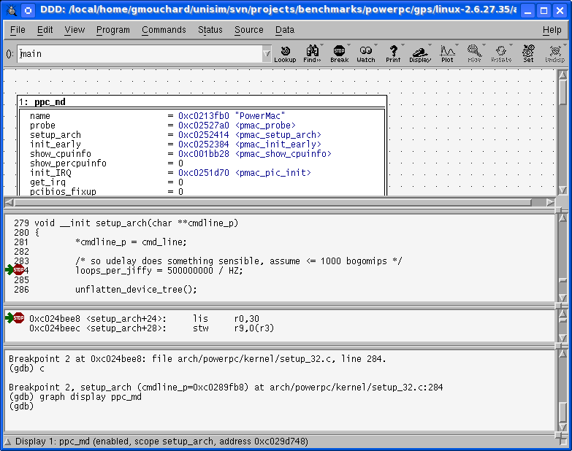
UNISIM Virtex 5 FXT Simulator
PPC440 Embedded Processor Block
SPLB0
SPLB1
PPC440
OS
+
Application
Crossbar
Multi
Format
Loader
ELF
S19
COFF
ICURD
MCI
RAM
DCR
Controller
DCUWR
DCURD
GDB Debugger
MPLB
Flash Mem.
(S29GL256P)
MPLB
PPC440
Boot
PPC440x5
MMU
Caches
GDB
Server
DTLB
UTLB
DL1
TCP/IP
ITLB
IL1
ROM
HW FPU
(optional APU)
Telnet/Putty
XPS
Timer/Counter
External
Input
Interrupt
Trying 127.0.0.1...
Connected to localhost.
Escape character is '^]'.
Booting...
Hello world !
> _
XPS
UART Lite
TCP/IP
XPS
IntC

