Slide 1
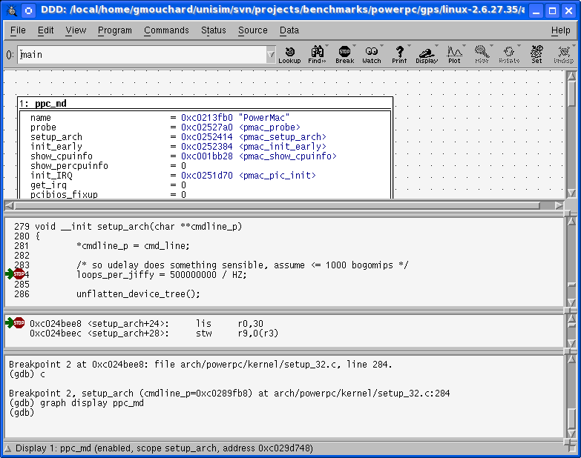
Virtex 5 FXT
SPLB0
SPLB1
Crossbar
Multi
Format
Loader
ELF
S19
COFF
PPC440
OS
+
App.
ICURD
MCI
RAM
DCR
Controller
DCUWR
DCURD
GDB Debugger
MPLB
Flash Mem.
(S29GL256P)
MPLB
PPC440
PPC440
Boot
GDB
Server
MMU
Caches
ROM
TCP/IP
UTLB
DTLB
DL1
ITLB
IL1
XPS
Timer/Counter
External
Input
Interrupt
XPS
IntC

