Slide 1
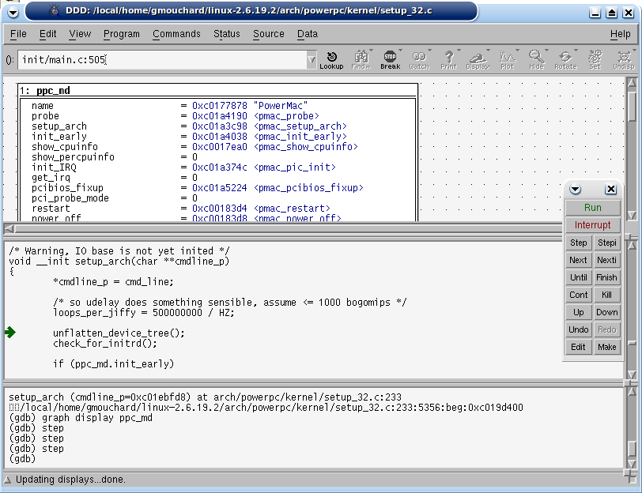
External
peripheral
DSP
BUS
GPIO
(xN)
Inline Debugger Console
Timer
Timer
Timer
inline-debugger> s
0x4000062c <T0TIMI_IRQHandler()>:
0x4000062c:mov r0, #3758096392
inline-debugger> s
0x40000630 <T0TIMI_IRQHandler()+0x4>:
0x40000630:orr r0, r0, #36864
inline-debugger> s
0x40000634 <T0TIMI_IRQHandler()+0x8>:
0x40000634:mov r1, #3758096392
inline-debugger> s
0x40000638 <T0TIMI_IRQHandler()+0xc>:
0x40000638:orr r1, r1, #36864
inline-debugger> s
0x4000063c <T0TIMI_IRQHandler()+0x10>:
0x4000063c:ldrh r1, [r1, #0]
…
RAM
BSPI
Inline
debugger
Interrupt ctl
(EIC)
ARM7TDMI
Timer
(x4)
Timer
Timer
Timer
TCP/IP
GDB Server
FLASH
S19
Loader
ELF
Loader
STR7 (ARM7TDMI)
GDB Debugger
STR7 S19
Application
STR7 ELF
Application

