Slide 1
  Unison Tutorial
  Reece Hart
  2006-05-12

Slide 2
Tutorial Outline
Introduction
  data sources, algorithms, update scheme
Schema
  overview, design themes, critical tables
Access
  web pages, command line tools, perl API, psql
Example Queries
  Finding sequences
  Finding parameters
  Getting predictions for a sequence
  Mining for sequence based on predictions
  Tips
Future Plans

Slide 3
What Can I Do With Unison?
Retrieve sequence analysis for a single sequence.
Mine for sequences based on predicted features, sequence origins, taxonomy, patents, orthology, and structure.
Find all sources of a single sequence.
Find patents for a sequence.
Locate sequence variations relative to domains and in structure.
Build new tools.

Slide 4
Design Goals
Sequences are stored non-redundantly.
  eliminates redundant computation and analysis
  Results are keyed to sequences, parameters, and optionally a model.
  Sequences are immutable and therefore results are never stale.
  Sequences are linked to their origins and aliases.
Fast, reliable, differential updates.
Multiple result sets for different invocations
Make no assumptions and provide no interpretations.
Synopses of prediction results only, but and enable regeneration of results.

Slide 5
Unison Contents
Non-redundant Sequences
  UniProtKB/Swiss-Prot, IPI, Genengenes, Genehub representative sequences, RefSeq, Curagen, Incyte, ..., Ensembl ab initio, miscellaneous fragments
Non-redundant Results
  Pfam, TMHMM, SignalP, protcomp
  BIG-PI, PSI-PRED, RegExp motifs
  disprot, dispro, pmap
Lots of other Data
  patents, PDB, SCOP, GO, GOng, NCBI tax, HomoloGene, MINT, ...
Statistics
  75 tables, 108 views, 120 functions
  ~6 CPU-years' worth of data, >440M protein features
  14GB of compressed data, 130GB on disk w/indexes

Slide 6
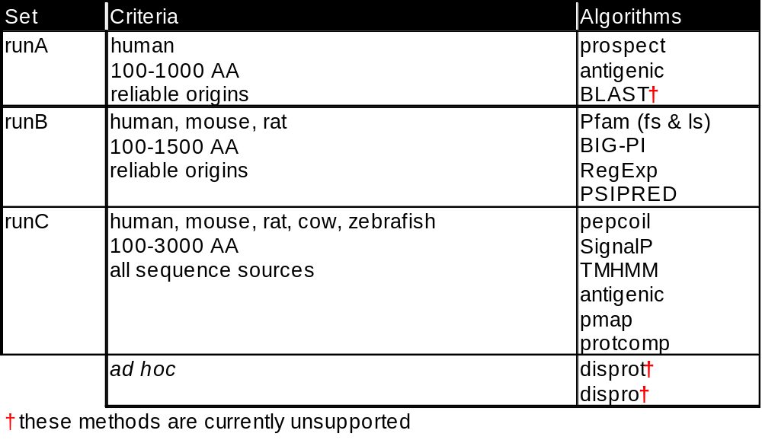
Update Procedure and Run Sets
data pushes to Oracle
phase 1:
load
sequences
and models
1 day
phase 2:
build
sequence
“run” sets
½ day
phase 3:
run
and
load
7 days?
phase 4:
mat'lized
views
½ day
phase 5:
finishing
copy and
push to
production
(web too)‏
1 day
“publicize”
for
external
site
2 days

Slide 7
Implementation
Hardware
  hostname csb
  4 dual-core Opterons, 2.4 GHz
  32GB RAM
  500GB FC-RAID
Linux
  SuSE 10.0, kernel 2.6
PostgreSQL 8.1.3
  3 databases: csb, csb-stage, csb-dev
  unison is a schema within each
Perl 5.8
Apache 2.0 web pages

Slide 8
Unison Schema

Slide 9
Design Themes
Abstraction and Normalization
  most tables are essentially data types
  expect a lot of joins, but views exist for common queries
  facilitates updates of new params, etc
Rely on database for correctness
  pedantic and paranoid use of triggers and constraints
Selective incorporation of external databases
  schemas: unison, ncbi, tax, dali, go, pdb

Slide 10
Results Cube
feature types (HMM, TM, signal, etc)‏
Sequence Analysis
show structures predictions for a
given sequence
computing these takes
minutes-hours
Feature-Based Mining
show sequences which align to specified structures
computing these takes days-months
sequences
parameter slices

Slide 11
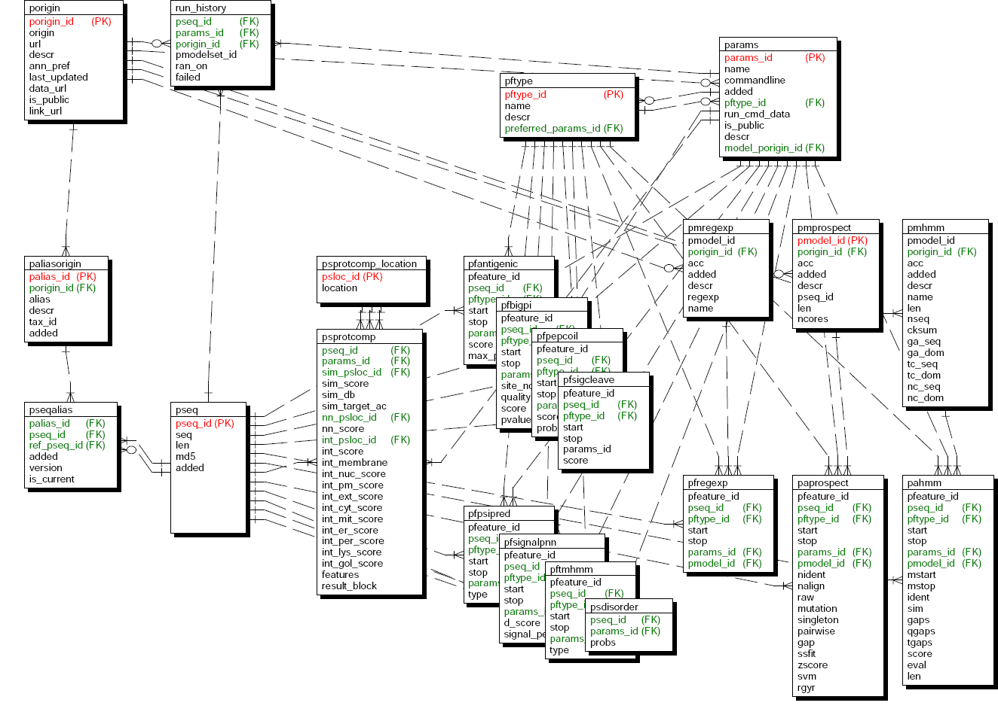
Schema Overview
Params/Models
Sequences
Results

Slide 12
Critical Tables, Views, Functions
Tables and views
  porigin, pseq, pftype, params
  palias (view) and current_annotations_v
  pahmm + pmhmm => pahmm_v
  pfbigpi => pfbigpi_v
  pfsignalpnn
  psprotcomp + psprotcomp_locations => psprotcomp_v
  pfregexp + pmregexp => pfregexp_v
  run_history => run_history_v
Functions
  pseq_id_from_sequence()‏
  params_id() and preferred_params_id_by_pftype()‏
  porigin_id()‏

Slide 13
Table and Column Names
X_id is always a primary or foreign key
  foreign and primary keys always have the same name
  except for pairwise sequence comparisons which use q_pseq_id and t_pseq_id
psX – protein sequence property
  e.g., psprotcomp
pfX – protein feature
  e.g., pfsignalpnn
paX and pmX – protein alignments to models
  e.g., pmhmm and pahmm

Slide 14
View Name Suffixes
_mv – materialized view
_dv – “defining view”
  mostly for internal use
  not optimized, often slow
  look for a corresponding _mv
_cv – “canned view”
  views for complex data mining
  exposed to public
  see canned_views table
_v – ye olde standard view

Slide 15
Accessing Unison
How:
  native protocol
  psql interactive shell (akin to sqlplus)‏
  perl DBI
  perl API
  ODBC/JDBC
  web pages (and linking to them)‏
  command line tools
  Oracle snapshot in biodev1 and bioprd1
Details:
  host csb
  database csb or csb-dev
  as self with Kerberos (user PUBLIC, no password is deprecated)‏
 Use Kerberos authentication wherever possible. Be prepared to change logins which use PUBLIC.

Slide 16
Web Page Linking
http://csb/unison/cgi/pseq_summary.pl?q=<query>
  query may be pseq_id, alias, md5, or sequence itself
  all links use GET method (i.e., params in URL)‏
Sequence analysis pages
  summary page
  aliases
  patents
  protein features
  protein structure and variant mapping
  HomoloGene homologs
  pmap and blat genome maps
Other pages
  feature-based mining
  browse “canned views”

Slide 17
unison-get-seq
Fetch sequences by pseq_id or alias, from stdin or args
Useful flags:
  -A select by alias
  -b “best alias” in defline
  -B “best annotation” in deflne
  -u Unison:pseq_id in defline (-bu may be used together)‏
  --iupac20 select only sequences with standard AA
  -v verbose – prints progress to stderr
Example:
  kinit
  unison-get-seq -Abu TNFA_HUMAN
  >Unison:98 UniProtKB/Swiss-Prot:TNFA_HUMAN (Tumor necrosis factor precursor (TNF-alpha) (Tumor necrosis factor ligand superfamily member 2) (TNF-a) (Cachectin))‏
  MSTESMIRDVELAEEALPKKTGGPQGSRRCLFLSLFSFLIVAGATTLFCLLHFGVIGPQR
  EEFPRDLSLISPLAQAVRSSSRTPSDKPVAHVVANPQAEGQLQWLNRRANALLANGVELR
  DNQLVVPSEGLYLIYSQVLFKGQGCPSTHVLLTHTISRIAVSYQTKVNLLSAIKSPCQRE
  TPEGAEAKPWYEPIYLGGVFQLEKGDRLSAEINRPDYLDFAESGQVYFGIIAL

Slide 18
unison-annotation
Provides features and other information for sequences specified by pseq_id, alias, or fasta
$ unison-annotation -S <myseqs.fa
*Unison:98:UniProtKB/Swiss-Prot:TNFA_HUMAN (Tumor necrosis fac...
*signalp (SignalP 3.0 (euk), ran on 2005-11-03 16:40)‏
*tm (TMHMM 2.0c, ran on 2005-11-16 14:05)‏
#start stop
35 57
*regexp (regexp, ran on 2005-11-16 11:26)‏
#start stop feature
133 138 ITIM
*pfam (Pfam 19.0 ls, ran on 2006-01-13 21:30)‏
#start stop score eval acc feature descr
102 233 210 4.8e-60 PF00229.8 TNF TNF(Tumour Necrosis Factor) family
*protcomp (protcomp default, ran on 2005-08-10 05:40)‏
#loc
Plasma membrane
*alia#alias origin descr
NP_000585 RefSeq tumor necrosis factor alpha [Homo sapiens].
PRO34403 GenenGenes Human TNF-a
PRO21907 GenenGenes Human TNF-a
PRO6 GenenGenes Human TNF-a
IPI00001671.1 IPI Tumor necrosis factor precursor; SWISS-PROT:P01375|
...
Provides features and other information for sequences specified by pseq_id, alias, or fasta
unison-annotation <myseqs.fa
*Unison:98:UniProtKB/Swiss-Prot:TNFA_HUMAN (Tumor necrosis factor precursor (TNF-alpha) (Tumor necrosis factor ligand superfamily member 2) (TNF-a) (Cachectin) [Contains: Tumor necrosis factor, membrane form; Tumor necrosis factor, soluble form])‏
*signalp (SignalP 3.0 (euk), ran on 2005-11-03 16:40)‏
*tm (TMHMM 2.0c, ran on 2005-11-16 14:05)‏
#start stop
35 57
*regexp (regexp, ran on 2005-11-16 11:26)‏
#start stop feature
133 138 ITIM
*bigpi (BIG-PI default, ran on 2005-02-06 01:50)‏
*patents
#count
42
*pfam (Pfam 19.0 ls, ran on 2006-01-13 21:30)‏
#start stop score eval acc feature descr
102 233 210 4.8e-60 PF00229.8 TNF TNF(Tumour Necrosis Factor) family
*protcomp (protcomp default, ran on 2005-08-10 05:40)‏
#loc
Plasma membrane
*alias
#alias descr origin
NP_000585 tumor necrosis factor alpha [Homo sapiens]. RefSeq
PRO34403 Human TNF-a GenenGenes
PRO21907 Human TNF-a GenenGenes
PRO6 Human TNF-a GenenGenes
IPI00001671.1 Tumor necrosis factor precursor; SWISS-PROT:P01375|REFSEQ_NP:NP_000585|TREMBL:Q9UIV3;O43647|REFSEQ_XP:XP_165823;XP_175231;XP_175158|ENSEMBL:ENSP00000229681 IPI
NP_000585.2 gi|25952111|ref|NP_000585.2| tumor necrosis factor alpha [Homo sapiens] RefSeq
TNFA_HUMAN Tumor necrosis factor precursor (TNF-alpha) (Tumor necrosis factor ligand superfamily member 2) (TNF-a) (Cachectin) [Contains: Tumor necrosis factor, membrane form; Tumor necrosis factor, soluble form] UniProtKB/Swiss-Prot
P01375 Tumor necrosis factor precursor (TNF-alpha) (Tumor necrosis factor ligand superfamily member 2) (TNF-a) (Cachectin) [Contains: Tumor necrosis factor, membrane form; Tumor necrosis factor, soluble form] UniProtKB/Swiss-Prot
Q5STB3 Tumor necrosis factor (TNF superfamily, member 2) UniProtKB/TrEMBL
Q5STB3_HUMAN Tumor necrosis factor (TNF superfamily, member 2) UniProtKB/TrEMBL
NM_000594 NP_000585 gi|25952111|ref|NP_000585.2| tumor necrosis factor alpha [Homo sapiens] GeneHub
*pfam (Pfam 19.0 ls, ran on 2006-01-13 21:30)‏
#start stop score eval acc feature descr
102 233 210 4.8e-60 PF00229.8 TNF TNF(Tumour Necrosis Factor) family
*protcomp (protcomp default, ran on 2005-08-10 05:40)‏
#loc
Plasma membrane
*alias
#alias descr origin
NP_000585 tumor necrosis factor alpha [Homo sapiens]. RefSeq
PRO34403 Human TNF-a GenenGenes
PRO21907 Human TNF-a GenenGenes
PRO6 Human TNF-a GenenGenes
IPI00001671.1 Tumor necrosis factor precursor; SWISS-PROT:P01375|REFSEQ_NP:NP_000585|TREMBL:Q9UIV3;O43647|REFSEQ_XP:XP_165823;XP_175231;XP_175158|ENSEMBL:ENSP00000229681 IPI
NP_000585.2 gi|25952111|ref|NP_000585.2| tumor necrosis factor alpha [Homo sapiens] RefSeq
TNFA_HUMAN Tumor necrosis factor precursor (TNF-alpha) (Tumor necrosis factor ligand superfamily member 2) (TNF-a) (Cachectin) [Contains: Tumor necrosis factor, membrane form; Tumor necrosis factor, soluble form] UniProtKB/Swiss-Prot
P01375 Tumor necrosis factor precursor (TNF-alpha) (Tumor necrosis factor ligand superfamily member 2) (TNF-a) (Cachectin) [Contains: Tumor necrosis factor, membrane form; Tumor necrosis factor, soluble form] UniProtKB/Swiss-Prot
Q5STB3 Tumor necrosis factor (TNF superfamily, member 2) UniProtKB/TrEMBL
Q5STB3_HUMAN Tumor necrosis factor (TNF superfamily, member 2) UniProtKB/TrEMBL
NM_000594 NP_000585 gi|25952111|ref|NP_000585.2| tumor necrosis factor alpha [Homo sapiens] GeneHub

Slide 19
Unison perl API
Unison perl modeule
  acts like a subclass of DBI
  adds many utility methods
  is stable but homely
The module is available to all users of /usr/local/tools/bin/perl by default
more info:
  perldoc Unison
  /gne/research/apps/unison/examples/
use Unison;
my $u = new Unison;
my $q = $u->pseq_id_by_sequence('YGGFM');
my $np = $u->selectrow_array(<<EOSQL,undef,$q);
SELECT count(*) FROM patents_v WHERE pseq_id=?
EOSQL
print(“$q\t$np\t”, $u->best_annotation($q), “\n”);
my $sth = $u->prepare('select * from run_history_v where pseq_id=?');
$sth->execute($q);
$sth->dump_results();

Slide 20
  psql
  PostgreSQL's command-line interface

Slide 21
psql intro
Do this:
  kinit
  psql -h csb -d csb
The most important commands
  \? – help
  \d+ [selection] – describe object
  \dv+ [selection] – view summary
  \dt+ [selection] – table summary
  \df+ [selection] – function summary
  selection may be:
    a table, view, or function name, optionally schema-qualified
      e.g., pseq, unison.palias
    a shell-style glob
  explain [query]

Slide 22
Browsing Tables and Views
unison@csb=> \dt+ unison.
List of relations
Schema | Name | Type | Owner | Description
--------+------------------------------------+-------+--------+---------------------------
unison | _readme | table | unison | READ THIS FIRST -- Unison
unison | best_annotation_mv | table | unison | materialized view of best
unison | canned_views | table | unison | curated data mining views
unison | ensembl_coordinates_mv | table | unison |
unison | ensembl_unambiguous_coordinates_mv | table | unison |
unison | ensembl_unambiguous_overlaps_mv | table | unison |
unison | genasm | table | unison | genome and assembly
unison@csb=> \dv+ unison.*pmap*
List of relations
Schema | Name | Type | Owner | Description
--------+---------------------------------+------+--------+------------------------------
unison | pmap_aln_unambiguous_overlaps_v | view | unison |
unison | pmap_aln_unambiguous_v | view | unison |
unison | pmap_v | view | unison | view of pmap alignments ...

Slide 23
Viewing a Table Definition
unison@csb=> \d+ pahmm
Table "unison.pahmm"
Column | | Description
-------------+-//--+----------------------------------------------------------
pfeature_id | // | unique feature id
pseq_id | // | unique protein sequence identifier -- see pseq(pseq_id)‏
pftype_id | // | protein feature type identifier -- see pftype(pftype_id)‏
start | // | start of prediction in protein sequence
stop | // | stop of prediction in protein sequence
params_id | // | parameter set identifier -- see params(params_id)‏
pmodel_id | // | unique protein model identifier
mstart | // | start of match /in model/
mstop | // | stop of match /in model/
ident | // |
sim | // |
gaps | // |
qgaps | // | number of gaps in query sequence
tgaps | // | number of gaps in target sequence
score | // | algorithm-specific score
eval | // | expectation value
len | // |
Indexes:
"pahmm_redundant_feature" UNIQUE, btree (pseq_id, "start", stop, pmodel_id, params_id, mstart, mstop) CLUSTER
"pahmm_search1" btree (pmodel_id, eval, params_id)‏
"pahmm_search2" btree (params_id, eval, pmodel_id)‏
"pahmm_search3" btree (params_id, score, pmodel_id)‏
Foreign-key constraints:
"pahmm_params_id_exists" FOREIGN KEY (params_id) REFERENCES params(params_id) ON UPDATE CASCADE ON DELETE CASCADE

Slide 24
Viewing a View Definition
unison@csb=> \d+ pmap_v
View "unison.pmap_v"
Column | Type | Modifiers | Description
------------+--------------+-----------+------------------------------------------------
params_id | integer | | parameter set identifier -- see params
genasm_id | integer | | genome assembly identifier -- see genasm
pseq_id | integer | | unique protein sequence identifier -- see pseq
aln_id | integer | | pmap_aln alignment identifier
pstart | integer | | start of alignment in protein sequence
pstop | integer | | stop of alignment in protein sequence
exons | bigint | | number of exons
aln_length | bigint | | length of alignment
pct_cov | integer | | percent coverage
ident | integer | |
pct_ident | integer | | percent identity
chr | text | | chromosome
strand | character(1) | | genomic strand ('+' or '-')‏
gstart | integer | | genomic start position on chromosome
gstop | integer | | genomic stop position on chromosome
View definition:
SELECT a.params_id, a.genasm_id, h.pseq_id, ah.aln_id, min(h.pstart) AS pstart, ...
FROM pmap_hsp h
JOIN pmap_alnhsp ah ON h.hsp_id = ah.hsp_id
JOIN pmap_aln a ON ah.aln_id = a.aln_id
JOIN pseq q ON h.pseq_id = q.pseq_id
GROUP BY a.params_id, a.genasm_id, h.pseq_id, ah.aln_id, h.chr, h.strand, ...
ORDER BY h.pseq_id, (sum(h.pstop - h.pstart + 1)::double precision / ...

Slide 25
  Reality Queries
  (using psql,
  but applies to all access modes)‏

Slide 26
Finding A Sequence
By sequence
  select pseq_id_from_sequence('MYSEQ')‏
By md5
  select pseq_id from pseq where md5='f9e8d7...';
By alias
  select pseq_id from palias where alias='PRO54321'
    or alias LIKE 'NP_00123%'
    or alias ~ '^NP_0123'
  AND porigin_id=porigin_id('RefSeq')‏
  AND porigin_id=porigin_id('GenenGenes')‏
  AND tax_id=gs2tax_id('BRARE')‏
By NCBI gene
  select pseq_id from palias where porigin_id=porigin_id('RefSeq gi') and alias=73967277;

Slide 27
Finding Parameters
select params_id,name,descr from params;
commandline in params
Consider using:
  select params_id('Pfam 19.0 ls')‏
  select preferred_params_id_by_pftype('HMM')‏
params_id | name | descr | commandline
-----------+-------------------------------+--------------------------------+--------------------------------
19 | BIG-PI default | BIG-PI GPI prediction; http:// | bigpi metazoa %s short
3 | BLAST | UNSUPPORTED! Unison internal u | blastall -FF -z2829482 -p blas
36 | Bcl-2 ls | Bcl-2 homology domains custom | ldhmmpfam --acc -E10 -Z8183
4 | EMBOSS/antigenic | antigenicity predictions; http | antigenic -minlen 6 -rformat s
37 | EMBOSS/pepcoil | EMBOSS pepcoil coiled-coil pre | pepcoil -noother -window 28 -f
5 | EMBOSS/sigcleave | signal cleavage prediction; ht | sigcleave -minweight 3.5 -rfor
11 | Genome BLAT | genomic localization of protei | gfClient -t=dnax -q=prot trp 1
38 | PMAP 2006-03-20 | genomic localization of protei | pmap.2006-03-20 -d NHGD_R35 -B
8 | PSSM default | |
33 | Pfam 19.0 fs | Pfam 19.0 /f/ragmentary models | ldhmmpfam --acc -E10 -Z8183
34 | Pfam 19.0 ls | Pfam 19.0 local models | ldhmmpfam --acc -E10 -Z8183
14 | Prospect2 SCOP default | Prospect protein threading; ht | -scop
1 | Prospect2 default | Prospect protein threading; ht | -global
2 | Prospect2 global_local | Prospect protein threading; ht | -global_local
23 | Prospect2 ssp_psipred default | Prospect protein threading; ht | -global
17 | Psipred v2.45 | PSIPRED secondary structure pr | runpsipred -j 3 -h 0.001 -a 2
28 | SignalP 3.0 (euk) | Signal sequence prediction per | /gne/compbio/i686-linux-2.6/bi
29 | TMHMM 2.0c | TMHMM 2.0c, http://www.cbs.dtu | /gne/compbio/i686-linux-2.6/op
41 | dispro | http://www.ics.uci.edu/~baldig | MANUAL
39 | disprot VL3H | disprot protein disorder predi | MANUAL: temple-disprot.pl
31 | gne_prospect | Prospect protein threading; ht | gne_prospect -a 2 -p -b
0 | no args | |
20 | protcomp default | ProtComp protein localization | protcomp
12 | regexp | |
9 | tmdetect default | Genentech in-house TM detectio | tmdetect

Slide 28
What's Been Run?
Always consult run_history_v to see whether Unison contains the results you seek.
unison@csb=> select * from run_history_v where pseq_id=76;
pseq_id | params_id | params | // | ran_on | failed
---------+-----------+-------------------+-//-+------------------+--------
76 | 19 | BIG-PI default | // | 2005-02-06 01:50 | f
76 | 3 | BLAST | // | 2003-08-18 14:36 | f
76 | 36 | Bcl-2 ls | // | 2006-02-01 19:50 | f
76 | 4 | EMBOSS/antigenic | // | 2003-10-07 20:56 | f
76 | 37 | EMBOSS/pepcoil | // | 2006-05-03 18:37 | f
76 | 5 | EMBOSS/sigcleave | // | 2003-10-13 16:30 | f
76 | 11 | Genome BLAT | // | 2004-02-11 10:48 | f
76 | 38 | PMAP 2006-03-20 | // | 2006-03-23 14:53 | f
76 | 33 | Pfam 19.0 fs | // | 2006-01-12 03:05 | f
76 | 34 | Pfam 19.0 ls | // | 2006-01-13 21:20 | f
76 | 1 | Prospect2 default | // | 2004-02-25 15:14 | f
76 | 1 | Prospect2 default | // | 2004-02-20 08:03 | f
76 | 17 | Psipred v2.45 | // | 2005-06-11 07:51 | f
76 | 28 | SignalP 3.0 (euk) | // | 2005-11-03 16:22 | f
76 | 29 | TMHMM 2.0c | // | 2005-11-16 08:34 | f
76 | 41 | dispro | // | 2006-05-04 22:42 | f
76 | 39 | disprot VL3H | // | 2006-05-04 17:42 | f
76 | 20 | protcomp default | // | 2005-08-10 03:11 | f
76 | 12 | regexp | // | 2005-11-16 11:26 | f
76 | 12 | regexp | // | 2006-04-13 04:47 | f
76 | 9 | tmdetect default | // | 2006-02-21 17:38 | f

Slide 29
Fetching Pfam Domains
The hard way
unison@csb-dev=> SELECT A.pseq_id,M.name,M.acc,A.eval,A.score,M.descr
FROM pahmm A
JOIN pmhmm M on A.pmodel_id=M.pmodel_id
WHERE A.params_id=34 AND A.eval<1e-10 AND pseq_id=15;
pseq_id | name | acc | eval | score | descr
---------+---------+-----------+---------+-------+--------------------------------------
15 | Insulin | PF00049.8 | 6e-23 | 86 | Insulin/IGF/Relaxin family
15 | IGF2_C | PF08365.1 | 2.2e-35 | 128 | Insulin-like growth factor II E-
(2 rows)‏
Time: 1.900 ms

Slide 30
Fetching Pfam Domains 2
A better way
  use the pahmm_v view
  for queries you want to rerun, use preferred_params_id_by_pftype
unison@csb-dev=> SELECT pseq_id,name,acc,eval,score,descr
FROM pahmm_v
WHERE params_id=preferred_params_id_by_pftype('HMM') AND eval<1e-10 AND pseq_id=15;
pseq_id | name | acc | eval | score | ends | descr
---------+---------+-----------+---------+-------+------+------------------------------
15 | IGF2_C | PF08365.1 | 2.2e-35 | 128 | [] | Insulin-like growth factor...
15 | Insulin | PF00049.8 | 6e-23 | 86 | [] | Insulin/IGF/Relaxin family...
(2 rows)‏
Time: 2.574 ms

Slide 31
Fetching “All” Features
pseq_features_v provides current results for common feature
unison@csb-dev=> SELECT feature,start,stop,score,eval,descr FROM pseq_features_v WHERE pseq_id=82;
feature | start | stop | score | eval | descr
---------+-------+------+-------+---------+---------------------------------------------
SS | 1 | 31 | 0.884 | | signal sequence
TM | 7 | 29 | | | transmembrane domain
PAN_1 | 34 | 124 | 64 | 3.9e-16 | PAN domain
Kringle | 128 | 206 | 178 | 2e-50 | Kringle domain
Kringle | 211 | 288 | 178 | 1.6e-50 | Kringle domain
Kringle | 305 | 383 | 181 | 2e-51 | Kringle domain
Kringle | 391 | 469 | 155 | 1.3e-43 | Kringle domain
Trypsin | 495 | 716 | 223 | 4.3e-64 | Trypsin
Y-ITIM | 619 | 628 | | | ITIM motif with second upstream Y; more ...
ITIM | 623 | 628 | | | Immunotyrosine Inhibition Motif
(10 rows)‏
Time: 8.624 ms

Slide 32
  Wrap Up

Slide 33
Dos and Don'ts
(Not “Dos and Donuts”)‏
Do
  specify params_id in all queries for results.
  consult the run_history_v view, especially when your query returns no results.
  use the helper functions params_id, params_id_by_pftype, porigin_id, etc.
  experiment with Unison.
  provide feedback and suggestions.
Don't
  hesitate to ask questions.
  rely on PUBLIC user.

Slide 34
Developer Resources
Unison
  http://csb/unison/tour/
  /gne/research/apps/unison/examples/
  perldoc Unison
PostgreSQL
  psql \d commands
  http://www.postgresql.org/docs/
cvs -d :ext:csb/srv/cvs unison
  contains code examples
cvs -d :ext:csb/srv/cvs unison-web

Slide 35
The Future
Kiran will assume a greater role for Unison
  nearly all data loading and maintenance
  user help
  API maintenance
  Oracle data pushes
I will continue to be involved in
  mining efforts using Unison
  added new data types
  schema, API, and web oversight

