Slide 1
Matrices
20170412 S.J. Hahn

Slide 2
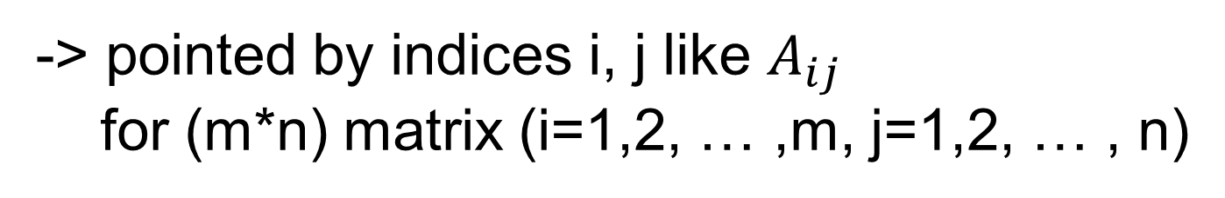
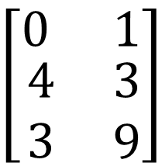

$$\left[\begin{matrix}0 & 1 \\ \begin{aligned}4 \\ 3\end{aligned} & \begin{aligned}3 \\ 9\end{aligned}\end{matrix}\right]$$
Matrices
-> a rectangular array of numbers
size
-> (row dimension) x (column dimension)
entries
-> also called coefficients or elements
Indices
-> pointed by indices i, j like $A_{ij}$
for (m*n) matrix (i=1,2, … ,m, j=1,2, … , n)
-> Slice of matrix can be done through index notation
like $A_{p:q,r:s}$, which is $\left(q−p+1\right)∗(s−r+1)$ matrix

Slide 3
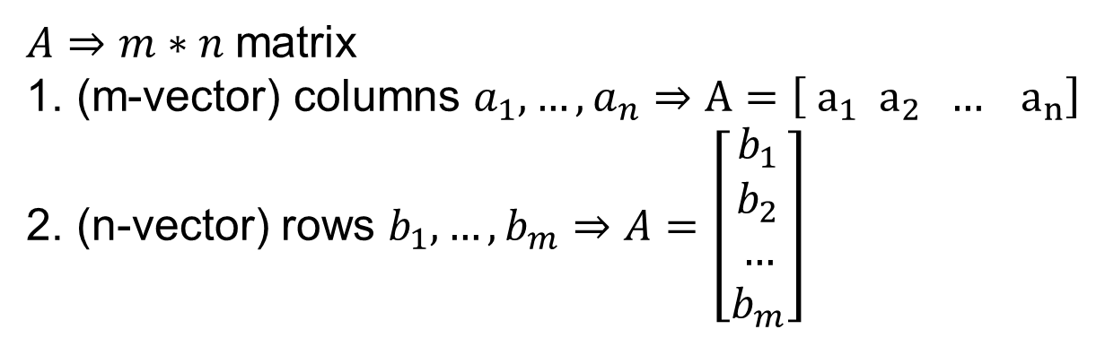
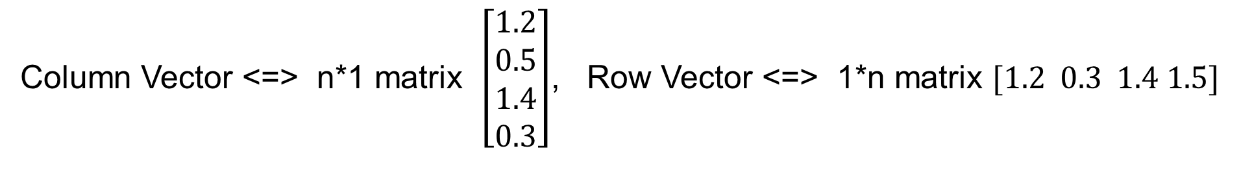
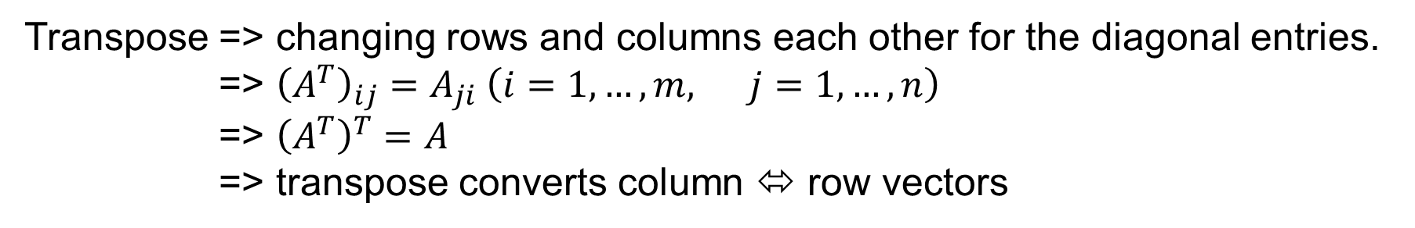
Row and Column vectors
Column Vector <=> n*1 matrix $\left[\begin{aligned}1.2 \\ 0.5 \\ 1.4 \\ 0.3\end{aligned}\right]$, Row Vector <=> 1*n matrix $[1.2 0.3 1.4 1.5]$
Transpose => changing rows and columns each other for the diagonal entries.
=> ${\left(A^{T}\right)}_{ij}=A_{ji} \left(i=1,…,m, j=1,…,n\right)$
=> ${\left(A^{T}\right)}^{T}=A$
=> transpose converts column ⬄ row vectors
A matrix can be represented in two ways : Column and Row representation
$A⇒m∗n$matrix
(m-vector) columns $a_{1}, …, a_{n}⇒A=\left[ a_{1} a_{2} … a_{n}\right]$
(n-vector) rows $b_{1}, …, b_{m}⇒A=\left[\begin{aligned}b_{1} \\ b_{2} \\ … \\ b_{m}\end{aligned}\right]$

Slide 4
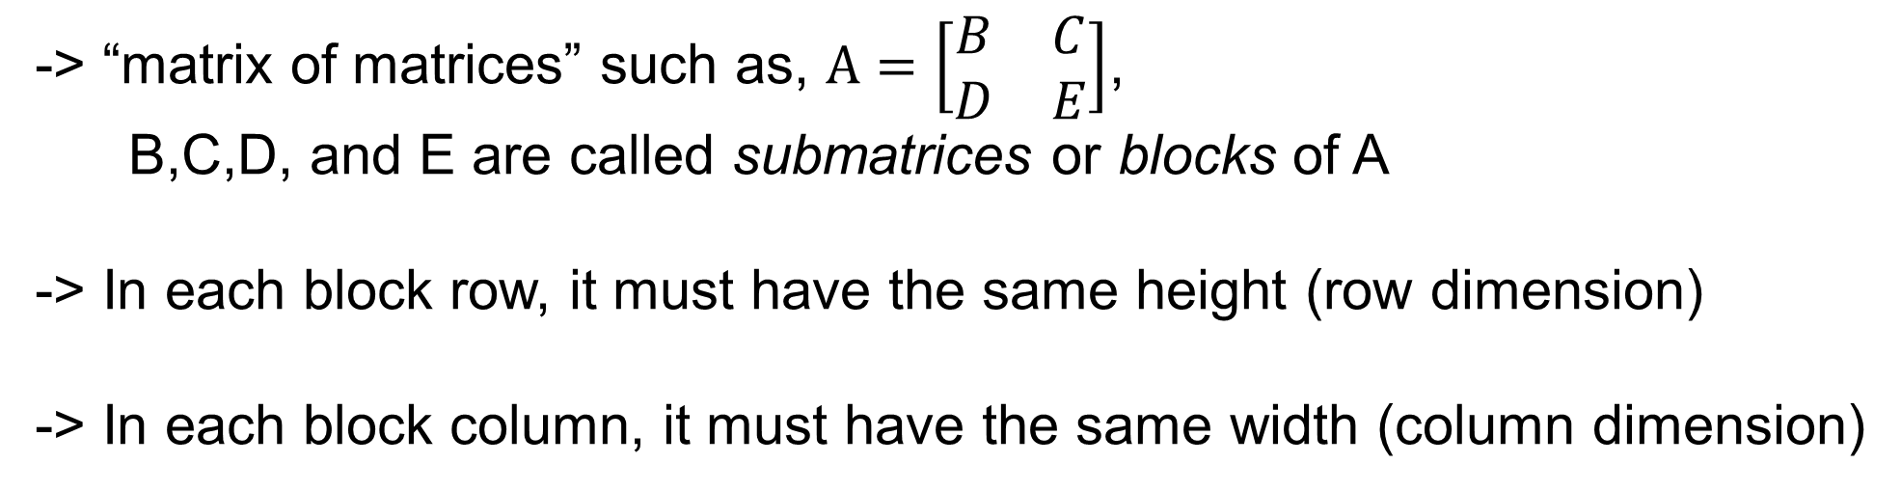
Block Matrix
-> “matrix of matrices” such as, $A=\left[\begin{matrix}B & C \\ D & E\end{matrix}\right]$,
B,C,D, and E are called submatrices or blocks of A
-> In each block row, it must have the same height (row dimension)
-> In each block column, it must have the same width (column dimension)
Square Matrix
-> Matrices with the same size of row and column dimension, n*n matrix

Slide 5
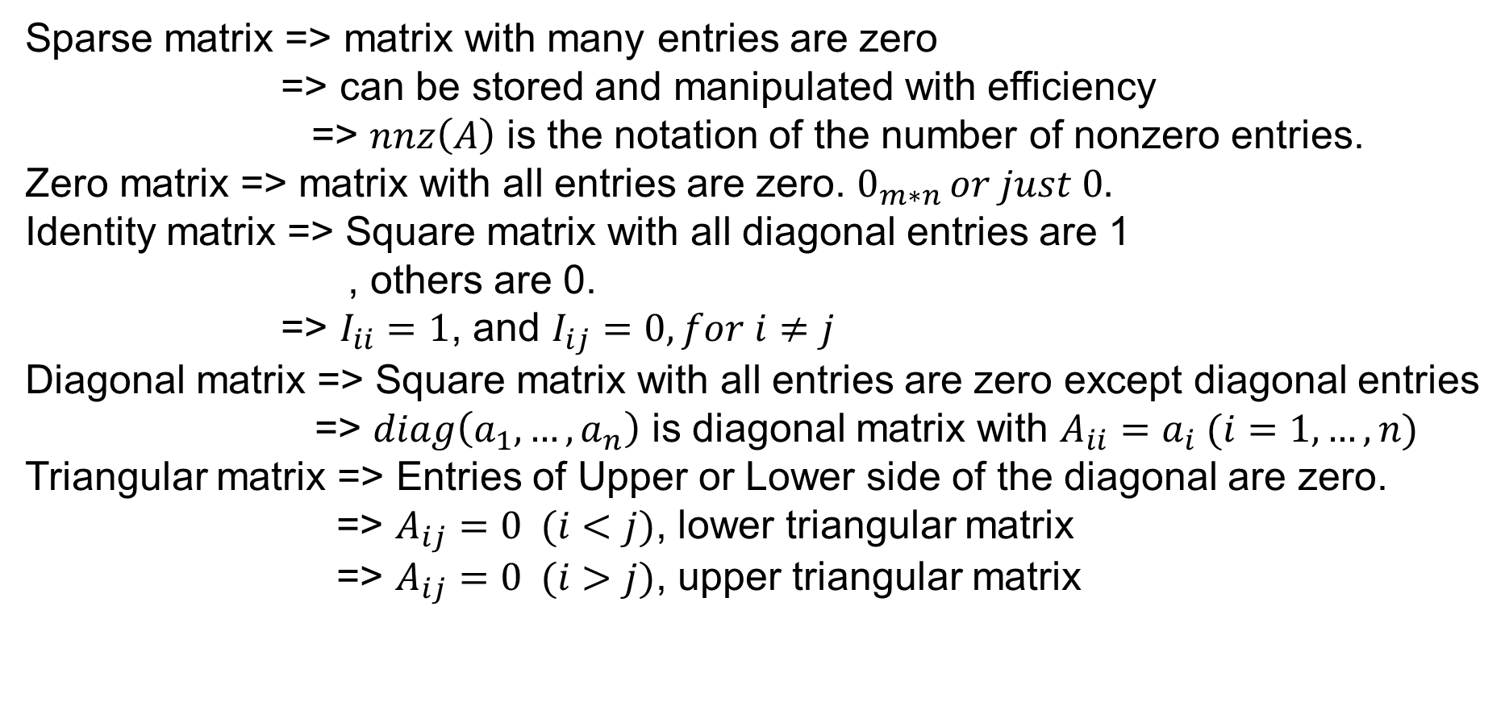
Special Matrices
Sparse matrix => matrix with many entries are zero
=> can be stored and manipulated with efficiency
=> $nnz\left(A\right)$ is the notation of the number of nonzero entries.
Zero matrix => matrix with all entries are zero. $0_{m∗n }or just 0.$
Identity matrix => Square matrix with all diagonal entries are 1
, others are 0.
=> $I_{ii}=1$, and $I_{ij}=0, for i≠j$
Diagonal matrix => Square matrix with all entries are zero except diagonal entries
=> $diag\left(a_{1},…,a_{n}\right)$ is diagonal matrix with $A_{ii}=a_{i} (i=1,…,n)$
Triangular matrix => Entries of Upper or Lower side of the diagonal are zero.
=> $A_{ij}=0 (i<j)$, lower triangular matrix
=> $A_{ij}=0 (i>j)$, upper triangular matrix

Slide 6
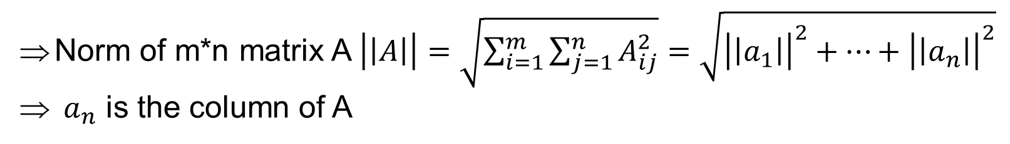
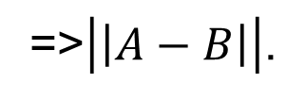
Matrix Norm
Norm of m*n matrix A $\left|\left|A\right|\right|=\sqrt{\sum_{i=1}^{m}{\sum_{j=1}^{n}{A_{ij}^{2}}}}=\sqrt{{\left|\left|a_{1}\right|\right|}^{2}+…+{\left|\left|a_{n}\right|\right|}^{2}}$
$a_{n}$ is the column of A
Matrix RMS values
=> $\frac{\left|\left|A\right|\right|}{\sqrt{mn}}$, a measure of matrix size, represents typical size of the entries.
Distance Between matrices
=>$\left|\left|A−B\right|\right|$.

Slide 7
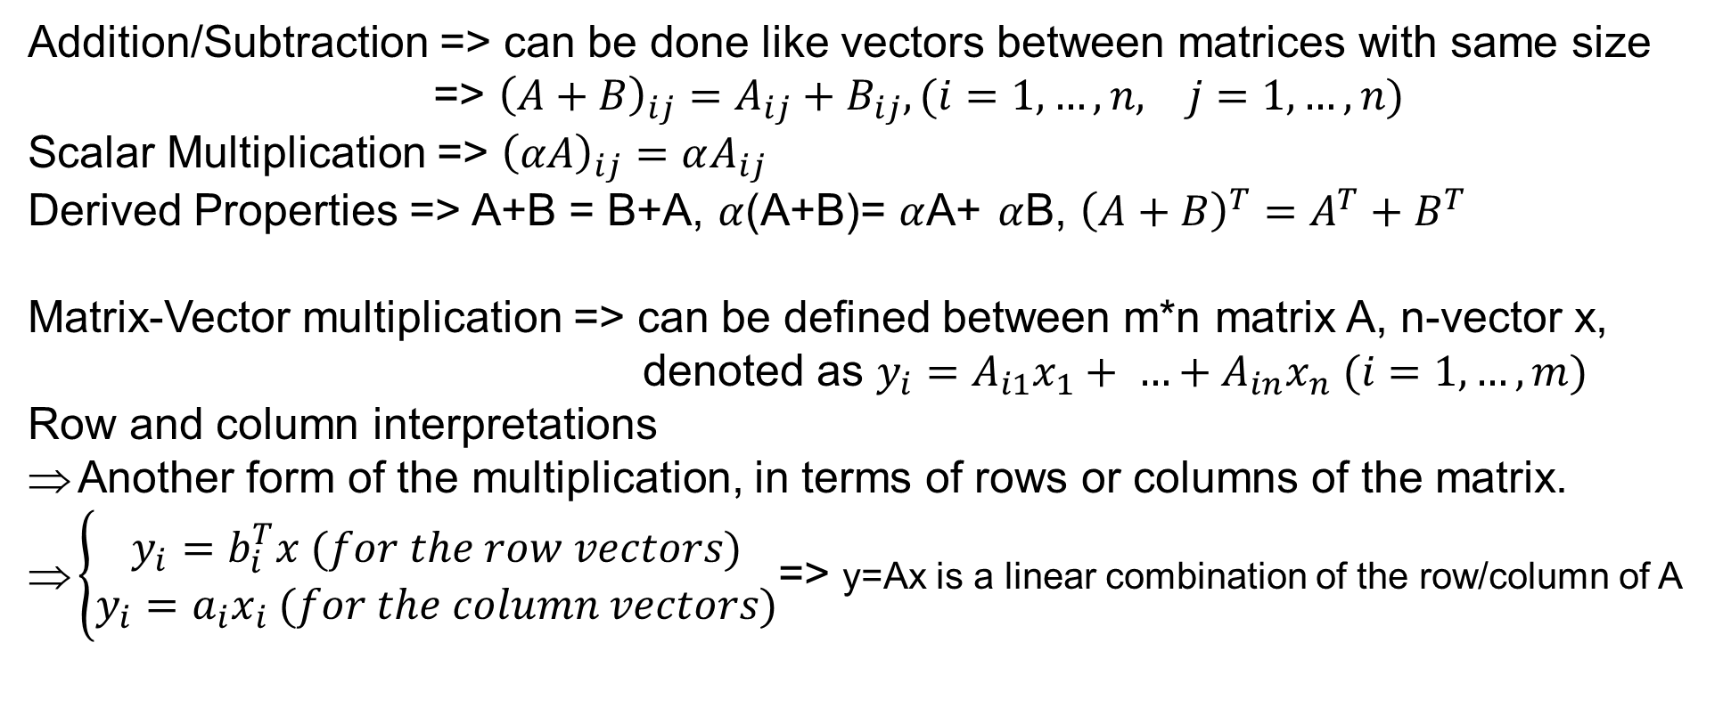
Matrices Calculation
Addition/Subtraction => can be done like vectors between matrices with same size
=> ${\left(A+B\right)}_{ij}=A_{ij}+B_{ij}, (i=1,…,n, j=1, …, n)$
Scalar Multiplication => ${\left(αA\right)}_{ij}=αA_{ij}$
Derived Properties => A+B = B+A, $α$(A+B)= $α$A+ $α$B, ${\left(A+B\right)}^{T}=A^{T}+B^{T}$
Matrix-Vector multiplication => can be defined between m*n matrix A, n-vector x,
denoted as $y_{i}=A_{i1}x_{1}+ …+A_{in}x_{n} (i=1,…,m)$
Row and column interpretations
Another form of the multiplication, in terms of rows or columns of the matrix.
$\left\{\begin{aligned}y_{i}=b_{i}^{T}x (for the row vectors) \\ y_{i}=a_{i}x_{i} (for the column vectors)\end{aligned}\right.$=> y=Ax is a linear combination of the row/column of A

Slide 8
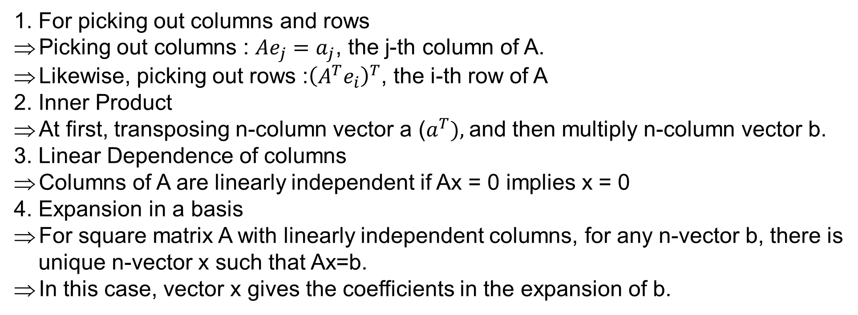
Uses of rows/columns interpretation
1. For picking out columns and rows
Picking out columns : $Ae_{j}=a_{j}$, the j-th column of A.
Likewise, picking out rows :${\left(A^{T}e_{i}\right)}^{T}$, the i-th row of A
2. Inner Product
At first, transposing n-column vector a ($a^{T}),$and then multiply n-column vector b.
3. Linear Dependence of columns
Columns of A are linearly independent if Ax = 0 implies x = 0
4. Expansion in a basis
For square matrix A with linearly independent columns, for any n-vector b, there is
unique n-vector x such that Ax=b.
In this case, vector x gives the coefficients in the expansion of b.
Complexity of matrix calculation
Mainly depends on the number of nonzero entries, nnz(A)

